Slide 1
Driver Drowsiness Detection System
Saksham Sharma 19BIT0056
Krittika Chaturvedi 19BIT0071
Ujjawal Srivastava 19BIT0072

Slide 2
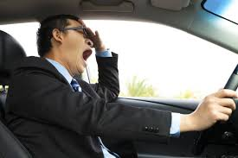
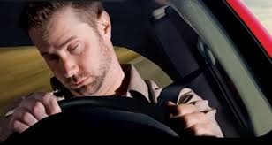
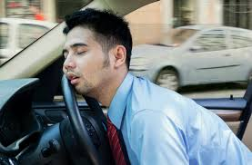
Aim
National Highway Traffic Safety Administration reported that in 2013 because of driver drowsiness 72,000 crashes, 44,000 injuries and 800 deaths occurred
The basic aim of the project is to detect the driver drowsiness while driving the car.
Many people fall a asleep during driving and end up meeting with accidents.
The proposed project aims to create an system that can detect the driver's state and predict if he or she is feeling drowsy

Slide 3
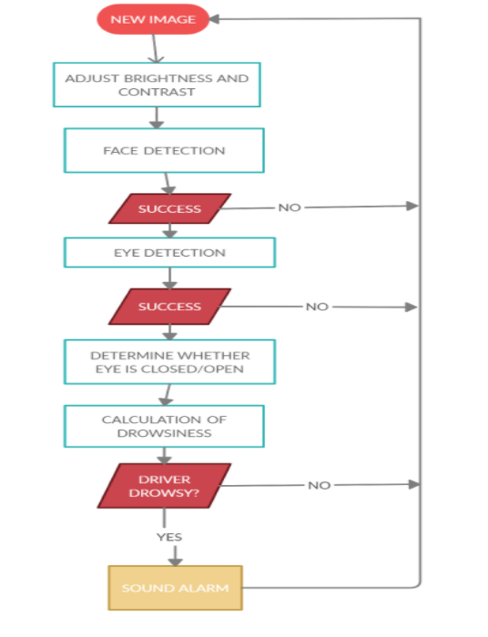
Design And Architecture

Slide 4
DATASET for this project
The dataset consists of around 1512 eye images taken in different lightning condition ,
There are both open eye and closed eye images
Images of people with different skin colours are also included to create variety in the images of people that might be using the project in future. This creates a diversity in the dataset that might be encountered by the CNN model in the future using a drowsiness detection system for drivers of different races and skin tones.

Slide 5



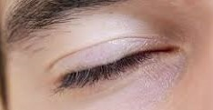
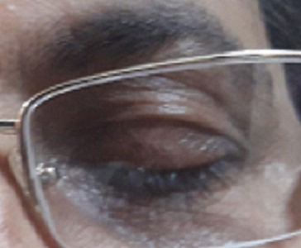
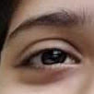
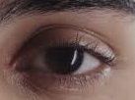
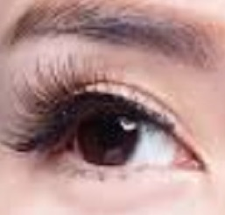
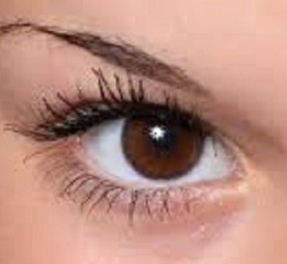
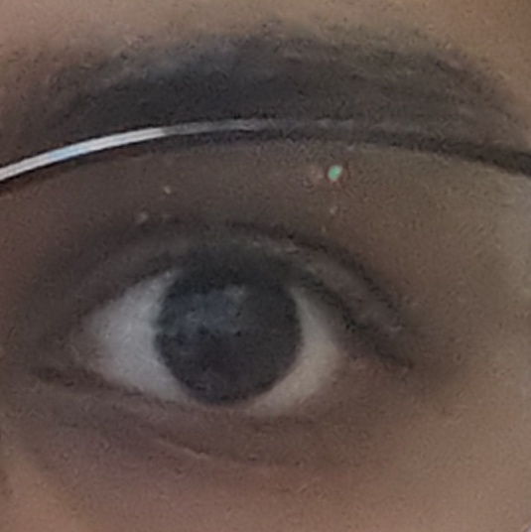
Sample Images-
DROWSY-
NOT DROWSY-

Slide 6
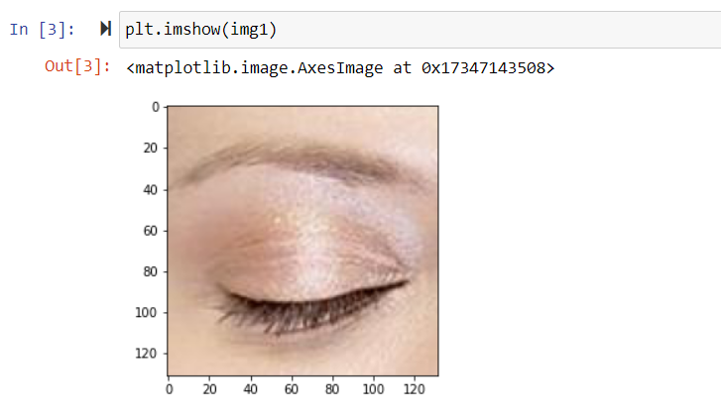
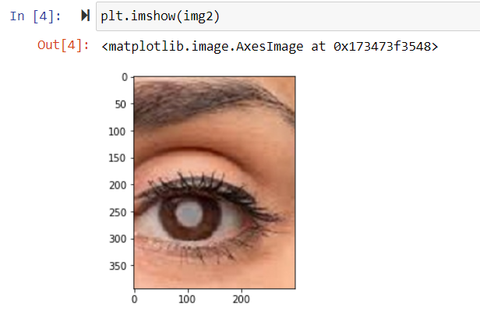
Loading Images :
The images are loaded into the model for scaling using matplotlib. Both for drowsy and not drowsy images are loaded and plotted using matplotlib.

Slide 7
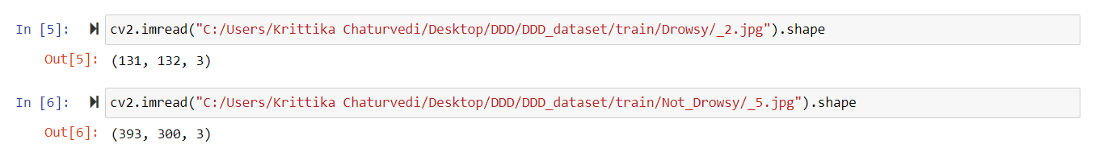
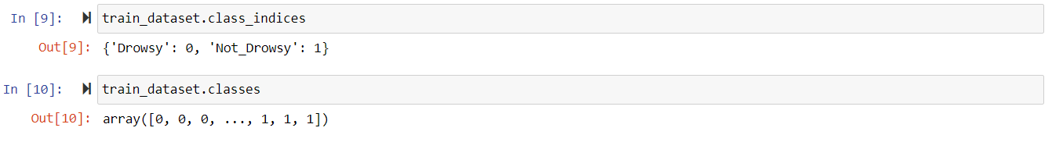
Dataset Preparation :
Images of different shape and size
Hence, first with the help of ImageDataGenerator function we rescaled our images in scale of 1/255 as its rgb value range was from 1 to 255, then we set color_mode to grayscale and target size of 24 X 24 respectively .
With the help of class_indices function we gave labels to these images as 0 and 1 on the bases of their folder name . Hence,
Drowsy -------------------> 0 Not_Drowsy -------------------> 1

Slide 8
Training of the dataset- The CNN model
The CNN model architecture consists of the following layers:
Convolutional Layer : 16 nodes, kernel size = 3
Convolutional Layer : 32 nodes, kernel size = 3
Convolutional Layer : 64 nodes, kernel size = 3
Fully Connected Layer : 128 nodes
Fully Connected Layer : 512 nodes
The final layer is also a fully connected layer with 1 node. In all the layers, a Relu activation function is used except the output layer in which we used Softmax.

Slide 9
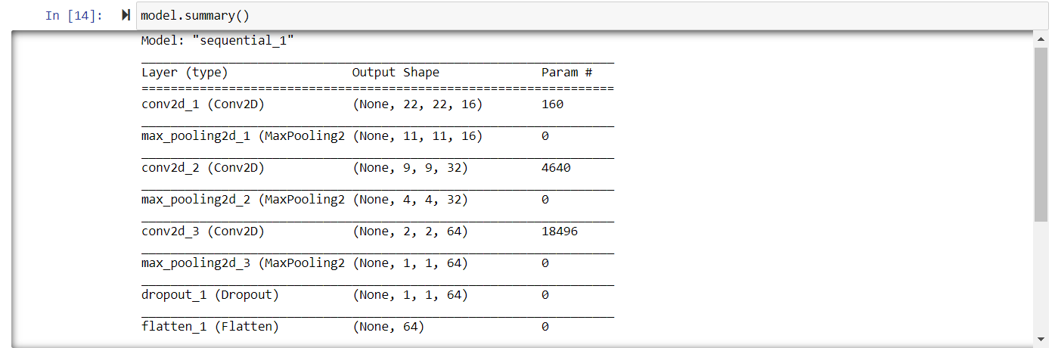
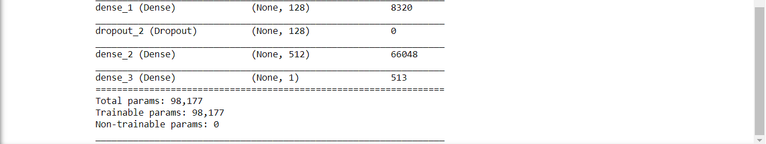

Slide 10
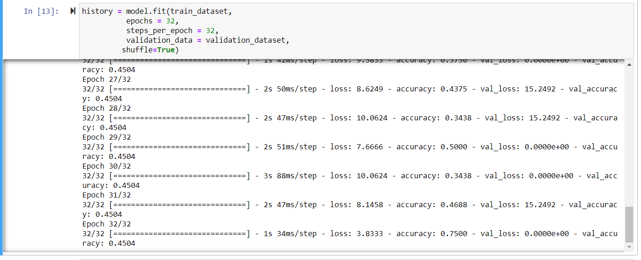
Calculating the Accuracy and the Loss

Slide 11
OpenCV Implementation :-
For the real time detection of the features we need to use OpenCV .
We set up a while loop to capture frames from the real time webcam input and converted the image in grayscale. Then we predict the left eye and right eye is opened or closed by passing the extracted image into our model .
If both eyes are open we set up the score as 0 and predicted eyes are open otherwise if both eyes are closed the score will increase and play the alarm if score > 15 .

Slide 12
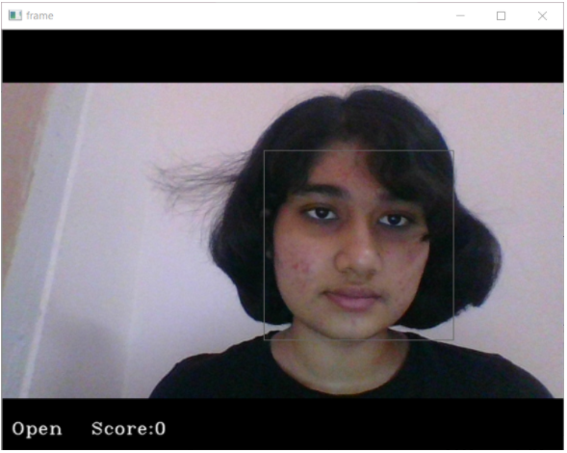
Open Eye Results-
Using the OpenCV we set the score as 0 when the right eye and left eye parameter that are defined in the code.

Slide 13
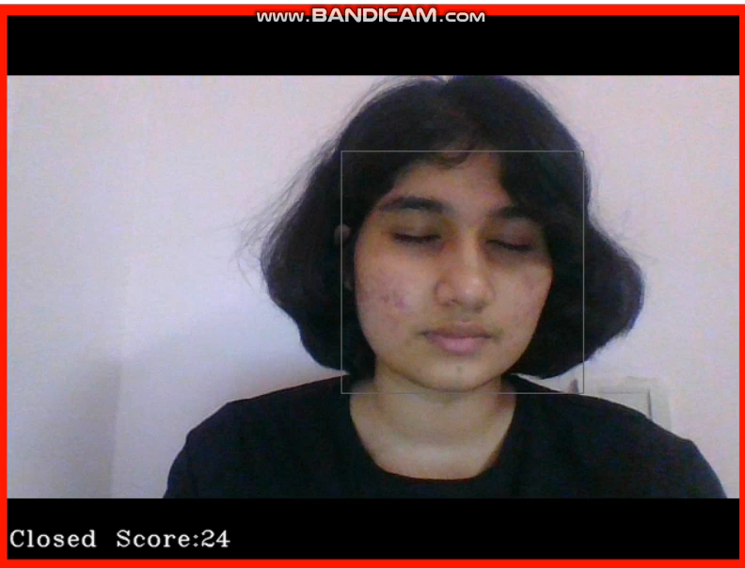
Closed Eye Result-
Using the OpenCV when the eye parameters are set to1 and the score couter that is defined is increased by one every second. When the score counter gets over the value of 15 the alarm is sounded.

