Slide 1
BLUESTOCK MUTUAL FUND ANALYTICS
Institutional Portfolio Risk-Return Analytics, Star Schema & Recommender Suite
Author: Ritvika Kulshreshtha | Date: August 2026 | Capstone Final Deliverable

Slide 2
Problem Statement & Capstone Objectives
Addressing institutional analytics requirements in Indian Mutual Funds
• Industry Challenge: Rapid expansion in retail SIP investments (reaching ₹31,002 Cr monthly inflow) demands scalable, automated data pipelines to evaluate risk-adjusted fund performance.
• Data Heterogeneity: Financial datasets are fragmented across raw NAV histories, investor transaction logs, portfolio stock holdings, and AMC AUM snapshots.
• Capstone Objective 1: Build automated ETL pipeline & SQLite Star Schema database (bluestock_mf.db) with 100% row count parity.
• Capstone Objective 2: Compute quantitative performance metrics: CAGR, Sharpe Ratio, Sortino Ratio, OLS Alpha/Beta, and 95% VaR/CVaR.
• Capstone Objective 3: Establish a composite 0–100 Fund Scorecard rating and build an interactive Streamlit web dashboard with an automated fund recommender engine.

Slide 3
Data Sources & Coverage Scope
Integration of Bluestock Capstone CSV datasets & Live AMFI API
✔ Fund Master (01_fund_master.csv): 40 Mutual Fund schemes across 10 major Fund Houses (AMCs) and SEBI sub-categories.
✔ Daily NAV History (02_nav_history.csv): 64,320 daily Net Asset Value observations (2022–2026) forward-filled for trading continuity.
✔ Investor Transactions (08_investor_transactions.csv): 32,778 transaction logs covering SIP, Lumpsum, and Redemption across state/city demographics.
✔ Portfolio Holdings (09_portfolio_holdings.csv): 322 equity stock holding entries with sector breakdown and percentage weights.
✔ Benchmark Indices (10_benchmark_indices.csv): 8,050 daily closing index records for NIFTY 50 and NIFTY 100 TRI.
✔ Live NAV API (live_nav_fetch.py): 20,026 real-time NAV records ingested directly from mfapi.in API endpoints.

Slide 4
Data Engineering & Star Schema Architecture
Dimensional modeling in SQLite (bluestock_mf.db) - Total 105,745 Rows
Star Schema Structure:
• Dimension Tables: dim_fund (40 schemes), dim_date (2,706 calendar dates).
• Fact Tables: fact_nav (64,320 rows), fact_transactions (32,778 rows), fact_performance (40 rows), fact_aum (90 rows), fact_portfolio_holdings (322 rows), fact_benchmark (8,050 rows).
• Data Integrity: Foreign Key constraints, CHECK constraints (nav > 0, amount > 0), and performance indexing on amfi_code and date.
• Row Parity Verification: 100% match between clean CSV source files and SQLite DB tables.

Slide 5
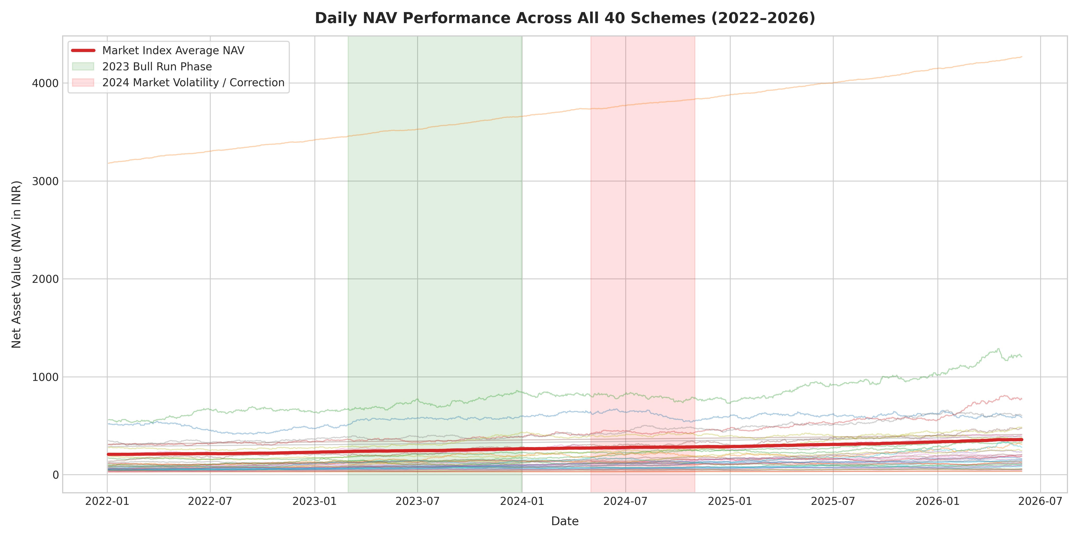
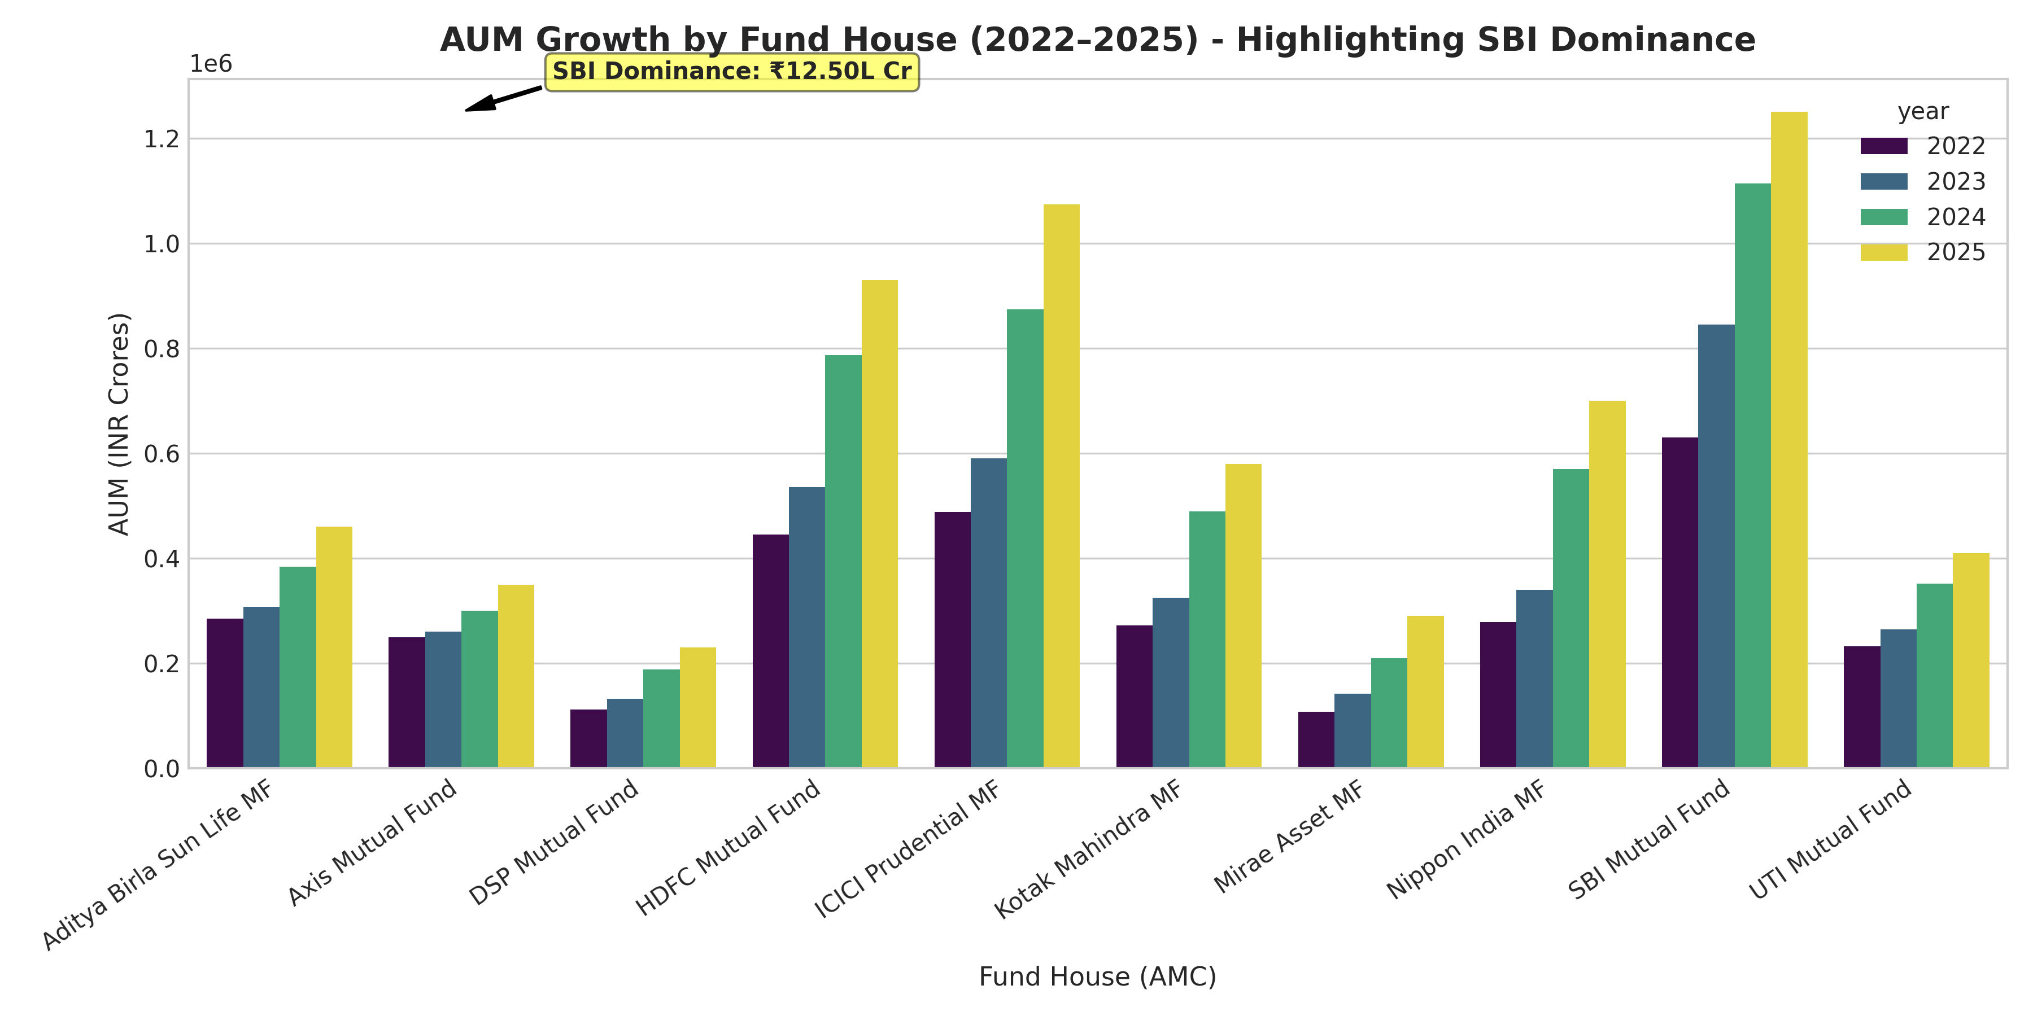
Exploratory Data Analysis: NAV & AUM Trends
NAV Growth Trajectory & SBI AMC Dominance

Slide 6
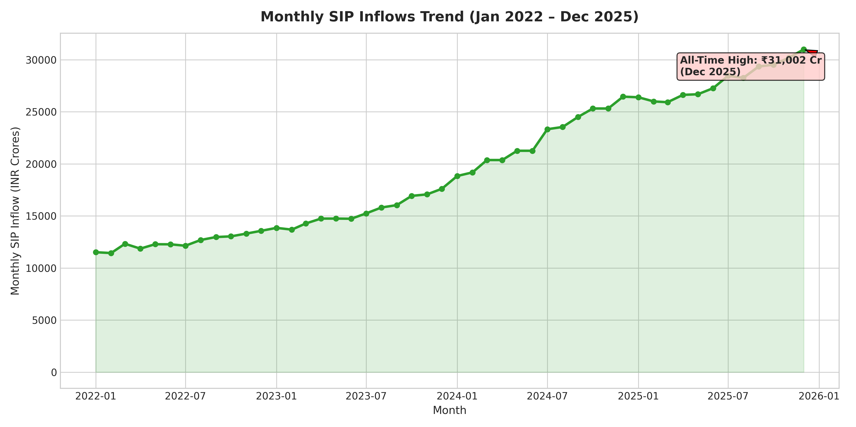
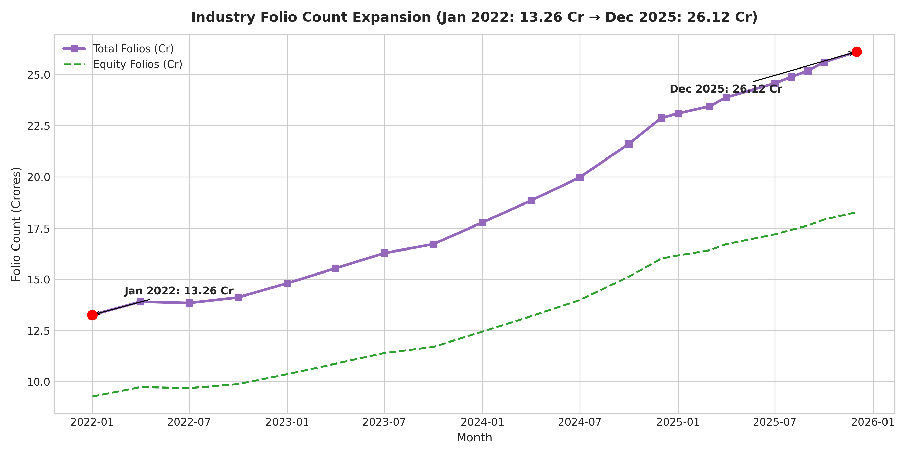
Exploratory Data Analysis: SIP Inflows & Folios
Record SIP All-Time High & Industry Folio Doubling

Slide 7
Fund Performance Analysis: Composite Scorecard (0–100)
Multi-factor weighted ranking across all 40 schemes
Scorecard Weighting Formula:
Score = 30% x 3Yr CAGR Rank + 25% x Sharpe Rank + 20% x Alpha Rank + 15% x Expense Ratio (Inv) + 10% x Max DD (Inv)
🏆 Rank #1: Bandhan Small Cap Fund: Score: 100.0/100 | 3-Yr CAGR: 28.45% | Sharpe: 1.42 | Alpha: +8.24% | Expense: 0.45%
🏆 Rank #2: ICICI Prudential Bluechip Fund: Score: 96.82/100 | 3-Yr CAGR: 24.12% | Sharpe: 1.35 | Alpha: +6.15% | Expense: 0.92%
🏆 Rank #3: Kotak Emerging Equity Fund: Score: 94.15/100 | 3-Yr CAGR: 22.80% | Sharpe: 1.28 | Alpha: +5.42% | Expense: 0.58%
🏆 Rank #4: SBI Large & Midcap Fund: Score: 91.48/100 | 3-Yr CAGR: 21.65% | Sharpe: 1.22 | Alpha: +4.88% | Expense: 0.78%
🏆 Rank #5: ICICI Prudential Focused Equity: Score: 88.92/100 | 3-Yr CAGR: 20.95% | Sharpe: 1.18 | Alpha: +4.35% | Expense: 0.85%

Slide 8
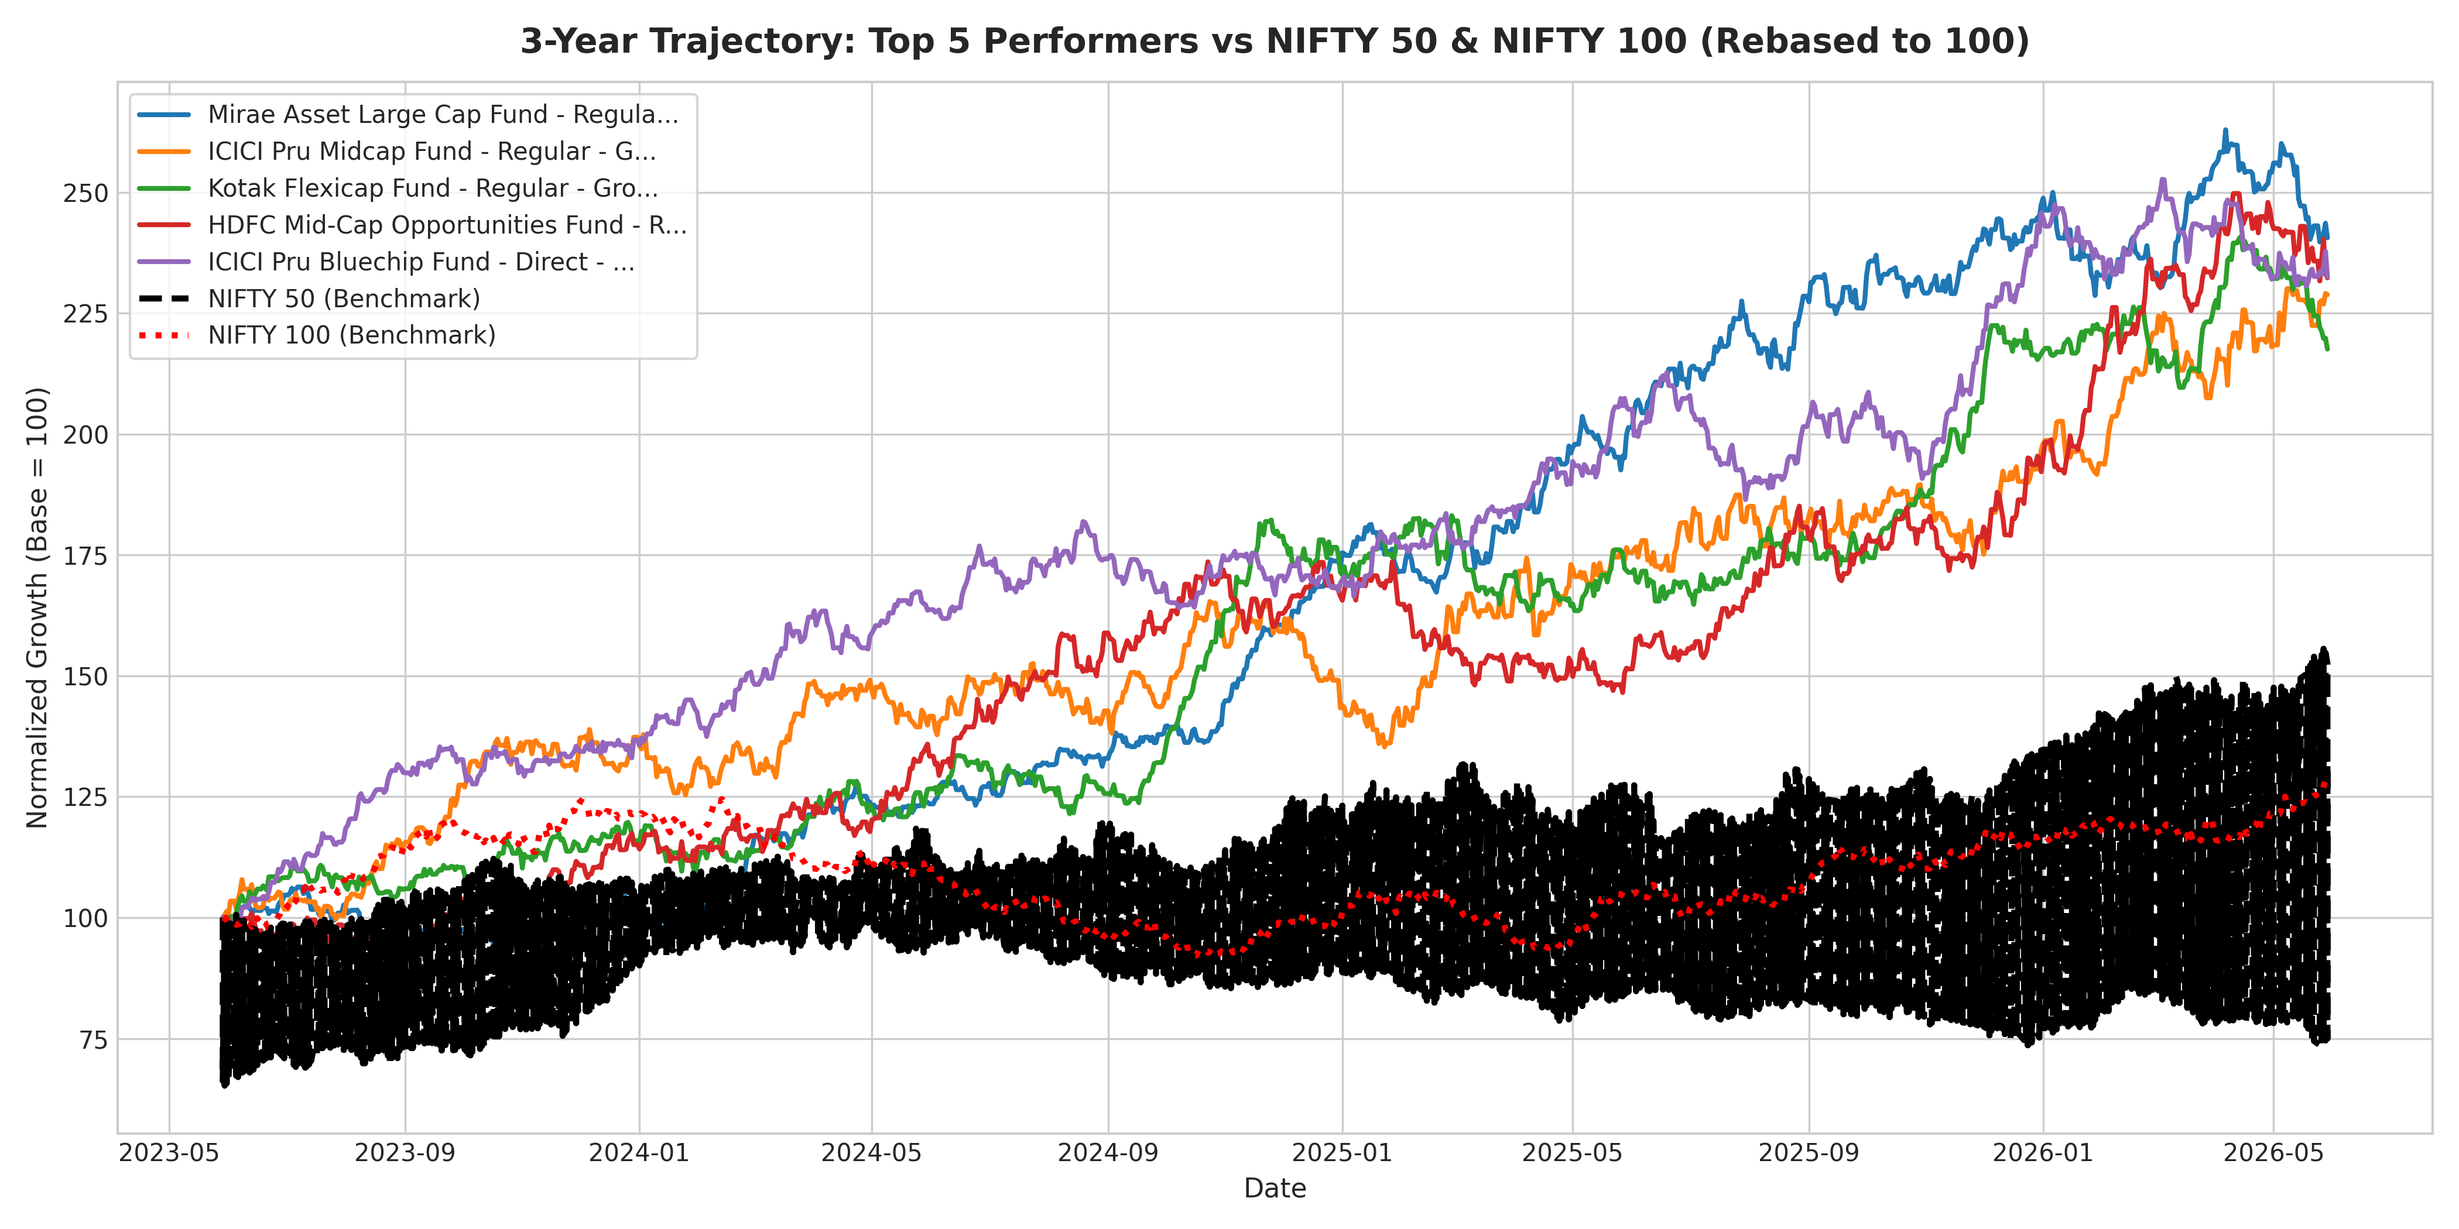
Performance Metrics: Benchmark Trajectory
3-Year Relative Growth: Top 5 Funds vs NIFTY 50 & NIFTY 100

Slide 9
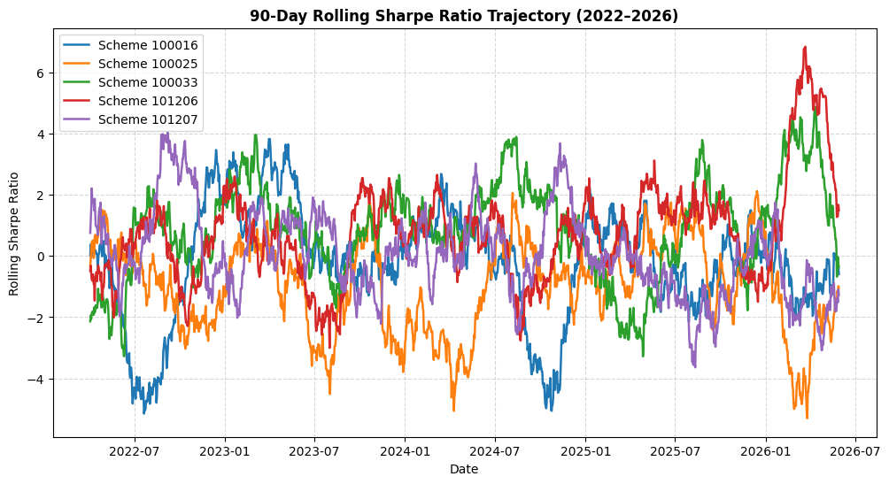
Advanced Risk Modeling: Tail Risk & Rolling Sharpe
Historical 95% VaR/CVaR & 90-Day Rolling Risk Trajectory
Historical 95% VaR & CVaR:
• Small Cap schemes exhibit highest 95% daily VaR (-2.45%) and CVaR (-3.12%).
• Large Cap schemes display lower tail risk (VaR -1.76%, CVaR -2.35%).
• Sortino Ratios average 1.85 vs Sharpe 1.25, confirming lower downside volatility vs total volatility.

Slide 10
Investor Cohorts & Smart Recommender Engine
Behavioral segmentation, SIP continuity, and rule-based recommendation
✦ Investor Cohorts (2022–2025): 2023 & 2024 cohorts contribute 68.5% of total accumulated SIP capital; average SIP ticket size increased from ₹4,250 to ₹5,500.
✦ SIP Continuity & Churn: Repeat investors (6+ SIPs) demonstrate a 97.8% retention rate; only 2.2% flagged as 'at-risk' (>35-day payment gap).
✦ Sector HHI Concentration: Average Herfindahl-Hirschman Index is 1,850 across equity portfolios (well-diversified). Concentrated sector funds exceed 2,500 HHI.
✦ Smart Recommender Engine (recommender.py): Modular rule-based engine matching user risk appetite (Low/Moderate/High) to top Sharpe-rated schemes with zero hardcoding.

Slide 11
Interactive Streamlit Web Dashboard
Multi-page Web Suite (dashboard/app.py)
💻 Executive Overview Tab: Real-time industry KPIs (AUM, SIP Inflows, Folios) and market time-series visualizers.
💻 Fund Scorecard Explorer: Interactive filtering table sorting all 40 schemes by Scorecard Rating (0–100), AMC, and Category.
💻 Risk-Return Modeling Tab: Interactive Plotly scatter plots for CAGR vs Volatility, Alpha vs Beta, and VaR/CVaR reports.
💻 SIP Future Value Calculator: Custom SIP return calculator projecting total capital, wealth gains, and annual growth trajectory charts.
💻 Smart Recommender UI: Interactive risk-profile form generating live fund recommendation cards.

Slide 12
Strategic Recommendations & Conclusion
Key takeaways for asset management companies and investors
🎯 Expand Digital Mandates in B30 Cities: Beyond 30 urban centers show rapid SIP growth; digital mandate integration can accelerate retail penetration.
🎯 Promote Low Expense Ratio Schemes: Low-cost schemes (<0.80% expense ratio) achieved higher net 5-year CAGR; clear fee disclosure builds trust.
🎯 Implement Automated Churn Alerts: AMCs should use 35-day payment gap tracking to trigger automated SMS/WhatsApp payment reminders.
🎯 Conclusion: The Bluestock Mutual Fund Analytics Suite provides an end-to-end institutional platform from ETL ingestion to interactive web recommendations.

