Slide 1
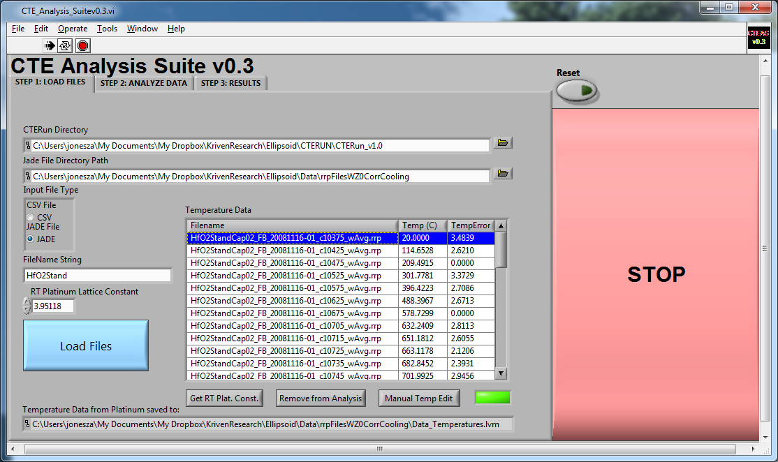
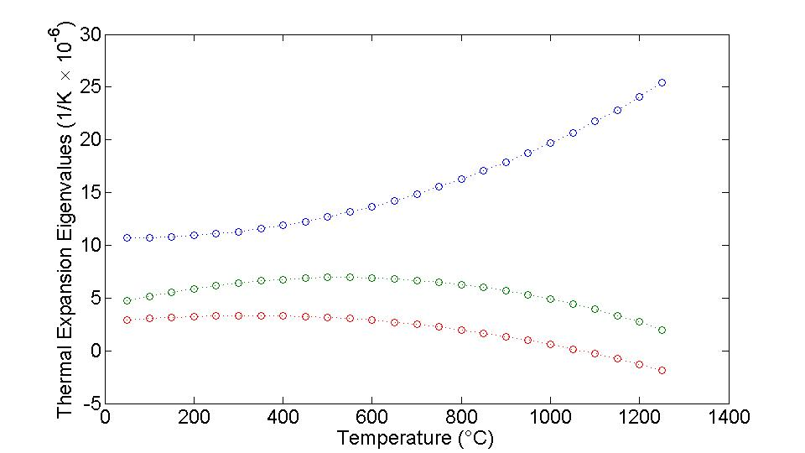
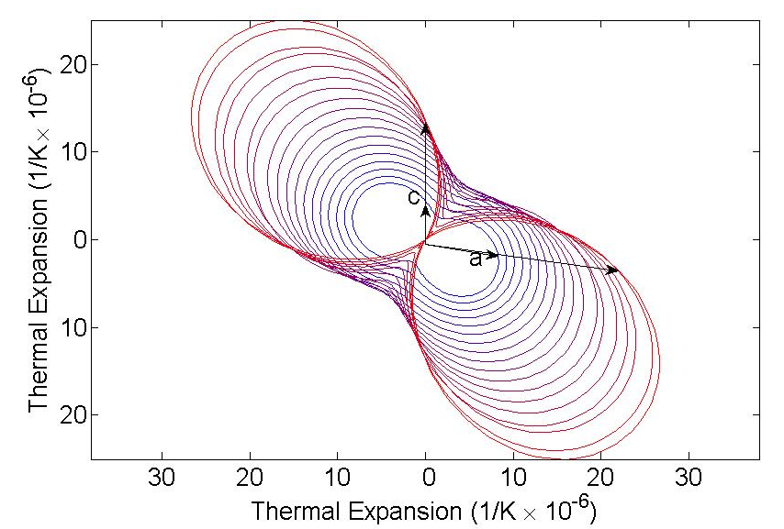
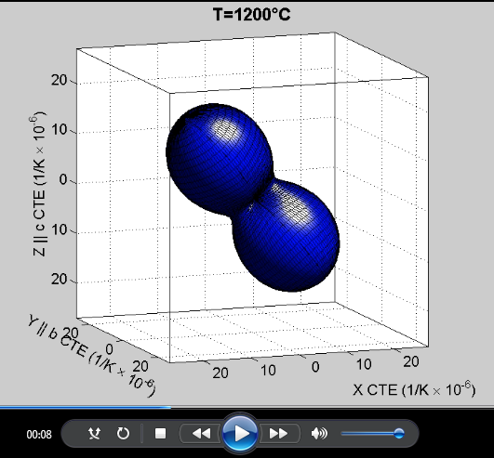
Coefficient of Thermal Expansion Analysis Suite (CTEAS)
Kriven Group: Grant ########
It is very common to describe CTE of a material using only the lattice parameters of a crystal. For many systems this method is satisfactory and describes the anisotropies in expansion that the crystal exhibits, but for systems of low symmetry (i.e. monoclinic or triclinic symmetry crystals) the CTE can be much more involved. The CTEAS program provides a simple method to visualize and understand the 3-D TE in low symmetry and high symmetry crystals in the same easy way. It also provides a simple interface for converting structural x-ray analysis into a CTE that can be related back to the crystal structure of the material. CTEAS makes the CTE of the most complex crystals easy to study and understand, thus making it an excellent tool for research as well as for teaching.
High Temperature XRD of ZrO₂
Finds best fit to CTE from high temperature XRD data
CTE as a function of temperature and crystallographic direction
Easy to use GUI interface
Several output options
Cooling
Heating
Movies of CTE as a function of temperature provide the most intuitive qualitative understanding of how CTE evolves on heating and how it changes as a function of crystallographic direction
XRD data for several temperatures is fit to the crystal symmetry providing a best fit CTE matrix at each temperature
The Eigenvalues of the CTE provide an easy way quantify the CTE in a low symmetry crystal
The CTE of a plane of interest can be isolated and viewed for several temperatures in polar coordinates

