Slide 1
Application Layer
Compiled by: Hiranya Prasad Bastakoti

Slide 2
Contents
Introduction and Functions
Web & Overview of HTTP
Non-Persistent and Persistent Connections,
HTTP Message Format
DNS and the Query Types Services provided by DNS
Overview of how DNS works
DNS records and messages
File Transfer and Email Protocols FTP, SFTP, SMTP, IMAP, POP3
Overview of Application Server Concepts Proxy, Web, Mail
Network Management SNMP and Transport mapping

Slide 3
Introduction
The application layer is the top-most layer of OSI model.
It provides services directly to user applications.
It enables the to access the network.
It provides user interfaces and support for services such as email, remote file access and transfer, shared database management and other types of distributed information services.
The functions of the application layer are:
It facilitates the user to use the services of the network.
It is used to develop network-based applications.
It provides user services like user login, naming network devices, formatting messages, and e-mails, transfer of files etc.
It is also concerned with error handling and recovery of the message as a whole

Slide 4
Functions of Application Layer
Network virtual terminal:- It is software terminal that allows user to logon and interact with the machine
File Transfer: It allows a user to access, retrieve and manage files in a remote computer.
Mail services: It provides the basis for email forwarding and storage facilities.
Directory services: It provides distributes database sources and access for global information about various objects and services.

Slide 5
Application layer protocols
Hyper Text Transfer Protocol, HTTP: It is the underlying protocol for world wide web. It defines how hypermedia messages are formatted and transmitted.
File Transfer Protocol, FTP: It is a client-server based protocol for transfer of files between client and server over the network.
Simple Mail Transfer Protocol, SMTP: It lays down the rules and semantics for sending and receiving electronic mails (e-mails).
Domain Name System, DNS: It is a naming system for devices in networks. It provides services for translating domain names to IP addresses.
TELNET: It provides bi-directional text-oriented services for remote login to the hosts over the network.
Simple Network Management Protocol, SNMP: It is for managing, monitoring the network and for organizing information about the networked devices.

Slide 6
Web & Overview of HTTP
The Web, or World Wide Web (W3), is basically a system of Internet servers that support specially formatted documents.
Web page consists of objects
The World Wide Web (WWW) is a repository of information linked together from points all over the world
Object can be HTML file, JPEG image, Java applet, audio file,…
The documents are formatted in a markup language called HTML (HyperText Markup Language) that supports links to other documents, as well as graphics, audio, and video files
Web page consists of base HTML-file which includes several referenced objects
Each object is addressable by a URL
.

Slide 7
HTTP
HTTP, the Hypertext Transfer Protocol, is the application-level protocol that is used to transfer data on the Web.
HTTP comprises the rules by which Web browsers and servers exchange information
Hyper Text Transfer Protocol is a file transfer protocol specifically designed to facilitate access to the WWW.
This protocol transfers data in the form of plain text, hypertext, audio, video, and so on
HTTP uses the services of TCP on a well-known port 80

Slide 8
Features of HTTP
HTTP is connectionless: The HTTP client, i.e., a browser initiates an HTTP request and after a request is made, the client waits for the response. The server processes the request and sends a response back after which client disconnect the connection. So client and server knows about each other during current request and response only. Further requests are made on new connection like client and server are new to each other.
HTTP is media independent: It means, any type of data can be sent by HTTP as long as both the client and the server know how to handle the data content. It is required for the client as well as the server to specify the content type using appropriate MIME-type.
HTTP is stateless: As mentioned above, HTTP is connectionless and it is a direct result of HTTP being a stateless protocol. The server and client are aware of each other only during a current request. Afterwards, both of them forget about each other. Due to this nature of the protocol, neither the client nor the browser can retain information between different requests across the web pages

Slide 9
How Does HTTP Work?
HTTP request
PC running
Explorer
HTTP response
HTTP request
Server
running
Apache Web
server
HTTP response
Mac running
Safari

Slide 10
How Does HTTP Work?
The above fig illustrates the HTTP transaction between the client and the server.
The client initializes the transaction by sending a request message.
The server replies by sending a response.
Although HTTP uses the services of TCP, HTTP itself is a stateless protocol(server maintains no information about past client requests)
It uses Uses TCP:
client initiates TCP connection (creates socket) to server, port 80 (default)
server accepts TCP connection from client
HTTP messages (application-layer protocol messages) exchanged between browser (HTTP client) and Web server (HTTP server)
TCP connection closed

Slide 11
How Does HTTP Work?
HTTP Is a request-response protocol. For example, a Web browser initiates a request to a server, typically by opening a TCP/IP connection. The request itself comprises
a request line,
a set of request headers, and
an entity.
The server sends a response that comprises
a status line,
a set of response headers, and
an entity.
The entity in the request or response can be thought of simply as the payload, which may be binary data. The other items are readable ASCII characters. When the response has been completed, either the browser or the server may terminate the TCP/IP connection, or the browser can send another request.

Slide 12
HTTP Connections
Persistent Versus Non-persistent Connection
Non-Persistent Connection: It requires connection setup again and again for each object to send.
Persistent connection: It does not require connection setup again and again. Multiple objects can use connection
HTTP prior to version 1.1 specified a nonpersistent connection, while a persistent connection is the default in version 1.1.
Persistent HTTP
Multiple objects can be sent over single TCP connection between client and server.
HTTP/1.1 uses persistent connections in default mode
Nonpersistent HTTP
At most one object is sent over a TCP connection.
HTTP/1.0 uses nonpersistent HTTP

Slide 13
Nonpersistent Connection
In a nonpersistent connection, one TCP connection is made for each request/response.
The following lists the steps in this strategy:
1. The client opens a TCP connection and sends a request.
2. The server sends the response and closes the connection.
3. The client reads the data until it encounters an end-of-file marker; it then closes the connection.
In this strategy, for N different pictures in different files, the connection must be opened and closed N times. The non persistent strategy imposes high overhead on the server because the server needs N different buffers and requires a slow start procedure each time a connection is opened.

Slide 14
Nonpersistent HTTP
(contains text,
references to 10
jpeg images)
Suppose user enters URL www.someSchool.edu/someDepartment/home.index
1a. HTTP client initiates TCP connection to HTTP server (process) at www.someSchool.edu on port 80
1b. HTTP server at host www.someSchool.edu waiting for TCP connection at port 80. “accepts” connection, notifying client
2. HTTP client sends HTTP request message (containing URL) into TCP connection socket. Message indicates that client wants object someDepartment/home.index
3. HTTP server receives request message, forms response message containing requested object, and sends message into its socket
time

Slide 15
Nonpersistent HTTP (cont.)
4. HTTP server closes TCP connection.
5. HTTP client receives response message containing html file, displays html. Parsing html file, finds 10 referenced jpeg objects
6. Steps 1-5 repeated for each of 10 jpeg objects
time

Slide 16
Persistent Connection
HTTP version 1.1 specifies a persistent connection by default.
In a persistent connection, the server leaves the connection open for more requests after sending a response. The server can close the connection at the request of a client or if a time-out has been reached.
The sender usually sends the length of the data with each response.
However, there are some occasions when the sender does not know the length of the data.
This is the case when a document is created dynamically or actively.
In these cases, the server informs the client that the length is not known and closes the connection after sending the data so the client knows that the end of the data has been reached

Slide 17
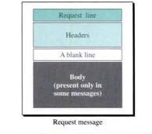
HTTP message
Two types of HTTP messages: request, response
Both uses almost same format
HTTP request message:
ASCII (human-readable format)
request line
(GET, POST,
HEAD commands)
GET /somedir/page.html HTTP/1.1
Host: www.someschool.edu
User-agent: Mozilla/4.0
Connection: close
Accept-language:fr
(extra carriage return, line feed; i.e., a blank line)
header
lines
Carriage return,
line feed
indicates end
of message

Slide 18
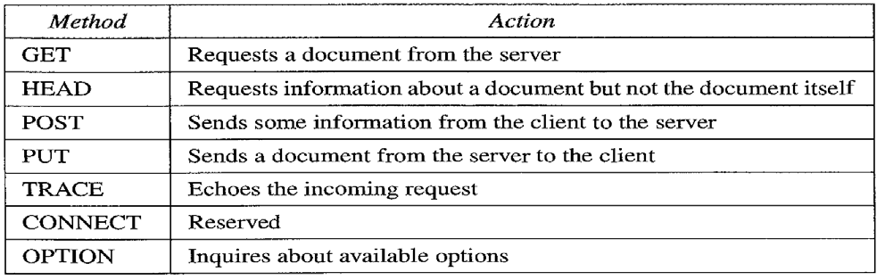
HTTP request message
Request line :defines the request type, resource (URL), and HTTP version
Request Type: In version 1.1 HTTP, several request types are defined. The request type categorizes the request messages into several methods.
These methods are defined as several kinds of messages. The request method is the actual command or request that a client issues to the server

Slide 19
Response Message:
A response message consists of a status line, a header, and sometimes a body.
Status Line: The status line defines the status of the response message.
It consists of the HTTP version, a space, a status code, a space, and a status phrase.
HTTP version: This field is the same as the corresponding field in the request line.
Status code: The status code field is similar to those in the FTP and the SMTP protocols.
It consists of three digits. Whereas the codes in the 100 range are only informational, the codes in the 200 range indicate a successful request. The codes in the 300 range redirect the client to another URL, and the codes in the 400 range indicate an error at the client site. Finally, the codes in the 500 range indicate an error at the server site

Slide 20
HTTP response message
status line
(protocol
status code
status phrase)
HTTP/1.1 200 OK
Connection close
Date: Thu, 06 Aug 1998 12:00:15 GMT
Server: Apache/1.3.0 (Unix)
Last-Modified: Mon, 22 Jun 1998 …...
Content-Length: 6821
Content-Type: text/html
data data data data data ...
header
lines
data, e.g.,
requested
HTML file

Slide 21
Other status codes are
200 OK
request succeeded, requested object later in this message
301 Moved Permanently
requested object moved, new location specified later in this message (Location:)
400 Bad Request
request message not understood by server
404 Not Found
requested document not found on this server
505 HTTP Version Not Supported

Slide 22
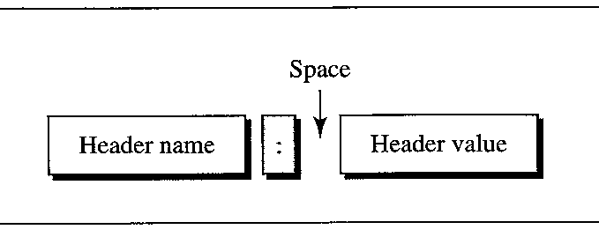
Header and Body
The header exchanges additional information between the client and the server.
For example, the client can request that the document be sent in special format, or the server can send extra information about the document.
The header can consist of one or more header lines.
Each header line has a header name, a colon, a space, and a header value). A header line belongs to one of four categories: general header, request header, response header, and entity header.
A request message can contain only general, request, and entity header. A response message, on the other hand, can contain only general, response, and entity headers
Body:
The body can be present in a request or response message. Usually, it contains the document to be sent or received

Slide 23
Overview of Domain Name System
Domain Name System is a hierarchical distributed database
DNS is the foundation of the Internet naming scheme
People prefer to use easy-to-remember names instead of IP addresses
Domain names are alphanumeric names for IP addresses e.g., neon.ece.utoronto.ca, www.google.com, ietf.org
The domain name system (DNS) is an Internet-wide distributed database that translates between domain names and IP addresses
DNS was created to support the Internet’s growing number of hosts

Slide 24
DNS Name hierarchy
DNS hierarchy can be represented by a tree
Root and top-level domains are administered by an Internet central name registration authority (ICANN- Internet Corporation for Assigned Names and Numbers)
Below top-level domain, administration of name space is delegated to organizations
Each organization can delegate further
Managed by UofT
Managed by ECE Dept.

Slide 25
Top-level domains
Three types of top-level domains:
Organizational: 3-character code indicates the function of the organization
Examples: gov, mil, edu, org, com, net
Geographical: 2-character country or region code
Examples: us, va, jp, de
Reverse domains: A special domain (in-addr.arpa) used for IP address-to-name mapping

Slide 26
Organizational top-level domains
com | Commercial organizations
edu | Educational institutions
gov | Government institutions
int | International organizations
mil | military institutions
net | Networking organizations
org | Non-profit organizations

Slide 27
Hierarchy of name servers
The resolution of the hierarchical name space is done by a hierarchy of name servers
Each server is responsible (authoritative) for a contiguous portion of the DNS namespace, called a zone.
Zone is a part of the subtree
DNS server answers queries about hosts in its zone

Slide 28

What Is a Domain Namespace?
Root Domain
Top-Level Domain
net
com
org
Second-Level Domain
nwtraders
Subdomain
west
south
east
sales
FQDN:
SERVER1.sales.south.nwtraders.com
Host: SERVER1

Slide 29








What Are the Components of a DNS Solution?
DNS Clients
DNS Servers
DNS Servers on the Internet
Resource
Record
Root “.”
.com
.edu
Resource
Record

Slide 30
Resolver and name server
An application program on a host accesses the domain system through a DNS client, called the resolver
Resolver contacts DNS server, called name server
DNS server returns IP address to resolver which passes the IP address to application
Reverse lookups are also possible, i.e., find the hostname given an IP address

Slide 31
What Is a DNS Query?
A query is a request for name resolution and is directed to a DNS server
Queries are recursive or iterative
DNS clients and DNS servers both initiate queries
DNS servers are authoritative or nonauthoritative for a namespace
An authoritative DNS server for the namespace will either:
Return the requested IP address
Return an authoritative “No”
A nonauthoritative DNS server for the namespace will either:
Check its cache
Use forwarders
Use root hints

Slide 32



How Recursive Queries Work
A recursive query is sent to a DNS server and requires a complete answer
mail1.contoso.msft
Database
172.16.64.11
DNS Client
Local DNS Server

Slide 33



How Iterative Queries Work
An iterative query directed to a DNS server may be answered with a referral to another DNS server
Local
DNS Server
Root Hint (.)
Iterative Query
Ask .com
Iterative Query
Ask nwtraders.com
.com
Recursive Query
mail1.nwtraders.com
172.16.64.11
Iterative Query
Authoritative Response
Nwtraders.com
Client Server

Slide 34

How Forwarders Work
A forwarder is a DNS server designated to resolve external or offsite DNS domain names
Iterative Query
Forwarder
Root Hint (.)
Ask .com
Iterative Query
Ask nwtraders.com
.com
Recursive Query
172.16.64.11
Iterative Query
172.16.64.11
Authoritative Response
Recursive query for
mail1.nwtraders.com
Nwtraders.com
Local
DNS Server
Client Server

Slide 35
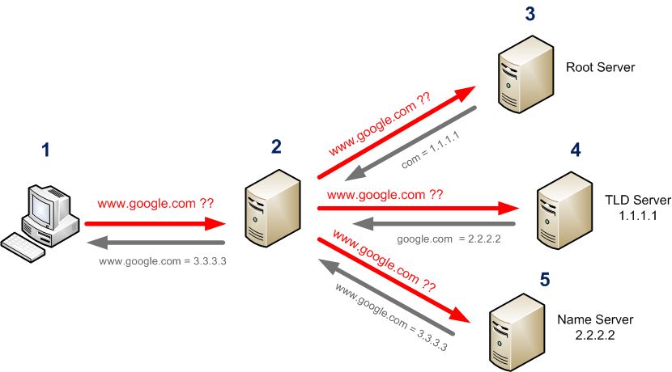
How DNS works?

Slide 36
How DNS Works?
Step 1: The client proposes a domain name resolution request and sends the request to the local domain name server.
Step 2: When the local domain name server receives the request, it first queries the local cache. If there is this record, the local domain name server directly returns the result of the query.
Step 3: If the local cache does not have the record, the local domain name server directly sends the request to the root domain name server, and then the root domain name server returns the primary domain name of the domain (the subdomain of the root) of the local domain name server. The address of the server.
Step 4: The local server sends a request to the domain name server returned in the previous step, and then the server that accepts the request queries its own cache. If there is no such record, it returns the address of the relevant lower-level domain name server.
Step 5: Repeat step 4 until you find the correct record.
Step 6: The local domain name server saves the returned results to the cache for the next use and returns the results to the client

Slide 37
DNS Record and Message
The name servers that together implement the DNS distributed database, store Resource Records (RR) for the hostname to IP address mappings.
Each DNS reply message carries one or more resource record
A resource record is a four-tuple that contains the following fields:
(Name, Value, Type, TTL)
TTL is the time to live of the resource record; it determines the time at which a resource should be removed from a cache
The meaning of Name and Value depend on Type

Slide 38
If Type=A, then Name is a hostname and Value is the IP address for the hostname. Thus, a Type A record provides the standard hostname to IP address mapping. As an example, (relay1.bar.foo.com, 145.37.93.126, A) is a Type A record.
If Type=NS, then Name is a domain (such as foo.com) and Value is the hostname of a server that knows how to obtain the IP addresses for hosts in the domain. This record is used to route DNS queries further along in the query chain. As an example, (foo.com, dns.foo.com, NS) is a Type NS record.
If Type=CNAME, then Value is a canonical hostname for the alias hostname Name. This record can provide querying hosts the canonical name for a hostname. As an example, (foo.com, relay1.bar.foo.com, CNAME) is a CNAME record.
If Type=MX, then Value is a hostname of a mail server that has an alias hostname Name. As an example, (foo. com. mail.bar.foo.com, MX) is an MX record. MX records allow the hostnames of mail servers to have simple aliases.

Slide 39
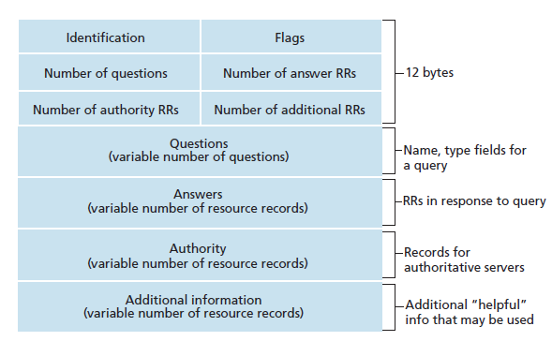
DNS Message Format

Slide 40
The first 12 bytes is the header section, which has a number of fields.
The first field is a 16-bit number that identifies the query. This identifier is copied into the reply message to a query, allowing the client to match received replies with sent queries.
There are a number of flags in the flag field. A one-bit query/reply flag indicates whether the message is a query (0) or a reply (1).
A one bit authoritative flag is set in a reply message when a name server is an authoritative server for a queried name.
A one bit recursion-desired flag is set when a client (host or name server) desires that the name server to perform recursion when it doesn't have the record. A one-bit recursion available field is set in a reply if the name server supports recursion.
In the header, there are also four "number of" fields. These fields indicate the number of occurrences of the four types of "data" sections that follow the header

Slide 41
The question section contains information about the query that is being made. This section includes (i) a name field that contains the name that is being queried, and (ii) a type field that indicates the type of question being asked about the name (e.g., a host address associated with a name - type "A", or the mail server for a name - type "MX").
In a reply from a name server, the answer section contains the resource records for the name that was originally queried. Recall that in each resource record there is the Type (e.g., A, NS, CSNAME and MX), the Value and the TTL. A reply can return multiple RRs in the answer, since a hostname can have multiple IP addresses (e.g., for replicated Web servers, as discussed earlier in this section).
The authority section contains records of other authoritative servers.
The additional section contains other "helpful" records. For example, the answer field in a reply to an MX query will contain the hostname of a mail server associated with the alias name Name. The additional section will contain a Type A record providing the IP address for the canonical hostname of the mail server.

Slide 42
FTP
FTP (File Transfer Protocol) is a protocol for transferring a file from one host to another host.
Transferring files from a client computer to a server computer is called "uploading" and transferring from a server to a client is "downloading".
In a typical FTP session, the user is sitting in front of one host (the local host) and wants to transfer files to or from a remote host.
In order for the user to access the remote account, the user must provide a user identification and a password.
After providing this authorization information, the user can transfer files from the local file system to the remote file system and vice versa.
As shown in Figure below the user interacts with FTP through an FTP user agent. The user first provides the hostname of the remote host, which causes the FTP client process in the local host to establish a TCP connection with the FTP server process in the remote host. The user then provides the user identification and password, which get sent over the TCP connection as part of FTP commands.
Once the server has authorized the user, the user copies one or more files stored in the local file system into the remote file system (or vice versa).

Slide 43
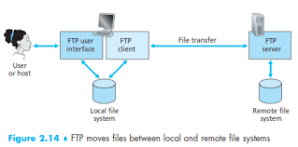
FTP

Slide 44
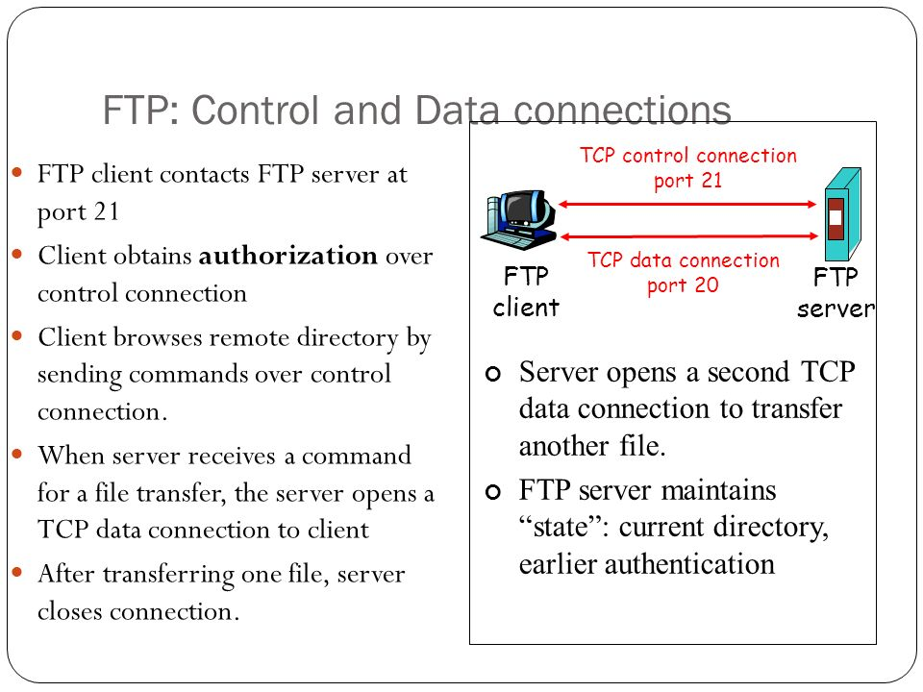
FTP

Slide 45
FTP commands, responses
Sample commands:
sent as ASCII text over control channel
USER username
PASS password
LIST return list of file in current directory
RETR filename retrieves (gets) file
STOR filename stores (puts) file onto remote host
Sample return codes
status code and phrase (as in HTTP)
331 Username OK, password required
125 data connection already open; transfer starting
425 Can’t open data connection
452 Error writing file

Slide 46
SFTP
SFTP stands for Secure File Transfer Protocol. It is a protocol which provides the secure channel, to transfer or copies the file from one host to another host or systems.
SFTP establishes the control connection under SSH(secure shell) protocol and It is used in port no-22.
It supports the full security and authentication functionality of SSH.
SFTP has pretty much replaced legacy FTP as a file transfer protocol, and is quickly replacing FTP/S.
SFTP also protects against password sniffing and man-in-the-middle attacks. It protects the integrity of the data using encryption and cryptographic hash functions, and authenticates both the server and the user.

Slide 47
Email and Email Protocols
It is a store and forward method of composing, sending, storing, and receiving messages over electronic communication systems.
One of the most popular network services is electronic mail (email).
Simple Mail Transfer Protocol (SMTP) is the standard mechanism for electronic mail in the internet; the first e-mail systems simply consisted by file transfer, protocols.
Basic Functions of email:
1. Composition 2. Transfer 3. Reporting 4. Displaying and 5. Disposition
E-mail Protocols are set of rules that help the client to properly transmit the information to or from the mail server. Email protocols are SMTP, POP, and IMAP

Slide 48
Electronic Mail
outgoing
message queue
Three major components:
user agents : : They allow the people to read and send e-mail
mail servers :They move the messages from the source to the destination.
simple mail transfer protocol: SMTP
User Agent
a.k.a. “mail reader”
composing, editing, reading mail messages
e.g., Eudora, Outlook, elm, Netscape Messenger
outgoing, incoming messages stored on server
user mailbox
user
agent
mail
server
user
agent
SMTP
mail
server
user
agent
SMTP
SMTP
mail
server
user
agent
user
agent
user
agent

Slide 49
Electronic Mail: mail servers
Mail Servers
mailbox contains incoming messages for user
message queue of outgoing (to be sent) mail messages
SMTP protocol between mail servers to send email messages
client: sending mail server
“server”: receiving mail server
user
agent
mail
server
user
agent
SMTP
mail
server
user
agent
SMTP
SMTP
mail
server
user
agent
user
agent
user
agent

Slide 50


Scenario: Alice sends message to Bob
1) Alice uses UA to compose message and “to” bob@someschool.edu
2) Alice’s UA sends message to her mail server; message placed in message queue
3) Client side of SMTP opens TCP connection with Bob’s mail server
4) SMTP client sends Alice’s message over the TCP connection
5) Bob’s mail server places the message in Bob’s mailbox
6) Bob invokes his user agent to read message
1
mail
server
mail
server
user
agent
user
agent
2
3
6
4
5

Slide 51
SMTP
SMTP stands for Simple Mail Transfer Protocol.
Simple Mail Transfer Protocol (SMTP) is the standard protocol for sending emails across the Internet.
It is a standard protocol used for sending e-mail efficiently and reliably over the internet.
SMTP is application level protocol.
SMTP is connection oriented protocol.
SMTP is text based protocol.
It handles exchange of messages between e-mail servers over TCP/IP network.
Apart from transferring e-mail, SMPT also provides notification regarding incoming mail.
When you send e-mail, your e-mail client sends it to your e-mail server which further contacts the recipient mail server using SMTP client.
These SMTP commands specify the sender’s and receiver’s e-mail address, along with the message to be send.
The exchange of commands between servers is carried out without intervention of any user.
In case, message cannot be delivered, an error report is sent to the sender which makes SMTP a reliable protocol.
By default, the SMTP protocol works on three ports:
Port 25 - this is the default SMTP non-encrypted port
Port 2525 - this port is opened on all SiteGround servers in case port 25 is filtered (by your ISP for example) and you want to send non-encrypted emails with SMTP
Port 465 - this is the port used if you want to send messages using SMTP securely

Slide 52
IMAP
The Internet Message Access Protocol (IMAP) is a mail protocol used for accessing email on a remote web server from a local client.
IMAP allows the client program to manipulate the e-mail message on the server without downloading them on the local computer.
The e-mail is hold and maintained by the remote server.
It enables us to take any action such as downloading, delete the mail without reading the mail.
It enables us to create, manipulate and delete remote message folders called mail boxes.
IMAP enables the users to search the e-mails.
It allows concurrent access to multiple mailboxes on multiple mail servers.
By default, the IMAP protocol works on two ports:
Port 143 - this is the default IMAP non-encrypted port
Port 993 - this is the port you need to use if you want to connect using IMAP securely

Slide 53
POP
POP stands for Post Office Protocol.
Post Office Protocol version 3 (POP3) is a standard mail protocol used to receive emails from a remote server to a local email client. POP3 allows you to download email messages on your local computer and read them even when you are offline
It is generally used to support a single client.
There are several versions of POP but the POP 3 is the current standard.
POP is an application layer internet standard protocol.
Since POP supports offline access to the messages, thus requires less internet usage time.
POP does not allow search facility.
In order to access the messaged, it is necessary to download them.
It allows only one mailbox to be created on server.
It is not suitable for accessing non mail data.
By default, the POP3 protocol works on two ports:
Port 110 - this is the default POP3 non-encrypted port
Port 995 - this is the port you need to use if you want to connect using POP3 securely

Slide 54
POP and IMAP Comparison
S.N. | POP | IMAP
1 | Generally used to support single client. | Designed to handle multiple clients.
2 | Messages are accessed offline. | Messages are accessed online although it also supports offline mode.
3 | POP does not allow search facility. | It offers ability to search emails.
4 | All the messages have to be downloaded. | It allows selective transfer of messages to the client.
5 | Only one mailbox can be created on the server. | Multiple mailboxes can be created on the server.
6 | Not suitable for accessing non-mail data. | Suitable for accessing non-mail data i.e. attachment.

Slide 55
7 | POP commands are generally abbreviated into codes of three or four letters. Eg. STAT. | IMAP commands are not abbreviated, they are full. Eg. STATUS.
8 | It requires minimum use of server resources. | Clients are totally dependent on server.
9 | Mails once downloaded cannot be accessed from some other location. | Allows mails to be accessed from multiple locations.
10 | The e-mails are not downloaded automatically. | Users can view the headings and sender of e-mails and then decide to download.
10 | POP requires less internet usage time. | IMAP requires more internet usage time.

Slide 56
SNMP
SNMP stands for simple network management protocol.
It is a way that servers can share information about their current state, and also a channel through which an administer can modify pre-defined values.
While the protocol itself is very simple, the structure of programs that implement SNMP can be very complex.
SNMP is a set of protocols that describes management data and the protocols for exchanging that data between heterogeneous systems.
The protocols include both the description of the management data, defined in the Management Information Base (MIB), and the operations for exchanging or changing that information.
By implementing common protocols, management data can be exchanged between different platforms with relative ease.
SNMP defines an architecture that consists of:
Network management applications
Network management agents and subagents
Network elements, such as hosts and gateways

Slide 57
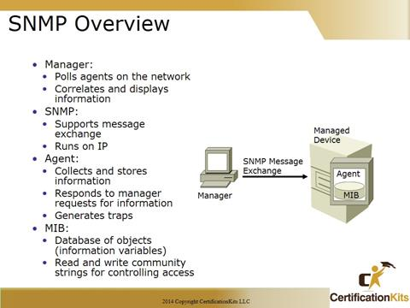
Components of SNMP

Slide 58
MIB
A management information base (MIB) is a formal description of a set of network Objects that can be managed using the Simple Network Management Protocol (SNMP).
The format of the MIB is defined as part of the SNMP. (All other MIBs are extensions of this basic management information base.) MIB-I refers to the initial MIB definition; MIB-II refers to the current definition. SNMPv2 includes MIB-II and adds some new objects.
There are MIBs (or more accurately, MIB extensions) for each set of related network entities that can be managed.
For example, there are MIB definitions specified in the form of Requests for Comments (RFCs) for AppleTalk, domain name system (DNS), Fiber Distributed-Data Interface, and RS-232C network objects. Product developers can create and register new MIB extensions.
Companies that have created MIB extensions for their sets of products include Cisco, Fore, IBM, Novell, QMS, and Onramp.

Slide 59
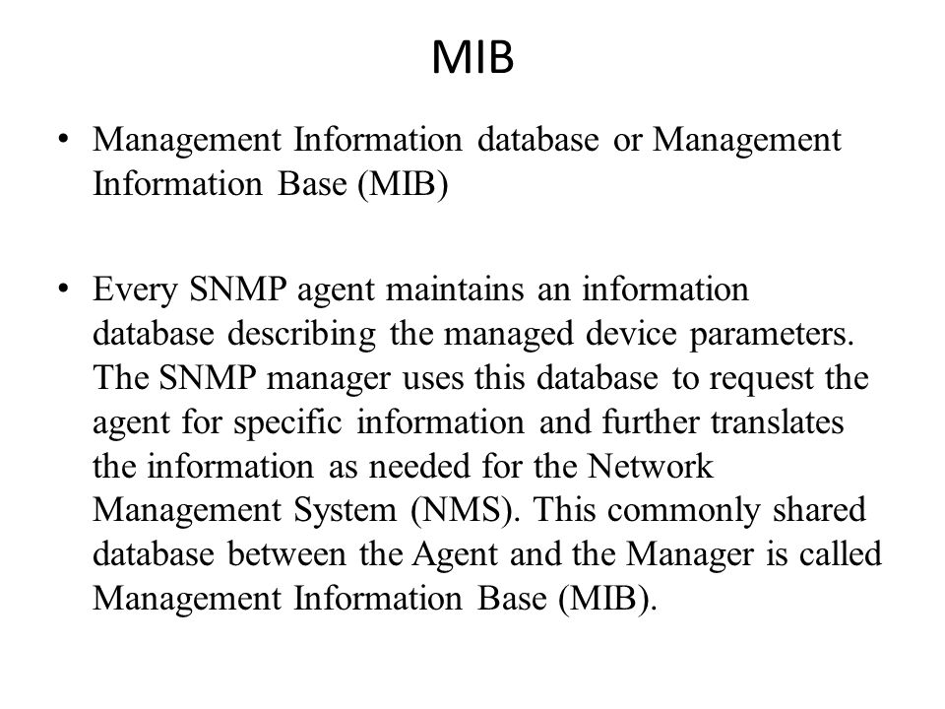
MIB

