Slide 1
Проектирование и создание JavaScript framework'а для высоконагруженных сайтов
Никита Манько / Mikita Manko

Slide 2


Никита Манько,
sr. software engineer @ EPAM
@MikitaManko

Slide 3
Проект
Front-end: UI Widgets
Back-end: services & DBs

Slide 4
Проект
Integration with sites of 70+ brands (real hell)

Slide 5
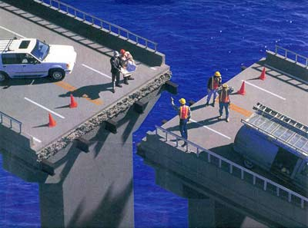

Slide 6
What is high-load?
1m+ hits per
day/hour/minutes?

Slide 7
Architecture
Core
Isolated modules/widgets
Events
Internal widgets

Slide 8
Architecture
Single responsibility – for each separate task create separate module

Slide 9
Widgets/Modules
Versions
Inheritance

Slide 10
Widgets/Modules
Context/sandbox

Slide 11
High-load tips & tricks
Akamai

Slide 12
High-load tips & tricks
Report tracking

Slide 13
High-load tips & tricks
Local Storage

Slide 14
High-load tips & tricks
Move 3-rd party APIs to client

Slide 15
High-load tips & tricks
AppDynamics

Slide 16
High-load tips & tricks
Client-side profiling

Slide 17
High-load tips & tricks
jMeter load tests

Slide 18
High-load tips & tricks
Jasmine

Slide 19
High-load tips & tricks
Selenium web-driver UI tests

Slide 20
High-load tips & tricks
Mobile Optimized (OOP is here?)

Slide 21
High-load tips & tricks
Client-side error tracking

Slide 22
High-load tips & tricks
Move more stuff to front-end

Slide 23

A slide with no useful information at all
Just filling the gap between previous slide and the next one (which will be along in just a moment).
No need to write it down, unless you feel completed to do so.
In fact I’m not really sure why I bothered with it.
Nothing on this slide is examinable.

Slide 24

Вопросы?
Никита Манько,
sr. software engineer @ EPAM
@MikitaManko
gmail@MikitaManko.com

