Slide 1
Global Map Performance
Dzianis Sheka,
Javascript developer at Wargaming.net

Slide 2
What does map mean
geographical data
ux - scroll, zoom, tooltips, hover

Slide 3
Demo
http://www.openstreetmap.org/#map=11/52.1071/23.8115

Slide 4
What does map mean
What does global map 2.0 metagame mean
geographical data
ux - scroll, zoom, tooltips, hover
game entities - provinces, clans, battles, divisions
game entities to geographical one mapping
applying actions to gamefield

Slide 5
Demo
https://ru.wargaming.net/globalmap/#cluster/1510_ru_absolute_front_1_06_061

Slide 6
Problems: organizational
quick switch from prototype to release
Agile: short iterations, hard to inject long running tasks
big technical debt

Slide 7
Problems: technical
leaflet + marionette.js as out-dated technology
different layers: borders, fillings, markers
different data sources: accounts, common, clan, tactical situation
browser frozen when need to process too much
design with beautiful shadows

Slide 8
Metrics
unified environment
numbers
fps ?
tile rendering time

Slide 9
Solution
profile code execution
separate entities into tiles
process data in a functional style
progressive rendering

Slide 10
Solution: profile code execution
profiler.start('_removeTiles ' + tilesKey.length);
_.each(tilesKey, (tileKey) => {
const tile = this._getTileByKey(tileKey);
if (!_.isUndefined(tile)) {
this.markersLayer.removeLayer(tile.layer);
utils.refreshMarkerLayers({
tile: tile,
lMap: this.lMap,
fillMode: this.fillMode
});
}
});
profiler.end('_removeTiles ' + tilesKey.length);
},
Notes:
https://developer.mozilla.org/en-US/docs/Web/API/Window/performance

Slide 11
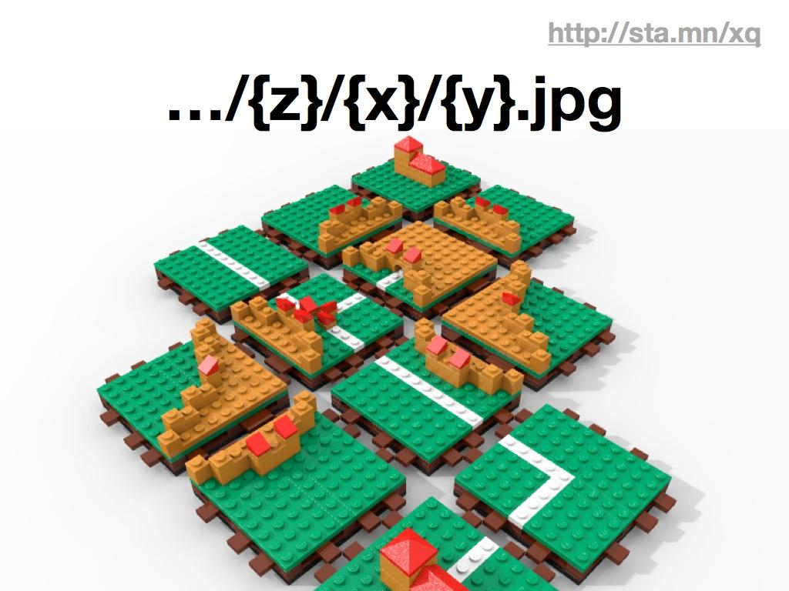
Solution: tile

Slide 12
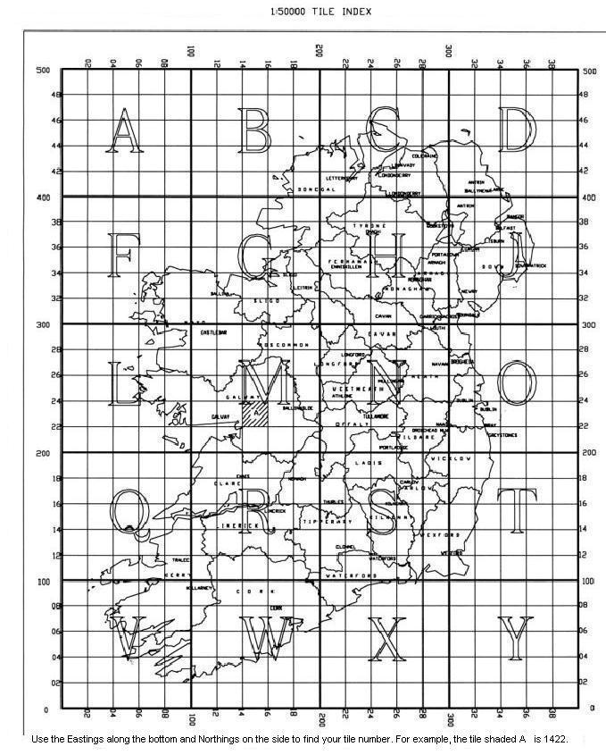
Solution: tile

Slide 13
Solution: tile
need to reduce call to dom api (batching)
reduce number of objects to draw (1 tile - 25 objects)
good old concept
standard for gis

Slide 14

Solution: functional javascript
Notes:
http://shop.oreilly.com/product/0636920028857.do
https://medium.com/javascript-scene/the-two-pillars-of-javascript-pt-2-functional-programming-a63aa53a41a4#.yencrkvkw

Slide 15
Solution: functional style processing - pipeline
Data
merged data
filtering
processing
drawing
Data

Slide 16
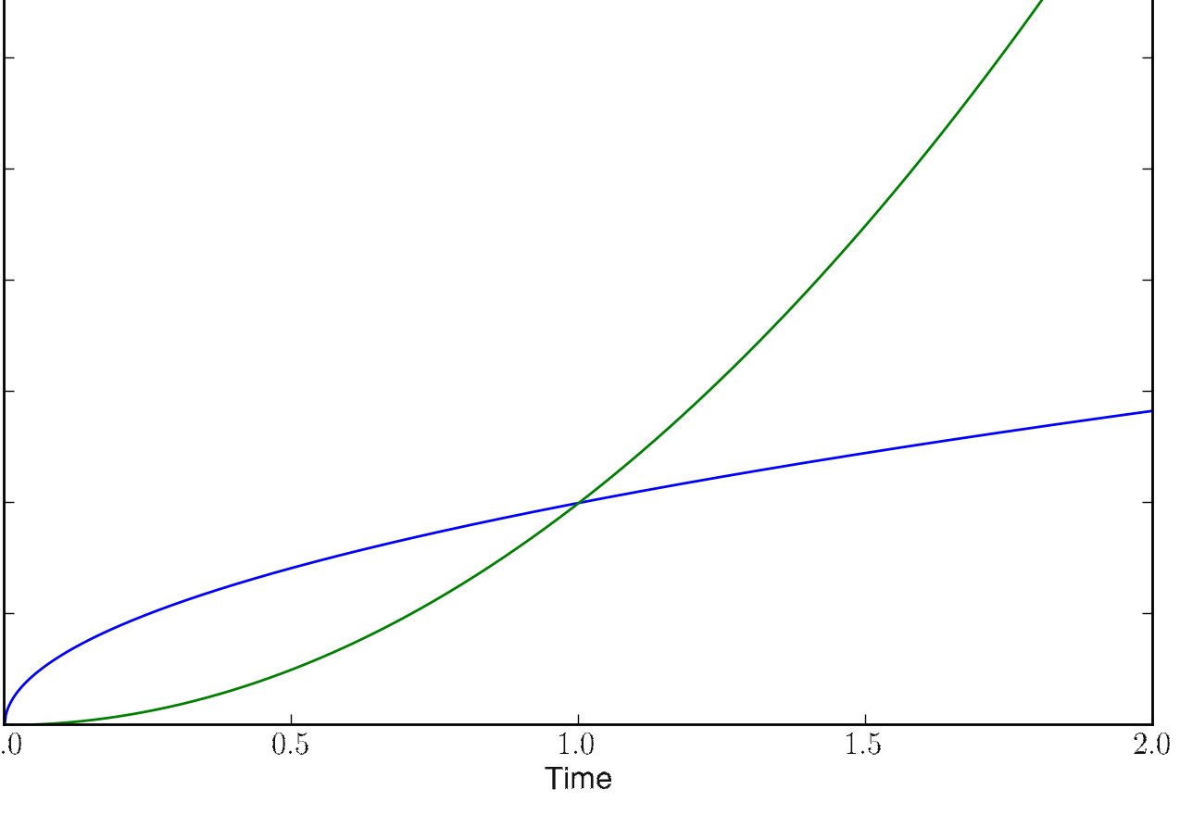
Solution: functional javascript - learning curve

Slide 17
Solution
profile code execution
separate entities into tiles
process data in a functional style
progressive rendering

Slide 18
Solution: renderer - dom control
Sync mode
DRAW
RENDERER
Request Animation Frame
Browser
Dom Api
Event loop
Notes:
https://developer.mozilla.org/en-US/docs/Web/API/window/requestAnimationFrame

Slide 19
Solution: progressive rendering for markers
Without effects
Add effects later
Event handlers for container - event delegation

Slide 20
Solution: progressive rendering for markers
&__simplified.tactical-info * {
box-shadow: none;
border: none;
text-shadow: none;
}

Slide 21
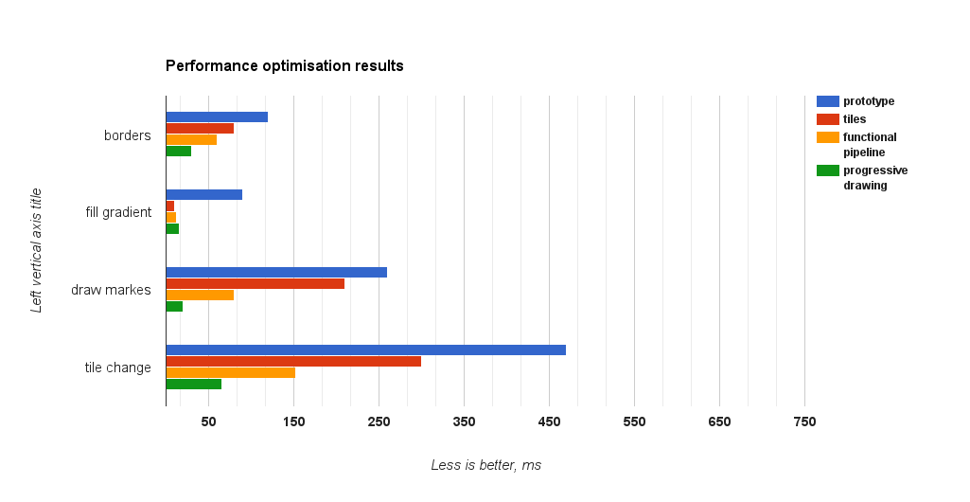
Results

Slide 22
Results
transition from Object Hierarchy to Data Structure and Algorithms
protocol standardisations
more space for optimizations
Notes:
http://geojson.org/

Slide 23
What next
new viewport based on RTREE
WEBGL drawing using vector tiles
Notes:
https://www.npmjs.com/package/rbush
https://www.mapbox.com/blog/mapbox-gl/

Slide 24
Thank you!
Questions?

