Slide 1
UI Development Basics
DOM, HTML, CSS

Slide 2

Intro

Slide 3
Expectation
How it works (render process)
How to choose layout architecture
Performance optimization

Slide 4
Agenda
HTML Source/DOM tree/DOM Render
Repaints and reflows
Layout architecture
Q & A

Slide 5
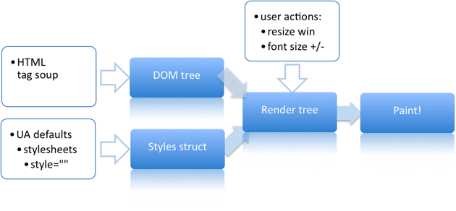
HTML Source/DOM tree/DOM Render
The rendering process

Slide 6
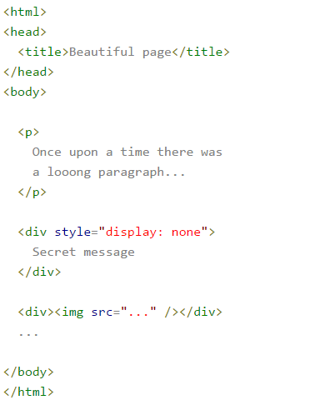
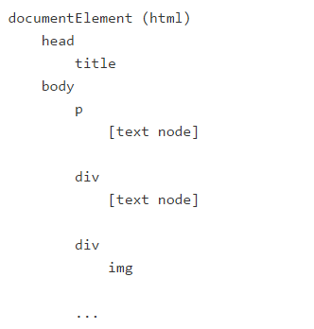
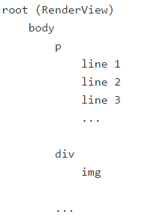
HTML Source/DOM tree/DOM Render
HTML source The DOM tree The render tree

Slide 7
Repaints and reflows
Parts of the render tree (or the whole tree) will need to be revalidated and the node dimensions recalculated. This is called a reflow, or relayout, or relayouting. Note that there's at least one reflow - the initial layout of the page.
Parts of the screen will need to be updated, either because of changes in geometric properties of a node or because of stylistic change, such as changing the background color. This screen update is called a repaint, or a redraw.

Slide 8
Repaints and reflows
Task (repaint or reflow ?)
var bstyle = document.body.style;
bstyle.padding = "20px";
bstyle.border = "10px solid red";
bstyle.color = "blue";
bstyle.backgroundColor = "#fad";
bstyle.fontSize = "2em";
document.body.appendChild(document.createTextNode('dude!'));
Var left = el.offsetLeft;

Slide 9
Repaints and reflows
Reflow (
offsetTop, offsetLeft, offsetWidth, offsetHeight
scrollTop/Left/Width/Height
clientTop/Left/Width/Height
// no-no!
for(big; loop; here)
{
el.style.left = el.offsetLeft + 10 + "px";
el.style.top = el.offsetTop + 10 + "px"; }
// better
var left = el.offsetLeft,
top = el.offsetTop,
esty = el.style;
for(big; loop; here)
{
left += 10;
top += 10;
esty.left = left + "px";
esty.top = top + "px";
}
// bad
var left = 10,
top = 10;
el.style.left = left + "px";
el.style.top = top + "px";
// better
el.className += " theclassname";
// or when top and left are calculated dynamically...
// better
el.style.cssText += "; left: " + left + "px;
top: " + top + "px;";

Slide 10

Layout architecture

Slide 11
Layout architecture
Why Table Layout is a bad practice?
Why “Float” Layout is a bad practice?
Absolute, “Percentage”, Flex, Inline-Block how to choose The Best.

Slide 12
The End
Thank you for your attention!

