Slide 1
REVOLUTIONIZING LIVESTOCK MANAGEMENT: HARNESSING IOT FOR CATTLE MONITORING

Slide 2
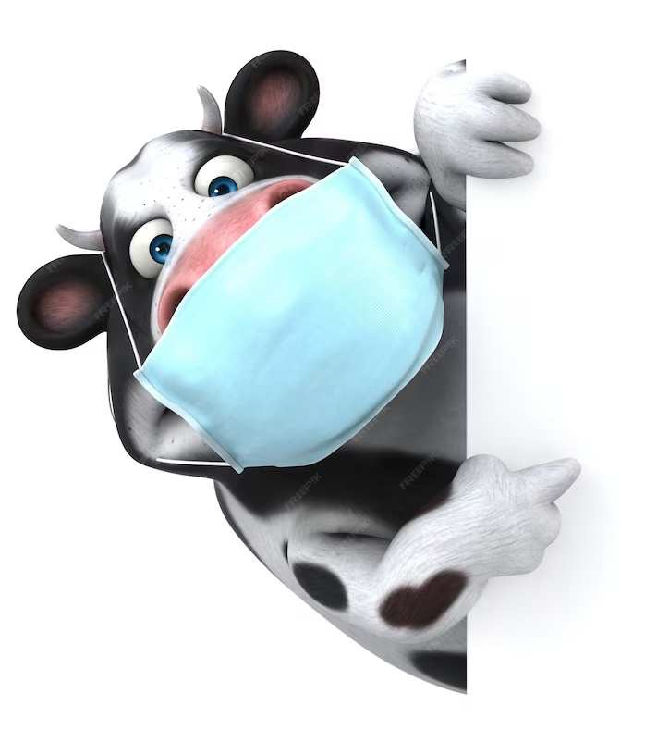
INTRODUCTION
Welcome to the revolution of livestock management with IoT technology. This presentation will explore the potential of IoT in cattle monitoring and its impact on the industry.

Slide 3
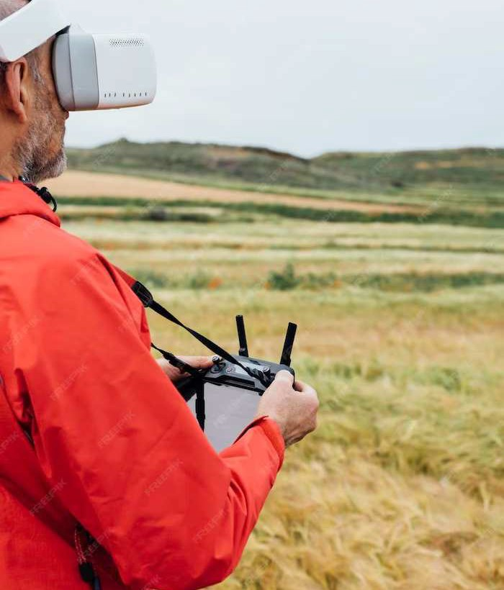
CHALLENGES IN LIVESTOCK MANAGEMENT
Traditional cattle monitoring methods are labor-intensive and often fail to provide real-time data. IoT offers solutions to these challenges by enabling continuous and remote monitoring, leading to improved productivity and animal welfare.

Slide 4

IOT APPLICATIONS IN CATTLE MONITORING
Through the use of IoT devices such as smart collars and sensors, real-time data on health, location, and behavior of cattle can be collected and analyzed. This data can be utilized for proactive health management and resource optimization.

Slide 5
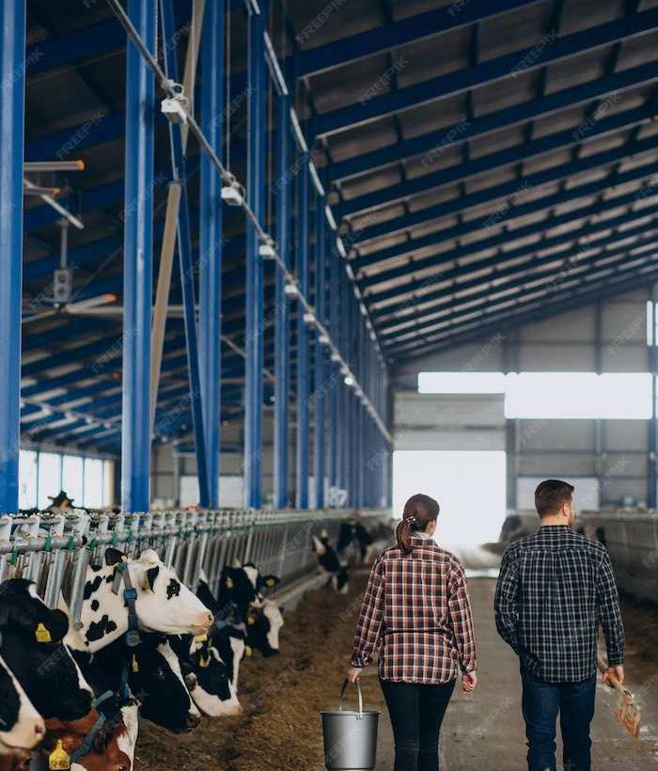
BENEFITS OF IOT IN LIVESTOCK MANAGEMENT
The implementation of IoT technology in cattle monitoring leads to enhanced efﬁciency, cost savings, and improved animal welfare. Moreover, it enables data-driven decision making and facilitates early disease detection.

Slide 6
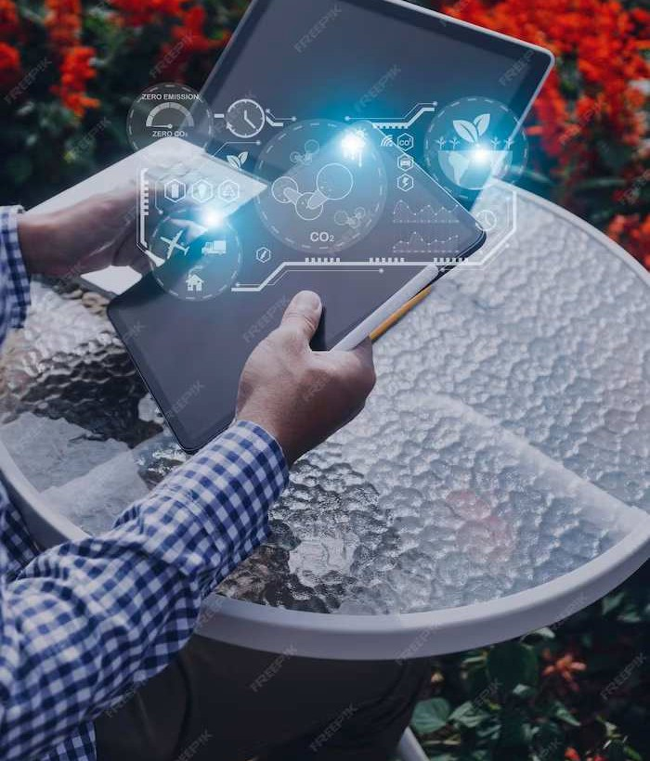
FUTURE TRENDS IN LIVESTOCK MANAGEMENT
The future of cattle monitoring lies in the integration of IoT with AI and big data analytics. This will enable predictive health monitoring and precision farming methods, further revolutionizing the industry.

Slide 7
CONCLUSION
The integration of IoT in cattle monitoring presents a signiﬁcant opportunity to revolutionize the livestock industry. With continuous advancements, it promises to enhance efﬁciency, sustainability, and animal welfare for the future.

Slide 8



Thanks!
Do you have any questions? youremail@email.com
+91 620 421 838
www.yourwebsite.com @yourusername

