Slide 1
MLB Analysis: How to win it All!?
Andrey Tokarev
Karla Murphy
Jared Graeve
Simon Feinsilver

Slide 2

MoneyBall: Part 2…

Slide 3
Minus Brad Pitt ☹

Slide 4
Objectives
Compare the Total Salary Spent between the World Series Winners and “Losers”
Do the teams that spend the most, win the most?
Evaluate guiding parameters for salary spent for the World Series Winners
Are there statistical commonalities between World Series Winners

Slide 5
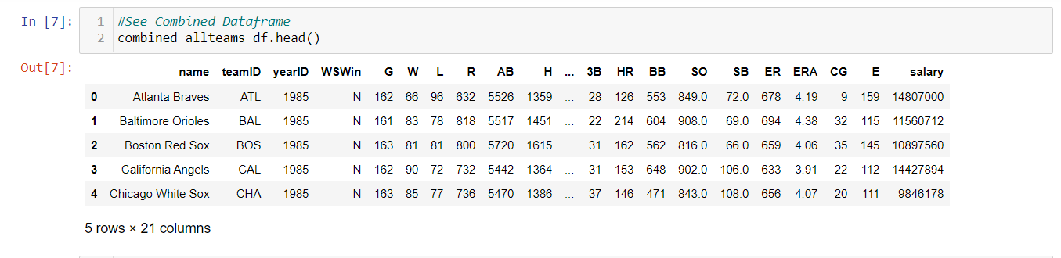
But first: Data Collection
Baseball has a history of statistical analysis
Kaggle has a great baseball databank full of csv files
Able to read in those csv files, merge, and go to work!
Limited scope of analysis to more modern era (1985-2015)

Slide 6
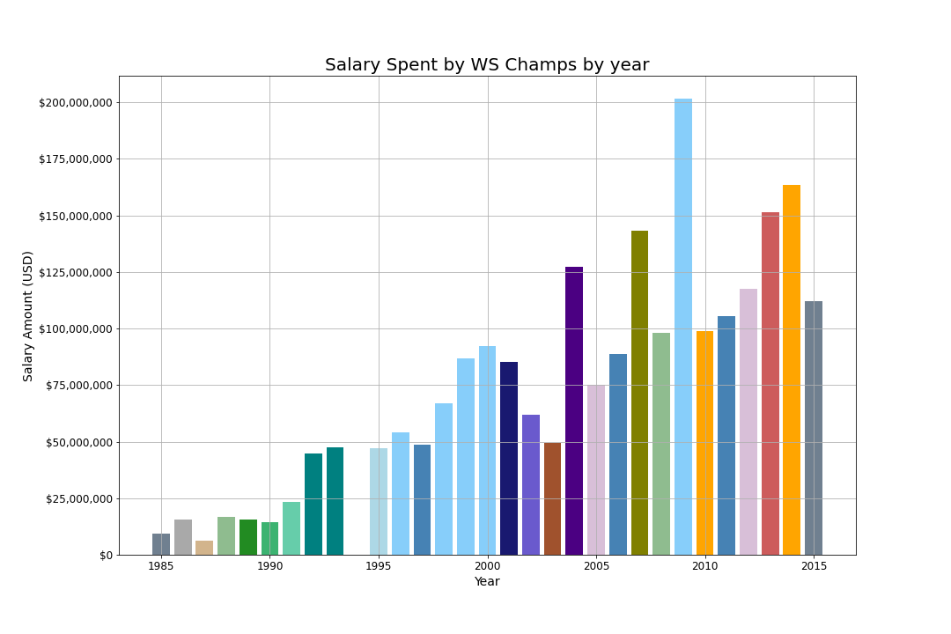
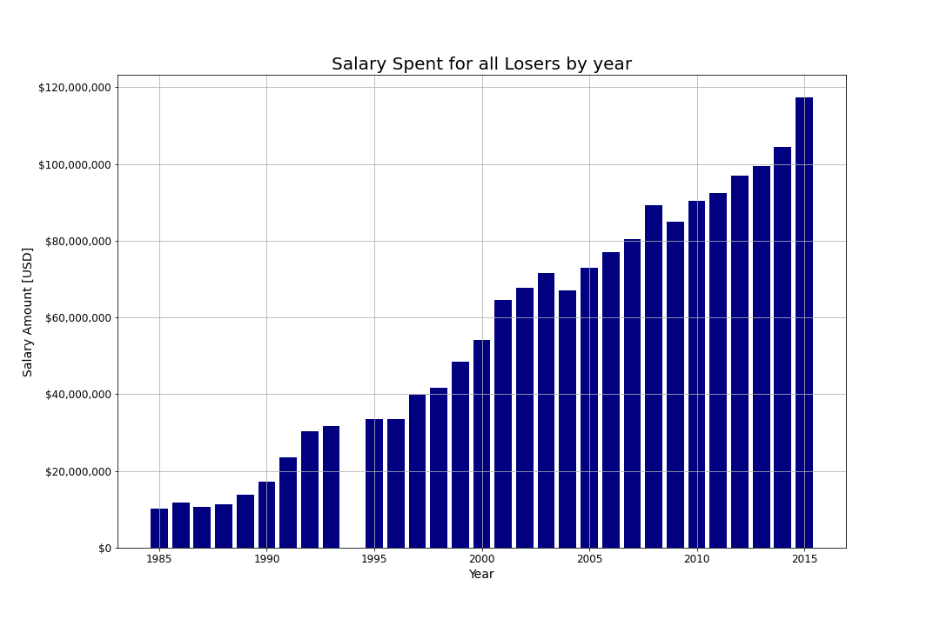
Objective 1: Compare Salaries between winners and Losers

Slide 7
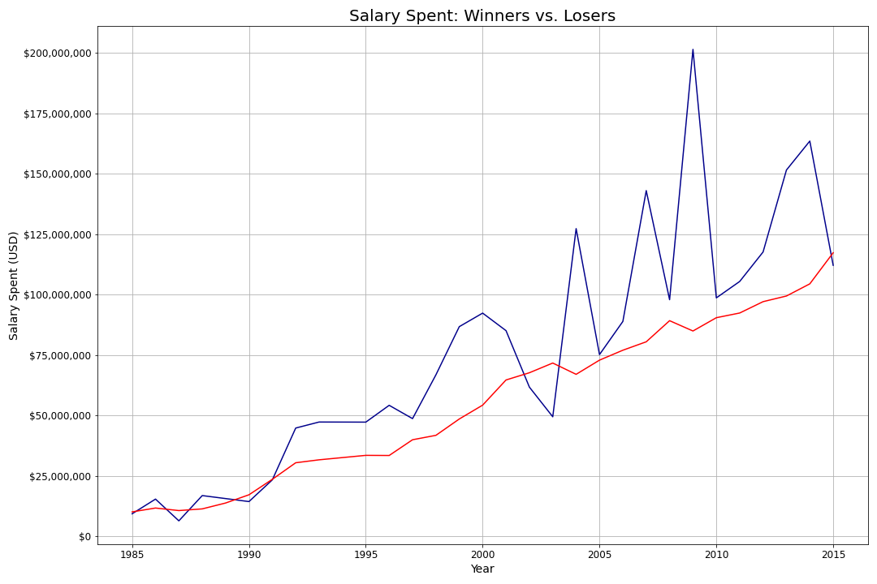
Summary Graph of Winners vs. Losers

Slide 8
Objective 1: conclusions
What we CAN conclude:
What we CAN’T conclude:
Some time around 1990 spending became a formidable weapon in the pursuit of a championship
By and large, teams that win the championship are spending more than teams that don’t win the championship
We can’t definitively say that you HAVE to spend more than the league average to win a championship
Can’t definitively say that spending more money will GUARANTEE a championship

Slide 9
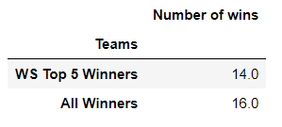
Objective 2: Do teams that spend the most, win the most?
Analyze further the effect of spending on winning championships
How often do teams that are top 5 spenders in the league for that year win the championship
30 teams in MLB, how often do the top 5 teams (16.67%) win the championship?

Slide 10
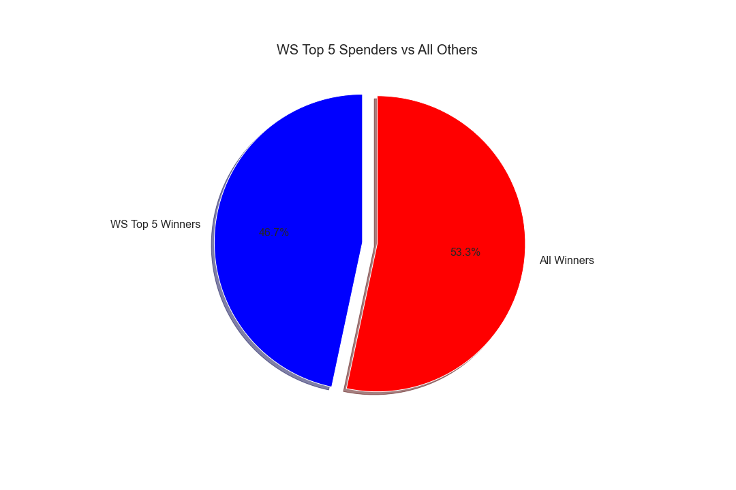

Slide 11
Objective 2: conclusions
What we CAN conclude:
What we CAN’T conclude:
If an owner is willing to be a top 5 spender, they have about a 50% chance of winning the World Series
Cannot conclude that you have to be a top 5 spender to win
Over half of the winners from 1985-2015 were not top 5 spenders

Slide 12
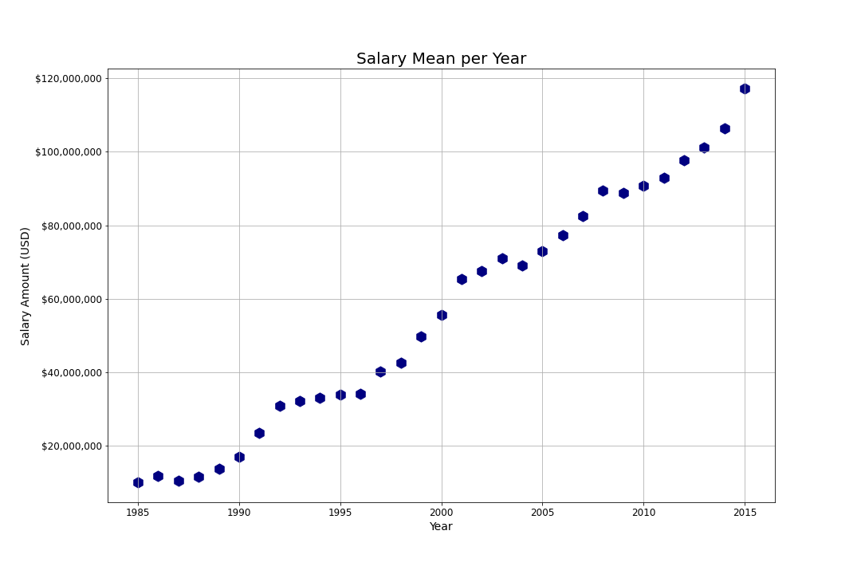
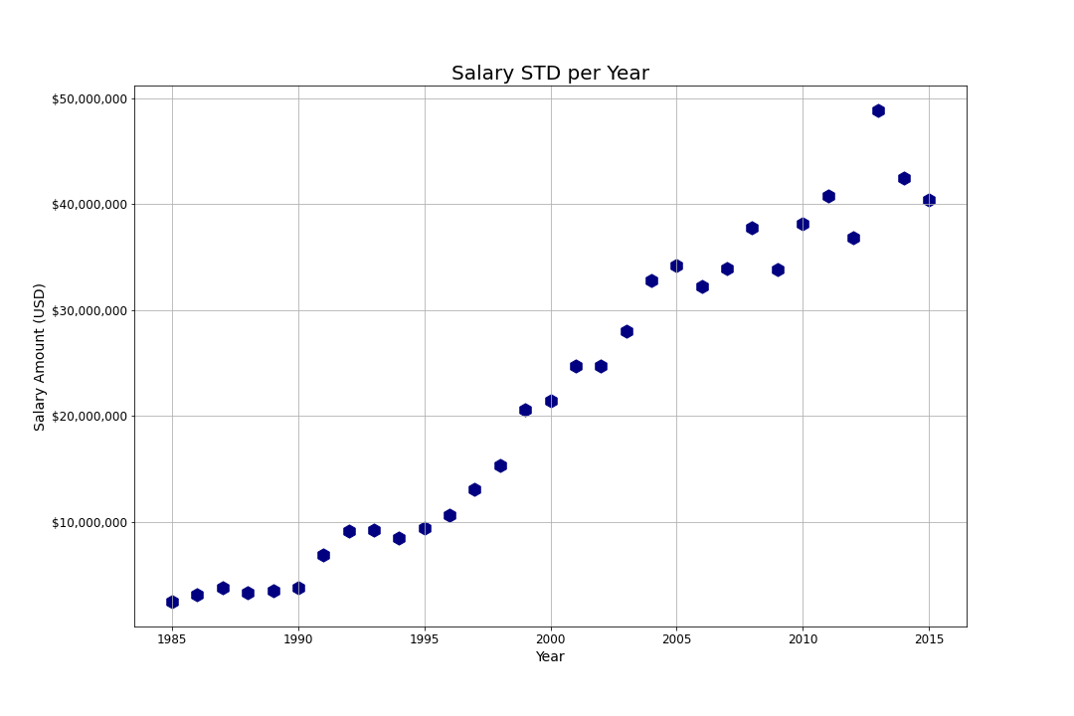
Objective 3: Evaluate spending parameters for World series winners

Slide 13
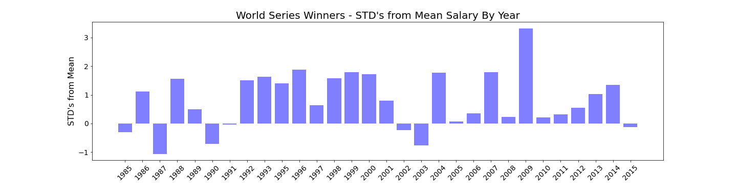
Winner STD’s from Mean

Slide 14
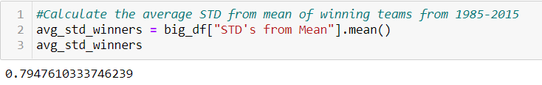
Winner AVG STD’s from Mean
On average, winners spent .79 STD’s above the mean for that year
THE SPENDING FORMULA:
Spend Amount($) = Mean Salary + (STD * .79)
Example:
2021 Expected Mean Salary: $150MM
2021 Expected STD: $40MM
$150MM + ($40MM * .79)
We would recommend the owner spend $181,600,000 if serious about winning!!!

Slide 15
Objective 3: conclusions
What we CAN conclude:
What we CAN’T conclude:
Winning teams spend, on average, .79 STD’s above the mean salary
Spending Formula
Can’t conclude that spending .79 STD’s above the mean will guarantee a championship
Spending Formula Problems:
How to project Salary Mean and STD in coming years

Slide 16
Objective 4: Statistical Profile of a World Series Winning Team
Offensive Statistics
Batting Average
Hits
Home Runs
Runs
Doubles
Triples
Walks
Stolen Bases
Strikeouts
Defensive Statistics
Earned Runs
Earned Run Average
Hits Allowed
Walks Allowed
Strikeouts
Home Runs Allowed
Errors

Slide 17
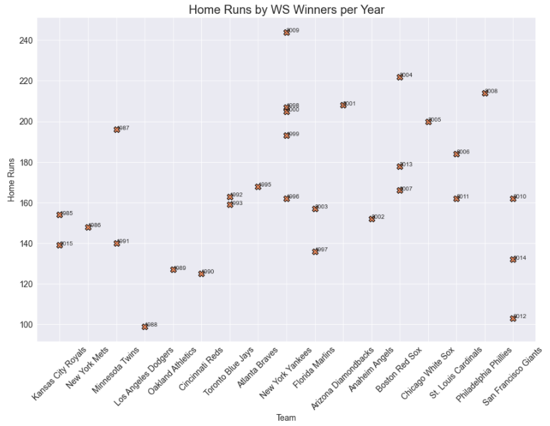
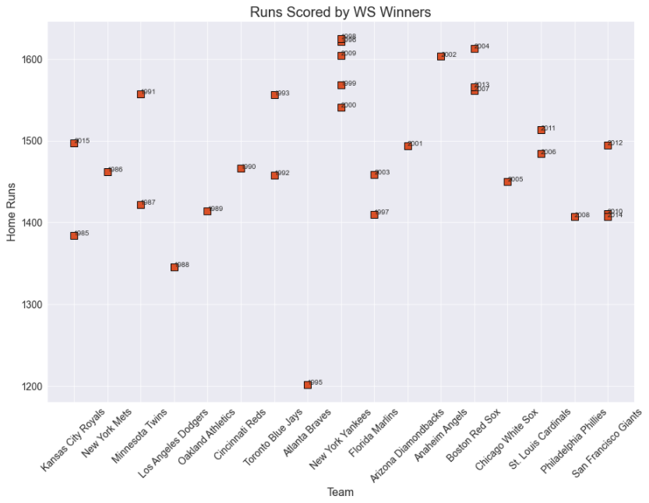
Objective 4: Statistical commonalities between Winners
Offense

Slide 18
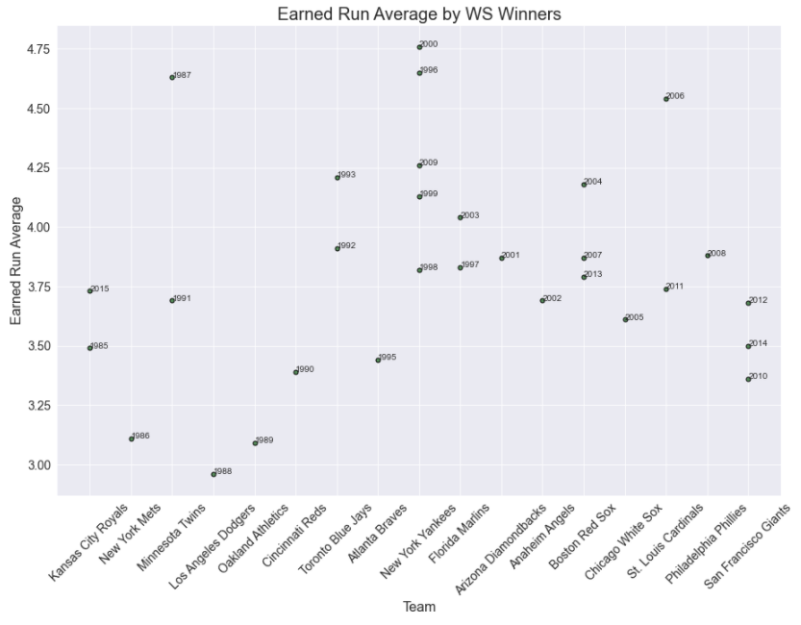
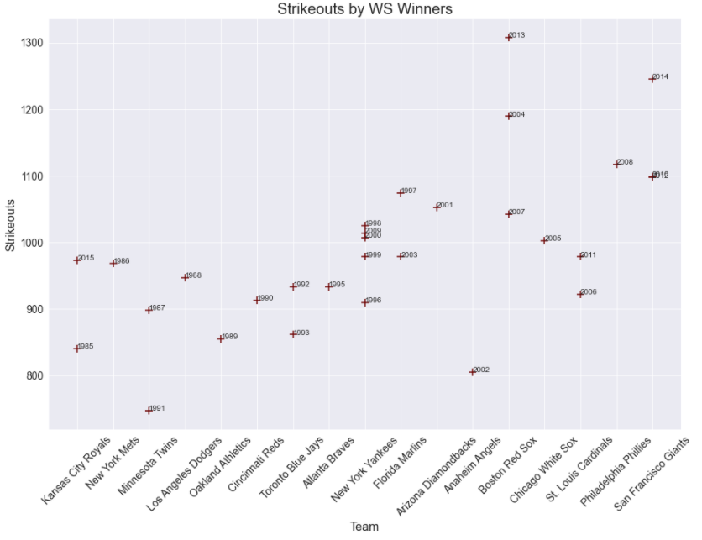
Objective 4: Statistical commonalities between Winners
Defense

Slide 19
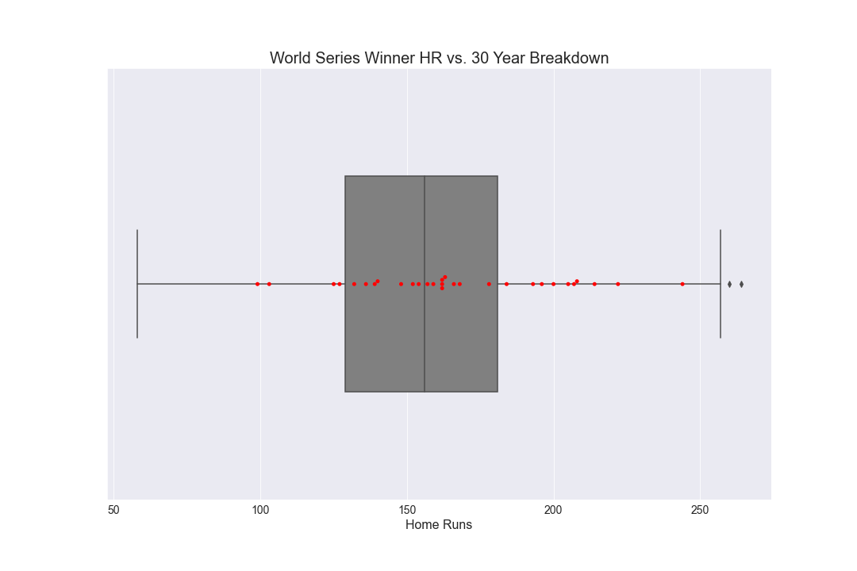
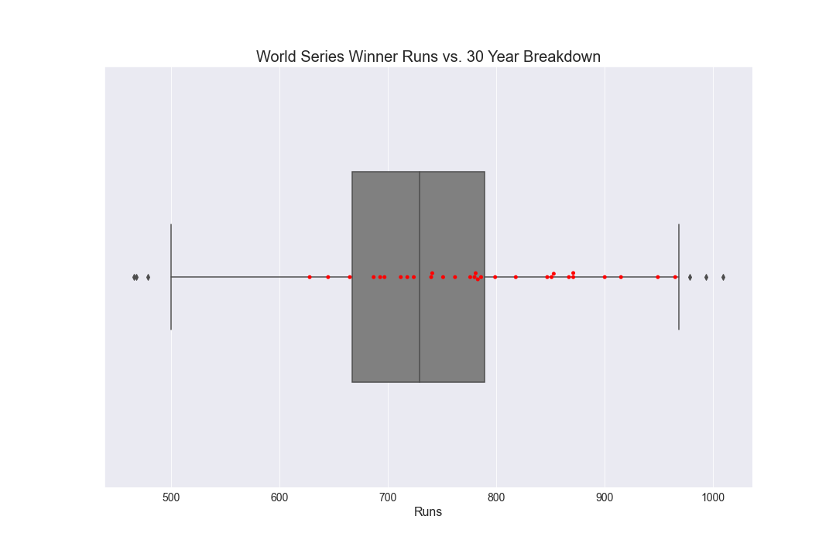
Objective 4: Statistical Comparison between Winners and other teams
Offense

Slide 20
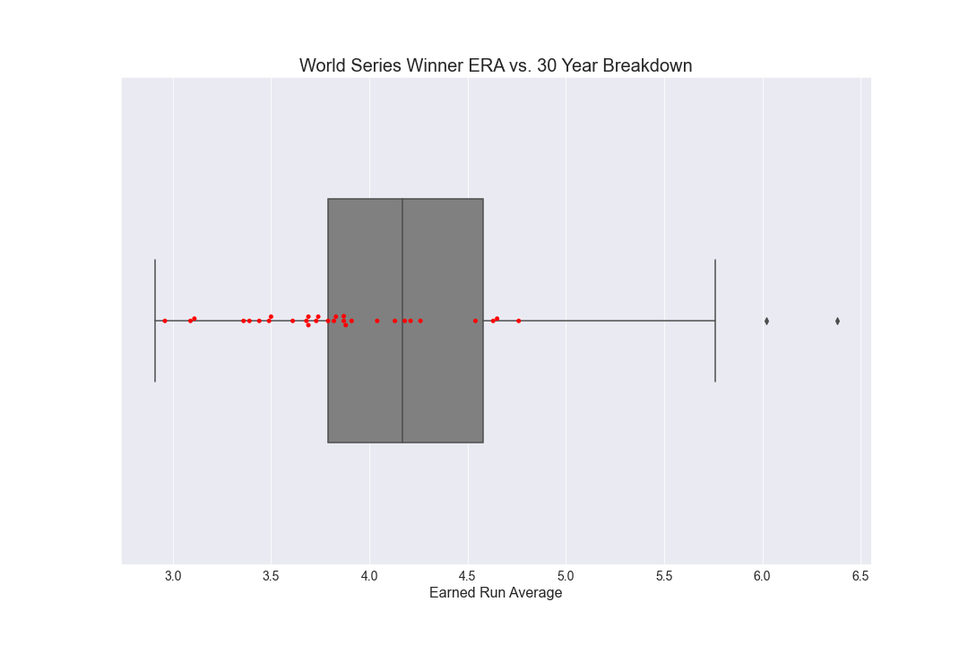
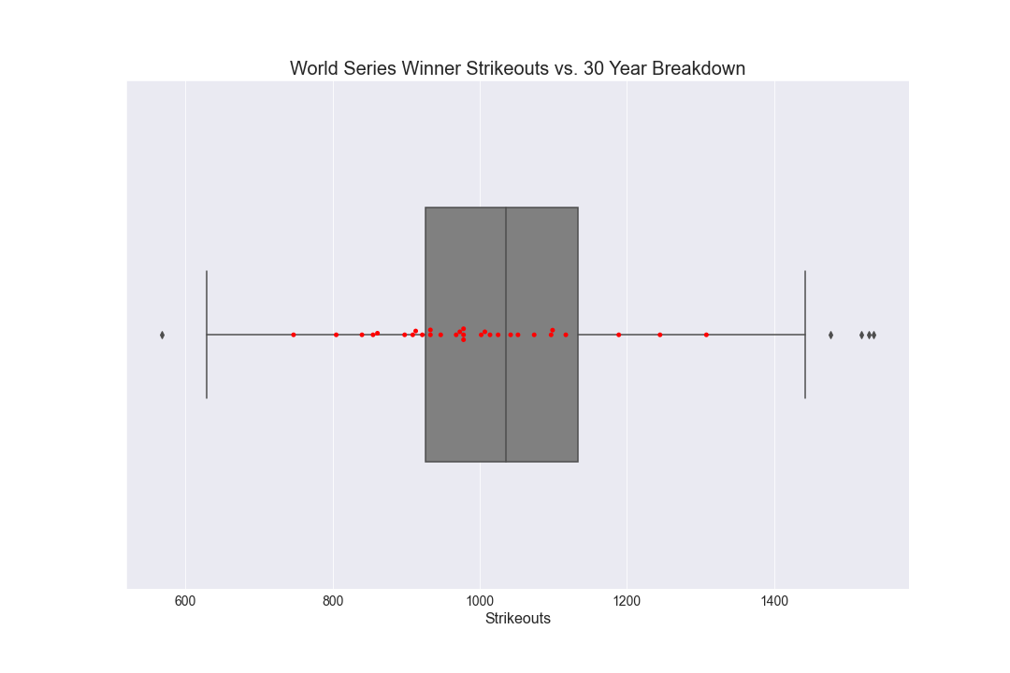
Objective 4: Statistical Comparison between Winners and other teams
Defense

Slide 21
Objective 4: World Series Winner Profile
Offensive Statistics
Home Runs: 10 of 30 champs were above the 75% line, 19 of 30 were above the mean. 26 of 30 were above the 25% quartile. Fairly even distribution
Runs: 12 of 30 above the 75% line, 21 above the mean, 27 above the 25% line. Fairly even distribution
Hits: 15 of 30 at or above the 75% line, 21 above the mean, 28 above the 25% line. A lot of outliers below the minimum line.
Doubles: 9 of 30 above 75%, 19 above the mean, 26 above 25%.
Triples: 9 of 30 above the 75% line; 18 at or above the mean; 27 above 25%
Walks: 12 of 30 above the 75% line; 18 at or above the mean; 23 above the 25% line
Stolen Bases 10 above the 75% line, 20 above the mean, 23 above the 25% line.
Strikeouts: 9 below the 25% line, 21 below the mean, 27 below the 75% line

Slide 22
Objective 4: World Series Winner Profile
Defensive Statistics
Earned Run Average (ERA): 15 of 30 at or below the 25% line, 23 below the mean, 27 below the 75% line.
Hits Allowed: 15 below the 25% line, 23 below the mean, 30 below the 75% line.
Home Runs Allowed: 12 of 30 below the 25% line, 21 at or below the mean, 26 at or below the 75% line.
Errors: 13 of 30 below the 25% line, 20 below the mean, 26 below the 75% line.
Strikeouts: 9 of 30 above the 75% line, 20 above the mean, 28 above the 25% line.
Walks: 9 below the 25% line, 18 below the mean, 23 below the 75% line.

Slide 23
Objective 4: conclusions
What we CAN conclude:
The offensive profile seems to be more evenly distributed than the defense.
Across all offensive categories, the main qualifier appears to be that a World Series winner should aim to AT LEAST perform in the top 3 quartiles for each statistic.
Teams need to score runs. 2/3 of the 30 champs performed above the mean.
In order to score runs, teams should concentrate on players who get hits and can steal bases. 2/3 of champs performed above the mean in both categories.
A lot of money is paid for power stats (doubles, triples, and home runs) but this appears to be misplaced as the winners are evenly distributed compared to all teams.
Getting on bases and advancing into scoring position are much more important

Slide 24
Objective 4: conclusions
What we CAN conclude:
Pitching appears to be more important than Hitting
Half of the teams performed in the top 25% of all teams in Earned Run Average and Hits allowed. Finding players who have low ERA’s and allow a low amount of hits greatly increases your chance to win the worlds series.
Achieving a team that achieves a low ERA and allows fewer hits can come in a variety of ways. Whether it is playing more defense, striking out more batters, allowing fewer walks, or not giving up home runs doesn’t appear to matter as these are all fairly evenly distributed.

Slide 25
Objective 4: conclusions
What CAN’T be accounted for:
Team of Destiny Syndrome: Some teams appear to underperform statistically when looking at the season as a whole, but still manage to win the world series. “Catching on fire” and playing a short period of vastly superior baseball, at the right time, has led to a few cases of teams winning the World Series such as the 2006 St. Louis Cardinals or the 2003 Florida Marlins.
Ebbs and Flows: In some years, pitching is vastly superior across the league while in others hitting is much more dominant. The 1995 Braves had a dominant pitching year but 1995 appears to be down as a whole. Further analysis would be revealing.
Cheating: The league of the 90’s was mired with the use of performance enhancing drugs which resulted in inflated numbers.

