Slide 1
DD&D
Dungeons, dragons, & Deals

Slide 2
Brief Background
Who: A 3-man game-dev studio
What: An E-Commerce website
When: A few months ago
Where: Over the internet
Why: To lower their operational costs
How: It’s complicated...

Slide 3
How, continued…
Tools:
Nginx: Used to provide load balanced access to PHP servers.
PHP-CGI: PHP server using the Common Gateway Interface. Used for server-side scripting and serving HTML to the browser upon request.
MySQL Server: Open-source RDBMS software
Git + GitHub: Source and Version Control.
Terminal: Tabbed Command Prompt Instances.
Hosting: Self-hosted
DNS: ddnd.crabdance.com (41.193.78.209), courtesy of afraid.org

Slide 4

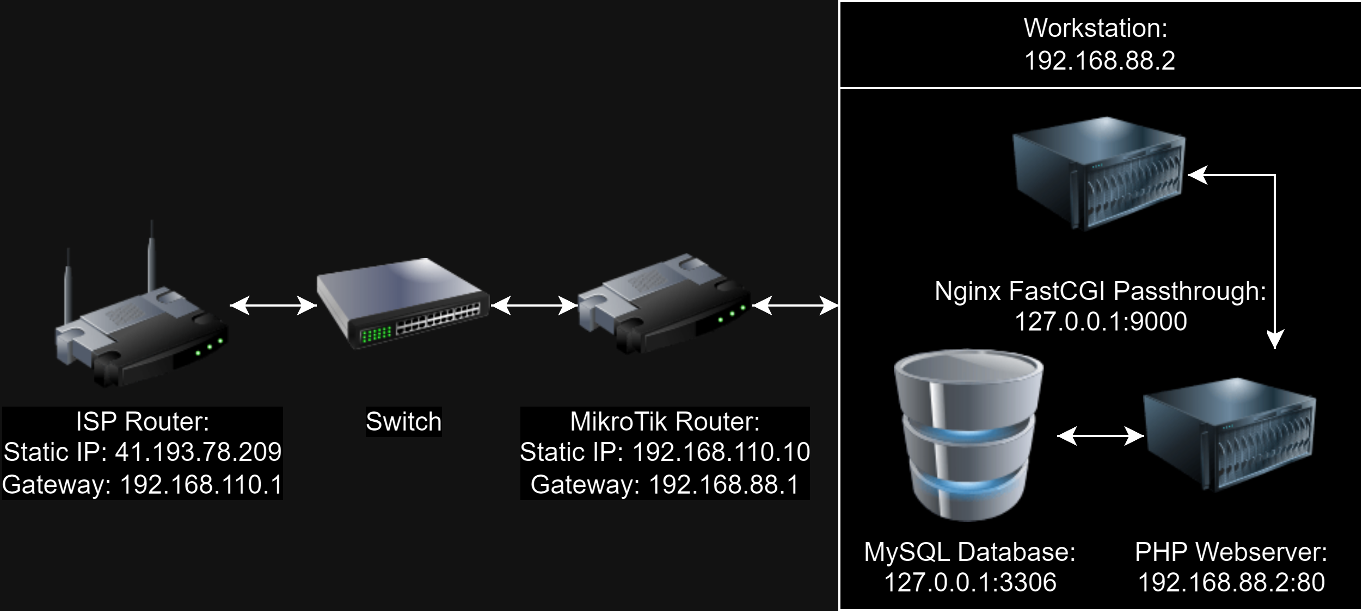



Network Topology

Slide 5
Internal Architecture
Client (Behaviour upon Inclusion):
Scripts: Echoes JSON data to the browser. Example: verification
Generators: Echoes HTML code to the browser to be drawn.
Server (Behaviour Definition):
Scripts: Define utility functions
Generators: Define utility functions which return html code by reading and formatting template html files.
Page-load Procedure: index.php -> client generator -> server generators -> server scripts
Client Script Procedure: client script -> server scripts

Slide 6
Website Design:
What I am:
C++ Developer
Cultured x64 Assembly Dabbler
Vulkan Rendering Engine Architect
What I am not:
Web developer
Good looking
Function over Form. Let the backend developer worry about the function, let the game developers (clients) with functional colour vision worry about form.

Slide 7
Functionality:
Account Creation
Account Login
Account Deactivation (3-click policy)
Viewing Account Information
Viewing all Past Orders
Viewing Store Page
Adding Items to Cart
Modifying Number of Cart Item Quantity
Removing Items from Cart
Cart Checkout

