Slide 1
Desktop Based Chat Application
Presented by-
Jeevan Niroula: 171616
Saroj Bhattarai: 171637
Sujit Shrestha: 171643

Slide 2
Topic Coverage
Introduction
Project Description
Problem Statement
Project Objective
Pros and Cons
Methodologies
Technical Description of Project
Working Program
Conclusion
Future Works

Slide 3
Introduction
Chat is communication between people.
Chat applications are platforms where people can chat with one another.
Chat application are built on a network.
Network is used to communicate messages.
Network in chat application can be global(using internet) or enclosed(intranet using local area network).

Slide 4
Project Description
Desktop Based Chat application offers messaging feature between users.
Uses Transmission Control Protocol(TCP) as the network protocol for communication.
Build on Java, sockets for establishing connections and multithreading feature for allowing multiple users to be online.
Uses database to store user records and for login authentication

Slide 5
Problem Statement
Almost all chat applications offer online messaging feature via internet.
These chat application wont work in case of internet disconnection.
Not safe from security perspective.
Most chat application offers additional features to messaging which can bring distraction in workplace.
Suspect to online surveillance from unauthorized agencies.

Slide 6
Project Objective
To provide texting services in local network only ensuring security from unauthorized foreign access.
To provide only the basic chat feature in the application alleviating any distractions henceforth enforcing productivity.
To create minimalistic user interface so that even the people not familiar with technology can easily access this application.
To establish the communication between the users via server on real time basis.

Slide 7
Pros and Cons
Pros
Enhanced Security against unauthorized foreign entity.
Runs on local network without an internet connection.
Minimalistic design with only messaging feature available avoiding any distractions.
The user will be able to chat with each other on real time basis.

Slide 8
Pros and Cons
Cons
Not designed to run on internet. Runs only on local network.
Only messaging feature available.
Only one server. Does not run if the server fails.
No database backup.

Slide 9
Methodologies
For this project, we have used the Incremental Model of Software Process Model. This model combines linear sequential model with the iterative prototype model.
The process is repeated following the delivery of each increment, until the complete product is produced.

Slide 10
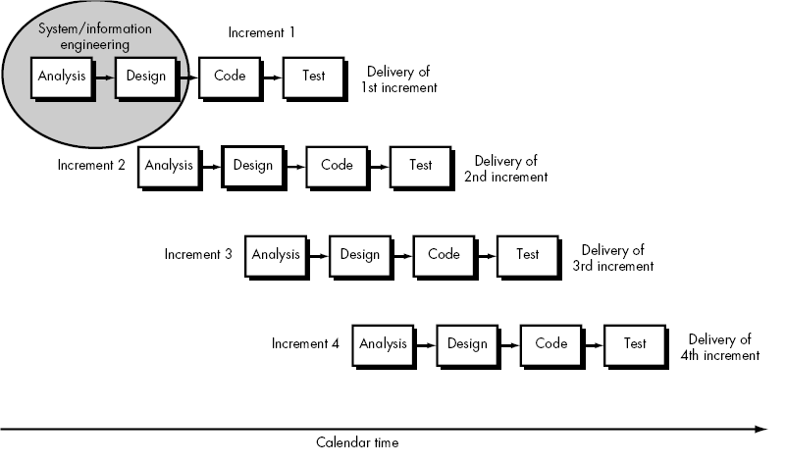
Fig: Incremental Model of Software Process Model

Slide 11
Analysis phase of project’s SDLC
Initial requirements were:
Create a new account.
Login using an existing account.
View all users who are online to current user.
Send text messages to a friend
The requirements were fulfilled at the final iteration of the product’s development lifecycle.

Slide 12
Design phase of project’s SDLC
The phased consisted of designing
Use Case Diagram of the system
System Sequence Diagram for Login
System Sequence Diagram for Register

Slide 13
Use Case Diagram

Slide 14
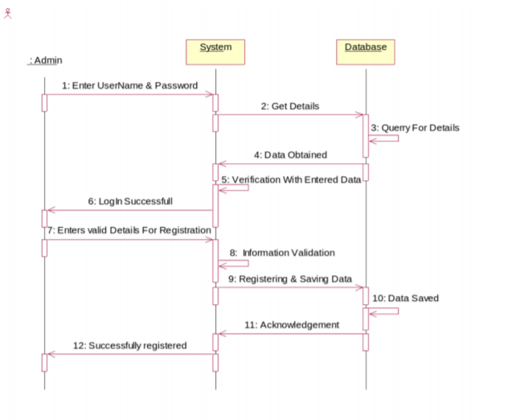
Sequence Diagram design for login and register

Slide 15
Coding and Implementation
For front-end: Java Swing GUI
For back-end: Java
For database: MYSQL
For local server: XAMPP

Slide 16
Technical Description of Project
JAVA:
Object oriented programming language
Write Once Run Anywhere(WORA)
Java code can run on all platforms that support Java without the need for recompilation.

Slide 17
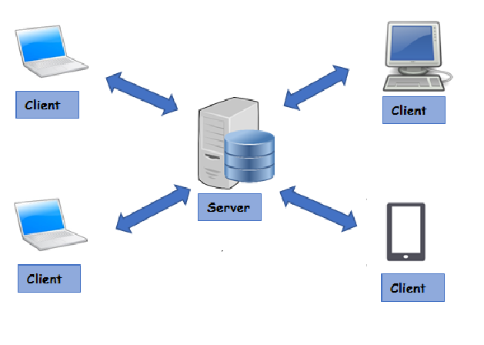
Technical Description of Project
Client Server Architecture
Server hosts, delivers and manages most of the resources and services to be consumed by the clients.
Many clients connected to a server

Slide 18
Technical Description of Project
Transmission Control Protocol(TCP)
a standard that defines how to establish and maintain a network conversation to send data.
connection is established and maintained until the application programs at each end have finished exchanging messages

Slide 19
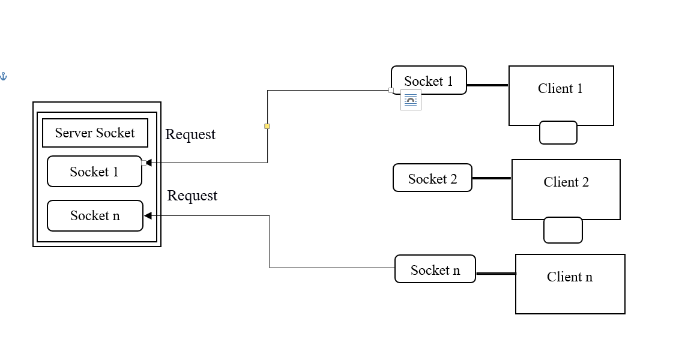
Technical Description of Project
Socket
Provide Communication mechanism between two computers

Slide 20
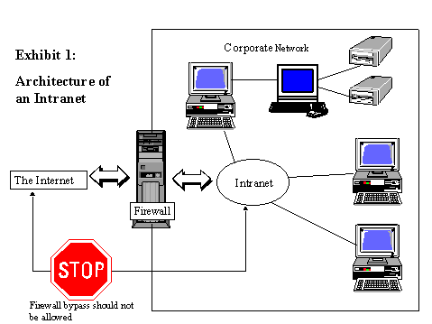
Technical Description of Project
Intranet
Private network within organization

Slide 21
Technical Description of Project
Swing
Swing is a GUI widget toolkit for Java.
Database
A database is an organized collection of data.
Xampp
It is a free and open source cross-platform web server solution.
makes it extremely easy for developers to create a local web server for testing and deployment purposes.

Slide 22
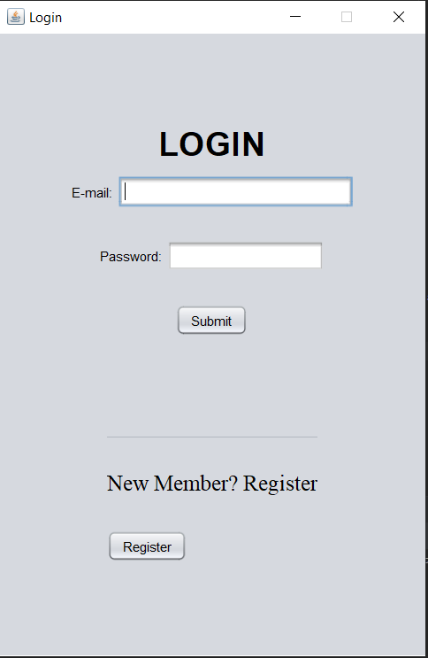
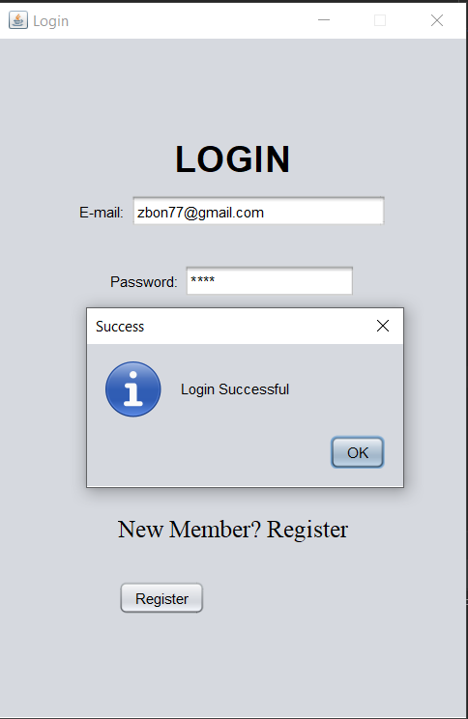
Working program
Client Login:

Slide 23
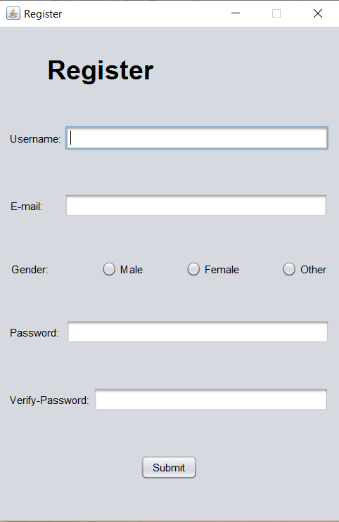
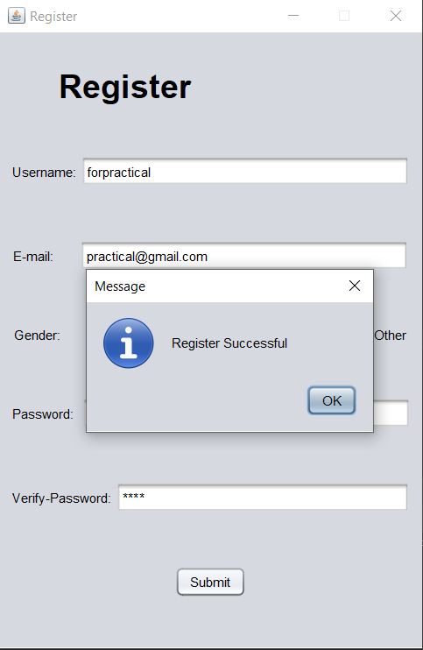
Working Program
Client Registration

Slide 24


Working Program
Server Output for login success.
Server Output for login failure

Slide 25
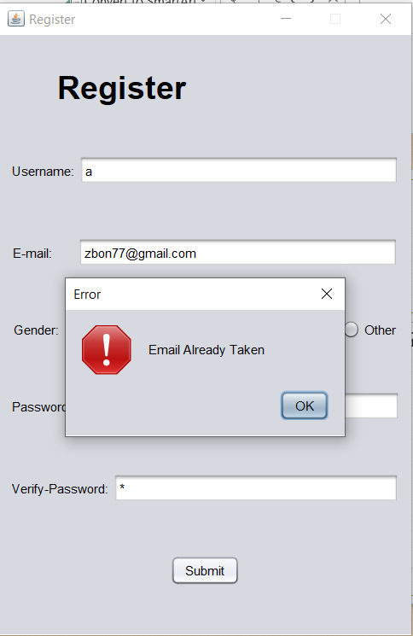
Working Program
Client Output for Registering under same email
Server Output for Registering under same email

Slide 26
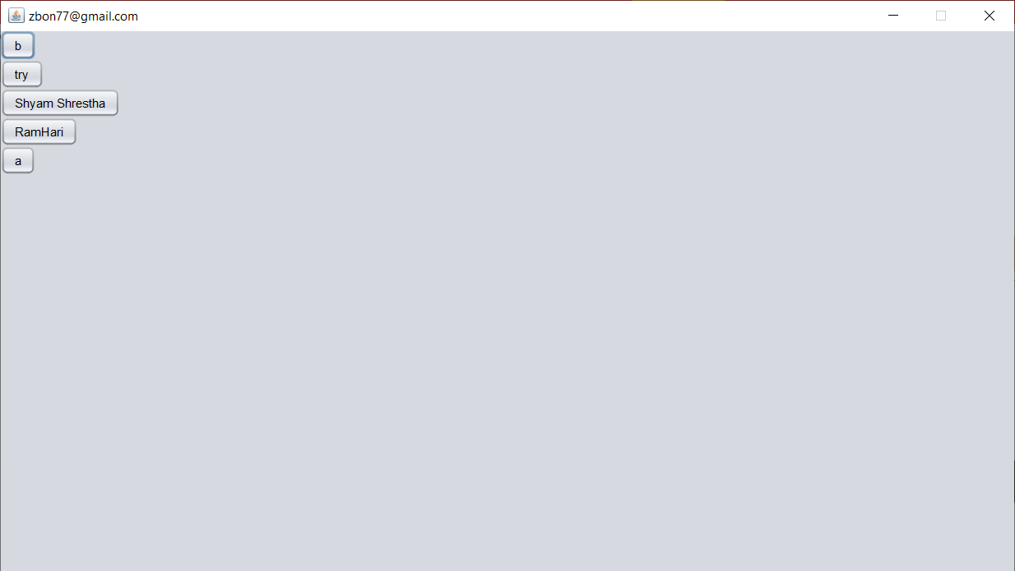
Working Program(Unfinished)
Client After login success
(Current online Users in the system)

Slide 27
Working Program
Server sending all online users details to client

Slide 28
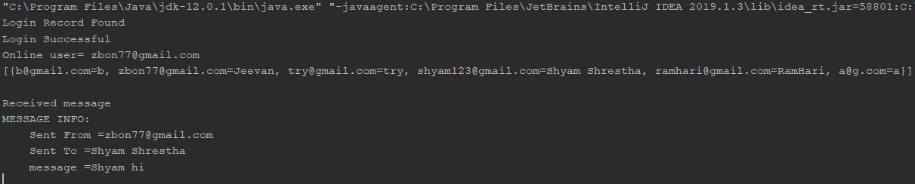
Working Program
Server receiving message form client

Slide 29
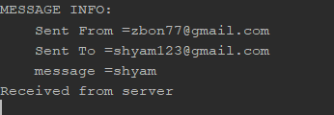
Working Program(Unfinished)
Client Receiving messages from Client

Slide 30
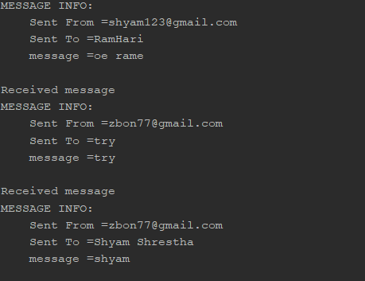
Working Program
Server receiving all client messages

Slide 31
Conclusion
The lack of local network based chatting feature among the students, scholars and employee motivated us on creating the project
This project is applicable for enclosed network or intranet.
Being simple and primitive, this offers minimalistic and easy-to-use messaging feature to get the job done.

Slide 32
Future Works
Store messages in database
Normalize database to reduce redundancy
Make UI attractive
Add emoji support, sending files etc.
Store password in encrypted format

Slide 33
THANK YOU.

