Slide 1

P5 : Segmentez des clients d’un site e-commerce
Soutenance pour la formation de Data Scientist
Aline Pillot

Slide 2



Context
E-commerce website
Customers segmentation
  Understand different type customers
  Marketing
  Maintenance contract

Slide 3
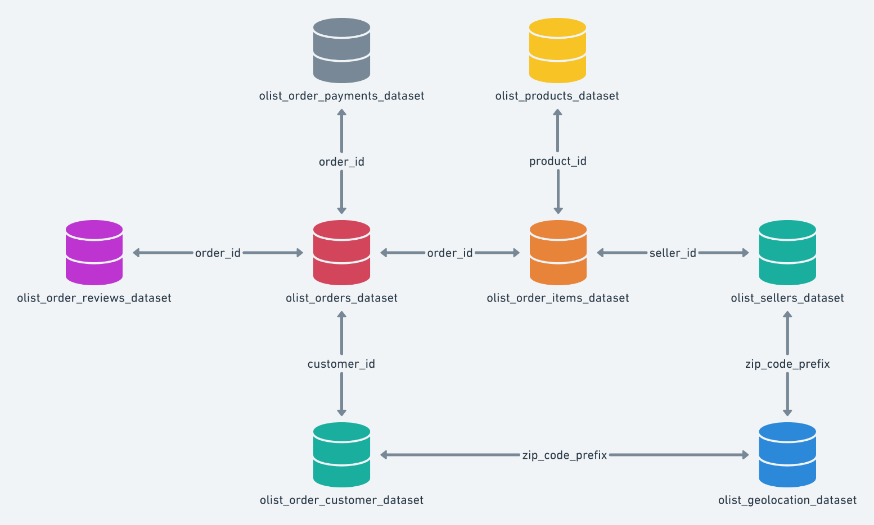
DataSet presentation

Slide 4
Cleaning - selection
99441 orders
99224 reviews
112650 order items
98666 uniques
Customer_unique_id
Customer_city
Customer_state
Order_purchase_timestamp
Price
Review_score
Review_comment_message
99441 customers
96096 uniques

Slide 5
Feature engineering for RFM
Recency
Timestamp of the last order
Frequency
Number of orders
Monetary
Sum of amount of all orders
Days since last order

Slide 6
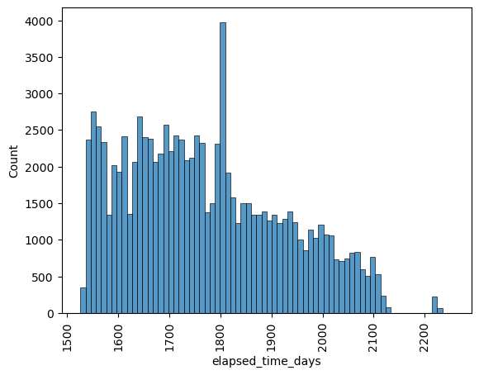
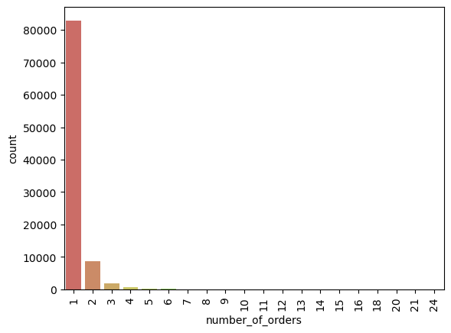
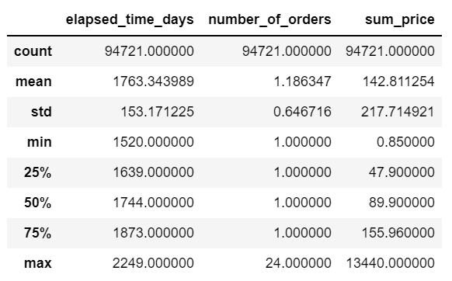
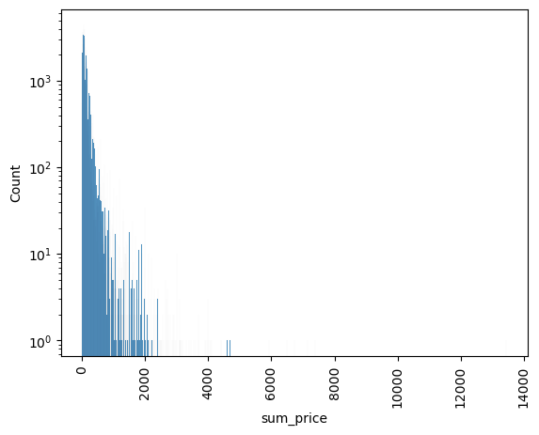
Exploratory analysis

Slide 7
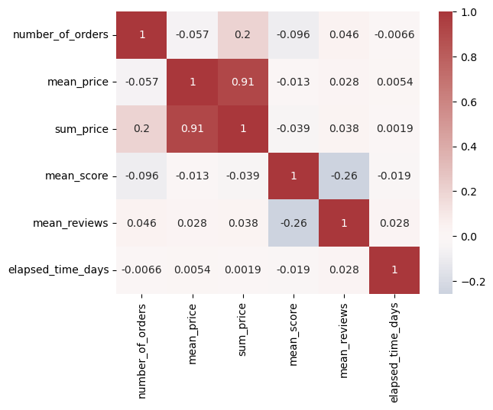
Exploratory analysis

Slide 8
Modelisation

Slide 9
3 modelisations
Kmeans
Centroïds
DBScan
Density
Hierarchical clustering
Nested clusters

Slide 10
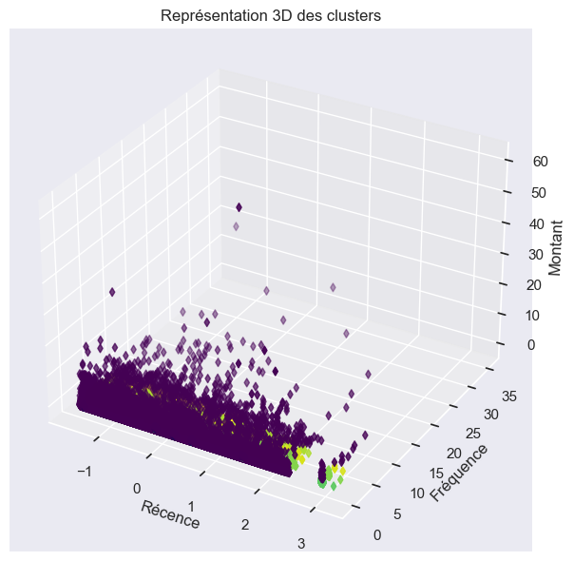
DBScan model
DBScan : OPTICS
  15 clusters
  81971 outliers
Not suitable !

Slide 11
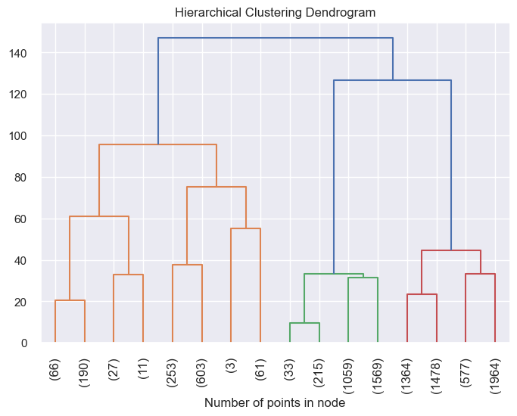
Clustering Hierachic Algorithm
Clustering Hierachic Algorithm
  Agglomerative Clustering
  N = 4
Not suitable !

Slide 12
Models
Model | DATA | Silhouette score | Cluster number | Comment
Kmeans | RFM
Kmeans | RFM + review score
Kmeans | FM + review score + comment freq
Kmeans | Score RFM
Kmeans | Score RFM + review score
OPTICS | RFM |  | 15 | Outliers
Agglomerative clustering | RFM |  | 4 | Need sampling

Slide 13
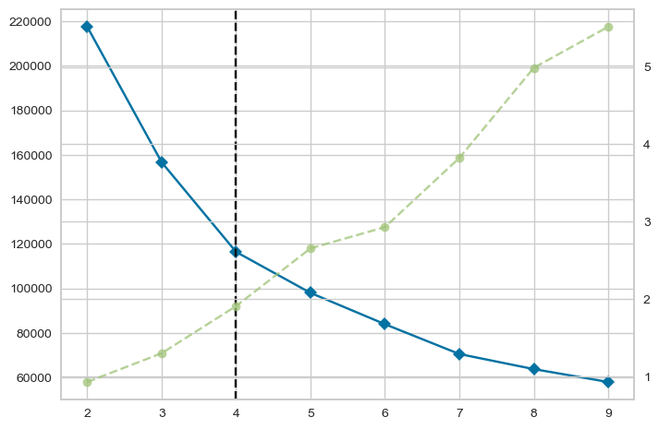
Modelisations
First model
  Kmeans
  Data : RFM
Results
  K = 4
  Silhouette_score = 0.44

Slide 14
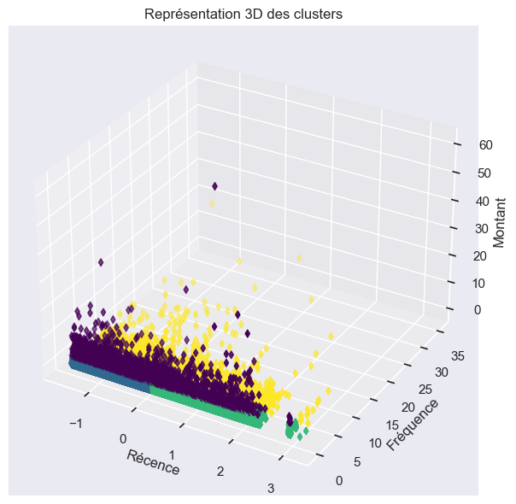
Modelisations
First model
  Kmeans
  Data : RFM
Results
  K = 4
  Silhouette_score = 0.44

Slide 15
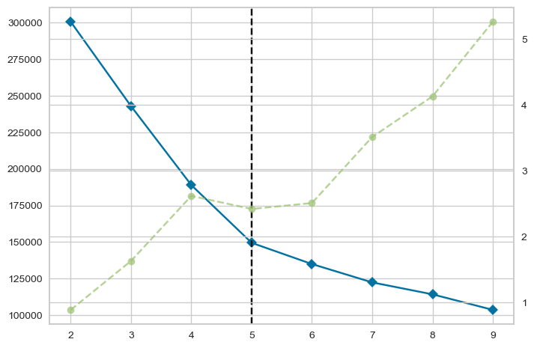
Modelisations
Second model
  Kmeans
  Data : RFM + score
Results
  K = 5
  Silhouette_score = 0.38

Slide 16
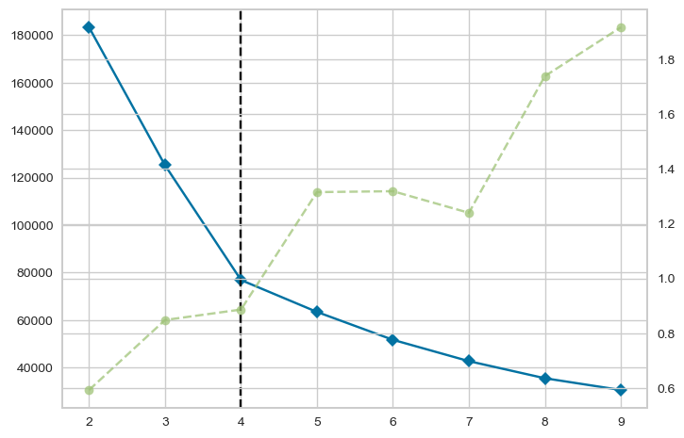
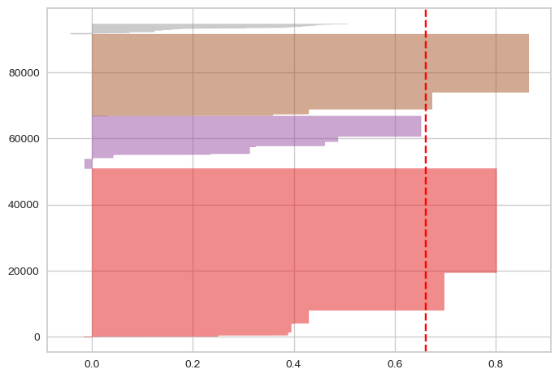
Modelisations
Third model
  Kmeans
  Data : Frequency, score, comments
Results
  K = 4
  Silhouette_score = 0.66

Slide 17
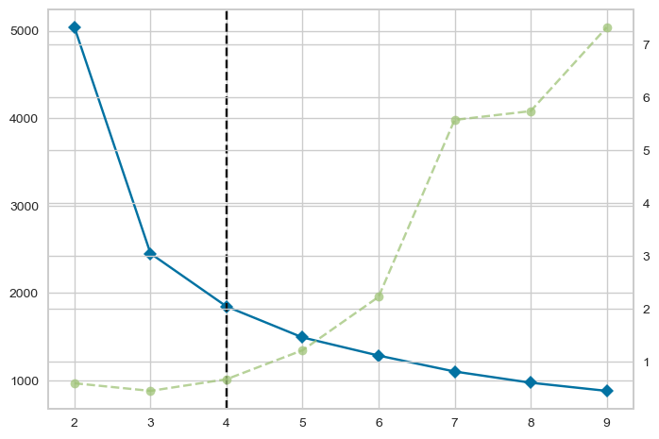
Modelisations
Fourth model
  Kmeans
  Data : RFM ‘score’
Results
  K = 4
  Silhouette_score = 0.43

Slide 18
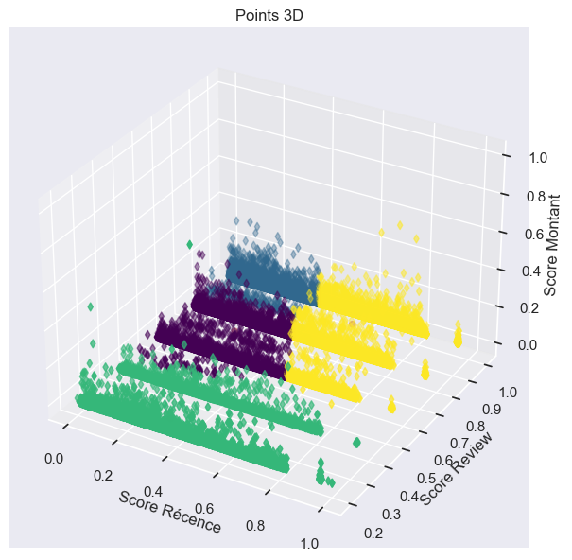
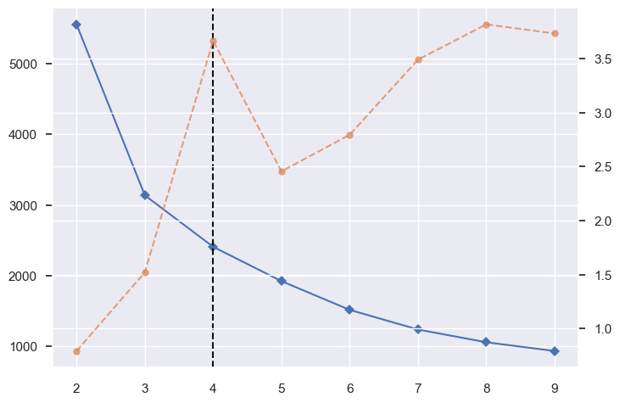
Modelisations
Fifth model
  Kmeans
  Data : RFM ‘score’ + reviews score
Results
  K = 4
  Silhouette_score = 0.46

Slide 19
Models
Model | DATA | Silhouette score | Cluster number | Comment
Kmeans | RFM | 0.44 | 4
Kmeans | RFM + review score | 0.38 | 5 | Worse silhouette score
Kmeans | FM + review score + comment freq | 0.66 | 4 | 3 clusters + 1
Kmeans | Score RFM | 0.43 | 4 | No improvment
Kmeans | Score RFM + review score | 0.46 | 4 | No clustering with Monetary
OPTICS | RFM |  | 15 | Outliers
Agglomerative clustering | RFM |  | 4 | Need sampling

Slide 20
Selected model
Kmeans with first RFM datas
Yellow : High frequency
Purple : High monetary
Blue : Last order recent
Vert : Last order old
Cluster stability OK

Slide 21
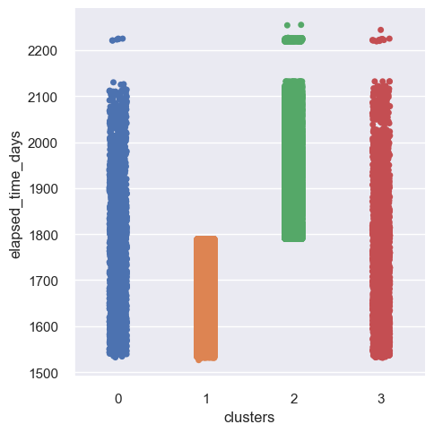
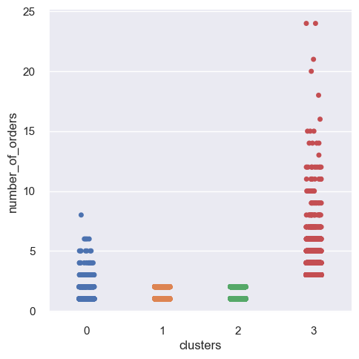
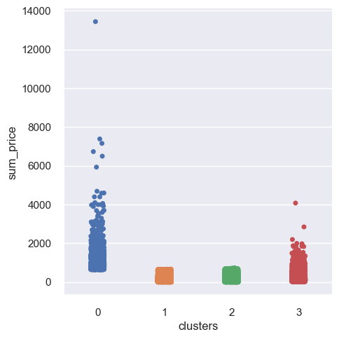
Cluster interpretation

Slide 22

Maintenance
Date_0
Date_1
Date_2
RFM_t0
RFM_t1
RFM_t2

Slide 23
Maintenance
RFM_t1
RFM_t0
Model 0
StandardScaler()
Kmeans(n = 4)
Model x1
StandardScaler()
Kmeans(n=4)
Clusters_t0
Clusters_t1

Slide 24
Maintenance
RFM_t1
RFM_t0
Model 0
StandardScaler()
Kmeans(n = 4)
Model x1
StandardScaler()
Kmeans(n=4)
Clusters_t0
Clusters_t1
Clusters_0_t1

Slide 25
Maintenance
RFM_t1
RFM_t0
Model 0
StandardScaler()
Kmeans(n = 4)
Model x1
StandardScaler()
Kmeans(n=4)
Clusters_t0
Clusters_t1
Clusters_0_t1

Slide 26
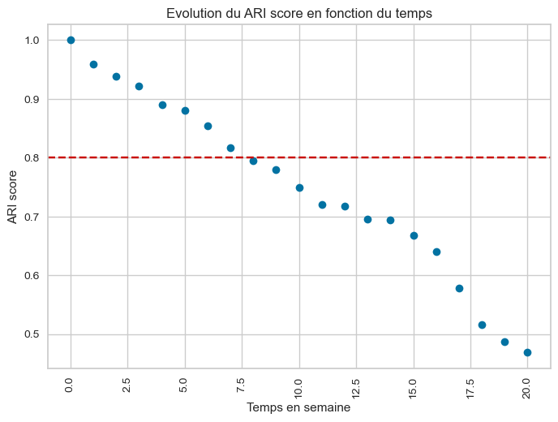
Maintenance
ARI < 0.8
8 weeks

Slide 27
Conclusion
Dataset clean and full
Best model : Kmeans
K = 4
Stable
Maintenance : 8 weeks

Slide 28
Thank you
Any questions ?

