Slide 1

P4 : Anticipez les besoins en consommation de bâtiments
Soutenance pour la formation de Data Scientist
Aline Pillot

Slide 2

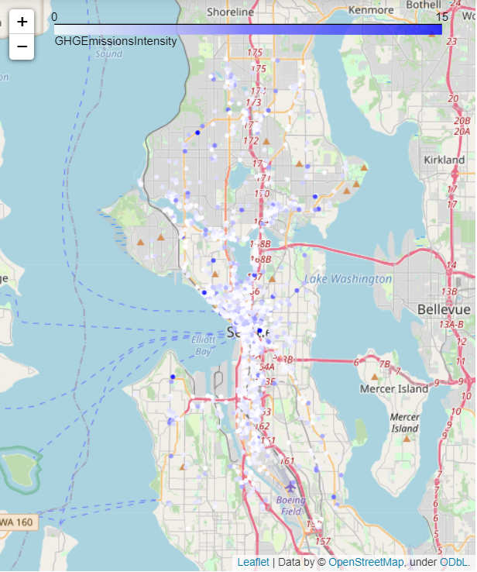
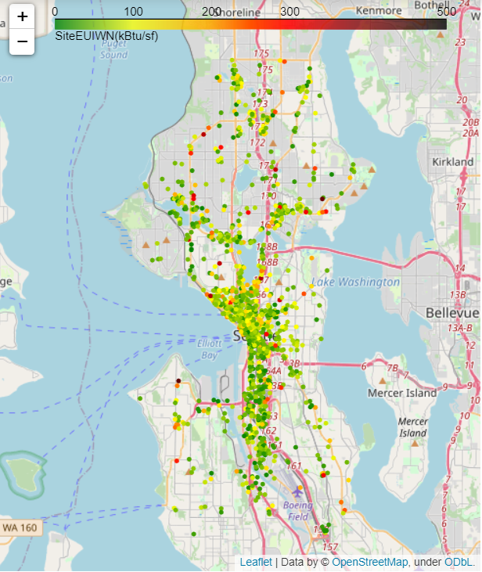
Context
Seattle
Predict energy use
Predict CO₂ emission
Non residential buildings
ENERGYSTARScore

Slide 3
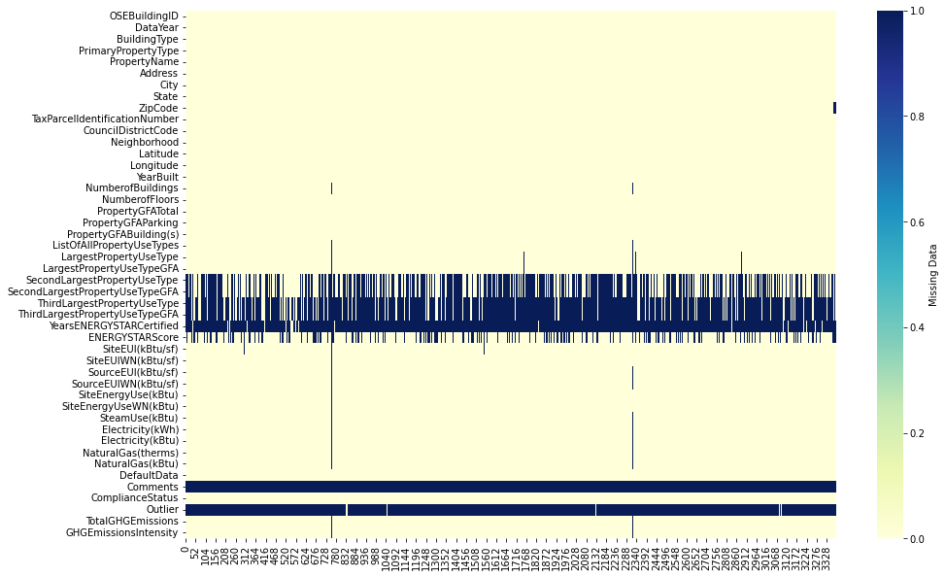
DataSet Presentation
Seattle
2016
3376 rows
46 columns
Targets :
  SiteEUIWN
  GHGEmissionIntensity

Slide 4
Cleaning – main steps
3376 rows
46 columns
Selection
  Non residential
  Compliant data
Surface
  Imputation (LargestPUT and parking)
  Comparison
Energy
  Outliers
  Comparison
1514 rows
46 columns

Slide 5
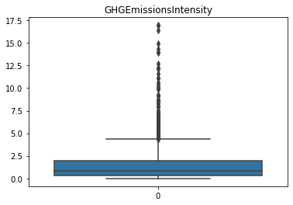
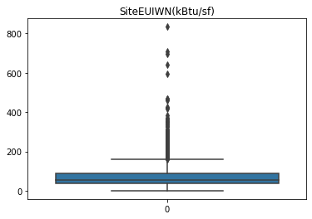
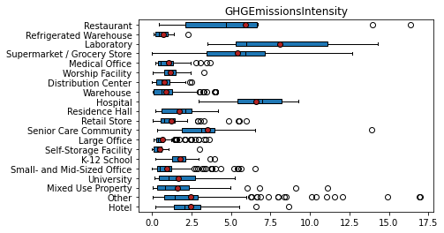
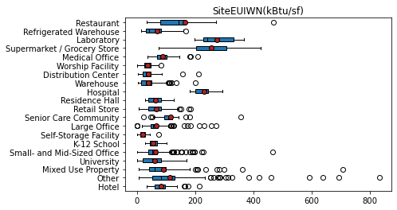
Outliers Energy

Slide 6
Cleaning – main steps
3376 rows
46 columns
Selection
  Non residential
  Compliant data
Surface
  Imputation (LargestPUT and parking)
  Comparison
Energy
  Outliers
  Comparison
1514 rows
46 columns
1317 rows
16 features

Slide 7
Feature engineering
YearBuilt to Age
PropertyUseTypes : OneHotEncoder with proportions
Proportions of energy types
Feature selection

Slide 8
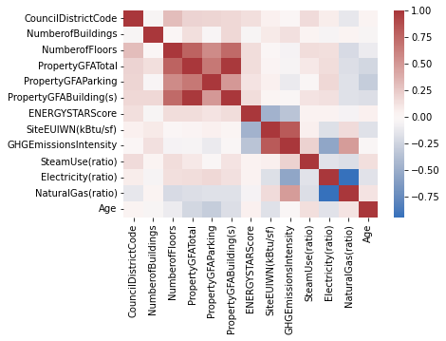
Feature selection
Correlation

Slide 9
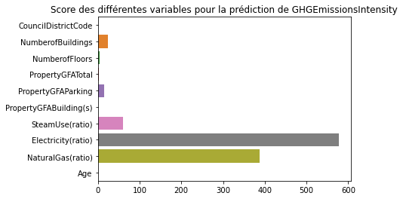
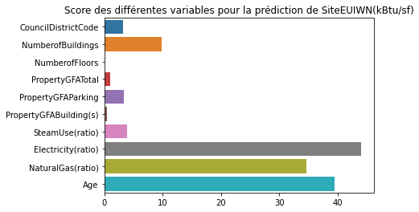
Feature selection
SelectKBest
Correlation

Slide 10
Preprocessor
Categorical features
OneHotEncoder
DataSet clean
Preprocessed data
Numerical features
RobustScaler
Preprocessor

Slide 11
Modelisation

Slide 12
Pipeline
DataSet clean
Train set
80%
Test set
20%
Train-test split
Pipeline
Preprocessor
Pipeline.fit
Pipeline.transform
Models
Train score
y pred

Slide 13
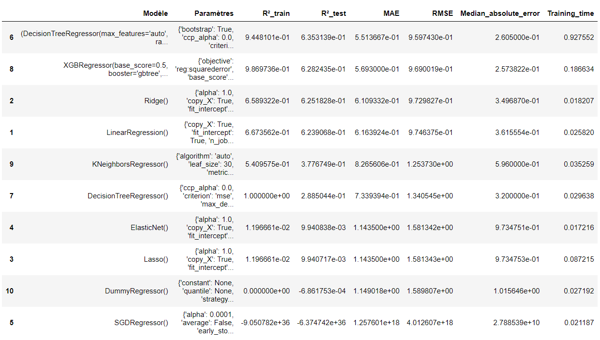
GHGEmissionsIntensity
9 models + dummy (mean)
5 metrics + time

Slide 14
GHGEmissionsIntensity
Overfitting

Slide 15
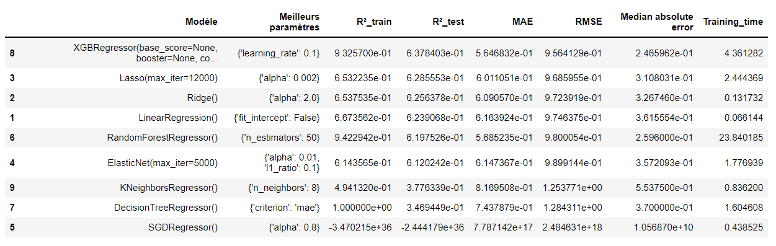
GHGEmissionsIntensity - GridSearchCV
Lasso : 0,629
Ridge : 0,626
LinearReg : 0,624

Slide 16
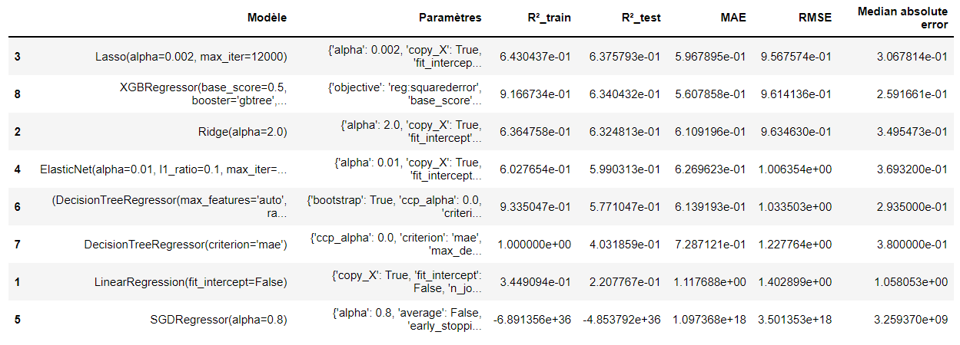
Feature selection - SelectFromModel
Improvment
Lasso : 0,629
Ridge : 0,626
LinearReg : 0,624

Slide 17
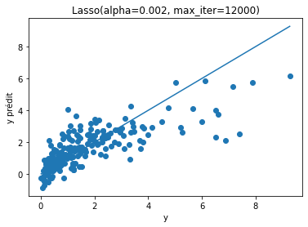
Feature selection - SelectFromModel
Selected model :
Lasso

Slide 18
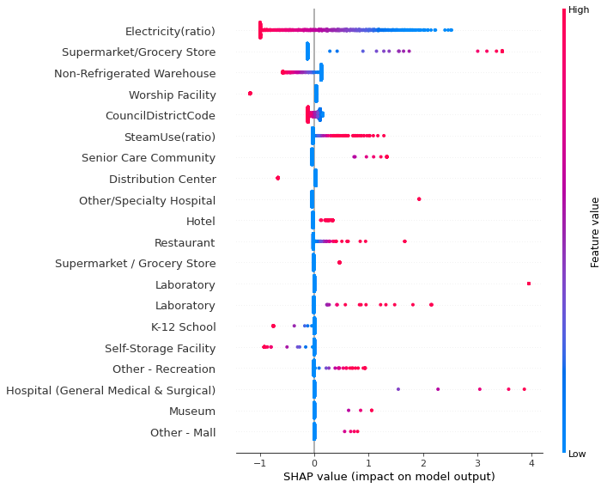
Feature importance with SHAP

Slide 19
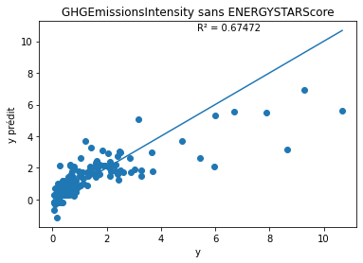
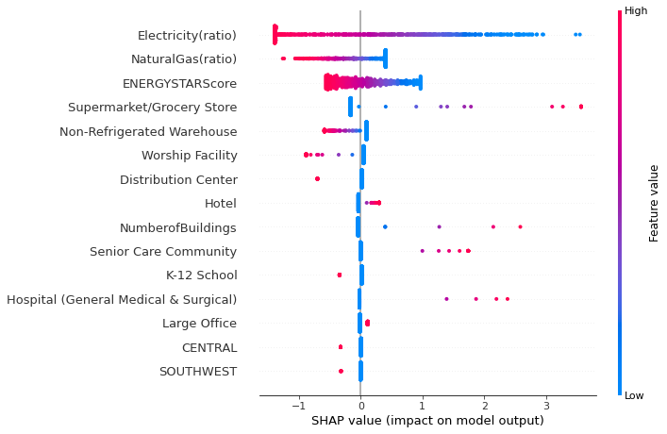

ENERGYSTARScore
From 0,675 to 0,779

Slide 20
Second target SiteEUIWN(kBtu/sf)
Same procedure :
  First try
  SearchGridCV; hyperparameters
  Feature selection
  Fine tuning of hyperparameters of choosen model
  Feature importance

Slide 21
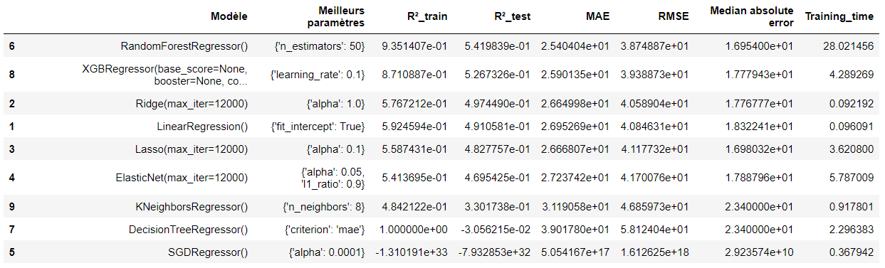
GridSearchCV
Ridge : 0,497
LinearReg : 0,491
Lasso : 0,483
ElasticNet : 0,470

Slide 22
Second target SiteEUIWN(kBtu/sf)
Same procedure :
  First try
  SearchGridCV; hyperparameters
  Feature selection
  Fine tuning of hyperparameters of choosen model
  Feature importance

Slide 23
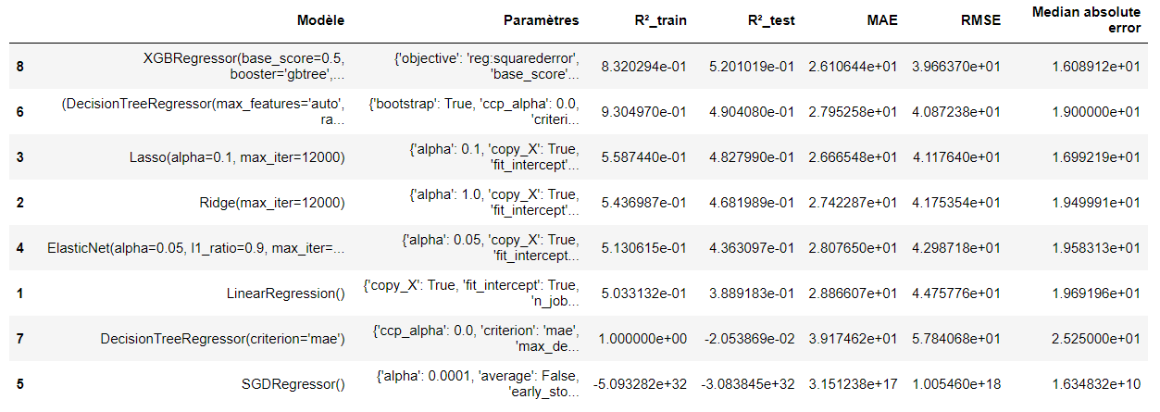
Feature selection - SelectFromModel
Ridge : 0,497
LinearReg : 0,491
Lasso : 0,483
ElasticNet : 0,470
No improvment

Slide 24
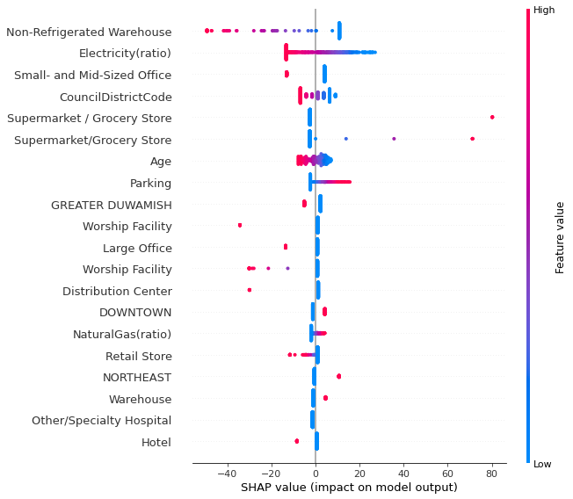
Second target SiteEUIWN(kBtu/sf)
Same procedure :
  First try
  SearchGridCV; hyperparameters
  Feature selection
  Feature importance
Ridge : 0,497
LinearReg : 0,491
Lasso : 0,483
ElasticNet : 0,470

Slide 25
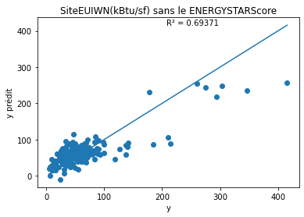
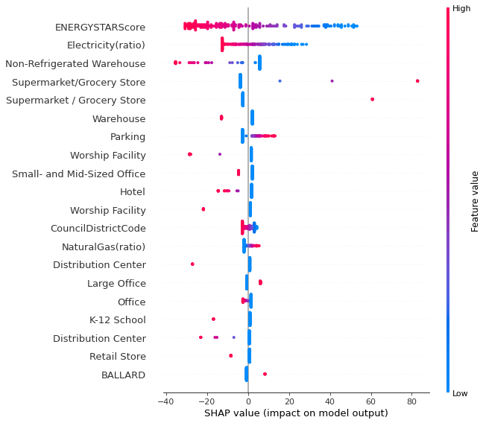
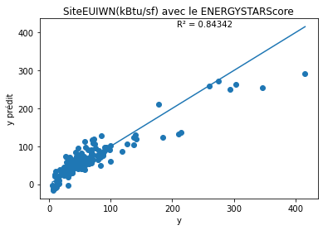
ENERGYSTARScore
From 0,694 to 0,843

Slide 26
Conclusion
 | GHGEmissions | EnergyUse
Best model | Lasso | Ridge
Hyperparameter | α = 0,002 | α = 1,0
R² | 0,675 | 0,694
R² with ENERGYSTARScore | 0,779 | 0,843
ENERGYSTARScore improve modelisation
Improvments :
  Feature engineering (feature importance, PrimaryPropertyType)
  Preprocessing (StandardScaler, PolynomialFeature)

Slide 27
Thank you
Any questions ?

