Slide 1
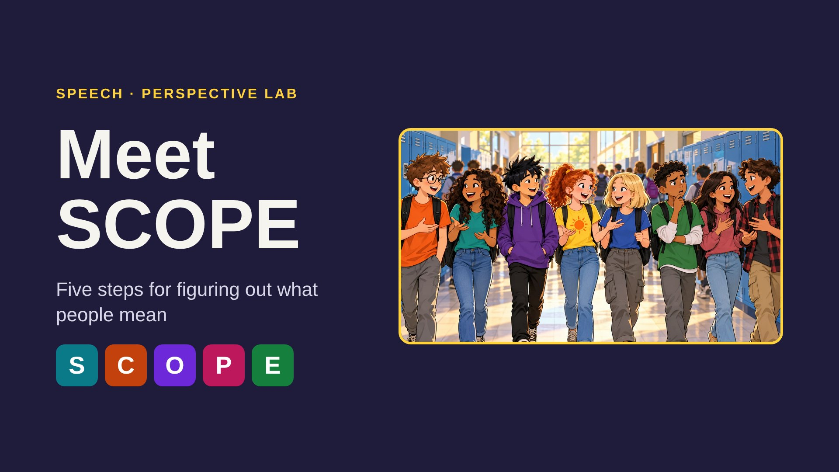
Notes:
Welcome students. SCOPE is a five-step tool we will use in every session to figure out what is going on and what people might mean. Ask: "Has anyone ever said something and you weren't sure what they meant?" Take one or two quick stories.

Slide 2
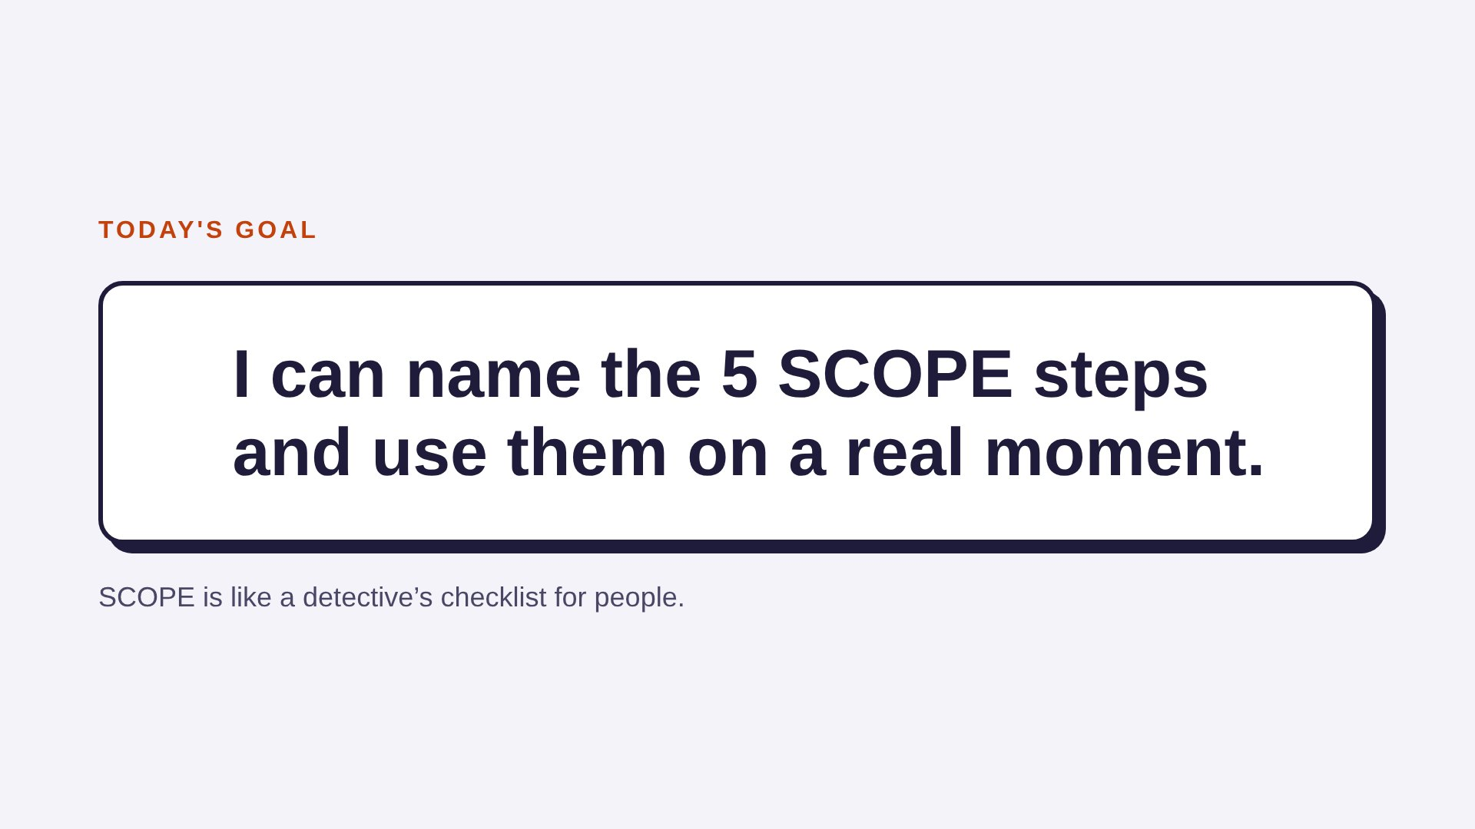
Notes:
Read the goal together. Explain the detective idea: a detective doesn't decide right away. They look, collect clues, and think about more than one answer before they act. SCOPE asks us to do the same with people.

Slide 3
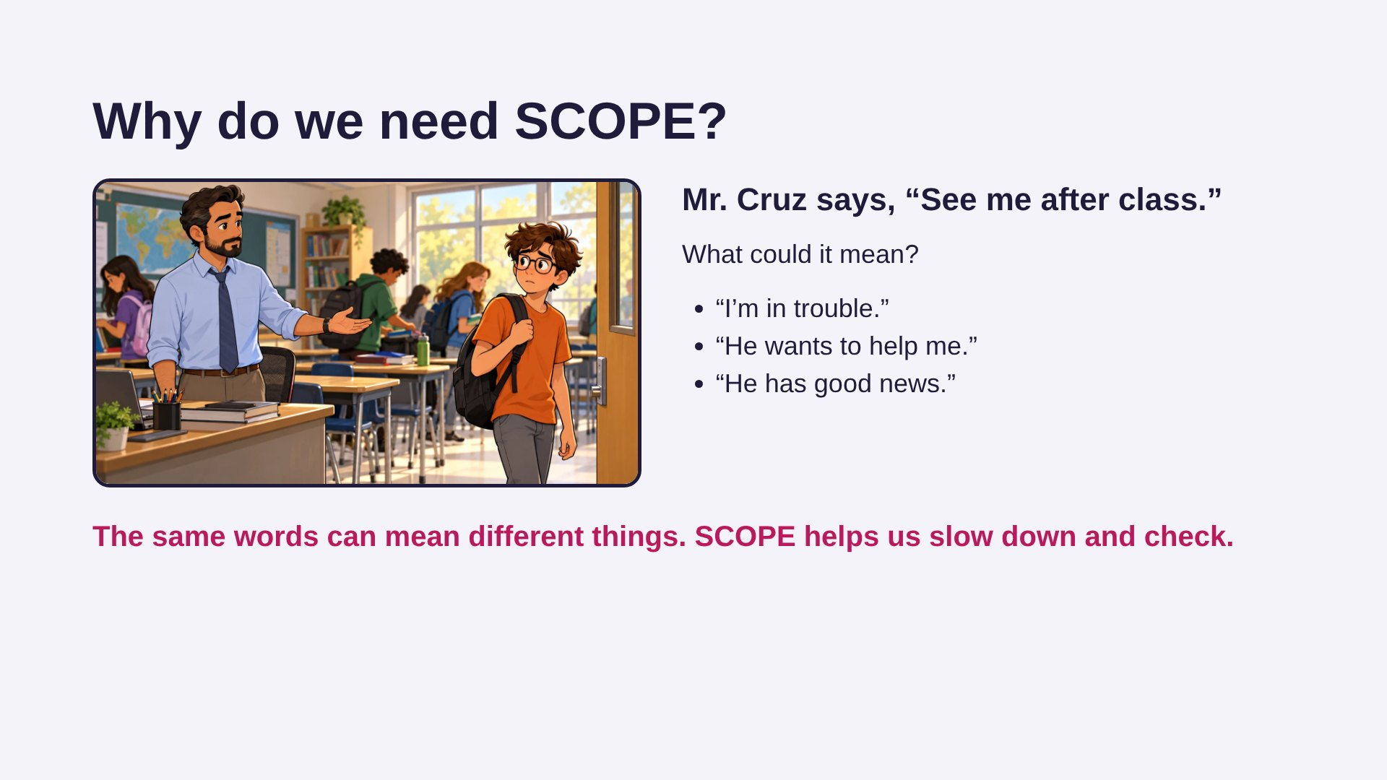
Notes:
Most students jump to "I'm in trouble." Ask: "How would each idea make you feel? What clues would help you know which one is right?" Point out that our first guess is not always right. SCOPE gives us steps to check before we decide how to feel or what to do.

Slide 4
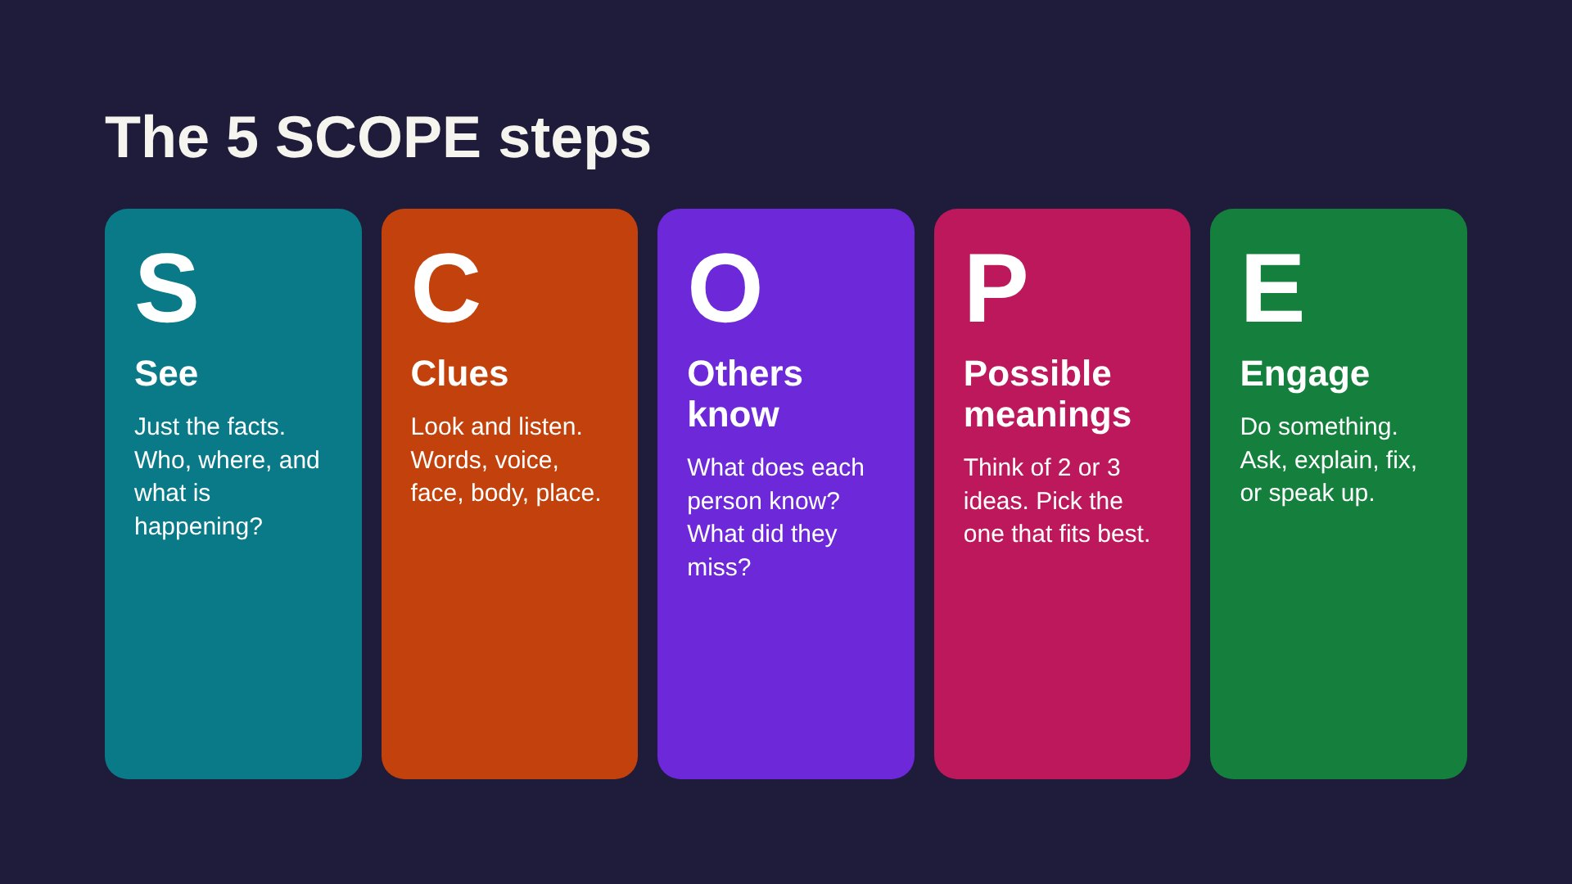
Notes:
Teach a quick hand motion for each step if your students like movement: S – hand over eyes like a visor, C – magnifying glass, O – point to your head, P – hold up 2 or 3 fingers, E – open hands toward a partner. Have students say the five words back.

Slide 5
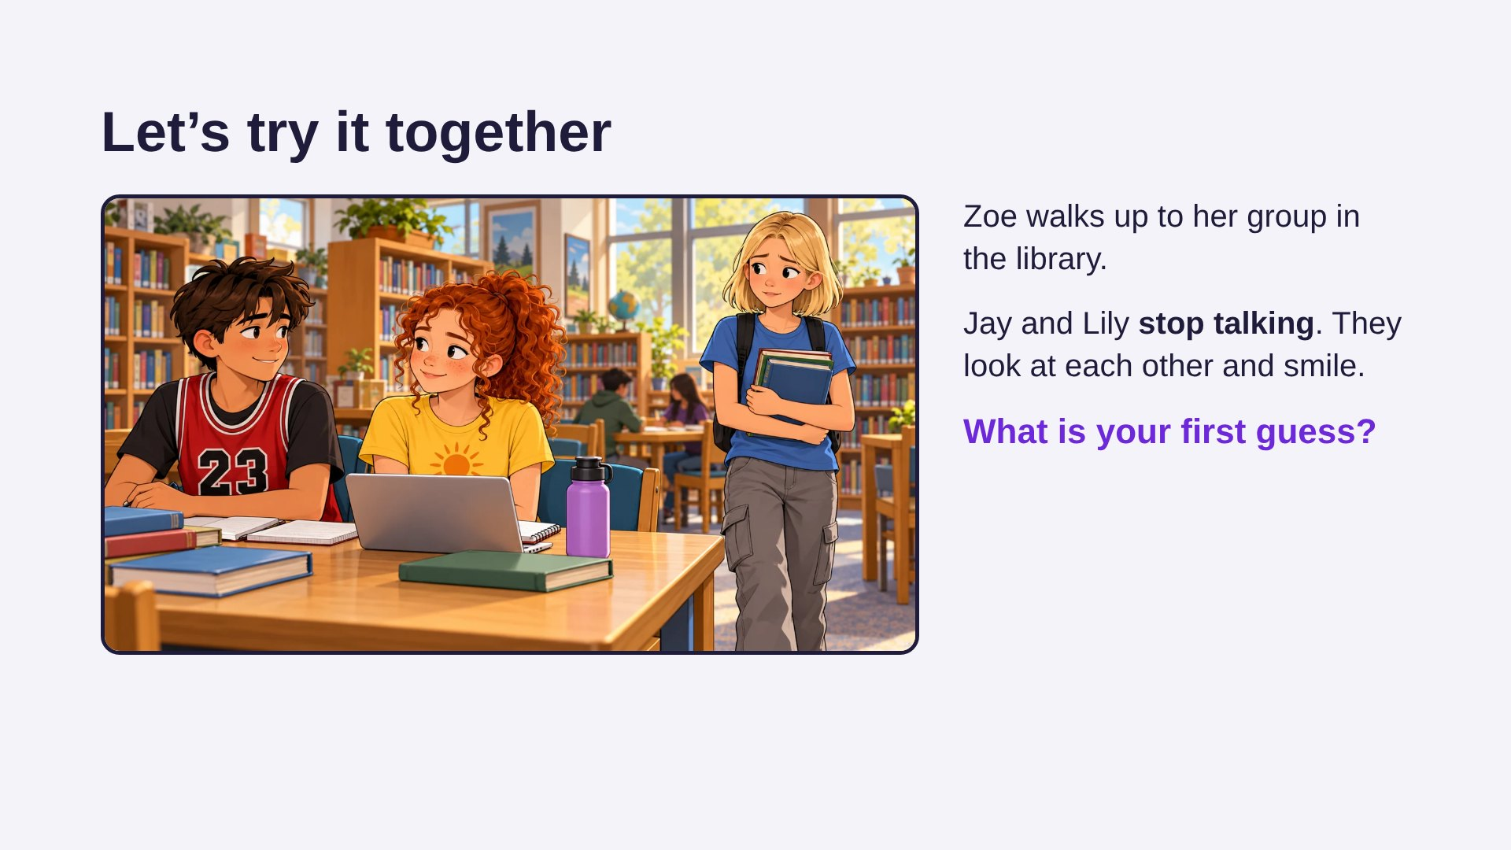
Notes:
Read the story aloud. Take first guesses without correcting anyone. Many students will say "They were talking about her." Write it down or remember it. Say: "Let's use SCOPE to check that guess, one step at a time."

Slide 6
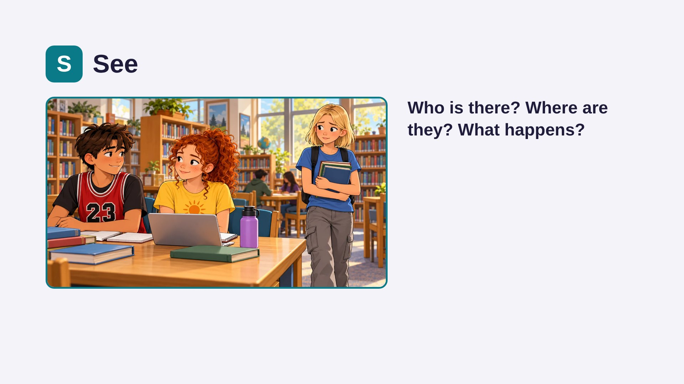
Notes:
See is ONLY the facts, like a camera. No feelings or guesses yet. If a student says "They were talking about her," say: "That's a guess. We'll get to guesses at P. What would a camera see?" Click to show the idea after students answer.

Slide 7
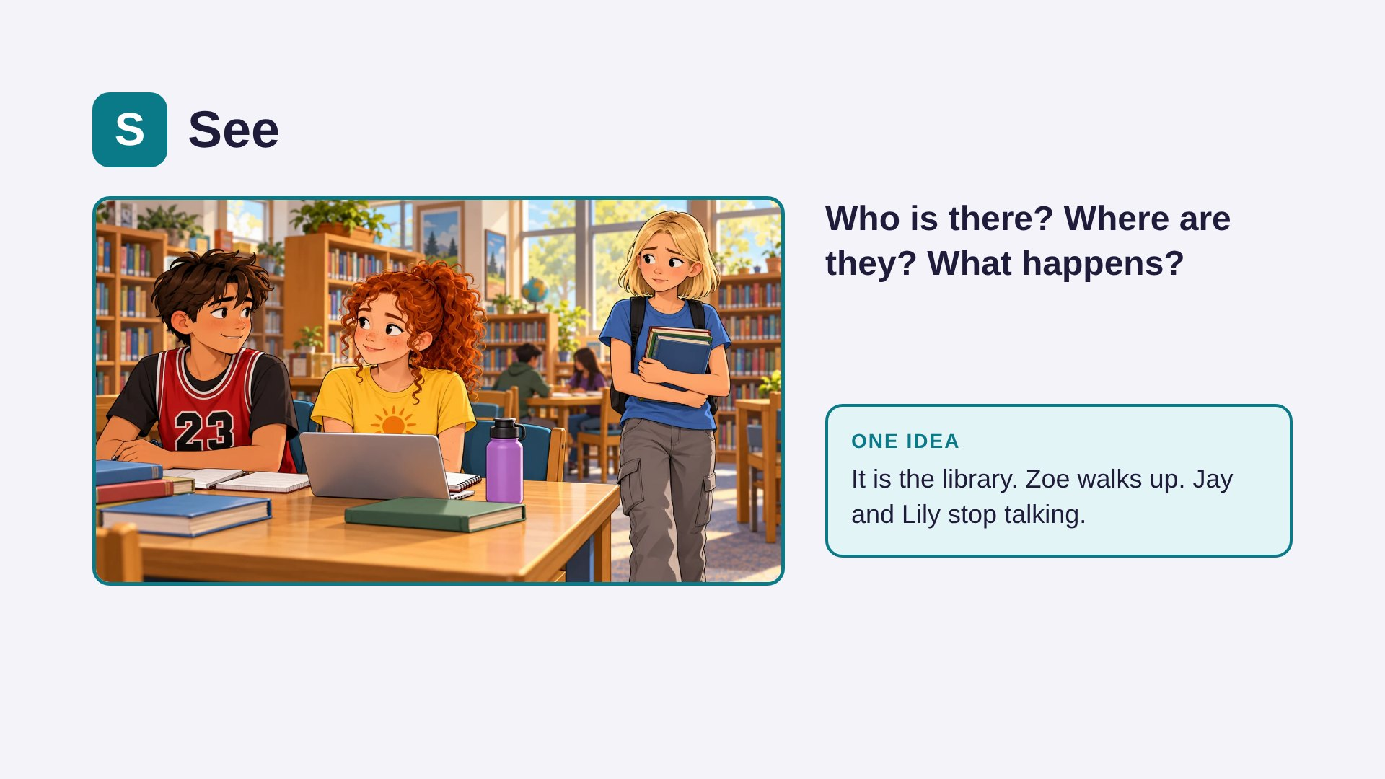
Notes:
(Answer shown) See is ONLY the facts, like a camera. No feelings or guesses yet. If a student says "They were talking about her," say: "That's a guess. We'll get to guesses at P. What would a camera see?" Click to show the idea after students answer.

Slide 8
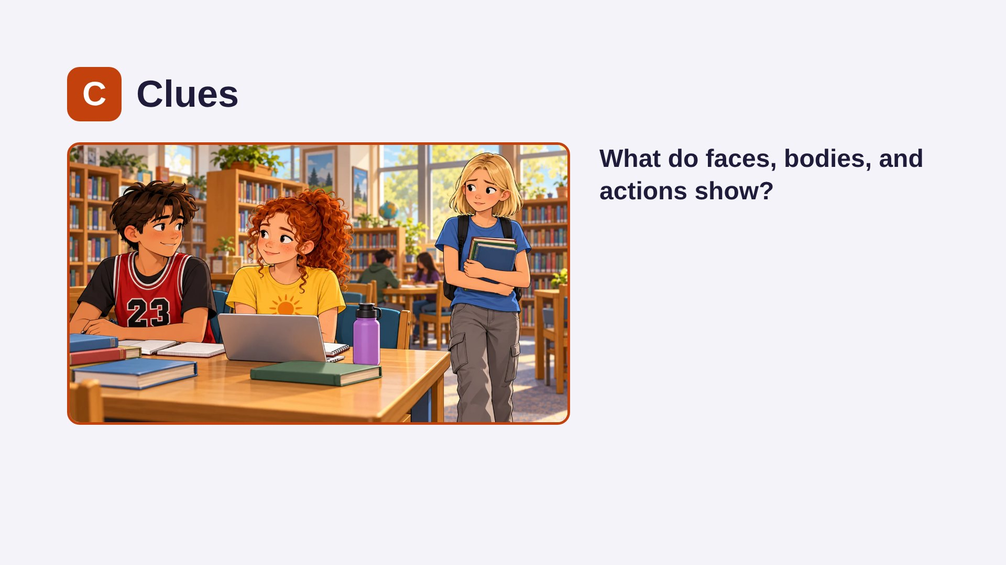
Notes:
Clues are things we can point to. Ask students to point at each clue in the picture. Remind them: faces and bodies are clues, not proof. "Their smiles LOOK friendly" is a careful way to say it. A friendly smile is an important clue for the P step.

Slide 9
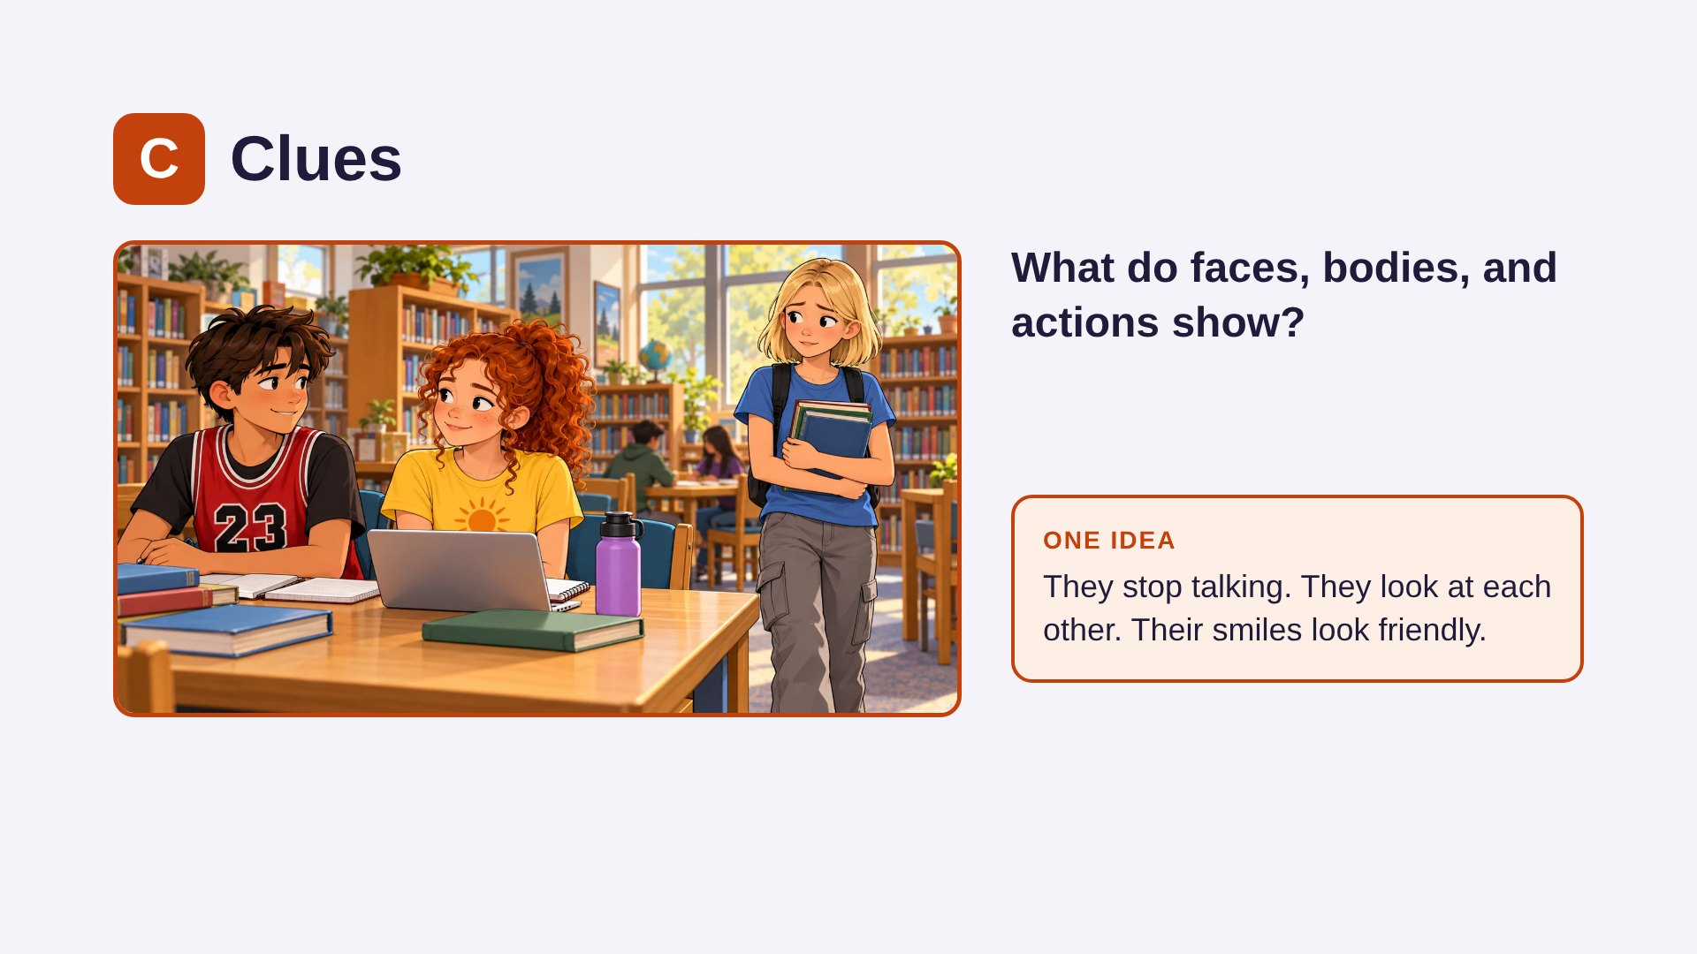
Notes:
(Answer shown) Clues are things we can point to. Ask students to point at each clue in the picture. Remind them: faces and bodies are clues, not proof. "Their smiles LOOK friendly" is a careful way to say it. A friendly smile is an important clue for the P step.

Slide 10
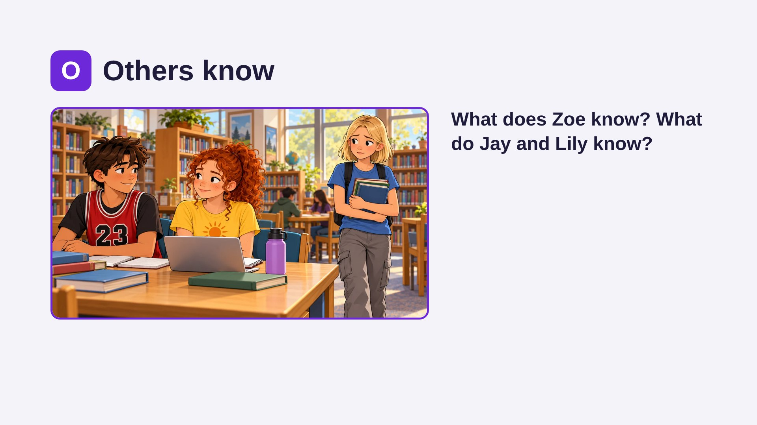
Notes:
The big idea: people only know what they have seen or heard. Zoe is missing information, so any guess she makes is just a guess. Ask: "What would help Zoe find out what they were talking about?" (Asking them.)

Slide 11
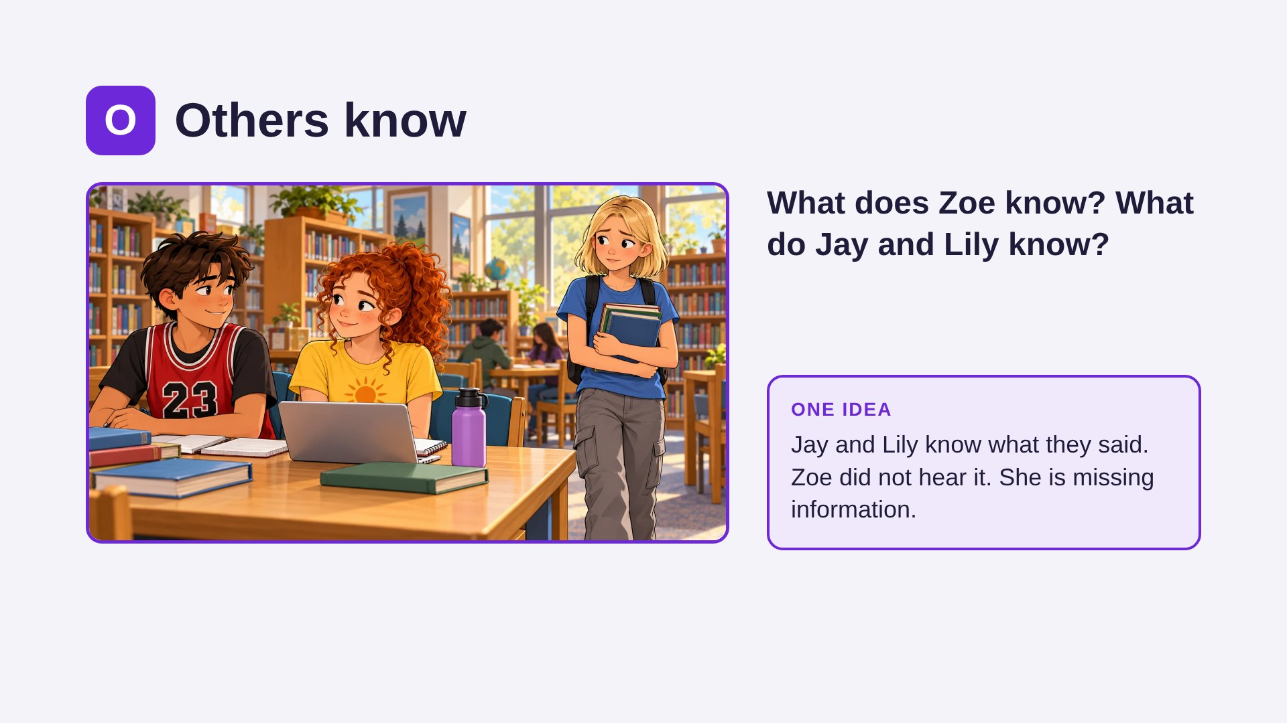
Notes:
(Answer shown) The big idea: people only know what they have seen or heard. Zoe is missing information, so any guess she makes is just a guess. Ask: "What would help Zoe find out what they were talking about?" (Asking them.)

Slide 12
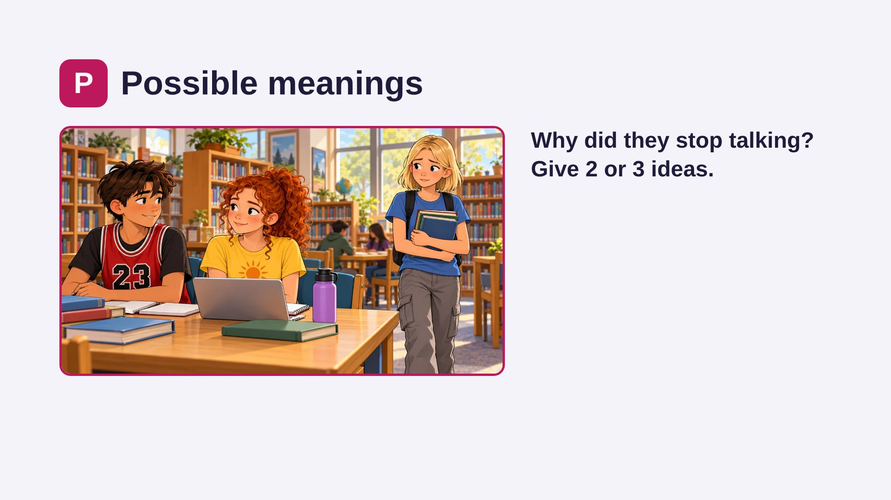
Notes:
Get at least two ideas before showing these. Then go back to the clues: "Which idea fits the friendly smiles best?" Show how our first guess ("talking about her") is only one idea, and maybe not the best fit. Any idea that fits the clues is a good idea.

Slide 13
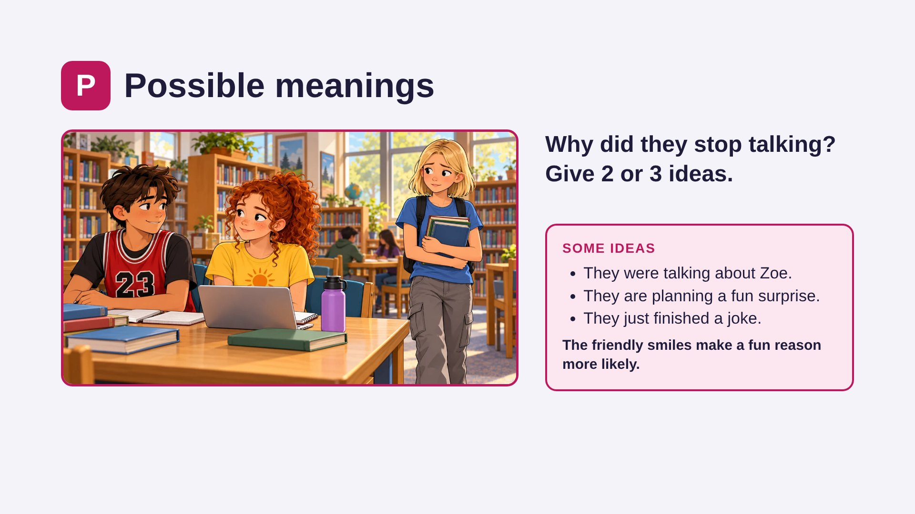
Notes:
(Answer shown) Get at least two ideas before showing these. Then go back to the clues: "Which idea fits the friendly smiles best?" Show how our first guess ("talking about her") is only one idea, and maybe not the best fit. Any idea that fits the clues is a good idea.

Slide 14
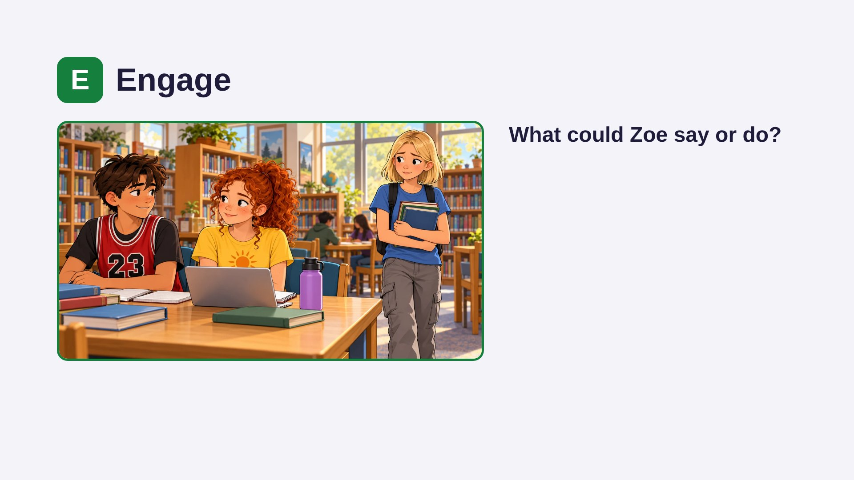
Notes:
Engage means doing something: ask, explain, fix, or speak up. Compare: if Zoe guessed "they were talking about me" and walked away, how might the afternoon go? If she asks "What's up?", what might happen? Practice saying "Hey! What's up?" in a friendly voice.

Slide 15
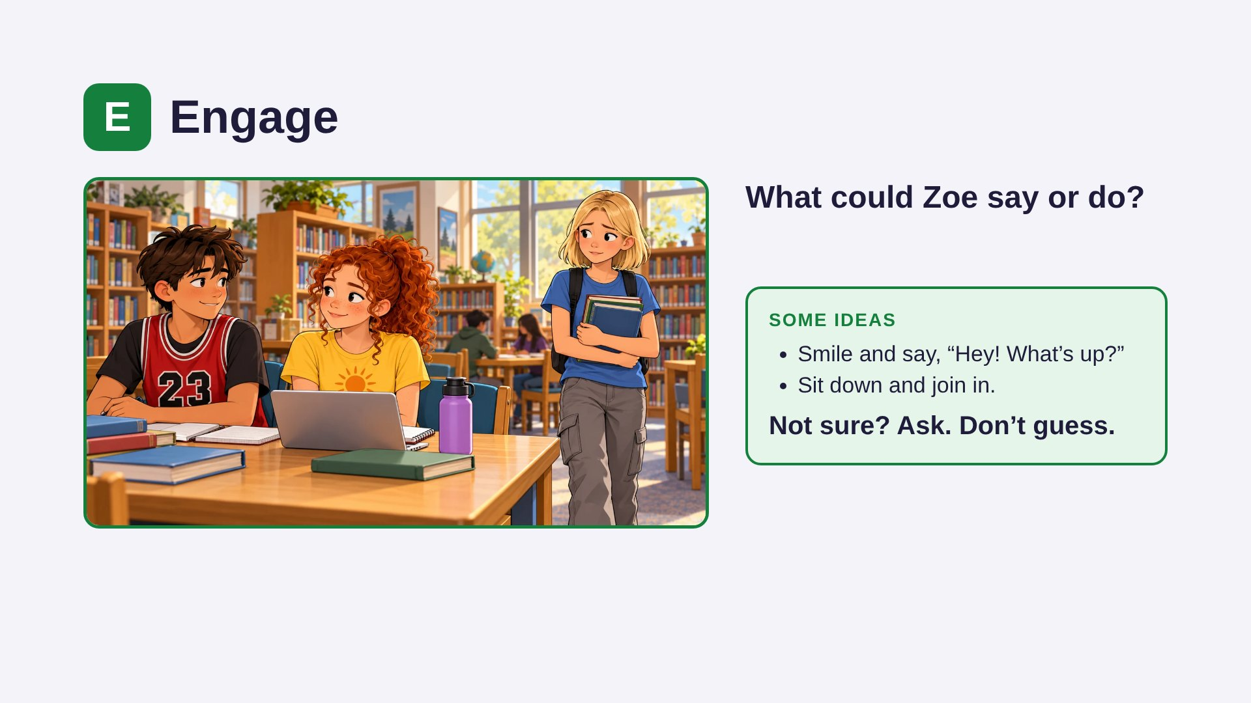
Notes:
(Answer shown) Engage means doing something: ask, explain, fix, or speak up. Compare: if Zoe guessed "they were talking about me" and walked away, how might the afternoon go? If she asks "What's up?", what might happen? Practice saying "Hey! What's up?" in a friendly voice.

Slide 16
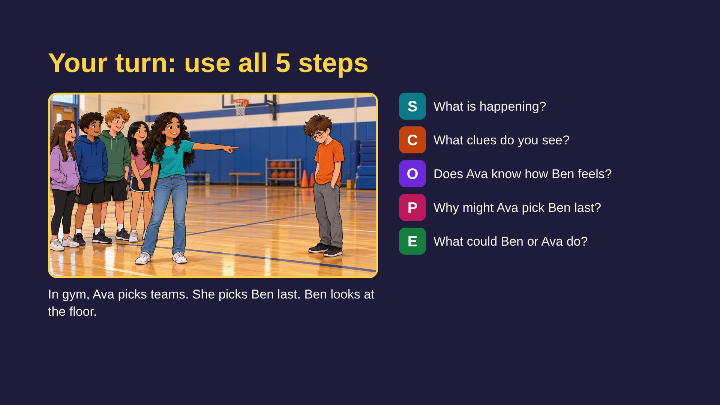
Notes:
Students lead this one. Sample answers: S – Gym class. Ava picks teams. Ben is picked last. C – Ben looks at the floor. Other kids are standing with their teams. O – Ava may not know Ben feels bad. Ben does not know why she picked him last. P – "She doesn't like me." / "She picked her close friends first." / "She just went down the line." / "She didn't think about it." E – Ben could say, "Can I play forward?" and join in; a friend could say, "Glad you're on our team!"; Ava could say "Come on, Ben!" Accept any idea that fits the clues.

Slide 17
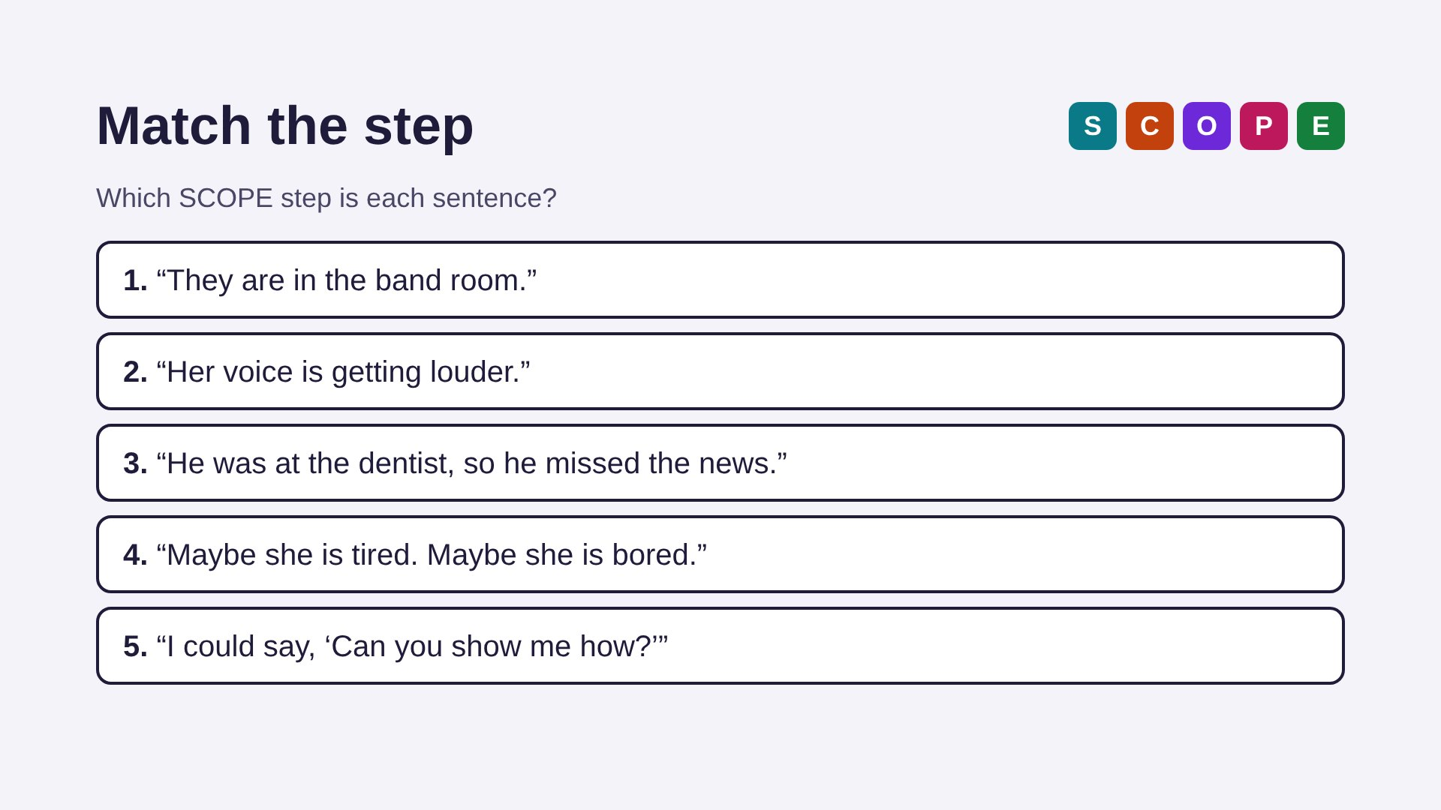
Notes:
Answers: 1 = S (where they are). 2 = C (a voice clue). 3 = O (what he knows or missed). 4 = P (more than one idea). 5 = E (something you can say). Students can point to a colored letter, say the word, or use the hand motion.

Slide 18
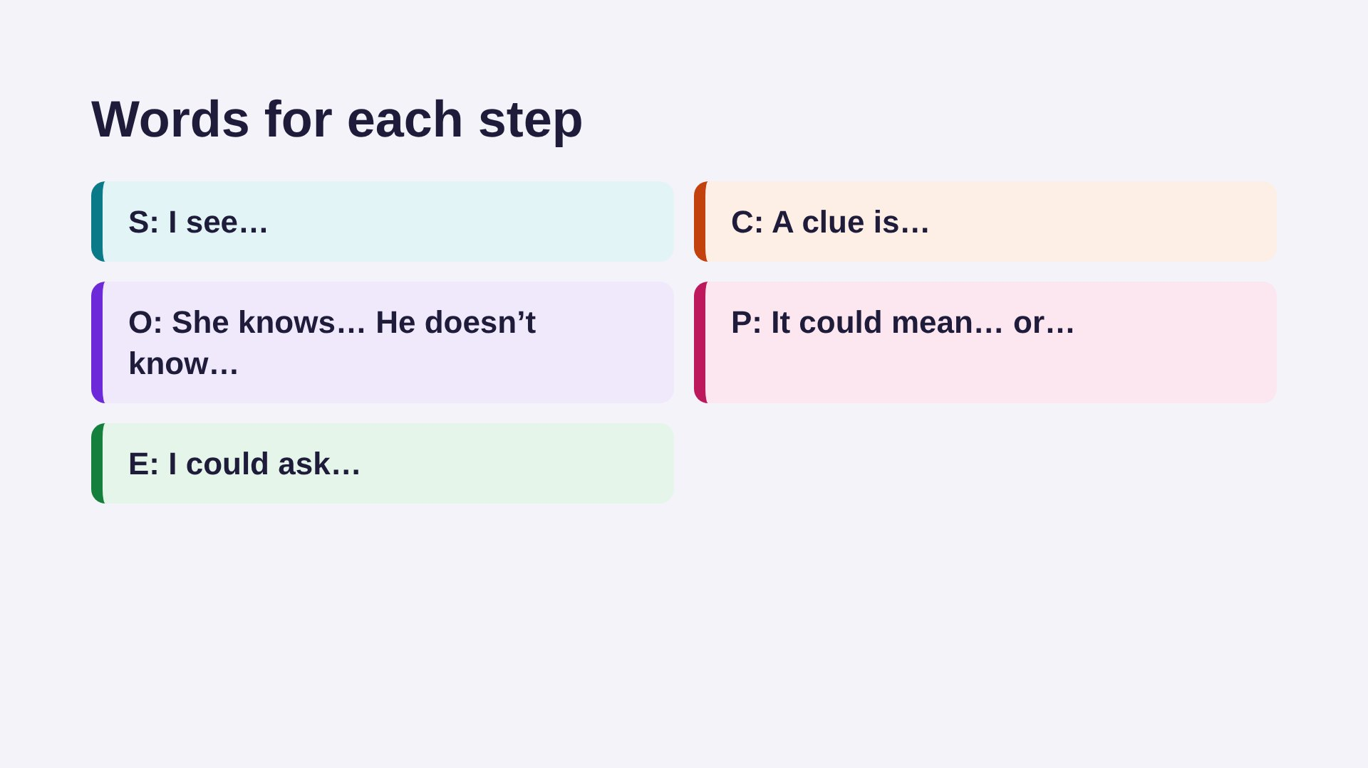
Notes:
Talk it through: "Which step was easiest? Which was hardest?" and "Tell about a time you guessed wrong about what someone meant." Students can use these starters.

Slide 19
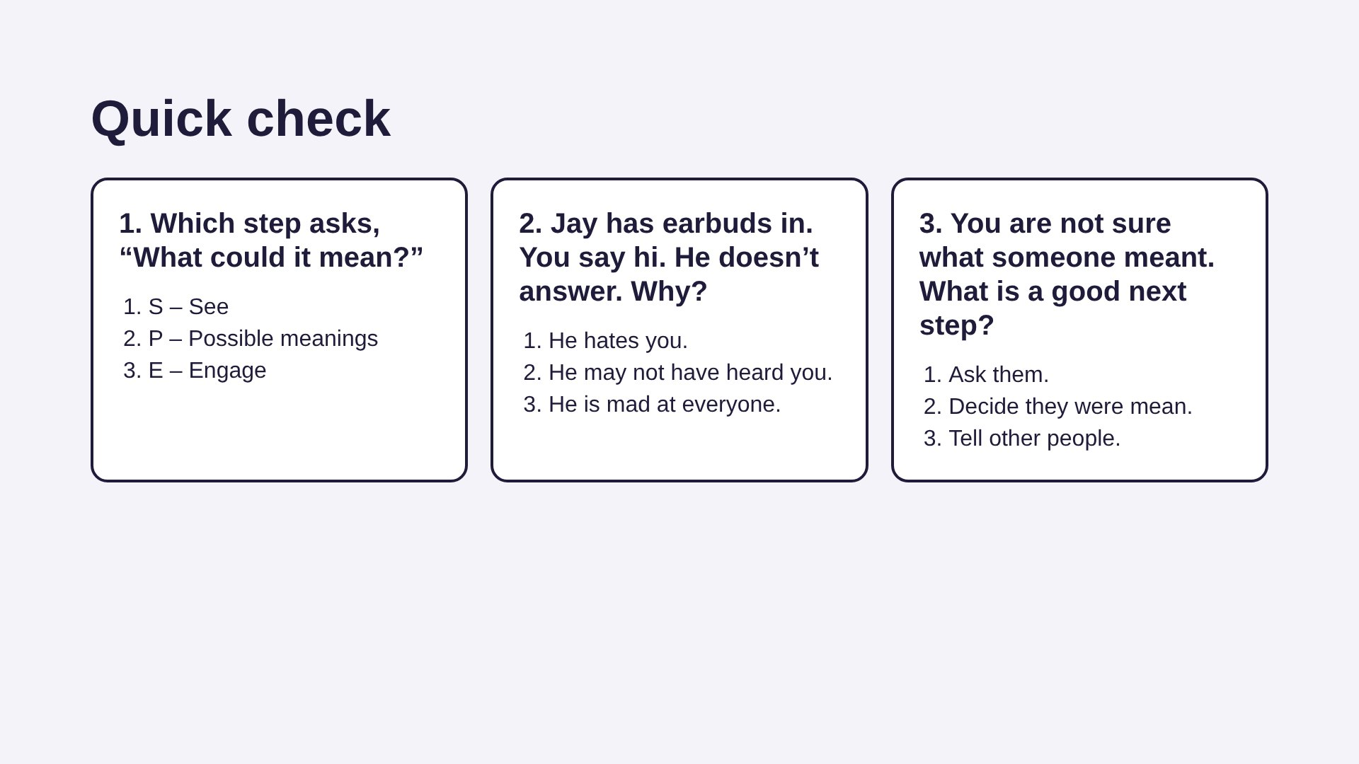
Notes:
Answers: 1 – P, Possible meanings. 2 – "He may not have heard you." (This is the O step: he didn't hear you, so he doesn't know you said hi.) 3 – "Ask them."

Slide 20
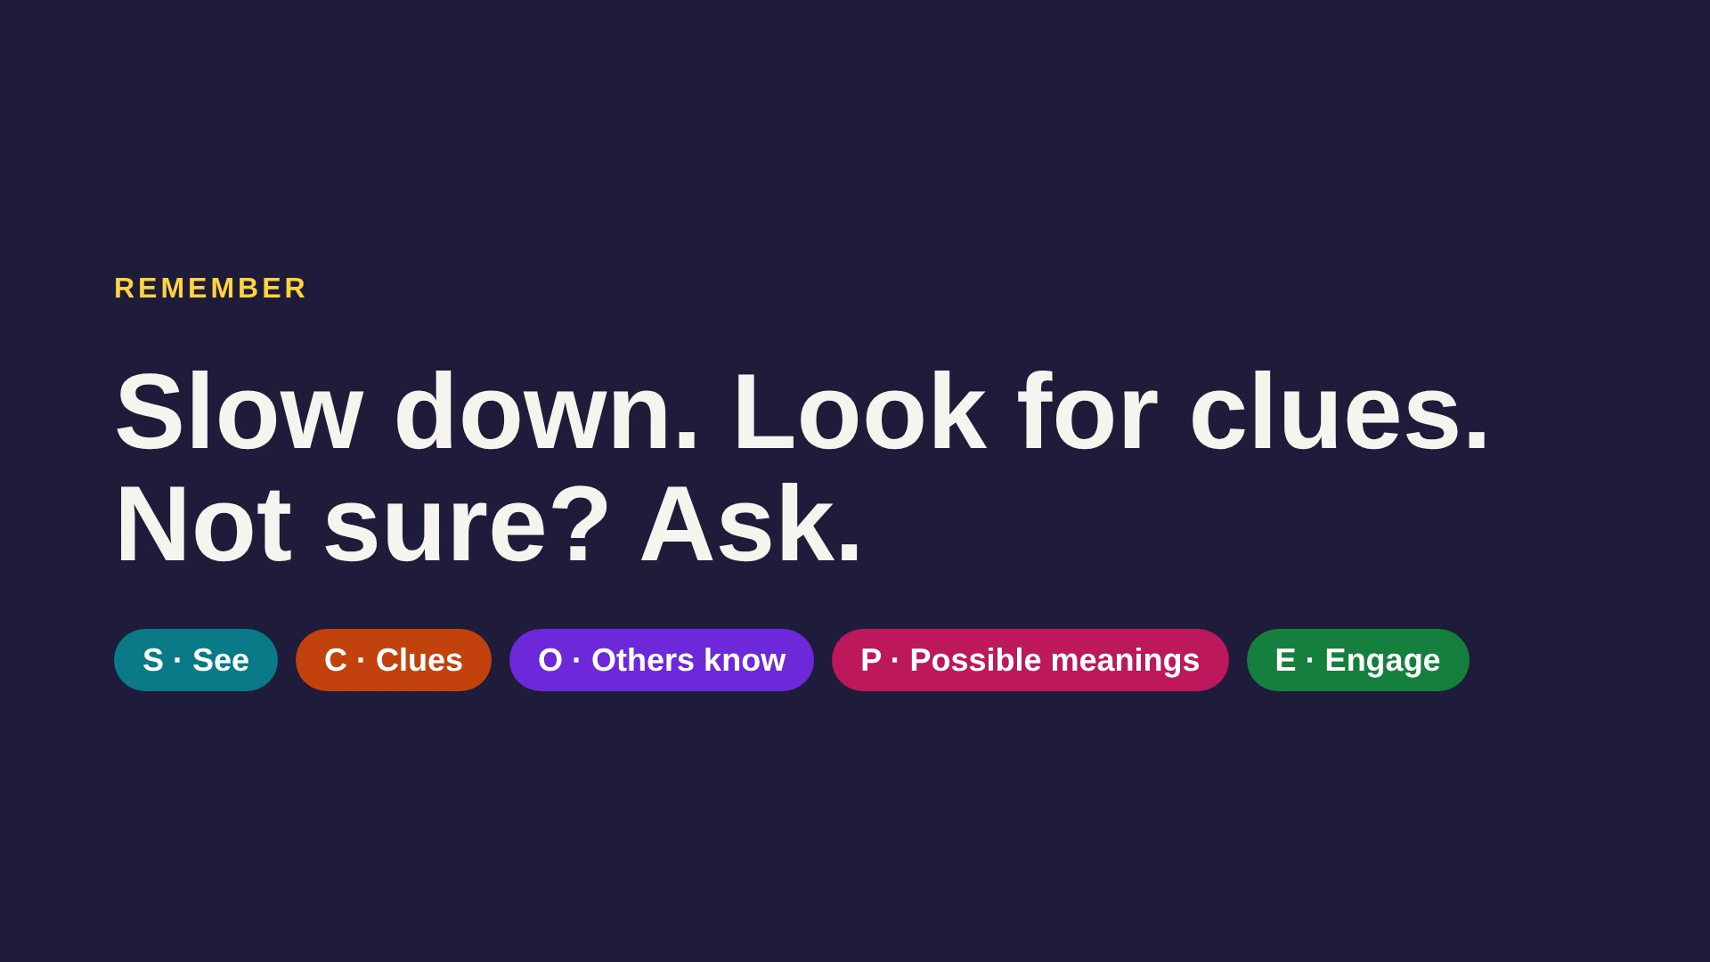
Notes:
Ask each student to name one SCOPE step from memory (or show its hand motion). Tell them we will use SCOPE in every session from now on.

