Slide 1

Sprint 1 Demo
Empowering Voices Through Technology
Team: Julian Hutchins | Kyle Jang | Natan Najera Torres
Fall 2025

Slide 2
Introduction
A Woman’s Worth (AWW) is a nonprofit dedicated to empowering women through storytelling and growth.
Objective: Create a modern, accessible, and inspiring digital platform.
Sprint 1 Focus: Requirements gathering, documentation, and framework research, and using Figma for prototyping and design sketching
Frameworks Identified: React (Front-End) and Node.js/(possibly)Express (Back-End).
A Woman’s Worth — Sprint 1 Demo
Notes:
Presenter: Team Lead (Julian)

Slide 3
Sprint Objectives
Collect and refine client requirements through meetings.
Documented user stories, use cases, and UML diagrams.
Begin feature mockups and design wireframes.
Nailing down mandatory features given to us by client: their logo, colors being demonstrated in this demo presentations background, and a blog feature that will be showed later in demo.
A Woman’s Worth — Sprint 1 Demo
Notes:
Presenter: Team Lead (Julian)

Slide 4
Requirements Gathering Process
Conducted client meetings with AWW leadership (Gaye Hallman & Patty).
Discussed pain points: outdated site, no CMS, limited donation options.
Key requirements: Story Sharing, Events, Donations, Merchandise, and AI Chatbot(decided for next semester).
Information logged into user stories and requirement tables.
A Woman’s Worth — Sprint 1 Demo
Notes:
Presenter: Team Member

Slide 5
User Stories & Use Cases
US-01: Participant shares a recovery story safely (Story Submission).
US-02: Donor completes secure donation process with receipt (Donation).
US-03: Staff manage events and announcements easily (Event Management).
US-04: Supporter buys merchandise to support AWW (E-Commerce).
US-05: Users navigate site with AI chatbot help (Accessibility).
Use Cases include Create Profile, Share Story, Manage Content, and Donate.
A Woman’s Worth — Sprint 1 Demo
Notes:
Presenter: Team Member

Slide 6
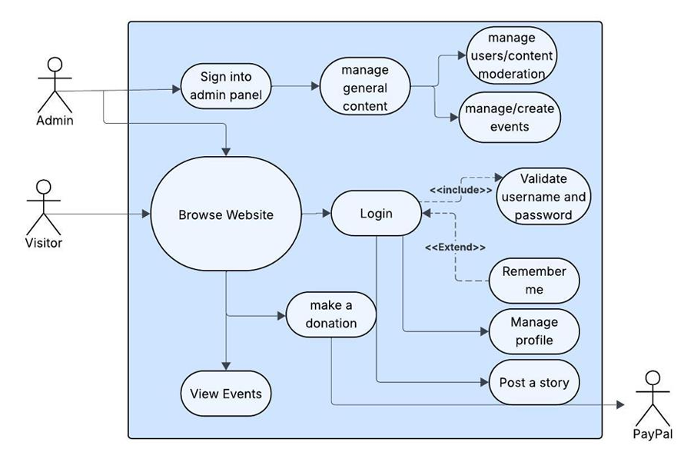
UML Diagram Overview
Use Case Diagram: Depicts interactions among visitors/members, and administrators.
Shows browsing, logging in, logging out, donating. Registering to become a member and Managing profile,
For admin it gives access to events, moderation, and user accounts.
A Woman’s Worth — Sprint 1 Demo
Notes:
Presenter: Team Member

Slide 7
Installation & Evaluation
Existing site: simple but outdated — lacks CMS(content management system) and analytics.
Problems: Manual updates, limited PayPal-only donation system, no volunteer management.
Planned Solution: React + Node+ Strapi CMS integration.
Outcome: A foundation for scalable and maintainable full-stack structure.
A Woman’s Worth — Sprint 1 Demo
Notes:
Presenter: Team Member

Slide 8
Kanban Overview & Team Contributions
Kanban setup tracked all Sprint 1 tasks: To Do → In Progress → Done.
(Completed in Sprint 1)
Finalize Functional Requirements Non-Functional Requirements — Natan
User stories -- Natan
Complete Use Cases — julian
Finish UML Diagrams — julian
Evaluate existing AWW website / system setup — Kyle
Conduct Meeting of minutes— Kyle
Requirements and specifications – Entire Team
Deliver Sprint 1 presentation and demo — Entire Team
Complete Sprint retrospective and plan Sprint 2 — Entire Team
A Woman’s Worth — Sprint 1 Demo
Notes:
Presenter: Team Lead (Julian)

Slide 9
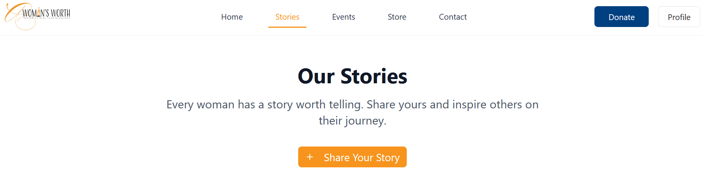
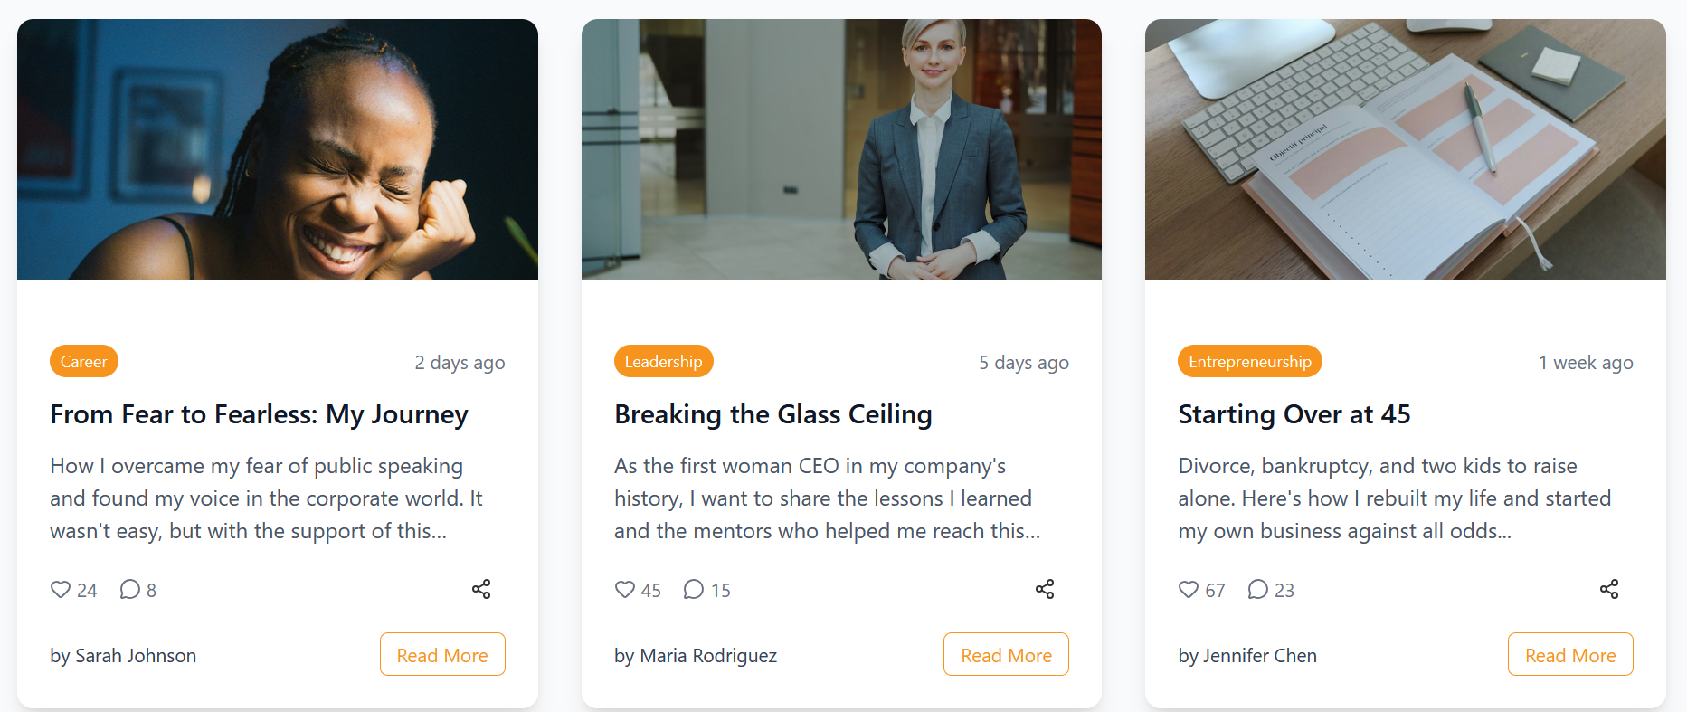
Feature Demonstration
Share stories blog section
a feature that allows women to share their thoughts, stories, success and difficulties.
This is a key deliverable our client requested, we wanted to make it as user friendly as possible.
A Woman’s Worth — Sprint 1 Demo
Notes:
Presenter: Team Member

Slide 10
Need to learn Skills & Learning Process
Front-End: React components, routing(Kyle).
Back-End: Express APIs (Natan).
Database: MongoDB schema design and integration (Julian).
Each member to complete structured tutorials on skills needing reinforcement.
A Woman’s Worth — Sprint 1 Demo
Notes:
Presenter: Team Member

Slide 11
Responsible Use of AI
Tools Used: ChatGPT, GitHub Copilot for organizing and features suggestions.
Applications: Used for Requirement refinement, UML suggestions, and brainstorming ideas.
Limitations: AI required review to ensure factual accuracy and tone alignment.
Accountability: All content finalized by human review and validation.
A Woman’s Worth — Sprint 1 Demo
Notes:
Presenter: Team Member

Slide 12
Sprint Achievements & Challenges
Achievements: Documented all requirements and use cases, user stories, use case system diagrams, began website wireframe design and features.
Strong collaboration between team and client.
Challenges: Balancing and learning new frameworks
Solutions: Frequent test, video tutorials if needed.
A Woman’s Worth — Sprint 1 Demo
Notes:
Presenter: Team Lead (Julian)

Slide 13
Next Steps & Sprint 2 Plan
Begin finalizing AWW’s new design
Begin full-stack implementation
Develop donation platform
Retrospective: Improved communication with client and more focus on sprint timelines.
A Woman’s Worth — Sprint 1 Demo
Notes:
Presenter: Team Lead (Julian)

Slide 14
Conclusion
Sprint 1 built the wireframe foundation for AWW’s transformation.
Next up: Developing secure, accessible, and community-focused web features.
Thank you to our clients for their collaboration.
A Woman’s Worth — Refuse to miss your blessings!
A Woman’s Worth — Sprint 1 Demo
Notes:
Presenter: Team Lead (Julian)

