Slide 1
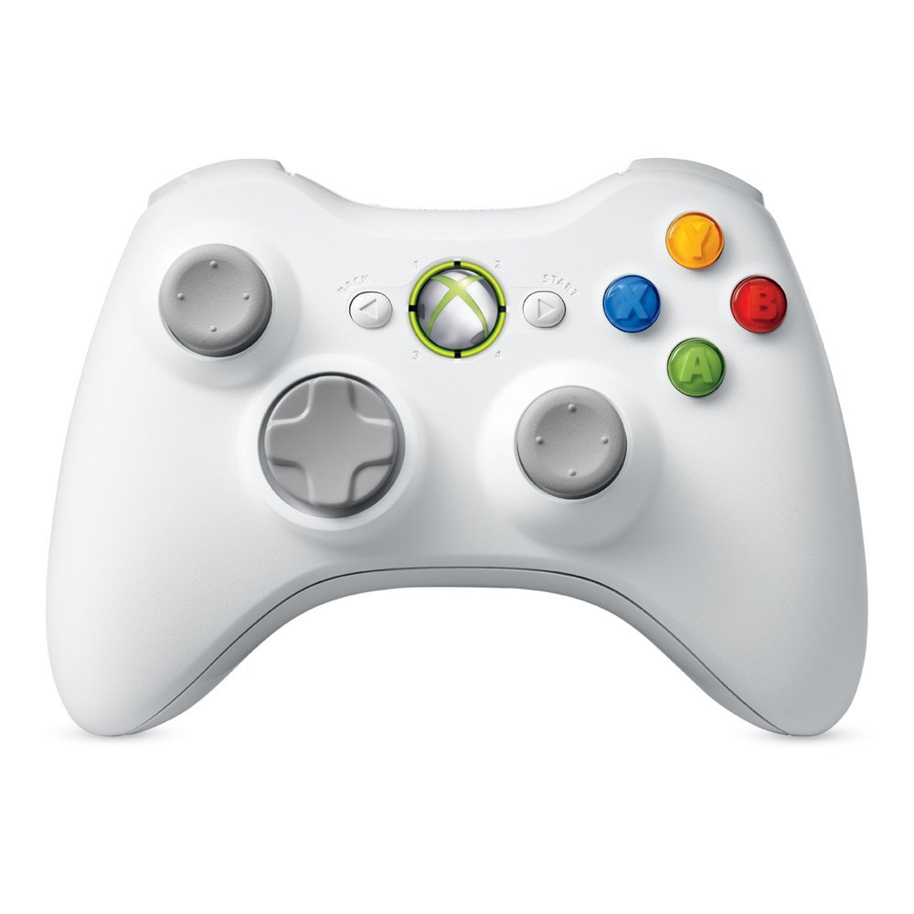
land
takeoff
translate forward/backward
alt_hold
turn left/right
stabilize
disarm
arm
tilt camera up
translate up/down
tilt camera down
translate left/right
Notes:
Xbox 360 Wireless Controller

Slide 2
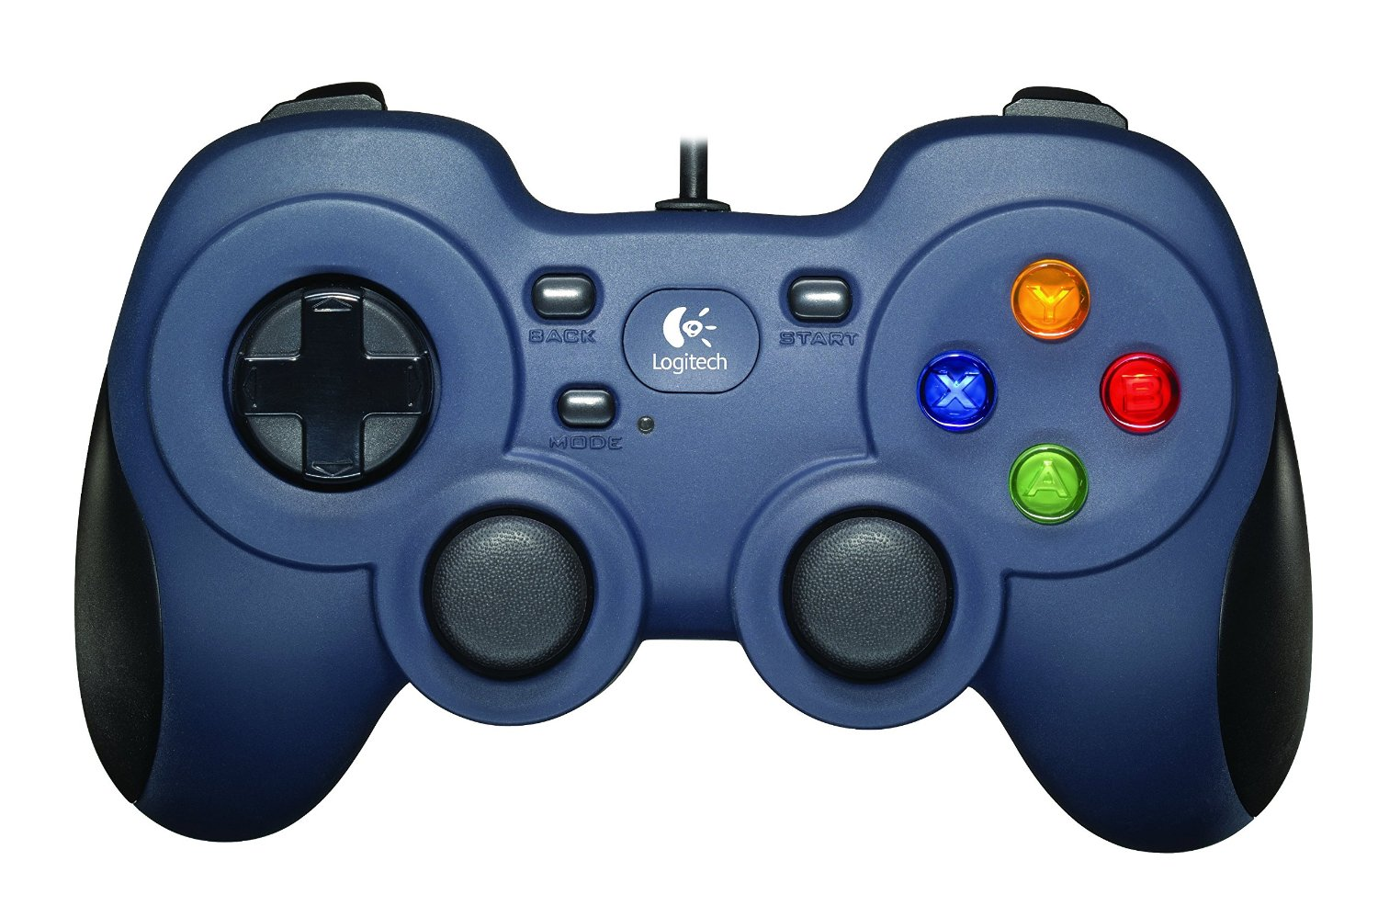
Notes:
Logitech F310 Wired USB Controller

