Slide 1
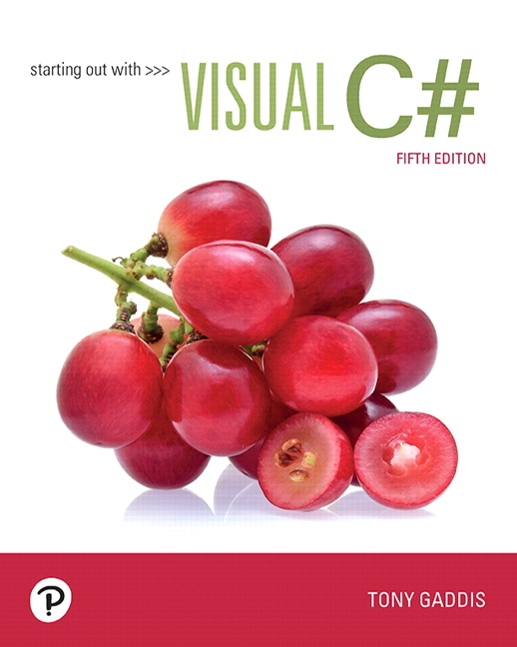
Starting out with Visual
Fifth Edition
Chapter 2
Introduction to Visual
Copyright © 2017, 2014, 2012 Pearson Education, Inc. All Rights Reserved
Notes:
If this PowerPoint presentation contains mathematical equations, you may need to check that your computer has the following installed:
1) MathType Plugin
2) Math Player (free versions available)
3) NVDA Reader (free versions available)

Slide 2
Topics
2.1 Getting Started with Forms and Controls
2.2 Creating the G U I for Your First Visual C# Application
Code
2.4 Writing Code for the Hello World Application
2.5 Label Controls
2.6 Making Sense of IntelliSense
2.7 PictureBox Controls
2.8 Comments, Blank Lines, and Indentation
2.9 Writing the Code to Close an Application’s Form
2.10 Dealing with Syntax Error
2.3 Introduction to

Slide 3
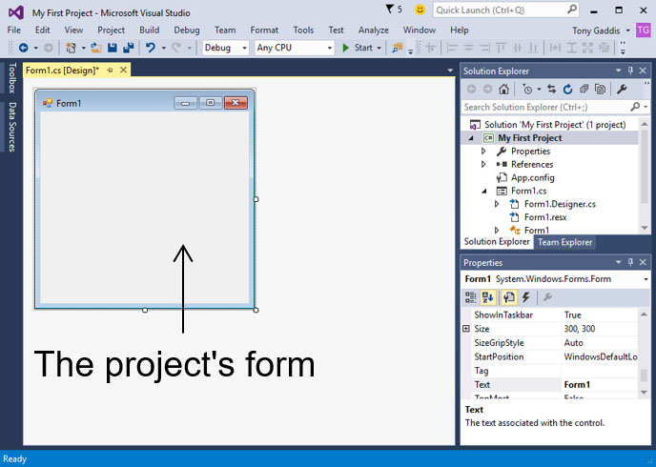
2.1 Getting Started with Forms and Controls
A Visual
application project starts with creating its G U I with
Designer
Toolbox
Properties window
In the Designer, an empty form is automatically created
An application’s G U I is made of forms and controls
Each form and control in the application’s G U I must have a name as I D. The default blank form is named “Form1” automatically.

Slide 4
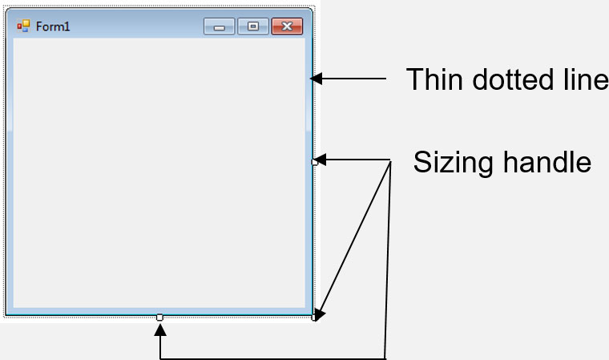
The Form’s Bounding Box and Sizing Handles
The default empty form has a dimension (size) of 300 pixels wide by 300 pixels high
A form in Designer is enclosed with thin dotted lines called the bounding box
The bounding box has small sizing handles; you can use them to resize the form

Slide 5
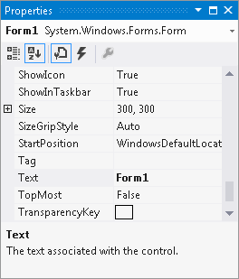
The Properties Window
The appearance and other characteristics of a G U I object are determined by the object's properties
The Properties window lists all properties
When selecting an object, its properties are displayed
in Properties windows
Each property has 2 columns:
Left: property’s name
Right: property’s value

Slide 6
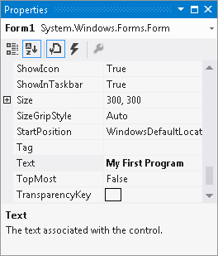
Changing a Property’s Value
Select an object, such as the Form, by clicking it once
Click View and select Properties if the Properties window is not available
Find the property’s name in the list and change its value
The Text property determines the text to be displayed
in the form’s title bar
Example: Change the
value from “Form1”
to
“My First Program”

Slide 7
Adding Controls to a Form
In the Toolbox, select the Control (e.g. a Button), then you can either:
double click the Button control
click and drag the Button control to the form
On the form, you can
resize the control using its bounding box and sizing handles
move the control’s position by dragging it
change its properties in the Properties window

Slide 8
Rules for Naming Controls
Controls’ names are identifiers of the controls
The naming conventions are:
The first character must be a letter (lower or uppercase, does not matter) or an underscore (_)
All other characters can be alphanumerical characters or underscores
The name cannot contain spaces
Examples of good names are:
showDayButton
DisplayTotal
_ScoreLabel

Slide 9
2.2 Creating the G U I for Your First Visual c sharp Application
Components: a Form and a Button control
Purpose:
Create the application’s G U I
Write the code that causes “Hello World” to appear when the user clicks the button (details are available in section 2.3)

Slide 10
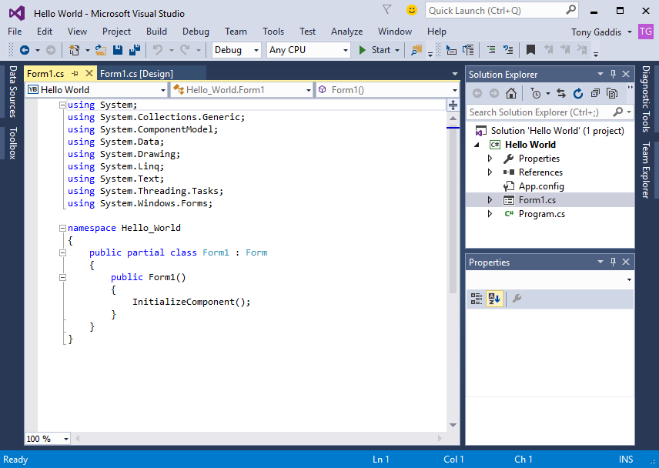
2.3 Introduction to c sharp Code
code is primarily organized in three ways:
Namespace: a container that holds classes
Class: a container that holds methods
Method: a group of one or more programming statements that perform some operations
A file that contains program code is called a source code file

Slide 11
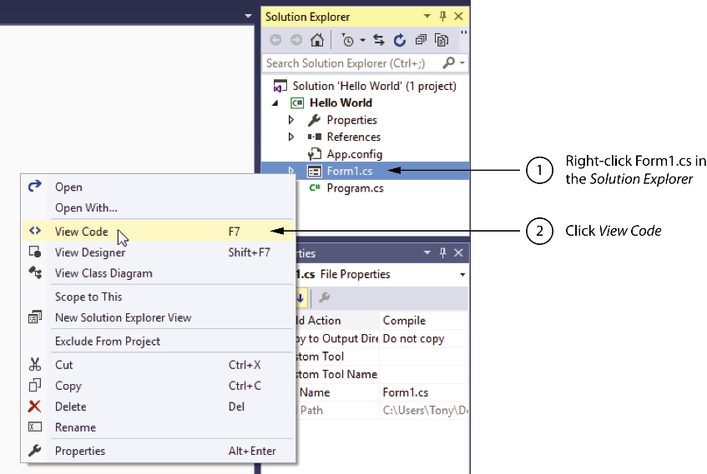
Source Codes in the Solution Explorer
Each time a new project is created the following two source code files are automatically created:
Program.c s file: contains the application’s start-up code to be executed when the application runs
Form1.c s contains code that is associated with the Form1 form
You can open them through the Solution Explorer

Slide 12
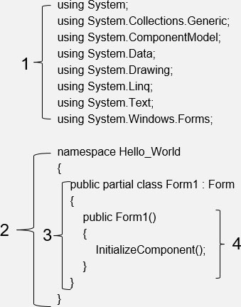
Organization of the Form1.cs
A sample of Form1.c s:
The using directives indicate which namespaces of .NET Framework this program will use.
The user-defined namespace of the project not .NET Framework namespaces
Class declaration
A method
code is organized as methods, which are contained inside classes, which are contained inside namespaces

Slide 13
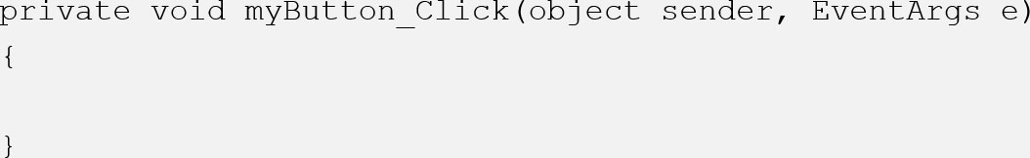
Adding Your Code
G U I applications are event-driven which means they interact with users
An event is a user’s action such as mouse clicking, key pressing, etc.
Double clicking a control, such as Button, will link the control to a default Event Handler
An event handler is a method that executes when a specific event takes place
A code segment similar to the following will be created automatically:

Slide 14
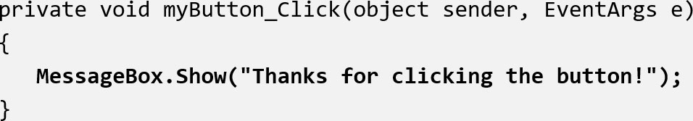
Message Boxes
A message box (aka dialog box) displays a message
The .NET Framework provides a method named MessageBox.Show
can use it to pop up a window and display a message. A sample code is (bold line):
Placing it in the myButton_Click event handler can display the string in the message box when the button is clicked

Slide 15
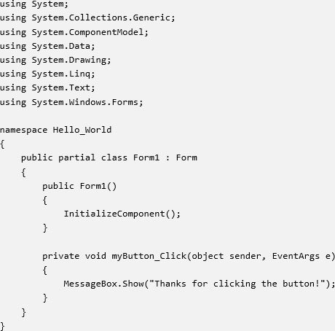
2.4 Writing Code for the Hello World Application
The completed source code of Form1.c s is:

Slide 16
2.5 Label Controls
A Label control displays text on a form and can be used to display unchanging text or program output
Commonly used properties are:
Text: gets or sets the text associated with Label control
Name: gets or sets the name of Label control
Font: allows you to set the font, font style, and font size
BorderStyle: allows you to display a border around the control’s text
AutoSize: controls the way they can be resized
TextAlign: set the text alignments

Slide 17
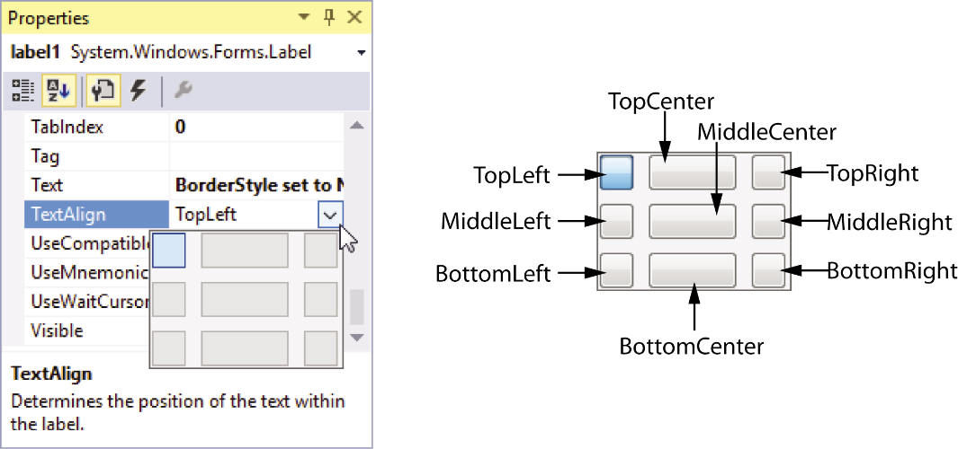
Handling Text Alignments
The TextAlign property supports the following values:
TopLeft | TopCenter | TopRight
MiddleLeft | MiddleCenter | MiddleRight
BottomLeft | BottomCenter | BottomRight
You can select them by clicking the down-arrow button of the TextAlign property

Slide 18
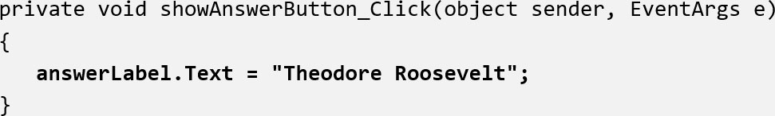
Using Code to Display Output in a Label Control
By adding the following bold line to a Button's event handler, a Label control can display output of the application.
Notice that
the equal sign (=) is known as assignment operator
the item receiving the value must be on the left of the = operator
the Text property accepts a string only
if you need to clear the text of a Label, simply assign an empty string (“”) to clear the Text property

Slide 19
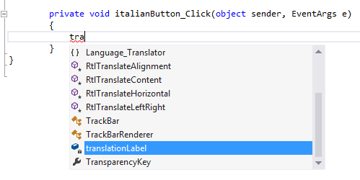
2.6 Making Sense of IntelliSense
IntelliSense provides automatic code completion as you write programming statements
It provides an array of options that make language references easily accessible
With it, you can find the information you need, and insert language elements directly into your code

Slide 20
2.7 PictureBox Controls
A PictureBox control displays a graphic image on a form
Commonly used properties are:
Image: specifies the image that it will display
SizeMode: specifies how the control’s image is to be displayed
Visible: determines whether the control is visible on the form at run time

Slide 21
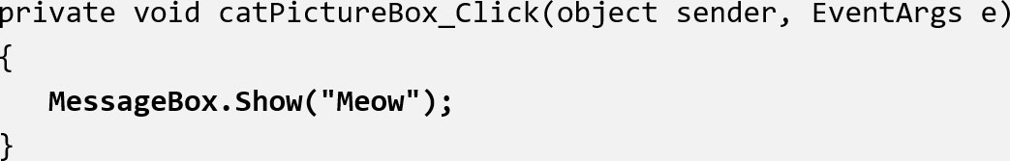
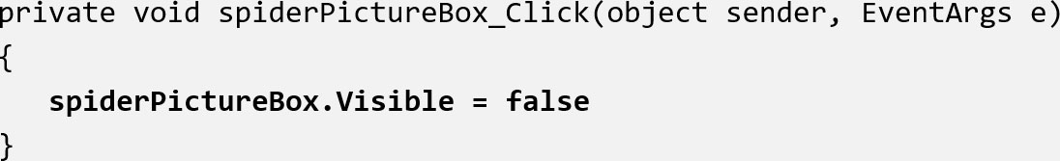
Creating Clickable Images
You can double click the PictureBox control in the Designer to create a Click event handler and then add your codes to it. For example,
And

Slide 22
Sequential Execution of Statements
Programmers need to carefully arrange the sequence of statements in order to generate the correct results
In the following example, the statements in the method execute in the order that they appear:
Private void showBackButton_Click(object sender, EventArgs e)
{
cardBackPictureBox.visible = true;
cardFacePictureBox.visible = false;
}
Incorrect arrangement of sequence can cause logic errors

Slide 23

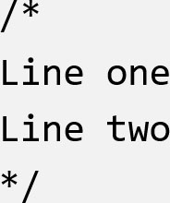
2.8 Comments, Blank Links, and Indentation
Comments are brief notes that are placed in a program’s source code to explain how parts of the program work
A line comment appears on one line in a program
A block comment can occupy multiple consecutive lines in a program

Slide 24
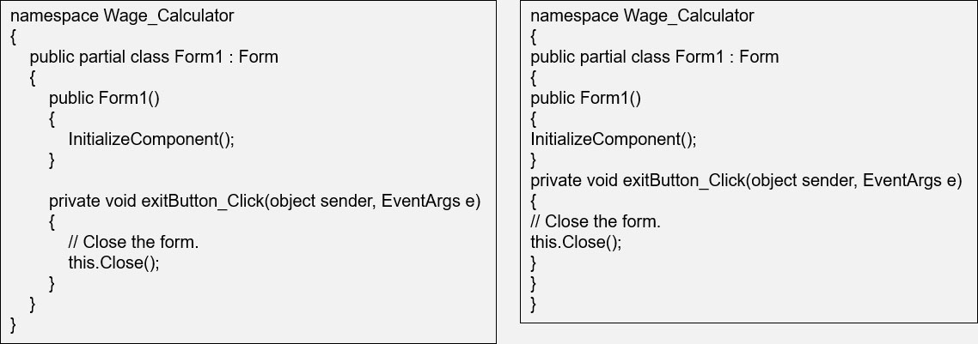
Using Blank Lines and Indentation
Programmers frequently use blank lines and indentation in their codes to make the code more human-readable
Compare the following two identical codes:

Slide 25

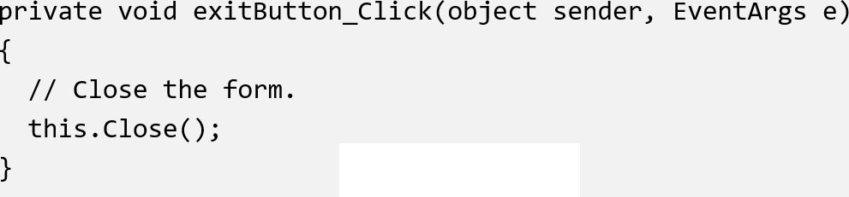
2.9 Writing the Code to Close an Application’s Form
To close an application’s form in code, use the following statement:
A commonly used practice is to create an Exit button and manually add the code to it:

Slide 26
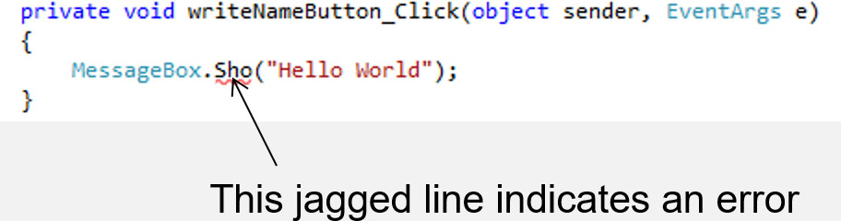
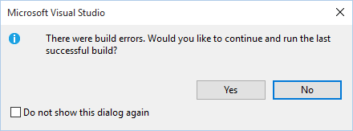
2.10 Dealing with Syntax Errors
The Visual Studio code editor examines each statement as you type it and reports any syntax errors that are found
If a syntax error is found, it is underlined with a jagged line
If a syntax error exists and you attempt to compile and execute, you will see the following window

Slide 27

Copyright

