Slide 1
C# Intro
Mike Mostafavi

Slide 2
Computer Hardware
Input Devices
Output Devices
Storage Devices
Processing Devices
Communication Device

Slide 3
Computer Software
System Software
Application Software

Slide 4
Programming Languages
Machine languages: sequences of 0s and 1s
Assembly languages: use short words known as “mnemonics” to write program
Must be translated by assembler
Still considered low-level languages
High-level languages: more human readable languages that allow programmers to create programs without knowing how CPU works.
Modern languages are high-level

Slide 5
Compilers and Interpreters
A compiler translates a high-level language program to a separate machine program for CPU to read and execute
Source code: the statements a programmer writes in a high-level language
Compilation: translates a text-based source code to binary codes
Interpreter reads, translates, and executes the instructions of a high-level language program
Examples are PHP, Perl, Python, and ASP.NET

Slide 6
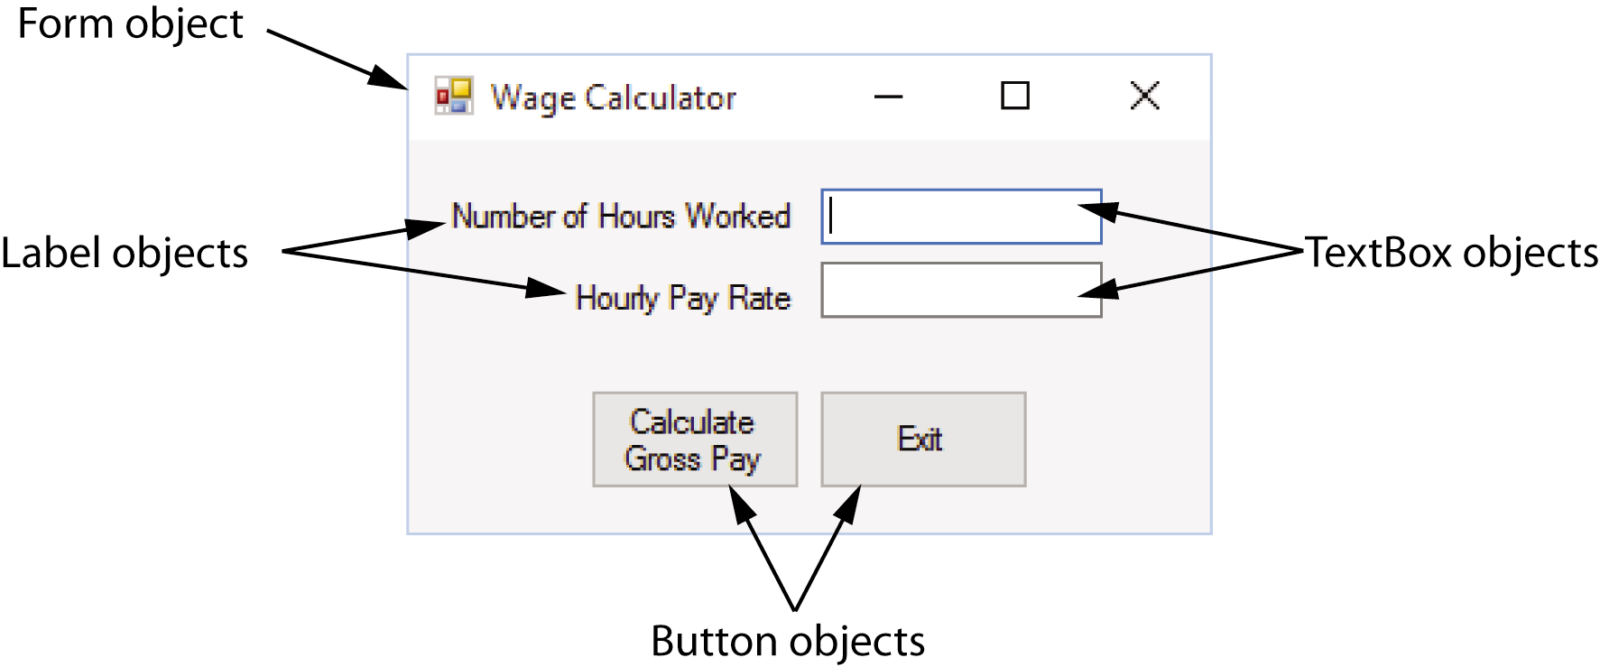
OBJECTs
Most programming languages use object-oriented programming in which a program component is called an “object”
Program objects have properties (or fields) and methods
Properties – data stored in an object
Methods – the operations an object can perform

Slide 7
Controls
Objects that are visible in a program GUI are known as controls
Commonly used controls are Labels, Buttons, and TextBoxes
They enhance the functionality of your programs
There are invisible objects in a GUI such as Timers, and OpenFileDialog

Slide 8
The program Development Process
The process of creating a program is known as the programming development cycle
It has six phases:
Understand the program’s purpose
Design the GUI
Design the program’s logic
Write the code
Correct syntax errors
Test the program and correct logic errors

