Slide 1

Fido Was Here
By
Sara Grillo
&
Giulia Valcamonica
Design and Implementation of Mobile Applications

Slide 2
The Idea
The purpose of our application is to help the lost Fidos(cats and dogs) to find their owners.
The application goals:
-Provide a platform where to report lost Fidos
-Provide a way to search for lost Fidos
-Provide a way to show statistics about lost Fidos
-Provide a simple and intuitive interface, suitable for everyone

Slide 3


The Platform
We’ve chosen Flutter framework that uses Dart as programming language. The reason is that Flutter allows to create cross-platform applications.

Slide 4
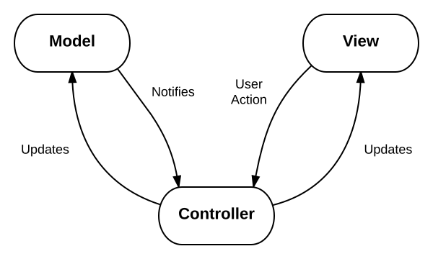
Model View Controller
We’ve chosen to use MVC so that our code could be more
readable and easier to update

Slide 5
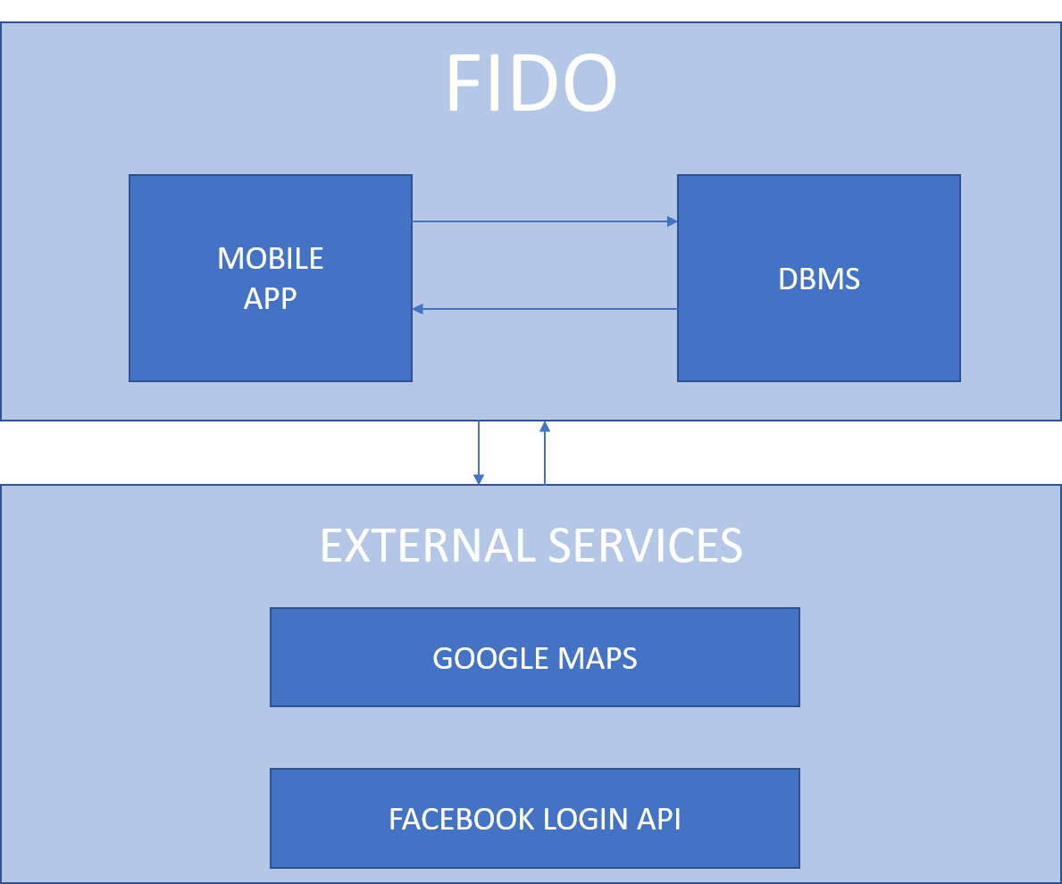
High Level Architecture

Slide 6

Database
FidoWasHere uses an external databases (Postgresql) hosted by Heroku websites

Slide 7

Functionalities
- User Authentication (mail and )
- Create and Access reports
- Close reports
- Look for reports
- Use GPS positions
- Build statistics

Slide 8


User Authentication
Mail & Password
Facebook

Slide 9
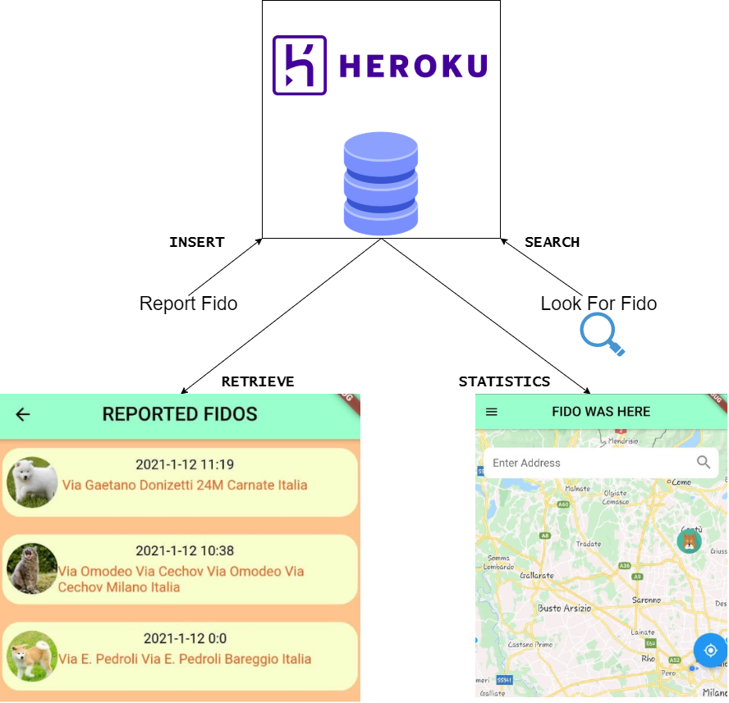
Usage of the Database

Slide 10


Reports
Two possible types of Fido
Objective: build an identikit of the lost Fido
To do this the application requires some information about:
Fido’s breed, Fido’s gender, Fido’s coat color,Fido’s photo, where it was found

Slide 11
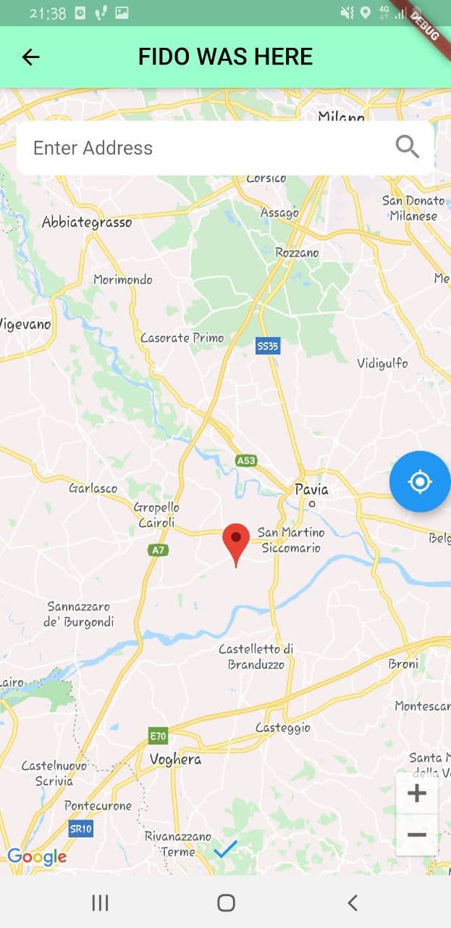
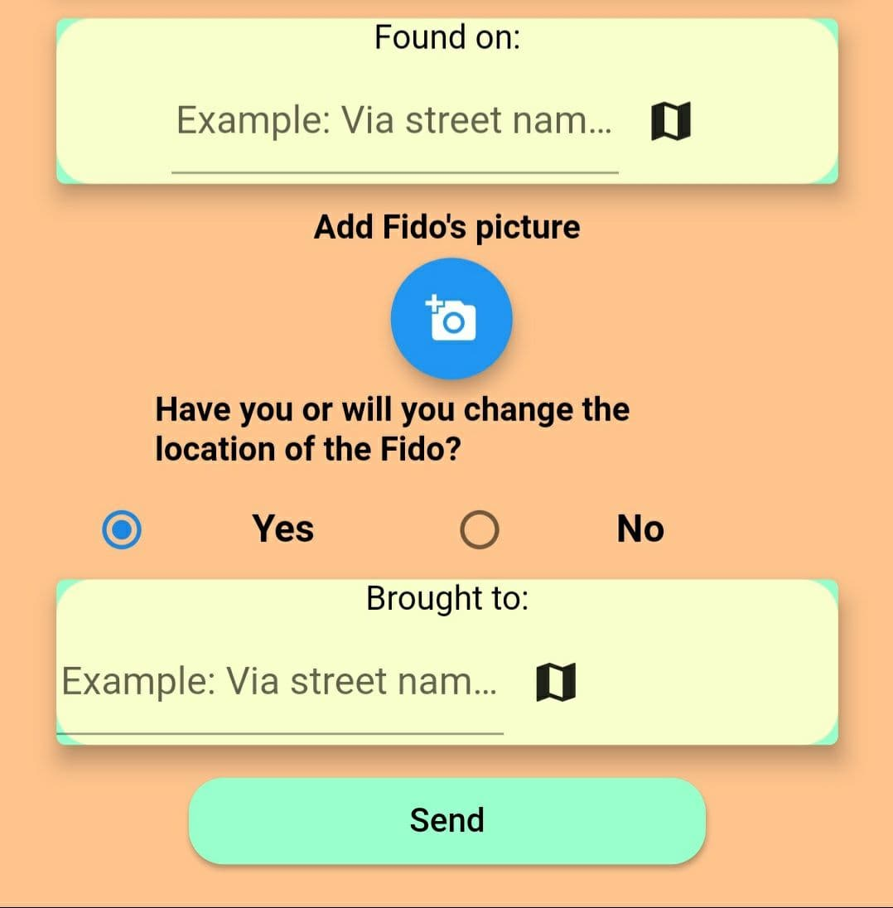

Google Maps
Google Maps API: display an interactive map, that can be scrolled or searched for a location
Markers can be added and visualized on the map while a user is filling a report

Slide 12
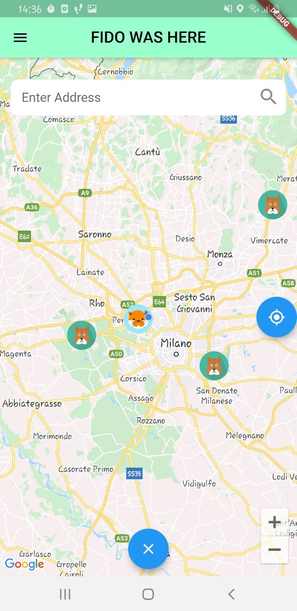
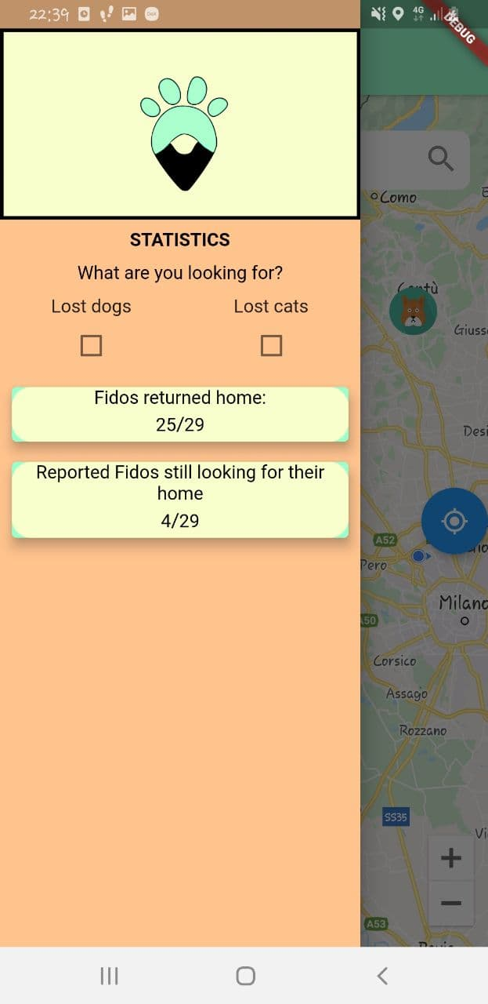
Statistics
The found locations
of the reported
Fidos can be visualized on the map
The visualized data
could varying accordingly
to the selected type of Fidos
In the statistics it’s possible to select the type of Fidos that a user wants to see and therefore visualize the markers of the corresponding reports on the map

Slide 13
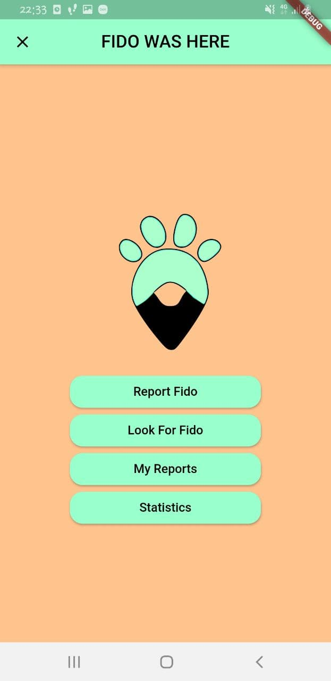
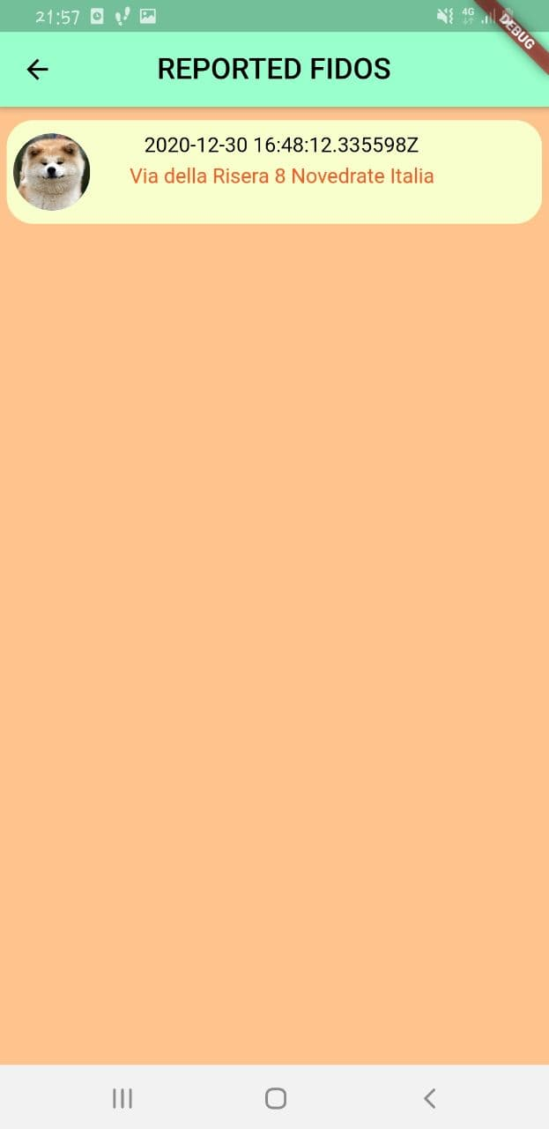
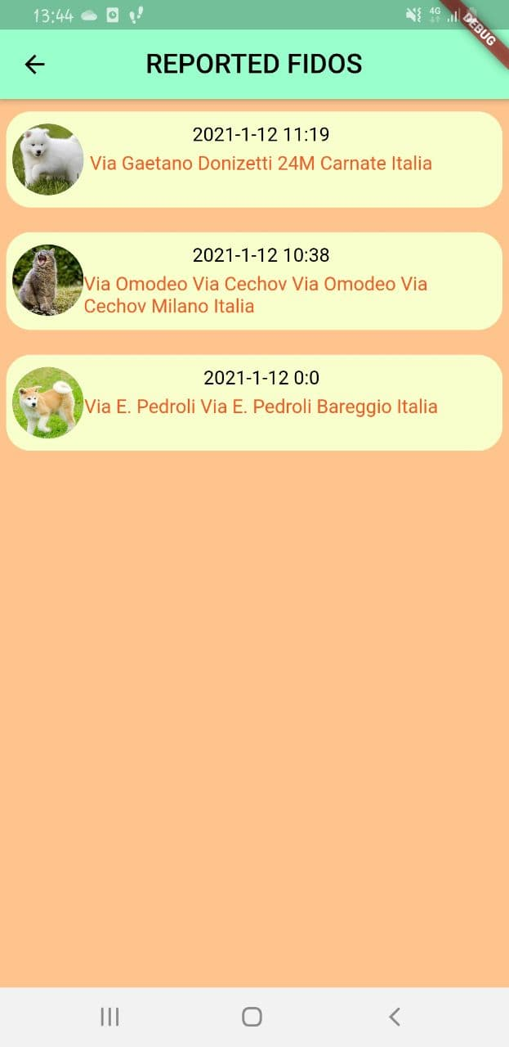
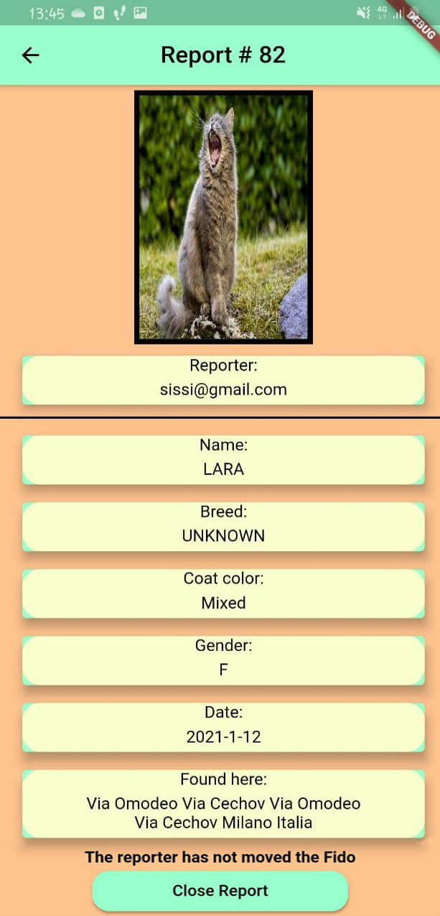
Close Reports

Slide 14
Possible expansions
Fido Was Here aims to be able to built report about any type of pets that people can possibly lost.
Another target is to be able to record also missing Fidos identikit along with reports, in such a way when a user builds a report it could be matched with the missing signalization and the owner can be immediately notified.

