Slide 1
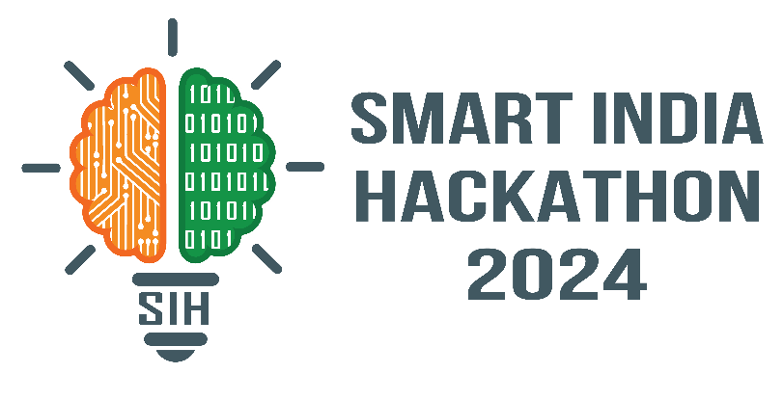
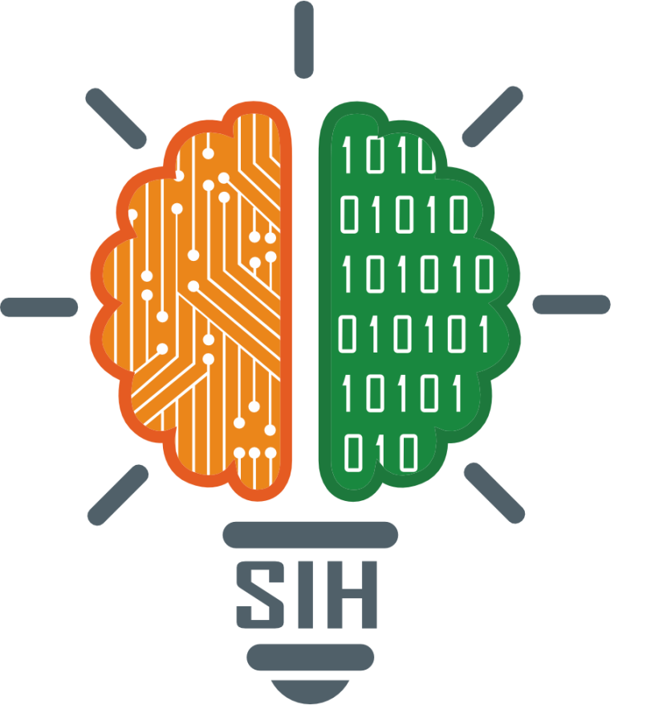
SMART INDIA HACKATHON 2024
Team Details and Problem Statement
Problem Statement ID - 1715
Problem Statement Title - AI tool/mobile app for Indian Sign Language(ISL) generator from audio-visual content in English/Hindi to ISL content and vise-versa.
Theme- Miscellaneous
PS Category- Software
Team ID- MUJSIH017
Team Name - Clueless Coders

Slide 2
Clueless Coders
Idea/Approach Details
Indian Sign Language (ISL) is a visual-gestural language used by deaf and hard-of-hearing individuals across India. It encompasses a rich vocabulary of hand movements, facial expressions and body postures to convey messaging.
Our solution is to Develop a user-friendly web/mobile app, which comprises models that translate from spoken language to Indian Sign Language (ISL) and vice-versa in real time. Tailored to help Deaf, Mute, Blind and Non-ISL individuals with effortless and swift interpersonal communication.
The project distinguishes itself by integration of LLMs for advanced text comprehension and (YOLOv4-CSP/Open CV) for precise gesture mapping, a novel application in this field. Leveraging these cutting-edge AI technologies ensures high accuracy and adaptability to diverse ISL nuances, including accurate gesture detection, clear speech extraction (using Nemo-Training, sbert, DeepSpeech) and precise conversation interconversion.
This solution bridges the communication gap between deaf and mute individuals who use ISL and those who communicate through spoken language. By providing a real-time, accurate conversion of speech to ISL, it facilitates effective communication in various settings such as education industry, public-transport, media (news and sports),etc. enhancing accessibility and inclusivity.
This integration provides real-time performance and a user-friendly interface, greatly enhancing communication between auditory-impaired, visually impaired, and auditory-abled communities.
To deal with different scenarios, we plan to integrate different pre-built and tuned open-sourced DL models to work and convert different forms of communication-inputs.
For Speech and Text conversion; Alphacephi is a low-resource model that can function perfectly well in very low resource equipment and is trained on multiple international and Indic languages.
The sbert(Indian Sentence Similarity) model is a very good STS model tuned for thousands of hours on major Indian languages and dialects. For models specific to certain accents and languages, AI4Bharat and Vakyansh provide very good tuned models.
For ISL Gestures conversion, YOLOv4-CSP model is preferred for its ease of access and parameterized. We will be fine tuning the model further according the ISL Alphabet databases to cater to different types of gestures. We are referring to established general ISL conversion models; at the word and speech level.
Finally for text Processing we will be using open-source language models like BERT, T5, etc. LLMs which are good at Language Processing.
MUJSIH017 - Clueless Coders
2

Slide 3
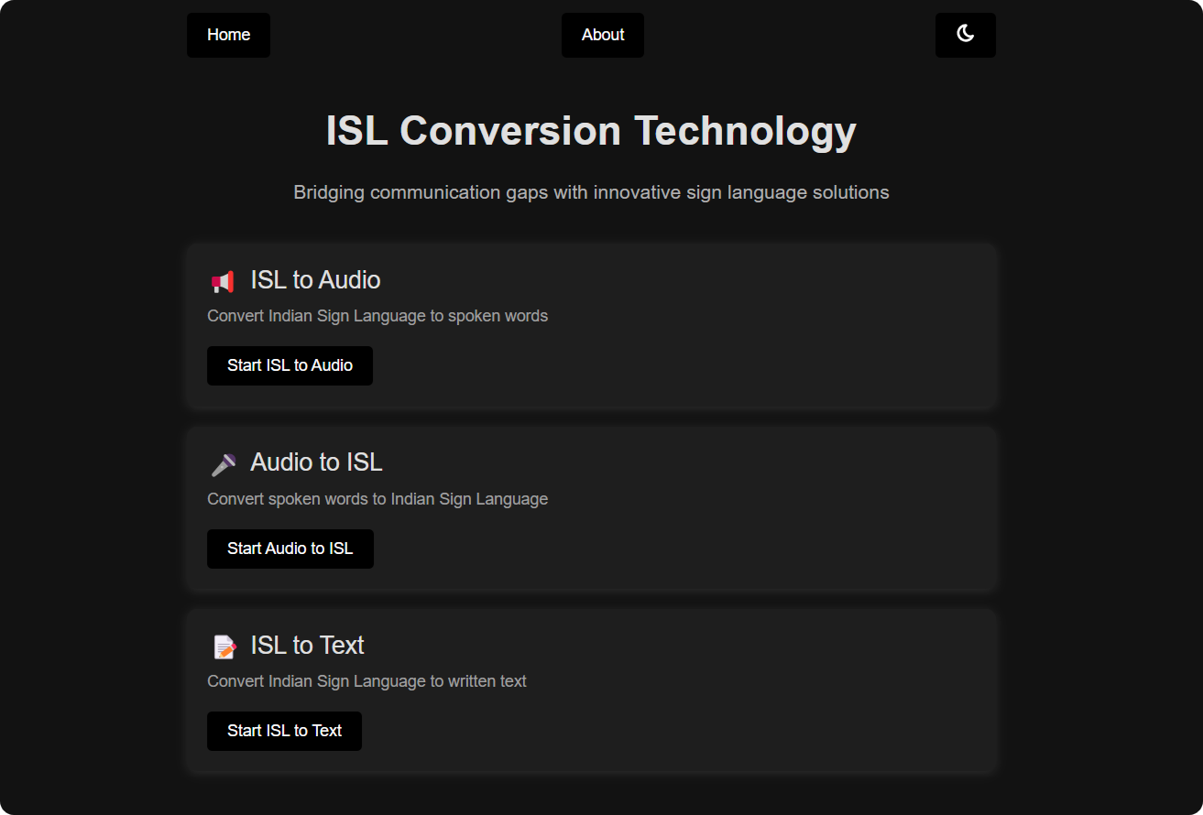
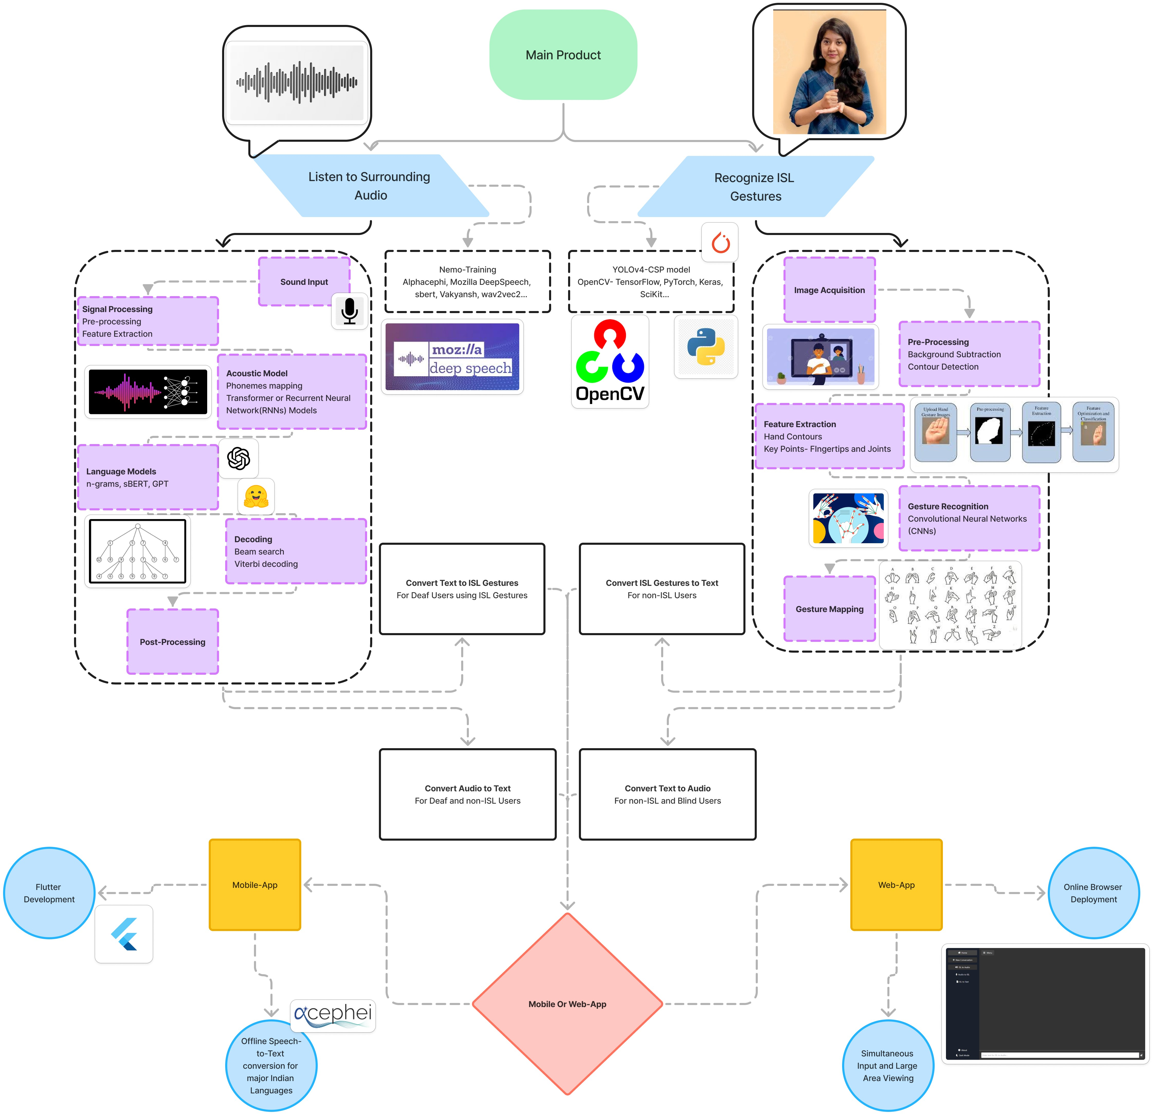
TECHNICAL APPROACH
Clueless Coders
TECH STACK:
Front-End: Flutter App-Development, React Native, JavaScript, ReactJS.
Back-End: Python, Kotlin, Swift, JS and TS.
Speech to Text- Nemo-Training, Alphacephi, Mozilla DeepSpeech, sbert, Vakyansh, wav2vec2, Talk-back-feature.
ISL to Text- YOLOv4-CSP model, OpenCV, TensorFlow, PyTorch, Keras, SciKit.
NLTK/Transformers- NLP Text Processing
LLAMA 3.1,RoBERTa, DistilBERT, XLNet, T5 models.
3. Data-Storage: MongoDB, AWS for permanent site and data hosting.

Slide 4
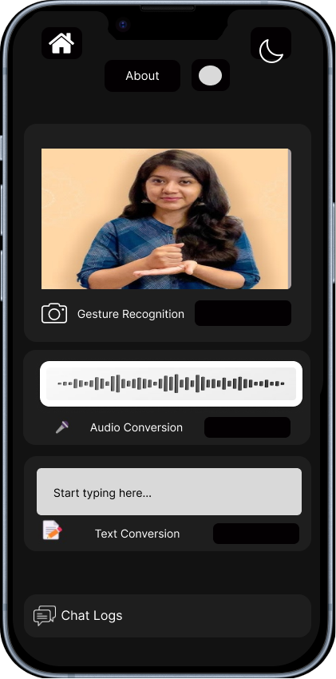
FEASIBILITY AND VIABILITY
Clueless Coders
Technical Feasibility:
Speech Recognition: Advanced but needs fine-tuning for diverse Indian accents.
ISL Gesture Generation: Requires deep understanding of ISL; real-time processing is challenging.
NLP & Computer Vision: Essential for accurate and real-time ISL conversion.
Using Talk-back feature for Clear speech inputs in crowded places.
Challenges & Risks:
Accuracy: Regional dialects, noise, and ISL grammar complexity.
Real-Time Processing: High computational demand on mobile devices.
User Adoption: Acceptance and ease of use among the deaf and mute community.
Privacy: Handling sensitive audio data.
Strategies:
Dataset Expansion: Train models on diverse regional accents.
Collaboration: Work with ISL experts for accurate gesture mapping.
Optimization: Develop lightweight models for better performance.
User-Centered Design: Engage with the community for feedback and adoption.

Slide 5
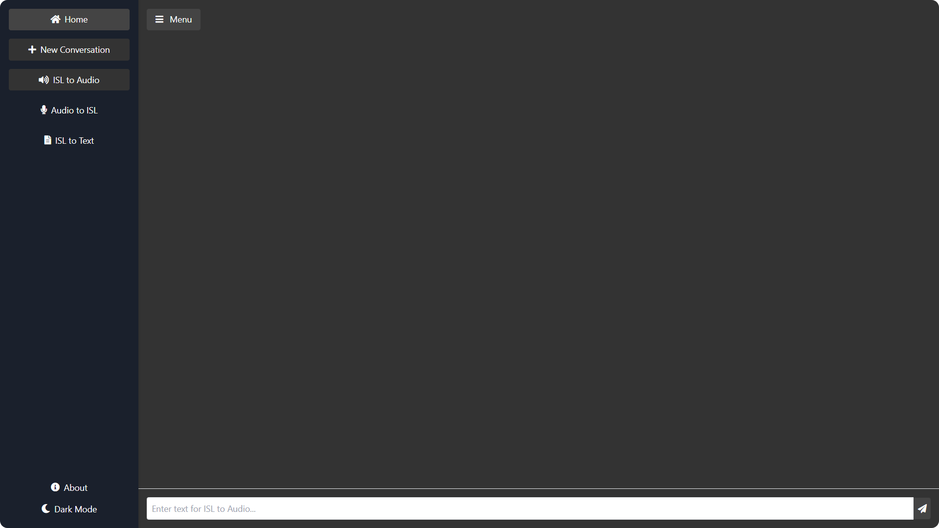
IMPACT AND BENEFITS
Clueless Coders
Potential Impact→
Enhanced Communication: Breaks barriers between differently-abled (deaf, blind) individuals and those unfamiliar with ISL, fostering inclusivity.
Increased Access: Enables the differently-abled communities to participate fully in education, healthcare, and daily interactions.
Benefits→
Social: Promotes equal opportunities and social integration for the deaf community.
Economic: Improves job prospects and educational outcomes by facilitating better communication.
Technological: Advances AI and language processing technologies, contributing to broader applications.
Environmental: Reduces the need for printed materials and interpreters in various settings, lowering carbon footprint.
Example Applications→
Railway Platform Display:
Develop an application that converts spoken announcements on railway platforms into ISL, allowing deaf individuals to understand them.
2. Mobile App for ISL interpretation :
Create a mobile app that uses a camera to help hearing individuals understand the sign language used by deaf individuals.

Slide 6




RESEARCH AND REFERENCES
Clueless Coders
Key Data Sources
Indian Sign Language Portal iSign
Dataset
ISL Research & Training Center
DePwd
Catalog | Open Government Data (OGD) Platform India
Pre-Built Models
AI4Bharat Models
Vakyansh Models
Alphacephi VOSK
Kaldi Speech Recognition
Mozilla DeepSpeech
Sbert
Research Papers
Indian Sign Language Translator using Gesture Recognition
NLP English to ISL Converter
Gesture to Text using SURF
ISL to Text Conversion
Harnessing AI to Generate Indian Sign Language from Natural Speech and Text
Gesture Conversion
Kaggle ISL Dataset
ISign Dataset-Paper
Word-Level ISL Detection
Speech to ISL Conversion
Speech to ISL web
Text to ISL App
ISL with CNNs
Any Model Can Talk
References
ISL Research and Training Center
Benchmark for ISL Processing
GitHub link

