Slide 1


Slide 2


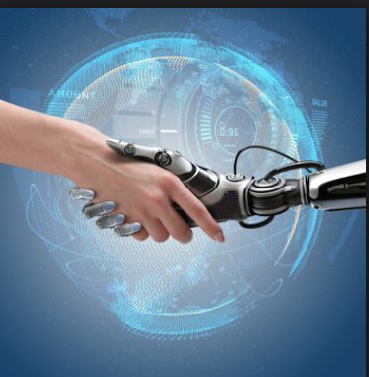
CROWN CARE

Slide 3

What are ChatBots?
A chatbot is a conversational agent that interacts with users using natural language.
Numerous applications of chatbots - Customer Service, call centers etc

Slide 4
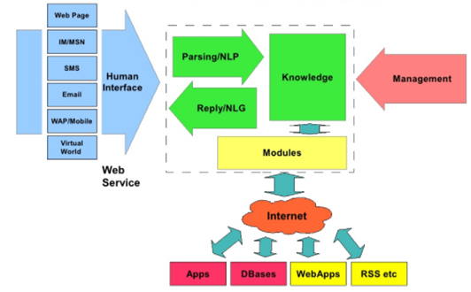
Flow Chart…

Slide 5
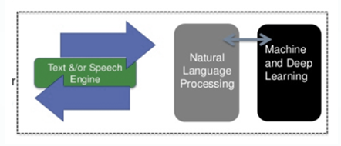

The Artificial Intelligence behind ChatBots

Slide 6
Need for ChatBots?
Widespread use of personal machines
Better Human Computer Interaction
“To express their interest, wishes, or queries directly and naturally, by speaking, typing, and pointing”.

Slide 7


Human Interaction Vs. ChatBots
Sometimes
Always Cool

Slide 8

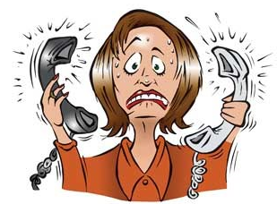



CROWN Team’s nature of work before ChatBot

Slide 9
CROWN Team - Category wise Analysis
Type of query | CALLS |  |  |  | MAILS |  |  |  | GRAND TOTAL
 | ONTIME | BEYOND TAT | TOTAL | CONT % | ONTIME | BEYOND TAT | TOTAL | CONT % | ONTIME | TOTAL | PERF%
AVAILABILITY/LEADTIME/IBTT | 251 | 0 | 251 | 4% | 31 | 0 | 31 | 2% | 282 | 282 | 100%
GENERAL ENQUIRIES | 310 | 0 | 310 | 5% | 134 | 0 | 134 | 8% | 444 | 444 | 100%
MAJOR MODIFICATION | 1355 | 106 | 1461 | 25% | 337 | 51 | 388 | 24% | 1692 | 1849 | 92%
MINOR MODIFICATION | 1182 | 51 | 1233 | 21% | 354 | 27 | 381 | 24% | 1536 | 1614 | 95%
NEW DESIGN | 55 | 0 | 55 | 1% | 95 | 12 | 107 | 7% | 150 | 162 | 93%
ORDER STATUS | 2336 | 102 | 2438 | 42% | 521 | 31 | 552 | 35% | 2857 | 2990 | 96%
Grand Total | 5489 | 259 | 5748 | 95% | 1472 | 121 | 1593 | 92% | 6961 | 7341 | 95%

Slide 10
Category wise Pareto chart Analysis

Slide 11
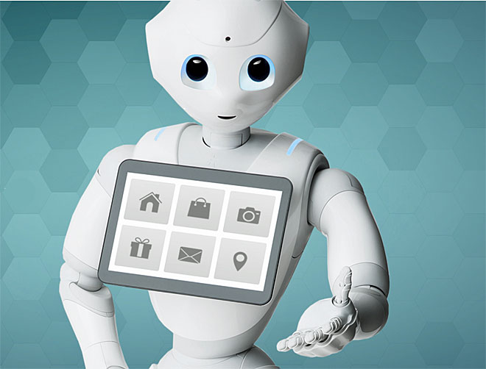



Post ChatBot Implementation ……
URB
ADH
HST

Slide 12
Benefits of ChatBots to CROWN Team
Expected to address 41% of Queries from RSO’s through ChatBot
Reduction of calls lodging with helpdesk
Manpower utilization for value added service.
(Example confirming modification production possibility for order conversion )
Hands on information for RSO
Reduced dependency of CROWN
Instant service to the customer
Improve the customer satisfaction / our service to Retail team

Slide 13
Challenges
K no w
Success

