Slide 1


Slide 2

UML

Slide 3
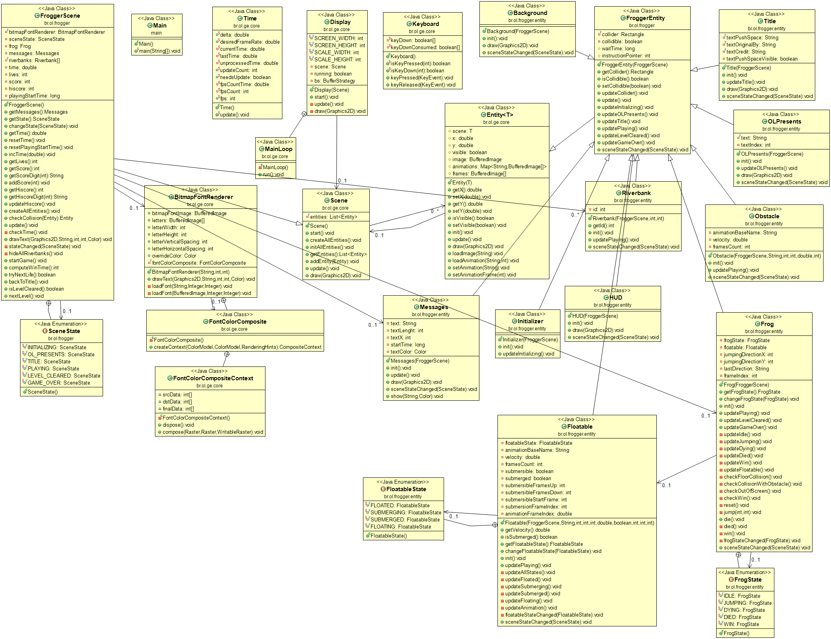

Slide 4
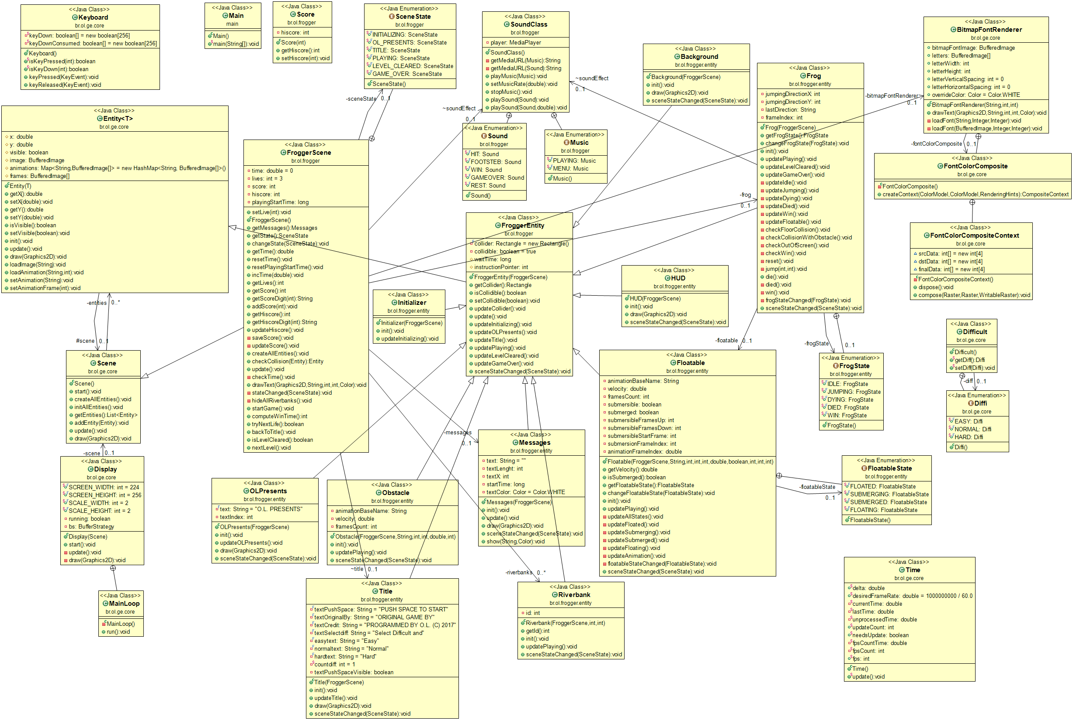

Slide 5
GAME PLAY

Slide 6
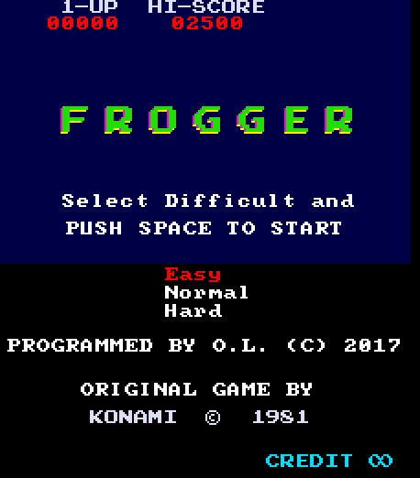
MENU

Slide 7
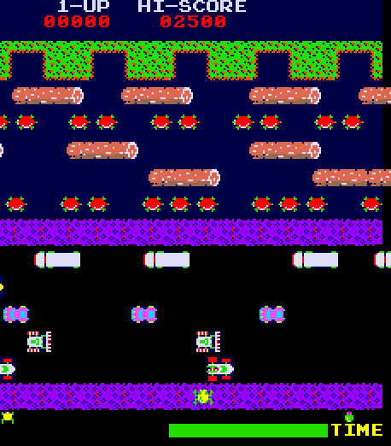
EASY MODE

Slide 8
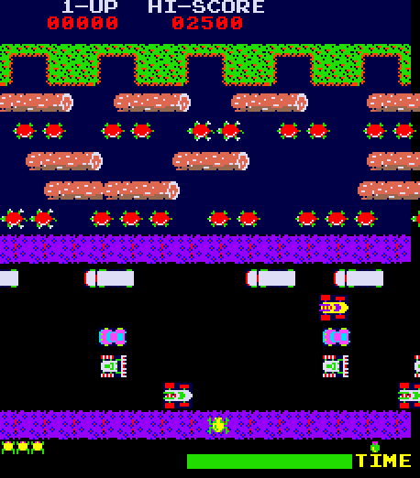
NORMAL MODE

Slide 9
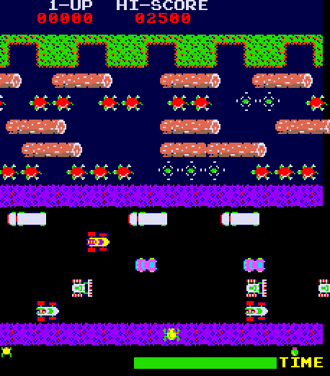
HARD MODE

Slide 10
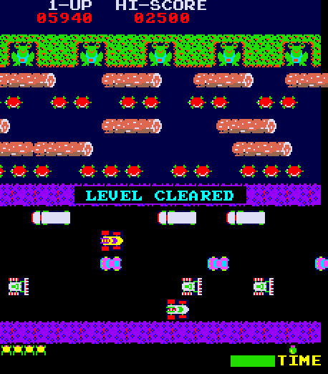
LEVEL CLEARD

