Slide 1

A First Book of ANSI C
Fourth Edition
Chapter 3
Processing and Interactive Input

Slide 2
Objectives
Assignment
Mathematical Library Functions
Interactive Input
Formatted Output
Symbolic Constants
Case Study: Interactive Input
Common Programming and Compiler Errors

Slide 3
Assignment
The general syntax for an assignment statement is
  variable = operand;
  The operand to the right of the assignment operator (=) can be a constant, a variable, or an expression
The equal sign in C does not have the same meaning as an equal sign in algebra
  length=25; is read “length is assigned the value 25”
Subsequent assignment statements can be used to change the value assigned to a variable
    length = 3.7;
    length = 6.28;

Slide 4
Assignment (continued)
The operand to the right of the equal sign in an assignment statement can be a variable or any valid C expression
  sum = 3 + 7;
  product = .05 * 14.6;
    The value of the expression to the right of = is computed first and then the calculated value is stored in the variable to the left of =
Variables used in the expression to the right of the = must be initialized if the result is to make sense
amount + 1892 = 1000 + 10 * 5 is invalid!

Slide 5
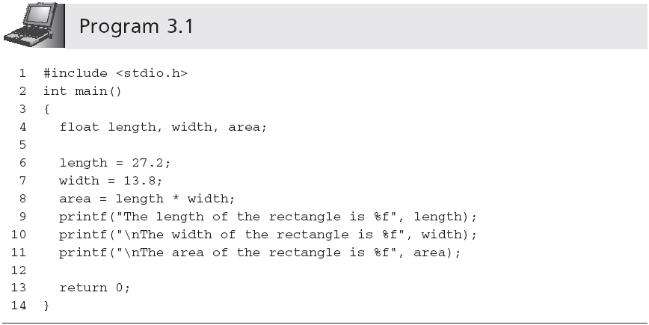
Assignment (continued)
If width was not initialized, the computer uses the value that happens to occupy that memory space previously (compiler would probably issue a warning)

Slide 6
Assignment (continued)
= has the lowest precedence of all the binary and unary arithmetic operators introduced in Section 2.4
Multiple assignments are possible in the same statement
  a = b = c = 25;
    All = operators have the same precedence
    Operator has right-to-left associativity
      c = 25;
      b = c;
      a = b;

Slide 7
Implicit Type Conversions
Data type conversions take place across assignment operators
  double result;
  result = 4; //integer 4 is converted to 4.0
The automatic conversion across an assignment operator is called an implicit type conversion
  int answer;
  answer = 2.764; //2.764 is converted to 2
  Here the implicit conversion is from a higher precision to a lower precision data type; the compiler will issue a warning

Slide 8
Explicit Type Conversions (Casts)
The operator used to force the conversion of a value to another type is the cast operator
  (dataType) expression
    where dataType is the desired data type of the expression following the cast
Example:
  If sum is declared as double sum;, (int) sum is the integer value determined by truncating sum’s fractional part

Slide 9
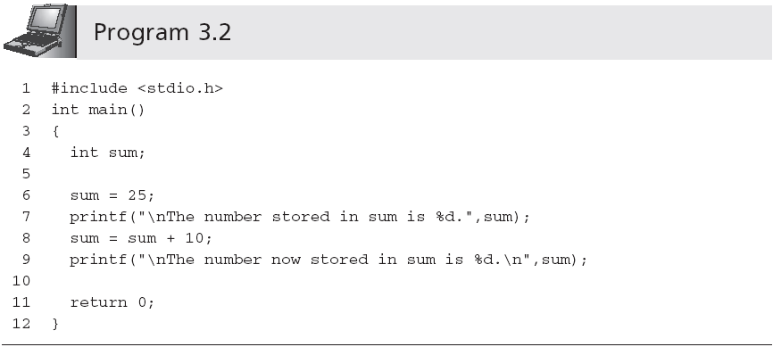
Assignment Variations
sum = sum + 10 is not an equation—it is an expression that is evaluated in two major steps

Slide 10
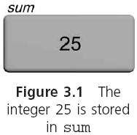
Assignment Variations (continued)

Slide 11
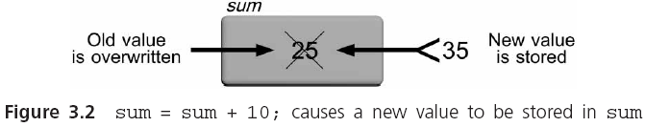
Assignment Variations (continued)

Slide 12
Assignment Variations (continued)
Assignment expressions like sum = sum + 25 can be written using the following operators:
  += -= *= /= %=
sum = sum + 10 can be written as sum += 10
price *= rate is equivalent to price = price * rate
price *= rate + 1 is equivalent to price = price * (rate + 1)

Slide 13
Accumulating(累加)
The first statement initializes sum to 0
  This removes any previously stored value in sum that would invalidate the final total
  A previously stored number, if it has not been initialized to a specific and known value, is frequently called a garbage value

Slide 14
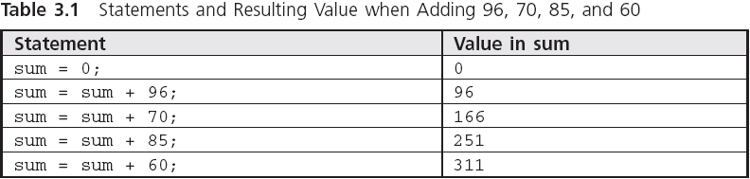
Accumulating (continued)

Slide 15
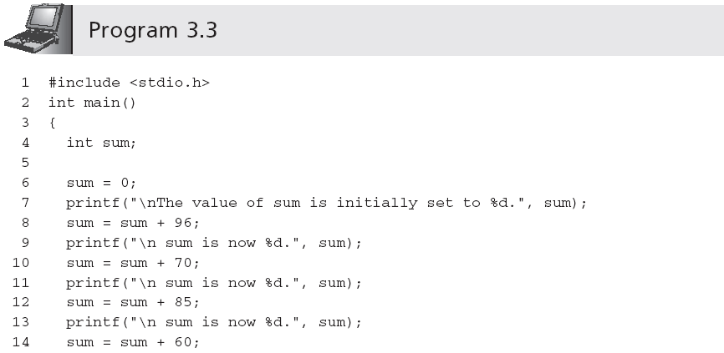
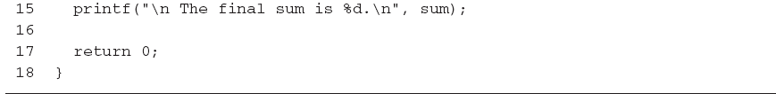
Accumulating (continued)

Slide 16
Counting(计数)
A counting statement is very similar to the accumulating statement
  variable = variable + fixedNumber;
Examples: i = i + 1; and m = m + 2;
Increment operator (++): variable = variable + 1 can be replaced by variable++ or ++variable

Slide 17
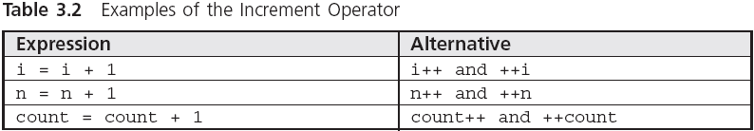
Counting (continued)

Slide 18
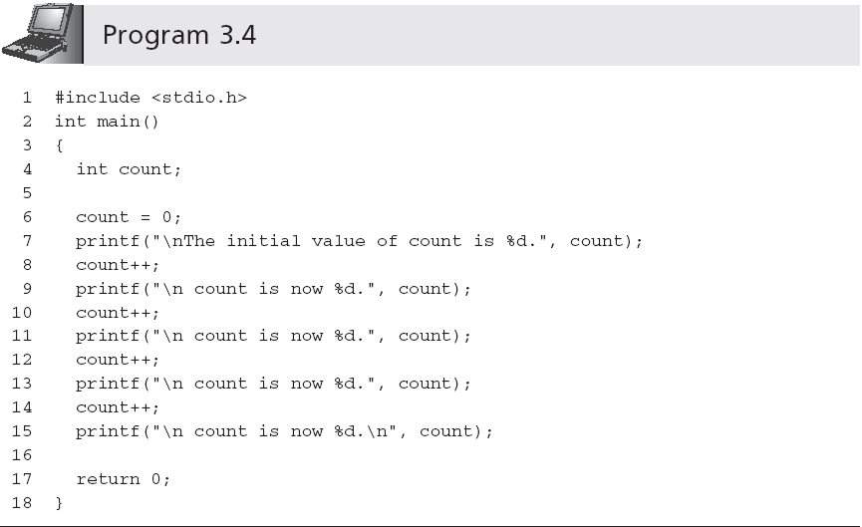
Counting (continued)

Slide 19
Counting (continued)
When the ++ operator appears before a variable, it is called a prefix increment operator; when it appears after a variable, it is called postfix increment operator
  k = ++n; is equivalent to
    n = n + 1; // increment n first
    k = n; // assign n's value to k
  k = n++; is equivalent to
    k = n; // assign n's value to k
    n = n + 1; // and then increment n

Slide 20
Counting (continued)
Prefix decrement operator: the expression k = --n first decrements the value of n by 1 before assigning the value of n to k
Postfix decrement operator: the expression k = n-- first assigns the current value of n to k and then reduces the value of n by 1

Slide 21
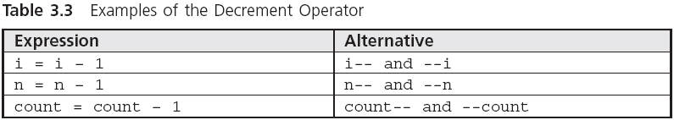
Counting (continued)

Slide 22
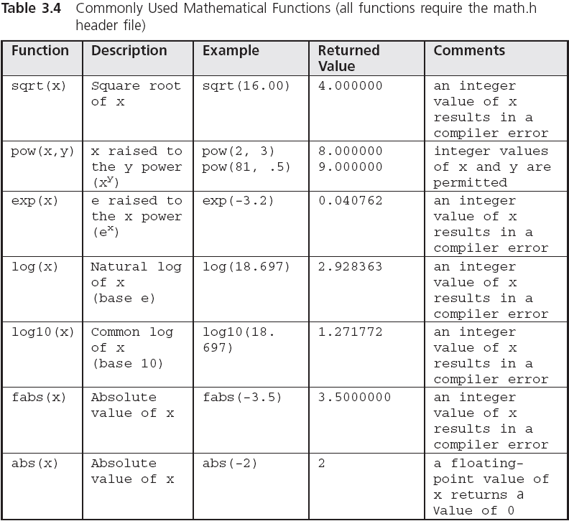
Mathematical Library Functions

Slide 23
Mathematical Library Functions (continued)
The argument to sqrt must be floating-point value; passing an integer value results in a compiler error
  Return value is double-precision
Must include #include <math.h>

Slide 24
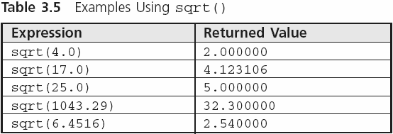
Mathematical Library Functions (continued)

Slide 25
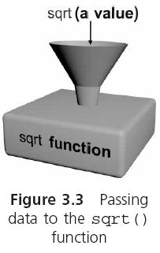
Mathematical Library Functions (continued)

Slide 26
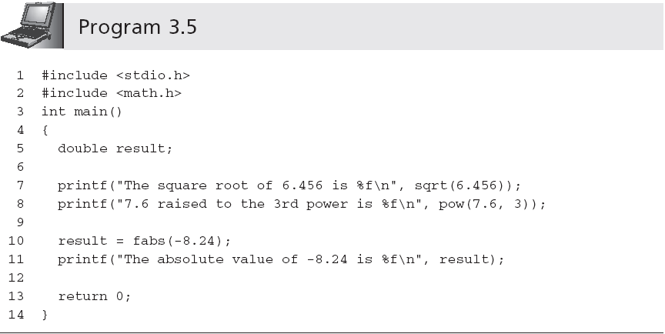
Mathematical Library Functions (continued)
Argument need not be a single constant

Slide 27
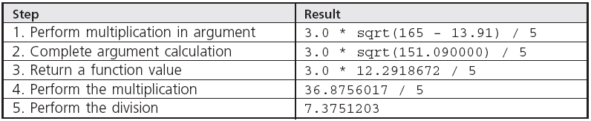
Mathematical Library Functions (continued)
The step-by-step evaluation of the expression
  3.0 * sqrt(5 * 33 - 13.91) / 5

Slide 28
Mathematical Library Functions (continued)
Determine the time it takes a ball to hit the ground after it has been dropped from an 800-foot tower
  time = sqrt(2 * distance/g), where g = 32.2 ft/sec2

Slide 29
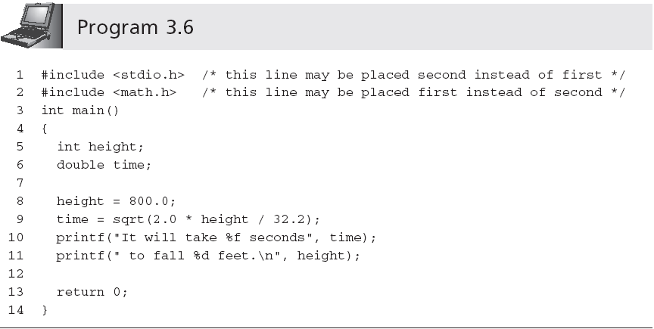
Mathematical Library Functions (continued)

Slide 30
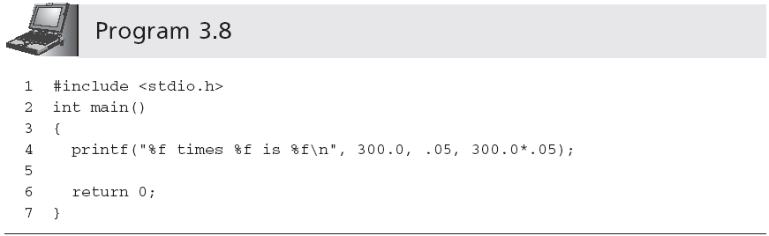
Interactive Input

Slide 31
Interactive Input (continued)
This program must be rewritten to multiply different numbers
scanf() is used to enter data into a program while it is executing; the value is stored in a variable
  It requires a control string as the first argument inside the function name parentheses

Slide 32
Interactive Input (continued)
The control string passed to scanf() typically consists of conversion control sequences only
scanf() requires that a list of variable addresses follow the control string
  scanf("%d", &num1);

Slide 33
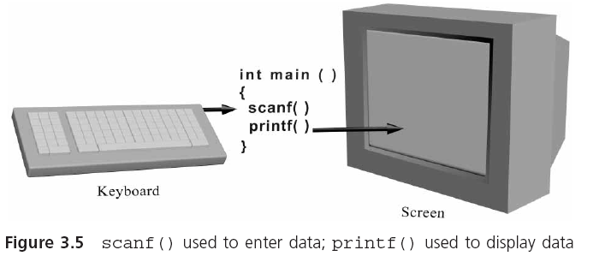
Interactive Input (continued)

Slide 34
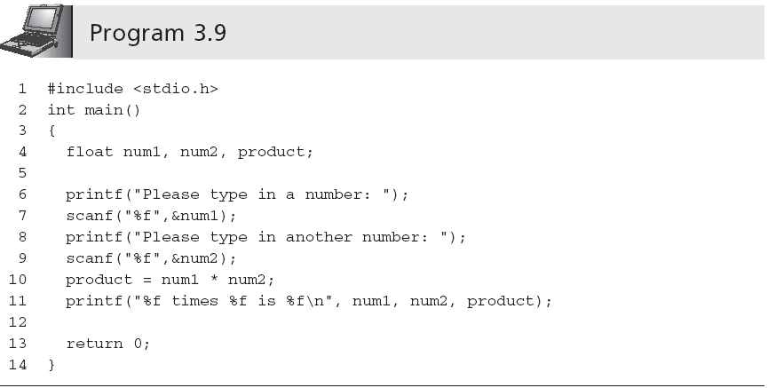
Interactive Input (continued)
This statement produces a prompt
Address operator (&)

Slide 35
Interactive Input (continued)
scanf() can be used to enter many values
  scanf("%f %f",&num1,&num2); //"%f%f" is the same
A space can affect what the value being entered is when scanf() is expecting a character data type
  scanf("%c%c%c",&ch1,&ch2,&ch3); stores the next three characters typed in the variables ch1, ch2, and ch3; if you type x y z, then x is stored in ch1, a blank is stored in ch2, and y is stored in ch3
  scanf("%c %c %c",&ch1,&ch2,&ch3); causes scanf() to look for three characters, each character separated by exactly one space

Slide 36
Interactive Input (continued)
In printing a double-precision number using printf(), the conversion control sequence for a single-precision variable, %f, can be used
When using scanf(), if a double-precision number is to be entered, you must use the %lf conversion control sequence
scanf() does not test the data type of the values being entered
In scanf("%d %f", &num1, &num2), if user enters 22.87, 22 is stored in num1 and .87 in num2

Slide 37
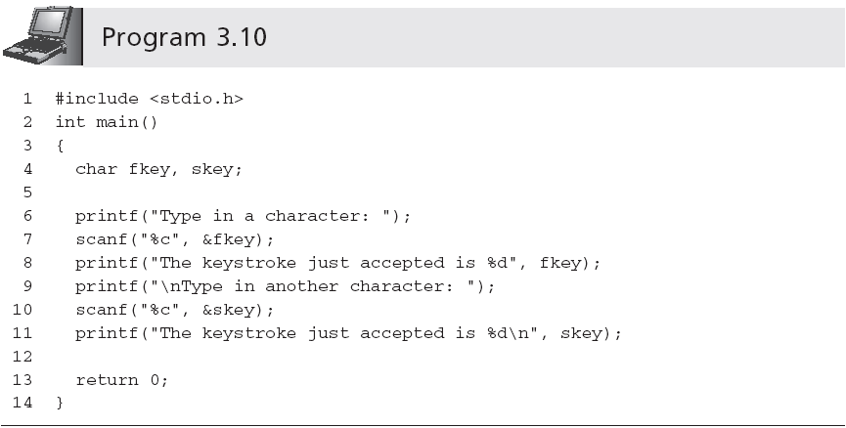
Caution: The Phantom Newline Character
  Type in a character: m
  The keystroke just accepted is 109
  Type in another character: The keystroke just accepted is 10

Slide 38
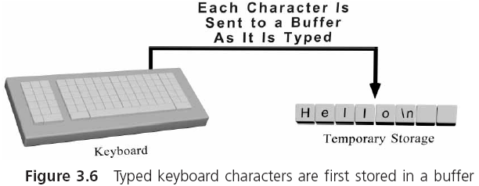
Caution: The Phantom Newline Character (continued)

Slide 39
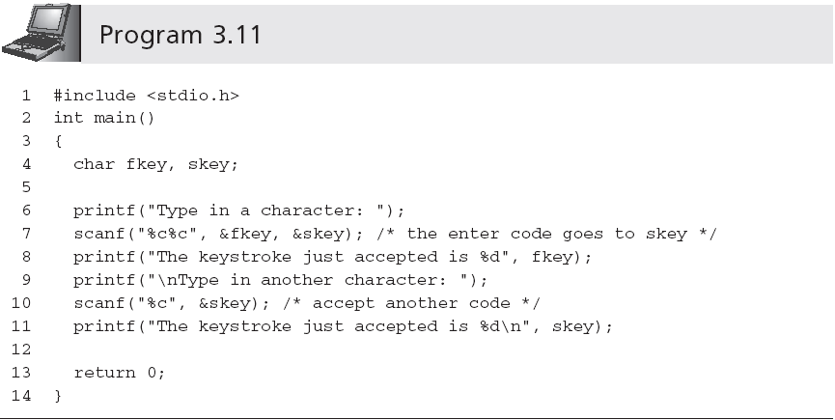
Caution: The Phantom Newline Character (continued)

Slide 40
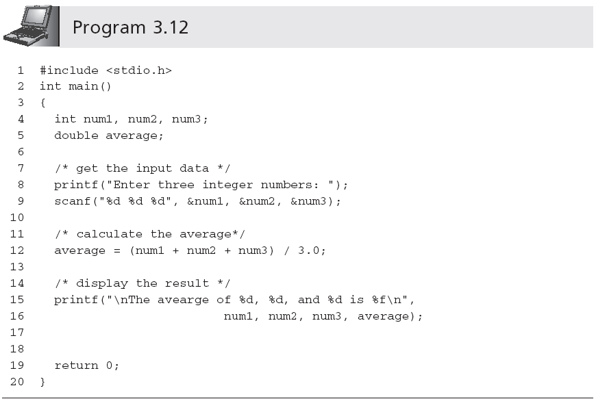
A First Look at User-Input Validation (用户输入确认)

Slide 41
A First Look at User-Input Validation(用户输入确认)
As written, Program 3.12 is not robust健全的
The problem becomes evident when a user enters a non-integer value
  Enter three integer numbers: 10 20.68 20
  The average of 10, 20, and -858993460 is -286331143.333333
Handling invalid data input is called user-input validation
  Validating the entered data either during or immediately after the data have been entered

Slide 42
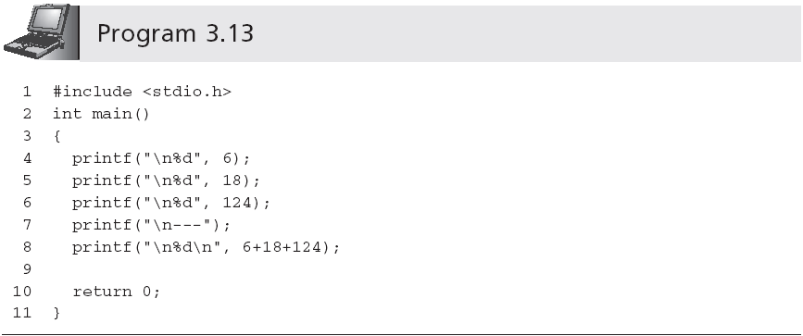
Formatted Output
6
18
124
---
148
Output is not aligned 对准

Slide 43
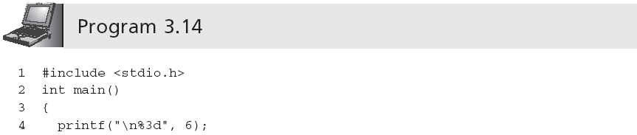
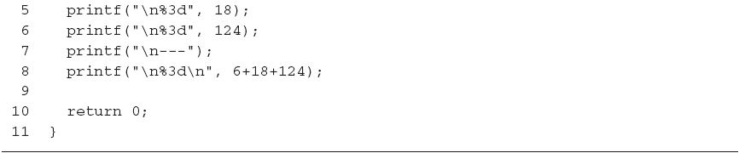
Formatted Output (continued)
Field width specifier
6
18
124
---
148

Slide 44
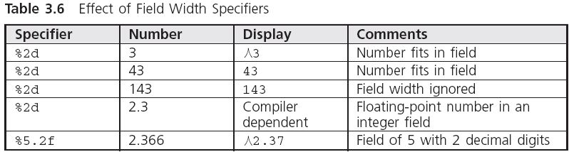
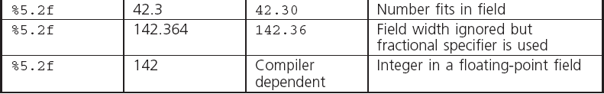
Formatted Output (continued)

Slide 45
Format Modifiers
Left justification: printf("%-10d",59); produces the display 59٨٨٨٨٨٨٨٨
Explicit sign display: printf("%+10d",59); produces the display ٨٨٨٨٨٨٨+59
Format modifiers may be combined
  %-+10d would cause an integer number to both display its sign and be left-justified in a field width of 10 spaces
    The order of the format modifiers is not critical
      %+-10d is the same

Slide 46
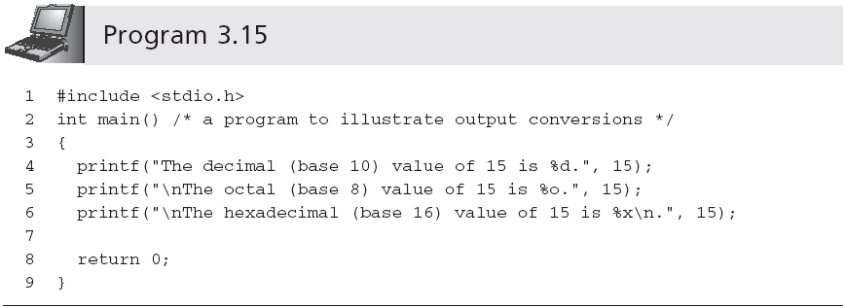
Other Number Bases [Optional]
The decimal (base 10) value of 15 is 15.
The octal (base 8) value of 15 is 17.
The hexadecimal (base 16) value of 15 is f.

Slide 47
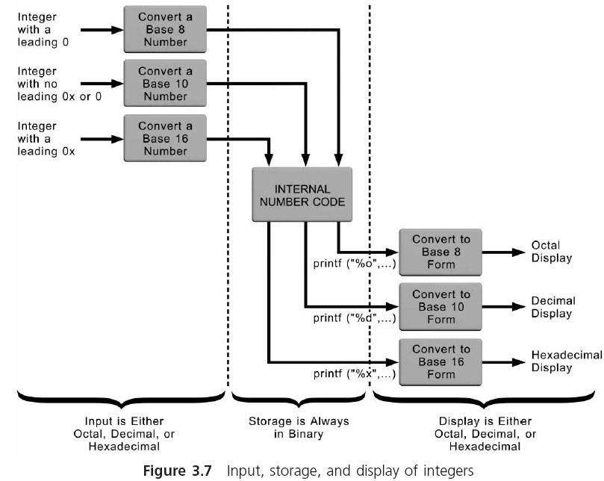
Other Number Bases (continued)

Slide 48
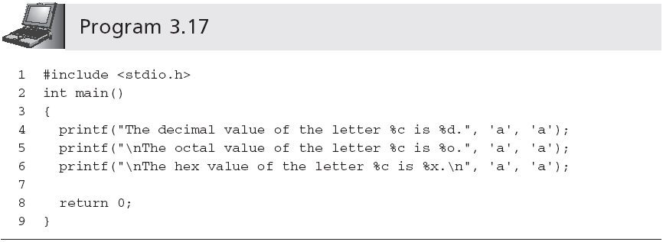
Other Number Bases (continued)
The decimal value of the letter a is 97.
The octal value of the letter a is 141.
The hex value of the letter a is 61.

Slide 49
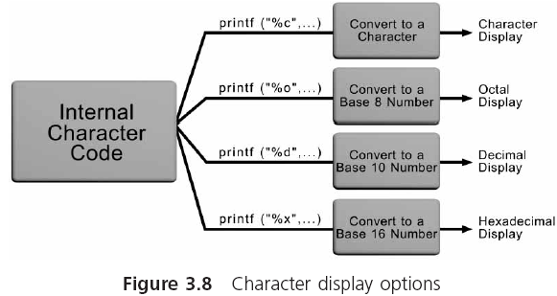
Other Number Bases (continued)

Slide 50
Symbolic Constants
Literal data refers to any data within a program that explicitly identifies itself
Literal values that appear many times in the same program are called magic numbers
C allows you to define the value once by equating the number to a symbolic name（符号名）
  #define SALESTAX 0.05
  #define PI 3.1416
  Also called symbolic constants and named constants

Slide 51
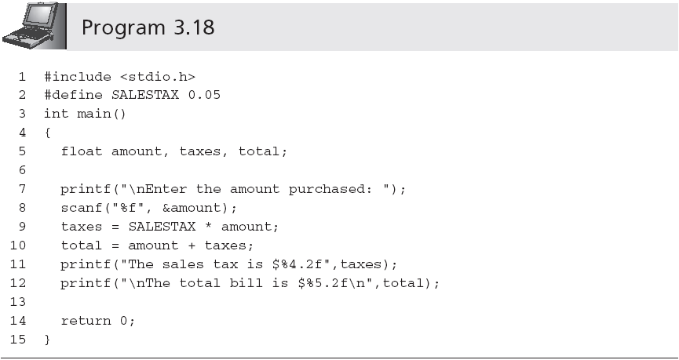
Symbolic Constants (continued)
# sign is a signal to a C preprocessor

Slide 52
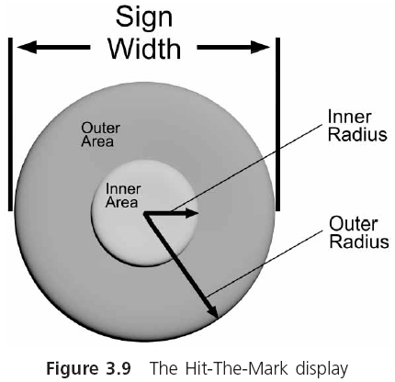
Case Study: Interactive Input

Slide 53
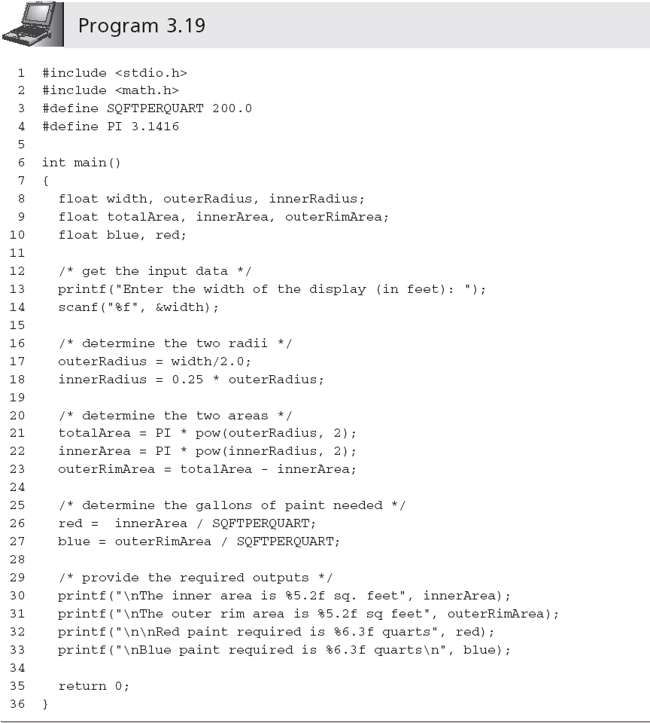
Case Study: Interactive Input (continued)

Slide 54
Common Programming Errors
Forgetting to assign initial values to all variables before the variables are used in an expression
Calling sqrt() with an integer argument
Forgetting to use the address operator, &, in front of variable names in a scanf() function call
Not including the correct control sequences in scanf() function calls for the data values that must be entered
Including a message within the control string passed to scanf()

Slide 55
Common Programming Errors (continued)
Terminating a #define command to the preprocessor with a semicolon
Placing an equal sign in a #define command when equating a symbolic constant to a value
Using the increment and decrement operators with variables that appear more than once in the same expression
Being unwilling to test a program in depth

Slide 56
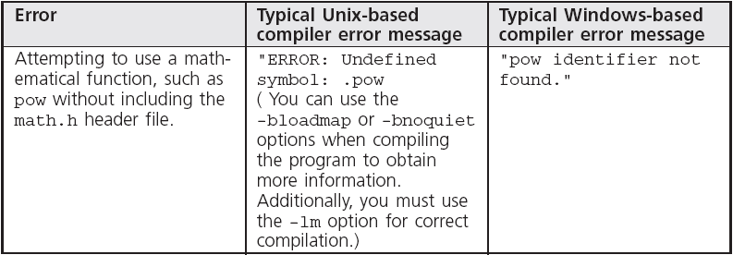
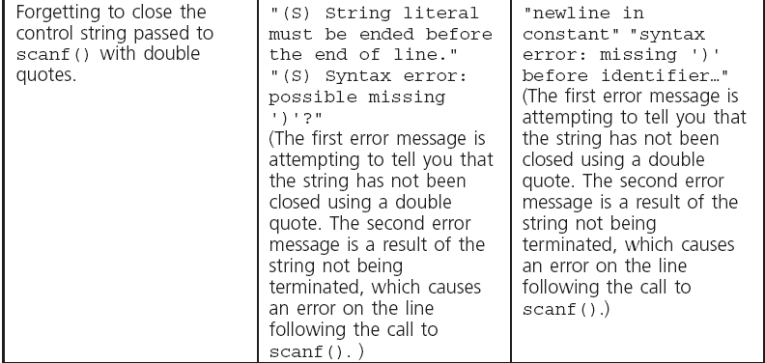
Common Compiler Errors

Slide 57
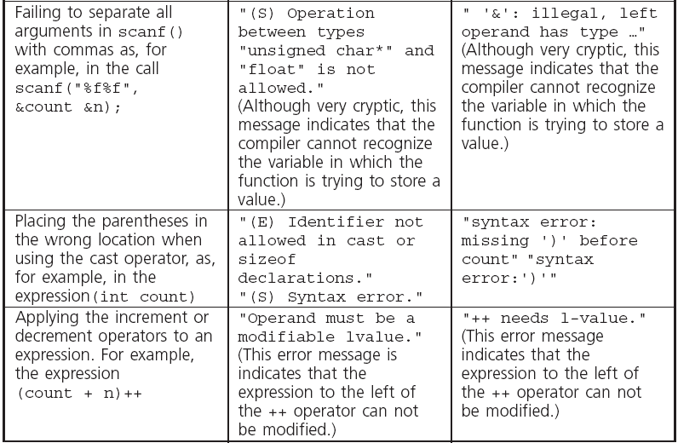
Common Compiler Errors (continued)

Slide 58
Summary
Arithmetic calculations can be performed using assignment statements or mathematical functions
The assignment symbol, =, is an operator
C provides the +=, -=, *= and /= assignment operators
The increment operator, ++, adds 1 to a variable
The decrement operator, --, subtracts 1 from a variable
C provides library functions for calculating square root, logarithmic, and other mathematical computations

Slide 59
Summary (continued)
Mathematical functions may be included within larger expressions
scanf() is a standard library function used for data input
When a scanf() function is encountered, the program temporarily suspends further statement execution until sufficient data has been entered for the number of variable addresses contained in the scanf() function call

Slide 60
Summary (continued)
It is good programming practice to display a message, prior to a scanf() function call, that alerts the user as to the type and number of data items to be entered
Field width specifiers can be included with conversion control sequences to explicitly specify the format of displayed fields
Each compiled C program is automatically passed through a preprocessor
Expressions can be made equivalent to a single identifier using the preprocessor #define command

