Slide 1
A First Book of ANSI C
Fourth Edition
Chapter 8
Arrays

Slide 2
Objectives
One-Dimensional Arrays
Array Initialization
Arrays as Function Arguments
Case Study: Computing Averages and Standard Deviations
Two-Dimensional Arrays
Common Programming and Compiler Errors
A First Book of ANSI C, Fourth Edition

Slide 3
Introduction
Atomic variable: variable whose value cannot be further subdivided into a built-in data type
  Also called a scalar variable(标量变量)
Data structure (aggregate data type): data type with two main characteristics
  Its values can be decomposed into individual data elements, each of which is either atomic or another data structure
  It provides an access for locating individual data elements within the data structure
A First Book of ANSI C, Fourth Edition

Slide 4
Introduction (continued)
One of the simplest data structures, called an array, is used to store and process a set of values, all of the same data type, that forms a logical group
A First Book of ANSI C, Fourth Edition

Slide 5
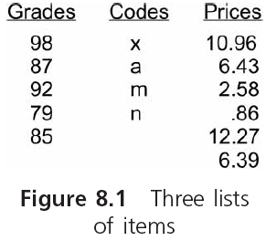
Introduction (continued)
A First Book of ANSI C, Fourth Edition

Slide 6
One-Dimensional Arrays
A one-dimensional array, also called a single-dimensional array and a single-subscript array, is a list of values of the same data type that is stored using a single group name
A First Book of ANSI C, Fourth Edition

Slide 7

填空题
2分
A(n) __ [填空1] __ array is a list of values of the same data type that is stored using a single group name.
Each item in an array is called a(n) __ [填空2] ___ or component of the array.
正常使用填空题需3.0以上版本雨课堂
A First Book of ANSI C, Fourth Edition
作答

Slide 8
One-Dimensional Arrays (continued)
To create a one-dimensional array:
  #define NUMELS 5
  int grades[NUMELS];
In C, the starting index value for all arrays is 0
Each item in an array is called an element or component of the array
Any element can be accessed by giving the name of the array and the element’s position
  The position is the element’s index or subscript
  Each element is called an indexed variable(索引变量) or a subscripted variable(下标变量)
A First Book of ANSI C, Fourth Edition

Slide 9
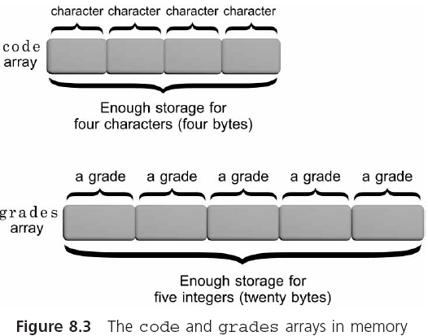
One-Dimensional Arrays (continued)
A First Book of ANSI C, Fourth Edition

Slide 10
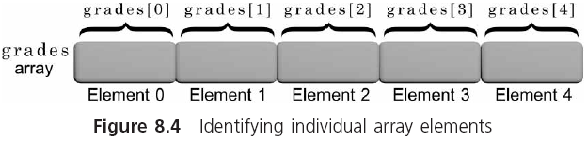
One-Dimensional Arrays (continued)
A First Book of ANSI C, Fourth Edition

Slide 11
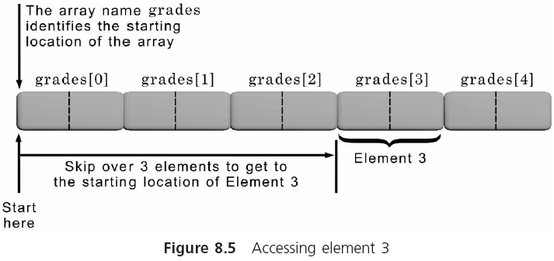
One-Dimensional Arrays (continued)
A First Book of ANSI C, Fourth Edition

Slide 12
One-Dimensional Arrays (continued)
Subscripted variables can be used anywhere scalar variables are valid
  grades[0] = 98;
  grades[1] = grades[0] - 11;
Any expression that evaluates an integer may be used as a subscript
  #define NUMELS 5
  total = 0; /* initialize total to zero */
  for (i = 0; i < NUMELS; i++)
  total = total + grades[i]; /* add a grade */
A First Book of ANSI C, Fourth Edition

Slide 13
Input and Output of Array Values
Individual array elements can be assigned values using individual assignment statements or, interactively, using the scanf() function
    #define NUMELS 5
    for(i = 0; i < NUMELS; i++)
    {
    printf("Enter a grade: ");
    scanf("%d", &grades[i]);
    }
Be careful: C does not check the value of the index being used (called a bounds check(上下界检查 )
A First Book of ANSI C, Fourth Edition

Slide 14
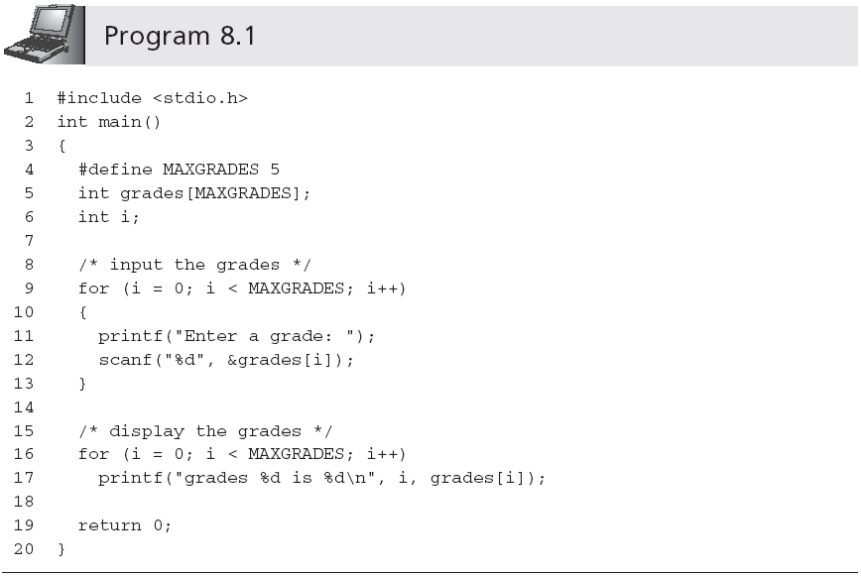
Input and Output of Array Values (continued)
Sample output:
Enter a grade: 85
Enter a grade: 90
Enter a grade: 78
Enter a grade: 75
Enter a grade: 92
grades 0 is 85
grades 1 is 90
grades 2 is 78
grades 3 is 75
grades 4 is 92
A First Book of ANSI C, Fourth Edition

Slide 15
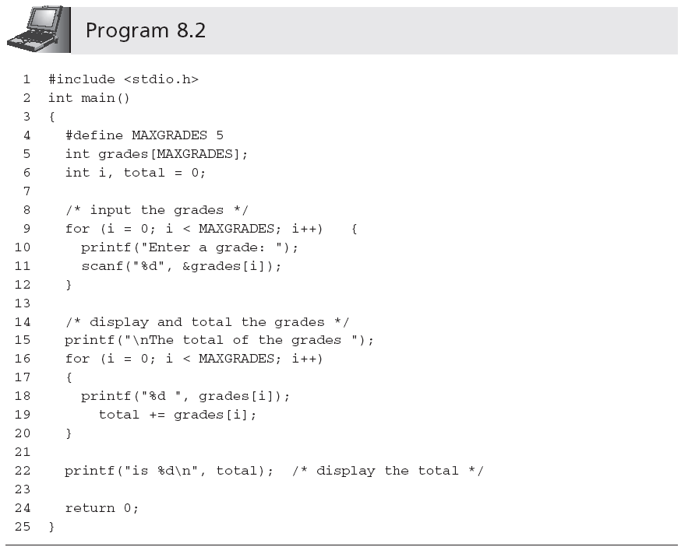
Input and Output of Array Values (continued)
Statement is outside of the second for loop; total is displayed only once, after all values have been added
A First Book of ANSI C, Fourth Edition

Slide 16
单选题
1分
Which describe is correct about following declaration?
int x, *p, a[10];
此题未设置答案，请点击右侧设置按钮
A
x, p and a are same type: int.
B
a[10] is int date type.
C
p is an integer variable.
D
a is an integer array which have 10 elements.
A First Book of ANSI C, Fourth Edition
提交

Slide 17
Array Initialization
The individual elements of all global and static arrays (local or global) are, by default, set to 0 at compilation time
The values within auto local arrays are undefined
Examples of initializations:
  int grades[5] = {98, 87, 92, 79, 85};
  double length[7] = {8.8, 6.4, 4.9, 11.2};
  char codes[6] = {'s', 'a', 'm', 'p', 'l', e'};
  char codes[] = {'s', 'a', 'm', 'p', 'l', 'e'};
  char codes[] = "sample"; /* size is 7 */
A First Book of ANSI C, Fourth Edition

Slide 18
Array Initialization (continued)
The NULL character, which is the escape sequence \0, is automatically appended to all strings by the C compiler
A First Book of ANSI C, Fourth Edition

Slide 19
填空题
1分
The NULL character (__ [填空1] _) is automatically appended to all strings by the C compiler.
正常使用填空题需3.0以上版本雨课堂
A First Book of ANSI C, Fourth Edition
作答

Slide 20
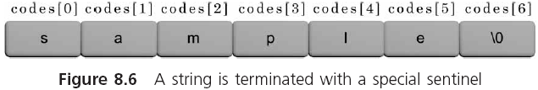
Array Initialization (continued)
A First Book of ANSI C, Fourth Edition

Slide 21
单选题
1分
There are ( ) elements in array codes?
char codes[10]={‘t’,‘e’,‘s’,‘t’};
A
4
B
5
C
6
D
10
A First Book of ANSI C, Fourth Edition
提交

Slide 22
单选题
1分
There are ( ) elements in array codes?
char codes[ ]={‘t’,‘e’,‘s’,‘t’};
A
4
B
5
C
6
D
10
A First Book of ANSI C, Fourth Edition
提交

Slide 23
单选题
1分
There are ( ) elements in array codes?
char codes[ ]=“test”;
A
4
B
5
C
6
D
10
A First Book of ANSI C, Fourth Edition
提交

Slide 24
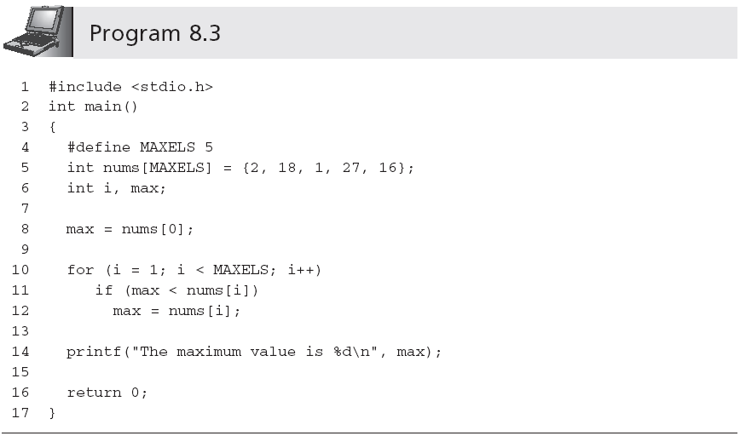
Array Initialization (continued)
A First Book of ANSI C, Fourth Edition

Slide 25
Arrays as Function Arguments
Individual array elements are passed to a function by including them as subscripted variables in the function call argument list
  findMin(grades[2], grades[6]);
  Pass by value
When passing a complete array to a function, the called function receives access to the actual array, rather than a copy of the values in the array
  findMax(grades);
  Pass by reference
A First Book of ANSI C, Fourth Edition

Slide 26
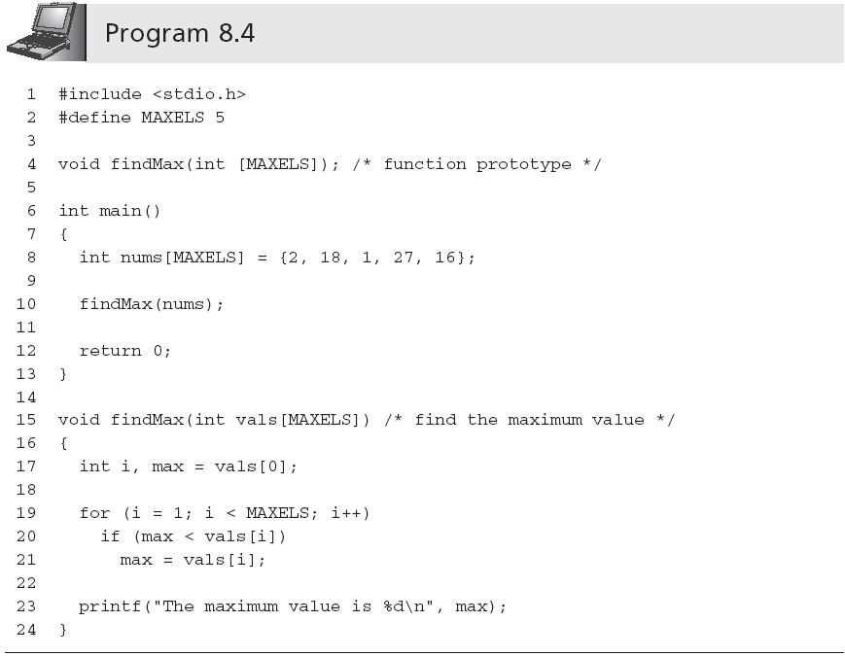
Arrays as Function Arguments (continued)
Size can be omitted
A First Book of ANSI C, Fourth Edition

Slide 27
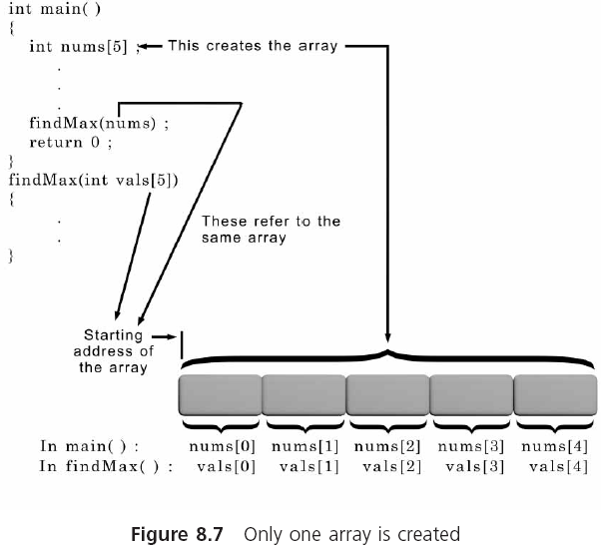
Arrays as Function Arguments (continued)
A First Book of ANSI C, Fourth Edition

Slide 28
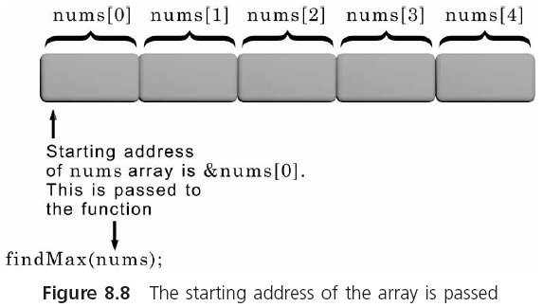
Arrays as Function Arguments (continued)
A First Book of ANSI C, Fourth Edition

Slide 29
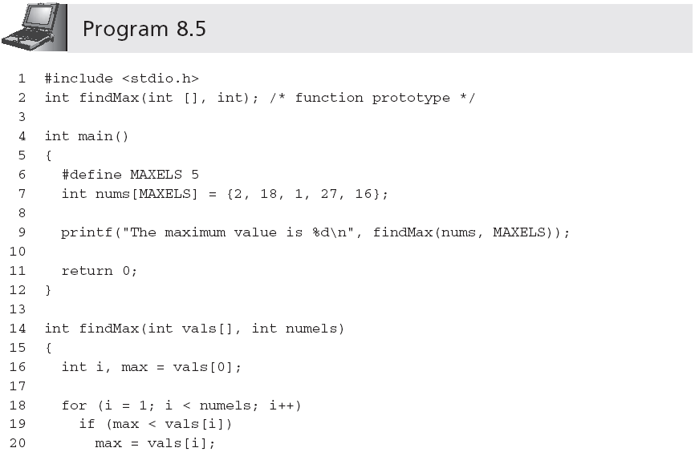
Arrays as Function Arguments (continued)
A First Book of ANSI C, Fourth Edition

Slide 30
Case Study: Computing Averages and Standard Deviations
Two statistical functions are created to determine the average and standard deviation(标准偏差), respectively, of an array of numbers
A First Book of ANSI C, Fourth Edition

Slide 31
Requirements Specification
Need two functions
  Determine the average…
  Determine the standard deviation of a list of integer numbers
Each function must accept an array and return the calculated values to the calling function
We now apply the top-down development procedure to developing the required functions
A First Book of ANSI C, Fourth Edition

Slide 32
Analyze the Problem
Determine the input items: list of integer numbers
Determine the desired outputs: (1) average, and (2) standard deviation
List the algorithms relating the inputs and outputs:
  Average Function: Calculate the average by adding the grades and dividing by the # of added grades
  Standard Deviation Function:
    Subtract the average from each individual grade. Each number in the new set is called a deviation.
    Square each deviation found in Step 1.
    Add the squared deviations and divide the sum by the number of deviations.
    The square root of the number found in Step 3 is the standard deviation.
A First Book of ANSI C, Fourth Edition

Slide 33
Select an Overall Solution
Problem-Solver Algorithm is adapted:
  Initialize an array of integers
  Call the average function
  Call the standard deviation function
  Display the returned value of the average function
  Display the returned value of the standard deviation function
A First Book of ANSI C, Fourth Edition

Slide 34
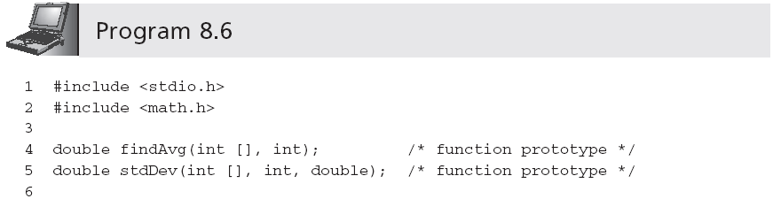
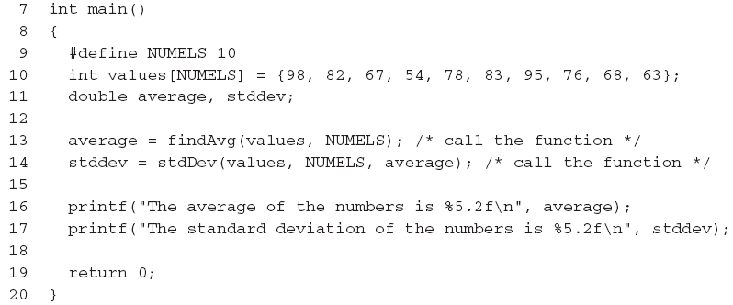
Write the Functions
A First Book of ANSI C, Fourth Edition

Slide 35
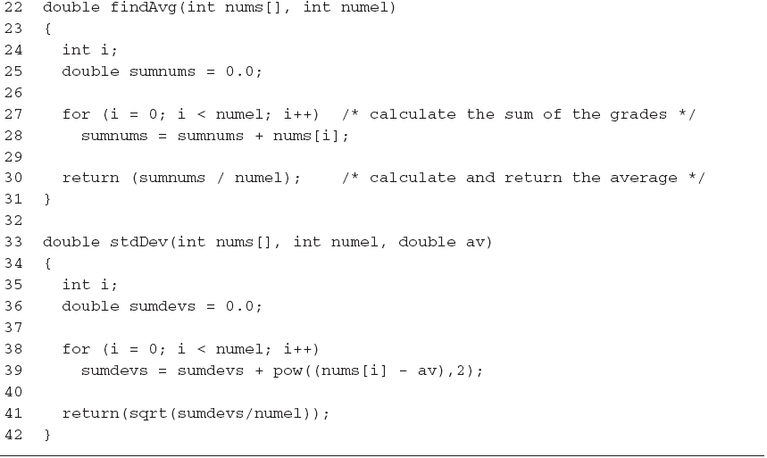
Write the Functions (continued)
A First Book of ANSI C, Fourth Edition

Slide 36
Test and Debug the Functions
Write a main() program unit to call the function and display the returned results (see Program 8.6)
A test run using Program 8.6 produced the following display:
  The average of the numbers is 76.40
  The standard deviation of the numbers is 13.15
Testing is not complete without verifying the calculation at the boundary points
  Checking the calculation with all of the same values, such as all 0s and all 100s
  Use five 0s and five 100s
A First Book of ANSI C, Fourth Edition

Slide 37
Two-Dimensional Arrays
A two-dimensional array, or table, consists of both rows and columns of elements
  int val[3][4];
A First Book of ANSI C, Fourth Edition

Slide 38
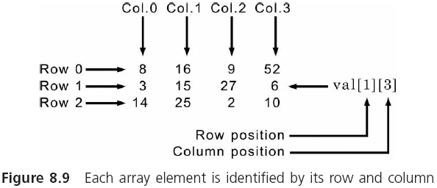
Two-Dimensional Arrays (continued)
A First Book of ANSI C, Fourth Edition

Slide 39
Two-Dimensional Arrays (continued)
Initialization:
  #define NUMROWS 3
  #define NUMCOLS 4
  int val[NUMROWS][NUMCOLS] = { {8,16,9,52},
  {3,15,27,6},
  {14,25,2,10} };
The inner braces can be omitted:
  int val[NUMROWS][NUMCOLS] = {8,16,9,52,3,15,27, 6,14,25,2,10};
Initialization is done in row order
A First Book of ANSI C, Fourth Edition

Slide 40
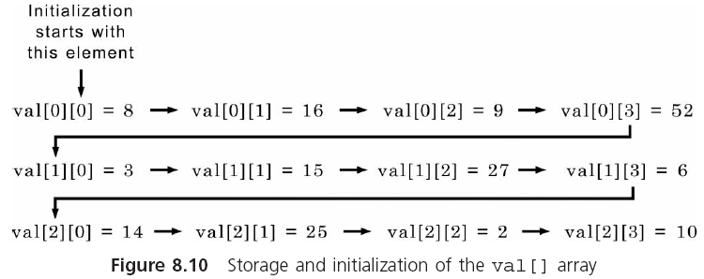
Two-Dimensional Arrays (continued)
A First Book of ANSI C, Fourth Edition

Slide 41
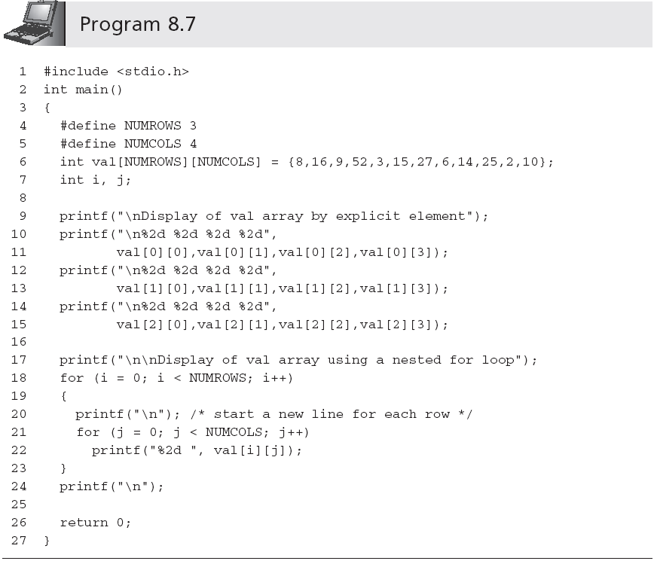
Two-Dimensional Arrays (continued)
A First Book of ANSI C, Fourth Edition

Slide 42
Two-Dimensional Arrays (continued)
The display produced by Program 8.7 is
    Display of val array by explicit element
    8 16 9 52
    3 15 27 6
    14 25 2 10
    Display of val array using a nested for loop
    8 16 9 52
    3 15 27 6
    14 25 2 10
A First Book of ANSI C, Fourth Edition

Slide 43
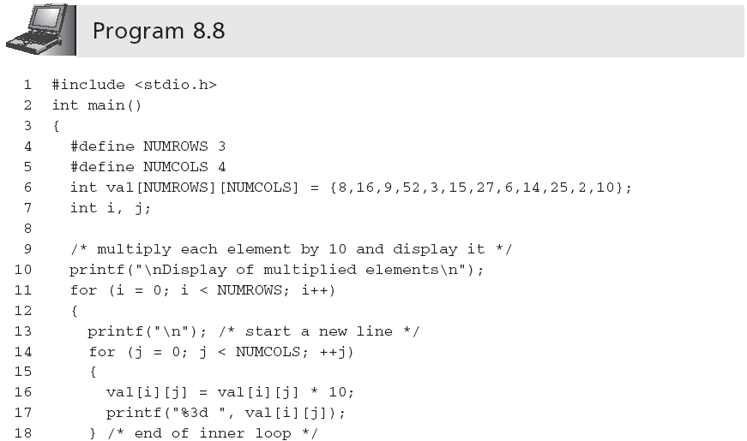
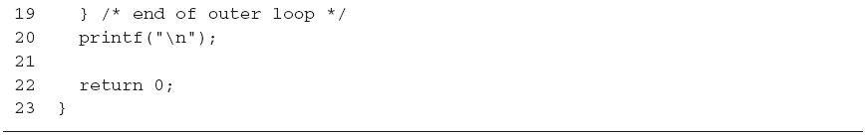
Two-Dimensional Arrays (continued)
A First Book of ANSI C, Fourth Edition

Slide 44
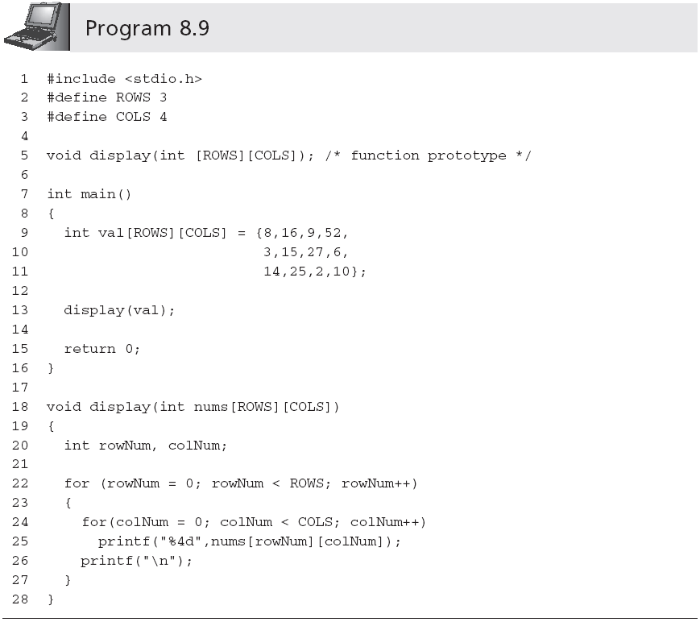
Two-Dimensional Arrays (continued)
Row size can be omitted
A First Book of ANSI C, Fourth Edition

Slide 45
Larger Dimensional Arrays
A three-dimensional array can be viewed as a book of data tables (the third subscript is called the rank)
  int response[4][10][6];
A four-dimensional array can be represented as a shelf of books where the fourth dimension is used to declare a desired book on the shelf
A five-dimensional array can be viewed as a bookcase filled with books where the fifth dimension refers to a selected shelf in the bookcase
Arrays of three, four, five, six, or more dimensions can be viewed as mathematical n-tuples(N重元组)
A First Book of ANSI C, Fourth Edition

Slide 46
Common Programming Errors
Forgetting to declare the array
Using a subscript that references a nonexistent array element
Not using a large enough conditional value in a for loop counter to cycle through all the array elements
Forgetting to initialize the array
A First Book of ANSI C, Fourth Edition

Slide 47
Summary
A single-dimensional array is a data structure that can store a list of values of the same data type
Elements are stored in contiguous locations
  Referenced using the array name and a subscript
Single-dimensional arrays may be initialized when they are declared
Single-dimensional arrays are passed to a function by passing the name of the array as an argument
A First Book of ANSI C, Fourth Edition

Slide 48
Summary (continued)
A two-dimensional array is declared by listing both a row and a column size with the data type and name of the array
Two-dimensional arrays may be initialized when they are declared
Two-dimensional arrays are passed to a function by passing the name of the array as an argument
A First Book of ANSI C, Fourth Edition

