Slide 1
A First Book of ANSI C
Fourth Edition
Chapter 9
Character Strings

Slide 2
Objectives
String Fundamentals
Library Functions
Input Data Validation
Formatting Strings (Optional)
Case Study: Character and Word Counting
Common Programming and Compiler Errors
A First Book of ANSI C, Fourth Edition

Slide 3
String Fundamentals
A string literal is any sequence of characters enclosed in double quotes
  "Good Morning!"
  Also called: string constant, string value, string
  A string is stored as an array of characters terminated by an end-of-string symbolic constant named NULL ('\0')
A First Book of ANSI C, Fourth Edition

Slide 4

单选题
1分
There are ( ) elements in array codes?
char codes[10]={‘t’,‘e’,‘s’,‘t’};
A
4
B
5
C
6
D
10
A First Book of ANSI C, Fourth Edition
提交

Slide 5
单选题
1分
There are ( ) elements in array codes?
char codes[ ]={‘t’,‘e’,‘s’,‘t’};
A
4
B
5
C
6
D
10
A First Book of ANSI C, Fourth Edition
提交

Slide 6
单选题
1分
There are ( ) elements in array codes?
char codes[ ]=“test”;
A
4
B
5
C
6
D
10
A First Book of ANSI C, Fourth Edition
提交

Slide 7
String Input and Output
gets() accepts and stores the characters typed at the terminal into the character array
  Pressing the Enter key generates a newline character, \n, which is interpreted by gets() as the end-of-character entry
  All the characters encountered by gets(), except the newline character, are stored in the message array
A First Book of ANSI C, Fourth Edition

Slide 8
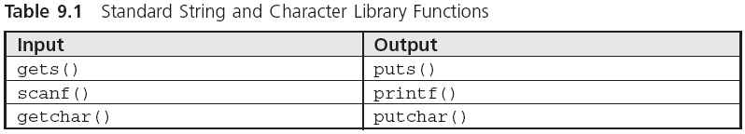
String Input and Output (continued)
A First Book of ANSI C, Fourth Edition

Slide 9
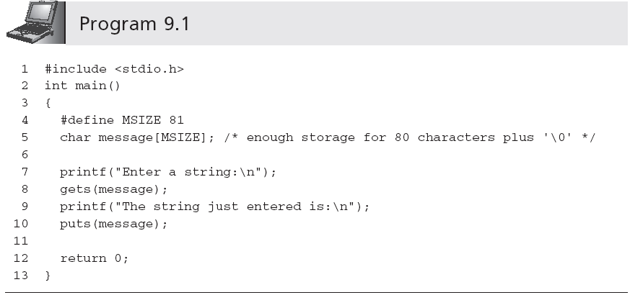
String Input and Output (continued)
Sample run:
Enter a string:
This is a test input of a string of characters.
The string just entered is:
This is a test input of a string of characters.
A First Book of ANSI C, Fourth Edition

Slide 10
String Input and Output (continued)
A printf() function call can be used in place of a puts() function call
  printf("%s\n",message); ≡ puts(message);
This correspondence between the output functions is not duplicated by the input functions scanf() and gets()
  scanf() reads a set of characters up to either a blank space or a newline character
    scanf("%s",message); //No & is required
  gets() stops accepting characters only when a newline is detected
A First Book of ANSI C, Fourth Edition

Slide 11
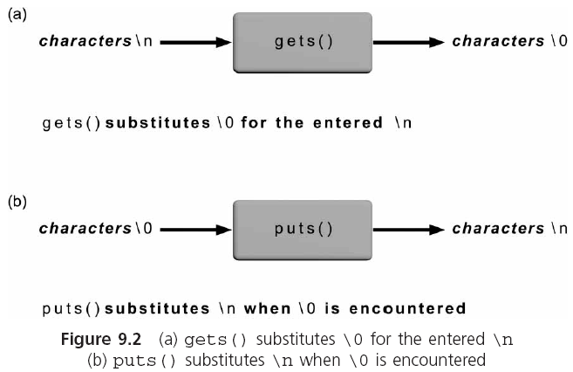
String Input and Output (continued)
A First Book of ANSI C, Fourth Edition

Slide 12
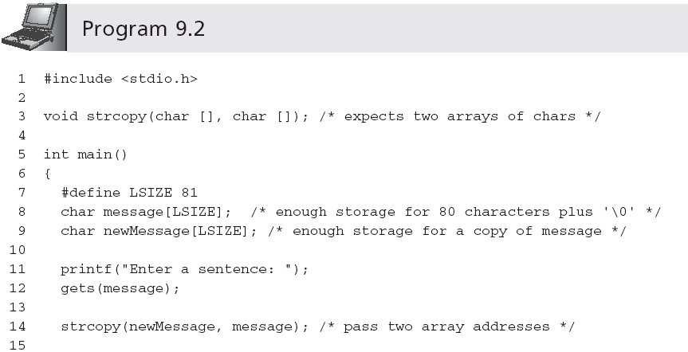
String Processing
A First Book of ANSI C, Fourth Edition

Slide 13
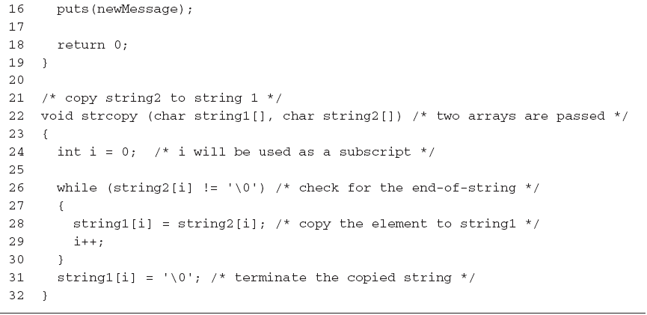
String Processing (continued)
A First Book of ANSI C, Fourth Edition

Slide 14
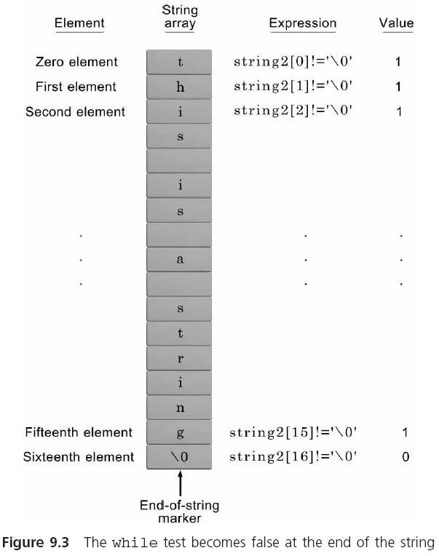
String Processing (continued)
NOTE: Because the expression string2[i] is only 0 at the end of a string and non-0 for every
other character, the expression while (string2[i] != '\0') can be replaced by the
simpler expression while (string2[i]).
A First Book of ANSI C, Fourth Edition

Slide 15
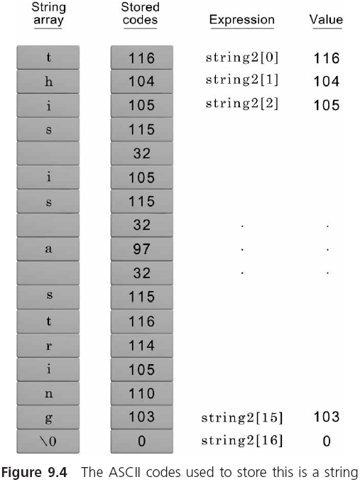
String Processing (continued)
A First Book of ANSI C, Fourth Edition

Slide 16
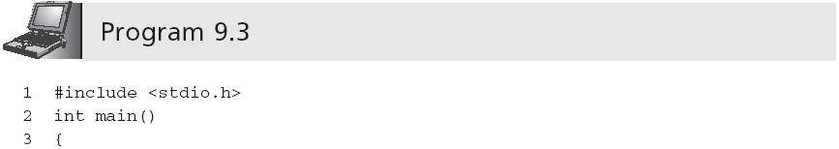
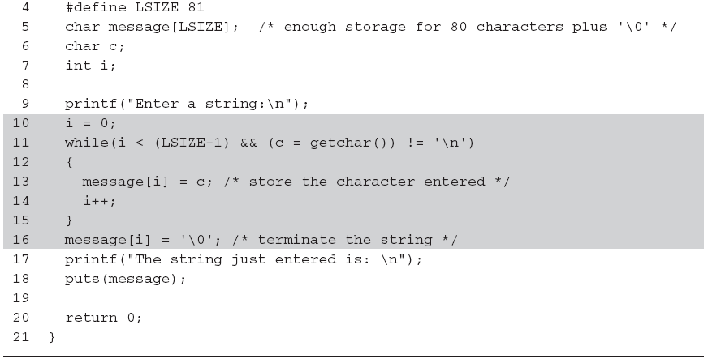
String Processing (continued)
Be careful: omitting the parentheses causes the entire expression to be equivalent to
c = (getchar() != '\n')
A First Book of ANSI C, Fourth Edition

Slide 17
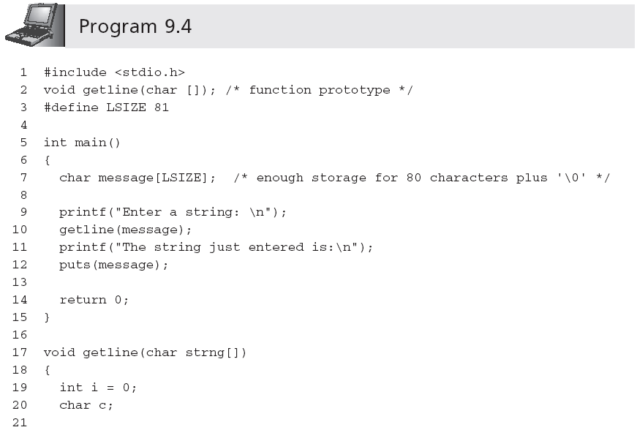
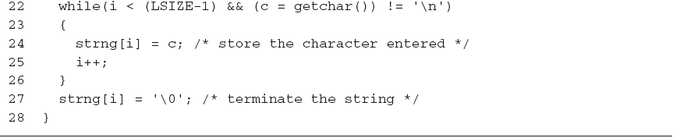
String Processing (continued)
A First Book of ANSI C, Fourth Edition

Slide 18
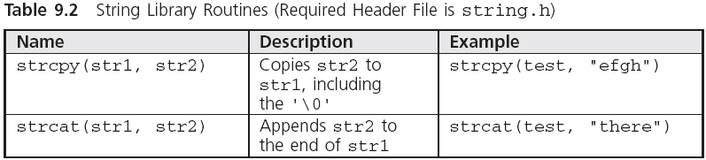
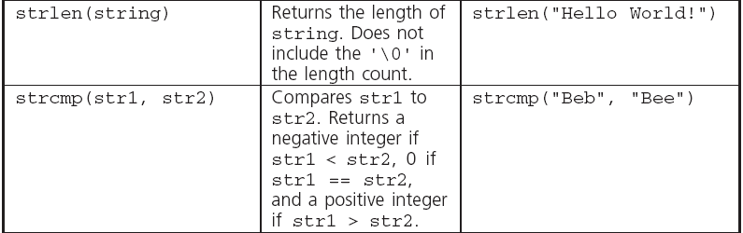
Library Functions
Note: Attempting to copy a larger string into a smaller string causes the copy to overflow the destination array beginning with the memory area immediately following the last array element.
A First Book of ANSI C, Fourth Edition

Slide 19
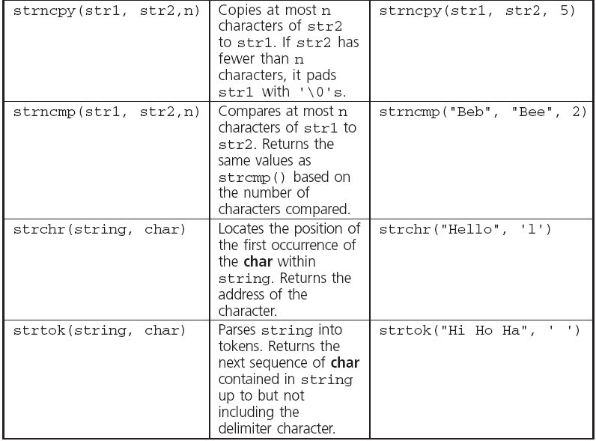
Library Functions (continued)
A First Book of ANSI C, Fourth Edition

Slide 20
Library Functions (continued)
When comparing strings, their individual characters are evaluated in pairs; if a difference is found, the string with the first lower character is the smaller one
  "Good Bye" is less than "Hello" because the first 'G' in Good Bye is less than the first 'H' in Hello
  "Hello" is less than "Hello " because the '\0' terminating the first string is less than the ' ' in the second string
  "123" is greater than "122" because '3' in 123 is greater than '2' in 122
  "1237" is greater than "123" because '7' in 1237 is greater than '\0' in 123
A First Book of ANSI C, Fourth Edition

Slide 21
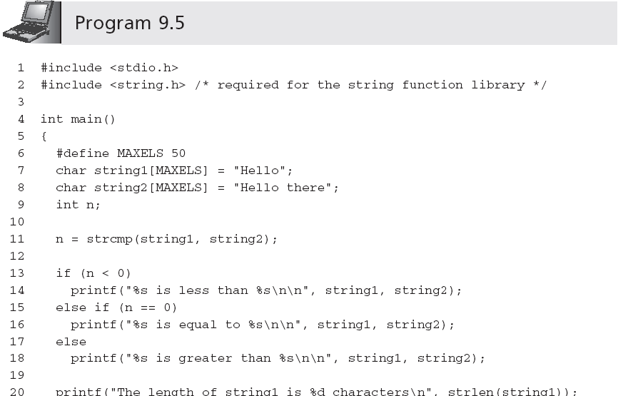
Library Functions (continued)
A First Book of ANSI C, Fourth Edition

Slide 22
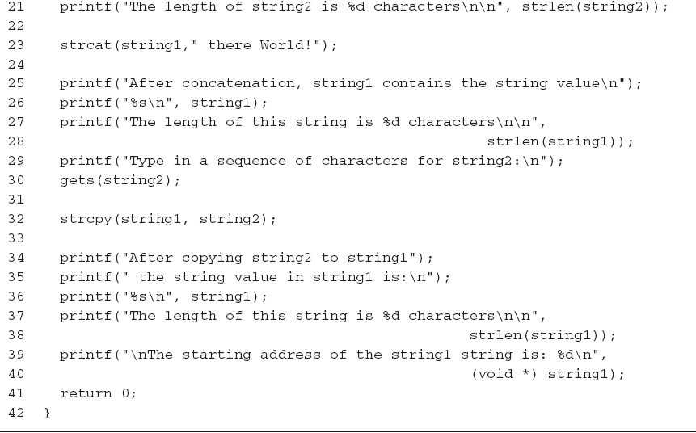
Library Functions (continued)
A First Book of ANSI C, Fourth Edition

Slide 23
Library Functions (continued)
Sample output:
  Hello is less than Hello there
  The length of string1 is 5 characters
  The length of string2 is 11 characters
  After concatenation, string1 contains the string value
  Hello there World!
  The length of this string is 18 characters
  Type in a sequence of characters for string2:
  It's a wonderful day
  After copying string2 to string1, the string value in string1 is:
  It's a wonderful day
  The length of this string is 20 characters
  The starting address of the string1 string is: 1244836
A First Book of ANSI C, Fourth Edition

Slide 24
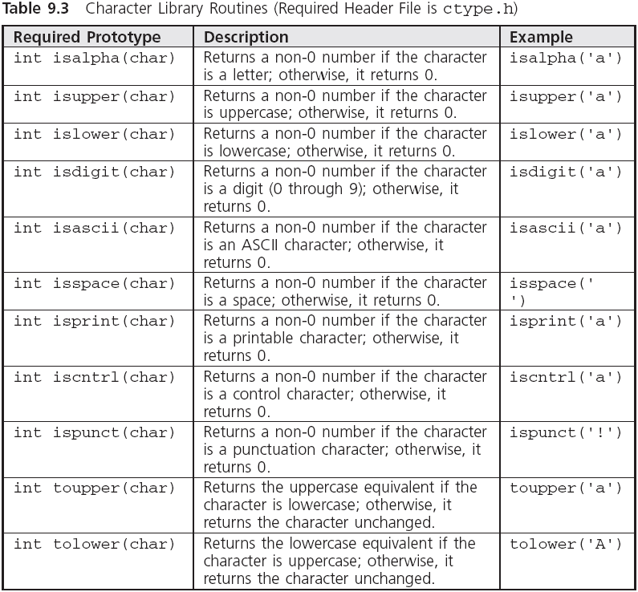
Character Routines
A First Book of ANSI C, Fourth Edition

Slide 25
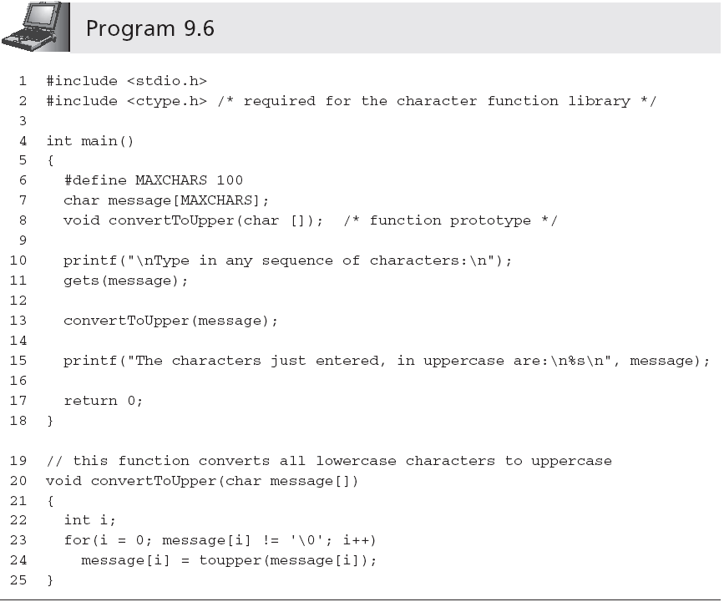
Character Routines (continued)
A First Book of ANSI C, Fourth Edition

Slide 26
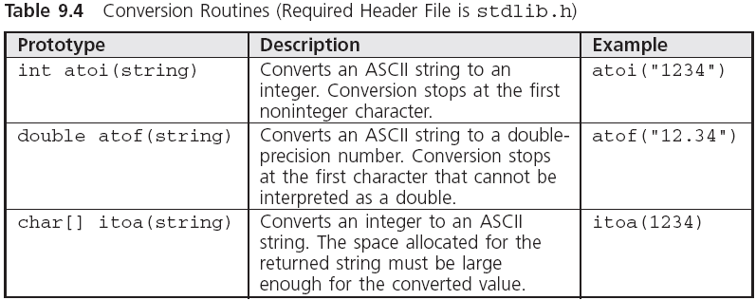
Conversion Routines
A First Book of ANSI C, Fourth Edition

Slide 27
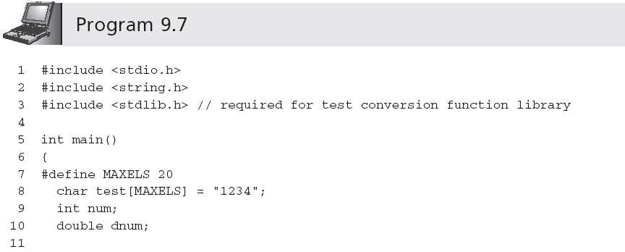
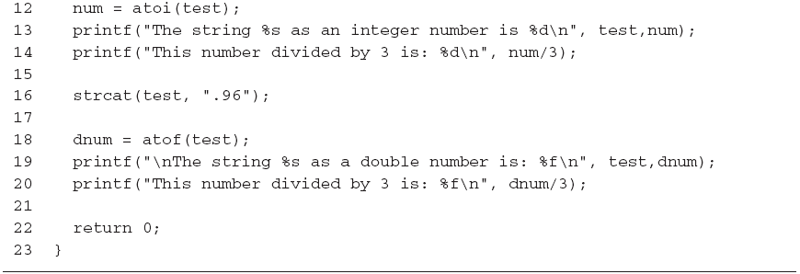
Conversion Routines (continued)
A First Book of ANSI C, Fourth Edition

Slide 28
Creating a Personal Library
Programmers create their own libraries of functions
  This permits the functions to be incorporated in any program without further expenditure of coding time
Each file in a library contains related functions
  #include <C:\\mylibrary\\dataChecks.h>
  #include "C:\\mylibrary\\dataChecks.h"
    The #include statement for dataChecks.h must be placed after the #include statements for the stdio.h and stdlib.h header files (the functions in dataChecks.h require stdio.h and stdlib.h functions to correctly compile)
A First Book of ANSI C, Fourth Edition

Slide 29
Formatting Strings
Examples:
  printf("|%25s|","Have a Happy Day");
    | Have a Happy Day|
  printf("|%-25s|","Have a Happy Day");
    |Have a Happy Day |
  printf("|%25.12s|","Have a Happy Day");
    | Have a Happy|
  printf("|%.12s|","Have a Happy Day");
    |Have a Happy|
A First Book of ANSI C, Fourth Edition

Slide 30
Exercise
The output of the following program is（ ）
char s1[10]={'S','e','t','\0','u','p','\0'};
printf("%s",s1);
A) Set B) Setup C) Set up D) 'S''e''t'
Which is valid express for element of array codes? ( )
char codes[] = ' sample ';
A.codes[7] B.codes[6] C.codes+7 D.codes+6
A First Book of ANSI C, Fourth Edition

Slide 31
Case Study: Character and Word Counting
We construct two string-processing functions
  Count the number of characters in a string
  Count words in a sting
    What constitutes a word?
A First Book of ANSI C, Fourth Edition

Slide 32
Program Requirement: Character Counting
Pass a string to a function and have the function return the number of characters in the string
Any character in the string (blank, printable, or nonprintable character) is to be counted
The end-of-string NULL character is not to be included in the final count
A First Book of ANSI C, Fourth Edition

Slide 33
Analyze the Problem
Determine the input data
Determine the required outputs
List the algorithm(s) relating the inputs to the outputs
A First Book of ANSI C, Fourth Edition

Slide 34
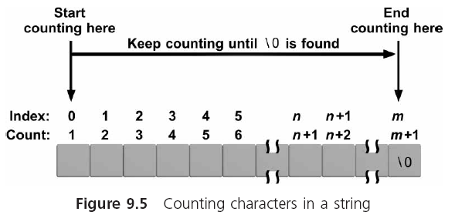
Analyze the Problem (continued)
A First Book of ANSI C, Fourth Edition

Slide 35
Code the Function
int countchar(char list[])
{
int i, count = 0;
for(i = 0; list[i] != '\0'; i++)
count++;
return(count);
}
A First Book of ANSI C, Fourth Edition

Slide 36
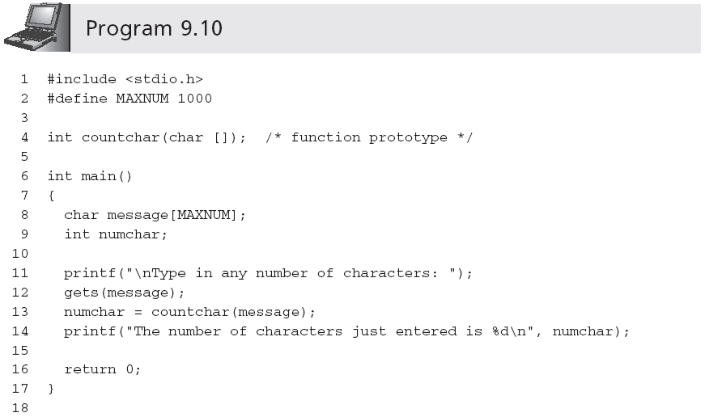
Test and Debug the Function
…
A First Book of ANSI C, Fourth Edition

Slide 37
Requirement Specification: Word Counting
The last word does not have a trailing blank(尾部空格)
More than one blank may be used between words
Leading blanks(先行空白) may be used before the first word
A First Book of ANSI C, Fourth Edition

Slide 38
Analyze the Problem
Determine the input data
Determine the required outputs
Algorithm:
  Set an integer variable named inaword to the symbolic constant NO
  Set the word count to 0
  For all the characters in the array
  If the current character is a blank
  set inaword to NO
  Else if (inaword equals NO)
  set inaword to the symbolic constant YES
  increment the word count
  EndIf
  EndFor
  Return the count
A First Book of ANSI C, Fourth Edition

Slide 39
Code the Function
int countword(char list[])
#define YES 1
#define NO 0
{
int i, inaword, count = 0;
inaword = NO;
for(i = 0; list[i] != '\0'; i++)
{
if (list[i] == ' ')
inaword = NO;
else if (inaword == NO)
{
inaword = YES;
count++;
}
}
return(count);
}
A First Book of ANSI C, Fourth Edition

Slide 40
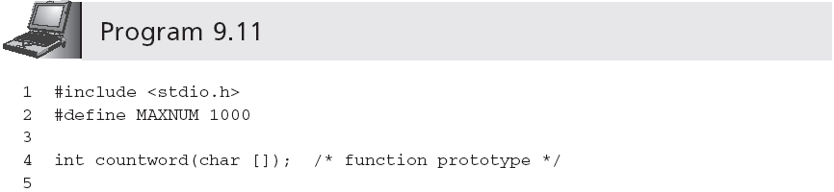
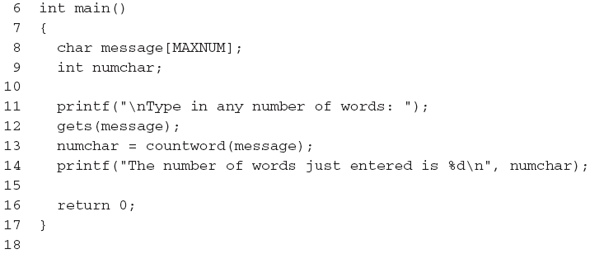
Test and Debug the Function
…
A First Book of ANSI C, Fourth Edition

Slide 41
Test and Debug the Function (continued)
A sample run using Program 9.11 follows:
  Type in any number of words: This is a test line with a bunch of words
  The number of words just entered is 10
Further tests that should be performed are
  Enter words with multiple spaces between them
  Enter words with leading spaces before the first word
  Enter words with trailing spaces after the last word
  Enter a sentence that ends in a period or question mark
A First Book of ANSI C, Fourth Edition

Slide 42
Common Programming Errors
Forgetting the terminating NULL character, '\0', when processing existing strings in a character-by-character manner
Forgetting to include the string.h, ctype.h, and stdlib.h header files when using the string library, character library, and conversion library functions, respectively
A First Book of ANSI C, Fourth Edition

Slide 43
Summary
A string is an array of characters terminated by the NULL ('\0') character
Character arrays can be initialized using a string assignment of the form char arrayName[] = "text";
Strings can always be processed using standard array-processing techniques
The gets(), scanf(), and getchar() library functions can be used to input a string
The puts(), printf(), and putchar() functions can be used to display strings
A First Book of ANSI C, Fourth Edition

