Slide 1

A First Book of ANSI C
Fourth Edition
Chapter 11
Arrays, Addresses, and Pointers

Slide 2
Objectives
Array Names as Pointers
Manipulating Pointers
Passing and Using Array Addresses
Processing Strings Using Pointers
Creating Strings Using Pointers
Common Programming and Compiler Errors

Slide 3
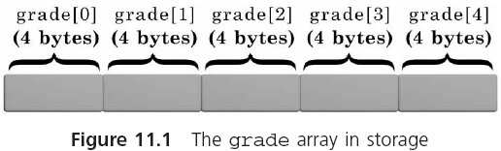
Array Names as Pointers

Slide 4
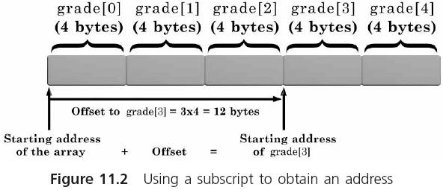
Array Names as Pointers (continued)

Slide 5
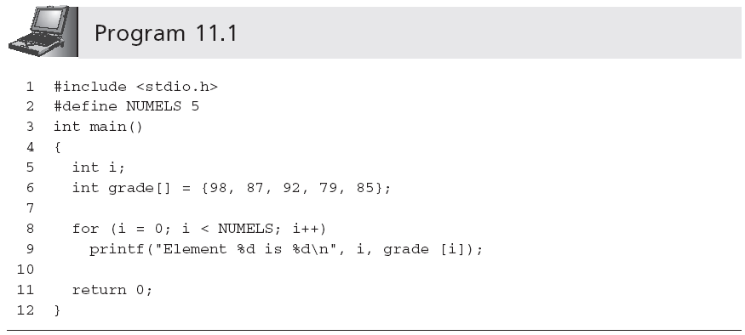
Array Names as Pointers (continued)

Slide 6
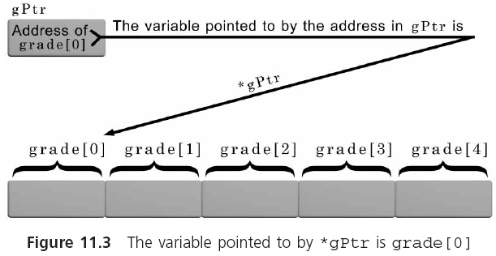
Array Names as Pointers (continued)

Slide 7
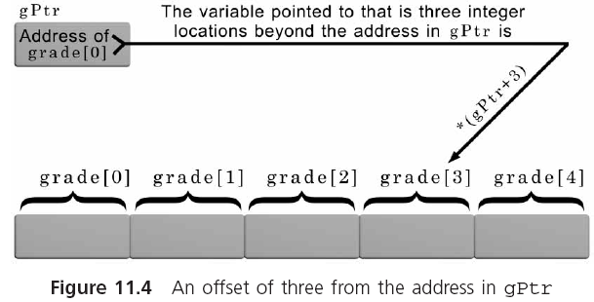
Array Names as Pointers (continued)

Slide 8
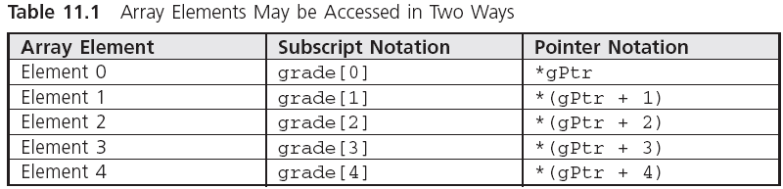
Array Names as Pointers (continued)

Slide 9
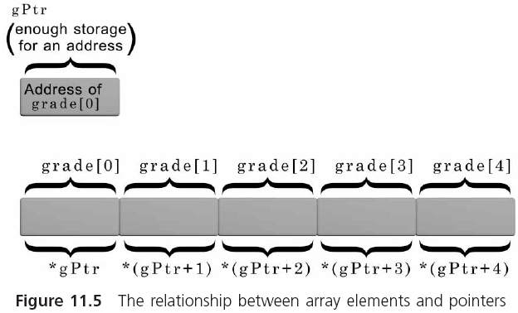
Array Names as Pointers (continued)

Slide 10
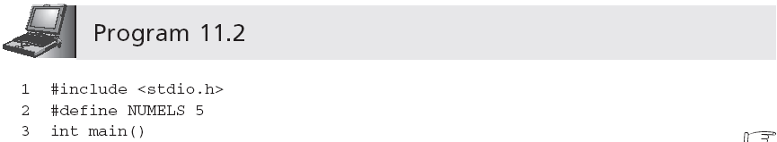
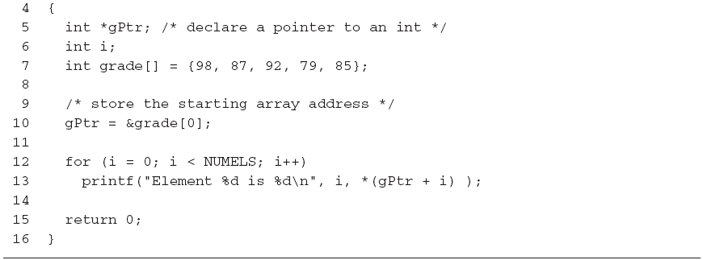
Array Names as Pointers (continued)
Parentheses are necessary

Slide 11
Array Names as Pointers (continued)
When an array is created, the compiler automatically creates an internal pointer constant for it and stores the base address of the array in this pointer

Slide 12
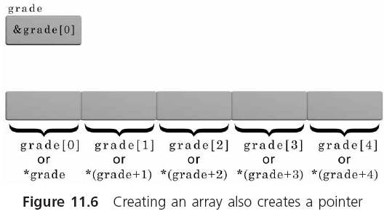
Array Names as Pointers (continued)

Slide 13

Array Names as Pointers (continued)

Slide 14
Array Names as Pointers (summary)
In most respects an array name and a pointer can be used interchangeably
An array name is a pointer constant
  grade = &grade[2]; valid??
A pointer access can always be replaced using subscript notation
  numPtr[i] is valid even if numPtr is a pointer variable
Pointers are more efficient than using subscripts for array processing because the internal conversion from subscripts to addresses is avoided

Slide 15
Manipulating Pointers
A pointer, constructed either as a variable or function parameter, contains a value: an address
By adding numbers to and subtracting numbers from pointers, we can obtain different addresses
The addresses in pointers can be compared using any of the relational operators (==, !=, <, >, etc.)
Pointers can be initialized when they are declared

Slide 16
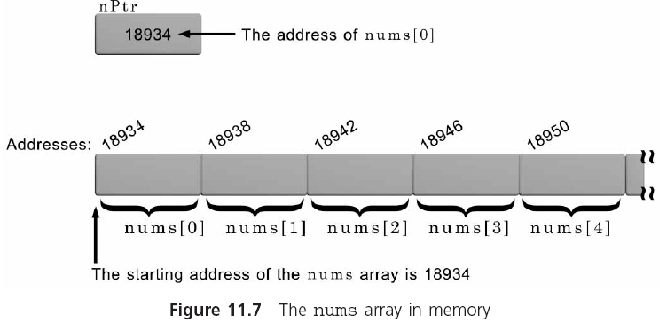
Pointer Arithmetic
int nums[100];
int *nPtr;
nPtr = &nums[0];
nPtr = nums;

Slide 17
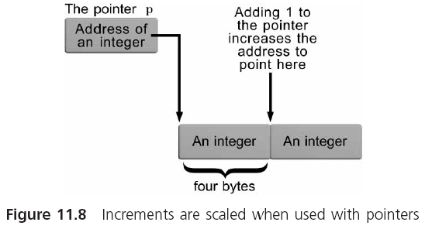
Pointer Arithmetic (continued)

Slide 18
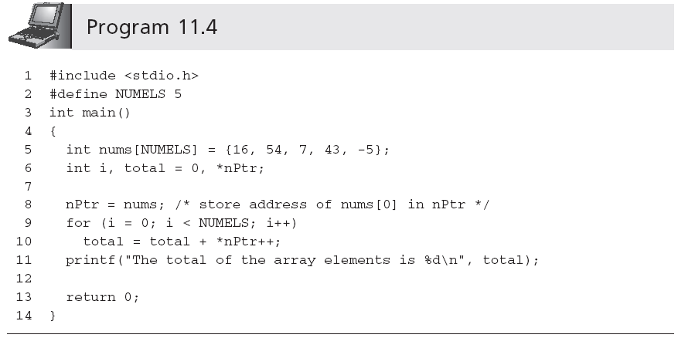
Pointer Arithmetic (continued)
Can be replaced with total += *nPtr++

Slide 19
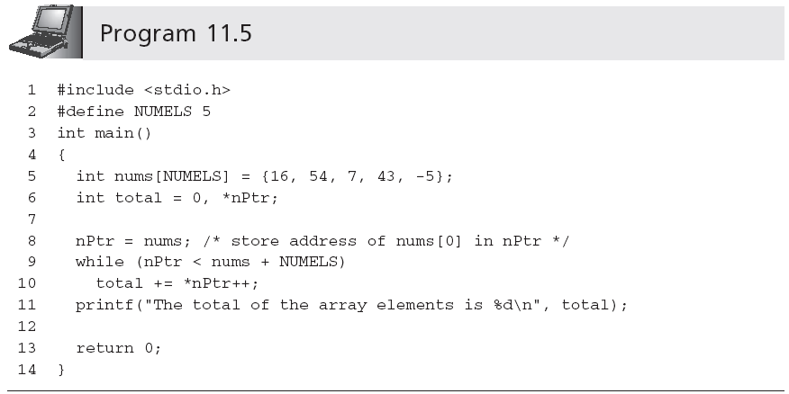
Pointer Arithmetic (continued)

Slide 20
Pointer Initialization
Pointers can be initialized when they are declared:
  int *ptNum = &miles; /* miles has been previously declared */
  double *zing = &prices[0];
  double *zing = prices;

Slide 21
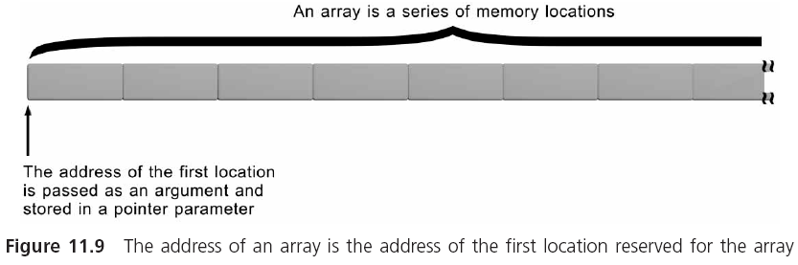
Passing and Using Array Addresses

Slide 22
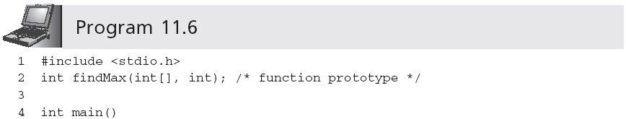
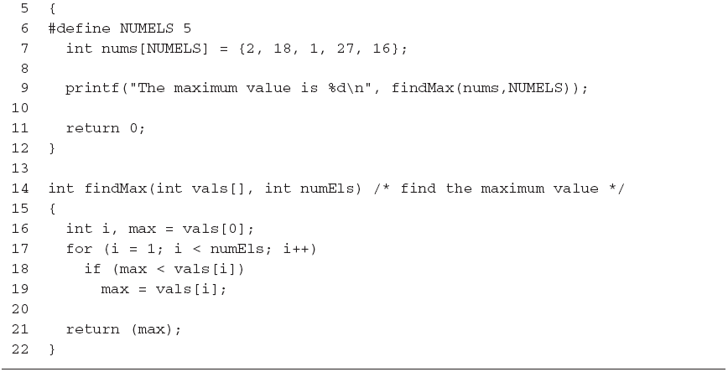
Passing and Using Array Addresses (continued)
Calling findMax(&nums[2], 3) would be valid too
Can be replaced with findMax(int *vals, int numEls)

Slide 23
Passing and Using Array Addresses (continued)
findMax() can be rewritten as:
  1 int findMax(int *vals, int numEls)
  2 /* vals declared as a pointer */
  3 {
  4 int i, max;
  5 max = *vals++;
  6
  7 for (i = 1; i < numEls; i++, vals++)
  8 if (max < *vals)
  9 max = *vals;
  10
  11 return(max);
  12 }

Slide 24
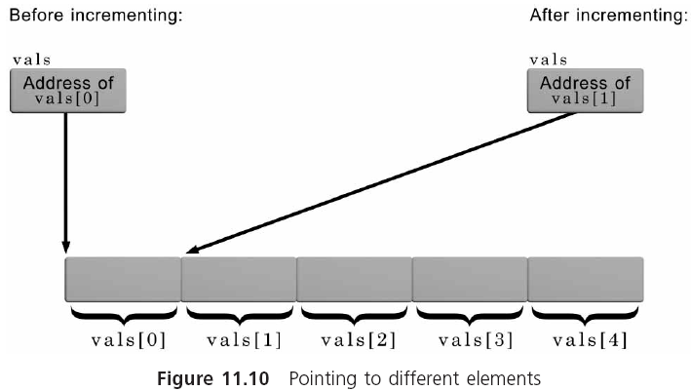
Passing and Using Array Addresses (continued)

Slide 25
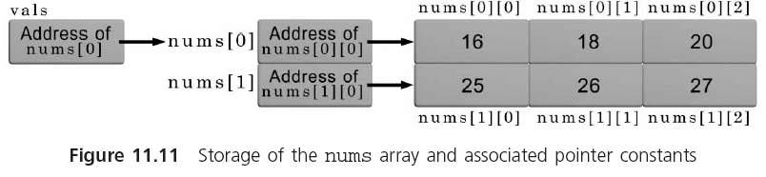

Advanced Pointer Notation
#define ROWS 2
#define COLS 3
int nums[ROWS][COLS] = { {16,18,20},
{25,26,27} };

Slide 26
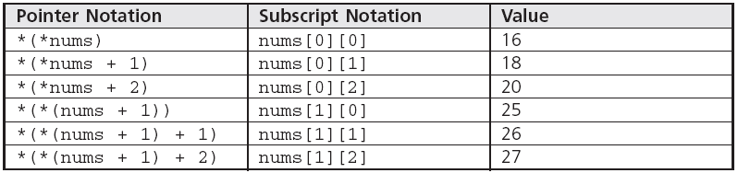
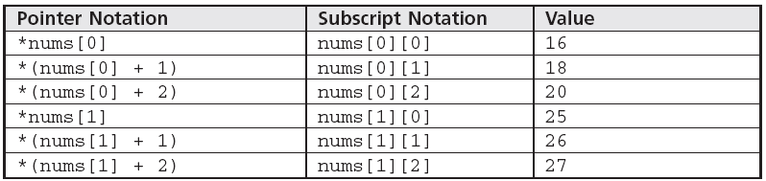
Advanced Pointer Notation (continued)

Slide 27
Advanced Pointer Notation (continued)
A function that receives an integer two-dimensional array can be declared as:
  calc(int pt[2][3])
  calc(int pt[][3])
  calc(int (*pt)[3])
    It refers to a single pointer of objects of three integers
The following declaration would be wrong:
  calc(int *pt[3])
    It refers to an array of three pointers, each one pointing to a single integer

Slide 28
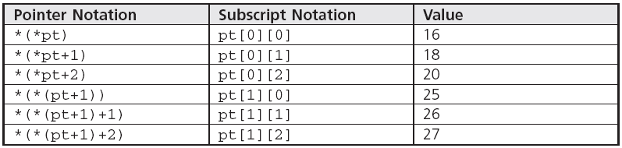
Advanced Pointer Notation (continued)
Once the correct declaration for pt is made (any of the three valid declarations), the following notations within the function calc() are all equivalent:

Slide 29
Advanced Pointer Notation (continued)
A function can return a pointer
  int *calc()
Pointers to functions are possible because function names, like array names, are themselves pointer constants
  int (*calc)()
    Declares calc to be a pointer to a function that returns an integer
    If, for example, sum() returns an integer, the assignment calc = sum; is valid

Slide 30
Processing Strings Using Pointers
void strcopy(char string1[], char string2[])
{
int i = 0;
while (string1[i] = string2[i])
i++;
}
void strcopy(char *string1, char *string2)
{
while (*string1 = *string2)
{
string1++;
string2++;
}
return;
}
while (*string1++ = *string2++)
;

Slide 31
Creating Strings Using Pointers
The definition of a string automatically involves a pointer (a pointer constant)
  char message1[81]; reserves storage for 81 characters and automatically creates a pointer constant, message1, that contains the address of message1[0]
It is also possible to create a string using a pointer
  char *message2;
  Now, assignment statements, such as message2 = "this is a string";, can be made
Strings cannot be copied using an assignment operator

Slide 32
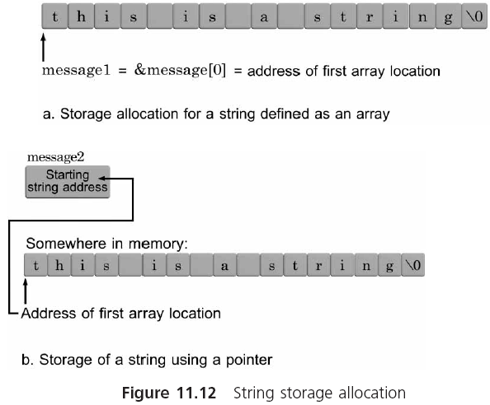
Creating Strings Using Pointers (continued)

Slide 33
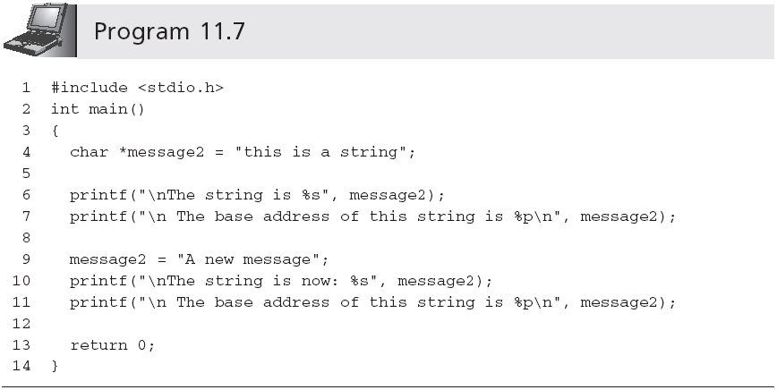
Creating Strings Using Pointers (continued)
Does not overwrite the first string

Slide 34
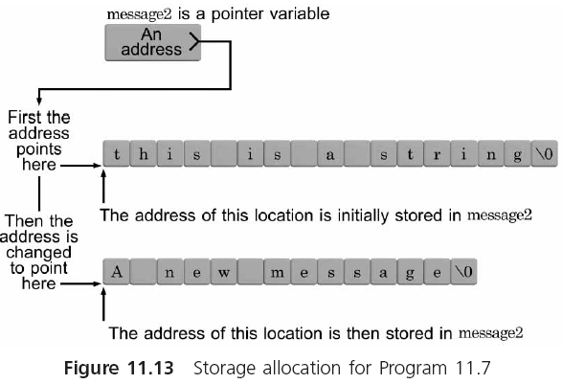
Creating Strings Using Pointers (continued)

Slide 35
Pointer Arrays
Example:
  char *seasons[4];
  seasons[0] = "Winter";
  seasons[1] = "Spring";
  seasons[2] = "Summer";
  seasons[3] = "Fall";
Or:
  char *seasons[4] = {"Winter",
  "Spring",
  "Summer",
  "Fall"};

Slide 36
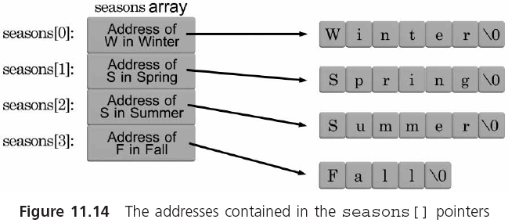
Pointer Arrays (continued)

Slide 37
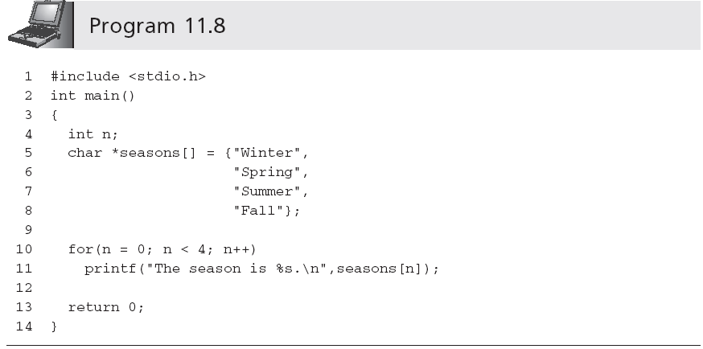
Pointer Arrays (continued)

Slide 38
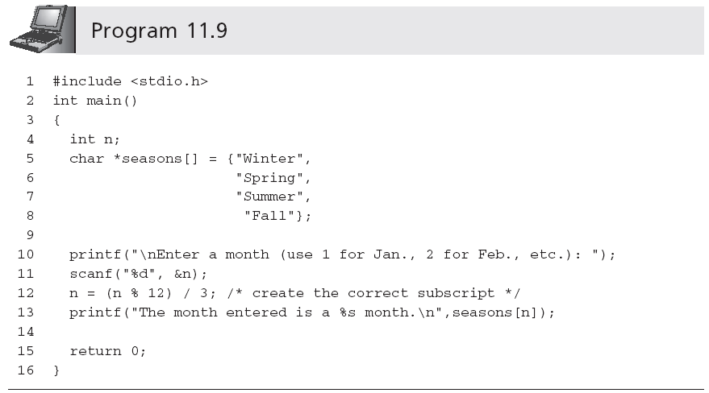
Pointer Arrays (continued)

Slide 39
Common Programming Errors
Using a pointer to reference nonexistent array elements
Incorrectly applying the address and indirection operators
Addresses of pointer constants cannot be taken
Not providing sufficient space for the end-of-string NULL character when a string is defined as an array of characters, and not including the \0 NULL character when the array is initialized

Slide 40
Common Programming Errors (continued)
Misunderstanding the terminology
  For example, if text is defined as
    char *text;
  it is sometimes referred to as a string
Becoming confused about whether a variable contains an address or is an address
  Pointer variables and pointer arguments contain addresses
  The address of a pointer constant cannot be taken
  The address “contained in” the pointer constant cannot be altered

Slide 41
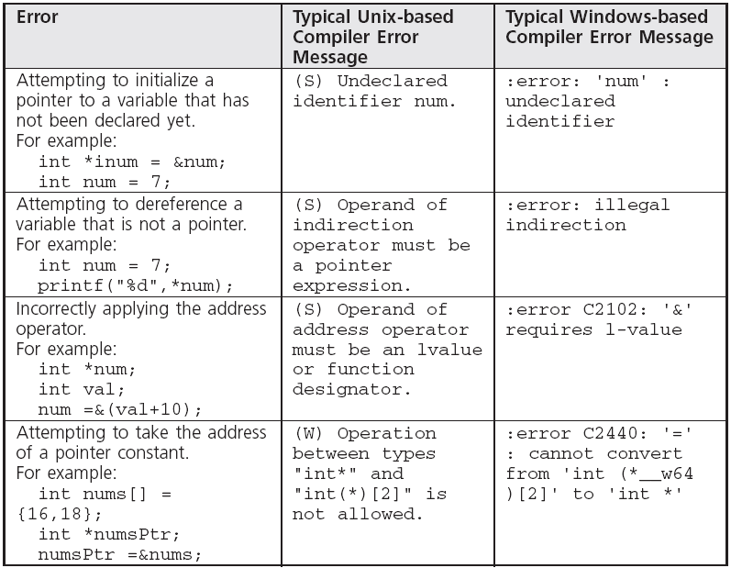
Common Compiler Errors

Slide 42
Summary
An array name is a pointer constant
Any access to an array element using subscript notation can always be replaced using pointer notation
Arrays are passed to functions by address, not by value
When a single-dimensional array is passed to a function, the parameter declaration for the array can be either an array declaration or a pointer declaration

Slide 43
Summary (continued)
In place of subscripts, pointer notation and pointer arithmetic are especially useful for manipulating string elements
String storage can be created by declaring an array of characters or a pointer to be a character
Pointers can be incremented, decremented, and compared

