Slide 1

A First Book of ANSI C
Fourth Edition
Chapter 13
Dynamic Data Structures

Slide 2
Objectives
Dynamic Memory Allocation
Introduction to Linked Lists
Stacks
Queues
Dynamically Linked Lists
Common Programming and Compiler Errors

Slide 3
Introduction
Dynamic memory allocation: an alternative to fixed memory allocation in which memory space grows or diminishes during program execution
Dynamic memory allocation makes it unnecessary to reserve a fixed amount of memory for a scalar, array, or structure variable in advance
  Also known as run-time allocation
  Requests are made for allocation and release of memory space while the program is running

Slide 4
Introduction to Linked Lists
An array of structures can be used to insert and delete ordered structures, but this is not an efficient use of memory
  Better alternative: a linked list
Linked list: set of structures, each containing at least one member whose value is the address of the next logically ordered structure in the list
  Also known as self-referencing structures

Slide 5
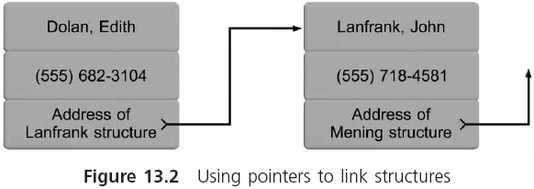
Introduction to Linked Lists (continued)

Slide 6
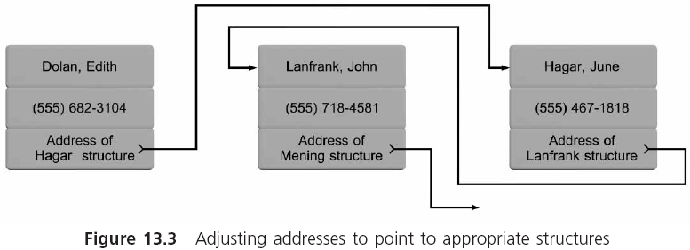
Introduction to Linked Lists (continued)

Slide 7
Introduction to Linked Lists (continued)
A NULL acts as a sentinel or flag to indicate when the last structure has been processed
In addition to an end-of-list sentinel value, we must provide a special pointer for storing the address of the first structure in the list

Slide 8
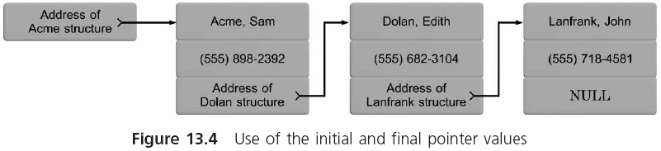
Introduction to Linked Lists (continued)

Slide 9
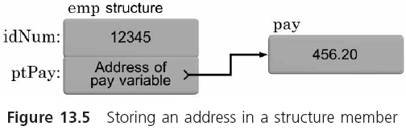
Introduction to Linked Lists (continued)

Slide 10
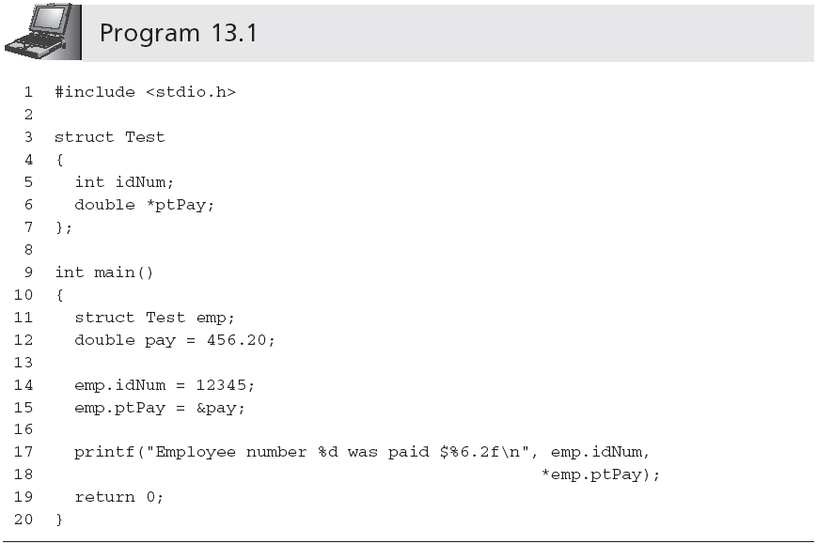
Introduction to Linked Lists (continued)
A structure can contain any data type, including a pointer. A pointer member of a structure is used like any other pointer variable.

Slide 11
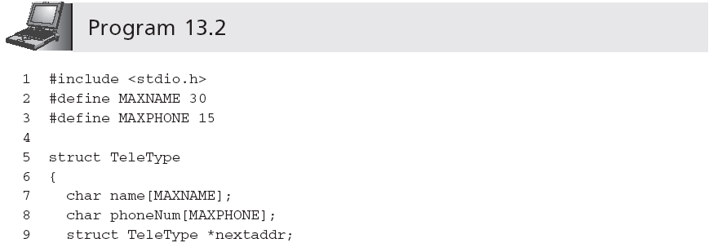
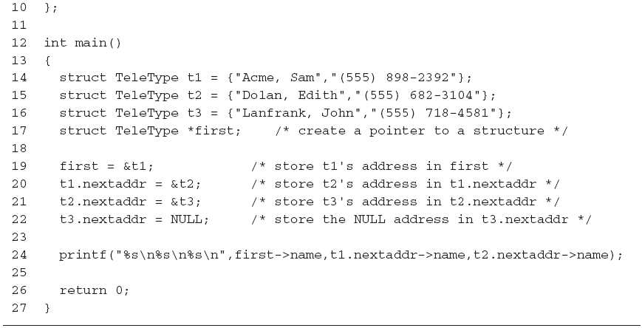
Introduction to Linked Lists (continued)
is evaluated as (t1.nextaddr)->name
it can be replaced by (*t1.nextaddr).name

Slide 12
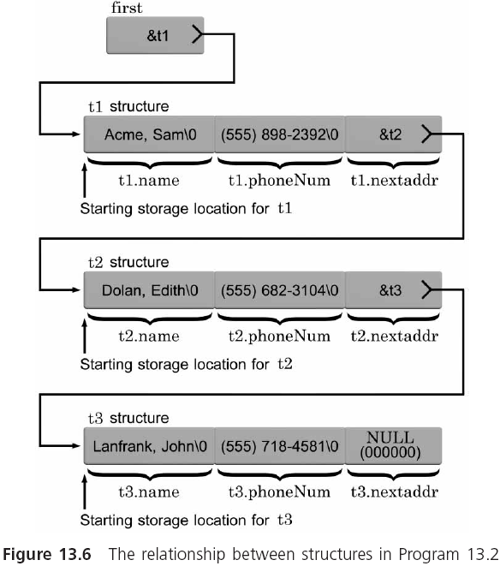
Introduction to Linked Lists (continued)

Slide 13
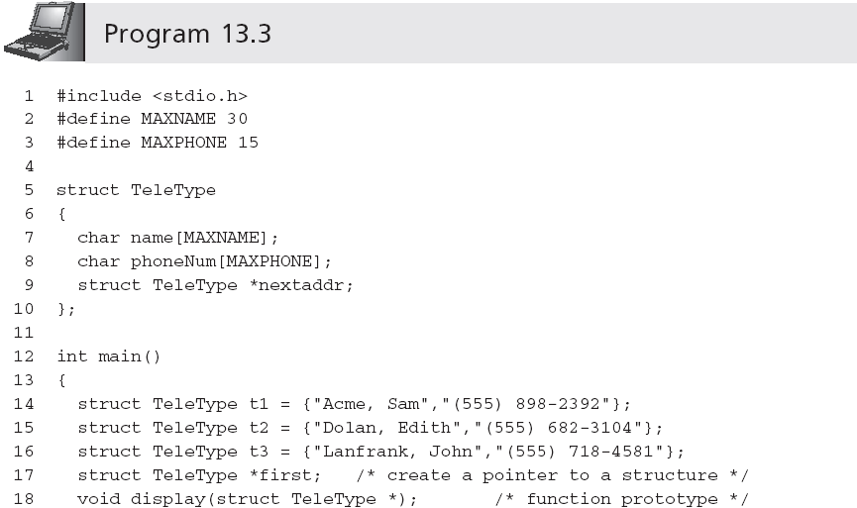
Introduction to Linked Lists (continued)
Disadvantage: exactly three structures are defined in main() by name, and storage for them is reserved at compile time

Slide 14
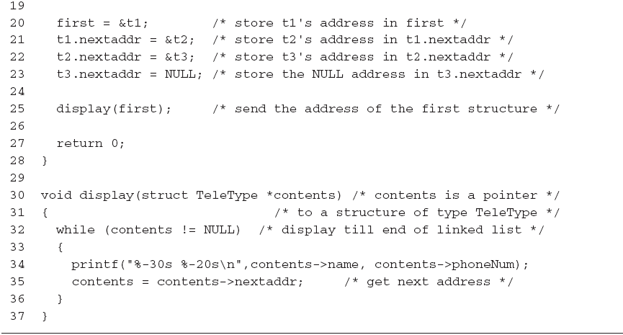
Introduction to Linked Lists (continued)
can be replaced by while(!contents)

Slide 15
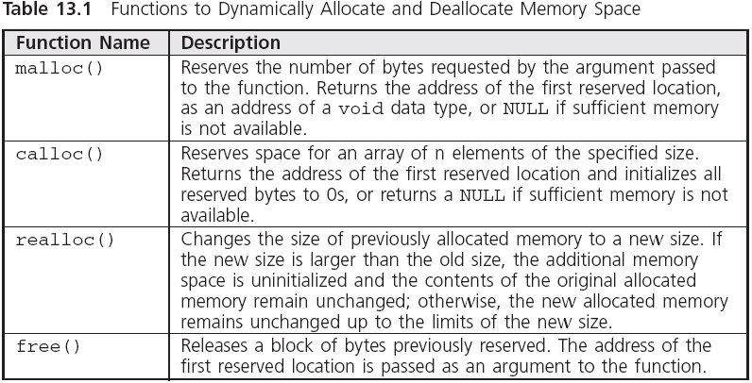
Dynamic Memory Allocation

Slide 16
Dynamic Memory Allocation (continued)
The malloc() and calloc() functions can frequently be used interchangeably
  The advantage of calloc() is that it initializes all newly allocated numeric memory to 0 and character allocated memory to NULL
  We use malloc() because it is the more general purpose of the two functions
  malloc(10*sizeof(char)) or calloc(10,sizeof(char)) requests enough memory to store 10 characters
The space allocated by malloc() comes from the computer’s heap

Slide 17
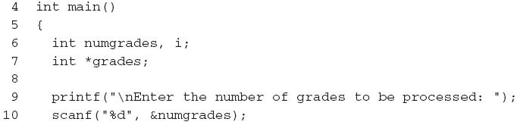
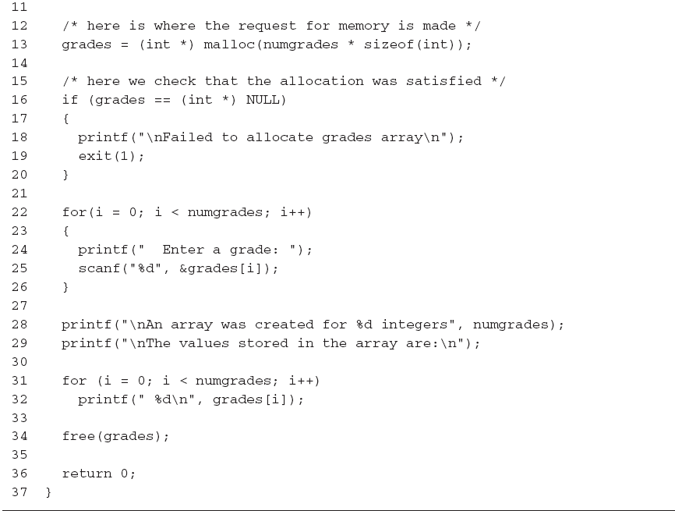
Dynamic Memory Allocation (continued)
…
Necessary because malloc() returns void

Slide 18
Dynamic Memory Allocation (continued)
malloc() is more typically used for dynamically allocating memory for structures
  struct OfficeInfo *Off;
  /* request space for one structure */
  Off = (struct OfficeInfo *) malloc(sizeof(struct OfficeInfo));
  /* check that space was allocated */
  if (Off == (struct OfficeInfo*) NULL)
  {
  printf("\nAllocation failed\n");
  exit(1);
  }

Slide 19
Stacks
Stack: special type of linked list in which objects can only be added to and removed from the top of the list
  Last-in, first-out (LIFO) list
In a true stack, the only item that can be seen and accessed is the top item

Slide 20
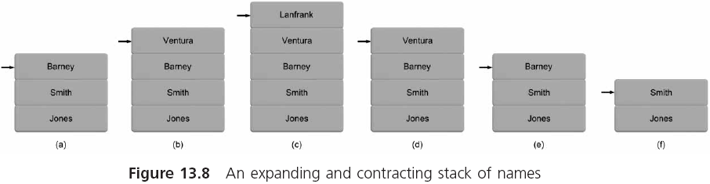
Stacks (continued)

Slide 21
Stack Implementation
Creating a stack requires the following four components:
  A structure definition
  A method of designating the current top stack structure
  An operation for placing a new structure on the stack
  An operation for removing a structure from the stack

Slide 22
PUSH and POP
PUSH (add a new structure to the stack)
Dynamically create a new structure
Put the address in the top-of-stack pointer into the address field of the new structure
Fill in the remaining fields of the new structure
Put the address of the new structure into the top-of-stack pointer
POP (remove a structure from the top of the stack)
Move the structure contents pointed to by the top-of-stack pointer into a work area
Free the structure pointed to by the top-of-stack pointer
Move the address in the work area address field into the top-of-stack pointer

Slide 23
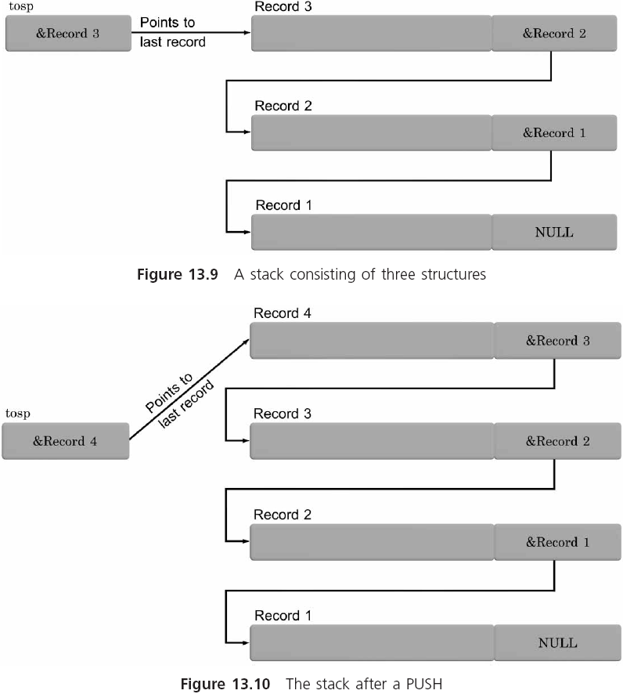
PUSH and POP (continued)

Slide 24
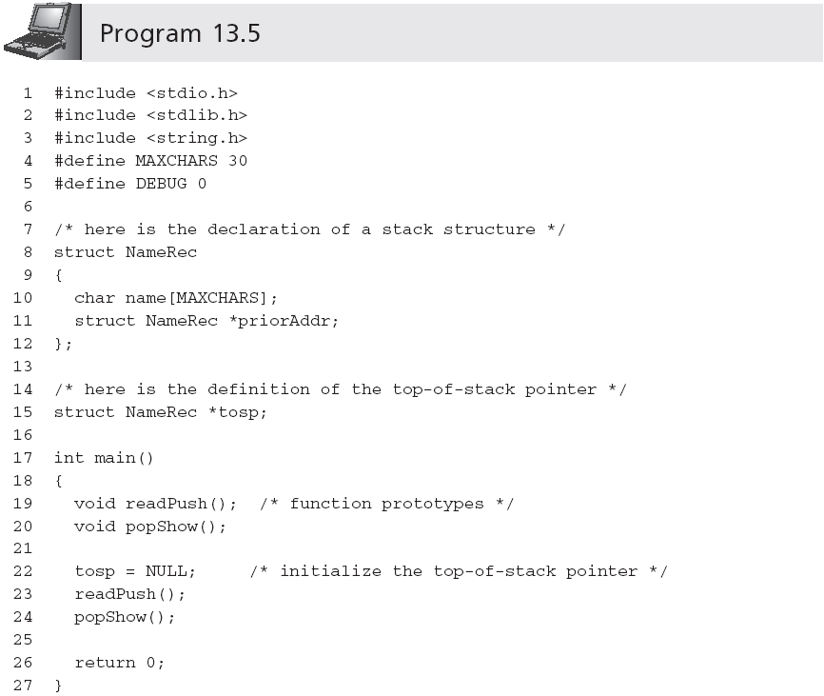
PUSH and POP (continued)

Slide 25
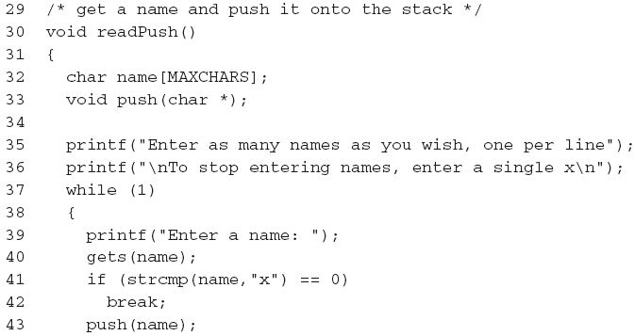
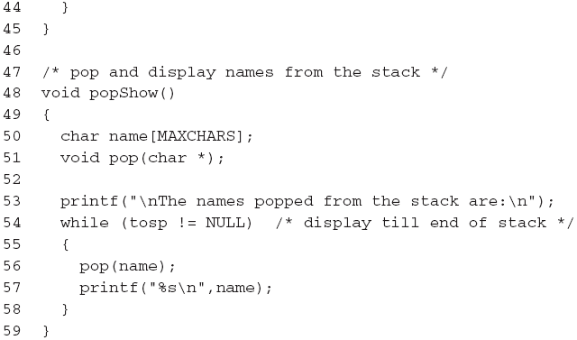
PUSH and POP (continued)

Slide 26
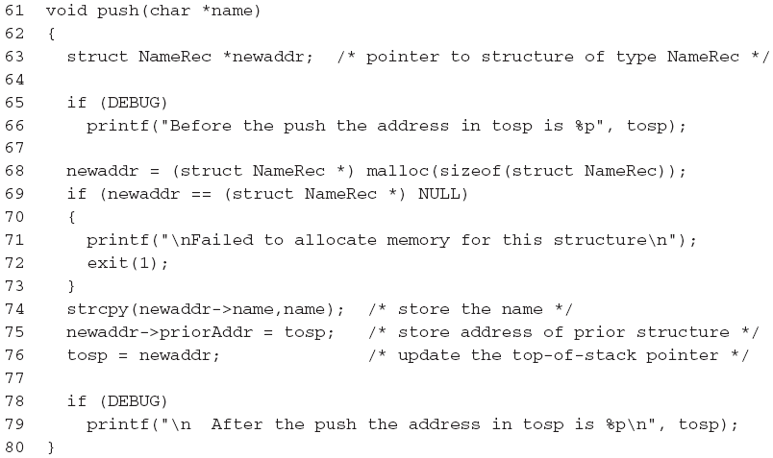
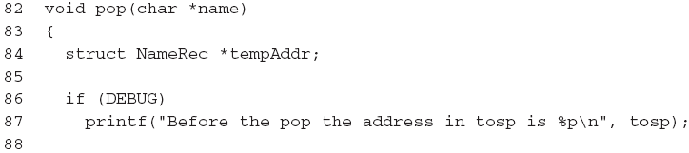
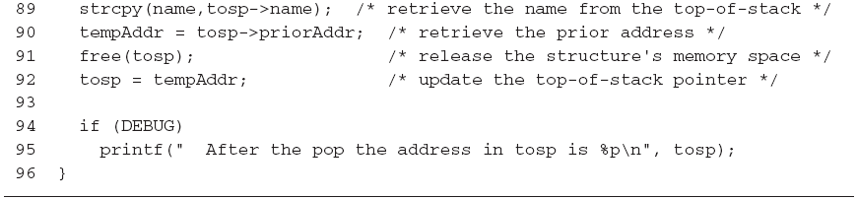
PUSH and POP (continued)

Slide 27
PUSH and POP (continued)
A sample run using Program 13.5 produced the following:
  Enter as many names as you wish, one per line
  To stop entering names, enter a single x
  Enter a name: Jane Jones
  Enter a name: Bill Smith
  Enter a name: Jim Robinson
  Enter a name: x
  The names popped from the stack are:
  Jim Robinson
  Bill Smith
  Jane Jones

Slide 28
Queues
A second important data structure that relies on linked structures is called a queue
  Items are removed from a queue in the order in which they were entered
  It is a first in, first out (FIFO) structure

Slide 29
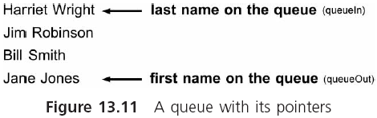
Queues (continued)

Slide 30
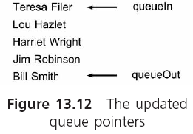
Queues (continued)

Slide 31
Enque and Serve
Enqueueing: placing a new item on top of the queue
Serving: removing an item from a queue

Slide 32
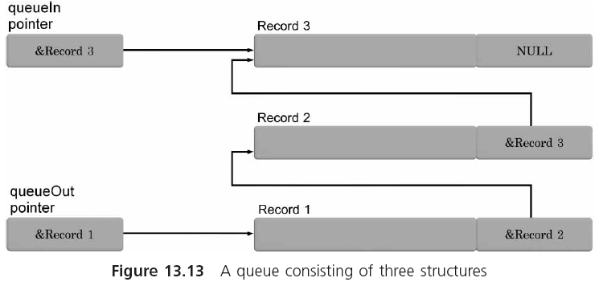
Enque and Serve (continued)

Slide 33
Enque and Serve (continued)
Enqueue (add a new structure to an existing queue)
Dynamically create a new a structure
Set the address field of the new structure to a NULL
Fill in the remaining fields of the new structure
Set the address field of the prior structure (which is pointed to by the queueIn pointer) to the address of the newly created structure
Update the address in the queueIn pointer with the address of the newly created structure

Slide 34
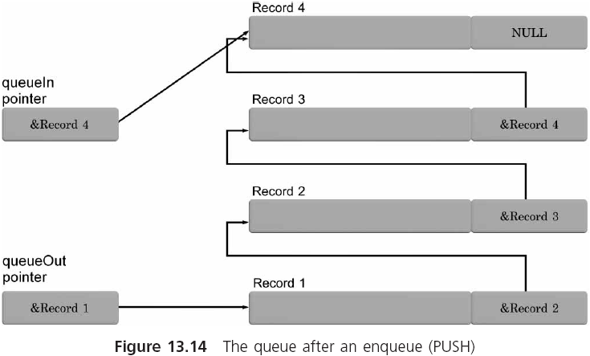
Enque and Serve (continued)

Slide 35
Enque and Serve (continued)
Serve (remove a structure from an existing queue)
Move the contents of the structure pointed to by the queueOut pointer into a work area
Free the structure pointed to by the queueOut pointer
Move the address in the work area address field into the queueOut pointer

Slide 36
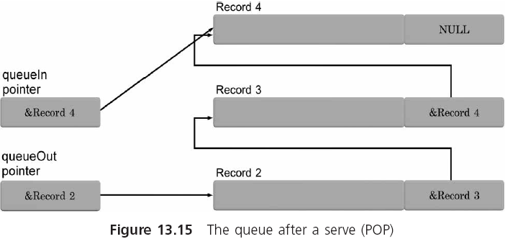
Enque and Serve (continued)

Slide 37
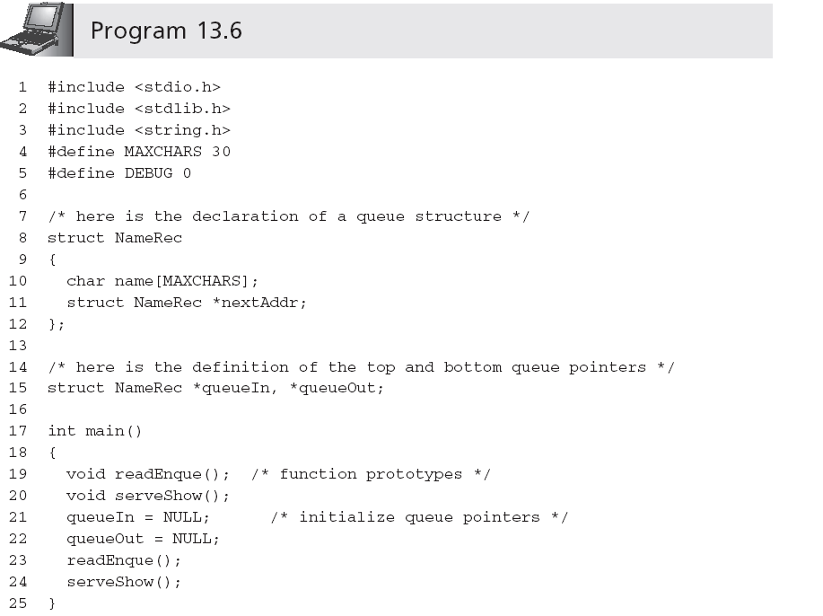
Enque and Serve (continued)

Slide 38
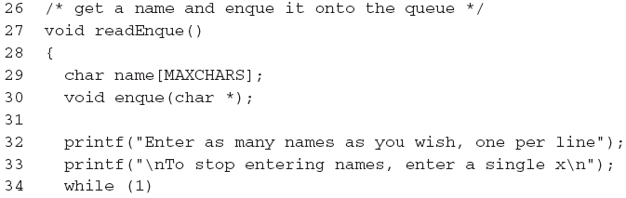
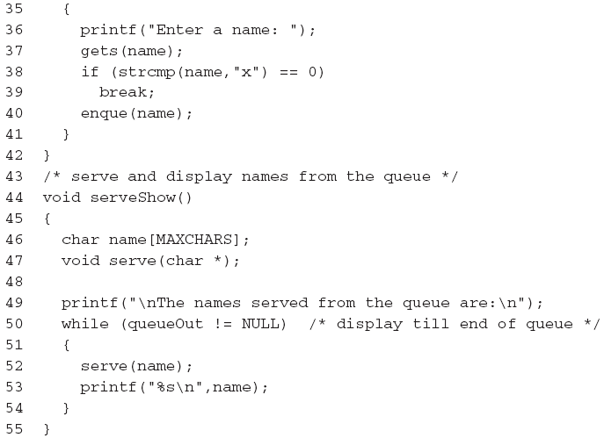
Enque and Serve (continued)

Slide 39
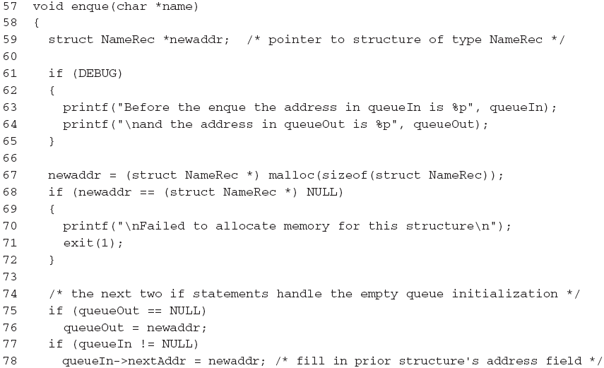
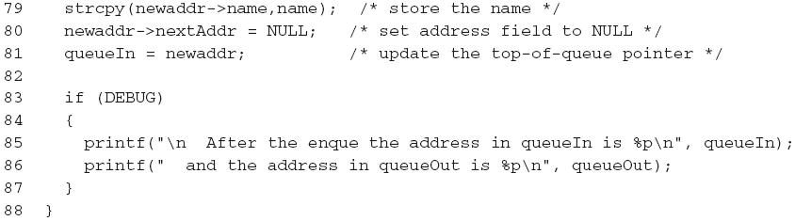
Enque and Serve (continued)

Slide 40
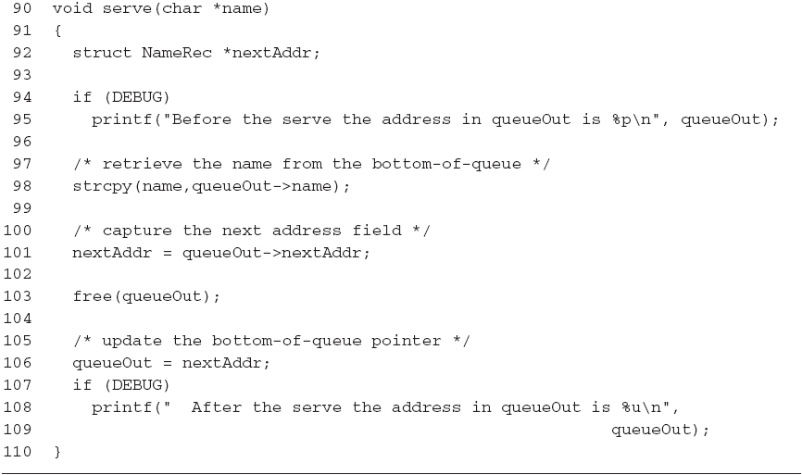
Enque and Serve (continued)

Slide 41
Enque and Serve (continued)
A sample run using Program 13.6 produced the following:
  Enter as many names as you wish, one per line
  To stop entering names, enter a single x
  Enter a name: Jane Jones
  Enter a name: Bill Smith
  Enter a name: Jim Robinson
  Enter a name: x
  The names served from the queue are:
  Jane Jones
  Bill Smith
  Jim Robinson

Slide 42
Dynamically Linked Lists
Both stacks and queues are examples of linked lists in which elements can only be added to and removed from the ends of the list
In a dynamically linked list, this capability is extended to permit adding or deleting a structure from anywhere within the list
Such a capability is extremely useful when structures must be kept within a specified order

Slide 43
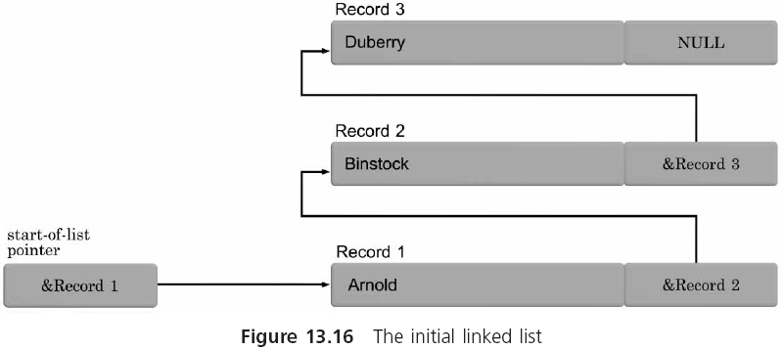
INSERT and DELETE
Key field

Slide 44
INSERT and DELETE (continued)
INSERT (add a new structure into a linked list)
Dynamically allocate space for a new structure
If no structures exist in the list
Set the address field of the new structure to a NULL
Set address in the first structure pointer to address of newly created structure
Else /* we are working with an existing list */
Locate where this new structure should be placed
If this structure should be the new first structure in the list
Copy current contents of first structure pointer into address field of newly created structure
Set address in the first structure pointer to address of newly created structure
Else
Copy the address in the prior structure’s address member into the address field of the newly created structure
Set address of prior structure’s address member to address of newly created structure
EndIf
EndIf

Slide 45
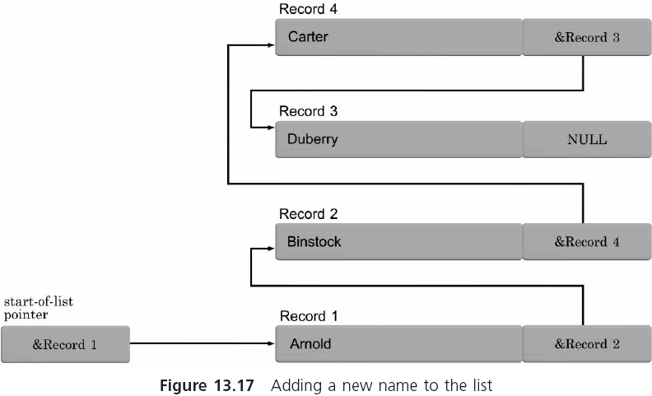
INSERT and DELETE (continued)

Slide 46
INSERT and DELETE (continued)
LINEAR LOCATION for INSERTING a NEW STRUCTURE
If the key field of the new structure is less than the first structure’s key field the new structure should be the new first structure
Else
While there are still more structures in the list
Compare the new structure’s key value to each structure key
Stop the comparison when the new structure key either falls between two existing structures or belongs at the end of the existing list
EndWhile
EndIf

Slide 47
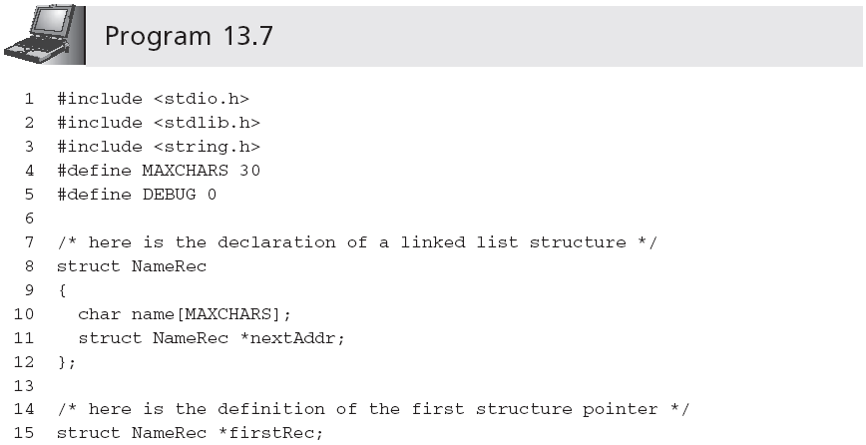
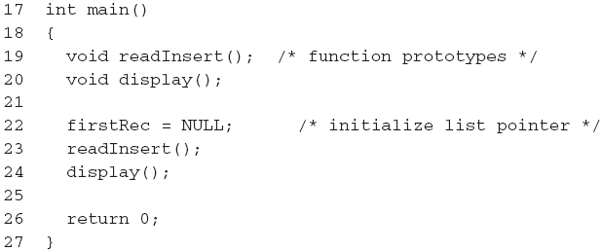
INSERT and DELETE (continued)
See Slide 50
See Slide 50

Slide 48
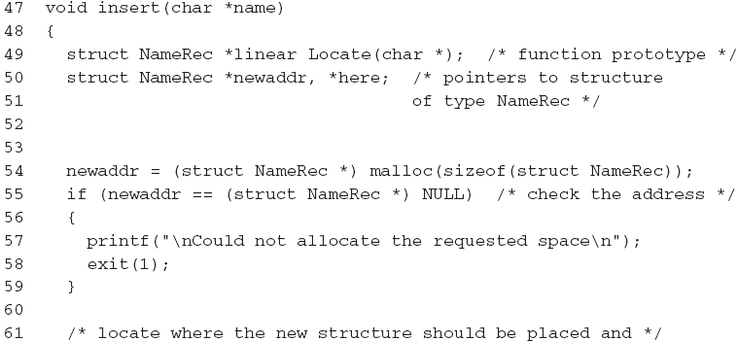
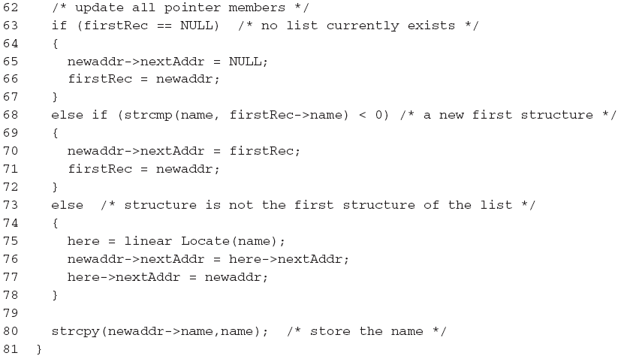
INSERT and DELETE (continued)

Slide 49
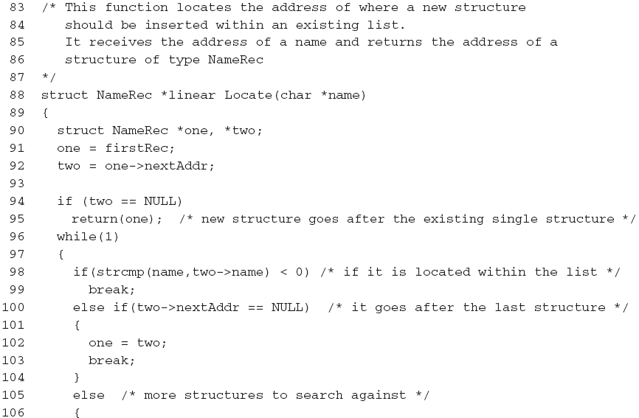
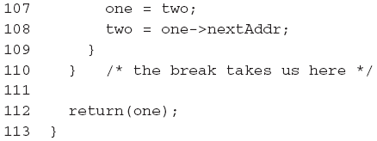
INSERT and DELETE (continued)

Slide 50
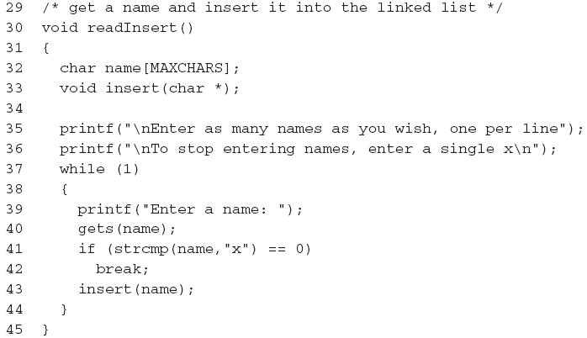
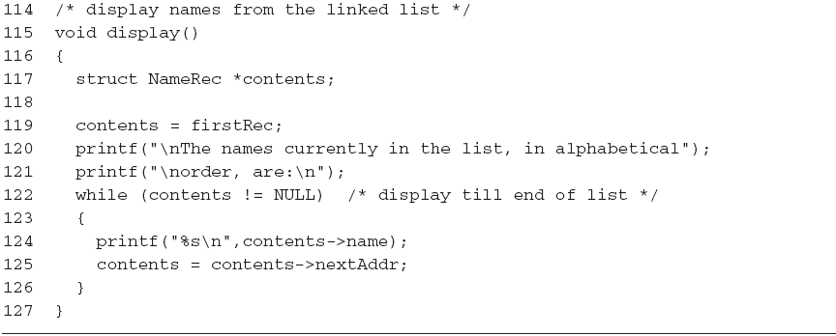
INSERT and DELETE (continued)
...(code for insert() and locate() goes here)…

Slide 51
INSERT and DELETE (continued)
The following sample run shows the results of these tests:
  Enter as many names as you wish, one per line
  To stop entering names, enter a single x
  Enter a name: Binstock
  Enter a name: Arnold
  Enter a name: Duberry
  Enter a name: Carter
  Enter a name: x
  The names currently in the list, in alphabetical
  order, are:
  Arnold
  Binstock
  Carter
  Duberry

Slide 52
Common Programming Errors
Not checking the return codes provided by malloc() and realloc()
Not correctly updating all relevant pointer addresses when adding or removing structures from dynamically created stacks, queues, and linked lists
Forgetting to free previously allocated memory space when the space is no longer needed

Slide 53
Common Programming Errors (continued)
Not preserving the integrity of the addresses contained in the top-of-stack pointer, queue-in, queue-out, and list pointer when dealing with a stack, queue, and dynamically linked list, respectively
Related to the previous error is the equally disastrous one of not correctly updating internal structure pointers when inserting and removing structures from a stack, queue, or dynamically linked list

Slide 54
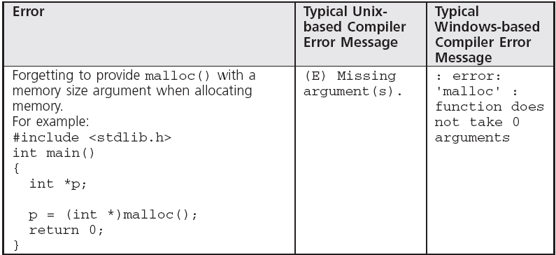
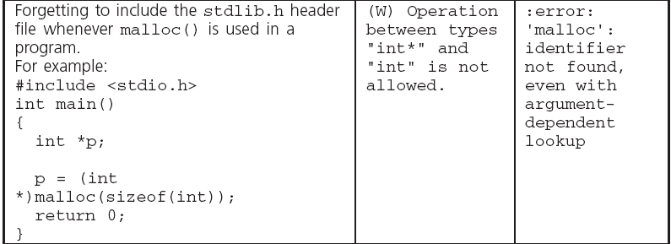
Common Compiler Errors

Slide 55

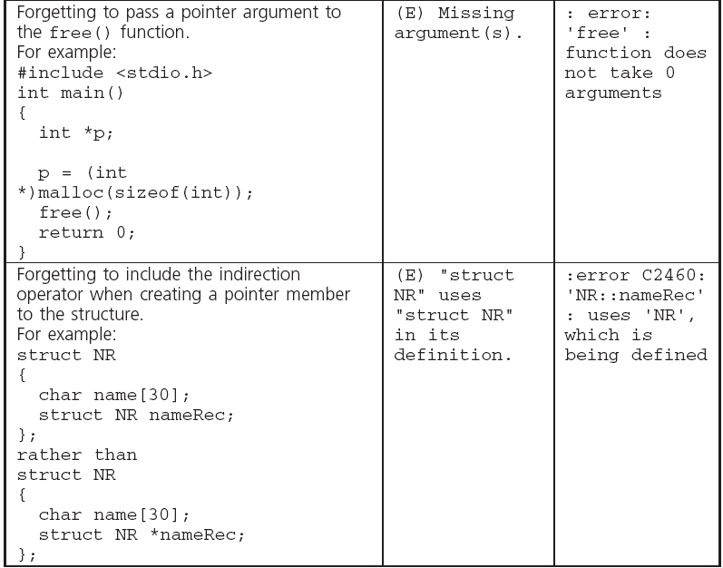
Common Compiler Errors (continued)

Slide 56
Summary
An alternative to fixed memory allocation for variables at compile time is the dynamic allocation of memory at run time
malloc() reserves a requested number of bytes and returns a pointer to the first reserved byte
realloc() operates in a similar fashion as malloc() except it is used to expand or contract an existing allocated space
free() is used to deallocate previously allocated memory space

Slide 57
Summary (continued)
A stack is a list consisting of structures that can only be added and removed from the top of the list
A queue is a list consisting of structures that are added to the top of the list and removed from the bottom of the list
A dynamically linked list consists of structures that can be added or removed from any position in the list

