Slide 1
Ai resume critiquer
CAPSTONE PROJECT
Presented By:
Student Name- Krrish Kunal Raut
College Name- Vidyabharti Mahavidyalaya, Amravati
Department- BCA (Data Science)

Slide 2
OUTLINE
Problem Statement (Should not include solution)
Proposed System/Solution
System Development Approach (Technology Used)
Algorithm & Deployment
Result
Conclusion
Future Scope
References

Slide 3
Problem Statement
.
AI-Powered Resume Critiquer & ATS Optimization System
In today’s competitive job market, students and fresh graduates often struggle to create professional, well-structured resumes that effectively highlight their skills, achievements, and career goals. Most applicants rely on generic templates or manual feedback, which fails to address role-specific requirements and Applicant Tracking System (ATS) compatibility. As a result, many qualified candidates are filtered out during automated resume screening processes before reaching recruiters.
There is a need for an intelligent, automated solution that can analyze resumes, evaluate keyword alignment with targeted job roles, assess ATS compatibility, and provide personalized, actionable feedback. Such a system should be accessible, easy to use, and capable of delivering instant, professional-level resume improvement suggestions.
This project aims to develop an AI-powered Resume Critiquer and ATS Optimization System that enables users to upload resumes, receive ATS match scores, and obtain structured, role-specific recommendations using generative AI. The platform helps students improve their resumes efficiently, increasing their visibility and chances of success in job and internship applications.

Slide 4
Proposed Solution
The proposed solution is a web-based intelligent platform that leverages Generative Artificial Intelligence and automated text analysis techniques to evaluate resumes and provide structured, personalized feedback in real time.
The system allows users to upload their resumes in PDF or text format and optionally specify a target job role. The platform extracts and processes the resume content, calculates an ATS compatibility score by matching role-specific keywords, and uses a Generative AI engine to generate professional, actionable improvement suggestions.
Key Components of the Solution:
User Interface (Web Application):
A simple and interactive web interface built using Streamlit that enables users to upload resumes, select AI mode, and view feedback instantly.
Resume Processing Module:
Extracts text from PDF and TXT files, cleans and structures the content for analysis.
ATS Scoring Engine:
Compares resume content with job role keywords to compute a compatibility score and provides visual indicators of resume strength.
Generative AI Feedback Engine:
Uses Google Gemini AI to generate structured, role-specific recommendations for improving resume clarity, impact, formatting, and keyword optimization.
Caching & Performance Control:
Prevents repeated API calls for the same resume using file hashing and request cooldown, improving efficiency and reducing costs.
Security & Configuration Layer:
Protects sensitive API keys using environment variables and excludes them from public repositories.

Slide 5
System Approach
Text Extraction:
The system extracts and preprocesses the resume content for analysis.
ATS Evaluation:
Job role keywords are matched against resume text to calculate an ATS compatibility score.
AI Analysis:
The processed resume content is sent to a Generative AI model to generate structured, role-specific feedback.
Result Display:
The platform displays the ATS score and AI-generated recommendations in a clear and user-friendly format.
User Input:
The user uploads a resume (PDF/TXT) and optionally enters a target job role through the web interface.
Performance Control:
Caching and request throttling are used to prevent repeated processing of the same resume and reduce API usage.

Slide 6
Algorithm & Deployment
Algorithm
Start the system.
Accept resume file (PDF/TXT) and optional target job role from the user.
Validate file format and check if the file is empty.
Extract and preprocess text from the resume.
Calculate ATS compatibility score by matching job role keywords with resume content.
Generate a structured prompt using the extracted resume text and job role.
Send the prompt to the Generative AI model.
Receive AI-generated feedback and recommendations.
Cache the result to avoid reprocessing the same resume.
Display ATS score and feedback to the user.
End.
Deployment
The application is hosted as a web-based platform using Streamlit.
The project source code is stored and managed on GitHub for version control.
Required dependencies are listed in a requirements.txt file for easy installation.
Environment variables are used to securely store API keys and configuration settings.
The application can be deployed on cloud platforms such as Streamlit Cloud, Hugging Face Spaces, or Render.
Users access the system through a web browser without installing any local software.
Continuous updates and improvements can be made by pushing changes to the GitHub repository and redeploying the application.
.

Slide 7
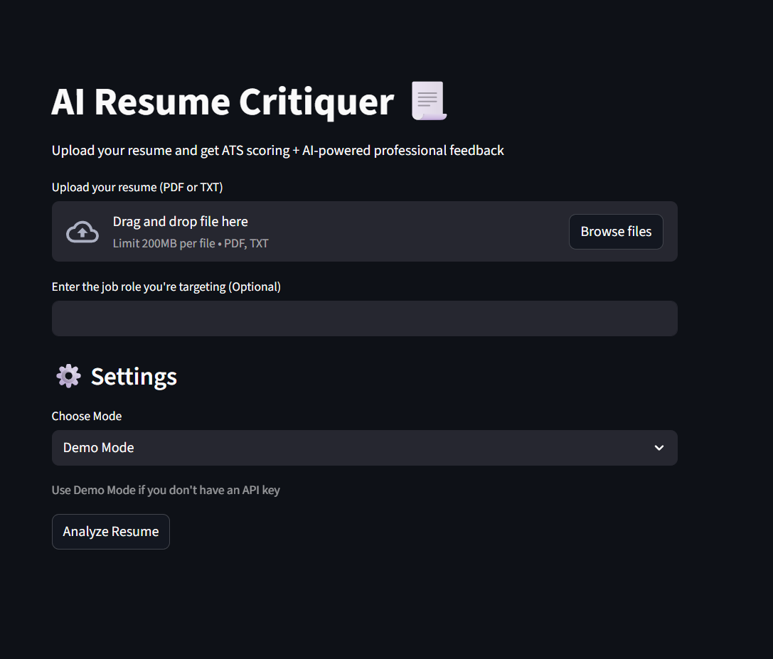
Result

Slide 8
Conclusion
Conclusion
The AI-Powered Resume Critiquer and ATS Optimization System successfully demonstrates how Generative Artificial Intelligence can be applied to improve the quality and effectiveness of resumes. By combining automated text extraction, ATS compatibility scoring, and AI-driven feedback, the system provides users with structured, role-specific recommendations in real time.
This project enhances students’ and job seekers’ ability to optimize their resumes for both automated screening systems and human recruiters. The platform is user-friendly, scalable, and secure, making it suitable for academic, professional, and institutional use. The solution highlights the potential of AI in transforming traditional career development tools into intelligent, accessible, and impactful digital platforms.

Slide 9
Future scope
Multi-Format Resume Support:
Extend the system to support additional file formats such as DOCX and image-based resumes using OCR technology.
Advanced ATS Simulation:
Implement industry-specific ATS algorithms to simulate real recruitment systems for more accurate scoring.
Personalized Career Insights:
Provide career path suggestions, skill gap analysis, and recommended certifications based on resume content.
Multi-Language Support:
Enable resume analysis and feedback in multiple languages for global accessibility.
Job Portal Integration:
Integrate with platforms like LinkedIn and job portals to analyze job descriptions and tailor resumes automatically.
Analytics Dashboard:
Add user dashboards to track resume improvement progress over time and compare ATS scores across versions.
Enterprise Deployment:
Scale the system for institutional use in colleges, training centers, and recruitment agencies.
.

Slide 10
References
Streamlit Documentation. Streamlit: The Fastest Way to Build Data Apps in Python. Available at: https://docs.streamlit.io
Google Generative AI Documentation. Gemini API & SDK Guide. Available at: https://ai.google.dev
PyPDF2 Documentation. Python PDF Processing Library. Available at: https://pypdf2.readthedocs.io
GitHub. Version Control and Collaboration Platform. Available at: https://github.com
Python Software Foundation. Python Programming Language Documentation. Available at: https://docs.python.org

Slide 11
Github link
Github Link -
https://github.com/Krrish-Raut/ai-resume-critiquer.git
Deployment link -
https://ai-resume-critiquer-nansgpymrs4uywzkbyhnd3.streamlit.app

Slide 12
THANK YOU

