Slide 1

EcoStream AI
Transforming Waste Management with
Computer Vision & Geospatial Intelligence
Team Members:
Prajwal Patil (23BTRCT101)
Prakash Sharma (23BTRCT104)
Neerav Babel (23BTRCt088) Mahantappa R Patted (23BTRCT066) Krrish Jain (23BTRCT061)
Guide: Dr. ShivaKumar C
PCL Review Presentation • Computer Vision + Geospatial AI •

Slide 2

02 / Problem Statement
🚨 The Problem
Crores
🏙️ Overflowing Waste
Uncollected garbage in urban areas causes public health hazards and environmental pollution.
wasted on inefficient routing
🚛 Blind Routing
60–70%
Garbage trucks follow fixed routes with no data — missing critical overflow zones daily.
of waste pickup relies on manual reporting
📋 Manual Reporting Friction
Citizens must fill long forms to report waste. Most don't bother — leaving hotspots unreported.
Zero Visibility
for municipalities on real-time waste spots
🌍 Climate Impact
Inefficient collection worsens urban carbon footprint and misses sustainability targets.
⭐ Our Unique Approach: Passive AI — User just takes a photo, the system does everything else automatically.

Slide 3

03 / Proposed Solution
💡 How EcoStream AI Works
EcoStream AI is a real-time, computer-vision powered ecosystem connecting a citizen-facing smartphone scanner with a live Government Command Center — powered entirely by Passive AI.
📱 Citizen App
🤖 AI Processing
🗺️ Gov Dashboard
✓ Scans waste with phone camera
✓ YOLO detects waste materials
✓ Live KDE heatmap updates
✓ Gets instant AI classification
✓ Llama 4 multimodal analysis
✓ Red/orange hotspot alerts
✓ Receives local disposal rules
✓ RAG chatbot retrieves laws
✓ One-click zone clearance
✓ Contributes to city heatmap
✓ Parallel inference pipeline
✓ Predictive analytics view
"A scalable ecosystem that takes the guesswork out of keeping our cities clean."

Slide 4

04 / Target Users
👥 Who Uses EcoStream AI?
🌱 Eco-Warrior Citizen
🏛️ Municipal Dispatcher
👩
👨‍💼
Riya — The Active Resident
Officer Sharma — Gov Official
→ Sees a plastic bottle pile on her street
→ Manages fleet in Bengaluru daily
→ Doesn't know the municipal hotline
→ Limited trucks, unlimited hotspots
→ Opens EcoStream, snaps a photo
→ Opens Command Dashboard at 8 AM
→ AI identifies, advises, and plots it
→ Sees live heatmap of critical zones
→ Feels empowered — city is cleaner!
→ Routes trucks intelligently — done!
Both users interact with the same backend — creating a closed-loop civic feedback system.

Slide 5

05 / Core Features
⚙️ Core Features
🤖 Real-time Multimodal Vision
💬 Rule-Grounded RAG Chatbot
🗺️ Live Geospatial Heatmaps
Dual-pipeline YOLO + Llama 4 Vision engine classifies complex waste types (plastic, metal, e-waste) with high accuracy.
AI assistant grounded in local Indian municipal disposal laws. Uses ChromaDB vector store — never hallucinates.
Central dashboard dynamically updates Kernel Density Estimation hotspots within seconds of a citizen scan.
📊 Predictive Analytics
🚛 Zone Collection Logic
Automatically forecasts next-day waste accumulation zones using advanced statistical modeling — proactive dispatch.
Government operators clear geographical radius zones with a single click once garbage trucks pick up waste.

Slide 6

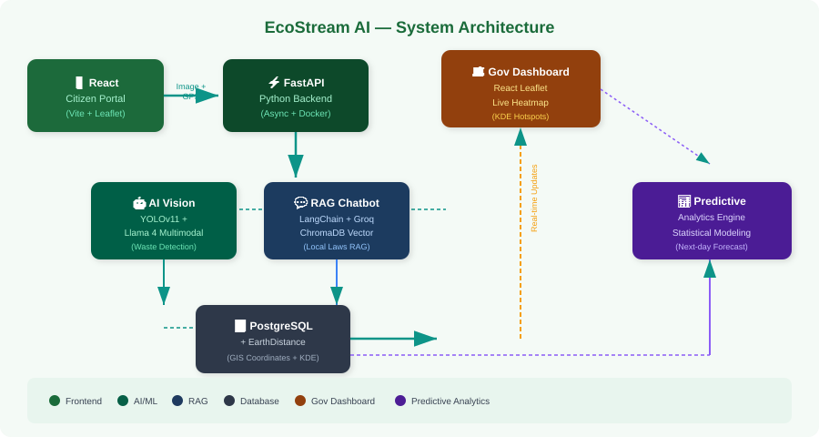
06 / System Architecture
🧱 System Architecture

Slide 7

07 / Tech Stack
🛠️ Tech Stack & Why These Tools?
React + Vite + Leaflet
Frontend
Why: Vite is 10× faster for dev. Leaflet enables interactive maps without costly Google Maps API fees.
FastAPI (Python)
Backend
Why: Async by design — handles hundreds of concurrent AI image streams flawlessly with minimal latency.
YOLOv11 + LangChain + Llama 4
AI / ML
Why: YOLO for lightning-fast edge inference. Llama 4 for state-of-the-art open-weights multimodal understanding.
PostgreSQL + EarthDistance
Database
Why: Postgres processes GIS radius checks natively at blazing speed — traditional DBs can't match this.
Docker + Microservices
Infra
Why: Heavy Vision container isolated from API routing — prevents crashes, enables independent scaling.

Slide 8

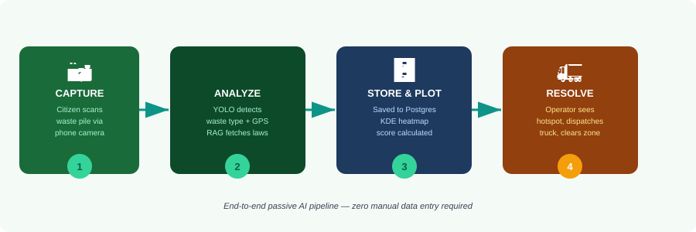
08 / Workflow
🔄 End-to-End Workflow
Step 1: Capture
Step 2: Analyze (Parallel)
Step 3: Store & Plot
Step 4: Resolve
Phone camera + GPS fetch
YOLO + RAG simultaneously
PostgreSQL + KDE scoring
Dispatch truck + clear zone

Slide 9

09 / Future Scope
📊 Innovation Roadmap
Phase 2
Phase 3
Phase 4
🎮 Gamification & Eco-Tokens
🚛 Automated Truck Dispatch
📱 Native Mobile App
✦ Reward citizens with 'Eco-Tokens' for reporting waste correctly
✦ Connect hotspot prediction to VRP (Vehicle Routing Problem) solver
✦ Port Vite PWA to true React Native iOS/Android app
✦ Municipal tax discounts for top eco-warriors
✦ Auto-generate optimal truck routes each morning
✦ Background GPS tracking for passive reporting
✦ Leaderboards and community challenges per ward
✦ Reduces fuel consumption and response time
✦ Offline-first capability for low-connectivity areas
✦ Increases citizen participation rate exponentially
✦ Integration with smart city infrastructure APIs
✦ App Store & Play Store distribution
Vision: A self-sustaining smart city waste ecosystem powered by community + AI + automation.

Slide 10
🧪 Conclusion
EcoStream AI bridges the gap between civic responsibility and municipal efficiency through the power of multi-modal AI tracking.
Technological Milestones:
Delivered a fully asynchronous, multimodal AI pipeline capable of complex environmental classification.
Built a zero-hallucination RAG chatbot ensuring strict compliance with local government disposal laws.
Integrated real-time GIS mathematical forecasting (KDE) to replace manual infrastructure surveys.
"A scalable, production-ready ecosystem that proves AI can take the guesswork out of keeping our cities clean and sustainable."

