Slide 1
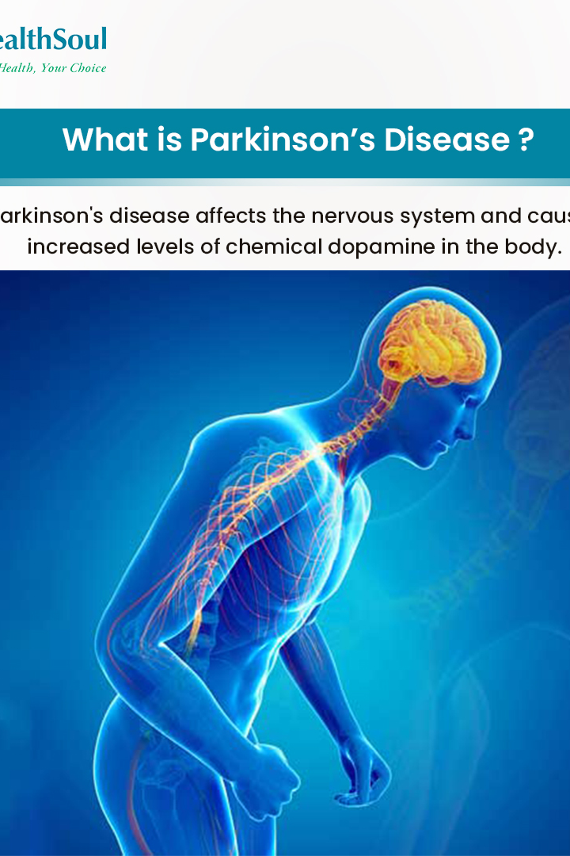
Parkinson's Intensity Estimation through Voice Pattern Analysis

Slide 2

Brief Overview of Parkinson's Disease
Parkinson's disease is a neurodegenerative disorder that primarily affects movement. It occurs when nerve cells (neurons) in the brain that produce dopamine, a chemical messenger crucial for movement control, become damaged or die. The exact cause of Parkinson's is not fully understood, and both genetic and environmental factors may contribute. Key characteristics and symptoms of Parkinson's disease include:
Tremors
Bradykinesia (Slowness of movements)
Stiffness
Postural Instability
Impaired Coordination
Changes in Facial Expression
Parkinson's disease is a progressive condition, meaning symptoms worsen over time. While there is no cure, various treatments, including medications and physical therapy, can help manage symptoms and improve quality of life for individuals with Parkinson's. Ongoing research aims to better understand the disease's underlying mechanisms and develop more effective treatments.

Slide 3

Importance of Intensity Detection and Monitoring
Early detection and monitoring of Parkinson's disease are crucial for several reasons:
1. Early Intervention
2. Slowing Disease Progression
3. Improved Symptom Management
4. Enhanced Patient Care
5. Clinical Research and Development
6. Prevention of Complications

Slide 4

Parkinson's Disease and Voice Patterns
Parkinson's disease can impact various aspects of an individual's life, including their voice patterns. In the context of Parkinson's, changes in voice patterns are often referred to as "hypokinetic dysarthria." Some key points about Parkinson's disease and voice patterns include:
1. Monotone and Reduced Loudness
2. Impact on Communication
3. Speech Rate Changes
4. Difficulty Initiating Speech
5. Voice Tremors
Understanding and analyzing these voice pattern changes have become an area of interest in research and healthcare. Machine learning models can be trained to detect and analyze these alterations in voice characteristics, offering a potential avenue for early detection and monitoring of Parkinson's disease. By leveraging voice patterns as a diagnostic tool, researchers aim to create non-invasive, accessible methods for assessing Parkinson's severity and progression.

Slide 5

Reasons for using Voice Patterns for Intensity Estimation
1. Non-Invasiveness: Voice pattern analysis provides a non-invasive method for assessing Parkinson's intensity. It involves recording and analyzing natural speech, eliminating the need for invasive procedures or physical examinations.
2. Early Detection: Changes in voice patterns can occur in the early stages of Parkinson's disease, even before other motor symptoms become apparent. Utilizing voice patterns allows for early detection, enabling timely intervention and treatment.
3. Quantifiable Markers: Voice patterns offer quantifiable markers that can be objectively measured and analyzed. Machine learning models can be trained to identify subtle variations in speech characteristics associated with Parkinson's, providing a quantitative basis for intensity estimation.
4. Accessible and Cost-Effective: Voice recording is a relatively simple and cost-effective method, making it accessible for both healthcare professionals and patients. This accessibility supports widespread adoption and monitoring, especially in remote or underserved areas.
5. Continuous Monitoring: Voice pattern analysis facilitates continuous monitoring of Parkinson's intensity. Regular assessments over time can provide insights into disease progression, allowing for dynamic adjustments to treatment plans.
6. Integration with Technology: Advances in technology, including machine learning and mobile applications, make it feasible to integrate voice pattern analysis into wearable devices or mobile apps. This enables real-time monitoring and immediate feedback for both patients and healthcare providers.

Slide 6
Machine Learning Algorithms and Methodologies used
1. Linear Regression:
Imported from sklearn.linear_model.
Used for linear regression modeling.
2. Elastic Net Regressor:
Imported from sklearn.linear_model.
Used for elastic net regression modeling.
3. Principal Component Analysis (PCA):
Imported from sklearn.decomposition.
Used for dimensionality reduction.
4. Train-Test Split:
Imported from sklearn.model_selection.
Used for splitting the dataset into training and testing sets.
5. Random Forest Regressor:
Imported from sklearn.ensemble.
Used for random forest regression modeling.
6. Evaluation Metrics:
Various evaluation metrics are used, such as mean squared error, root mean squared error, mean absolute error, and R-squared score.
Imported from sklearn.metrics.

Slide 7

Project Components
1. Data Loading
2. Data Exploration
3. Data Preprocessing:
- Handling missing values.
- Extracting features and target variable.
- Scaling or normalizing the data.
- Splitting the data into training and testing sets.
4. Dimensionality Reduction:
- Applying Principal Component Analysis (PCA) for dimensionality reduction.
5. Model Training:
- Training machine learning models using Linear Regression, Elastic Net Regressor, and Random Forest Regressor.
6. Model Evaluation:
- Evaluating the performance of the models using various metrics, such as mean squared error, root mean squared error, mean absolute error, and R-squared score.
7. Model Selection

Slide 8
Project Components (continued)
8. Prediction:
- Making predictions on the test set using the selected model.
9. Result Analysis:
- Analyzing the results and model performance.
10. Visualization:
- Plotting graphs to visualize the actual vs predicted values.
11. Hyperparameter Tuning:
- Fine-tuning hyperparameters for the Elastic Net Regressor and Random Forest Regressor.
12. Miscellaneous:
- Importing necessary libraries.
- Printing and displaying information about the dataset and model performance.

Slide 9

Final Outputs
Discover the anticipated final output of our project, including the expected results of our intensity estimation model and their potential implications for Parkinson's disease management.

Slide 10
Benefits and Applications
Early Detection: Parkinson's intensity estimation can contribute to early disease detection, enabling timely intervention and treatment to alleviate symptoms and potentially slow disease progression.
Personalized Treatment Plans: Accurate intensity estimation allows healthcare professionals to tailor treatment plans to the specific needs of individuals, providing personalized care and optimizing symptom management.
Objective Monitoring: Objective measures of Parkinson's intensity, derived from voice patterns or other data, provide a quantitative basis for monitoring disease progression. This can supplement subjective assessments and enhance the precision of clinical evaluations.
Clinical Trials and Research: Accurate intensity estimation contributes valuable data to clinical trials and research studies focused on Parkinson's disease. This aids in understanding the efficacy of treatments, identifying potential biomarkers, and advancing scientific knowledge.
Optimizing Resource Allocation: Efficiently estimating Parkinson's intensity helps healthcare systems allocate resources effectively, ensuring that individuals with higher intensity levels receive appropriate attention and care.
Empowering Patients: Providing patients with insights into the intensity of their Parkinson's disease empowers them to actively participate in their care. It enhances self-awareness and encourages lifestyle modifications that may positively impact their health.

Slide 11

Challenges and Limitations
Parkinson's intensity estimation using voice patterns presents several challenges and limitations that researchers and developers need to consider:
1. Heterogeneity of Symptoms: Parkinson's disease manifests with a wide range of symptoms and progresses differently in each individual. The heterogeneity of symptoms makes it challenging to capture the full complexity of the disease solely through voice pattern analysis.
2. Variability in Speech: Natural variations in speech due to factors like age, gender, and cultural differences can introduce noise into the analysis. Distinguishing between Parkinson's-related changes and normal speech variability is a complex task.
3. Co-occurring Conditions: Individuals with Parkinson's disease may also have co-occurring conditions or comorbidities that influence voice patterns. Distinguishing the impact of Parkinson's from other contributing factors poses a significant challenge.
4. Lack of Standardization: The absence of standardized protocols for voice recording and analysis can lead to inconsistencies in data collection. Variations in recording equipment, ambient noise, and speech tasks may affect the reliability of results.

Slide 12
Challenges and Limitations (continued)
5. Dynamic Nature of Symptoms: Parkinson's symptoms can fluctuate throughout the day or across different days, making it challenging to obtain a representative and consistent sample for analysis. Dynamic changes in symptoms may not be fully captured during a single voice recording.
6. Limited Training Data: Obtaining large and diverse datasets for training machine learning models can be challenging, especially considering the relatively low prevalence of Parkinson's disease. Limited training data may impact the generalization ability of the models.
7. Ethical and Privacy Concerns: Voice data is personal and sensitive information. Ensuring the privacy and ethical use of voice recordings is crucial. Maintaining confidentiality while collecting and storing voice data requires robust security measures.
Despite these challenges, ongoing research and advancements in technology offer opportunities to address some of these limitations and improve the effectiveness of voice-based intensity estimation in Parkinson's disease. Collaborative efforts in data collection, model development, and cross-disciplinary research are essential for overcoming these challenges.

Slide 13
Conclusion and Future Scope
In conclusion, this project aimed to predict the Unified Parkinson's Disease Rating Scale (UPDRS) scores using machine learning. After exploring and cleaning the data, three different models were tested—Linear Regression, Elastic Net Regressor, and Random Forest Regressor. The Random Forest Regressor, fine-tuned through hyperparameter optimization, emerged as the most effective in predicting UPDRS scores. Visualizations comparing actual and predicted scores highlighted the model's accuracy. For the future, there's room to enhance the model by incorporating more features, trying advanced algorithms, and collaborating with medical experts for clinical insights. The project provides a foundation for predicting UPDRS scores, offering opportunities for further improvements and real-world applications in Parkinson's disease monitoring.

Slide 14
Bibliography
The dataset used in this project was sourced from multiple platforms, including
Kaggle (https://www.kaggle.com)
GitHub (https://github.com)
The online repository of the University of California, Irvine (UCI) (https://archive.ics.uci.edu/dataset/174/parkinsons)
The data compilation involves information related to Parkinson's disease, and efforts have been made to adhere to the respective terms of use and licensing agreements associated with each dataset. Proper attribution and acknowledgment are given to the original sources, and the project adheres to ethical standards in data utilization

