Slide 1
RESEARCH INTERNSHIP · IIT BHU
MMRDR
Multimodal Retinal Disease Recognition
Diabetic Retinopathy Grading · Lesion Detection · Custom Architecture
Krrish Baghla · krrishb.mc.24@nitj.ac.in

Slide 2
THE DATASET
MMRDR — Multimodal Retinal Image Dataset
CFP
UWF
OCT
11,118 images
10,404 images
2,938 images
Color Fundus Photography
Ultra-Wide Field Imaging
Optical Coherence Tomography
5-Grade DR
7 Lesion Types
24,460
Severity Scale
Per Image
Total Images

Slide 3
WHAT I DID
Internship Progress — Step by Step
01
Data Pipeline
Automated extraction via Figshare API · 80/20 train-test split · 512×512 resolution
02
Baseline ResNet-50
5-grade DR classification on CFP · Lesion detection with bounding boxes
03
Eye Masking
Removed bounding boxes outside retinal boundary · Cleaner detections
04
Custom Architecture
Multi-scale fusion · Dual-head for grading + lesion · GradCAM explainability

Slide 4
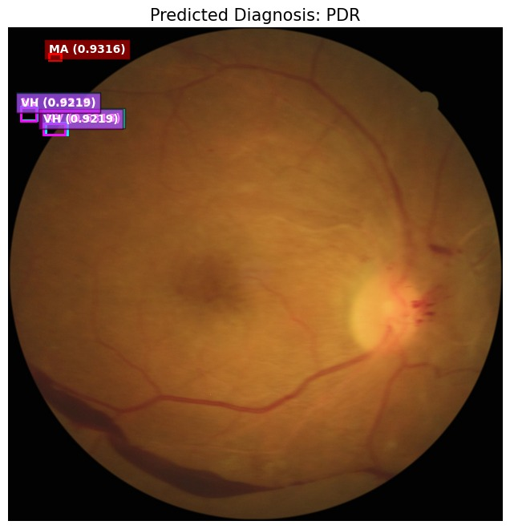
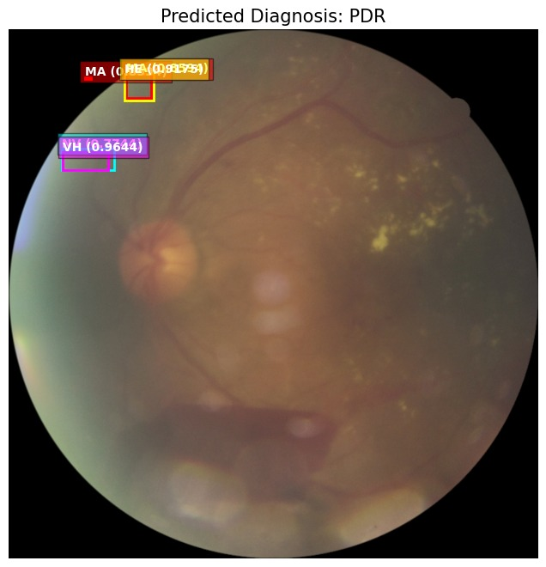
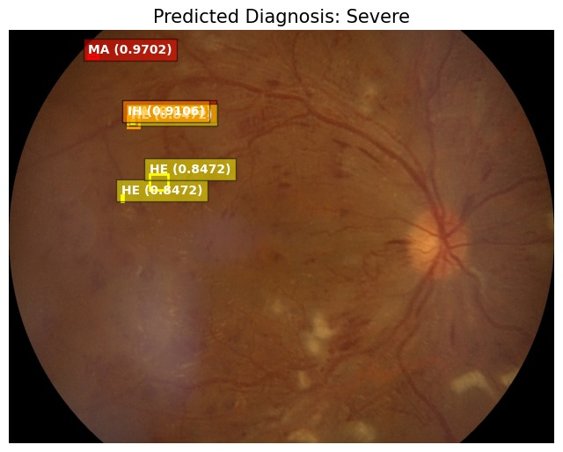
BASELINE MODEL
ResNet-50 · Lesion Detection Results
PDR · MA + VH detected
PDR · MA + NE + VH
Severe · MA + IH + HE
⚠ Issue: Bounding boxes were being predicted outside the retinal boundary → Led to custom architecture + eye masking

Slide 5
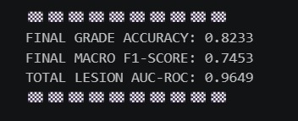
BASELINE RESULTS
ResNet-50 — Performance Metrics
82.33%
74.53%
96.49%
Grade Accuracy
Macro F1-Score
Lesion AUC-ROC
Training Terminal Output

Slide 6
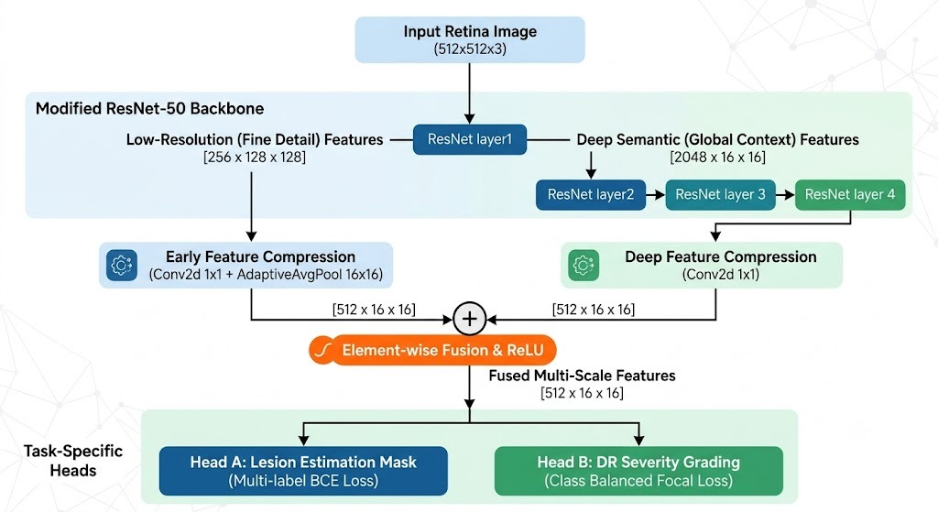
CUSTOM ARCHITECTURE
Modified ResNet-50 · Multi-Scale Dual-Head

Slide 7
HOW IT WORKS
Architecture Highlights
Low-Res Branch
Deep Semantic Branch
Element-wise Fusion
Early features [256×128×128] via ResNet Layer1 → fine detail preservation
Global context [2048×16×16] via Layers 2–4 → high-level understanding
Both branches compressed to [512×16×16], fused with ReLU activation
Head A — Lesion
Head B — DR Grade
Eye Masking
Multi-label BCE Loss for lesion estimation mask detection
Class-Balanced Focal Loss for 5-class severity grading
Circular mask applied to exclude predictions outside retinal boundary

Slide 8
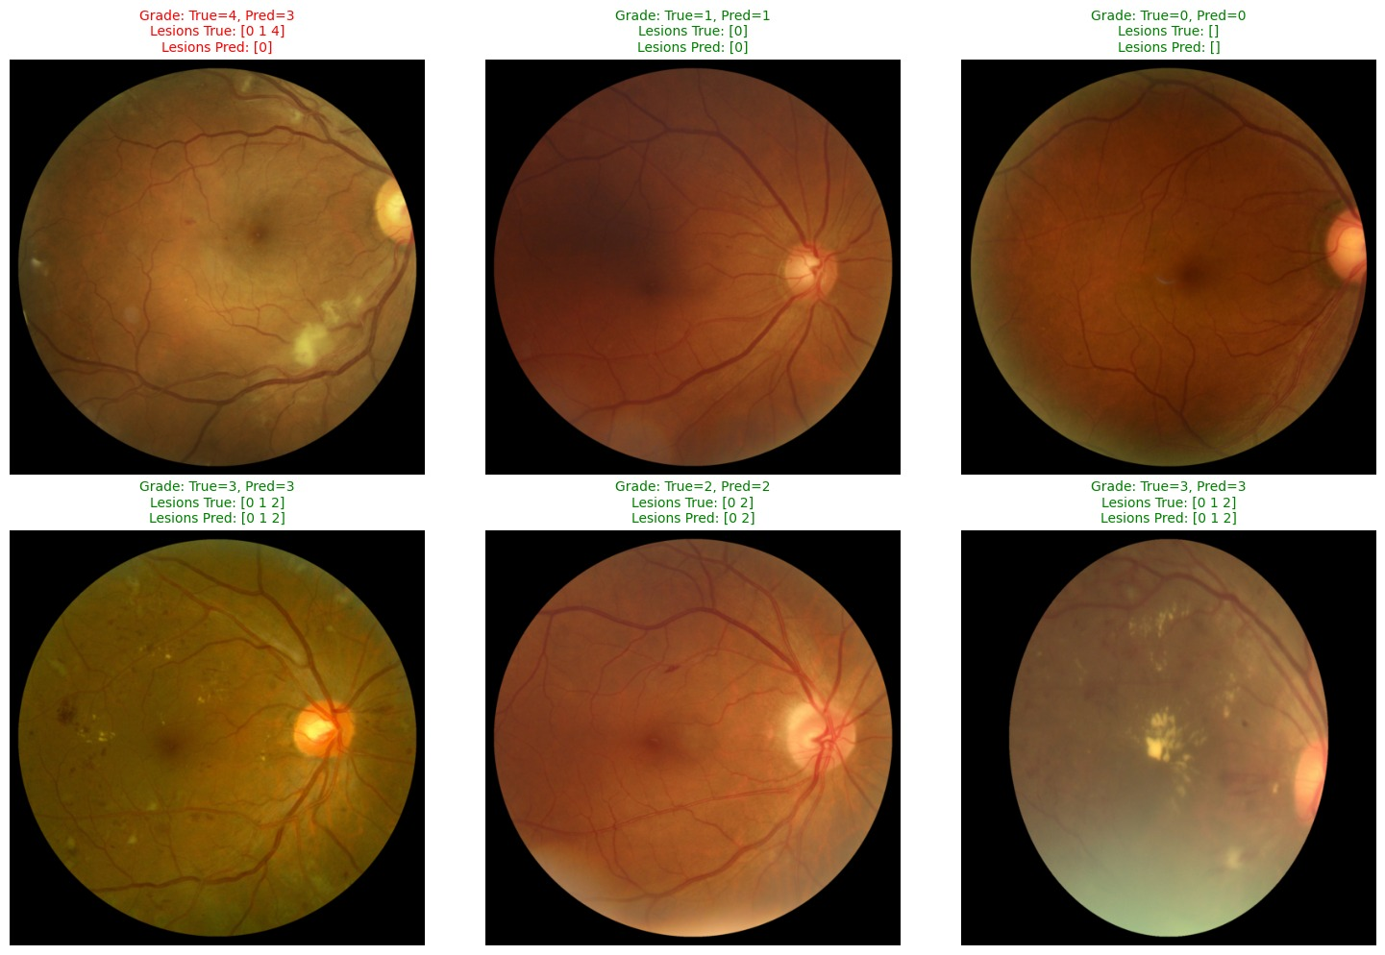
PREDICTION SAMPLES
Custom Architecture · Grade & Lesion Predictions

Slide 9
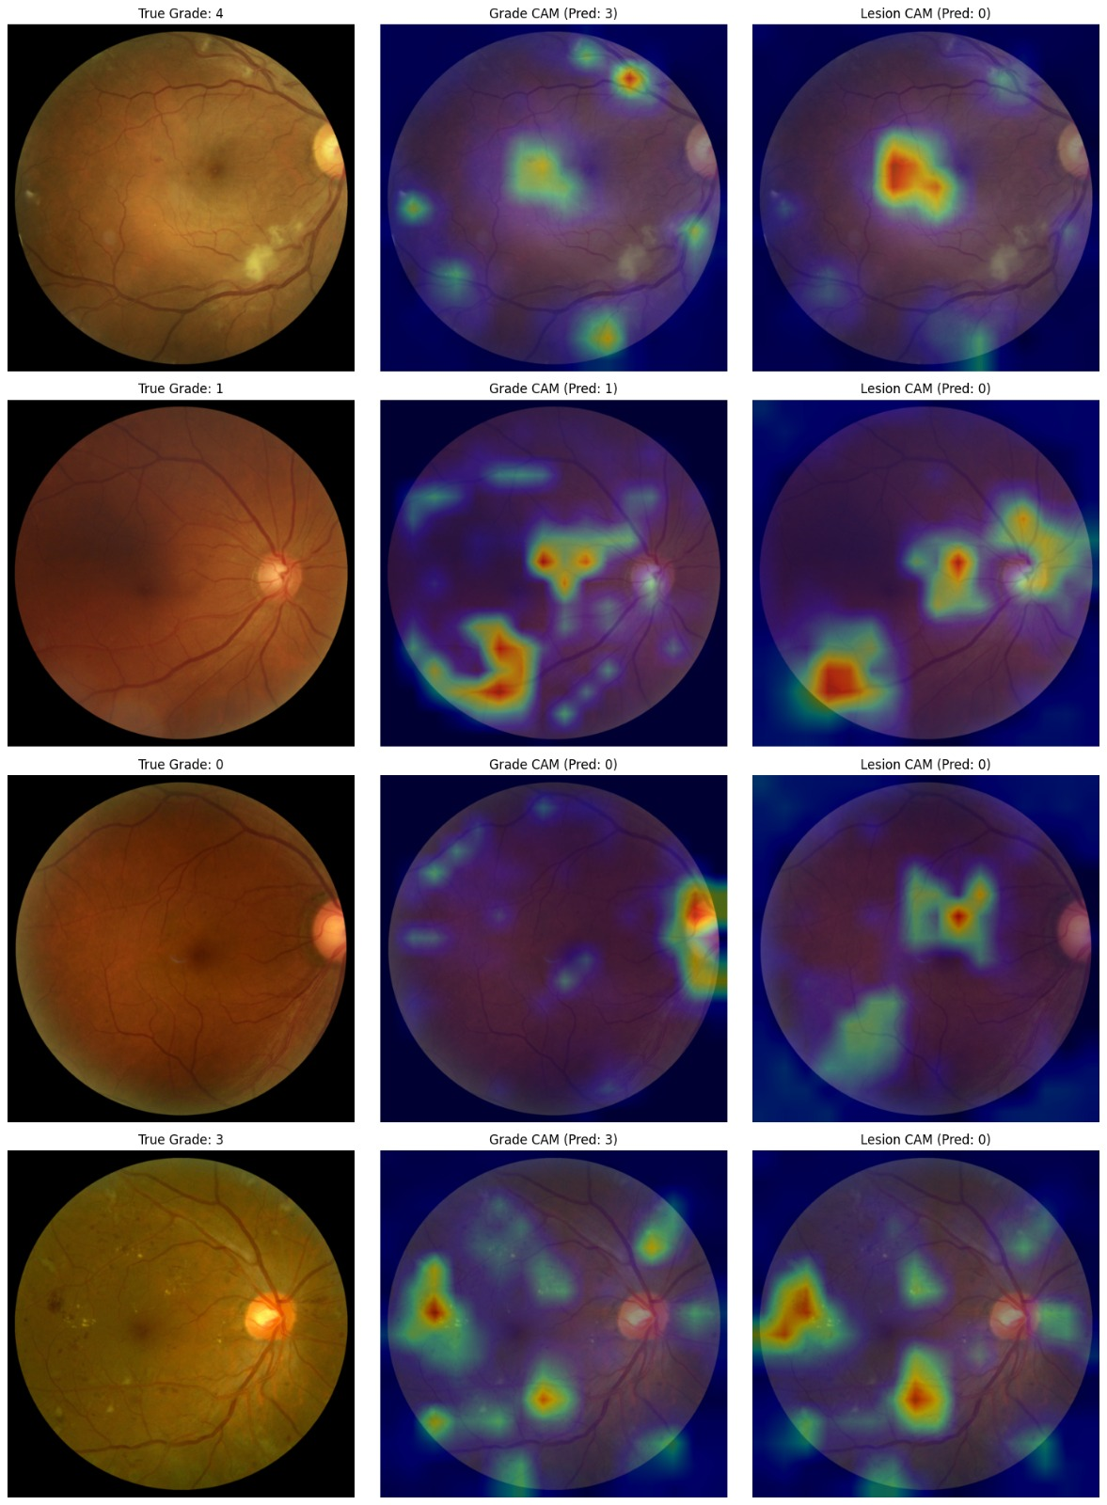
EXPLAINABILITY
GradCAM Heatmaps — Model Attention Visualization
True Grade 4
Pred: 3 (misclassified)
True Grade 1
Left: Original | Center: Grade CAM | Right: Lesion CAM
Pred: 1 ✓
True Grade 0
Pred: 0 ✓
Red/yellow = high model attention
True Grade 3
Pred: 3 ✓

Slide 10
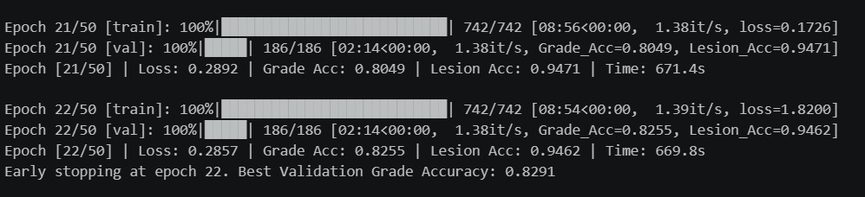
IMPROVED RESULTS
Custom Architecture — Final Metrics
Metric
Baseline ResNet-50
Custom Architecture
Grade Accuracy
82.33%
82.91% (early stop val)
Macro F1-Score
74.53%
—
Lesion AUC-ROC
96.49%
94.71% (val)
Lesion Accuracy
—
94.62% (val)
Eye Masking
✗ No
✓ Yes
Dual-Head Output
✗ No
✓ Grade + Lesion

Slide 11
CURRENT STATUS
Challenges & Planned Next Steps
CHALLENGES
NEXT STEPS
Overfitting despite L2 regularization — further hyperparameter tuning required
Evaluate on UWF & OCT modalities with fine-tuned models
Class imbalance across 0–4 DR grades affects sensitivity of higher grades
Integrate class-balanced sampling for minority DR grades
Bounding box predictions outside retinal boundary in baseline model
Explore RETFound & FLAIR foundation model fine-tuning
Key Skills Applied:
PyTorch · ResNet-50 · Multi-task Learning · GradCAM · Adam + CosineAnnealingLR · Mixed Precision · Focal Loss · Custom DataLoaders

Slide 12
THANK YOU
Questions & Discussion
Krrish Baghla · Research Intern, IIT BHU · krrishb.mc.24@nitj.ac.in

Slide 13
RETFound — Foundation Model for Retinal Images
Pre-trained ophthalmic foundation model by Zhou et al., Nature 2023
1
RETFound is a large-scale vision foundation model pre-trained via Masked Image Modeling (MAE) on 1.6M unlabeled retinal images.
Architecture
Input Retinal Image
ViT-Large Encoder
2
Supports multiple retinal imaging modalities including CFP and OCT, achieving strong generalizability with minimal fine-tuning.
Masked Autoencoder
Task-specific Head
3
We fine-tuned RETFound on MMRDR-CFP & MMRDR-UWF for 5-class DR grading and 7-label lesion detection tasks.
DR Grade / Lesions

Slide 14
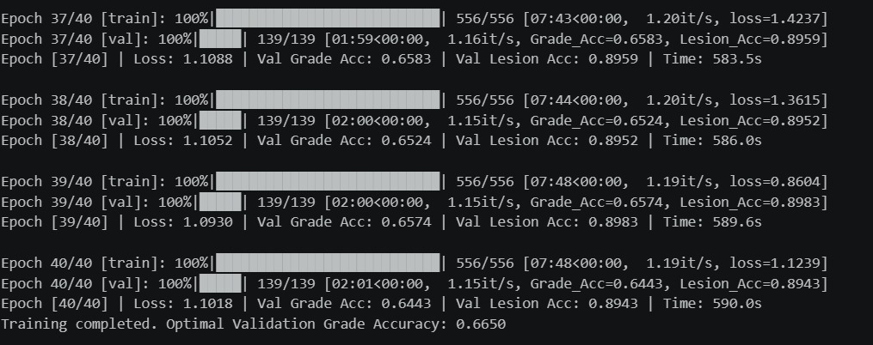
RETFound — Training Results
Fine-tuned on MMRDR-UWF with early stopping at epoch 28
74.5% Best Val Grade Acc
90.7% Best Lesion Acc
Epoch 28 Early Stopping

Slide 15
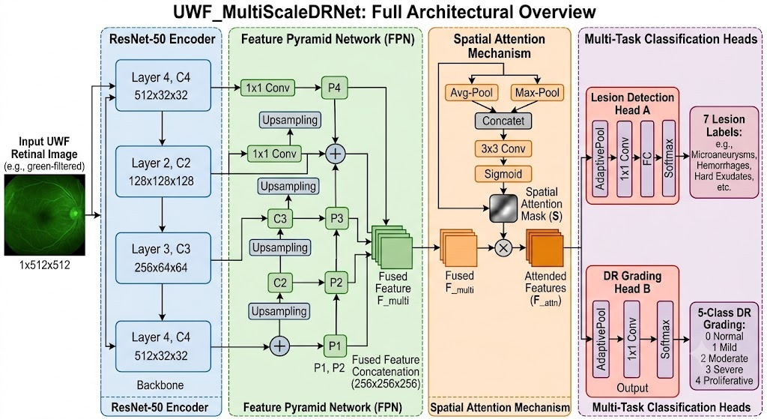
UWF_MultiScaleDRNet — Custom Architecture
Designed for UWF retinal image multi-task classification
ResNet-50 encoder + Feature Pyramid Network + Spatial Attention + dual classification heads for simultaneous DR grading and lesion detection.

Slide 16
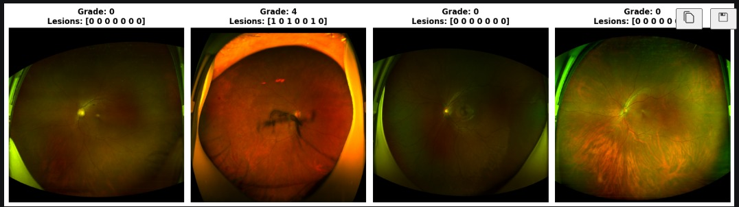
UWF Dataset — Sample Images
MMRDR-UWF: 10,404 images across 5 DR severity grades with 7 lesion labels
Sample UWF images showing Grade 0 (No DR) and Grade 4 (PDR) with corresponding lesion binary label vectors for 7 lesion types.
Grade 0 (No DR)
Grade 4 (PDR)
Grade 0 (No DR)
Grade 0 (No DR)

Slide 17
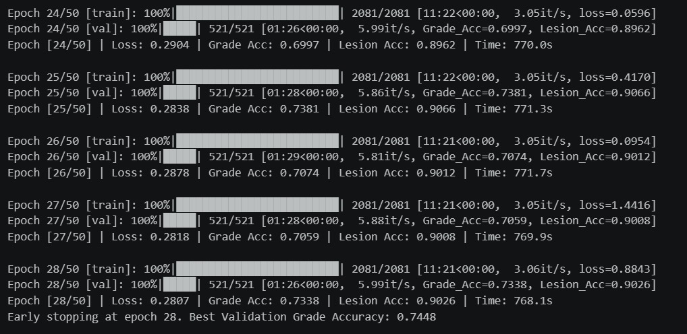
UWF Model — Training Results
UWF_MultiScaleDRNet trained for 40 epochs with multi-task loss
66.5% Best Val Grade Acc
89.6% Best Lesion Acc
40 Epochs Training Duration

Slide 18
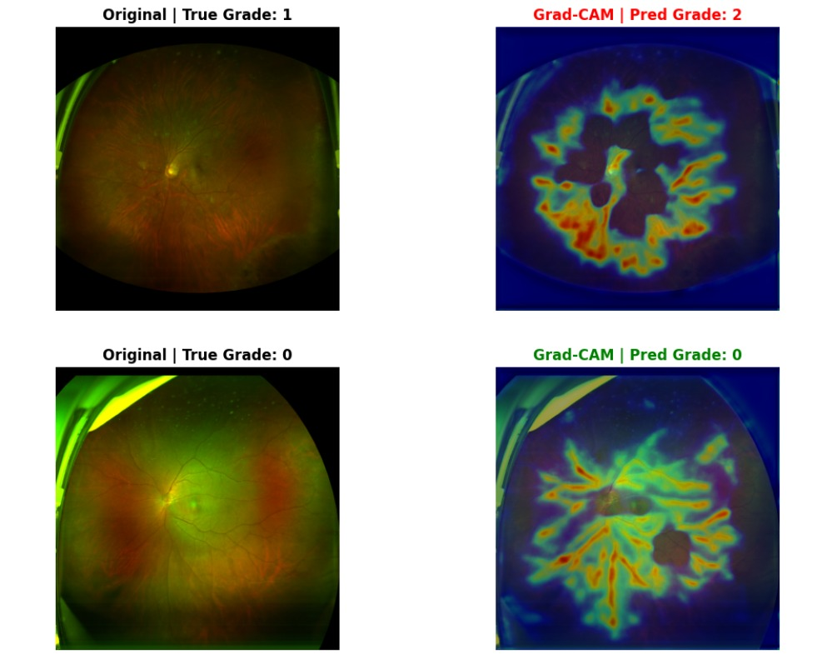
Grad-CAM Explainability — UWF
Visualizing model attention on retinal lesion regions (Grade 0 vs 2)
Grad-CAM maps highlight retinal vascular regions. Red/warm areas indicate highest model attention. Grade 1 misclassified as Grade 2 shows broader attention spread.

Slide 19
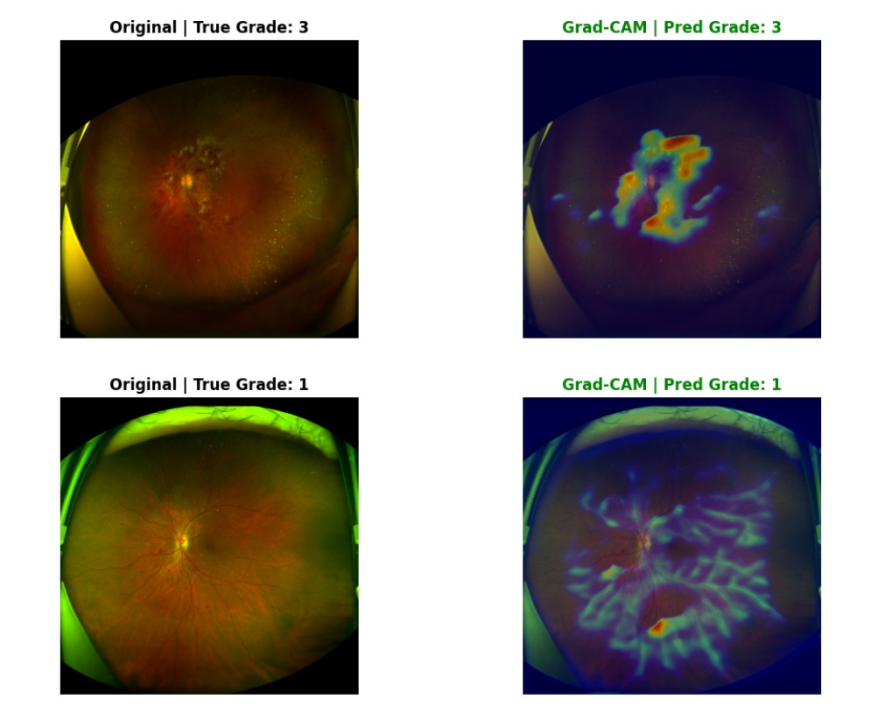
Grad-CAM Explainability — UWF
Model correctly identifies lesion clusters in Grade 3 (Severe NPDR) cases
Model correctly classifies both Grade 3 and Grade 1 UWF images. Attention concentrates near the optic disc and macula — clinically meaningful lesion regions.

Slide 20
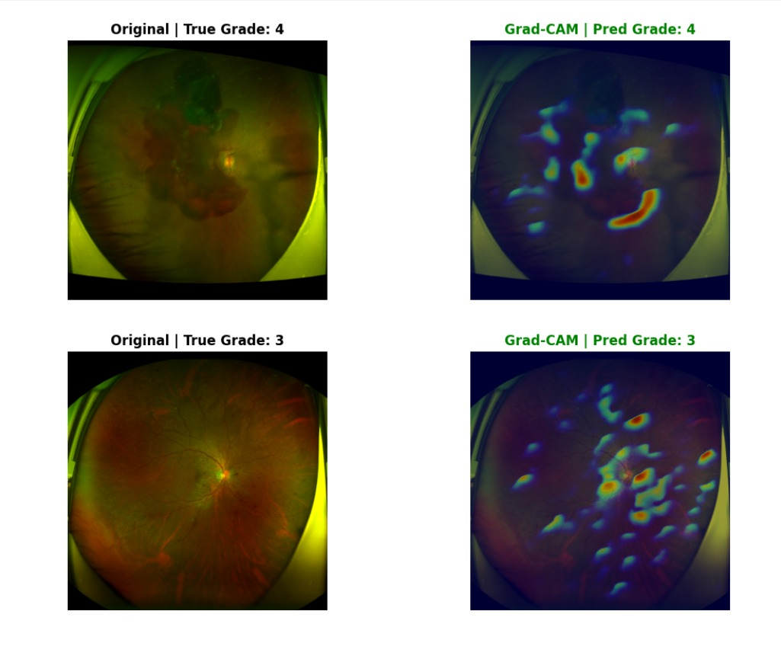
Grad-CAM Explainability — UWF
Attention patterns for Grade 4 (PDR) and Grade 3 (Severe NPDR)
Grade 4 (PDR) shows scattered lesion attention; Grade 3 Grad-CAM localizes dense dot hemorrhage clusters — validating clinical lesion-grade correlation.

Slide 21
Next Steps — Planned Experiments
Work delayed due to IIT BHU network access issues; schedule adjusted
⚠ Network access to IIT BHU compute cluster has been intermittent — experiments delayed. Below is the revised 7-day execution plan.
Day 1
OCT Training
Day 5
Zero-shot UWF (Set 2)
Fine-tune model on MMRDR-OCT for DME classification (3-class)
Second UWF batch — assess peripheral lesion detection robustness
Day 2
Zero-shot CFP (Set 1)
Day 6
Zero-shot OCT (Set 1)
Test RETFound zero-shot on new CFP data — first evaluation batch
Zero-shot DME classification on new OCT cohort
Day 3
Zero-shot CFP (Set 2)
Day 7
Zero-shot OCT (Set 2)
Test RETFound zero-shot on second CFP batch — cross-validate results
Final OCT batch — complete cross-modal zero-shot benchmark
Day 4
Zero-shot UWF (Set 1)
Evaluate zero-shot generalization on new UWF distribution

Slide 22
Key Achievements
✓ Implemented and fine-tuned RETFound on MMRDR-UWF → 74.5% Grade Acc, 90.7% Lesion Acc
✓ Built custom UWF_MultiScaleDRNet (ResNet-50 + FPN + Attention) for multi-task DR analysis
✓ Generated Grad-CAM explainability maps validating clinical lesion localization
✓ Achieved 66.5% Grade Accuracy and 89.6% Lesion Accuracy on custom UWF model
→ Upcoming: OCT training + zero-shot cross-modal evaluation across all 3 modalities

