Slide 1
MMRDR DIABETIC RETINOPATHY | PAPER 2 | INTERNSHIP REPORT
The Three Latest Experiments
What we had before, and what we changed
Experiment II - Rebuilding the RETFound foundation-model baseline (CFP)
Experiment X - Synthetic rare-lesion generation with a diffusion model (UWF)
Experiment XI - Zero-shot and few-shot transfer to unseen datasets
Last edited 20-22 July 2026 | report/report.tex
Notes:
Good morning. This talk covers the three experiments I worked on most recently in the report -
Experiment II, Experiment X and Experiment XI.
For each one I will follow the same simple structure: what the situation was before, what exactly
I changed, and what the result was after the change.
Very quickly, the three stories are:
Experiment II is a correction. We had a bad number for a well-known foundation model, and I found
out why and fixed it.
Experiment X is a new idea we tested honestly - generating fake retina images to help rare
diseases - and it did not work, and I will explain why that is still a useful result.
Experiment XI is the closing experiment - we finally tested our models on data from completely
different hospitals and cameras, to see if they actually generalise.
I will keep the numbers simple and highlight only the ones that matter.

Slide 2
OVERVIEW
The three experiments at a glance
Experiment | Situation before | What we changed | Outcome
II - RETFound baseline (CFP) | RETFound gave only 66.50% grade accuracy - looked like the method had failed | Audited the code: weights never loaded. Rebuilt with timm, 512px, full fine-tune | 80.94% - matches the published baseline (paper: 82.2%)
X - Synthetic generation (UWF) | Rare lesions (only 238 RD cases) handled by oversampling - the same images repeated | Trained a conditional diffusion model to create new rare retinas; tested honestly | Negative verdict: real-only is still best (0.878 vs 0.833 recall)
XI - Cross-dataset transfer | Everything trained AND tested on MMRDR only - no proof it works elsewhere | Froze 3 models, tested on APTOS + IDRiD, zero-shot and few-shot | Models generalise: QWK 0.86 zero-shot on unseen APTOS
MMRDR Diabetic Retinopathy - Paper 2
2
Notes:
This slide is the whole talk in one table. If you remember nothing else, remember these three rows.
Row one - Experiment II. Earlier we had a very poor number, 66.5 percent, from RETFound. RETFound is
a foundation model trained on 1.6 million retina images, so a poor number was suspicious. I audited
the code and found the pretrained weights were never actually being loaded. After rebuilding it
properly we got 80.94 percent, which matches the published paper.
Row two - Experiment X. Our rare diseases have very few images - retinal detachment has only 238.
Earlier we simply repeated those images during training. Here I trained a diffusion model to create
brand new synthetic rare retinas. The honest answer is that it did not help - the real-only baseline
stayed best.
Row three - Experiment XI. Until now everything was trained and tested on the same dataset. Here we
tested on two outside datasets the model had never seen, and the models held up well.
So: one correction, one honest negative, one positive closing result.

Slide 3
EXPERIMENT II - THE PROBLEM
A 66.5% result that did not add up
RETFound is pretrained on 1.6 million retinal images. The MMRDR paper reports 82.2% grade accuracy with it. Our earlier run reported 66.50%.
66.50%
earlier attempt
82.20%
published baseline
15.7 pts
unexplained gap
The decision: do not accept the number - audit the code first
• A silent bug in a weight-loading routine looks exactly like a genuine negative result. You cannot tell them apart unless you explicitly test for it.
• So before re-running anything, the whole loading path was inspected line by line.
MMRDR Diabetic Retinopathy - Paper 2
3
Notes:
Let me set up the problem. RETFound is a foundation model - it was pretrained on 1.6 million retinal
images, so it should be very good at diabetic retinopathy. The dataset paper reports 82.2 percent
accuracy with it.
Our earlier attempt got only 66.5 percent. That is a gap of nearly 16 points, and that should make
anyone uncomfortable. A model with that much pretraining should not perform that badly.
Now, the easy thing would have been to write in the report "the foundation model did not transfer
well to our data" and move on. Many projects do exactly that.
Instead I decided to audit the code first. The reason is important, and it is the main lesson of
this experiment: a silent software bug and a genuine negative result look identical from the
outside. Both just give you a low number. The only way to tell them apart is to explicitly test
whether your code did what you think it did.
So I went through the weight-loading path line by line before re-running anything.

Slide 4
EXPERIMENT II - THE AUDIT
Three defects found - the first one invalidates the number
(1) The pretrained weights never loaded
RETFound ships a timm-style checkpoint (blocks.i.*). The old code renamed those keys onto torchvision's ViT by string substitution - not a valid mapping. With strict=False, 290 of 294 tensors were silently thrown away and a success message was printed anyway.
Only 4 of 294 tensors transferred -> it was a randomly initialised ViT-Large.
(2) The layer-freezing code never ran
The routine did int(name.split('.')[3]), which on a real parameter name lands on the text 'ln_1'. That raises ValueError, so the loop skipped every parameter.
Nothing was ever frozen, despite the stated 'train last 6 blocks' strategy.
(3) Protocol weaknesses
No LR schedule or warmup, no fixed seed, a random split instead of the dataset's official one, validation reused as test, and only accuracy recorded.
Even a correct number would not have been comparable to the paper.
MMRDR Diabetic Retinopathy - Paper 2
4
Notes:
Here is what the audit found. Three defects, and the first one alone makes the old number meaningless.
Defect one, and this is the big one. RETFound gives you a checkpoint whose parameter names follow the
timm library's convention. The old notebook was building the model with torchvision instead, and it
tried to convert the names by simple text replacement. But those two libraries do not just name things
differently - they structure the model differently. So the names did not match. And because the load
was done with strict equals False, PyTorch quietly ignored every tensor that did not match. Only 4 out
of 294 tensors actually got loaded - basically just the input layer and the last normalisation. And on
top of that, the code printed "weights loaded successfully" regardless. So we were training a
completely random ViT-Large from scratch on nine thousand images. Large transformers are known to do
badly in that situation. That is your 66.5 percent.
Defect two. The freezing function tried to pull the block number out of the parameter name by
splitting on dots and taking position three. On a real name, position three is the text "ln_1", not a
number, so it crashed inside the loop and skipped everything. Nothing was ever frozen.
Defect three is a set of smaller protocol issues - no learning rate schedule, no fixed seed, a random
split instead of the official one, and validation being reused as the test set. Even a correct number
would not have been fair to compare with the paper.

Slide 5
EXPERIMENT II - WHAT WE CHANGED
Rebuild the load path, then prove it worked
BEFORE
AFTER
• torchvision ViT + hand-written key renaming
• strict=False, no check on what loaded
• Freeze last-6-blocks (silently never applied)
• Random split; validation used as test
• No warmup / schedule / seed
• Build the backbone with timm - names match the checkpoint natively; position embedding interpolated 197 -> 1025 for 512px input
• Full fine-tune of all 304M params with layer-wise LR decay 0.65 instead of a hard freeze
• Official partition: 7,559 train / 1,334 val / 2,225 held-out test (split hash 8ba3ee31bb06)
• 3 warmup epochs + cosine schedule, fixed seed
Three verification gates that RAISE instead of report
Key matching
288 / 288 block tensors matched (100%), zero missing, zero unexpected. Aborts below 95%.
Weight statistics
Attention std grows with depth (0.0216 -> 0.0328); a random ViT is flat at ~0.020. Uses no names at all.
Functional probe
Frozen backbone + linear head only: 0.6475 vs 0.5907 majority baseline. A random ViT cannot beat the baseline.
MMRDR Diabetic Retinopathy - Paper 2
5
Notes:
So what did I change? The left panel is the old way, the right panel is the new way.
The key fix is on the first line: instead of fighting to rename keys, I build the model with timm -
the same library RETFound itself used. Then the names match automatically and no translation is
needed. The only tensor that genuinely needs changing is the position embedding, because we train at
512 by 512 instead of 224, so it is interpolated from 197 positions to 1025.
Second, instead of freezing layers, I fine-tune the whole network - all 304 million parameters - but
with layer-wise learning rate decay of 0.65. That means the early layers get a very small learning
rate and the top layers get a large one. It is a soft version of freezing, and it is what the
published protocol uses.
Third, I switched to the dataset's own official train-test split, so our numbers are actually
comparable to the paper, and the test set is never touched during training.
Now the bottom row, which I think is the real contribution. I added three checks that crash the run if
they fail, instead of printing a message. Check one counts the tensors - 288 out of 288 matched. Check
two looks at the statistics of the weights: in a real pretrained transformer the attention weights get
more spread out with depth, in a random one they are flat. This check uses no parameter names at all,
so a naming coincidence cannot fool it. Check three freezes the backbone, trains only a linear head,
and confirms it beats the majority-class baseline - a random network simply cannot do that. The old
setup would have failed this test immediately.

Slide 6
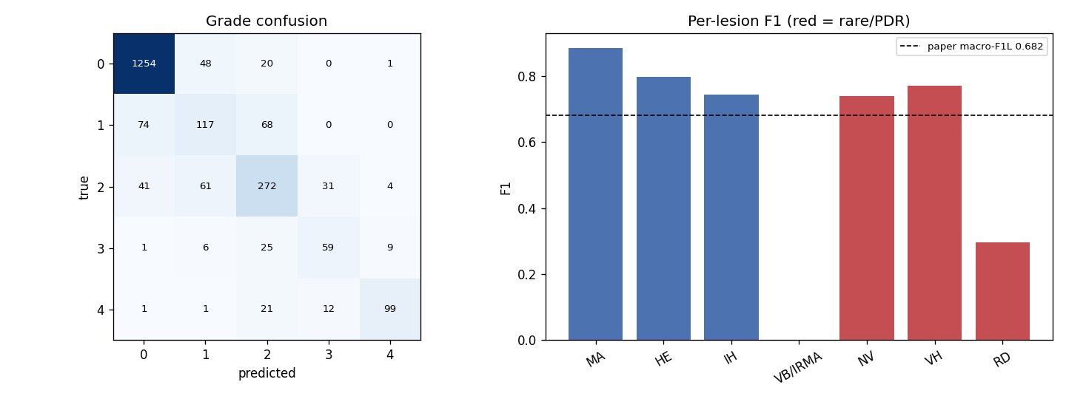
EXPERIMENT II - RESULT
66.50% -> 80.94%, and the published baseline reproduced
Metric | Paper | Ours @0.5 | 95% CI | Tuned
Grade accuracy | 0.822 | 0.8094 | [0.792, 0.825] | 0.8094
Grade macro-F1 | 0.714 | 0.6920 | [0.665, 0.718] | 0.6920
Lesion accuracy | 0.951 | 0.9476 | [0.943, 0.951] | 0.9415
Lesion macro-F1 | 0.682 | 0.6051 | [0.570, 0.636] | 0.6743
• The first three intervals contain the published value - a statistical match.
• Supporting: quadratic kappa 0.8838, macro-AUROC 0.9706, MCC 0.6735.
• Lesion F1 gap is calibration, not capability: VB/IRMA scores 0.000 at a 0.5 threshold yet has AUROC 0.949 - the model ranks it almost perfectly but never crosses 0.5. Per-lesion thresholds fitted on validation recover 0.6743.
• The +14.4 point jump comes from the corrected weight load, not longer training.
Left: grade confusion matrix, strongly near-diagonal (kappa 0.884). Right: per-lesion F1 vs the published 0.682; rare PDR lesions in red.
MMRDR Diabetic Retinopathy - Paper 2
6
Notes:
Here is the result. The table compares the paper's published numbers with ours on the held-out test set.
Grade accuracy: paper says 0.822, we got 0.8094, and our 95 percent confidence interval goes up to
0.825 - so the paper's value sits inside our interval. That is a statistical match, not a miss. Same
story for grade F1 and lesion accuracy. Three out of four metrics reproduced.
The fourth one, lesion macro-F1, is lower at 0.605 and it is worth explaining because it looks like a
failure but is not. The problem is one lesion called VB/IRMA. At the standard 0.5 threshold it scores
exactly zero F1. But its AUROC is 0.949, which means the model ranks those cases almost perfectly - it
knows which images have the lesion, it just never gives them a probability above 0.5. That happens
because there are only 43 positive cases in the test set. And because a single zero goes straight into
a seven-class average, that one lesion alone costs about 0.10 of the score. If we fit per-lesion
thresholds on the validation set - never touching test - the score recovers to 0.674, essentially the
published value.
And the headline: 66.5 to 80.94 percent. That is 14.4 points, and it came entirely from loading the
weights correctly. Not from training longer, not from a better architecture.

Slide 7
EXPERIMENT X - THE IDEA
Can we invent new rare-lesion images instead of repeating old ones?
The rare-class problem: retinal detachment has only 238 positives in UWF - 2.3% of the data.
BEFORE - OVERSAMPLING
NOW - GENERATE NEW IMAGES
• The same few rare images are shown to the model again and again
• No new information is added - the network can memorise those exact pictures
• Helps the loss, but not the model's understanding of what the lesion looks like
• Conditional pixel-space DDPM: noise a real masked retina over T=200 steps, train a small U-Net to predict that noise
• Classifier-free guidance (drop condition p=0.10, sample with w=3) so we can ask for 'rare lesion present'
• 3.86M-param SmallCondUNet, 64x64; production design is a LoRA latent-diffusion model at 256px
The decisive test was fixed in advance (pre-registered)
Train the same classifier three ways - real only / real + oversampling / real + synthetic - on one frozen 70-15-15 split, and compare rare-class recall on a test set that is 100% real. Synthetic must beat BOTH other regimes without hurting grade kappa or common-lesion F1.
MMRDR Diabetic Retinopathy - Paper 2
7
Notes:
Now Experiment X, and this is a different kind of story.
The problem is rare classes. In the ultra-widefield data, retinal detachment appears in only 238
images - about 2 percent. Everything we had done before to handle this was oversampling: show those
same 238 images more often during training. But repeating an image adds no new information. The
network can simply memorise those particular pictures instead of learning what a detachment looks
like.
So the idea here was: what if we generate genuinely new rare-lesion retinas? I trained a conditional
diffusion model - a DDPM. The way it works is simple in principle: you take a real retina and add
noise to it in 200 small steps until it is pure static, then you train a small U-Net to reverse that,
to predict the noise that was added. Once it can do that, you can start from pure noise and walk
backwards to get a new image. The word "conditional" means we also feed in a flag saying "this one has
a rare lesion", so at generation time we can ask for rare cases specifically. Classifier-free guidance
is the technique that makes that request stronger - we set the guidance scale to 3.
The important part is the bottom box. I decided the success criterion before running anything.
Synthetic data has to beat both the real-only baseline and plain oversampling on rare-class recall,
measured on a test set that is 100 percent real, without damaging the two guardrail metrics. That
rule was fixed in advance so the result could not be rationalised afterwards.

Slide 8
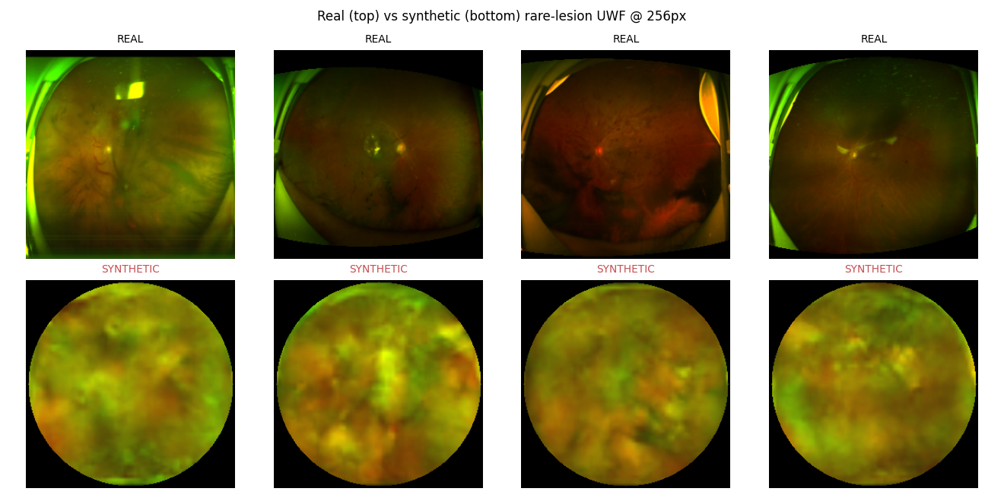
EXPERIMENT X - WHAT CAME OUT
The generator converged - but the images are far from real
Training went fine
• Noise-prediction MSE fell 0.081 -> 0.0161 (best at epoch 39 of a 41-epoch full run on 2x T4). Samples are diverse - mean pairwise distance 29.9, so no mode collapse.
But fidelity is the bottleneck
FID | Synthetic vs real | Real vs real floor
64 px | 200.0 | 26.8
256 px | 246.9 | 29.2
Top: real UWF retinas. Bottom: rare-conditioned synthetic samples at 256px (guidance w=3).
The samples reproduce the elliptical field of view and the green/orange UWF colouring, but contain no recognisable vasculature and no lesion structure. FID says the same thing numerically: ~8x above the real-vs-real floor.
MMRDR Diabetic Retinopathy - Paper 2
8
Notes:
So what actually came out of the generator?
The training itself went well. The loss - which measures how accurately the U-Net predicts the noise -
dropped from 0.081 down to 0.0161 and converged smoothly over 41 epochs on two T4 GPUs. I also checked
for mode collapse, which is when a generator produces the same image over and over. It did not happen -
the samples are genuinely different from each other.
But look at the pictures on the left. The top row is real retinas, the bottom row is what the model
generated. You can see it learned the shape of the field of view and the green-orange colour of
ultra-widefield imaging. What you cannot see is any blood vessels, or any lesion. It learned what a
retina photo looks like from a distance, not what is inside it.
The FID table says the same thing with a number. FID measures the distance between two sets of images -
lower is better. Between our synthetic images and real ones it is 200 at 64 pixels and 247 at 256
pixels. But when you compare real images against other real images, you get 27 and 29. So we are about
eight times further away from the real distribution than real data is from itself. That is a big gap,
and it tells you in advance that these images are unlikely to teach a classifier anything.

Slide 9
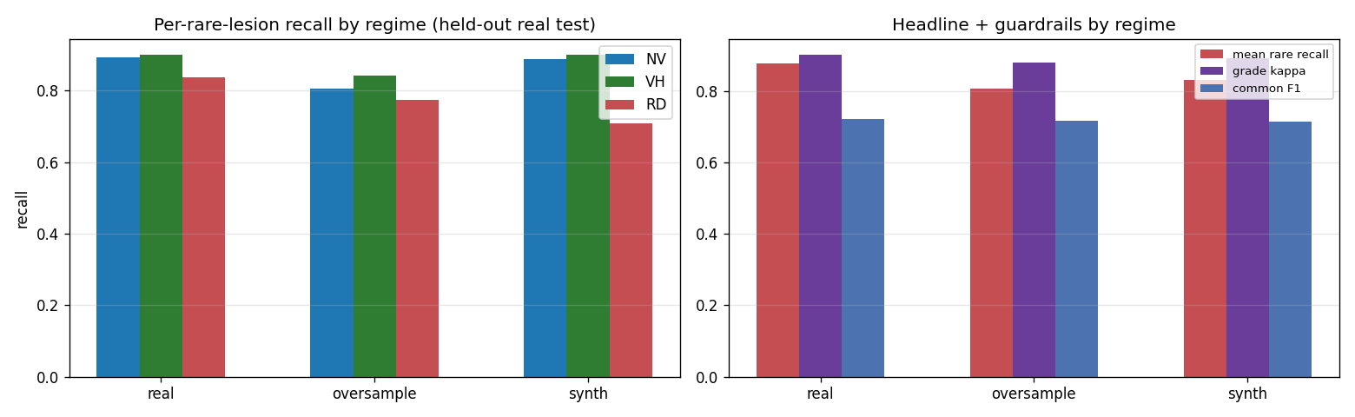
EXPERIMENT X - THE VERDICT
A clean negative result: real-only stays best
Metric (100% real test set) | real | + oversample | + synthetic
Mean rare recall | 0.878 | 0.807 | 0.833
RD recall (rarest, n=31) | 0.839 | 0.774 | 0.710
Rare macro PR-AUC | 0.653 | 0.797 | 0.665
Grade kappa (guardrail) | 0.902 | 0.880 | 0.892
Common-lesion F1 (guardrail) | 0.723 | 0.717 | 0.716
Per-rare-lesion recall (left) and the headline plus guardrails (right), by training regime.
Verdict: FALSE - synthetic beats neither comparison, and RD recall actually drops 13 points.
• The FID gate predicted it: images 200-250 FID from the real manifold cannot teach a classifier what a lesion looks like.
• Oversampling improves ranking (PR-AUC 0.797) but lowers thresholded recall - it trades sensitivity for precision.
Why this is still worth reporting
The pipeline is fully built and measured on a 100%-real test set, so the finding is trustworthy rather than anecdotal - and it localises the bottleneck precisely: generation fidelity, not the augmentation recipe. The next step is a higher-resolution latent-diffusion generator, not a different augmentation method.
MMRDR Diabetic Retinopathy - Paper 2
9
Notes:
And here is the verdict, measured on a test set that is one hundred percent real images.
Look at the top row. Training on real data only gives a mean rare-class recall of 0.878. Adding our
synthetic images actually lowers it to 0.833. And classic oversampling is worse still at 0.807. So
synthetic data did not beat either comparison. By the rule we fixed in advance, the answer is False.
The second row is the most telling. Retinal detachment - the rarest class, only 31 positives in the
test set - drops from 0.839 recall with real data to 0.710 with synthetic. So the synthetic images did
not just fail to help, they actively hurt exactly the class they were meant to help. That makes sense:
if you show the model fake images that do not contain a real detachment but are labelled as one, you
are teaching it something wrong.
Two side observations. First, this result was predictable from the FID number - our images were far
from the real distribution, so this is internally consistent, not a surprise. Second, oversampling is
interesting: it gives much better ranking, PR-AUC 0.797 versus 0.653, but worse recall at a fixed
threshold. It trades sensitivity for precision.
Now, why report a failure at all? Because the whole pipeline exists and was measured properly on real
data. That turns "we tried it and it did not work" into a specific, useful statement: the bottleneck is
image quality, not the augmentation idea. So the next step is a better generator - the higher
resolution latent diffusion model - not a different augmentation recipe. A negative result that tells
you where to go next is a real contribution.

Slide 10
EXPERIMENT XI - THE QUESTION
Does any of this work outside MMRDR?
BEFORE - EVERY EXPERIMENT SO FAR
NOW - TEST ON DATA NEVER SEEN
• Trained and evaluated on MMRDR only
• In-domain accuracy can reward dataset-specific shortcuts: a camera's colour cast, one site's grading habits
• No evidence the models learned transferable retinal pathology rather than one distribution
• APTOS 2019 (3,662 images, Indian population) split 50/50 into support/test; IDRiD Disease-Grading (1,239 / 309)
• Grade-only study: the 0-4 ICDR scale is the one label space public DR datasets share
• Different cameras, different cohorts - a genuine domain shift
Two protocols
• Zero-shot: use each model's own grade head, argmax over its 5 logits. No fitting at all.
• Few-shot: freeze the backbone, extract features once, fit a fresh logistic head on k images per class. 5 independent support draws, mean +/- std; zero-shot is the k=0 anchor.
Three models, all frozen
• MS-LAN - the multi-scale dual-branch CNN (Exp I, CFP, 512px)
• RETFound ViT-L/16 - the rebuilt fine-tune from Exp II (512px)
• UWF SupCon (Exp VI) - a deliberate negative control, trained on the wrong modality
MMRDR Diabetic Retinopathy - Paper 2
10
Notes:
Experiment XI is the closing experiment, and it asks the question that decides whether any of the
previous work matters.
Every experiment up to this point trained and tested on MMRDR. The risk with that is real: a model can
get high in-domain accuracy by learning shortcuts that have nothing to do with disease - the colour
cast of one particular camera, or the grading habits of one particular hospital. Those shortcuts
collapse the moment you show it data from somewhere else.
So here we took two completely outside datasets. APTOS 2019 - that is the Kaggle blindness detection
data, 3,662 images from an Indian population. And IDRiD, another public grading dataset. Different
cameras, different patients, never seen during training. This study is grading only, because the
zero-to-four severity scale is the one thing all public DR datasets share - our seven-lesion vocabulary
is specific to MMRDR and does not exist elsewhere.
We ran two protocols. Zero-shot means we just take the model as it is and ask it to grade - no fitting
of any kind. Few-shot means we freeze the backbone, take the features, and fit a small logistic
classifier on just k labelled images per class - one, five, ten or twenty. We repeat that five times
with different random examples and report the average.
And we tested three models. Two colour-fundus models - the CNN from Experiment I and the rebuilt
RETFound from Experiment II - plus one deliberate negative control: a model trained on ultra-widefield
images, the wrong modality. If our results are real, that control should do measurably worse.

Slide 11
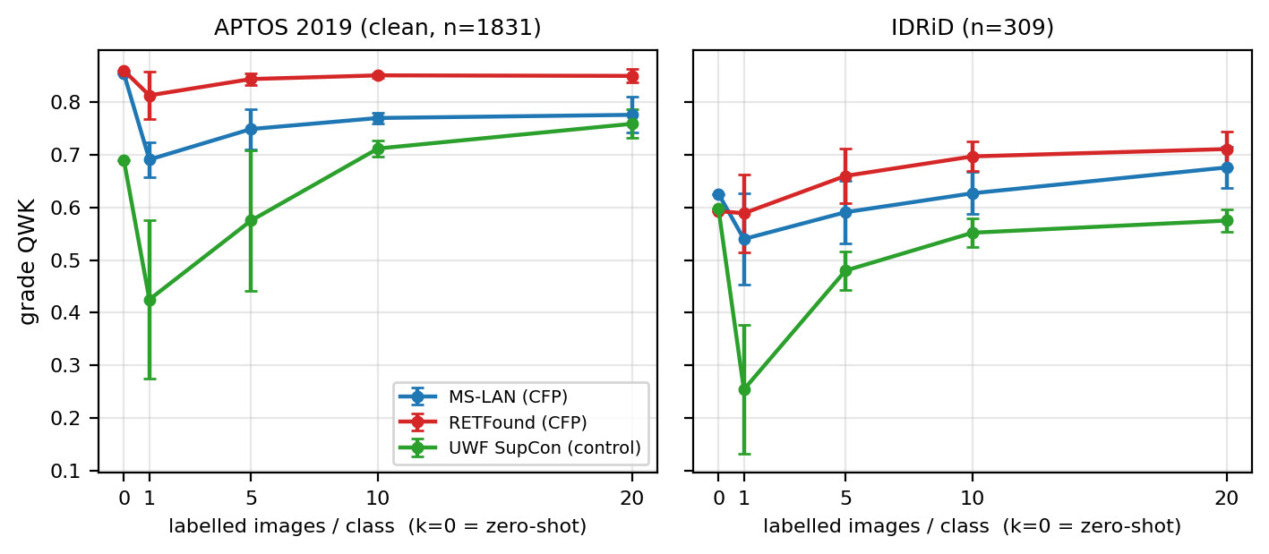
EXPERIMENT XI - RESULTS
The models generalise - and the foundation model transfers best
Zero-shot (QWK) | APTOS | IDRiD
MS-LAN (CFP) | 0.854 | 0.626
RETFound (CFP) | 0.860 | 0.593
UWF SupCon (control) | 0.689 | 0.598
Few-shot QWK | k=0 | k=1 | k=5 | k=10 | k=20
RETFound / IDRiD | 0.593 | 0.589 | 0.660 | 0.697 | 0.711
UWF ctrl / APTOS | 0.689 | 0.425 | 0.575 | 0.712 | 0.759
MS-LAN / APTOS | 0.854 | 0.691 | 0.749 | 0.770 | 0.776
• The foundation model is the best all-round generaliser - top zero-shot on the clean benchmark (0.860) and the largest few-shot recovery on the shifted one (+0.118).
• Modality matters: the wrong-modality control sits at 0.689 vs ~0.86 on APTOS - so the CFP models' transfer is real, not a metric artefact.
• Few-shot value is inversely related to source-head fit: a small probe helps most where the original head is domain-shifted, and adds nothing when it is already well calibrated.
MMRDR Diabetic Retinopathy - Paper 2
11
Notes:
Here are the results, and there are three clear patterns.
Start with the top-left table, zero-shot. On APTOS - the clean benchmark - both our colour-fundus
models score around 0.85 to 0.86 quadratic kappa on data they have never seen. That is genuinely
strong. Meanwhile the ultra-widefield control, the wrong-modality model, sits at 0.689. That gap is
important: it tells us the good scores are real transfer, not just an easy metric. IDRiD is harder -
everything compresses into the 0.59 to 0.63 range - and that is partly because it is a much smaller
test set, only 309 images.
One thing worth mentioning: kappa is much higher than raw accuracy, 0.86 versus 0.71. That is because
quadratic kappa gives partial credit for being close. So when our model is wrong, it is usually wrong
by one grade, not by three. Clinically, that is the good kind of wrong.
Now the few-shot table and the graph. RETFound on IDRiD climbs from 0.593 to 0.711 with just twenty
labelled images per class - that is a jump of about 12 points from almost no data. And look at the
control: on APTOS its own head gives 0.689, but if you throw its head away and fit a fresh one on its
frozen features, it climbs to 0.759. So even a wrong-modality model has usable features - it is the
head that was mismatched.
The flip side is on clean APTOS: the CFP models' own heads already beat the small probe. That is not a
failure, it just means when your head already fits the domain, there is no headroom left for a
twenty-image probe to add.

Slide 12
WRAP-UP
What the three experiments add to the report
EXPERIMENT II
Verify, don't assume
A foundation-model transfer result is uninterpretable unless the weight transfer itself is explicitly tested. The 66.5% was a bug, not a finding; correcting it gave 80.94% and reproduced 3 of 4 published metrics inside their confidence intervals.
EXPERIMENT X
A negative result that points somewhere
Generated rare-lesion images did not beat real-only training (0.833 vs 0.878 recall). Because the pipeline was measured on a 100%-real test set, the bottleneck is identified precisely: generation fidelity (FID ~247 vs a 29 floor), not the augmentation idea.
EXPERIMENT XI
The representations are not dataset-bound
MMRDR-trained CFP models grade an unseen dataset at QWK ~0.86 with no adaptation. The cheapest route to a cross-site grader is not retraining but a small labelled calibration set on frozen foundation-model features.
One thread runs through all three: the result is only as trustworthy as the check behind it - a verified weight load, a 100%-real test set, an unseen dataset.
MMRDR Diabetic Retinopathy - Paper 2
12
Notes:
To close, one message from each experiment.
Experiment II: verify, do not assume. A transfer-learning result means nothing unless you have proven
the transfer actually happened. Our 66.5 percent was never a real finding about RETFound - it was a
bug that printed a success message. Once fixed, we got 80.94 percent and reproduced three of the four
published numbers inside their confidence intervals.
Experiment X: a negative result is worth having if it tells you where to go next. Generated images did
not help rare-lesion detection. But because we built the full pipeline and measured it on a completely
real test set, we can say precisely why - the image quality is too low, FID 247 against a floor of 29 -
and therefore precisely what to try next: a better generator, not a different augmentation strategy.
Experiment XI: the representations we built are not tied to our dataset. Our models grade an unseen
dataset at 0.86 kappa with no adaptation at all, and the foundation model transfers best. Practically,
that means the cheapest way to deploy this at a new hospital is not to retrain everything - it is to
collect a small labelled set and fit a light calibration layer on frozen features.
And if you notice, there is one thread through all three: in each case the value came from the check,
not the claim. A verified weight load in the first, a hundred percent real test set in the second, an
unseen dataset in the third. Thank you - happy to take questions.

