Slide 1
Deep Learning for Diabetic Retinopathy
Three Key Experiments in Diabetic Retinopathy Deep Learning
Foundation Models · Synthetic Data · Cross-Dataset Generalization
Krrish Baghla | Research Intern, Dept. of CSE, IIT (BHU)
Supervisor: Dr. Sanjay Kumar Singh | MMRDR Diabetic Retinopathy Project (Paper 2)
Notes:
• Open by introducing yourself and the project in one line: this is Paper 2 of the internship, on the MMRDR multimodal retinal dataset for diabetic retinopathy.
• Say you'll walk through three representative experiments out of eleven — chosen because each makes a different point: reproducing a strong baseline, testing synthetic data, and testing generalization.

Slide 2
Roadmap
Three experiments from the MMRDR study
• The dataset: MMRDR multimodal retinal images — DR grade 0-4 (ICDR) + 7-lesion detection.
• Experiment II — RETFound: can a retinal foundation model reproduce the paper's baseline?
• Experiment X — Synthetic data: can generated rare-lesion images beat oversampling?
• Experiment XI — Transfer: do our models generalize to brand-new, unseen datasets?
• Theme: each experiment is an honest test — including when the answer is “no”.
1
Notes:
• Set the stage: every image has a DR severity grade from 0 (no DR) to 4 (proliferative), plus which of 7 lesion types are present.
• Give the audience the map: II is about a foundation model, X is about generating data, XI is about whether our models transfer to new datasets.
• Flag the honesty theme early so the negative result in Exp X lands as a strength, not a failure.

Slide 3
Experiment II — RETFound Foundation Model
The question & the hidden bug
• Goal: fine-tune RETFound (a retinal foundation model, MAE-pretrained ViT-Large) on CFP images for DR grading + lesion detection.
• Earlier attempt scored only 66.5% — the professor asked: “how are you sure you froze early layers and trained the last?”
• That question exposed two real bugs:
▪ Only 4 of 294 pretrained tensors actually loaded → we trained a RANDOM ViT, not RETFound.
▪ The freeze loop was a silent no-op → nothing was frozen.
• So 66.5% was never a RETFound result. We rebuilt it properly.
2
Notes:
• Explain RETFound plainly: it's a model pre-trained on huge numbers of retinal images, so it already 'knows' what retinas look like before we fine-tune it on our task.
• Tell the story of the bug honestly — this is the memorable part. The professor's question 'how do you KNOW you froze the layers?' is what exposed it.
• Land the two bugs: (1) the pretrained weights silently didn't load — only 4 of 294 tensors — so we were training a random model; (2) the freeze code did nothing. So the old 66.5% was meaningless.
• Reassure: we didn't hide this — we diagnosed it and rebuilt from scratch.

Slide 4
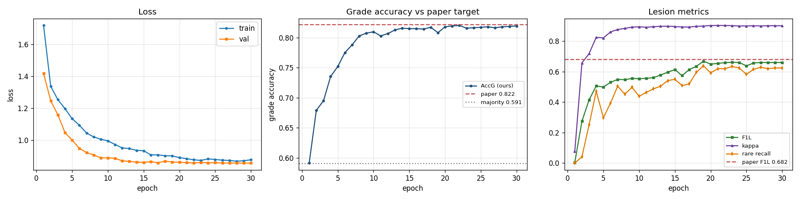
Experiment II — Method
Doing the fine-tune correctly, and proving it
• timm vit_large_patch16_224 at 512×512 so RETFound's MAE weights match natively — no fragile key remapping.
• Full fine-tune (0 frozen params, asserted), official train/test split (matching the paper), layer-wise LR decay.
• fp16 + gradient checkpointing on 2×T4 GPUs, 30 epochs (~9.5 h).
• Verification built in: weight-load hard-fails unless ≥95% of blocks match; a linear-probe sanity check must beat the majority baseline.
• Result: 288/288 blocks loaded, 0 missing — this time it really is RETFound.
Training & validation curves over 30 epochs — loss falls monotonically (no overfitting).
3
Notes:
• Key point: we switched to a model definition where RETFound's weights match natively, so there's no fragile hand-remapping to go wrong.
• Emphasise verification: the code now HARD-FAILS if the weights don't load, and a linear-probe check confirms the features are real. This directly answers the professor's question with evidence.
• Mention scale briefly — 512-pixel images, 2 T4 GPUs, about 9.5 hours — so they know it's a serious run.
• Punchline: this time 288 of 288 transformer blocks loaded correctly — it really is RETFound now.

Slide 5
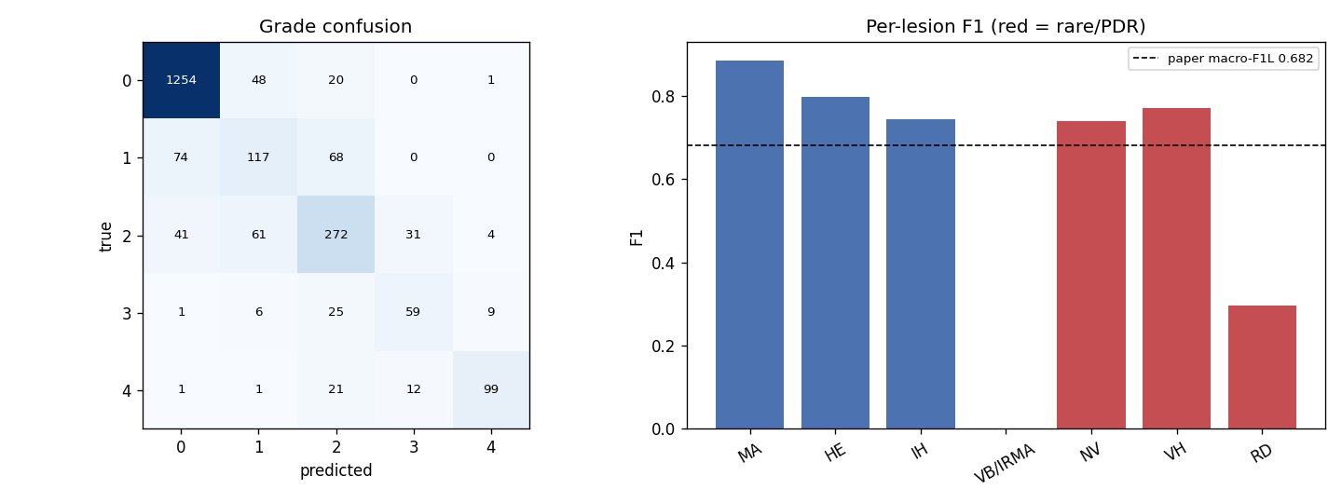
Experiment II — Results
Matches the published baseline
• Grade accuracy 0.809 (paper 0.822) — CI overlaps → statistical match.
• Grade macro-F1 0.692 (paper 0.714); Lesion accuracy 0.948 (paper 0.951).
• Lesion macro-F1 0.605, rising to 0.674 with tuned thresholds (paper 0.682).
• Quadratic kappa 0.884, macro-AUROC 0.971.
• Bottom line: +14.4 points over the broken run; 3 of 4 headline metrics statistically match the paper.
Per-grade and per-lesion breakdown of the rebuilt RETFound run.
4
Notes:
• Walk the numbers against the paper, not in isolation — that's what makes it a reproduction.
• Grade accuracy 0.809 vs the paper's 0.822: say the confidence intervals overlap, so it's a statistical match, not a shortfall.
• Note the one metric that's lower (lesion F1) is a threshold-calibration issue — tuning thresholds lifts it to 0.674, and the ranking quality (AUROC) is already excellent.
• Close with the headline: +14.4 points over the broken run, and 3 of 4 metrics match the paper. The experiment succeeded.

Slide 6
Experiment X — Synthetic Minority Generation
The question
• Rare lesions are scarce — only 238 retinal-detachment (RD) positives (2.3% of UWF).
• Oversampling can only duplicate the same few images → the model memorises them.
• Idea: generate NEW synthetic rare-lesion retinas with a diffusion model to add real variety.
• The decisive test: does adding synthetic images raise rare-class recall on a 100%-real held-out test set, vs real-only and vs oversampling?
5
Notes:
• Motivate with the scarcity number: only 238 retinal-detachment cases. Make it concrete — you can't learn much from copying the same 238 pictures.
• Frame the hypothesis as reasonable: if we could GENERATE new, varied rare-lesion images, maybe the model learns the lesion better than from duplicates.
• Stress the test is pre-registered and fair: the yardstick is rare-class recall on a test set that is 100% real — no synthetic images sneak into evaluation.

Slide 7
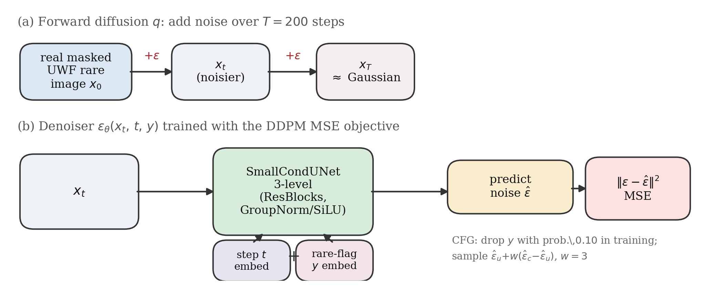
Experiment X — Method
Conditional diffusion + a fair downstream test
• Generator: a compact conditional pixel-space DDPM (SmallCondUNet, 64×64) with classifier-free guidance (w=3).
• Production design documented: LoRA latent-diffusion at 256×256 (the runnable slice is the 64px proof-of-concept).
• Downstream test: train the classifier under 3 regimes — real only, real+oversample, real+synthetic — on ONE frozen split.
• Validation & test sets are 100% real and identical across regimes; thresholds fitted on validation only.
• Guardrails watched: grade kappa and common-lesion F1.
Conditional-DDPM pipeline: add noise -> predict noise -> classifier-free guidance.
6
Notes:
• Keep the diffusion explanation light: a diffusion model learns to turn noise into realistic images; 'conditional' means we can ask it specifically for rare-lesion retinas.
• Be honest about scope: the runnable version is a small 64-pixel proof-of-concept; the full-scale design (256px latent diffusion) is documented but not the one we trained here.
• Explain the 3-regime comparison clearly: same model, same real val/test, only the training data differs — real, real+oversample, real+synthetic. That isolates the effect of synthetic data.
• Mention guardrails so they know we watched for collateral damage to the grade and common-lesion tasks.

Slide 8
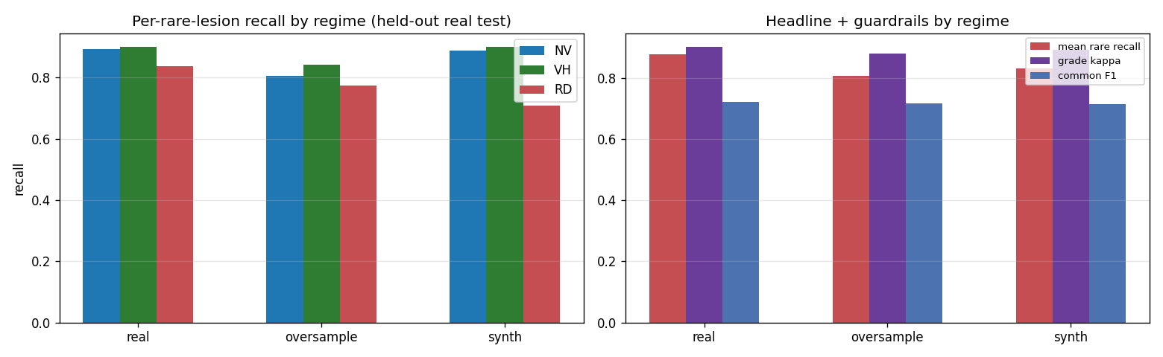
Experiment X — Results: a clean negative
Generation converged, but did not help
• Generator converged stably (loss 0.081 → 0.016), no mode collapse.
• But fidelity is poor: FID 200 (64px) / 247 (256px) vs a real-vs-real floor of only ~27–29.
• Downstream verdict is NEGATIVE:
▪ Rare recall — real-only 0.878 > +synthetic 0.833 > +oversample 0.807.
▪ RD (rarest class) actually drops from 0.839 to 0.710 with synthetic data.
• The contribution is the honest negative result: the bottleneck is generation fidelity (the FID gate), not the augmentation recipe.
Downstream verdict on the 100%-real test set: the real-only bars stay highest.
7
Notes:
• Deliver the negative result confidently — this is a real finding, not a failure to present around.
• First, the generator itself trained fine (loss went down, no collapse). So the pipeline works.
• But fidelity is poor: an FID of ~200–247 against a floor of ~27 means the synthetic images are far from real retinas — they get the shape and colour but no real vessels or lesions.
• The downstream numbers follow: real-only is BEST (0.878), synthetic is worse, oversampling worst; and the rarest class actually gets hurt.
• End on the contribution: the negative result is valuable because it pinpoints WHERE the problem is — image fidelity — so a future higher-resolution generator is the right next step, not a different recipe.

Slide 9
Experiment XI — Zero-Shot & Few-Shot Transfer
The concluding generalization study
• Question: do models trained on MMRDR generalize to brand-new, unseen datasets they never saw?
• Grade 0-4 only — the one label space that transfers cleanly (the 7-lesion scheme is MMRDR-specific).
• Unseen datasets: APTOS 2019 and IDRiD — both CFP fundus, same ICDR 0-4 scale, different populations.
• Top-3 models tested: MS-LAN (Exp I, CFP), RETFound (Exp II, CFP), and a UWF model (Exp VI) as a deliberate negative control.
8
Notes:
• Introduce this as the concluding experiment — the professor's final ask: test the trained models on data they've never seen.
• Explain the design choice: we only transfer the GRADE task, because the 0-4 severity scale is shared across public datasets, whereas our 7-lesion scheme is specific to MMRDR.
• Name the datasets — APTOS and IDRiD — and stress they're different populations, so this is a genuine domain-shift test.
• Explain the control: one model was trained on a DIFFERENT imaging modality (UWF), so we EXPECT it to transfer worse — it's a sanity check that the method measures what we think.

Slide 10
Experiment XI — Method
Two protocols, one ordinal headline metric
• Zero-shot (k=0): use the frozen model's own grade head, argmax on the external test — no fitting at all.
• Few-shot: freeze the backbone, fit a small linear probe on k images/class (k = 1, 5, 10, 20), 5 episodes, report mean ± std.
• Headline metric: quadratic-weighted kappa (QWK) — ordinal and robust to the grade-prior shift between datasets.
• Also reported: accuracy, balanced accuracy, macro-F1.
9
Notes:
• Define the two settings simply: zero-shot = we ask the model cold, no new training. Few-shot = we let it see just a handful of labelled examples and fit a tiny classifier on top of frozen features.
• Explain why QWK is the headline: it rewards being CLOSE on an ordinal scale (predicting grade 3 for a 4 is better than predicting 0), and it's robust when datasets have different grade proportions.
• Keep it brief — the audience mainly needs to trust the metric before seeing results.

Slide 11
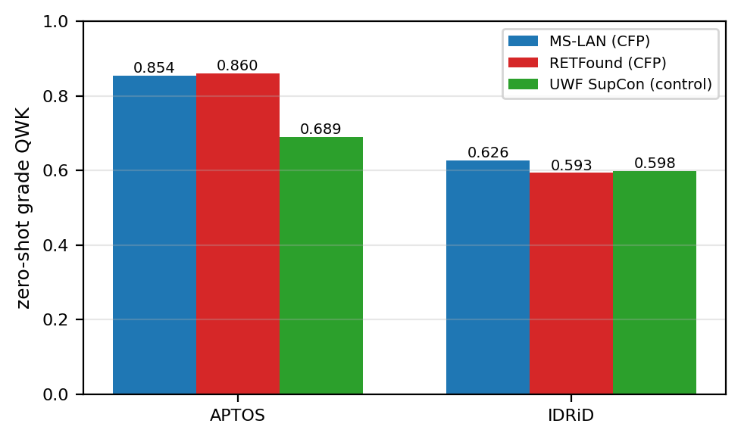
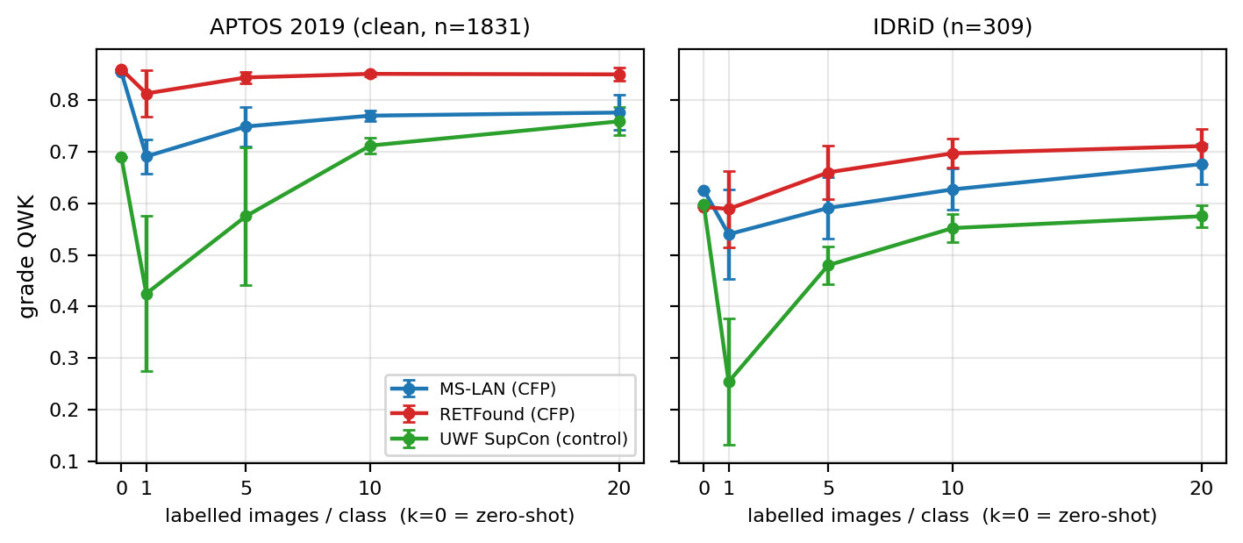
Experiment XI — Results
Foundation model transfers best; modality matters
• RETFound generalizes best zero-shot; few-shot (k up to 20) lifts every model further.
• The UWF control is measurably weaker (modality matters) but not near-chance.
Zero-shot QWK by model and dataset
Few-shot QWK vs. k (mean +/- std)
10
Notes:
• Lead with the winner: RETFound, the foundation model, transfers best zero-shot on the clean APTOS data (0.860). That's the satisfying result — the pre-training pays off on unseen data.
• Note the datasets differ in difficulty: on IDRiD everything drops, and the ranking shuffles — be honest that IDRiD is harder / noisier.
• Few-shot: just 20 examples per class lift performance further, showing the features are useful even where the raw head isn't perfect.
• Handle the control carefully and honestly: the UWF model IS worse (0.689 vs 0.86) — modality matters — but it's not random, because QWK is forgiving on an ordinal scale. Don't overclaim it 'failed'.
• State the caveat plainly: the external sets are augmented, so few-shot looks a bit rosy; zero-shot is the number to trust.

Slide 12
Takeaways
What the three experiments show together
• Exp II: done correctly, a foundation model reproduces the published baseline — and verification catches silent failures.
• Exp X: generated data did not beat oversampling; an honest negative result that localises the bottleneck (fidelity).
• Exp XI: MMRDR-trained CFP models genuinely generalize to unseen datasets; RETFound generalizes best.
• Common thread: rigorous, honest evaluation — including reporting when a method fails.
11
Notes:
• Tie the three together: correctly-done reproduction (II), an honest negative on synthetic data (X), and successful generalization (XI).
• Reinforce the meta-point for the professor: the value across all three is rigorous, verifiable evaluation — we prove our weights loaded, we test on 100%-real data, and we report failures.
• Invite questions.

