Slide 1

University Admission
Krishna Sai Desaboina

Slide 2
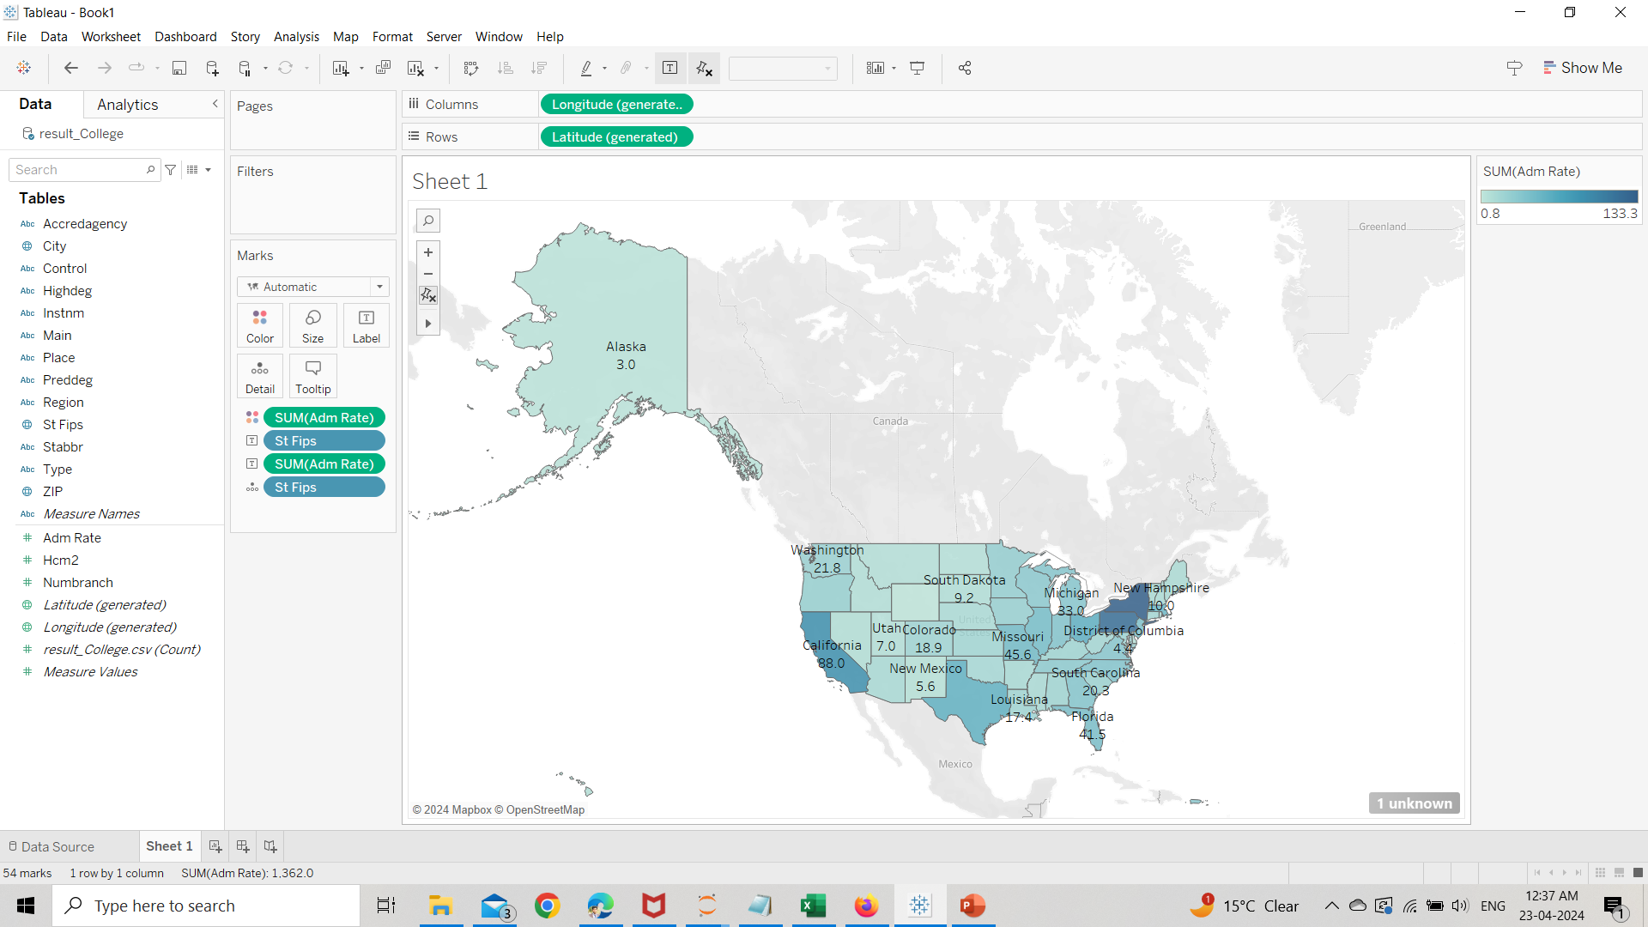
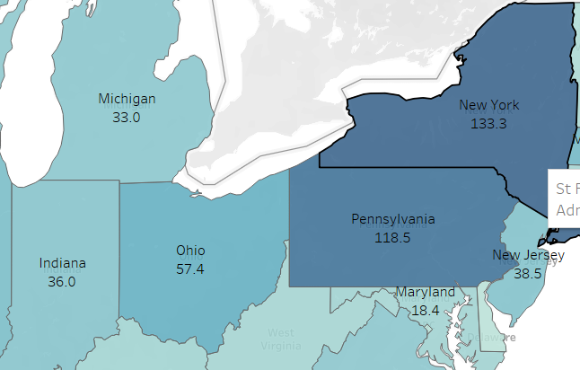
1. Which State has the Highest Admission Rate?
Ans: New York

Slide 3
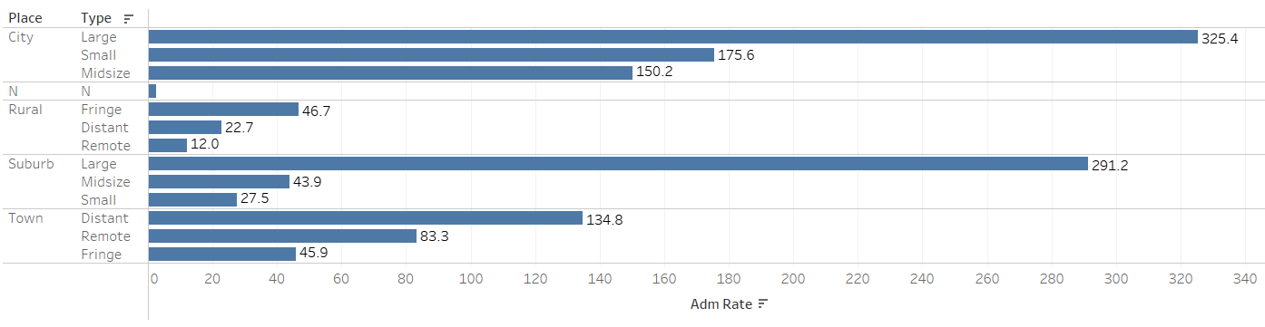
2. Which Places have the Highest Admission Rate?
Ans: Large City

Slide 4
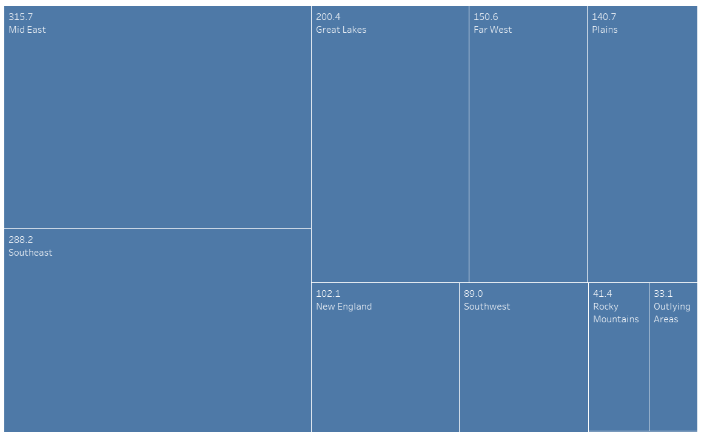
3. Which Region has the Highest Admission Rate?
Ans: Mid East

Slide 5
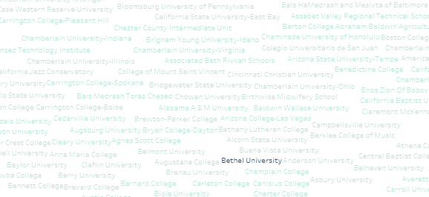
4. Which University has the Highest number of Branches?
Ans: Bethel University

