Slide 1
EDA
-By Vahanth

Slide 2
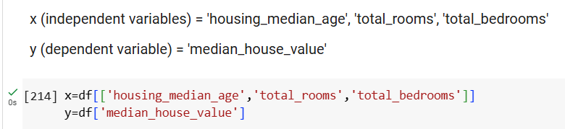
Which 3 or 4 variables in your data set are you interested in? The 4 variables which I found interesting are housing_median_rooms, total_rooms, total_bedrooms, median_house_value

Slide 3
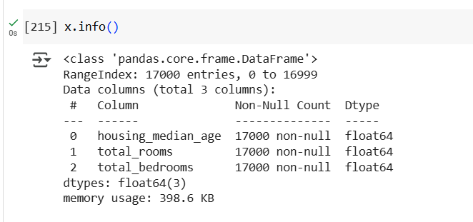
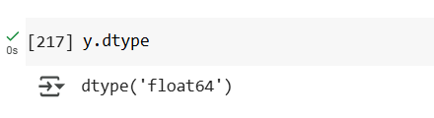
What are their data types? The data type of x variable is float and where as y int

Slide 4
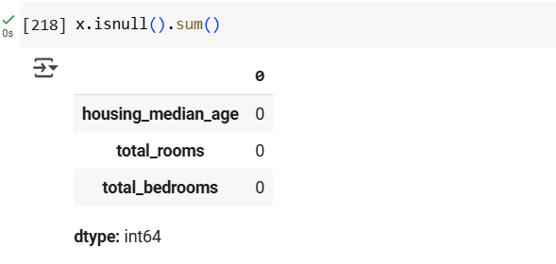
Any missing data? How much? There is no missing data in my dataset

Slide 5
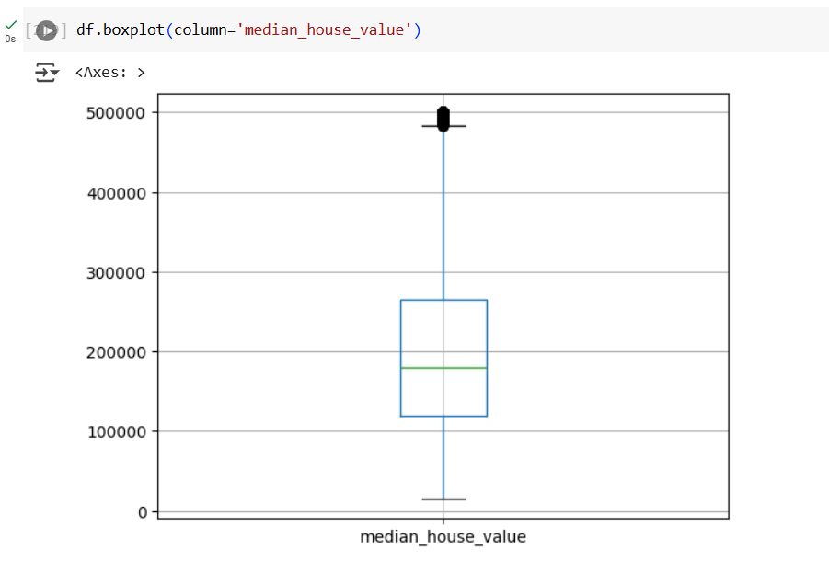
Any outliers? Do a box & whiskers diagram to see if you have any. Yes, There are outliers.

Slide 6
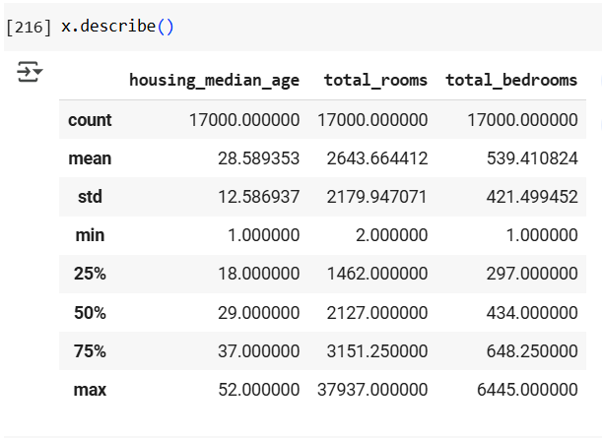
Tell me the basic statistics of each of your variables. For numeric variabes, calculate minimum, mean, median, mode, maximum, and standard deviation.

Slide 7
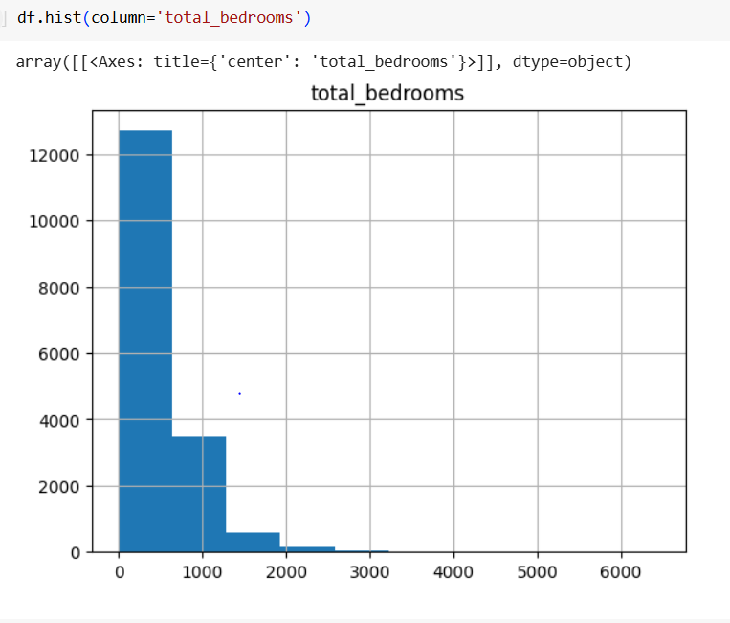
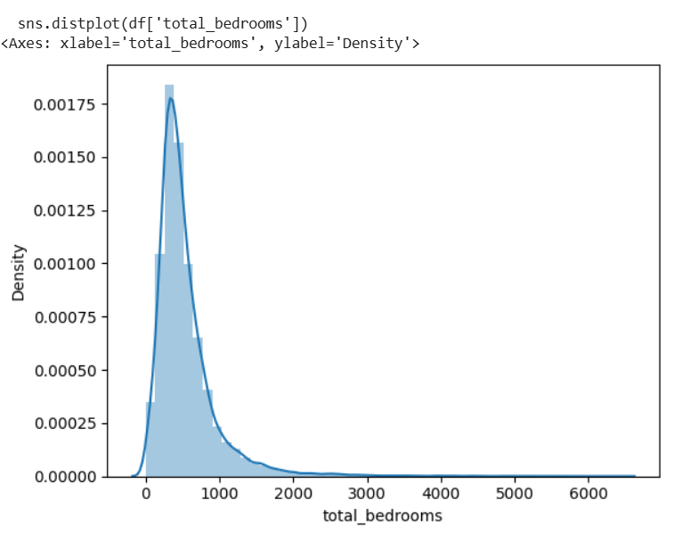
Show me histograms of your variables. Any shapes of these histograms normal? Or, do the shapes looks more like uniform, Poisson, or something else? Poisson Distribution

Slide 8
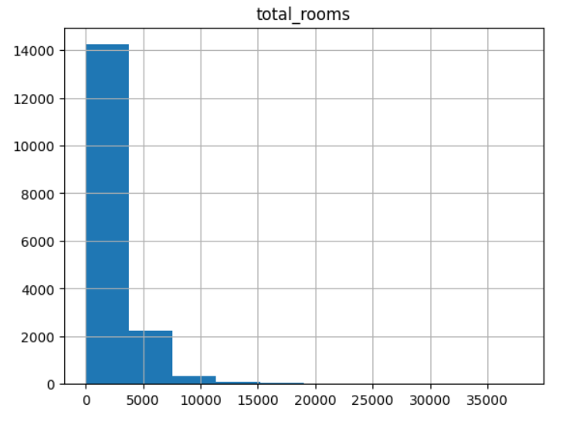
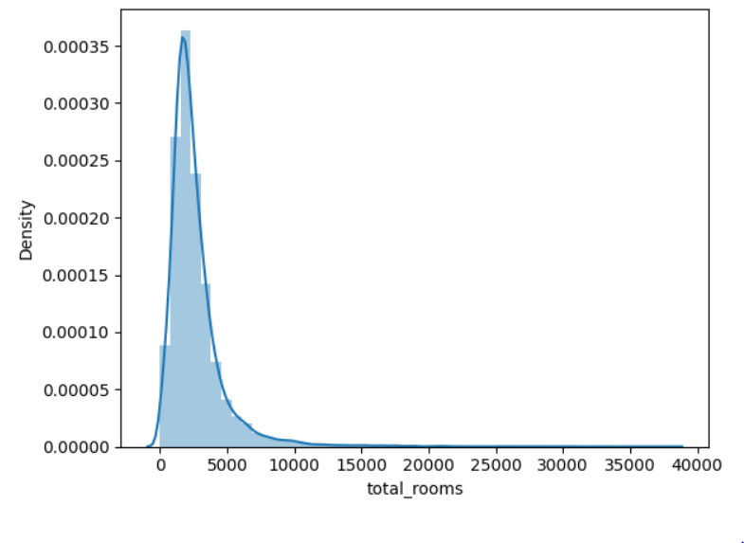
Poisson Distribution

Slide 9
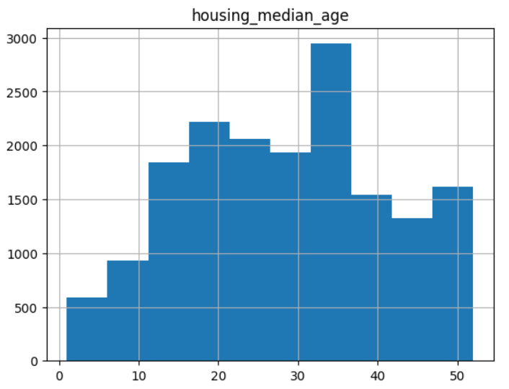
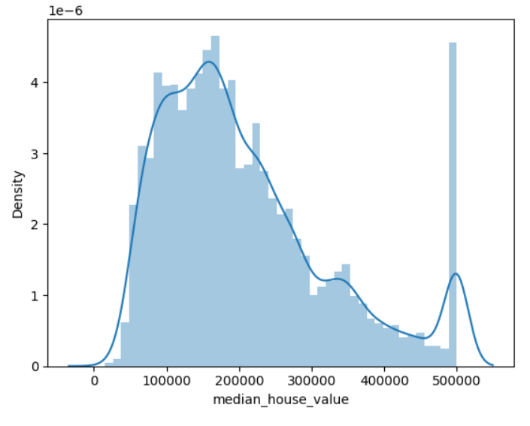
Poisson Distribution

Slide 10
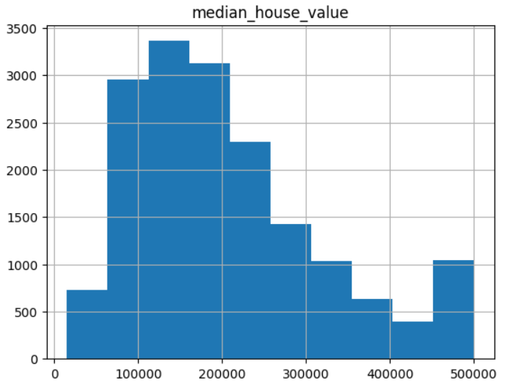
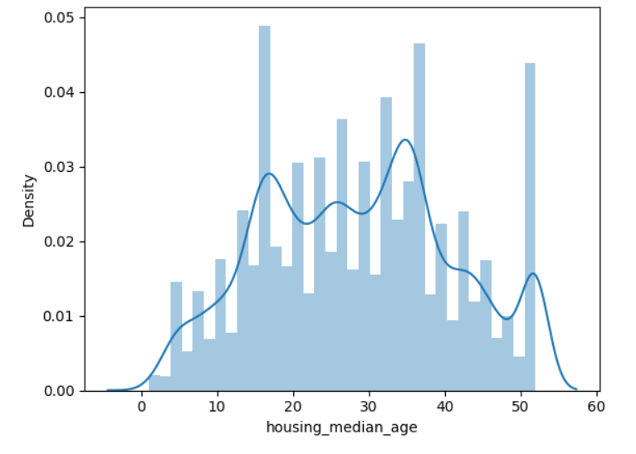
Uniform Distribution

Slide 11
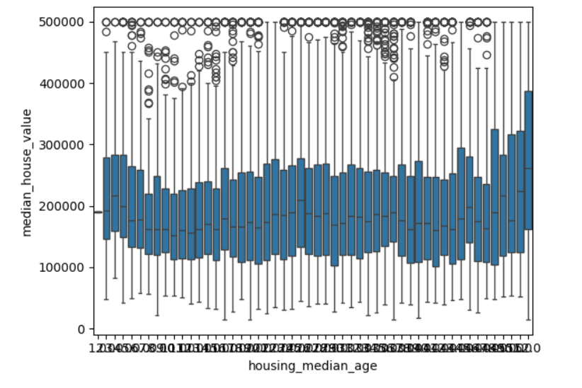
Pick two of your variables that you think have a relationship and produce a scatter plot, box & whiskers, or table of counts. Remember that your data types determine what you can do with the data.

Slide 12
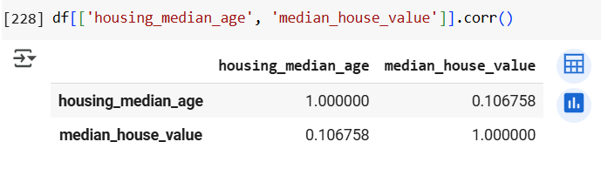
Thought that as age of the house increases the value of the house decreases but The plot shows that it’s wrong. The house price remains relatively stable as the age increases. The pearson correlation also very small 0.1 which states that the two variables are weak positively correlated.

Slide 13
Give me a paragraph for each variable of the 3 or 4 variables and tell me what you discovered? Are the statistics and graphs what you expected or are they different? Make some observations and explain to me what you see using words. Demonstrate to me that you paid attention to the information you produced answering the questions above.
The median_house_value is a dependent variable which range between 14999 to 500001.
The total_rooms is an independent variable with poisson distribution. The total_rooms is Positively correlated with the dependent variable median_house_value. As the total_rooms increases the house value also increases.
The total_bedrooms is an independent variable with poisson distribution. The total_bedrooms is Positively correlated with the dependent variable median_house_value. As the total_bedrooms increases the house value also increases.
The housing_median_age is an independent variable with uniform distribution. The housing_median_age is Positively correlated with the dependent variable median_house_value. Surprisingly as the housing age increases the value of the house increases.

