Slide 1




NETAJI SUBHAS UNIVERSITY OF TECHNOLOGY
DEPARTMENT OF COMPUTER SCIENCE ENGINEERING
MULTI-MODAL
DEEPFAKE DETECTION
Integrating Spatial, Temporal and Physiological Features
Under the Supervision of
Dr Rudresh Dwivedi
Submitted By – Group 109
Mahi Chaudhary 2022UCA1808
Tanmay Pawar 2022UCA1850
Krrish Kumar 2022UCA1880

Slide 2


1. | Overview | 3
2. | Literature Survey | 4
3. | Motivation | 5
4. | Proposed Methodology | 6
5. | Physiological Credibility Score | 7
6. | Fusion System | 8
7. | Results and Comparison | 11
8. | Future Work | 13
CONTENTS

Slide 3

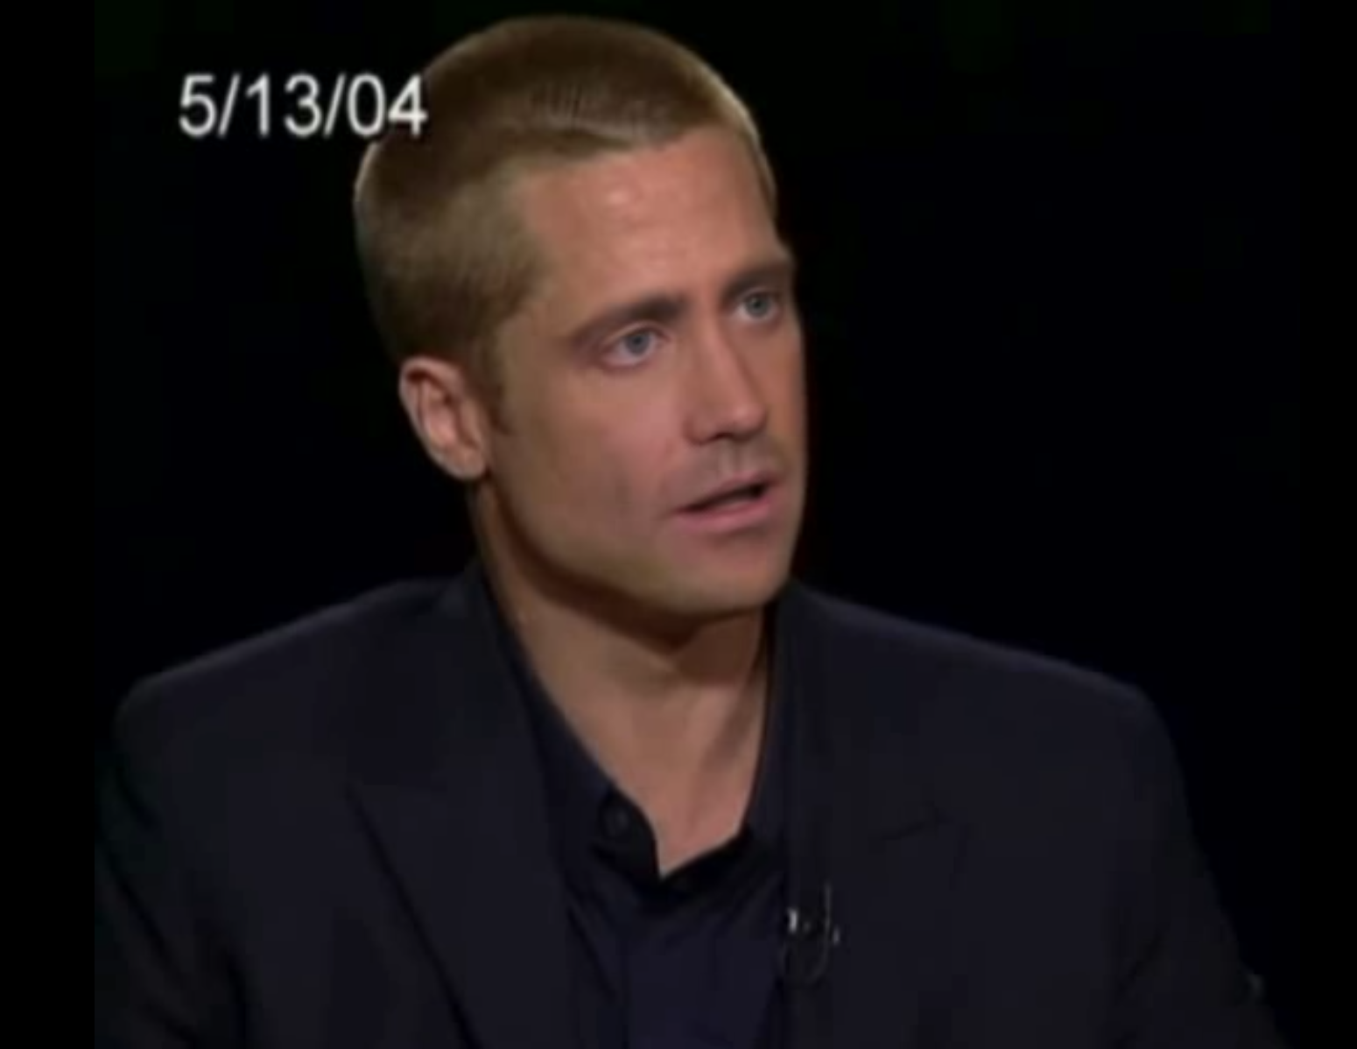
0
01
With the current state-of-the-art generative models, it is now possible to produce manipulated videos and images that are almost indistinguishable from real media
1/8
02
Though such innovations are legitimate where entertainment, learning, and accessibility are
concerned, their abuse presents real challenges.
Overview
REAL
Deepfake technology refers to AI-created content where a person’s facial appearance has been artificially modified or replaced.
03
Misuse comes with a high cost in areas like
misinformation operations, identity theft, political propaganda, and cyber-fraud
FAKE

Slide 4

2/8
Literature Survey
The Current Methods used for Deepfake detection can be generally classified into 3 categories -
I
II
III
Spatial Methods
Temporal Methods
Physiological Methods
Here CNNs like XceptionNet, ResNet and DesNet are extensively used to detect spatial level features in forged video frames
These are multimodal approaches, where a CNN architecture is used to detect spatial features and then a RNN is used for temporal modelling and identifying inconsistencies across frames
The most recent frontier, which involves analyzing physiological signals like heart rate, which are difficult to reproduce.

Slide 5

3/8
Not withstanding the new developments, current methods are subject to several shortcomings -
I
CNN-based detectors are dataset-specific and subject to overfitting and therefore perform less well under exposure to as yet unseen deepfake generation methods
Motivation
II
Temporal models yield greater robustness yet frequently overlook physiologically unrealistic discrepancies.
III
Physiological methods, as a subject of promise, are liable to ambient noise and demand longer video sequences before enabling any stable results

Slide 6
Data Preprocessing
6/8
I
Frame Extraction Strategy:
Video frames are extracted at 30 frames per second (FPS).
The CNN-RNN module uses sequences of 20 consecutive frames to detect short-term temporal anomalies.
The rPPG module uses longer sequences of 270 frames to ensure stable heart signal analysis.
II
Face Alignment and Normalization:
Face detection is performed using the face_recognition library.
Input frames are resized to 112×112 pixels.
Pixel values are normalized using standard ImageNet mean and standard deviation to match the pre-trained ResNeXt-50 requirement

Slide 7
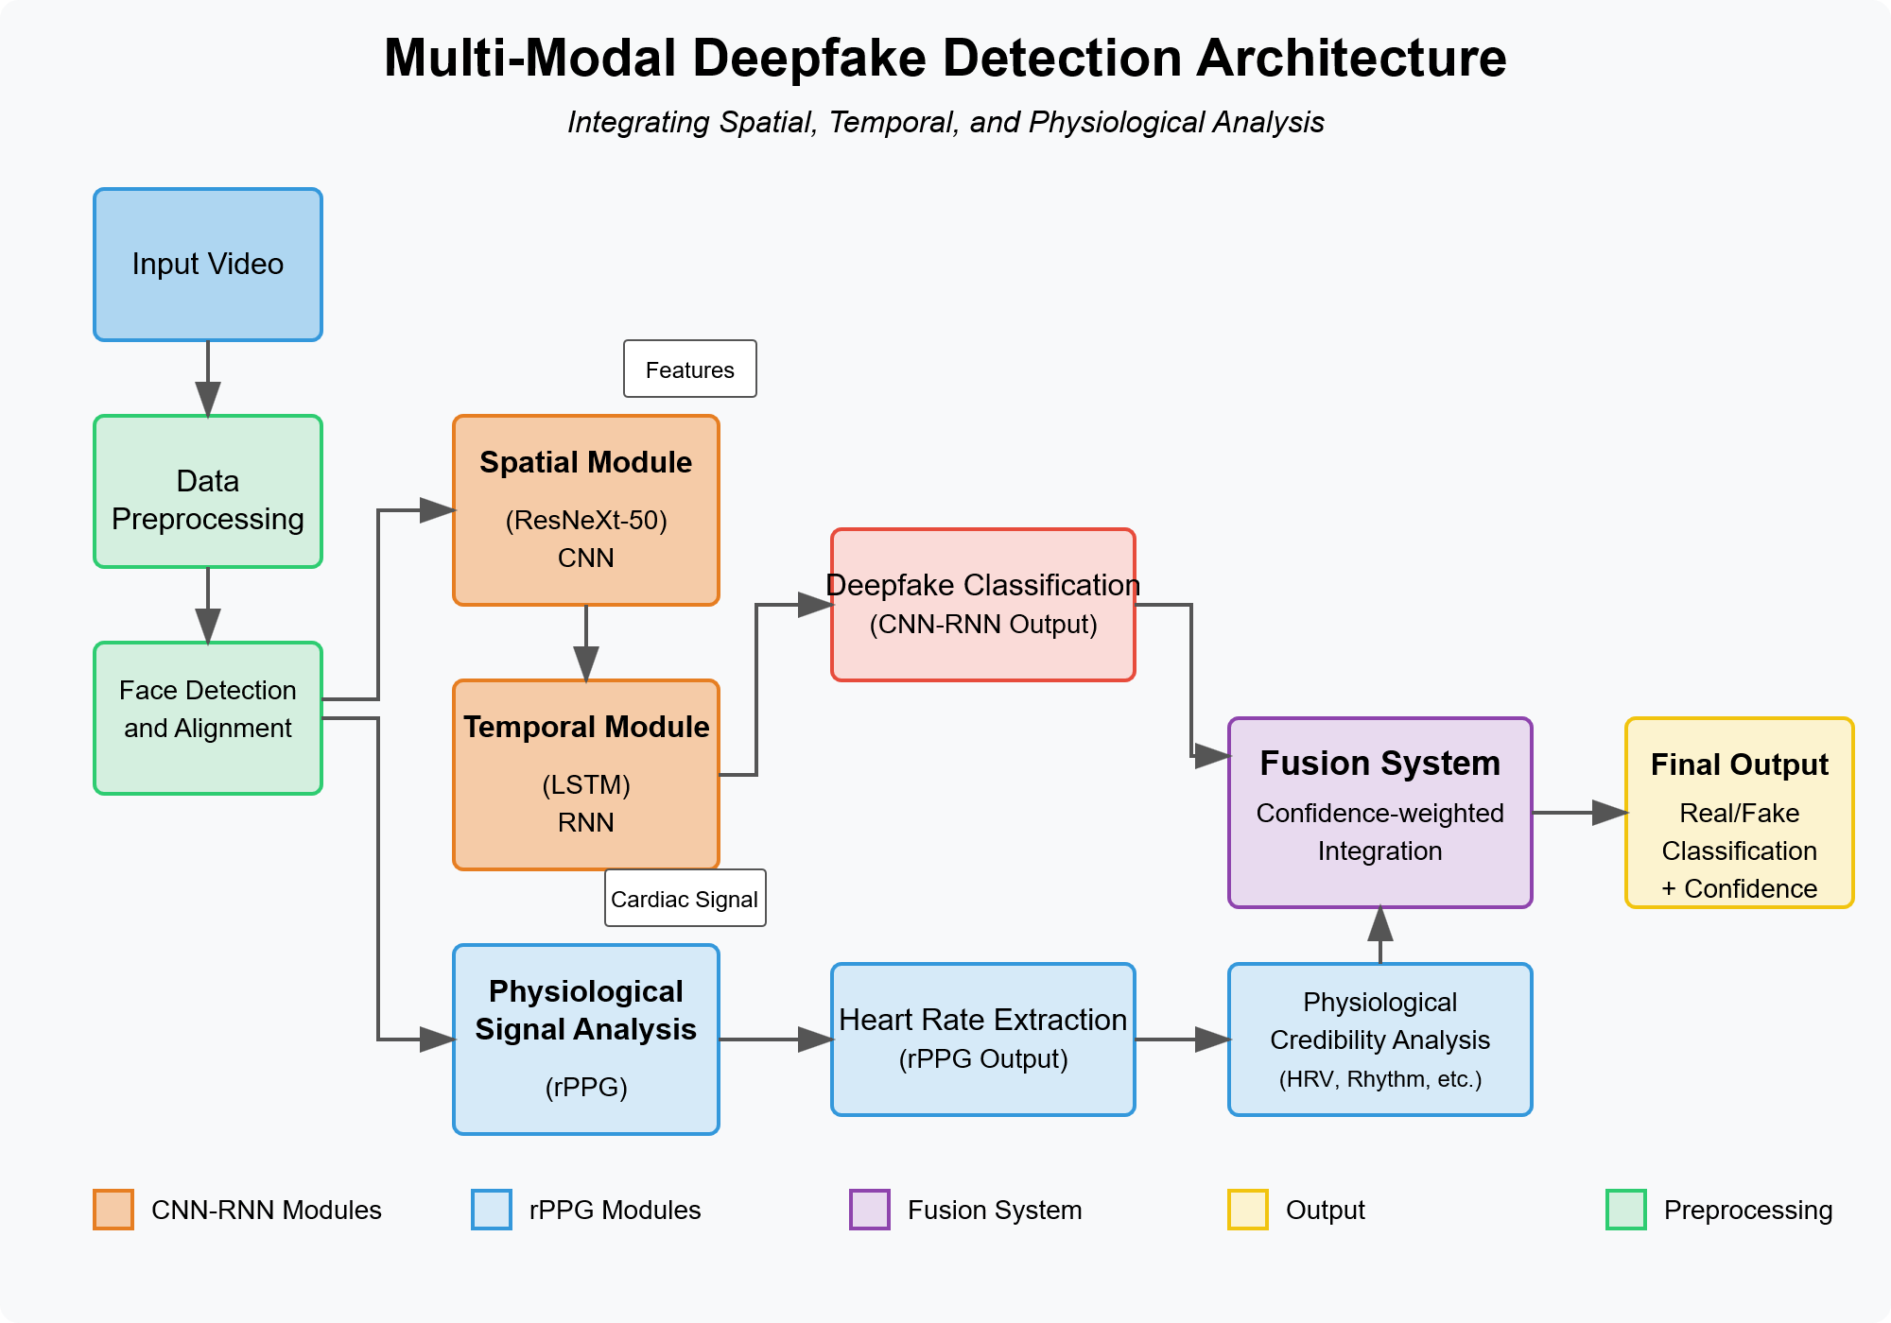
Proposed Methodology
4/8
Our designed deepfake detector involves a multi-modal architecture capable of storing an assortment of artifacts.
The framework comprises two parallel analysis streams: a CNN-RNN hybrid model for spatial-temporal feature extraction and an rPPG-based module of physiological signal analysis. Outputs of these pipes are connected with an intelligent fusion system to create a final classification output.

Slide 8
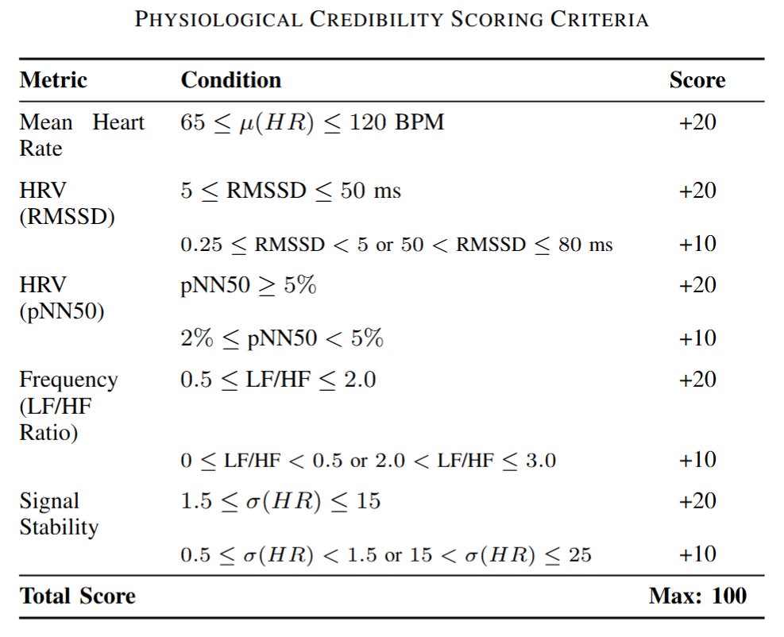
5/8
Physiological Credibility Score
It is a score between 0 and 100 that measures the biological validity of the rPPG signal extracted by checking vital heart rate (HR) and heart rate variability (HRV) parameters with known physiological norms.

Slide 9
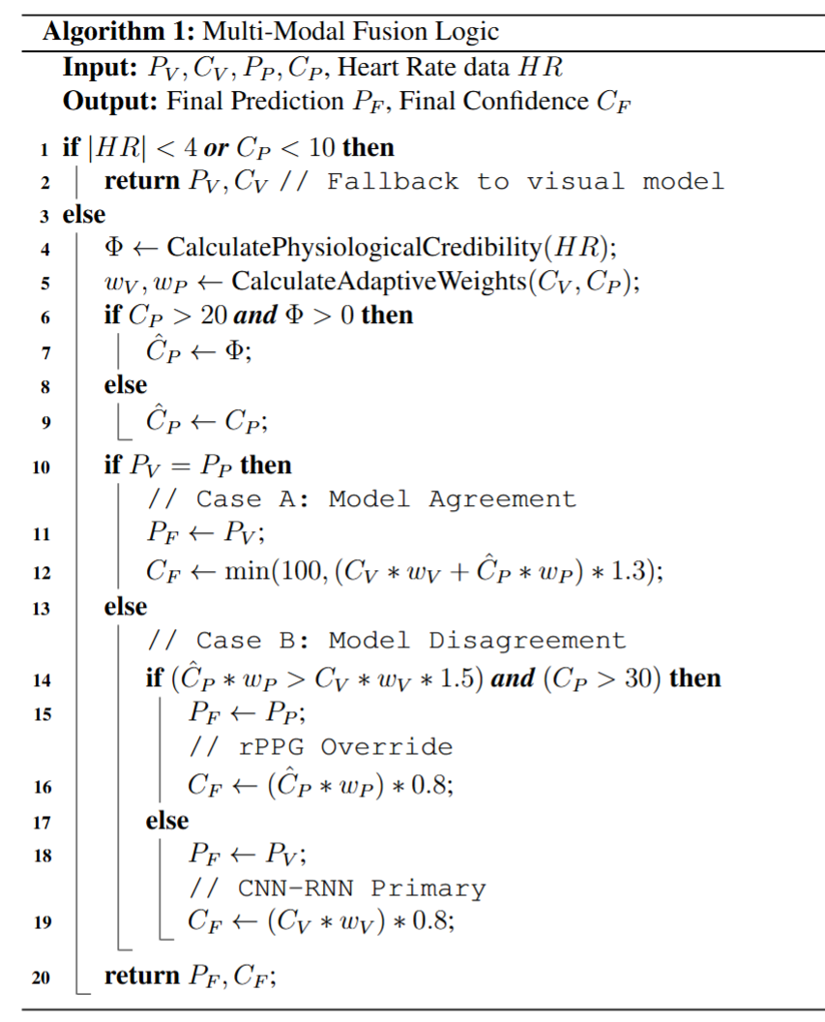
Fusion System
6/8
For fusing outputs from both visual and physiological processing pipes, we propose a confidence-weighted fusion algorithm.
The Terminologies used in the algorithm are -
P_v -> Prediction of Visual Model (CNN-RNN)
C_v -> Confidence of Visual Model (CNN-RNN)
w_v-> Adaptive weight of Visual Model (CNN-RNN)
HR -> Heart Rate data
P_p -> Prediction of Physiological Model (rPPG)
C-hat_p -> Effective Confidence of Physiological Model (rPPG)
C_p: Raw confidence score that the rPPG module provides
w_p -> Adaptive weight of Physiological Model (rppg)
P_f -> Final Prediction
C_f -> Final Confidence

Slide 10
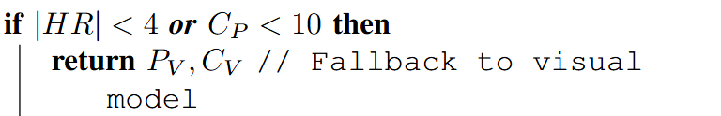
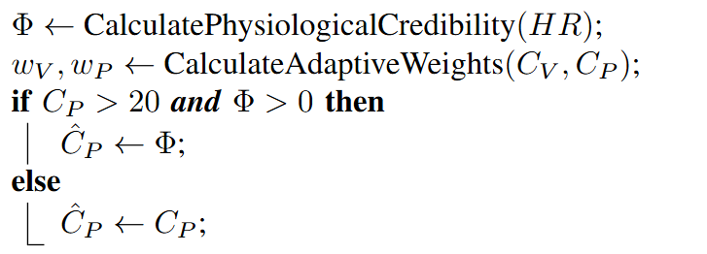
Fusion System
6/8
The Algorithm can be broken down into 3 parts -
I
Fallback Condition
If the rPPG signal is not reliable then the final output is based only on the CNN-RNN Module.
II
Adaptive Weight Calculation
The base weights are set such that the visual model is marginally dominant. These are then modulated by the relative confidence of each model and normalized to sum to 1:

Slide 11
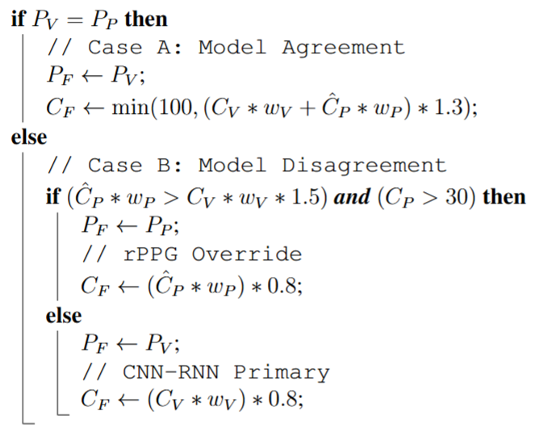
Fusion System
6/8
III
Decision Logic
If both the models agree, the final confidence is calculated as the weighted average of each of the confidences, amplified by a 30% agreement bonus.
If the models disagree a priority-based method is used to resolve the tie.

Slide 12
2/8
Datasets Used
Training Dataset
Generalization & Testing Datasets
Deepfake Detection Challenge (DFDC)is used as the primary dataset for training the CNN-RNN and calibrating the fusion system.
Celeb-DF (v2) and FaceForensics++ are used to evaluate robustness against diverse manipulation methods.

Slide 13
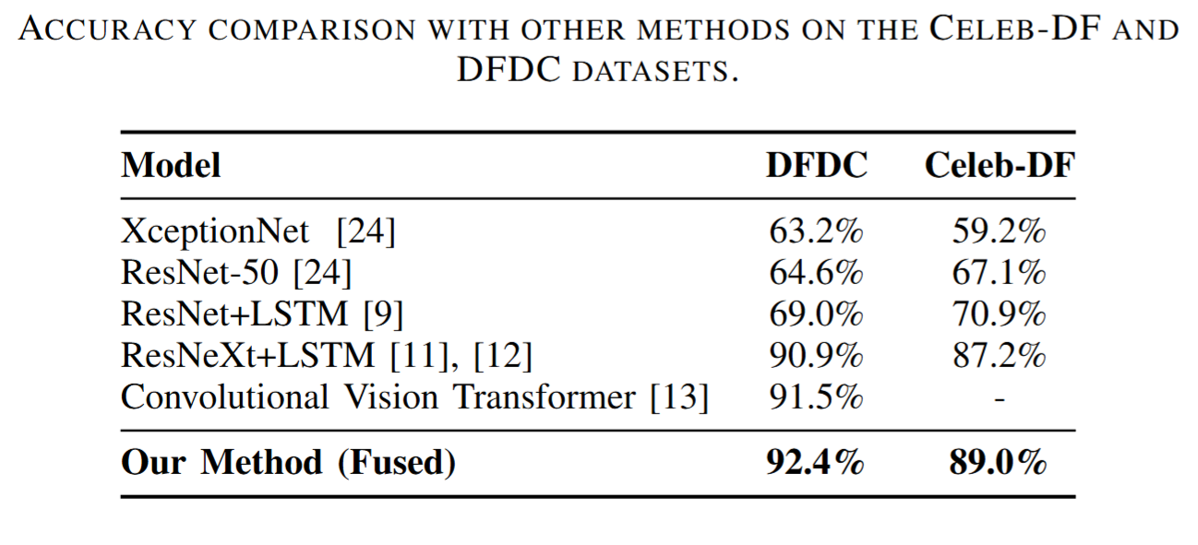
Results and Comparison
7/8
Our multi-modal framework reaches competitive performance with other state-of-the-art techniques,

Slide 14
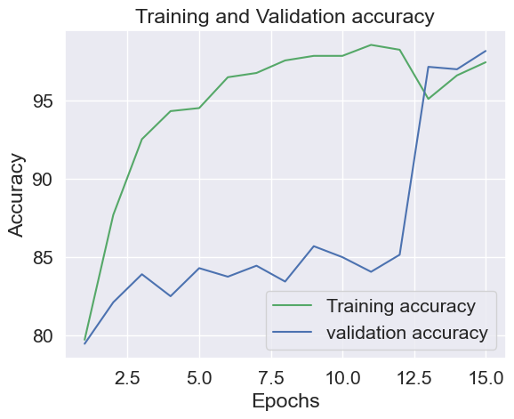
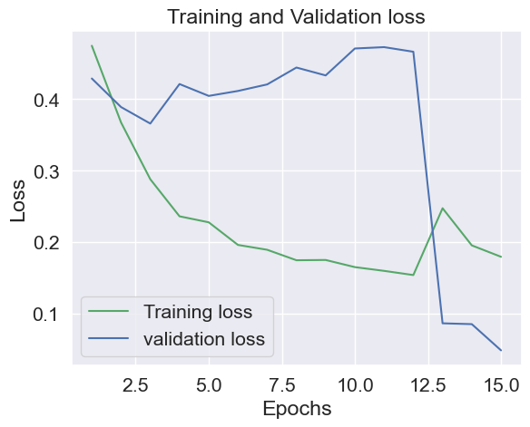

Plots
7/8
Training and Validation Accuracy
Training and Validation
Loss

Slide 15
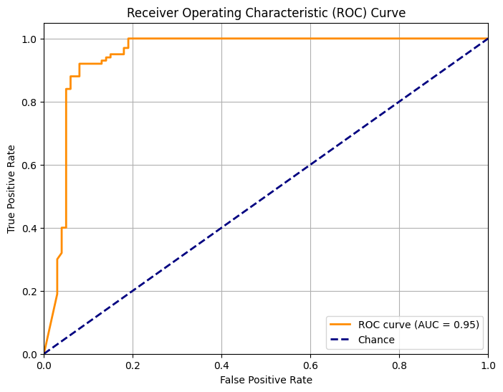
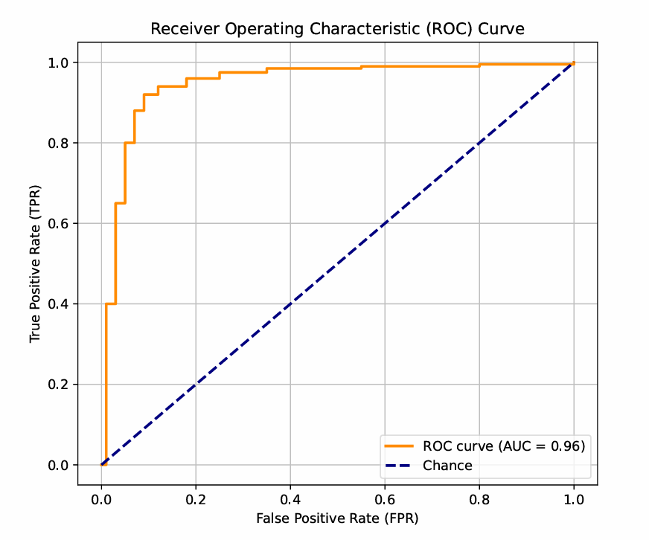
Plots
7/8
ROC Curve
CelebDF
ROC Curve
DDFDC

Slide 16
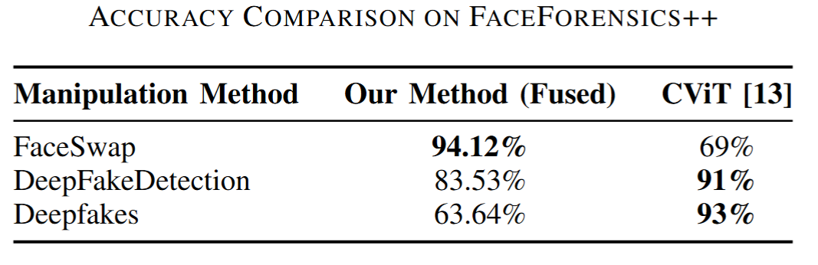
Results and Comparison
7/8
To provide a more granular comparison and specifically test generalization, we also evaluated our model on the challenging FaceForensics++ dataset

Slide 17
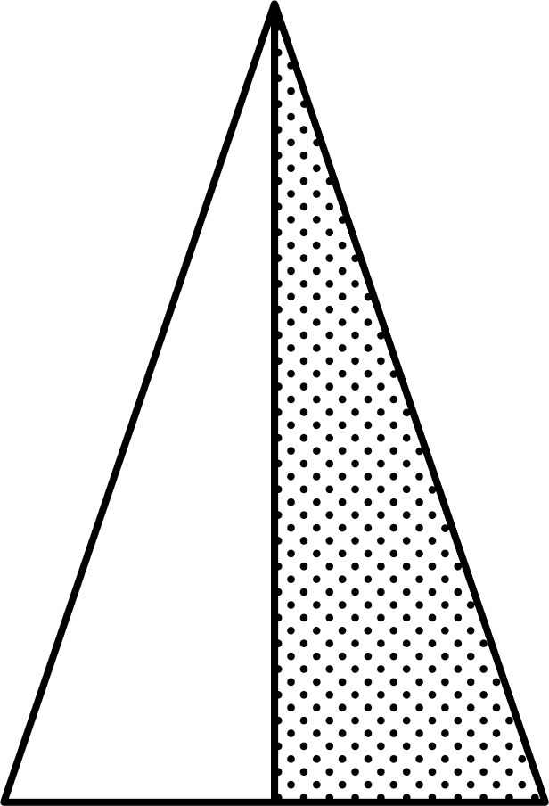
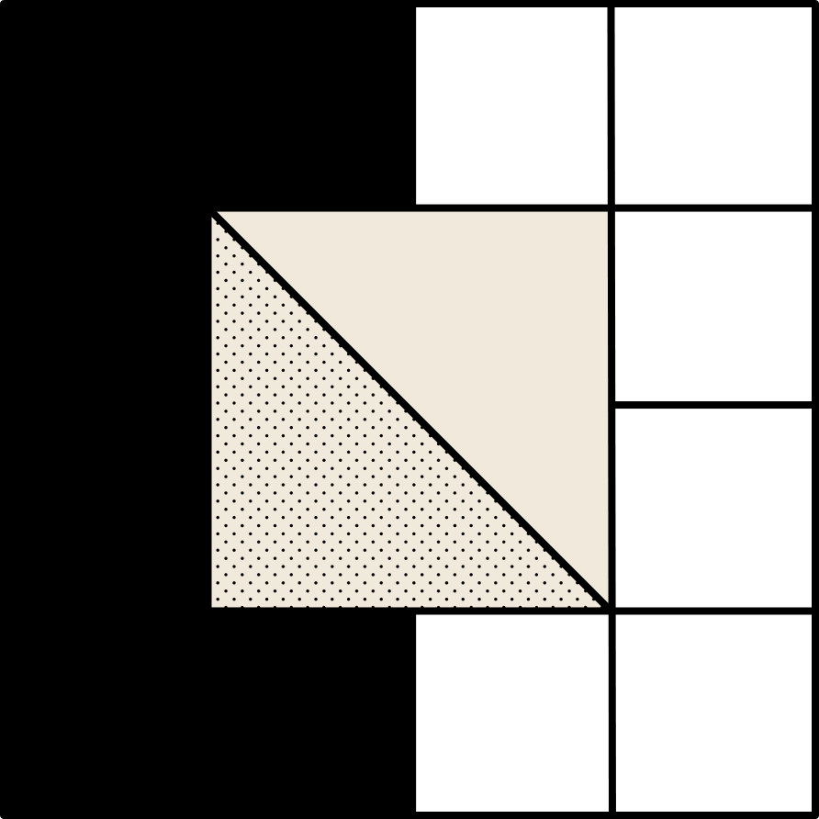
Future Work
8/8
Vision Transformer
Dataset Expansion
Adversarial Training
Integration of VIT as a parallel spatial feature extractor
Training on more diverse datasets.
Using the detector as a discriminator within a GAN framework

Slide 18

THANK YOU!
Group 109
Mahi Chaudhary
2022UCA1808
Tanmay Pawar
2022UCA1850
Krrish Kumar
2022UCA1880

