Slide 1

ALUMINIUM-AIR BATTERIES: Innovation in Energy Storage.
Project phase 2 presentation
Project Guide
Dr. S. B. Ghugare
Faculty
Department Of Chemical Engineering
AISSMS College of Engineering, Pune.
Krrishh Shirbhaiye
Student, BE Chemical
Department Of Chemical Engineering
AISSMS College of Engineering, Pune.

Slide 2
Index.
Issues Faced By Aluminum-Air Battery.
Sample Calculations(Material Balance).
Case Studies on Corrosion Prevention.
Non-Conductive Oil Layer.
Conductive Nanocomposites.
Ammonium Vanadate.
References.

Slide 3

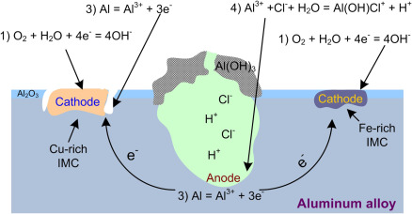
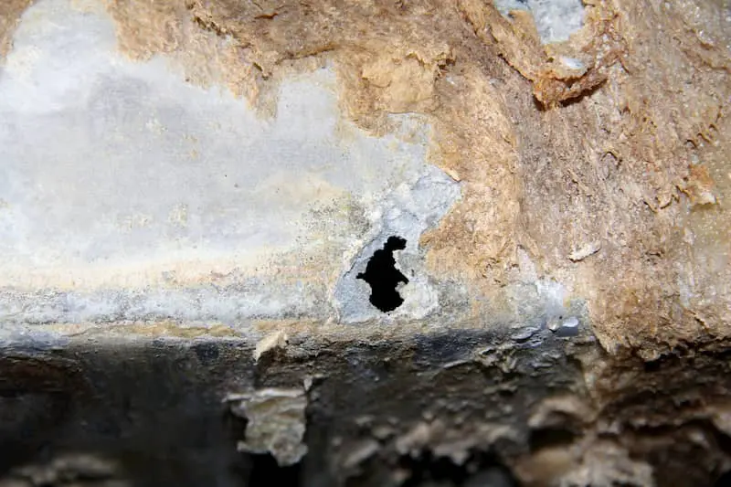
Issues faced by Aluminium-Air Battery.
. Aluminum-air batteries, while promising for energy storage, face several challenges that hinder their widespread use. One major issue is their limited cycle life; the battery’s aluminum anode degrades after only a few charges, reducing its efficiency over time. Additionally, the electrolytes used in aluminum-air batteries can be highly corrosive, complicating their design and adding to the cost. The technology also struggles with the lack of effective rechargeability, as aluminum corrosion is difficult to reverse, making long-term use less viable. Moreover, scaling the production of aluminum-air batteries for mass use presents cost and infrastructure development difficulties.

Slide 4
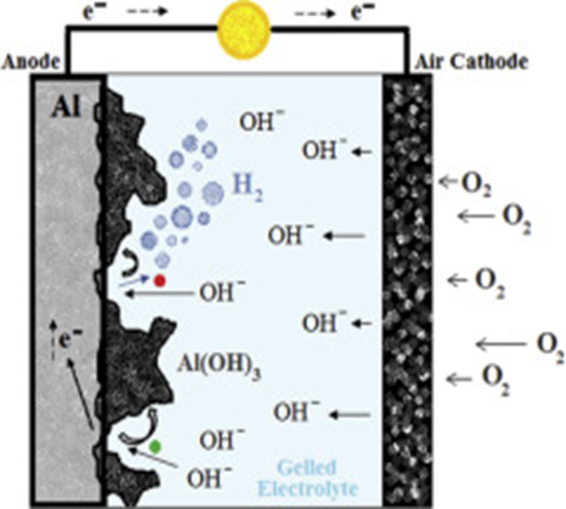
Sample Calculations (Material Balance.)
Mass of Aluminum = 1kg
Electrolyte = NaOH (20% by Weight)
Operating Temperature = 30C
Faraday’s Constant = 96485C/mol
Molar Mass of Aluminum = 27g/mol
Standard Energy Density = 8.1KWH/kg

Slide 5
Material Balance.
Reaction:
4Al+3O2+6H2O→4Al(OH)3+Electricity(2.71V).
Molar Mass of Al = 27g/mol.
Molar Mass of 4Al(OH)3 = 78g/mol.
Now,
Moles of Al = 1000g/27g/mol
= 37.04g
Now,
4 moles of Al reacts with 3 moles of O2.
Therefore, moles of oxygen = 3/4 x 37.04
= 27.78mol
Molar mass of oxygen = 32g/mol
Now,
Mass of Oxygen = 27.78 x 32
= 888.96g
= 0.89kg
Now,
For every 4 moles of Al, 6 moles of H2O are consumed.
the moles of water required are:
Moles of H2​O= 46​ x 37.04
=55.56mol.
Molar mass of H2​O = 18 g/mol.
The total mass of water used is:
Mass of H2​O=55.56×18
=1000g =1kg
Now,
4moles of aluminum produce 4 moles of aluminum hydroxide
Thus, the total moles of aluminum hydroxide formed are:
Moles of Al(OH)3 = 37.04mol
The corresponding mass of aluminum hydroxide is:
Mass of Al(OH)3 = 37.04 x 78
= 2889.12g = 2.89Kg

Slide 6
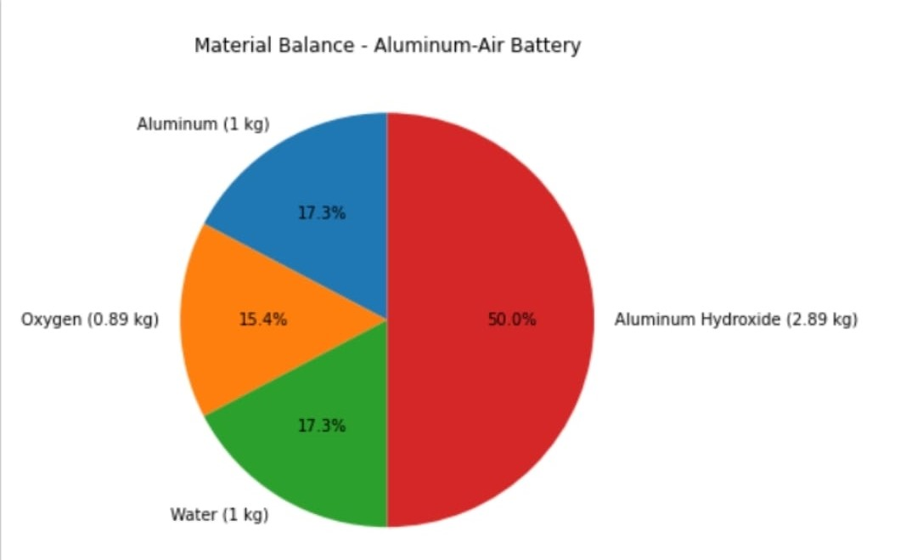
Pie Chart for Material Balance.

Slide 7
Case Studies on Corrosion Prevention.
A 2018 study in Science showed that applying a non-conductive oil layer can suppress corrosion during battery standby periods.
A 2021 Journal of Power Sources study demonstrated that conductive nanocomposites can reduce corrosion and hydrogen gas evolution in aluminum-air batteries.
A 2021 study published in ELSA found that adding ammonium vanadate combined with carboxymethylcellulose to the alkaline electrolyte can effectively inhibit corrosion.

Slide 8
Non-Conductive Oil Layer in Detail.
The non-conductive oil creates a physical barrier between the aluminum anode and the electrolyte.
This barrier prevents direct contact with the alkaline electrolyte, reducing the rate of unwanted side reactions, such as hydrogen gas evolution due to corrosion.
During battery operation, the oil layer can be displaced locally by the electrolyte where electrochemical reactions are required, ensuring functionality without compromising the suppression of corrosion during idle times
Advantages:
It significantly reduces self-discharge and material loss when the battery is unused.
By protecting the aluminum surface, the oil layer contributes to the overall durability of the battery.
Applying an oil layer is relatively straightforward and does not require complex chemical processes or significant modifications to existing designs.
Key Properties of the Ideal Oil:
Hydrophobic Nature.
Chemically Inert.
Low Viscosity.
Thermal Stability.
Non-Volatile.
Ecofriendly & Cost Effective.
Examples of Potential Oils:
Silicone Oils.
Mineral Oils.
Perfluoropolyether (PFPE).
Vegetable-Based Oils.
Synthetic Hydrocarbon Oils.
Modified Silicone or Synthetic Hydrocarbon Oils would likely be ideal due to their excellent balance of chemical stability, hydrophobicity, and cost-effectiveness.
Additives such as anti-oxidants or anti-corrosion agents could further enhance their performance.

Slide 9
Non-Conductive Oil Layer in Detail.
Modified Silicone Oil
Synthetic Hydrocarbon Oil
Modified silicone oil is known for its excellent thermal stability, chemical inertness, and water-repellent properties.
It forms a thin, non-reactive film on the aluminum surface that protects it from the corrosive effects of the electrolyte.
Its hydrophobic nature prevents moisture and electrolytes from reaching the aluminum, which helps reduce side reactions like hydrogen gas evolution.
Silicone oils are also highly stable over a wide temperature range, making them ideal for batteries used in varying environmental conditions.
However, their performance may drop slightly in highly alkaline electrolytes due to limited compatibility.
made from engineered hydrocarbons and provides good corrosion resistance by creating a barrier against the electrolyte.
These oils are generally more affordable than silicone oils and are effective in reducing corrosion in moderate conditions.
However, they may not offer the same level of thermal stability or long-term durability as silicone oils.
Additionally, synthetic hydrocarbon oils are more prone to chemical degradation in harsh environments, which can lead to a shorter lifespan for the coating.
modified silicone oil is better suited for applications requiring high durability and resistance to extreme conditions, while synthetic hydrocarbon oil is a cost-effective option for less demanding environments.

Slide 10
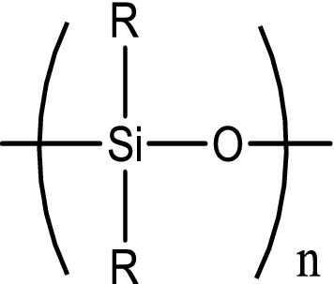
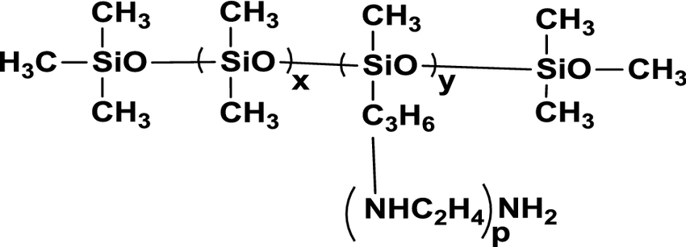
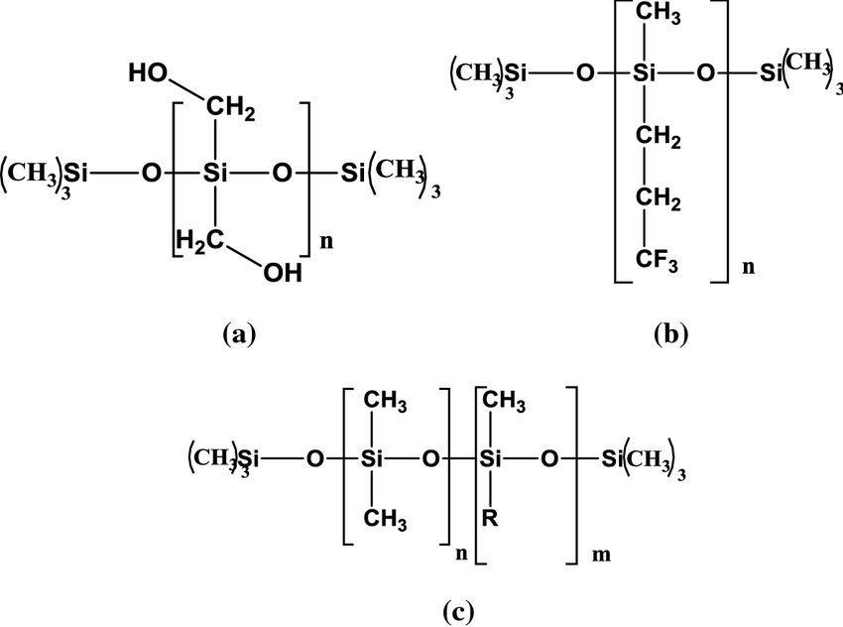
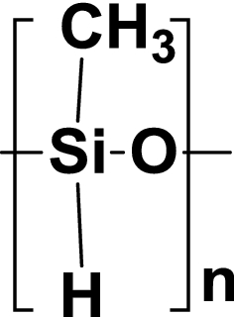
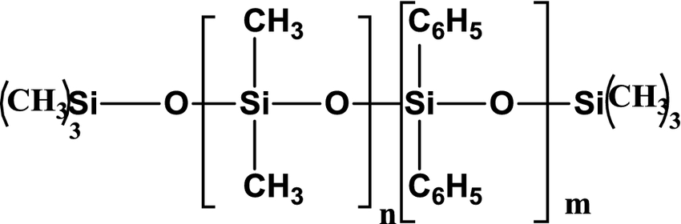
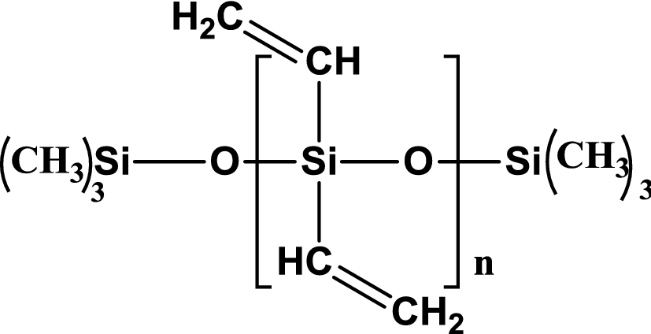
Types of modified silicone oils.
General structure of polydimethylsiloxane (PDMS).
Amino silicone oil
Polymethyl hydrogen
siloxane
Phenyl methyl silicone oil
Schemes of the chemical structure of a hydroxy silicone oil,
b trifuoropropylmethyl silicone oil,
and c Methyl alkyl silicone oil
Vinyl silicone oil

Slide 11
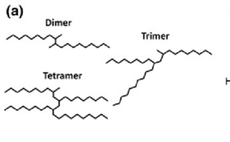
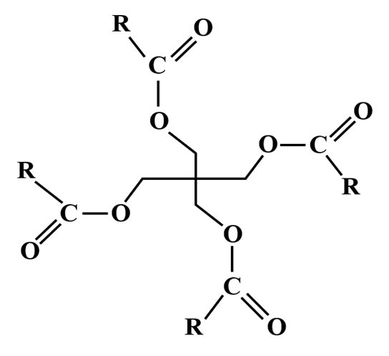
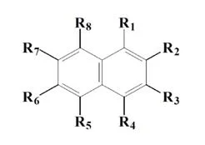
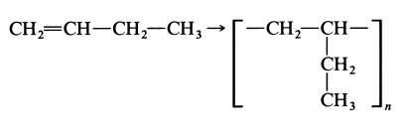
Types of Synthetic Hydrocarbon Oils.
Polyalphaolefins (PAO)
Structure of synthetic ester.
Alkylated Naphthalenes
Polybutene

Slide 12
Conductive Nanocomposites.
Uses:
1. Boosting Conductivity: The nanocomposites are made with materials like carbon nanotubes, graphene, or conductive polymers.
2. Reducing Corrosion: Conductive nanocomposites can form a protective layer over the aluminum anode, preventing it from reacting with the electrolyte and corroding.
3. Minimizing Hydrogen Gas Release: The nanocomposites help reduce this gas release by stabilizing the anode and making the electrochemical reactions more controlled, which helps improve the overall efficiency of the battery.
Information:
Conductive nanocomposites are materials made by combining tiny particles (like carbon, metal oxides, or certain polymers) with a main material to make it more conductive.
In aluminum-air batteries, these nanocomposites are helpful because they can solve two major problems: corrosion and the release of hydrogen gas at the aluminum part of the battery.
By improving the conductivity and stability of the aluminum, these composites help the battery last longer and work more efficiently.

Slide 13
Types of Conductive Nanocomposites can be used.
Graphene:. It is highly conductive, mechanically strong, and chemically stable. When incorporated into nanocomposites, graphene forms a protective layer on the aluminum surface, preventing direct exposure to the electrolyte and reducing the corrosion rate.
Carbon Nanotubes (CNTs): CNTs are cylindrical structures of carbon atoms with excellent electrical conductivity, strength, and stability. CNT-based nanocomposites can create a conductive network on the aluminum anode, enhancing charge transfer while providing a protective layer to prevent corrosion.
Activated Carbon: Activated carbon nanocomposites improve the electrochemical stability of the aluminum anode. The high surface area of activated carbon helps trap ions and reduce the rate of corrosion by stabilizing the electrochemical reactions at the anode.
Nickel Oxide (NiO): Nickel oxide is a metal oxide known for its stability and conductivity. In aluminum-air batteries, NiO nanocomposites can be used to form a protective coating on the aluminum anode, which prevents corrosion and enhances battery performance.
Iron Oxide (Fe2O3): Iron oxide is another metal oxide that is commonly used to form nanocomposites for corrosion prevention. It can enhance the mechanical properties of the anode and provide a stable surface layer that minimizes the corrosive effects of the electrolyte.
Zinc Oxide (ZnO): Zinc oxide-based nanocomposites are used to improve the electrochemical stability of the anode. ZnO can act as a corrosion inhibitor, forming a protective layer that reduces aluminum oxidation.
Conductive Polymers: Conductive polymers such as polyaniline (PANI) and polypyrrole (PPy) are often incorporated with nanoparticles like carbon or metal oxides to form nanocomposites. These polymers are used to create a thin, conductive, and protective layer on the aluminum anode, preventing corrosion and improving the overall battery stability.
Polymer-Carbon Nanocomposites: In some studies, polymers like polymethyl methacrylate (PMMA) or polyethylene glycol (PEG) are combined with carbon-based nanomaterials like CNTs or graphene. These composites help reduce corrosion by forming a flexible, protective film over the aluminum surface.

Slide 14
References.
Anti-corrosive additives for alkaline electrolytes in Al-air batteries: NH4VO3 and polyoxometalates. Anyie P. Atencio, Juan Ramón Aviles, Dayatri Bolaños, Roberto Urcuyo, Mavis L. Montero,Diego González-Flores,Pilar Ocón. First published: 06 August 2021. https://doi.org/10.1002/elsa.202100125
Suppressing corrosion and hydrogen gas evolution in aluminum-air batteries via conductive nanocomposites. M.A. Deyab, Q. Mohsen Firstpublished:15September2021. https://doi.org/10.1016/j.jpowsour.2021.230171
Suppressing corrosion in primary aluminum–air batteries via oil displacement. Brandon J. Hopkins, Yang Shao-Horn, and Douglas P. Hart https://doi.org/10.1126/science.aat9149
Stopping Self-Discharge in Metal-Air Batteries by Brandon J. Hopkins: S.M. Mechanical Engineering Massachusetts Institute of Technology, 2013; A.B. Engineering Sciences Harvard University, 2011: https://dspace.mit.edu/bitstream/handle/1721.1/120466/1083672099-MIT.pdf
Development of Aqueous Electrolytes and Corrosion Inhibitors in Aluminium-Air Battery. Proceedings Book of ICETSR, 2014, Malaysia Handbook on the Emerging Trends in Scientific Research ISBN: 978-969-9347-16-0 https://www.conscientiabeam.com/ebooks/ICETSR-%20282-%20%28634-657%29.pdf
Regulating solvation and interface chemistry to inhibit corrosion of the aluminum anode in aluminum-air batteries. Chaonan Lv, Yuxin Zhang, Jianjun Ma, Yuanxin Zhu, Dan Huang, Yixin Li, Haiyan Wang, and Yougen Tang. Issue 17, 2022. https://pubs.rsc.org/en/content/articlelanding/2022/ta/d2ta01064j
Lubrication Properties of Polyalphaoleﬁn and PolysiloxaneLubricants: Molecular Structure–Tribology Relationships. Thomas Zolper •Zhong Li •Changle Chen •Manfred Jungk •Tobin Marks •Yip-Wah Chung •Qian Wang https://www.researchgate.net/publication/257670268_Lubrication_Properties_of_Polyalphaolefin_and_Polysiloxane_Lubricants_Molecular_Structure-Tribology_Relationships

Slide 15
References.
Alternative Fluids – with a Particular Emphasis on Vegetable Oils – as Replacements of Transformer Oil. A Concise Review.https://www.researchgate.net/publication/347775919_Alternative_Fluids__with_a_Particular_Emphasis_on_Vegetable_Oils_-_as_Replacements_of_Transformer_Oil_A_Concise_Review
Alkylated Naphthalenes for High Temperature Applications. Maureen E. Hunter, Sachin Kumbhar. https://issuu.com/kim0824/docs/4_jul_aug_2020/s/10807134
Recent Advances in Nanomaterials Science. https://www.mdpi.com/journal/ijms/special_issues/nano_sci
Suppressing corrosion and hydrogen gas evolution in aluminum-air batteries via conductive nanocomposites. M.A. Deyab, Q. Mohsen. https://doi.org/10.1016/j.jpowsour.2021.230171

Slide 16
References.
.

Slide 17
THANK YOU

