Slide 1

ALUMINIUM-AIR BATTERIES: Innovation in Energy Storage.
Project phase 2 presentation
Project Guide
Dr. S. B. Ghugare
Faculty
Department Of Chemical Engineering
AISSMS College of Engineering, Pune.
Krrishh Shirbhaiye Adesh Pawar
Students, BE Chemical
Department Of Chemical Engineering
AISSMS College of Engineering, Pune.

Slide 2
Index.
Introduction.
Material Balance.
Energy Balance.
SOC, SOH, DOD.
Theoretical and Practical Energy Output.
Power Output and Current.
Battery Lifetime Estimation.
Self-discharge and Corrosion Losses.
BIS Standards.
References.

Slide 3

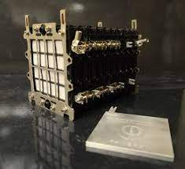
Introduction.
What is it? An aluminum-air battery generates electricity by reacting aluminum with oxygen from the air.
How does it work? Aluminum acts as the anode, oxygen as the cathode, and an electrolyte (usually NaOH or KOH) enables the reaction.
Why is it special? It has a super high energy density, meaning it can store much power for its weight.
The downside? The aluminum corrodes over time, so lithium-ion batteries aren’t rechargeable.
Where is it used? Mostly in military applications, backup power, and research for EVs.
The biggest challenge? Preventing aluminum corrosion and managing byproducts like aluminum hydroxide.

Slide 4
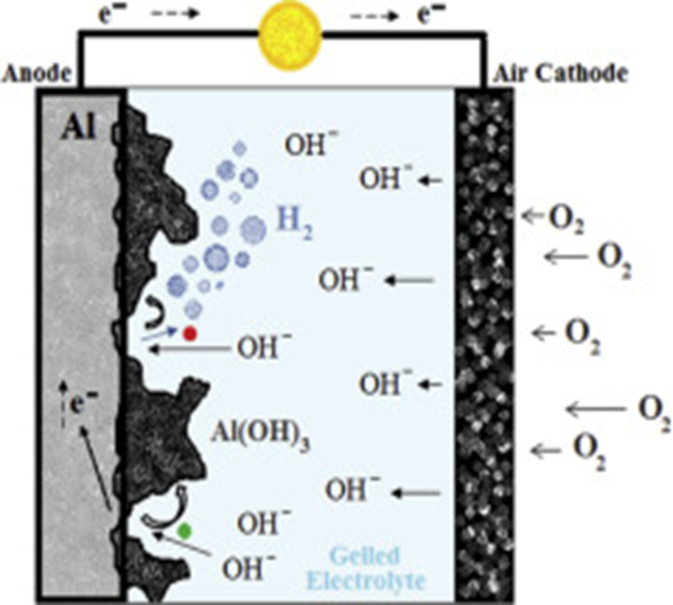
Assumptions for Calculation.
Mass of Aluminum = 1kg
Electrolyte = NaOH (20% by Weight)
Operating Temperature = 30C
Faraday’s Constant = 96485C/mol
Molar Mass of Aluminum = 27g/mol
Standard Energy Density = 8.1KWH/kg

Slide 5
Material Balance.
Reaction:
4Al+3O₂+6H₂O→4Al(OH)₃+Electricity(2.71V).
Molar Mass of Al = 27g/mol.
Molar Mass of 4Al(OH)₃ = 78g/mol.
Now,
Moles of Al = 1000g/27g/mol
= 37.04g
Now,
4 moles of Al reacts with 3 moles of O2.
Therefore, moles of oxygen = 3/4 x 37.04
= 27.78mol
Molar mass of oxygen = 32g/mol
Now,
Mass of Oxygen = 27.78 x 32
= 888.96g
= 0.89kg
Now,
For every 4 moles of Al, 6 moles of H₂O are consumed.
the moles of water required are:
Moles of H₂​O= 46​ x 37.04
=55.56mol.
Molar mass of H₂​O = 18 g/mol.
The total mass of water used is:
Mass of H₂​O=55.56×18
=1000g =1kg
Now,
4moles of aluminum produce 4 moles of aluminum hydroxide
Thus, the total moles of aluminum hydroxide formed are:
Moles of Al(OH)₃ = 37.04mol
The corresponding mass of aluminum hydroxide is:
Mass of Al(OH)₃ = 37.04 x 78
= 2889.12g = 2.89Kg

Slide 6
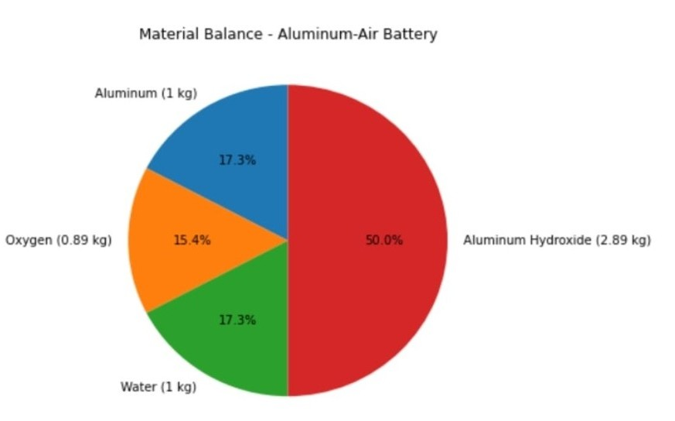
Pie Chart for Material Balance.

Slide 7
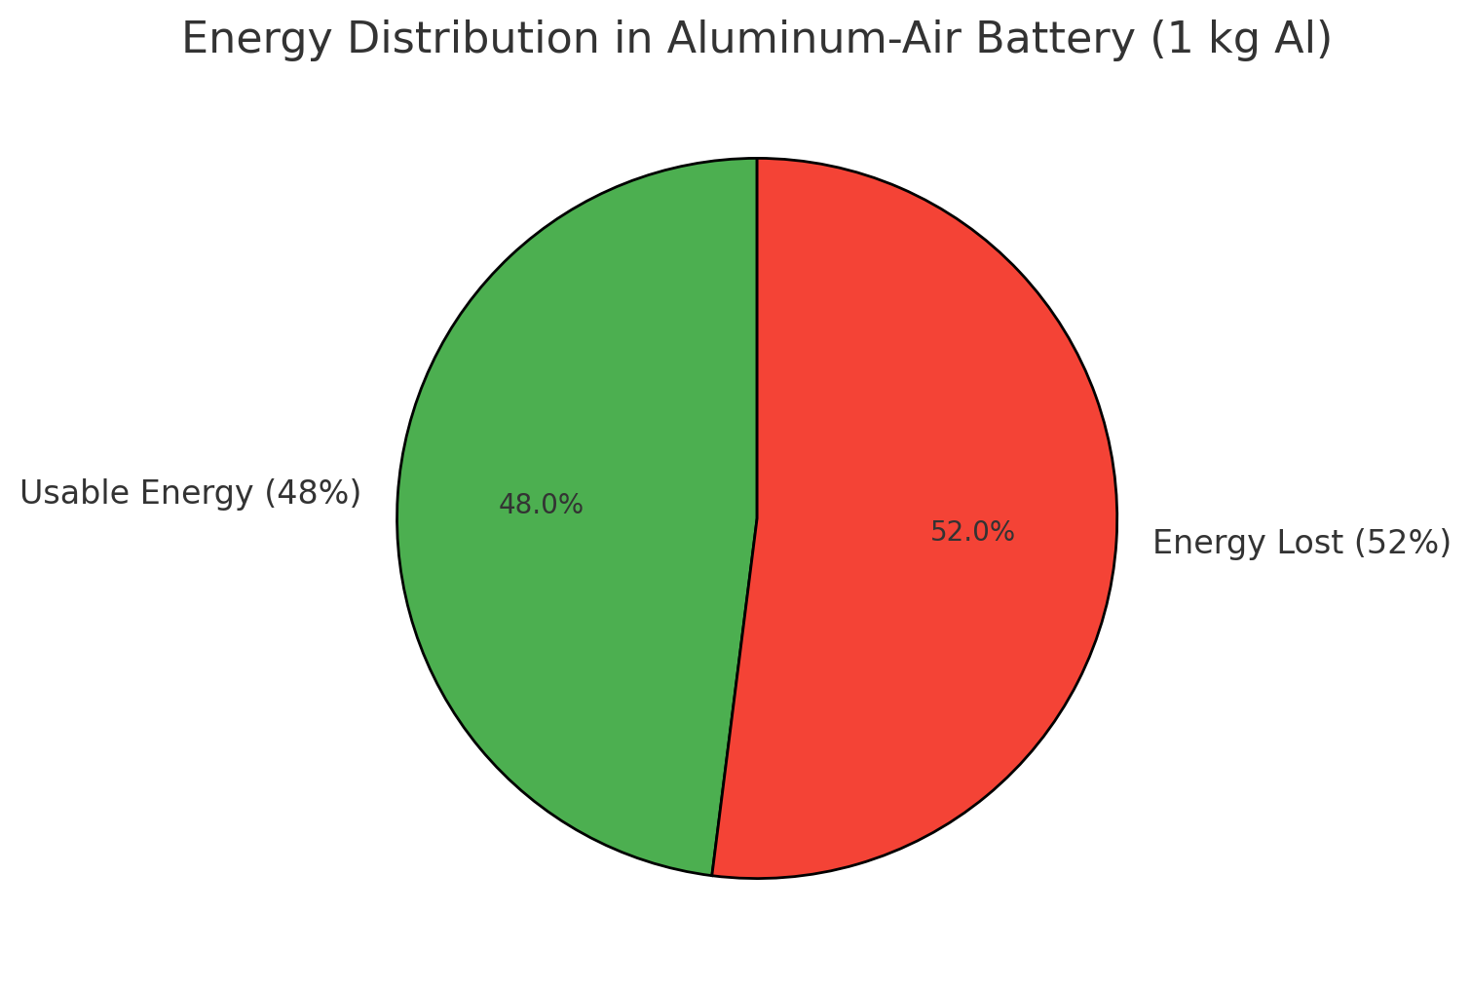
Energy Balance.
Moles of Aluminium Available:
Given:
Mass of aluminum = 1 kg = 1000 g
Molar mass of aluminum = 27 g/mol
Moles of Al = Mass of Al/Molar Mass of Al
​ = 1000​/27 = 37.04 moles
Charge Produced by Aluminium Oxidation:
Each Al atom loses 3 electrons in the reaction:
Total charge =
Moles of Al × Electrons lost per Al × Faraday’s Constant
= 37.04 × 3 × 96485
= 1.072×10^7 Coulombs.
Theoretical Energy Output:
Each mole of aluminum produces 8.1 kWh/kg based on standard energy density.
Total Energy = Mass of Aluminum × Energy Density
= 1 × 8.1 = 8.1 kWh
= 8.1 × 3600 = 29160 kJ
Efficiency Consideration:
The energy output depends on battery efficiency (typically 40-50% due to losses like hydrogen evolution).
Assuming 48% efficiency:
Usable Energy = 0.48 × 29160
=13997 kJ
≈14 MJ.

Slide 8
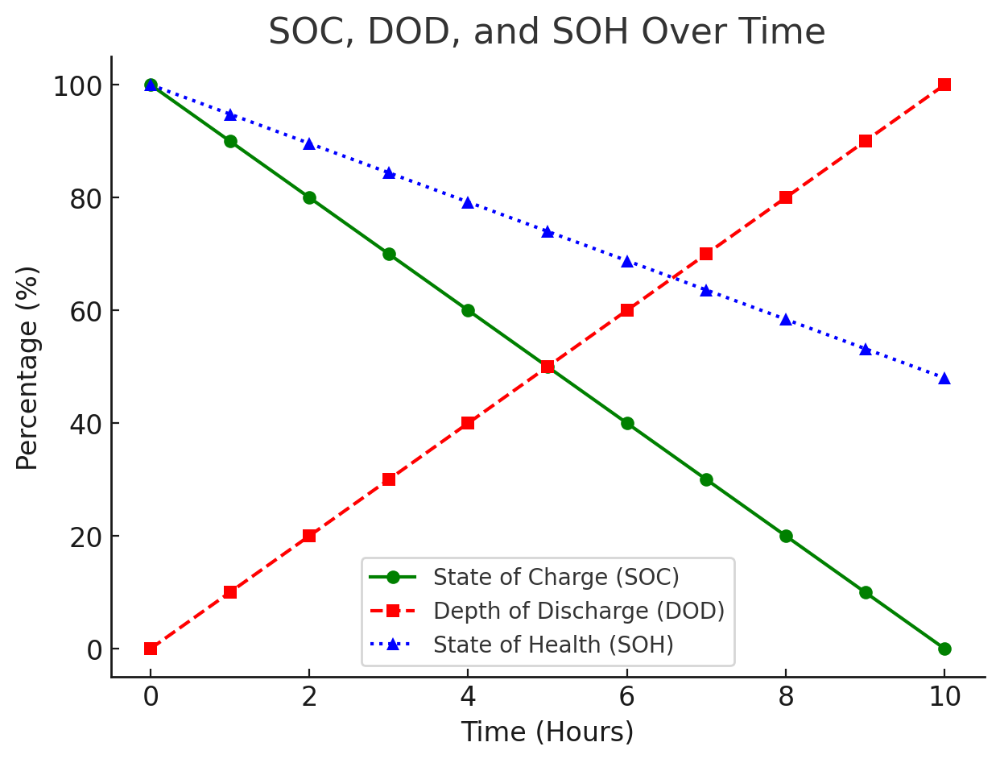
SOC, SOH & DOD.
State of Charge (SOC):
SOC is the ratio of the remaining charge to the full charge capacity.
SOC = Total charge/remaining charge​ ×100%
If x% of aluminum is consumed:
SOC = 100−x.
Depth of Discharge (DOD):
DOD is the percentage of energy used relative to the full capacity:
DOD = Energy Used​/Total Energy Capacity × 100%
DOD = 100−SOC.
State of Health (SOH):
SOH compares the current capacity with the initial capacity:
SOH= Current Capacity​/Initial Capacity ×100%
This depends on factors like corrosion and degradation of aluminum.

Slide 9
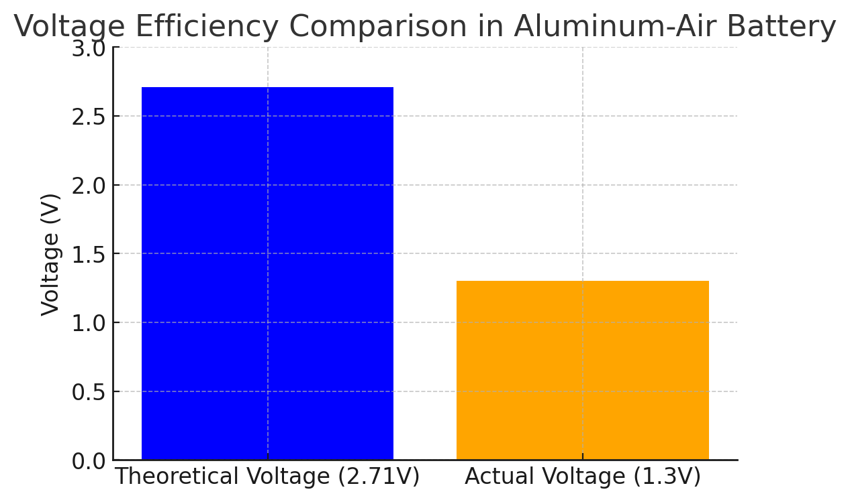

Theoretical and Practical Energy Output.
Theoretical Voltage Calculation:
The electrochemical reaction determines the theoretical voltage of an Aluminum-Air Battery:
Al+ $\frac{2}{3}$ ​O₂​ +3H₂​O→Al(OH)₃​.
The standard electrode potentials are:
Al → Al³⁺ + 3e⁻ → 𝐸0 =−2.71𝑉
O₂ + 4e⁻ + 2H₂O → 4OH⁻ → 𝐸0=0.40𝑉
The theoretical cell voltage is:
E theoretical​ = E cathode​ −E anode​
= 0.40−(−2.71) = 3.11V
Actual Voltage Calculation:
Due to real-world inefficiencies like:
Overpotential losses (electrode reactions slow down)
Internal resistance (electrolyte & connections)
Side reactions (hydrogen evolution, aluminum corrosion)
The measured actual voltage is typically:
E actual​ =1.3V
Voltage Efficiency Calculation:
Voltage efficiency (𝜂𝑒η e​ ) is given by:
ηe​ = Actual Voltage / Theoretical Voltage × 100
= 1.3 / 3.11 ×100
= 41.8%

Slide 10
Power Output and Current.
Since energy is related to power:
𝑃=𝑉𝐼
Assuming a typical discharge voltage of 1.3V, we can estimate the maximum current output:
I= P/V
= 3890 / 1.3
= 2992.3A
This is the theoretical current if the battery were discharged in one hour.
If the discharge time is 10 hours, then;
I10-hour​ = 2992.3 / 10
= 299.2 A

Slide 11
Battery Lifetime Estimation.
The aluminum-air battery is not rechargeable in the conventional sense, but its lifetime can be estimated based on corrosion rates and aluminum utilization.
The aluminum utilization factor (ηₐ) is typically 80-90%, meaning some aluminum is lost due to side reactions like hydrogen evolution.
Effective Usable Mass = ηa​ × Total Aluminium Mass.
= 0.85 ×1 = 0.85 kg.
Thus, the corrected practical energy is:
E final​ = 0.85 × 3.89
= 3.3 kWh

Slide 12
Self-discharge and Corrosion Losses.
Aluminum-air batteries suffer from corrosion when exposed to an alkaline electrolyte. NaOH solution has a corrosion rate of about 0.2-0.3% per day.
Annual Self-Discharge = 0.0025 × 365
=91.25%
So, if left unused, the battery would lose most of its aluminum within a year.

Slide 13
BIS Standards.
The Bureau of Indian Standards (BIS) establishes and enforces quality and safety standards for various products in India, including batteries.
While BIS has defined standards for common battery types like lead-acid and lithium-ion, specific standards for aluminum-air batteries are not explicitly detailed in the available information.
However, given the evolving nature of battery technologies, BIS standards may be updated to include emerging battery types such as aluminum-air batteries.
BIS Standards for lead-acid and lithium-ion Batteries are as follows:
For Lead-acid Battery:
For Lithium-ion Battery:
IS 7372:1995 - Lead-Acid Storage Batteries for Motor Vehicles.
IS 1652:1991 - Stationary Cells and Batteries, Lead Acid Type with Plante Positive Plates.
IS 15549:2005 - Stationary Valve Regulated Lead Acid Batteries
IS 16046 (Part 1 & 2):2018 - Secondary Cells and Batteries Containing Alkaline or Other Non-Acid Electrolytes.
IS 17855:2022 - Electrically Propelled Road Vehicles — Test Specification for Lithium-Ion Traction Battery Packs and Systems — Performance Testing.

Slide 14
References.
[1] BIS Certification and Standards for Batteries: A Comprehensive Guide.
Link- https://www.eximadvisory.com/blogs/bis-certification-standards-for-batteries-a-comprehensive-guide?utm
[2] Metal Air Batteries: What You Need to Know. By Ufine, Updated on October 24, 2024.
Link- https://www.ufinebattery.com/blog/metal-air-batteries-what-you-need-to-know/
[3] Stationary Cells and Batteries, Lead-Acid Type with Plante Positive Plates.
Link- https://law.resource.org/pub/in/bis/S05/is.1652.1991.pdf?utm
[4] Stationary Valve Regulated Lead Acid Batteries.
Link- https://law.resource.org/pub/in/bis/S05/is.15549.2005.pdf?utm
[5] Secondary Cells and Batteries Containing Alkaline or Other Non-Acid Electrolytes.
Link- https://archive.org/details/gov.in.is.15549.2005?utm
[6] Electrically Propelled Road Vehicles — Test Specification for Lithium-Ion Traction Battery Packs and Systems-
Performance testing.
Link- https://pib.gov.in/PressReleaseIframePage.aspx?PRID=1836787&utm

Slide 15
THANK YOU

