Slide 1


MATOSHRI COLLEGE OF ENGINEERING
Department Of Computer Engineering
Project Name:-
“AI-based Image Colorizer and Enhancer”
Under the Guidance of: Prof.
Submitted By: Krishna Kiran Aher

Slide 2
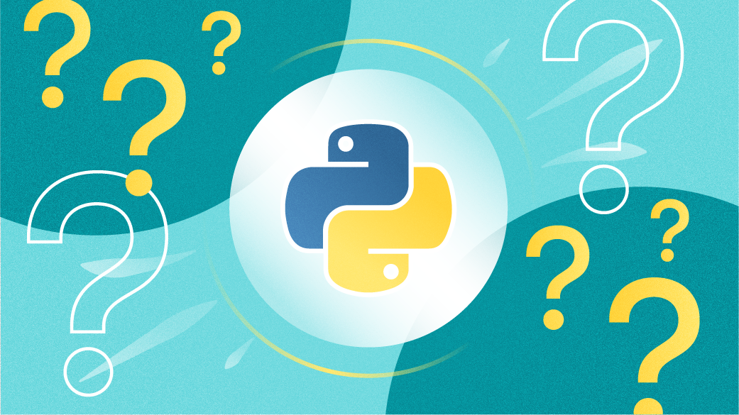

WEEK 1 – Python Programming Fundamentals
Topics Covered
• Data Types and Variables • Operators and Expressions • Conditional Statements (if-else) • Loops (for, while) • Functions and Lambda Functions • Exception Handling
Practical Work
• Implemented pattern-based programs using loops • Developed a mini calculator using conditional statements • Created reusable functions • Used lambda with map() and filter() • Handled runtime errors using try-except
AI/ML & Data Science Project – Internship 2026

Slide 3
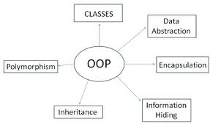
WEEK 2 – Object Oriented Programming
Topics Covered
• Class and Object • Constructor (init) • Inheritance (Single and Multilevel) • Polymorphism (Method Overriding) • Encapsulation • Abstraction
Practical Work
• Created custom classes (Student, Employee) • Implemented inheritance concepts • Demonstrated method overriding • Used private variables for encapsulation • Built small OOP-based mini application
AI/ML & Data Science Project – Internship 2026

Slide 4
WEEK 3 – NumPy and Pandas
Topics Covered
NumPy
• Array Creation and Indexing • Matrix Operations • Reshaping and Slicing
Pandas
• Series and DataFrame • Data Cleaning • Handling Missing Values • GroupBy and Aggregation • Merge and Join
Practical Work
• Loaded dataset using Pandas • Cleaned null values using dropna() and fillna() • Applied filtering using loc and iloc • Performed groupby() operations • Merged multiple datasets • Conducted feature engineering
AI/ML & Data Science Project – Internship 2026

Slide 5

WEEK 4 – Data Visualization and Regression
Topics Covered
Data Visualization
• Bar Chart • Histogram • Scatter Plot • Correlation Heatmap
Regression
• Linear Regression • Cost Function (MSE) • Gradient Descent • Polynomial Regression • Overfitting and Underfitting • R² Score
Practical Work
• Visualized dataset using Matplotlib and Seaborn • Identified correlation between features • Implemented Linear Regression model • Calculated MSE and R² score • Compared Linear and Polynomial regression • Evaluated model performance
AI/ML & Data Science Project – Internship 2026

Slide 6
WEEK 5 – CNN, NLP and Sentiment Analysis
Sentiment Analysis
• Text Classification • Logistic Regression • Naive Bayes
Practical Work
• Implemented basic CNN model for image classification • Performed image preprocessing (resizing, normalization) • Cleaned textual dataset • Converted text into numerical format using TF-IDF • Trained classification model for sentiment prediction • Evaluated model using confusion matrix
Topics Covered
Convolutional Neural Networks (CNN)
• Convolution Layer • ReLU Activation • Pooling Layer • Fully Connected Layer
Natural Language Processing (NLP)
• Text Cleaning • Tokenization • Stopword Removal • Lemmatization • TF-IDF Vectorization
AI/ML & Data Science Project – Internship 2026

Slide 7

WEEK 6 – Project: Project Finalization & Optimization
Topics Covered
• Model Optimization • Image Enhancement Techniques • Performance Testing • Output Analysis • Error Handling • Final System Integration
Practical Work Performed
• Fine-tuned DNN colorization model • Improved image contrast and brightness • Reduced noise in output images • Compared original vs colorized outputs • Tested system on multiple grayscale images • Optimized processing time
AI/ML & Data Science Project – Internship 2026

Slide 8

Content
Introduction
Problem Statement
Features
Software
Architecture
Component
Project Module
Applications
Projects
AI/ML & Data Science Project – Internship 2026

Slide 9
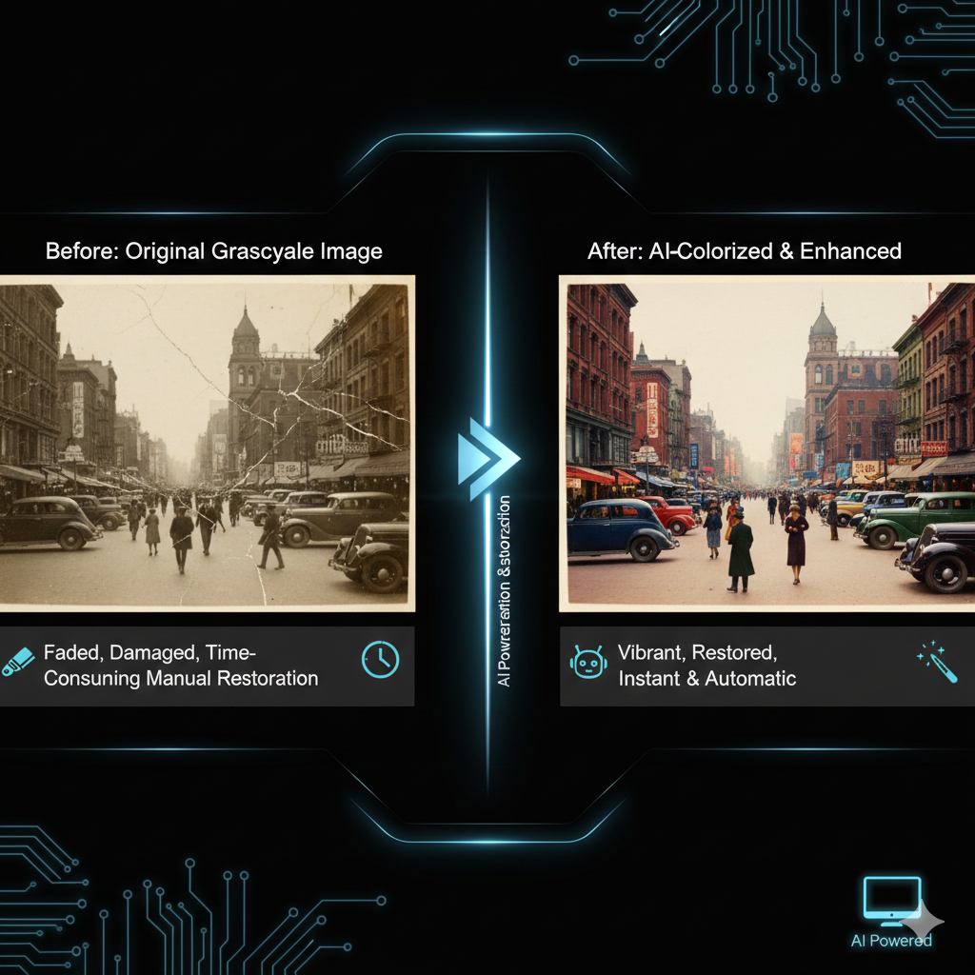
Introduction
•Real-World Context:
Many old photographs and grayscale images lose visual clarity over time. Manually restoring or colorizing images requires professional editing skills and is time-consuming.
AI/ML & Data Science Project – Internship 2026

Slide 10

Problem Statement
• Old images remain black & white • Low-quality images reduce visual appeal • Manual editing requires expertise • No structured feedback system for AI improvement • No privacy-focused restoration platform
AI/ML & Data Science Project – Internship 2026

Slide 11
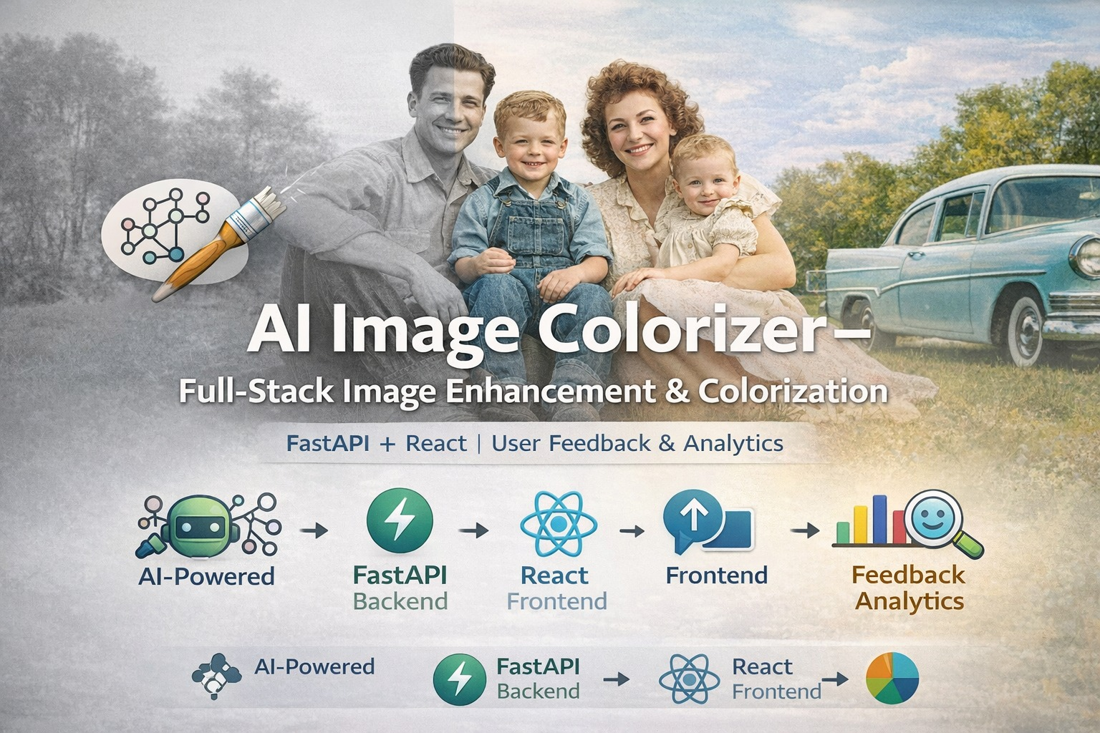
Objectives
An AI-based system that:
• Enhances image quality • Colorizes grayscale images • Provides multiple output variants • Collects user feedback • Generates analytics for improvement
AI/ML & Data Science Project – Internship 2026

Slide 12

Features
• AI-Based Image Enhancement • Grayscale to Color Conversion • Multiple Image Variants Generation • Real-Time Preview • Download as ZIP or Individual Files • Privacy-First (One-click delete) • Feedback Rating System (0–100 slider) • Sentiment Analysis on Reviews • Developer Analytics Dashboard
AI/ML & Data Science Project – Internship 2026

Slide 13
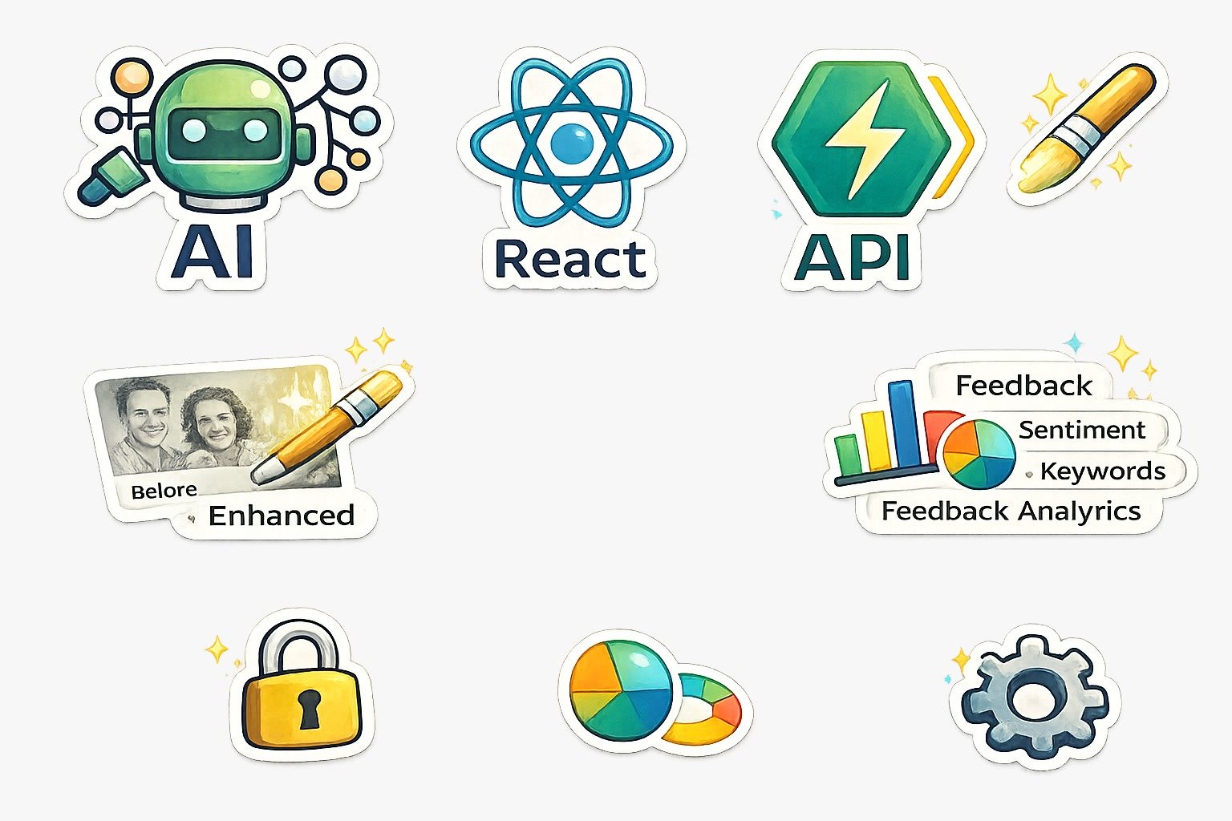

Technology Used
•Programming Language:
Python
•Backend Framework:
FastAPI
•Frontend Framework:
React-Vite
•Libraries Used:
OpenCV, NumPy, and AI-based colorization models
•Development Tools:
Visual Studio Code
AI/ML & Data Science Project – Internship 2026

Slide 14
Methodology Used
🔹 Image Enhancement
Denoising
Contrast correction (CLAHE)
Sharpening
Multiple output variants
🔹 Image Colorization
Pretrained OpenCV DNN Model
Deep learning-based color prediction
Grayscale → LAB → Colored image
🔹 Processing Pipeline
Mode selection (Enhance / Colorize / Both)
Modular architecture
API-based execution
🔹 Feedback & NLP
Slider rating (0–100)
Sentiment analysis (Polarity & Subjectivity)
Keyword extraction
🔹 Analytics
Average score calculation
Variance analysis
Chart generation
AI/ML & Data Science Project – Internship 2026

Slide 15
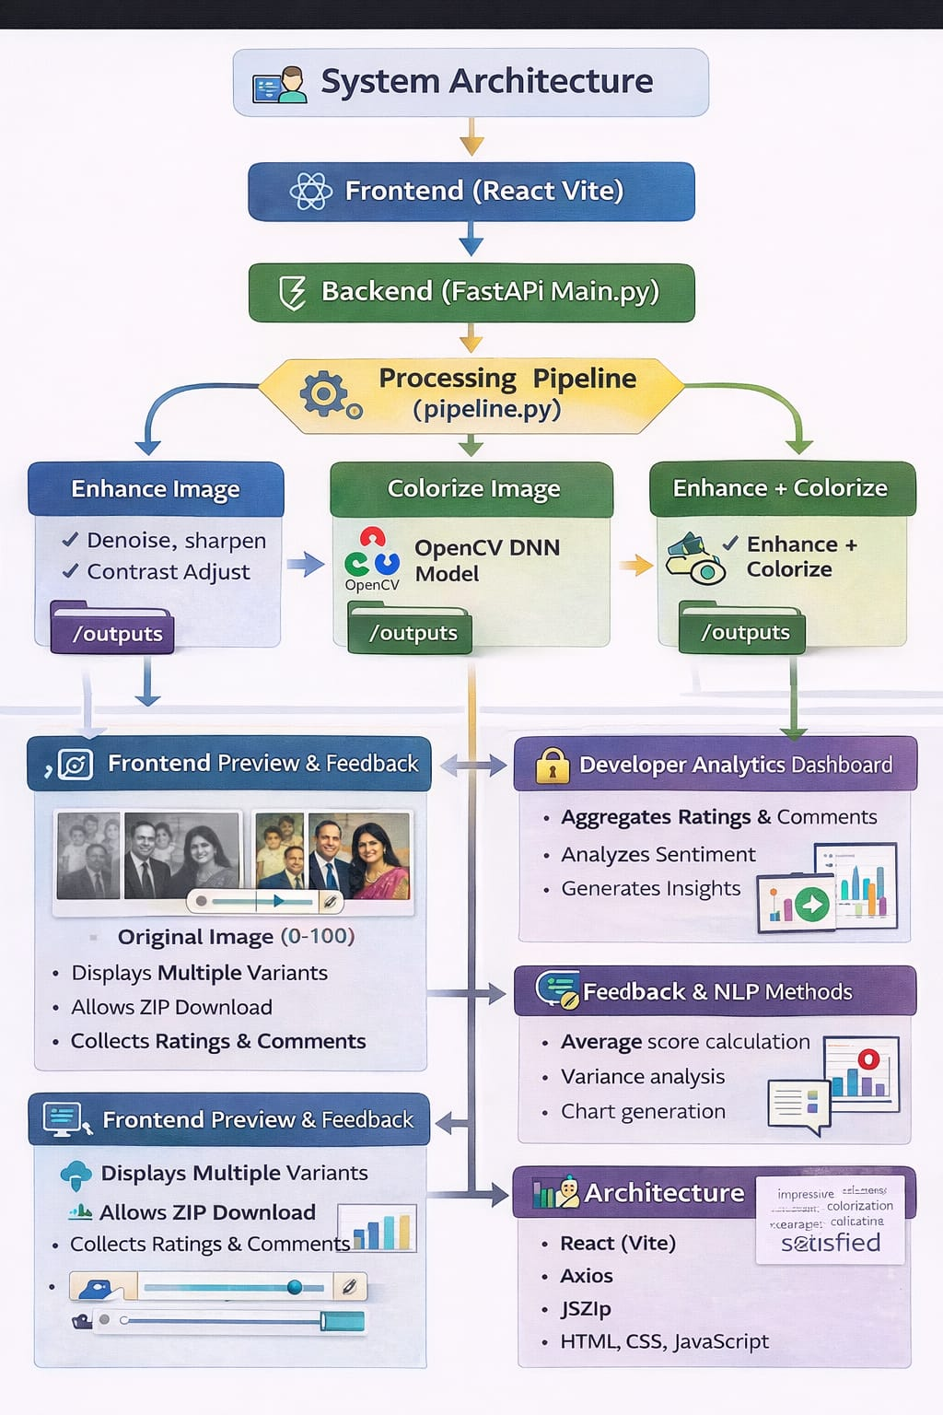
Architecture
AI/ML & Data Science Project – Internship 2026

Slide 16
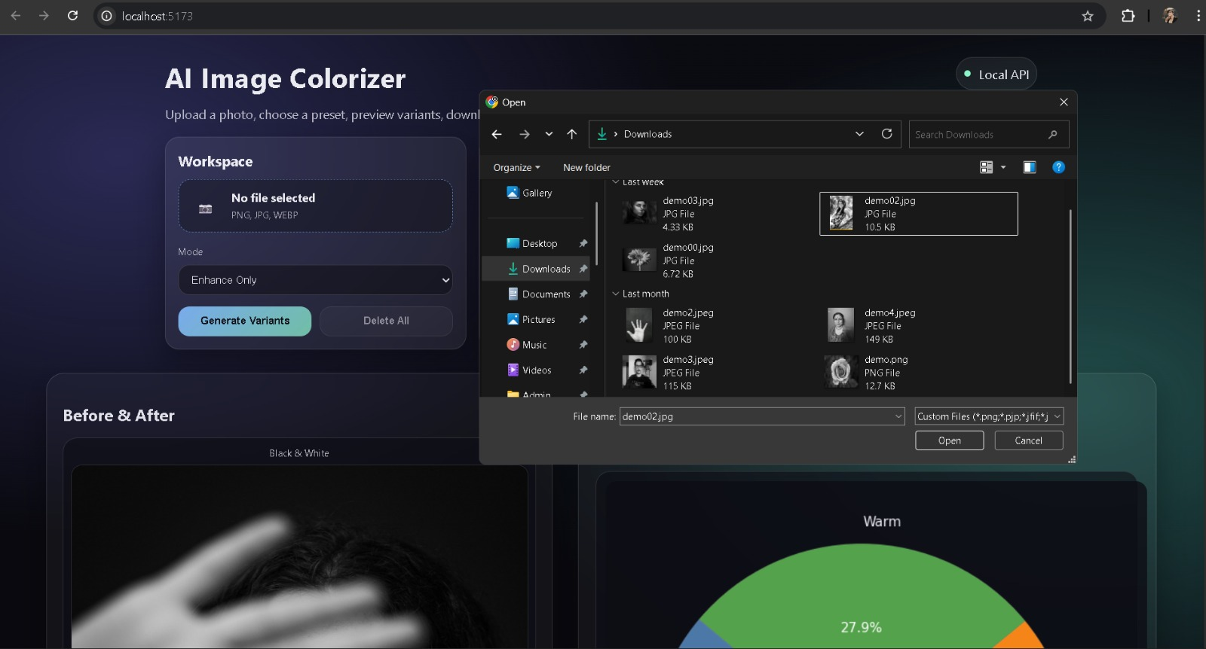
Input and Output Results
Figure 1: Image Upload Process
AI/ML & Data Science Project – Internship 2026

Slide 17
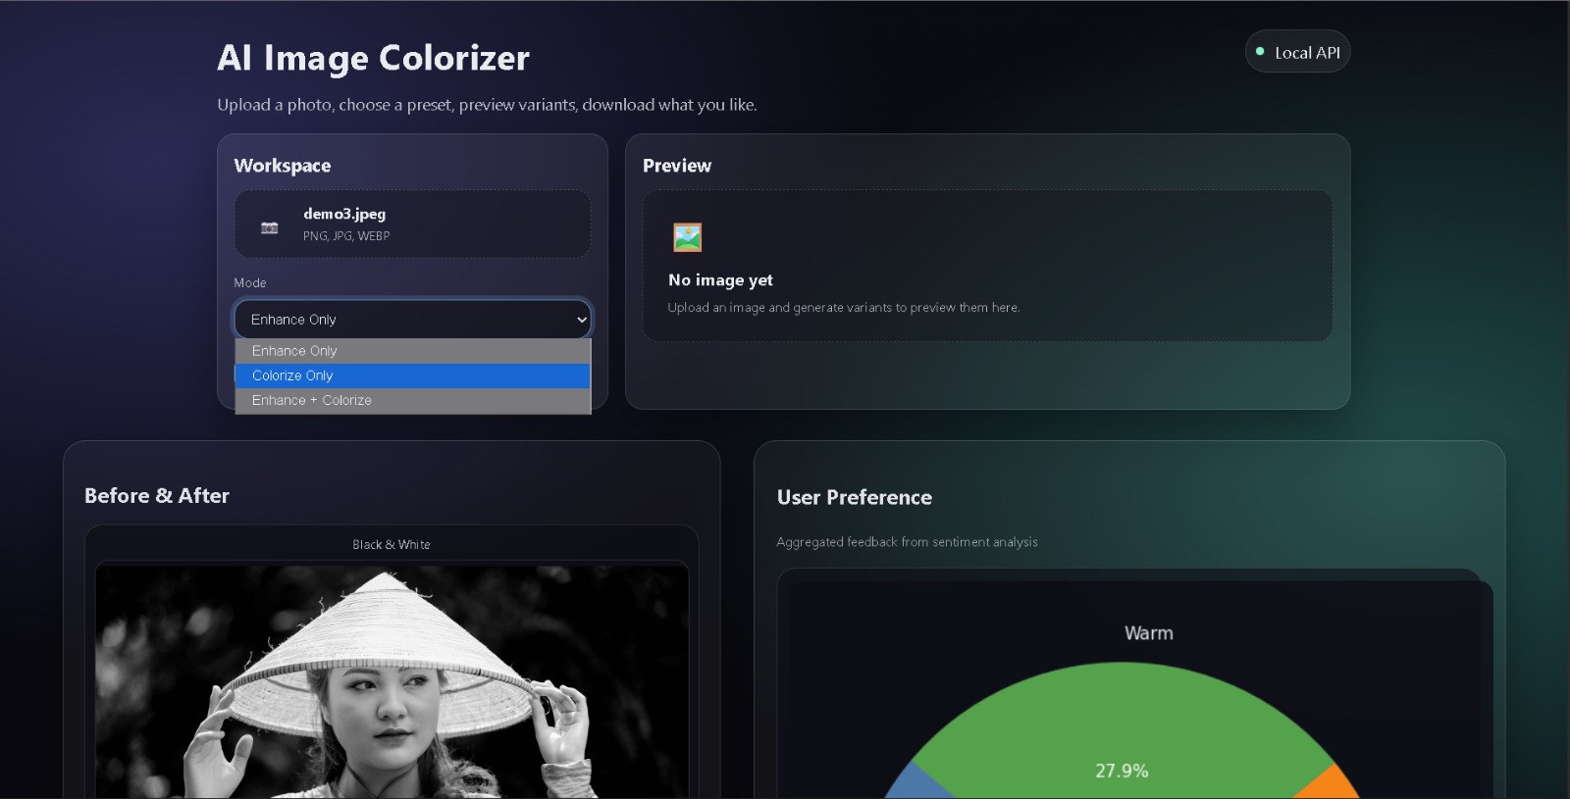
Input and Output Results
Figure 2: Processing Mode Selection
AI/ML & Data Science Project – Internship 2026

Slide 18
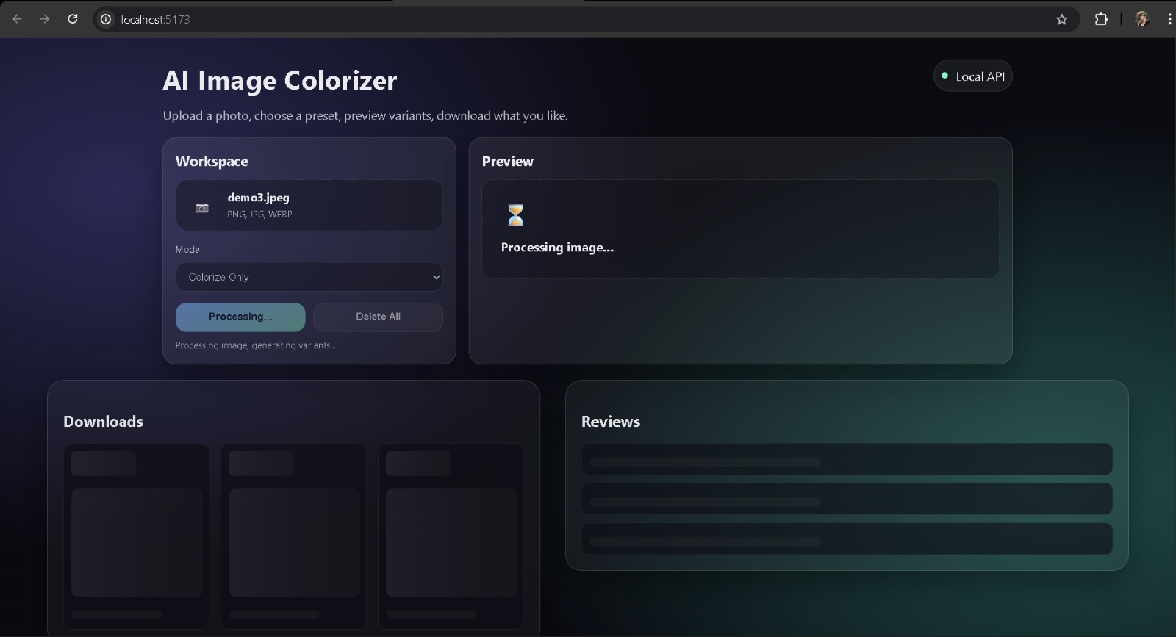
Input and Output Results
Figure 3: Image Processing Execution
AI/ML & Data Science Project – Internship 2026

Slide 19
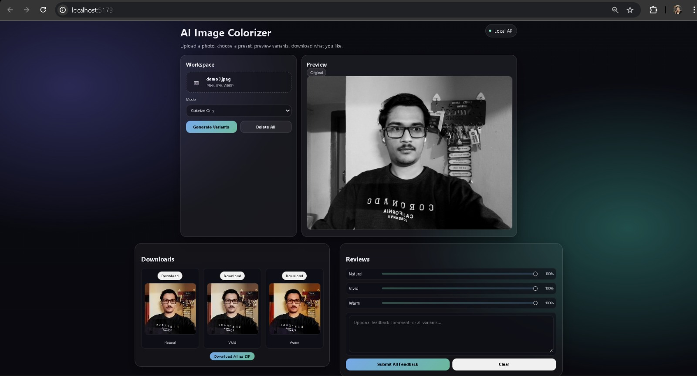
Input and Output Results
Figure 4: Image Enhancement and Colorization Result
AI/ML & Data Science Project – Internship 2026

Slide 20
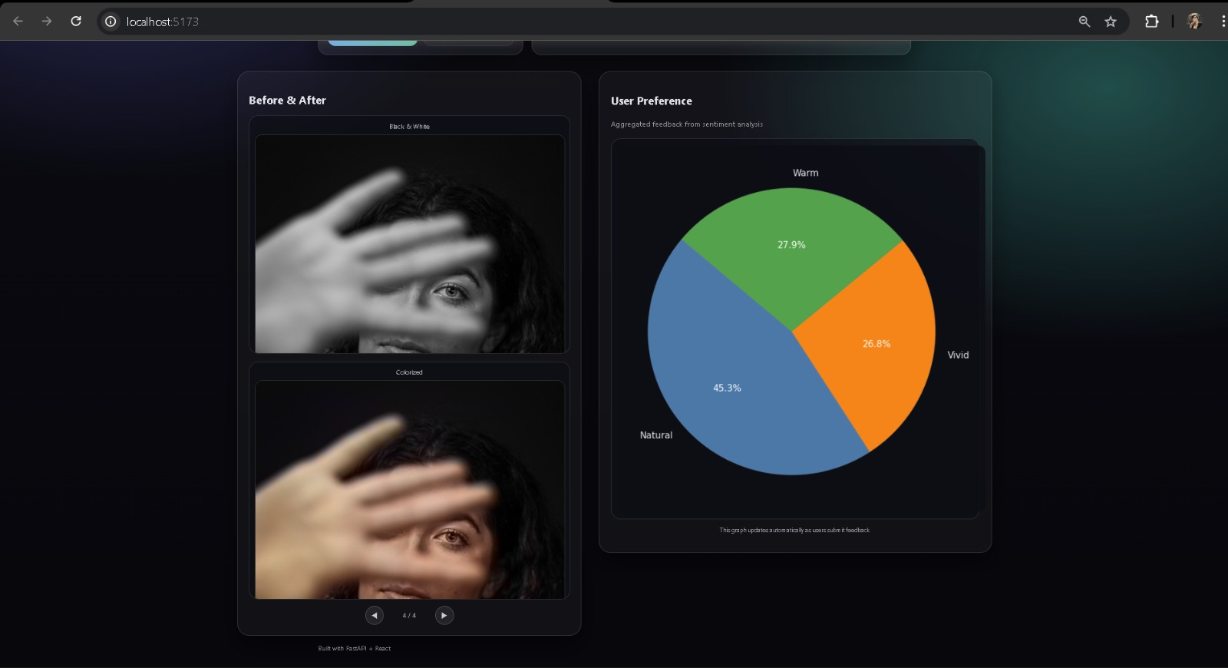
Input and Output Results
Figure 5: User Preference Analysis
AI/ML & Data Science Project – Internship 2026

Slide 21
Components
1.Data Upload Component • Accepts image files • Validates file type • Sends POST request to backend
2.Image Enhancement Component • Denoising • Contrast correction • Sharpening • Generates enhanced variants
3.Image Colorization Component • Loads OpenCV DNN Model • Converts grayscale to color • Generates realistic tones
AI/ML & Data Science Project – Internship 2026

Slide 22
Components
1.Data Upload Component • Accepts image files • Validates file type • Sends POST request to backend
2.Image Enhancement Component • Denoising • Contrast correction • Sharpening • Generates enhanced variants
3.Image Colorization Component • Loads OpenCV DNN Model • Converts grayscale to color • Generates realistic tones
4.Feedback Collection Component • Slider rating (0–100) • Optional comment • Stores reviews locally
5.NLP Processing Component • Sentiment Polarity • Subjectivity • Keyword extraction
6. Analytics Component • Average rating • Variance calculation • Generates charts (PNG)
7.Developer Dashboard • Common complaints • Frequent keywords • Token-protected access
AI/ML & Data Science Project – Internship 2026

Slide 23
Applications
• Restoration of Old Family Photos • Digital Archive Improvement • Historical Image Enhancement • Photography Enhancement • Educational AI Demonstration Tool • AI Research & Feedback-Based Model Improvement • Image Processing Learning Project

Slide 24
Future Scope
Take replies/reviews from the users.
Perform Sentiment analysis on the words and the number rating of each variant.
Dynamically alter the ‘Image Processing Variables’ in accordance.
DYNAMIC IMPROVEMENT
_WAP

Slide 25
Thank You..!!
-By
Krishna Kiran Aher
AI/ML & Data Science Project – Internship 2026

