Slide 1
FINAL ASSIGNMENT: BATTLE OF NEIGHBORHOODS
KRUNA RATKOVIC

Slide 2
GOAL: FIND BEST LOCATIONS FOR AN ITALIAN RESTAURANT IN LONDON
Problem Statement:
The goal is to use Data Analysis from web sources in order to chose the best location in London to open or invest in an Italian restaurant. We will explore all the neighborhoods of the safest borough in London which is Kingston upon Thames in order to provide a list of best locations as a suggestion to the entrepreneur.

Slide 3

BATTLE OF NEIGHBORHOODS

Slide 4
Introduction
London is the capital and largest city of England and the United Kingdom. It is considered to be one of the world's most important global cities and has been termed the world's most powerful, most desirable, most influential, most visited, most expensive, innovative, sustainable, most investment friendly and most popular for work city in the world. London exerts a considerable impact upon the arts, commerce, education, entertainment, fashion, finance, health care, media, professional services, research and development, tourism and transportation. London ranks 26 out of 300 major cities for economic performance and is one of the largest financial centers.
London has a diverse range of people and cultures, and more than 300 languages are spoken in the region. Its estimated mid-2018 municipal population (corresponding to Greater London) was 8,908,081, the most populous of any city in the European Union and accounting for 13.4% of the UK population.

Slide 5
Target audience
Entrepreneur who wants to find the best location to invest or open an Italian restaurant in London's borough Kingston upon Thames.
This location is supposed not to have many Italian restaurants around to avoid competition and must be a convenient neighborhood.

Slide 6
Collecting Data
London city data that contains different Boroughs:
We will scrape information of different boroughs in London from a Wikipedia page: https://en.wikipedia.org/wiki/List_of_London_boroughs
We will explore all neighborhoods in the safest borough Kingston upon Thames: https://en.wikipedia.org/wiki/List_of_districts_in_the_Royal_Borough_of_Kingston_upon_Thames.
Italian restaurants in each neighborhood of the borough Kingston upon Thames:
Data Source: Foursquare API
Description: By using this API we will get all the venues in different London neighborhoods. We can filter these venues to get only Italian restaurants. We can also find rating, tips and like count for each Italian restaurant using FourSquare API.

Slide 7
Data Approach
We will collect the London city data by using the Beautifulsoup library
Using Foursquare API we will get all venues for each neighborhood.
Filter out all venues which are Italian Restaurants.
Data Visualization and some analysis.
Find rating, tips and like count for each Italian restaurants using FourSquare API.
Using rating for each restaurant, we will sort that data.
Visualize the Ranking of neighborhoods using folium library(python)
Visualize the neighborhood Kingston upon Thames with all Italian Restaurants.
Deductions from these results and conclusions.

Slide 8
Data Analysis
We first imported all necessary libraries and installed Folium.
We used Beautiful soup to scrap the latitude and longitude of the boroughs in London, from 'https://en.wikipedia.org/wiki/List_of_London_boroughs’.
We defined a function in order to get the London data such as Boroughs, Neighborhoods together with their latitude and longitude.

Slide 9
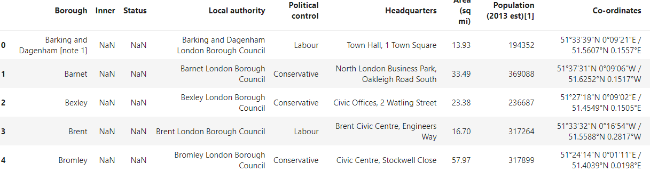
London Data

Slide 10
Neighborhoods in Kingston upon Thames
We create a data frame of all neighborhoods in Kingston upon Thames (that we found on a Wikipedia page: https://en.wikipedia.org/wiki/List_of_districts_in_the_Royal_Borough_of_Kingston_upon_Thames).
We need to find the coordinates of each Neighborhood in the Kingston upon Thames Neighborhood.
Now, we are going to start utilizing the Foursquare API to explore the neighborhoods and segment them.

Slide 11
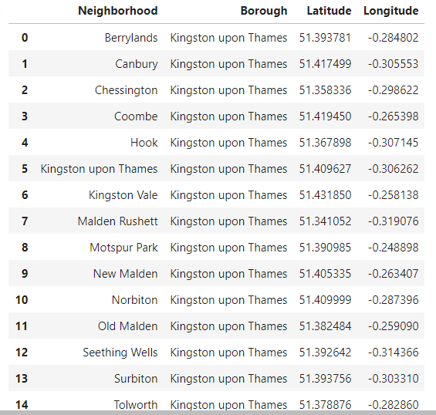

Slide 12
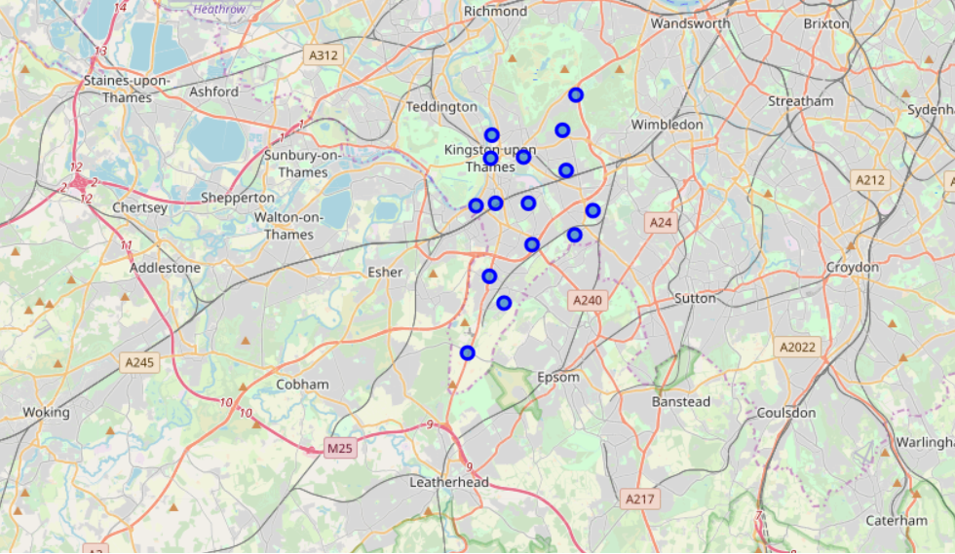
Using Folium map we visualize the borough Kingston upon Thames with all neighborhoods.

Slide 13
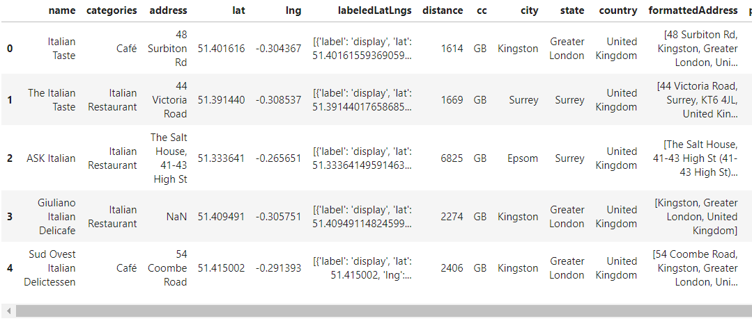
Using Foursquare API we make a dataframe with all Italian restaurants within the radius of 5500 meters from Berrylands (the center of Kingston upon Thames)

Slide 14
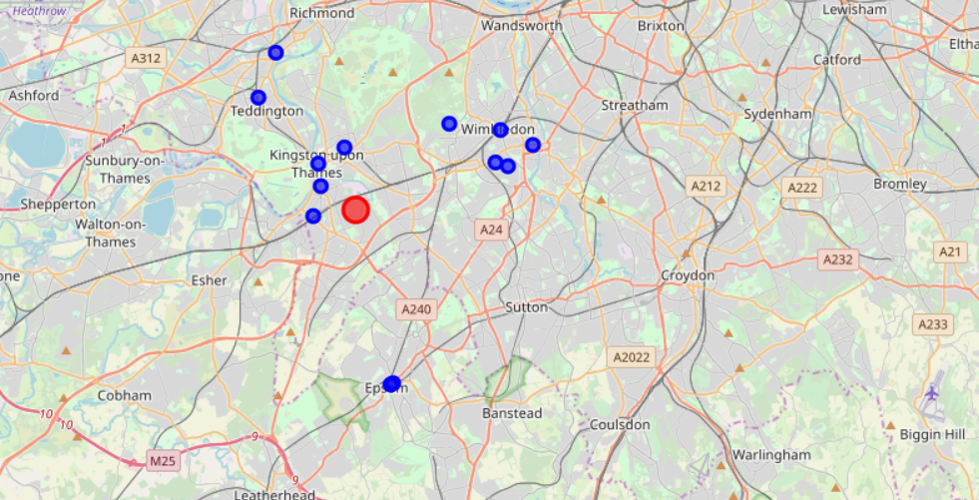
Using Folium map we vizualize Italian restaurants in Kingston upon Thames.

Slide 15
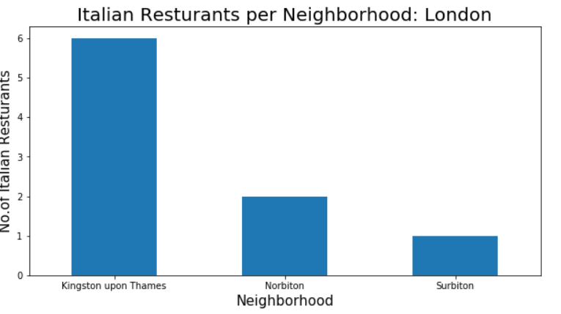
We plot the number of Italian restaurants in the borough Kingston Upon Thames.

Slide 16
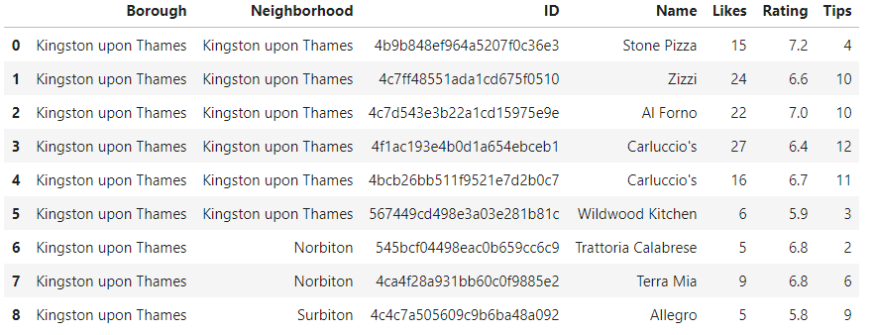
Using foursquare API we explore venue details (likes, rating and tips) for the found Italian restaurants.

Slide 17
Results / Conclusion
Neighboorhood Kingston upon Thames in Kingston upon Thames has the greatest number of Italian restaurants, which are also with the greatest rating. On the other side, neighborhoods Berrylands, Canbury, Chessington,Coombe, Hook, Kingston Vale, Malden Rushett, Motspur Park, New Malden, Old Malden, Seething Wells, don't have any Italian restaurant.
Neighborhoods Canbury and Berrylands have most attractive locations of this borough. Based on this information, I would state that Canbury and Berrylands are the best locations for Italian cuisine in Kingston upon Thames. Since there are no Italian restaurants, it makes competition easier than in other boroughs.
As a final note, all of the above analysis is depended on the adequacy and accuracy of Four Square data. A more comprehensive analysis and future work would need to incorporate data from other external databases.

