Slide 1

Capstone Presentation
Object Detection Using YOLO for Sign Recognition
Presented by :- Preet.T.Patel, Padhmanabh Wanikar, Krunal Dhapodkar
Sem: VI-C,A,A
PRN:-2207051088, 22070521058,22070521006

Slide 2
Proposed System and Methodology
Our proposed system leverages YOLOv12's advanced object detection capabilities to create a robust sign language detection system with the following components:
1.YOLOv12-based Detection Engine:
State-of-the-art object detection with improved small object detection The network design includes improved feature extraction capabilities to monitor delicate hand arrangement patterns.
The detection engine uses optimized anchor-free processing methods to speed up system operations.
2. Multi-scale Feature Integration:
The system utilizes a hierarchical feature pyramid structure to discover signs which appear at different object sizes.
The system implements improved spatial attention methods which direct focus toward important hand areas.
The detection system employs context-aware capabilities which distinguish between hand motions that have similar gestures.
3. Robust Data Processing Pipeline:
During training the system uses dynamic data augmentation methods to enhance generalization capabilities.
The system enables real-time processing of images under different lighting situations. Background invariant detection techniques
4. Efficient Model Architecture:
We applied model quantization along with pruning techniques for deploying the model onto restricted devices.
The system contains a real-time detection optimization of its inference process. A video frame batch processing system works to enhance system throughput.
5. User-friendly Interface:
Text interpretation of detected warning signs appears in real-time.
User feedback mechanism for continuous improvement
Cross-platform compatibility (desktop and mobile)
The system is designed to detect common phrases/words in American Sign Language, providing immediate textual interpretation to facilitate communication.
2
2

Slide 3
System Details
Software
Python (updated to latest version possible )
Ultralytics YOLO (installed and updated )
Google Colab
OpenCV
Storage: At least 2GB for dataset and models
Hardware
T4 GPU (as we’re using YOLOV11 for sign language detection)
3
3

Slide 4
Importing necessary library
ultralytics :- The ultralytics system delivers advanced computer vision capabilities through its cutting-edge tools for detecting objects while segmenting images as well as evaluating body postures and executing image classifications. YOLO (You Only Look Once) models serve as the foundation for its development
gdown :- The gdown library allows users to streamline the process of transferring files and directories from Google Drive.
yolo: - it is popular tool used in real time object detection and image segmentation
Ipython.display:- Ipython.display functions as an output display system designed for jupyter notebook.
code:-
6
!nvidia-smi
!pip install ultralytics
from ultralytics import YOLO
import gdown
from IPython.display import Image
3
4

Slide 5
Dataset Details
The Dataset for the project is taken from roboflow
dataset name : - English sentences Object detection
link to dataset:- English Sentences Dataset > Overview
Total images: 233 images
Training set: 204 images
8
Validation set: 20 images
Test set: 9 images
Resolution: 640×640 pixels (standardized)
Format: YOLO v11
3
5

Slide 6
Dataset Details
Augmentations & Preprocessing
Augmentation
Outputs per training example: 3
2
90° Rotate: Clockwise, Counter-Clockwise, Upside Down
Brightness: Between -15% and +15%
Blur: Up to 1px
Bounding Box: Rotation: Between -15° and +15°
Preprocessing
2 Auto-Orient: Applied
Resize: Stretch to 640x640
3
6

Slide 7
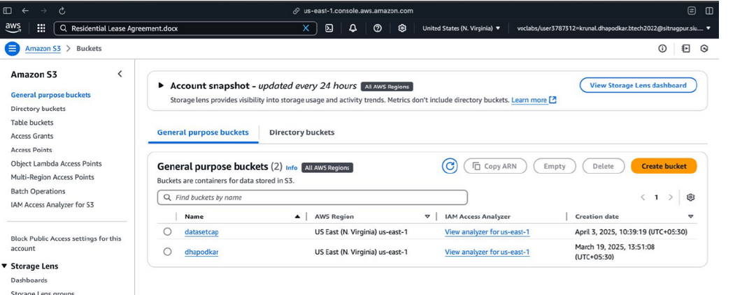
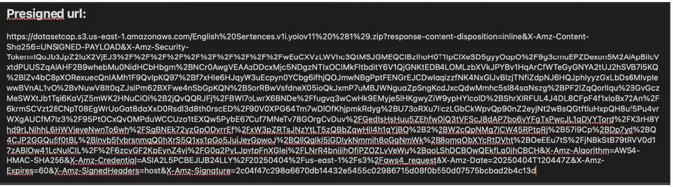
Secure storage in s3 bucket
Amazon S3 offers a secure method for sharing files through its efficient file-sharing functions which protect your AWS credential information. The system of pre-signed URLs enables temporary S3 object access for external users when they wish to download files within a particular time span. The following step-by-step instructions explain pre-signed URL generation and usage for S3.
3
7

Slide 8
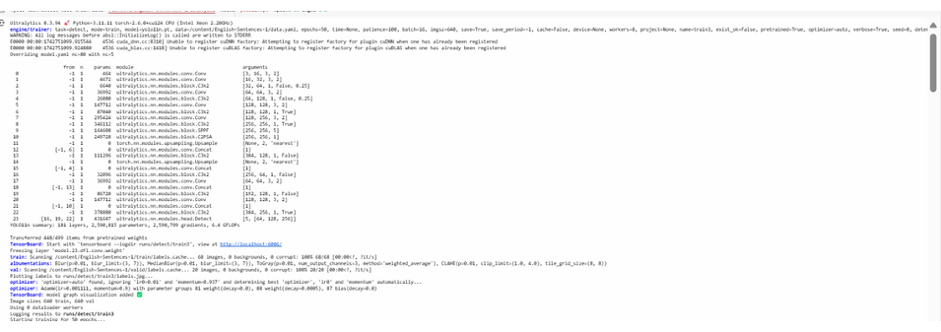
Model Training using YOLOv11
Defining the Task: Since we want to detect objects, task=detect is specified. 2.
Setting Training Parameters:
Mode: train
Dataset Path: data.yaml
Model Type: yolo11n.pt (pre-trained YOLOv11 model)
Number of Epochs: 50 (higher values improve accuracy)
Image Size: 640x640 pixels (standard resolution for YOLO models)
3
8

Slide 9
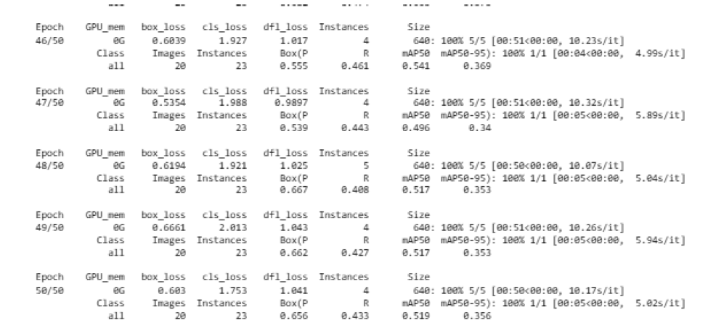
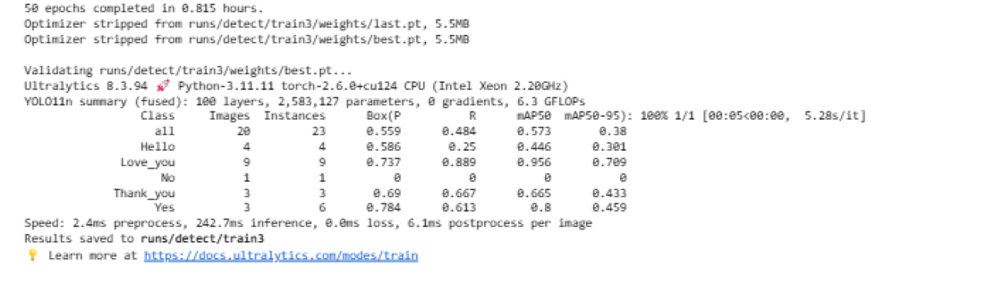

Slide 10
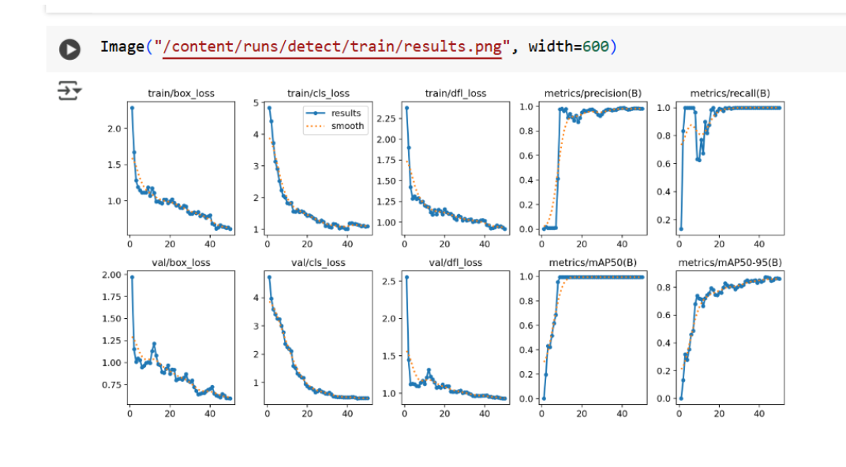
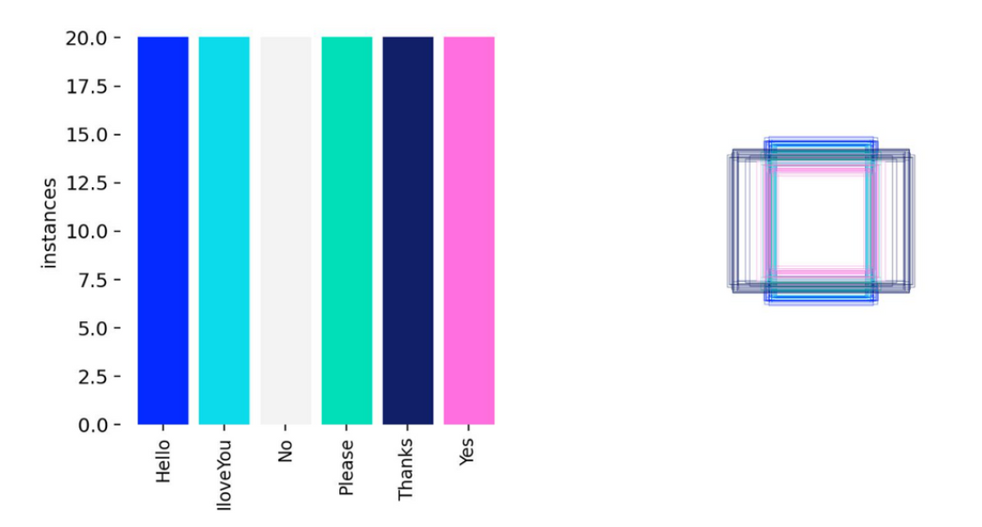
Result & Metrics
Displaying Annotated Labels
Code:- Image("/content/runs/detect/train/labels.jpg", width=600)
5
10

Slide 11
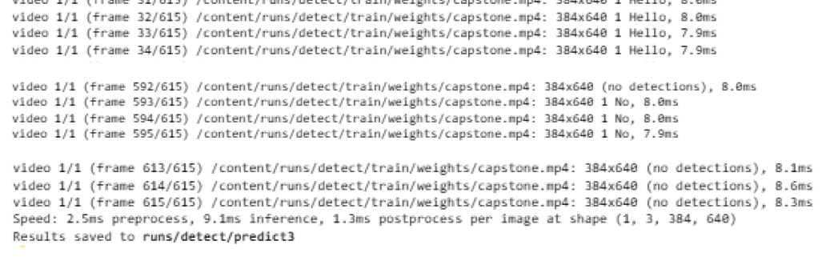
Model Prediction on Video
After training the model, it is tested on a video(capstone.mp4) to verify its performance. The best-trained weights (best.pt) are used for prediction.(conf=0.25) is the Confidence threshold for detecting an object. (save=True) is used to save the detected results as output.
4
11

Slide 12
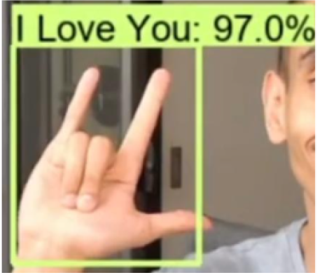
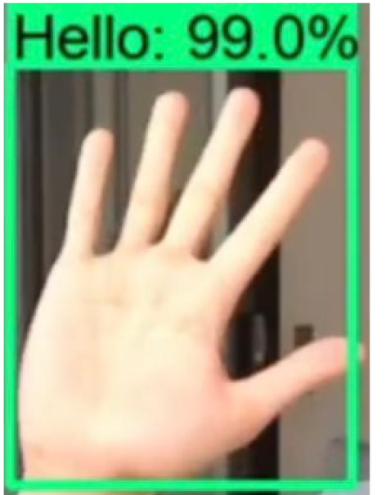
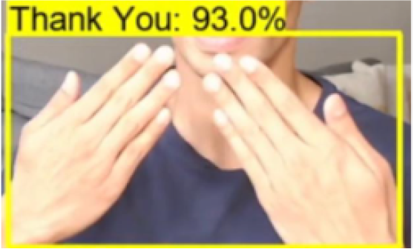
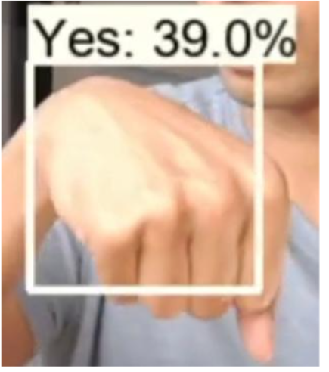
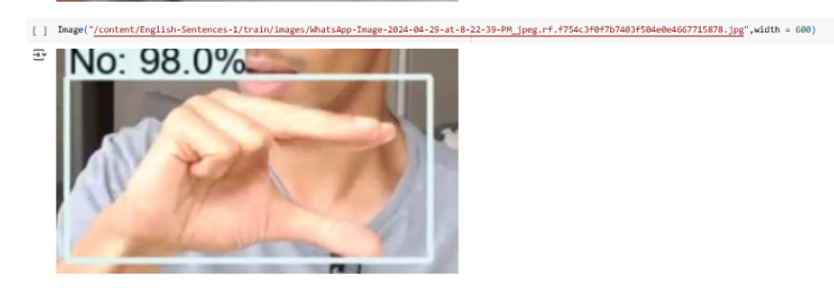
Predicting individual words through images
8

Slide 13
Future Improvements & Challenges
Dataset size limitations: More data is required for improved accuracy.
Generalization: The model may not perform well on unseen images if trained on a limited dataset.
these problems can be solved with big data models and powerful GPU but it would not be feasible & cost effective compared to pre-existing solutions.
Future Scope
Deploying the model on embedded systems (Raspberry Pi, Jetson Nano).
Improving accuracy with larger and more diverse datasets.
Integrating object tracking for real-time applications.
9
13

Slide 14
CONCLUSION
The implemented object detection system based on YOLOv11 achieved successful sign recognition using the detection framework. The system processed a built-in dataset and conducted evaluation tests using operational video files. Deep learning object detection research demonstrates effective real-time performance which serves as a basis for advancing autonomous systems and smart surveillance and assistive technology development.
9
14

Slide 15
THANK YOU FOR WATCHING !!!
10

