Slide 1

IS 635 Group Project Omniasanitas
Deepti Rathore
Krunal Solanki

Slide 2
Agenda
Tech Startup Overview
Problem Statement
Business Model
Hypothesis
Data Description
Visualizations
Monetization
Prototype

Slide 3
Introduction
Omniasanitas is a one-stop shop for all your medical needs whether it be consultations with doctors, laboratory test, medicines or insurance policies.
Since healthcare related information should remain confidential and secure, all the data will be stored on the blockchain.
Predictive machine learning models will be used to predict the insurance policy cost.

Slide 4
Lack of accessibility to healthcare
Some of the most crucial barriers for lack of access to healthcare are:
Financial Barriers
Availability Barriers
Logistical Barriers

Slide 5
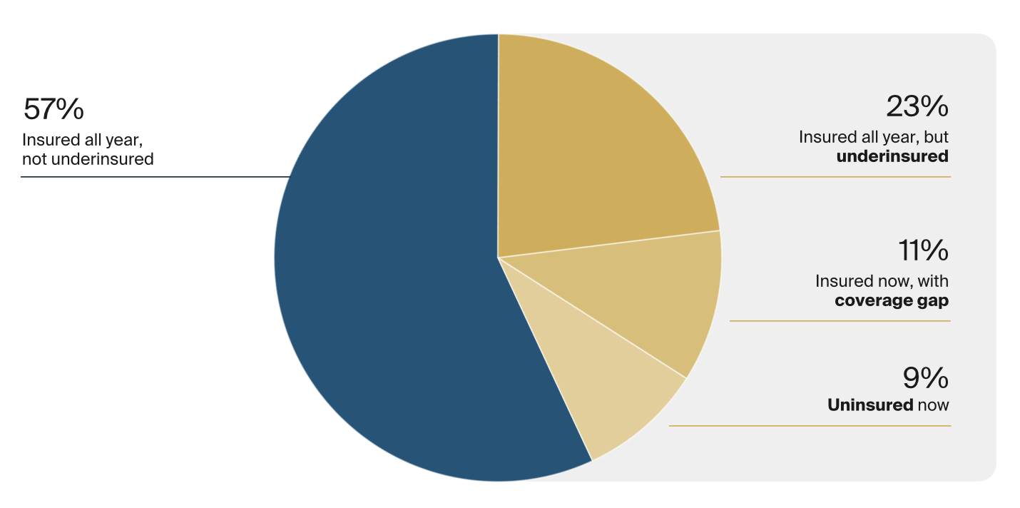
Lack of affordability of healthcare
For the survey, SSRS interviewed a nationally representative sample of 8,022 adults aged 19 and older between March 28 and July 4, 2022.
Forty-three percent of working-age adults were inadequately insured in 2022 which means over 2 in 5 people were not insured fully.

Slide 6
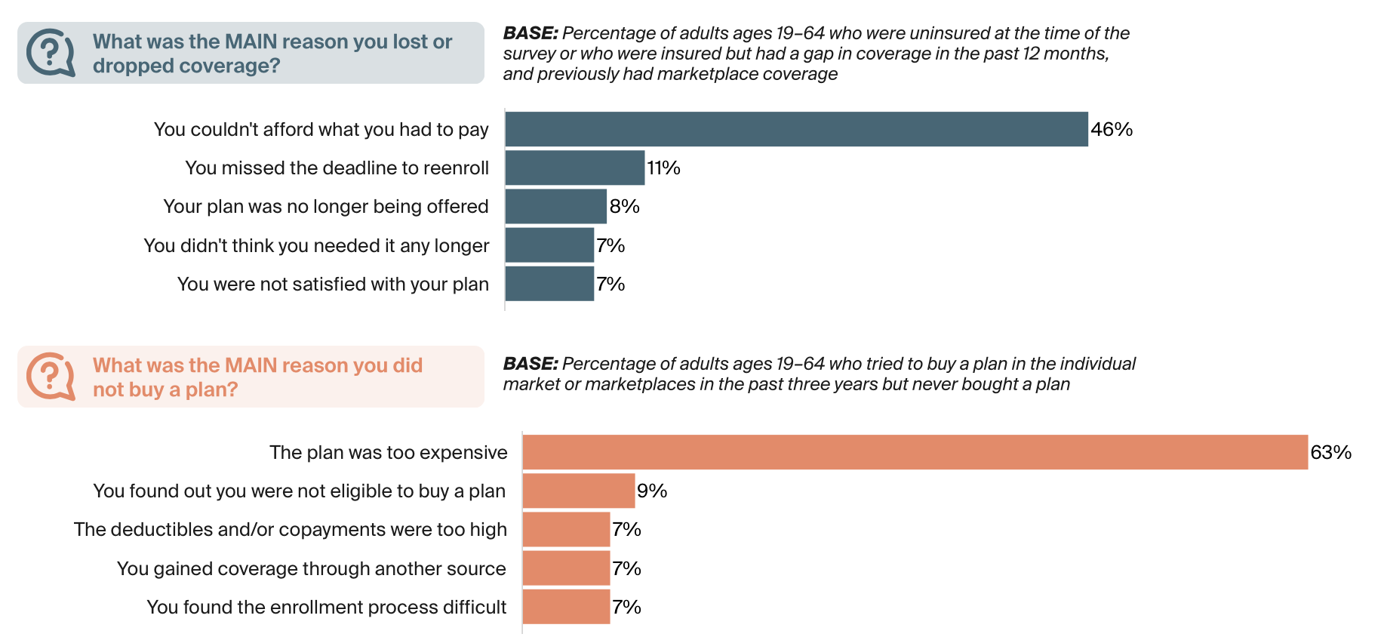
Lack of affordability of healthcare

Slide 7
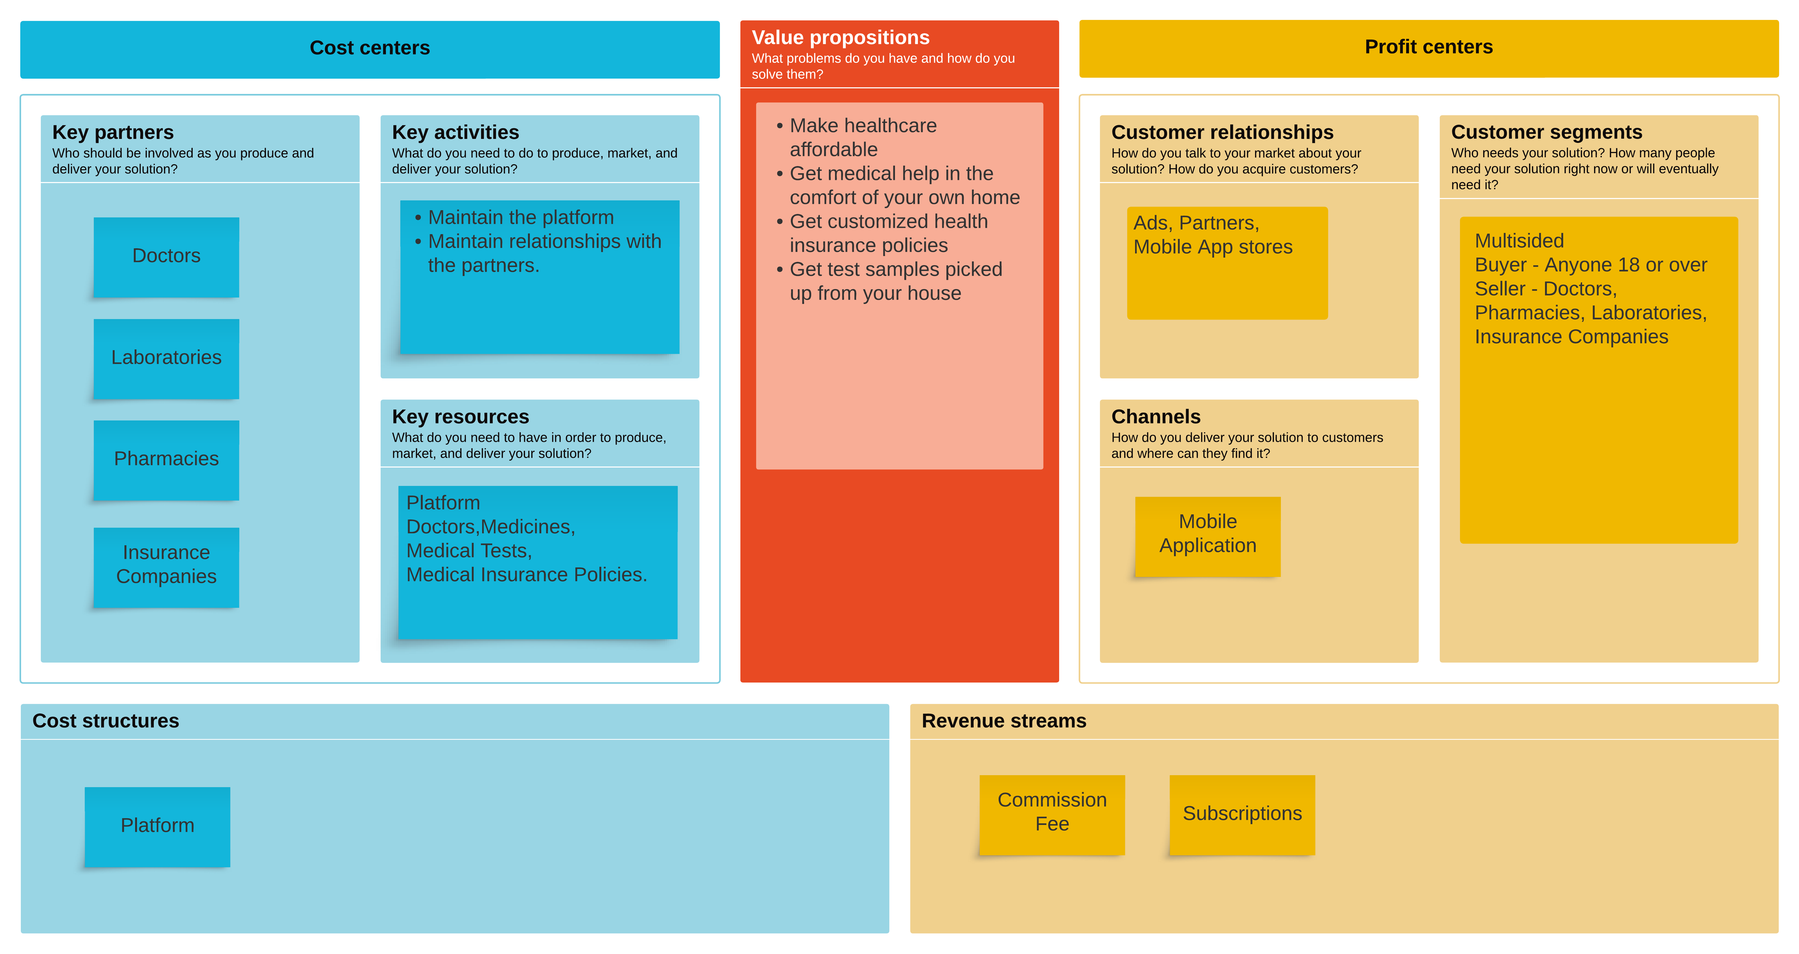
Business Model Canvas

Slide 8
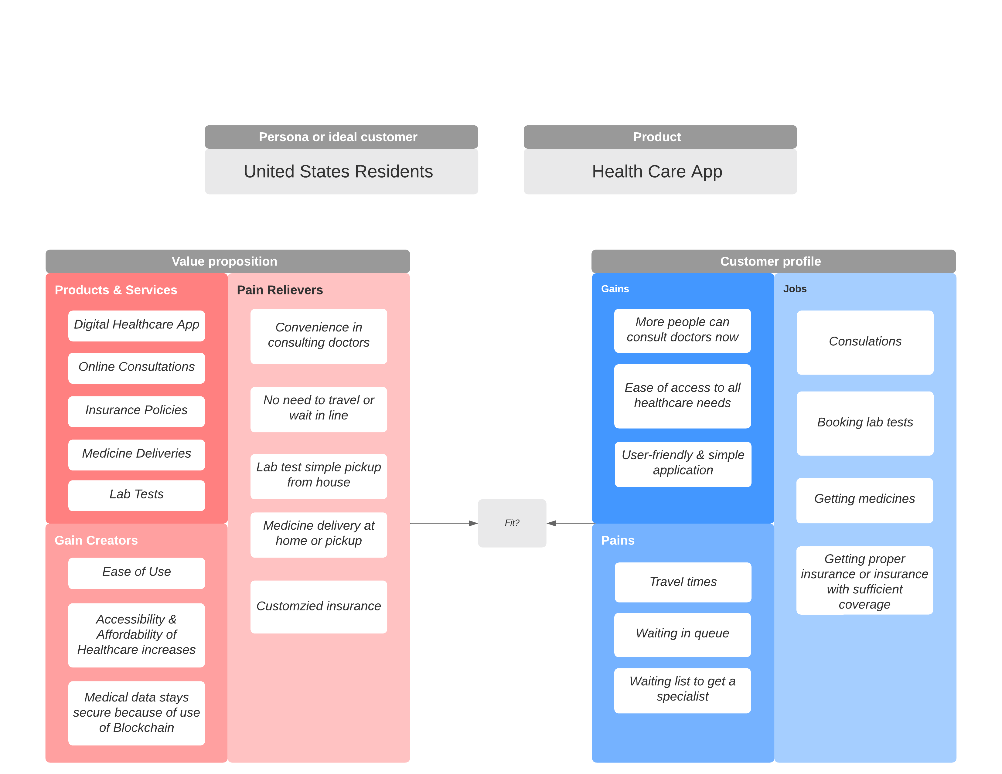
Value Proposition canvas

Slide 9
Hypotheses
The two hypotheses we want to test are:
In what states is healthcare more accessible?
And if it is accessible, is it affordable and how much of that is covered by insurance?

Slide 10
Data Description
To support our hypotheses, we found a dataset from Kaggle. This dataset shows variation of hospital charges in the various hospitals in the US for the top 100 diagnoses.
It also shows how price for the same diagnosis and the same treatment and in the same city can vary differently across different providers.
Variables in the dataset are Name of procedure, name of the hospital, state, zip code, number of discharges, the average charge for the procedure, average charges covered by insurance.

Slide 11
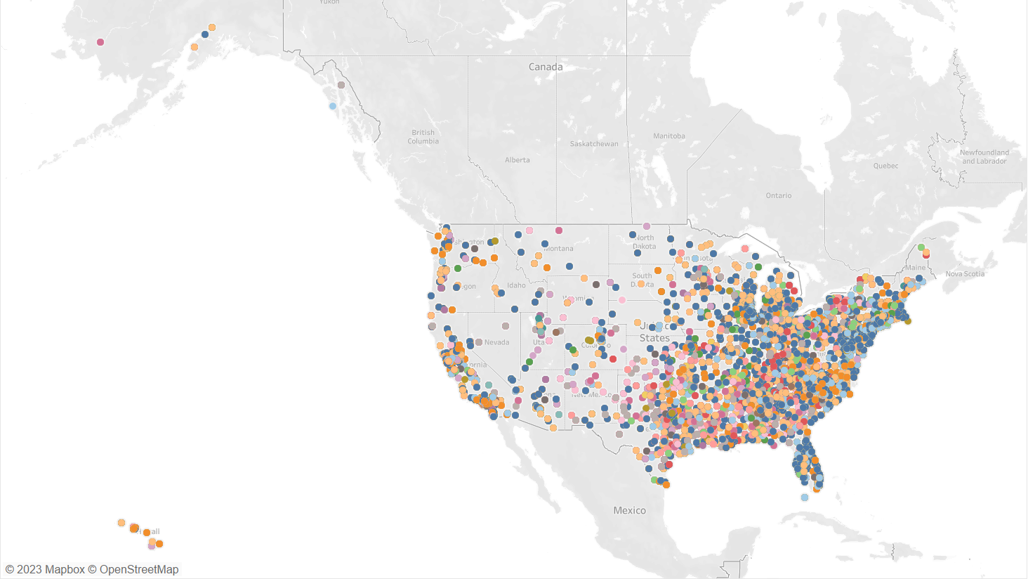
Visualizations
Visualization of Whole dataset

Slide 12
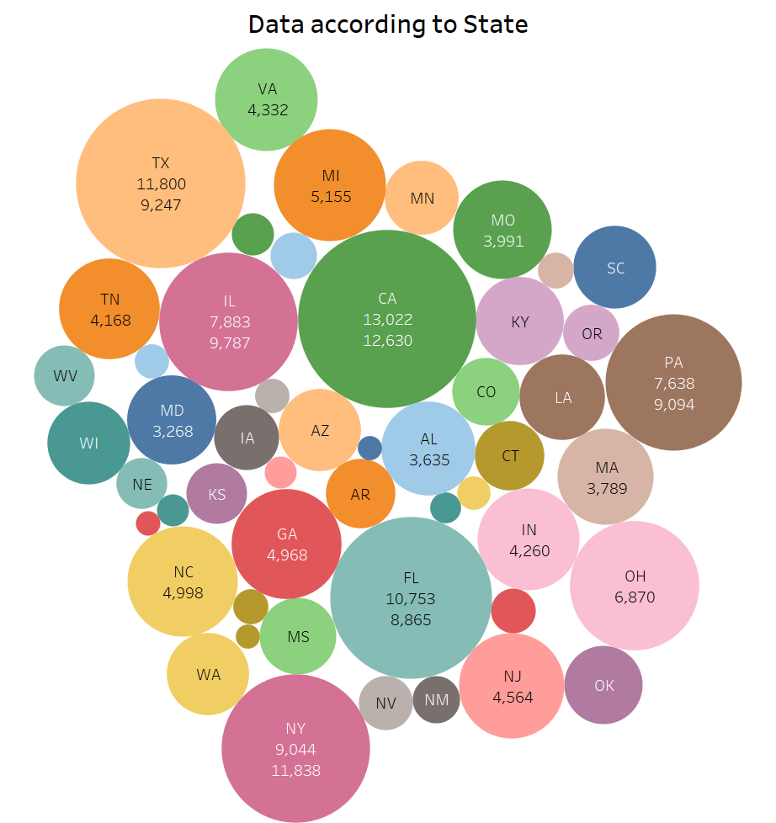
Visualizations

Slide 13
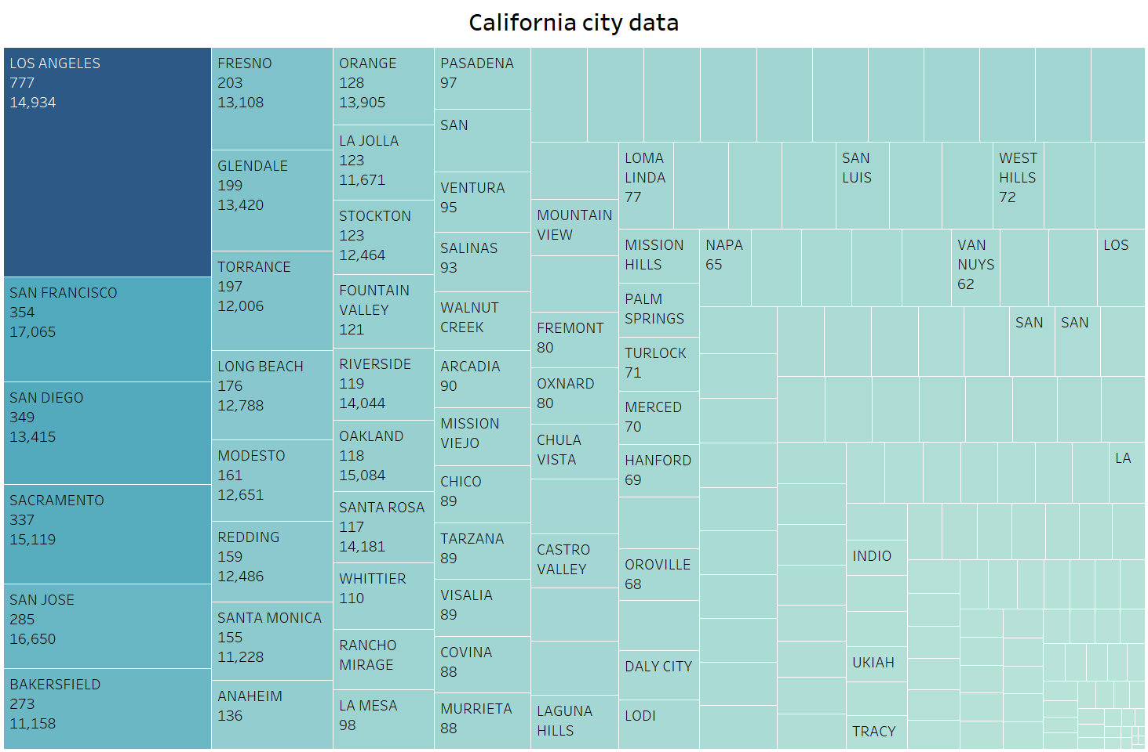
Visualizations

Slide 14
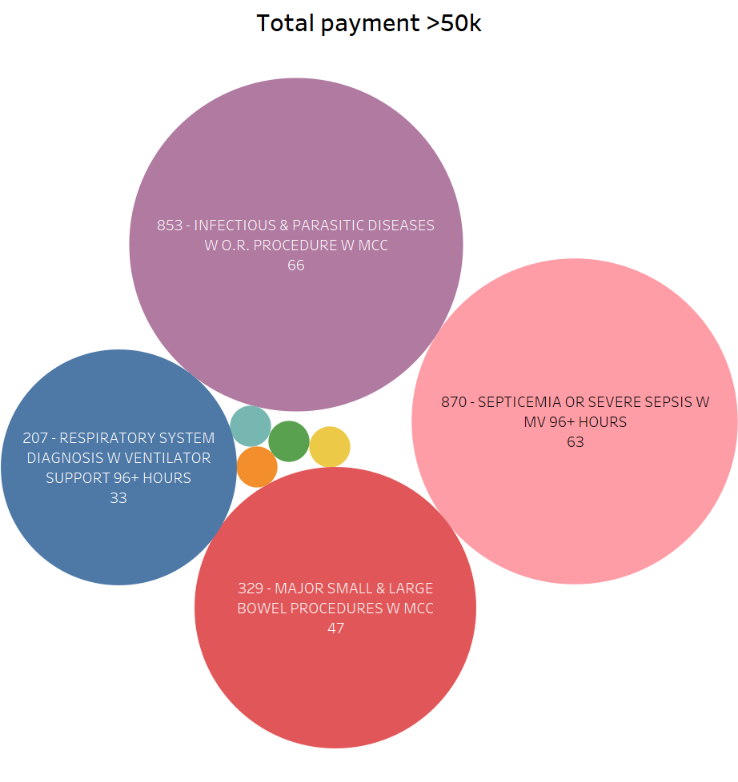
Visualizations

Slide 15
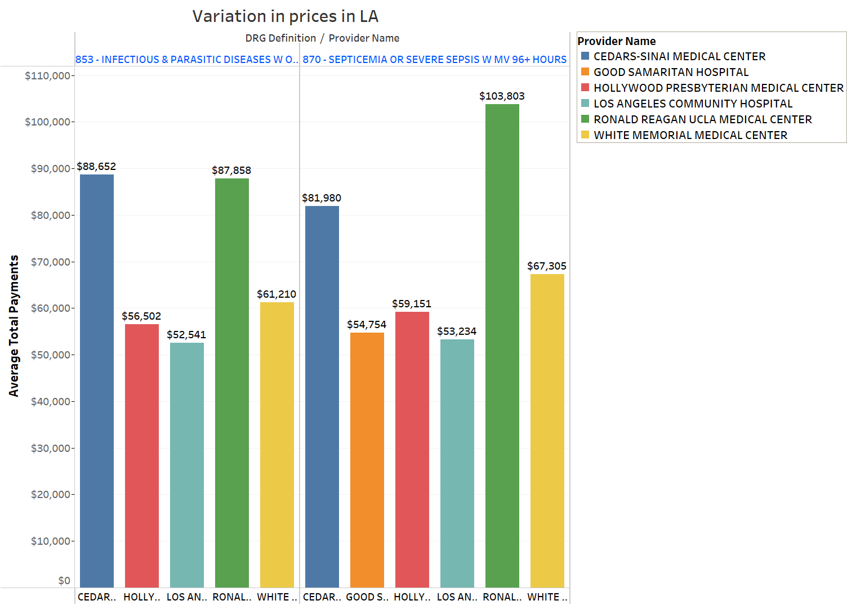
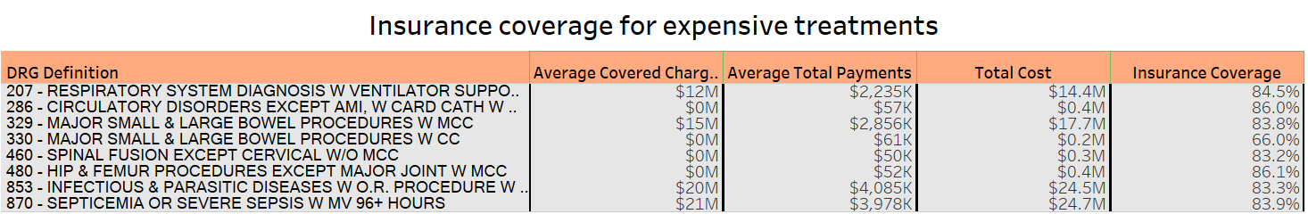
Visualizations

Slide 16
Monetization
Pricing Strategy
In-app purchases: This involves offering digital products or services within a mobile app and generating revenue through user purchases.
Subscription fees: The platform charges users a subscription fee of $10 per year to access content or features on the platform.
Revenue: Commission fees

Slide 17
Prototype

Slide 18
Thank you.

