Slide 1
Music Recommendation System (PRJ2025CE108)
Internal Guide:
Dr. Dhaval bhoi
(Assistant Professor)
External Guide:
P Abhishek
(Sr. Assistant Manager)
Prepared by:
Krunal Kevadiya (21CE054)
Divy Sheta (21CE134)

Slide 2
OVERVIEW
Company Intro
Tools & Technology
Project - Minor
T-1 : Task Management App
T-2 : Predict home prices
T-3 : Blood Donation Forecast
T-4 : Digit Classification
T-5 : Black Friday Sales Prediction
Project Information
Music Recommendation System
Demo

Slide 3




COMPANY INTRODUCTION
Name
Slash Mark IT Solutions (OPC) Pvt Ltd
Address
Rampur, Karimnagar, Telangana 505001
Website
https://slashmark.cloud/

Slide 4


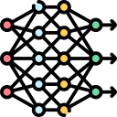


TOOLS & TECHNOLOGY
Python
Machine learning
Jupyter
notebook
Vs Code
Weekly task

Slide 5

PROJECT MINOR
Project 1
Develop a Python Task Management App
Predict home prices using XGBoost.
Project 2
Project 3
MNIST Digit Classification
Blood Donation Forecast
Project 4
Project 5
Black Friday Sales Prediction
Weekly task

Slide 6
T – 1 : Task Management App
Aim : Develop a Python task management app for adding, removing, listing, prioritizing, and
receiving task recommendations based on task priority.
Task ?
Process ?
Work ?
1. ADDING
2. REMOVING
3. LISTING
4. PRIORITIZING
Load existing list
Make new list
Make function
Save
Deployed
Csv download
Weekly task

Slide 7
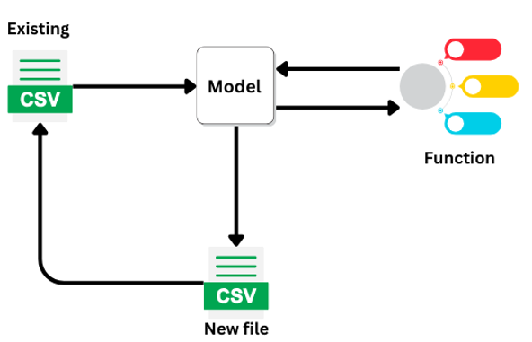
T – 1 : Task Management App –work flow
Weekly task

Slide 8
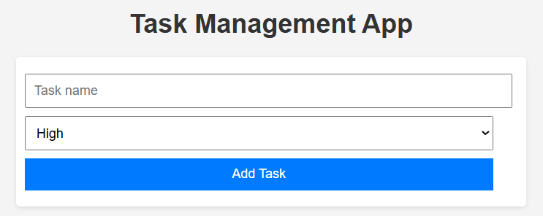
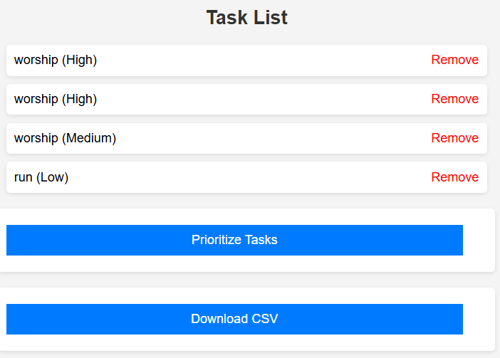
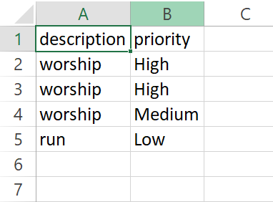
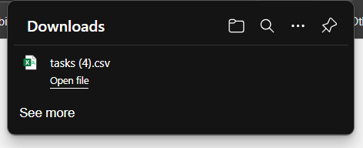
T – 1 : Task Management App – Demo
Weekly task

Slide 9
T – 2 : Digit Classification
Aim : Predict home prices using XGBoost .
Task ?
Dataset ?
Factors like :
Number of Bedroom
Number of Bathroom
Living Area
Total Area
Floor
year
kc_house_data : The dataset consists of house prices from King County an area in the US State of Washington (Kaggle.com)
Work ?
Try Using Different model
Deployed
Weekly task

Slide 10
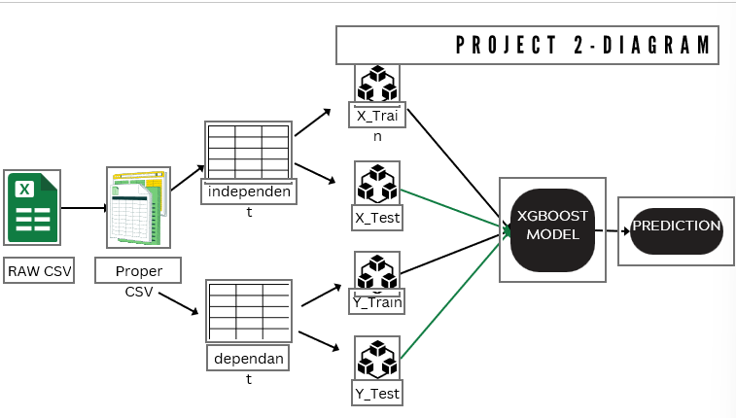
T – 2 : Predict home prices – work flow
Weekly task

Slide 11
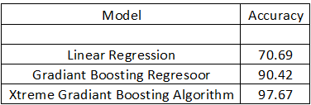
T – 2 : Predict home prices – Model
Weekly task

Slide 12
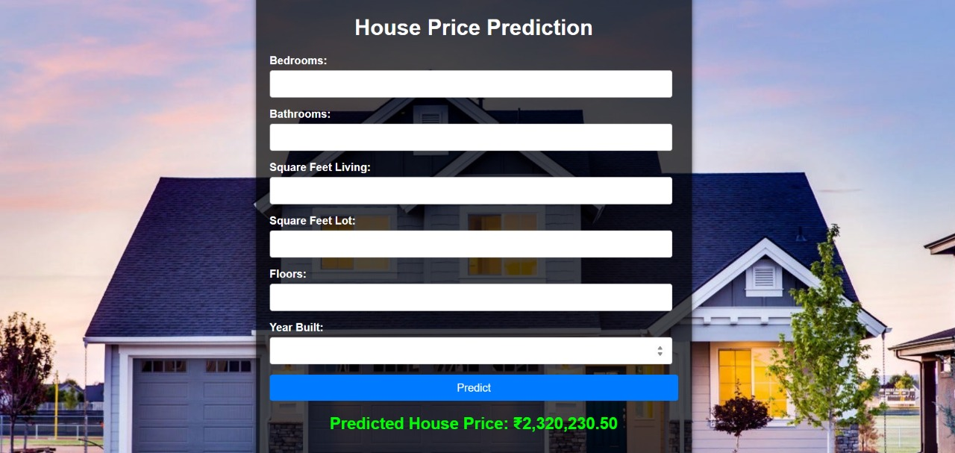
T – 2 : Predict home prices – Photo
Weekly task

Slide 13
T-3 : Blood Donation Forecast
Aim : Use machine learning to predict future blood donations, addressing a critical issue in the
healthcare system.
Dataset ?
Task ?
transfusion.data : This dataset contains data collected from blood donors and is used to predict whether
a donor will donate blood in the future.
Classification Problem
Work ?
Shape : Rows: 748 Columns: 5
Recency (months) – months since the last donation
Frequency – total number of donations
Monetary (c.c. blood) – total blood donated (in c.c.)
Time (months) – months since the first donation
Target (1/0) – whether the donor donated blood in March 2007
Deployed
Try logistic regression model
Weekly task

Slide 14
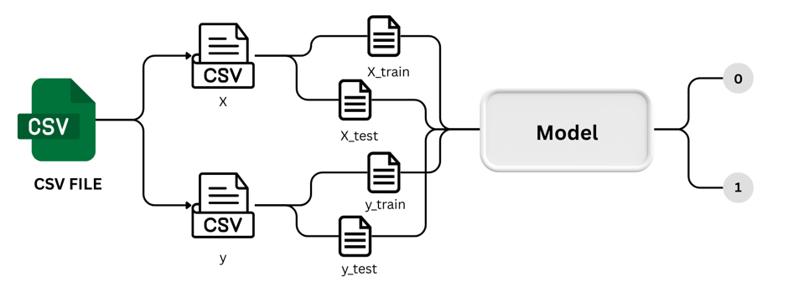
T-3 : Blood Donation Forecast – Workflow
a binary variable representing whether he/she donated blood in March 2007
Weekly task

Slide 15
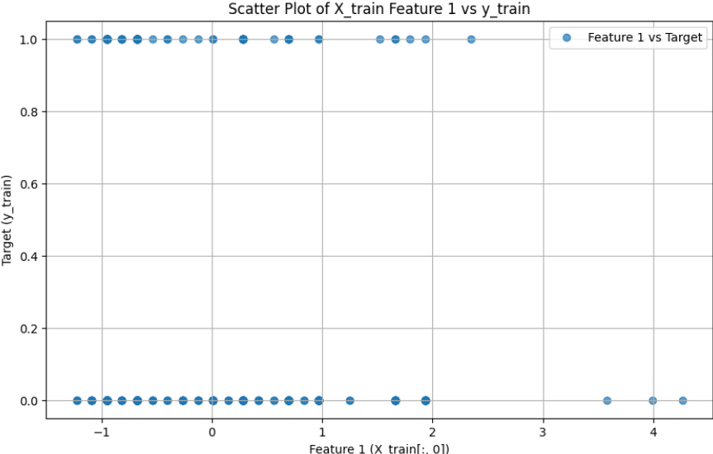
T-3 : Blood Donation Forecast – Result
MODEL | ACCU. SCORE
Logistic Regression | 80.21
Weekly task

Slide 16
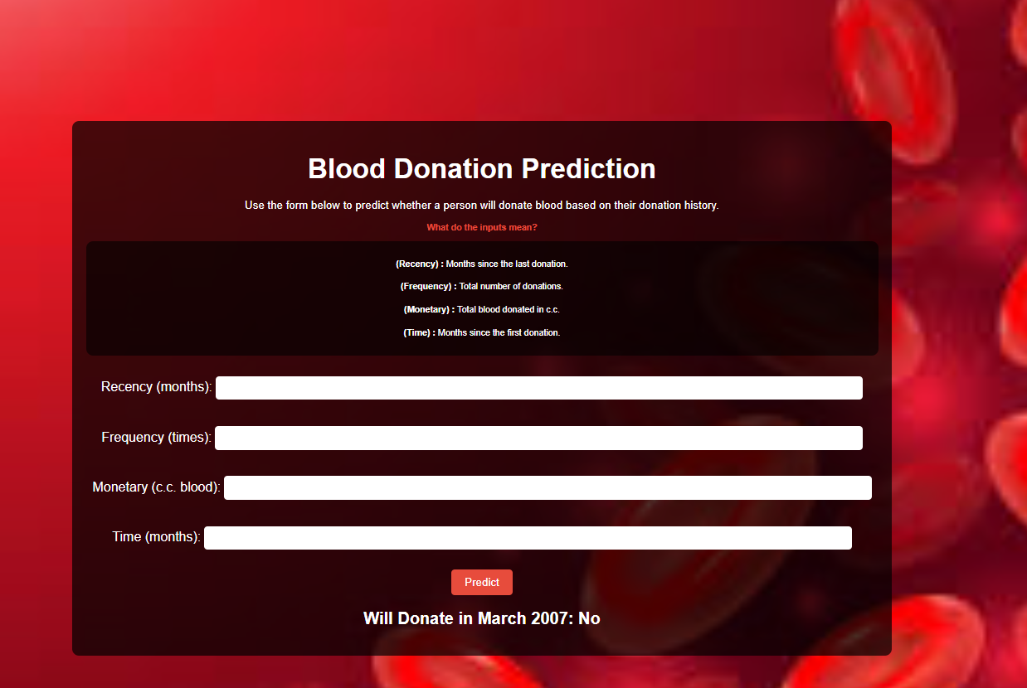
T-3 : Blood Donation Forecast – Photo
Weekly task

Slide 17
T-4 : Digit Classification
Aim : deep learning journey with the beginner-friendly MNIST dataset, focusing on
handwritten digit classification.
Task ?
Dataset ?
Classification problem
Make Network
mnist_data
Load using function of keras
It contain train and test file (60k ,10k)
It has 28 X 28 matrix – X_train , X_test
Targeted column – 1 – y_train ,y_test
Network ?
Without hidden layer , flatten layer
Without hidden but with flatten
With hidden and flatten
Weekly task

Slide 18
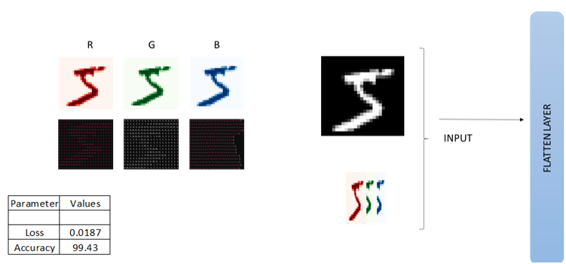
T-4 : Digit Classification – Dataset
Weekly task

Slide 19
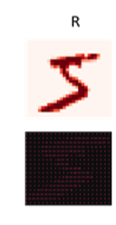
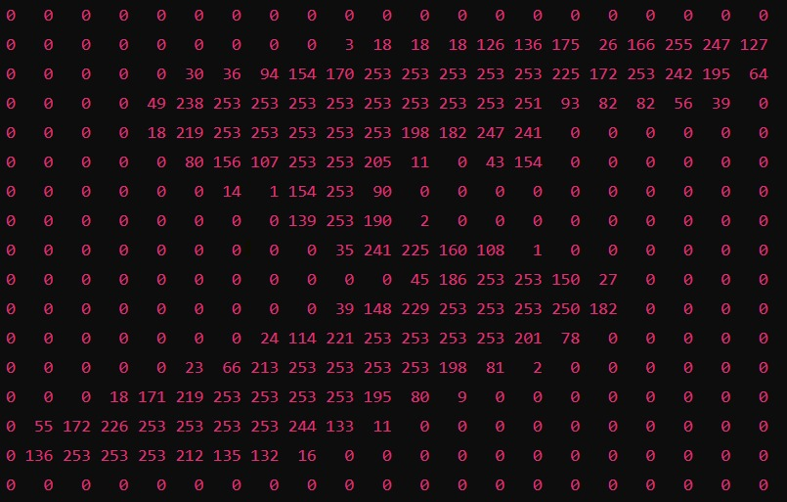
T-4 : Digit Classification – Dataset
Weekly task

Slide 20
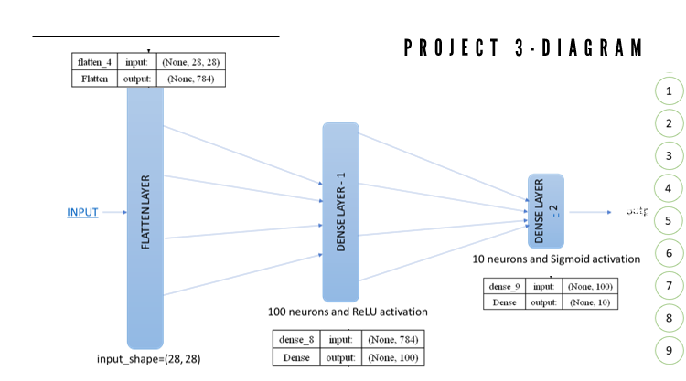
T-4 : Digit Classification – Workflow
4
Weekly task

Slide 21
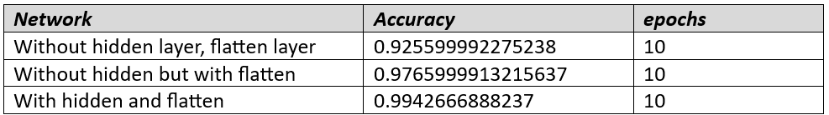
T-4 : Digit Classification – Network
Weekly task

Slide 22
T – 5 : Black Friday Sales Prediction
Aim : Verifying from emails to social media posts, 80 percent of extant text data is not structured.
Text mining is a way to extract valuable insights from this type of raw data. The method of
text mining converts unstructured text data into a structured format, promoting the
identification of important patterns and associations within data sets.
Task ? : prediction
Problem
Dataset
Model
Null values
Range values
Categorical values
Standardization
BlackFridaySales.csv
5 lakhs rows
12 column
Simple linear regression – 12.63
Decision tree regression – 55
Random forest regression – 63.10
XGBoost Regression – 67.16
Weekly task

Slide 23
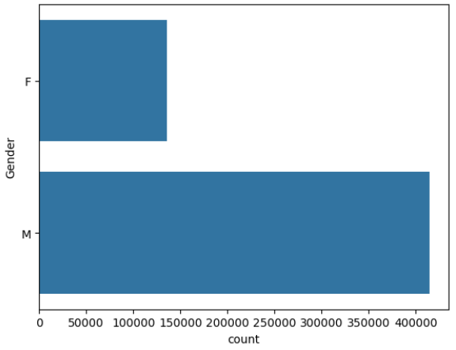
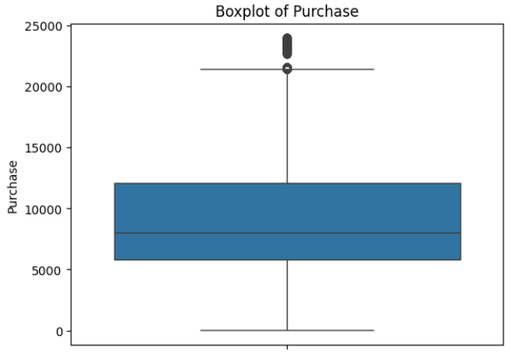
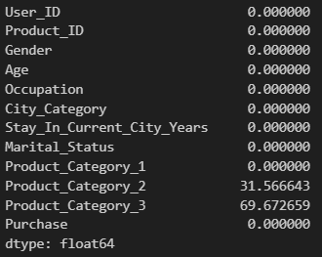
T – 5 : Black Friday Sales Prediction - Problem
Weekly task

Slide 24
Music Recommendation System

Slide 25
Music Recommendation System
Aim : Create a personalized music recommendation system that suggests tracks, albums, and playlists based on
user preferences,
listening history,
and content based and other ..
Model
Model - 1 random recommendations
Model -2_1 content based recommendation
Model -2_2 content based recommendation
Model – 3 Mixed model
Weekly task

Slide 26
Music Recommendation System – Model - 1
Model - 1 random recommendations
Work and Model ?
Make random recommendation model
Algorithm : NLP – tf - idf
Dataset
songdata (Kaggle.com)
rows : 57650
column : 4
Weekly task

Slide 27
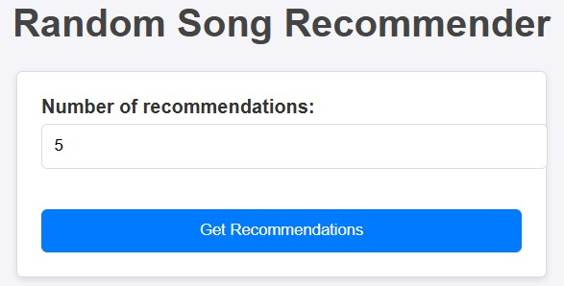
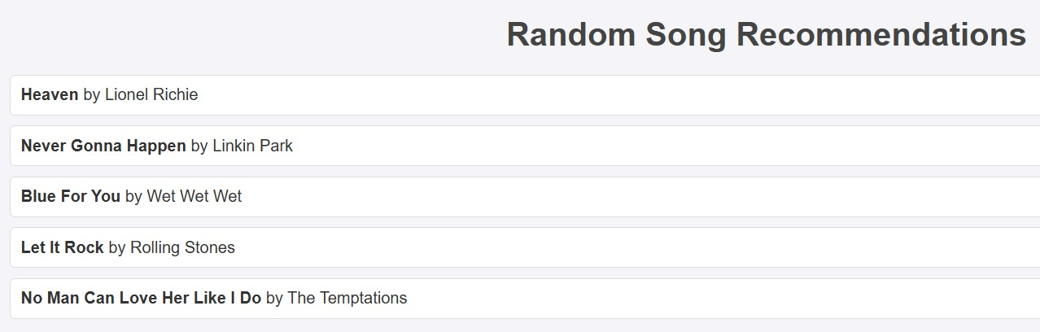
Music Recommendation System – Model – 1
Model - 1 random recommendations - Photo
Weekly task

Slide 28
Music Recommendation System – Model – 2_1
Model -2_1 content based recommendation
Work and Model ?
Make content based recommendation model
Algorithm : tf-idf algorithm and cosine similarities
Dataset
spotify_millsongdata (Kaggle.com)
rows : 57650
column : 4
Weekly task

Slide 29
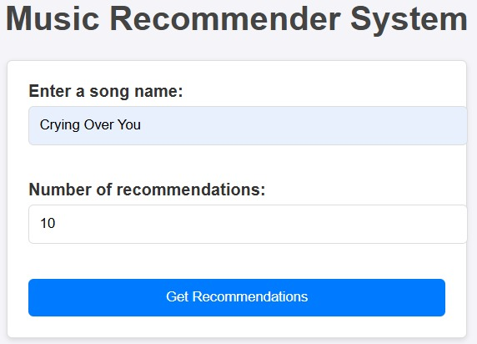
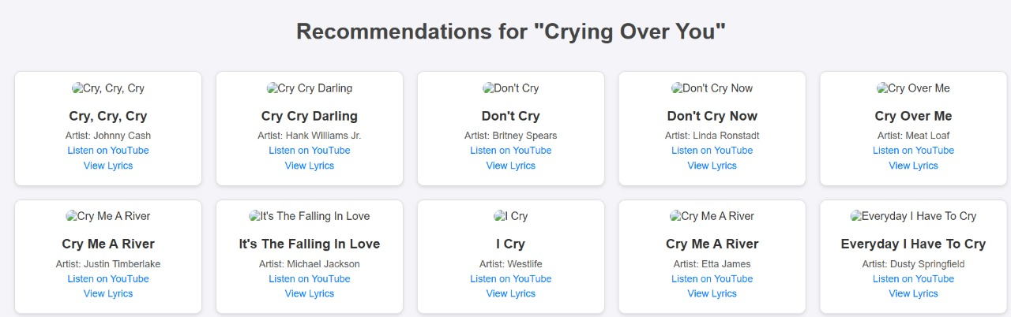
Music Recommendation System – Model – 1
Model -2_1 content based recommendation
Weekly task

Slide 30
Music Recommendation System – Model – 2_2
Model -2_2 content based recommendation
Work and Model ?
Make random recommendation model
apply t-SNE transformation
euclidean_distances
Dataset
data.csv
data_by_genres.csv
data_by_year.csv
170653 rows × 19 columns
Weekly task

Slide 31
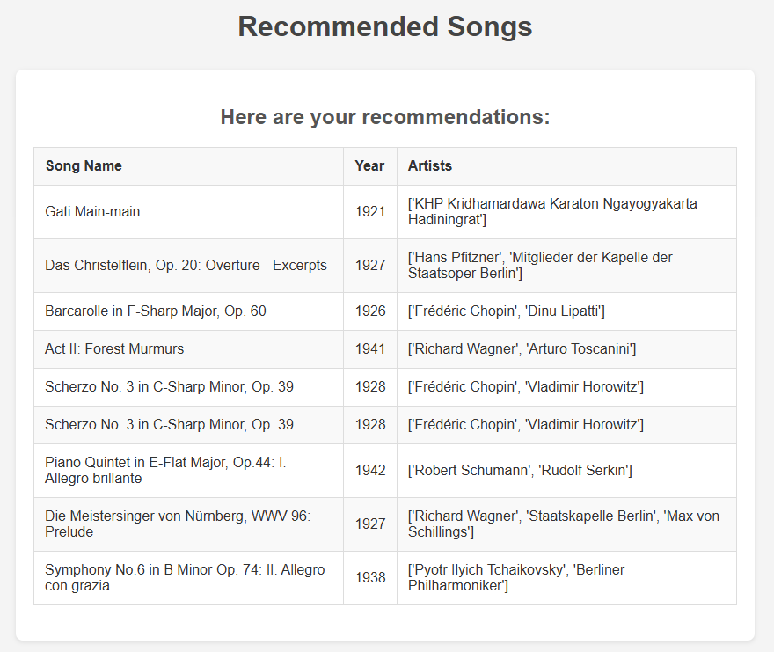
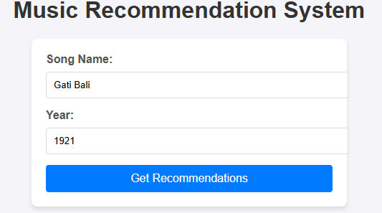
Music Recommendation System – Model – 1
Model -2_2 content based recommendation
Weekly task

Slide 32
Music Recommendation System – Model – 3
Model – 3 Mixed model
Work and Model ?
Popularity recommendation system
Item similarity recommendation system
Listen count based recommendation system
Based on user preference
Dataset
triplets_file.csv
song_data.csv
2000000 1000000
Weekly task

Slide 33
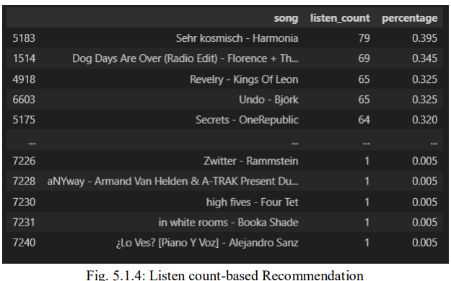
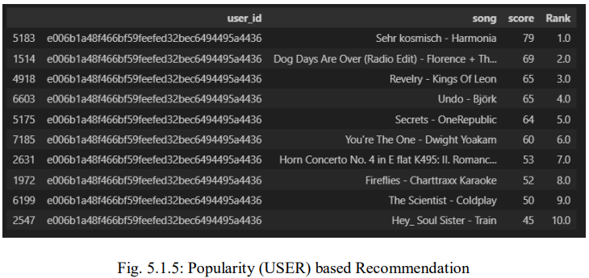
Music Recommendation System – Model – 3
Model – 3 Mixed model
Weekly task

Slide 34
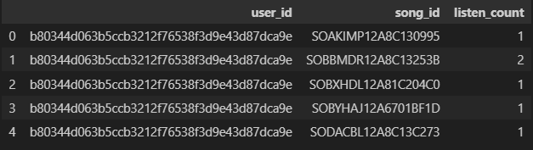
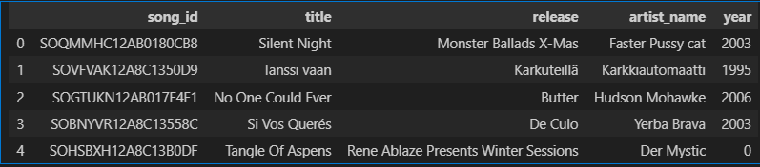
Music Recommendation System – Model – 3 - Gataset
Model – 3 Mixed model
Dataset :
Triplet data
song_data
Weekly task

Slide 35
Thank You!
Weekly task

