Slide 1
Music Recommendation System (PRJ2025CE108)
Internal Guide:
Dr. Dhaval bhoi
(Assistant Professor)
External Guide:
P Abhishek
(Sr. Assistant Manager)
Prepared by:
Krunal Kevadiya (21CE054)
Divy Sheta (21CE134)

Slide 2
OVERVIEW
01
Company Intro
Tools & Technology
02
03
Project - Minor
Project Information
04
Weekly task

Slide 3




COMPANY INTRODUCTION
Name
Slash Mark IT Solutions (OPC) Pvt Ltd
Address
Rampur, Karimnagar, Telangana 505001
Website
https://slashmark.cloud/

Slide 4


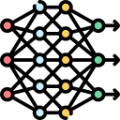


TOOLS & TECHNOLOGY
Python
Machine learning
Jupyter
notebook
Vs Code
Weekly task

Slide 5

PROJECT MINOR
Project 1
Develop a Python Task Management App
Predict home prices using XGBoost
Project 2
Project 3
MNIST Digit Classification
Blood Donation Forecast
Project 4
Project 5
Black Friday Sales Prediction
Weekly task

Slide 6
MINOR PROJECT - 1
Develop a Python task management app for adding, removing, listing, prioritizing, and receiving task recommendations based on task priority.
Adding
Removing
Listing
Prioritizing
Recommended based on priority
Weekly task

Slide 7
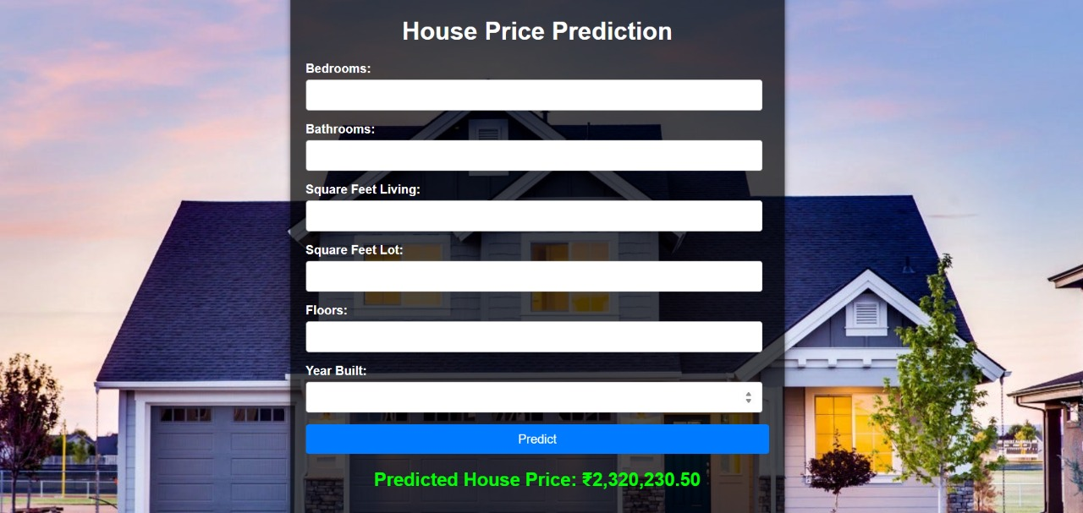
MINOR PROJECT - 2
Predict home prices using XGBoost with factors.
Weekly task

Slide 8
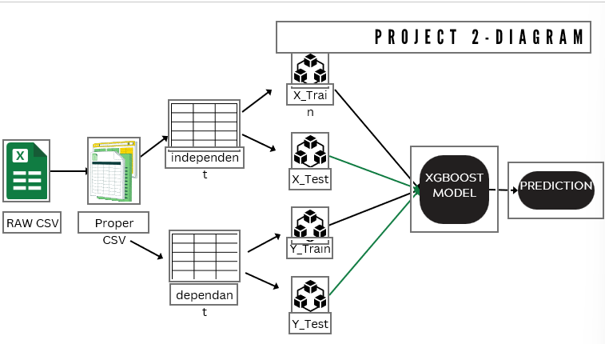
MINOR PROJECT - 2
Weekly task

Slide 9
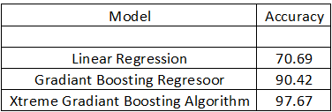
MINOR PROJECT - 2
Weekly task

Slide 10
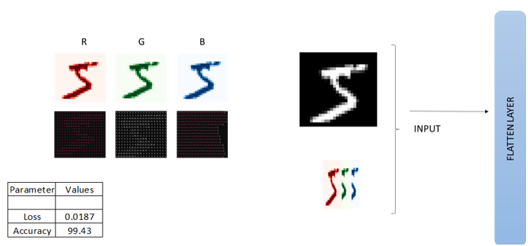
MINOR PROJECT - 3
Being your deep learning journey with the beginner-friendly MNIST dataset, focusing on handwritten digit classification.
Weekly task

Slide 11
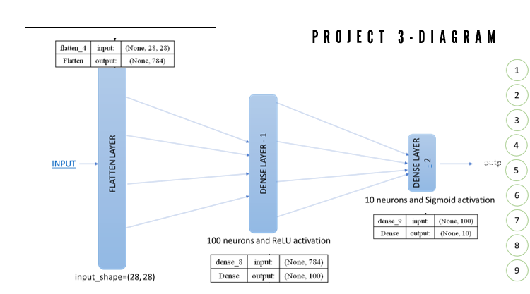
MINOR PROJECT - 3
Weekly task

Slide 12
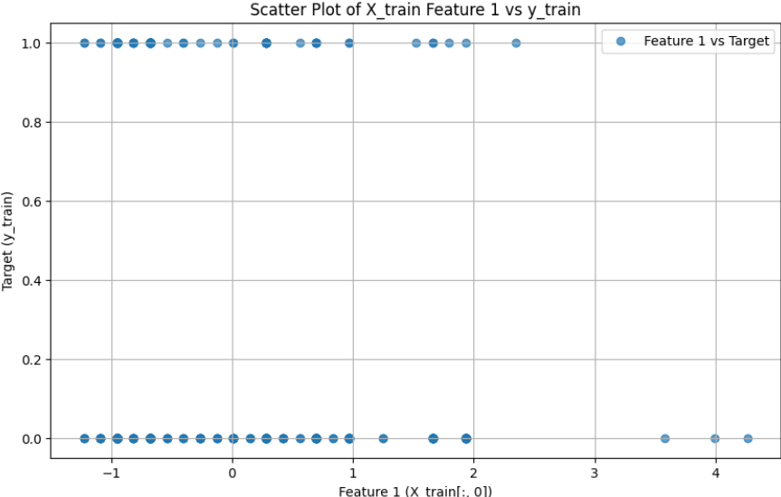
MINOR PROJECT - 4
Use machine learning to predict future blood donations, addressing a critical issue in the healthcare system.
R (Recency - months since the last donation)
F (Frequency - total number of donation)
M (Monetary - total blood donated in c.c.)
T (Time - months since the first donation)
Model
a binary variable representing whether he/she donated blood in March 2007
MODEL | ACCU. SCORE
Linear Regression | -
Logistic Regression | 80.21
Weekly task

Slide 13
MINOR PROJECT - 5
Black Friday Sales Prediction
Varying from emails to social media posts, 80 percent of extant text data is not structured. Text mining is a way to extract valuable insights from this type of raw data. The method of text mining converts unstructured text data into a structured format, promoting the identification of important patterns and associations within data sets.
Problem
Dataset
model
Null values
Range values
Categorical values
Standardization
5 lakhs rows
12 column
Simple linear regression – 12.63
Decision tree regression – 55
Random forest regression – 63.10
XGBoost Regression – 67.16
Weekly task

Slide 14
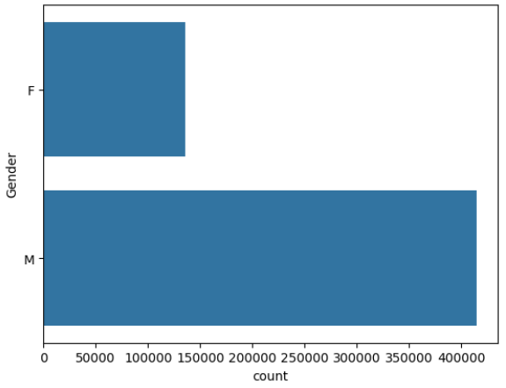
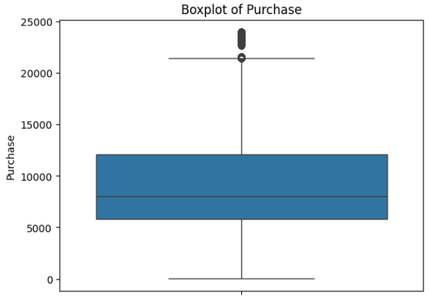
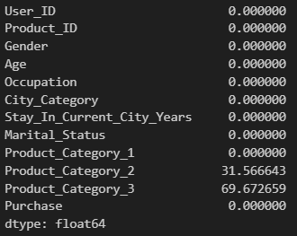
MINOR PROJECT - 5
Black Friday Sales Prediction – PROBLEM
Weekly task

Slide 15

PROJECT INFORMATION
Title : Music Recommendation System
Create a personalized music recommendation system that suggests tracks, albums, and playlists based on
user preferences,
listening history,
and content based.
Weekly task

Slide 16
PROJECT INFORMATION
Title : Music Recommendation System - Model - 1
Make random recombination model
- NLP – tf-idf algorithm
- dataset - songdata (Kaggle.com)
- 57650 * 4
column – artist , song , link , test or lyrics
Weekly task

Slide 17
PROJECT INFORMATION
Title : Music Recommendation System - Model - 2
Make content recombination model
- NLP – tf-idf algorithm and cosine similarities
- dataset - songdata (Kaggle.com)
- 57650 * 4
column – artist , song , link , test or lyrics
Weekly task

Slide 18
PROJECT INFORMATION
Title : Music Recommendation System - Model - 3
Make model with different types
- NLP – tf-idf algorithm and cosine similarities
- dataset - triplet and song data (Kaggle.com)
- combine this data
column – artist , song , release , song id ,user id,year , listen count
Weekly task

Slide 19
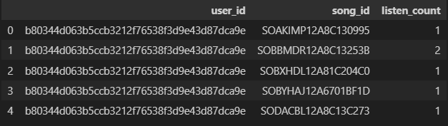
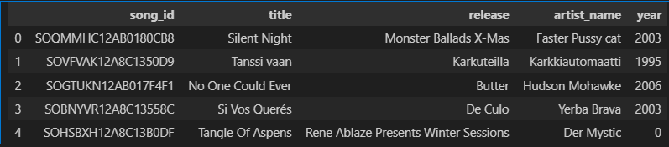
PROJECT INFORMATION
Title : Music Recommendation System
Dataset :
Triplet data
song_data
Weekly task

Slide 20
Thank You!
Weekly task

