Slide 1

E-COMMERCE DATA ANALYSIS
Myntra Product Catalog: Data Analysis Report
Data Analysis • Data Cleaning • Business Insights

Slide 2
INTRODUCTION
Project Overview
This project looks at a Myntra product list covering clothing and footwear. The goal is to understand the products, prices, discounts and customer ratings, and then find useful business insights.
PURPOSE OF THE
ANALYSIS
Build a clean, reliable dataset and find patterns in prices, discounts, categories and ratings that matter to a fashion business like Myntra.
1
Understand the raw data and check its quality
2
Fix missing values, wrong values and outliers
Data Cleaning
3
Explore patterns in one column, two columns and brands
Handling Outliers
Charts & Comparisons
4
Turn what we find into business insights
How Columns Relate
Brand & Category Insights
MYNTRA | E-Commerce Data Analysis
2

Slide 3
THE DATA
Dataset Overview
1,500
11
20
24
Product Records
Columns
Brands
Sub-Categories
Dataset: Myntra Dataset.csv. A list of Men's and Women's clothing and footwear products with price, discount and rating details.
COLUMNS IN THE DATASET
Product_ID
Product_Name
Brand
Gender
Category
Sub_Category
MRP
Selling_Price
Discount_Pct
Rating
Rating_Count
MYNTRA | E-Commerce Data Analysis
3

Slide 4
THE DATA
Data Understanding
NUMBER COLUMNS (5)
TEXT COLUMNS (6)
MRP
changed to decimal
• Product_ID
Selling_Price
decimal number
• Product_Name
• Brand
Discount_Pct
whole number
• Gender
Rating
decimal number
• Category
Rating_Count
decimal number
• Sub_Category
Duplicate rows found: 0
MYNTRA | E-Commerce Data Analysis
4

Slide 5
DATA CLEANING
Fixing Missing & Wrong Values
Column
Problem
What We Did
Sub_Category
3 missing values
Filled with the most common value ("Sports Shoes")
Selling_Price
3 missing values
Filled with the middle value (median)
Rating
5 missing + invalid entries (-1, 5.5)
Removed invalid values, then filled with the middle value of the same brand
Rating_Count
10 missing + invalid entries (-500, 999999)
Removed invalid values, then filled with the middle value (median)
Category
Mixed capital and small letters ("clothing", "FOOTWEAR")
Made all names the same style (e.g. "Clothing")
Product_Name
Extra spaces at the start or end
Removed the extra spaces
After cleaning: no missing values are left in all 11 columns, and there are no duplicate rows.
MYNTRA | E-Commerce Data Analysis
5

Slide 6
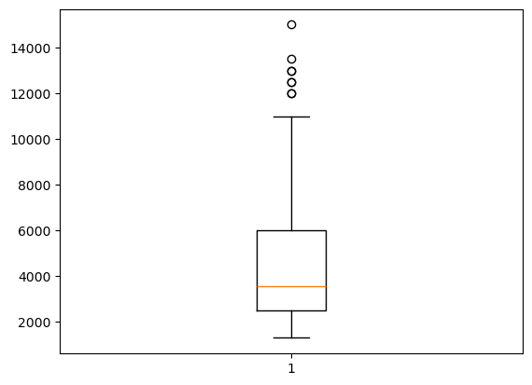
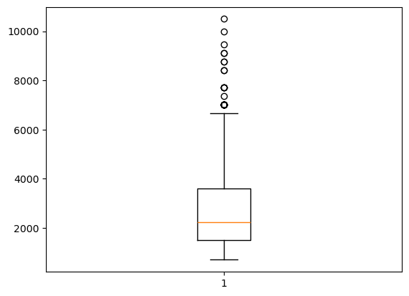
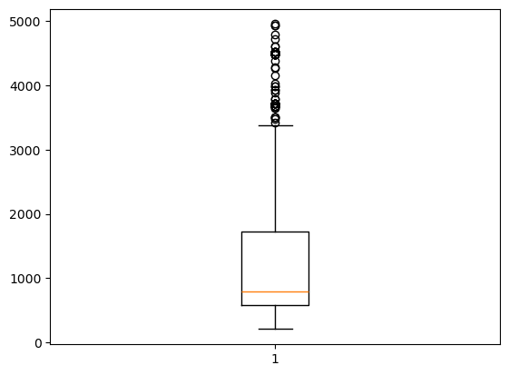
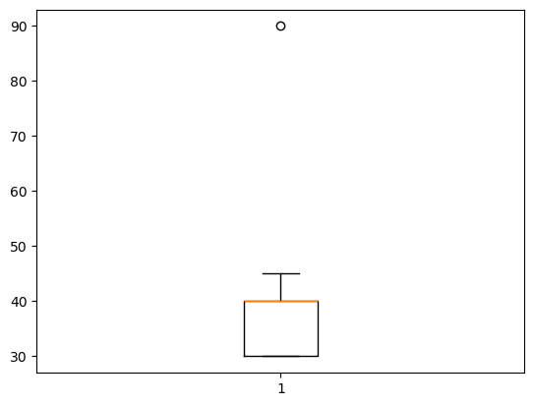
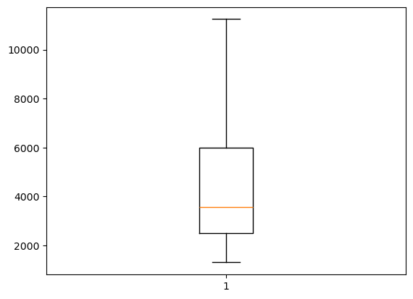
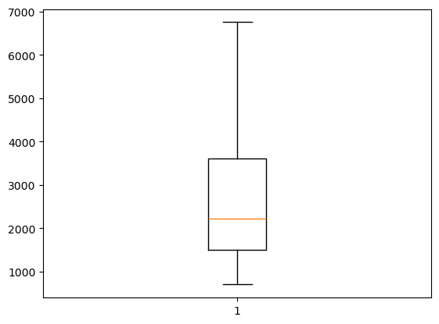
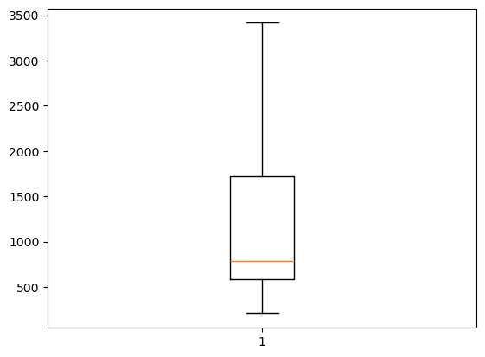
DATA CLEANING
Handling Outliers (IQR Method)
MRP
Selling Price
Rating Count
Discount %
Cap: 11,249 (was 14,999)
Skew after: 0.91
Cap: 6,749 (was 10,499)
Skew after: 0.98
Cap: 3,415 (was 4,950)
Skew after: 1.25
Limit: 55%, not capped
Skew: 0.28
BEFORE
BEFORE
BEFORE
BOXPLOT (KEPT AS IS)
AFTER
AFTER
AFTER
Valid outlier
One 90% discount (Adidas Men Running Shoes, MRP 6,999 → 699) is a genuine promotion, so it was kept.
INSIGHT
MRP, Selling Price and Rating Count: very high values were cut down to a limit, so a few extreme values no longer spoil the charts.
Discount %: the one 90% discount is above the 55% limit, but its MRP and Selling Price show it is a real offer, so we kept it.
MYNTRA | E-Commerce Data Analysis
6

Slide 7
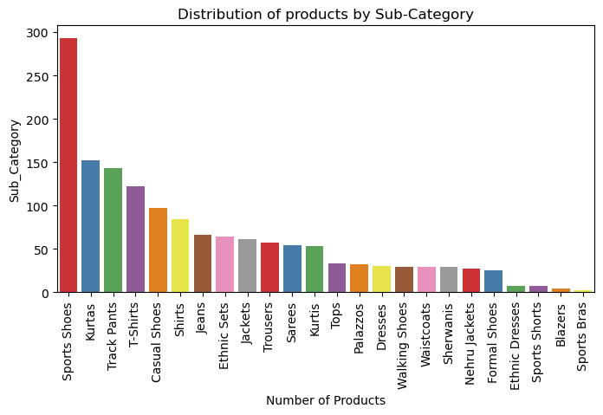
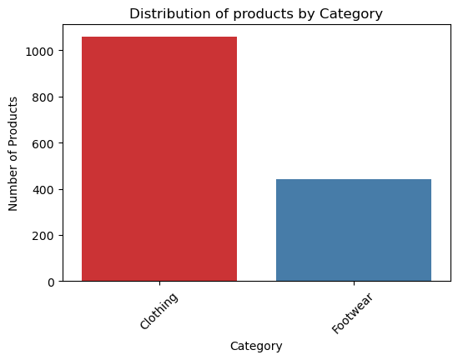
EXPLORATORY DATA ANALYSIS · UNIVARIATE
Category & Sub-Category Mix
Products by Category
Products by Sub-Category
INSIGHT
Clothing has 1,056 products (about 70%) and Footwear has 444 (about 30%), so the catalog is mostly clothing.
Sports Shoes is the biggest sub-category (293 products). Sports Bras is the smallest (only 2 products).
MYNTRA | E-Commerce Data Analysis
7

Slide 8
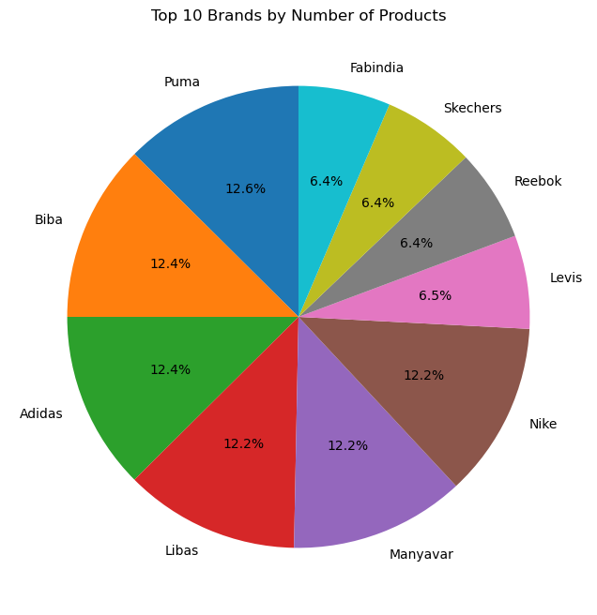
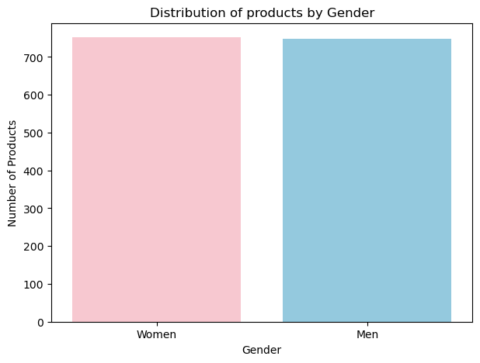
EXPLORATORY DATA ANALYSIS · UNIVARIATE
Gender & Brand Distribution
Products by Gender
Top 10 Brands by Product Count
INSIGHT
Women's products are slightly more than Men's products in the catalog.
Puma (121), Biba (120) and Adidas (120) lead the top 10 brands. No single brand dominates, the mix is fairly even.
MYNTRA | E-Commerce Data Analysis
8

Slide 9
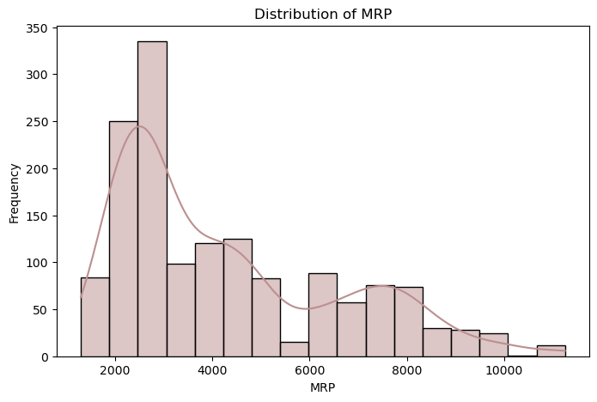
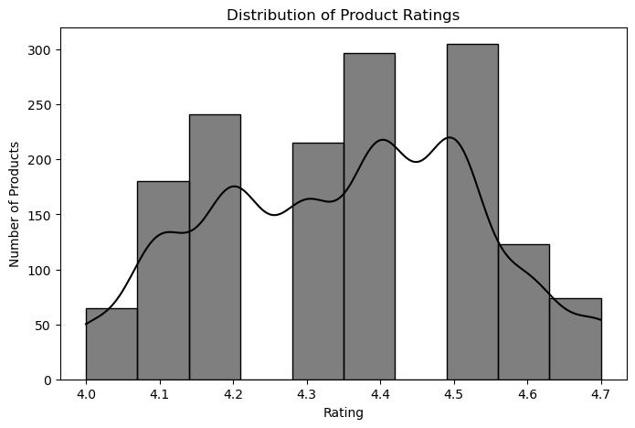
EXPLORATORY DATA ANALYSIS · UNIVARIATE
Price & Rating Distributions
Distribution of MRP
Distribution of Product Ratings
INSIGHT
Most MRPs are between ₹2,000 and ₹3,000. Fewer products are listed as the price goes up toward ₹11,000 (skew 0.91).
Ratings stay between 4.1 and 4.6, with most around 4.4 to 4.5. They are balanced and mostly positive (skew −0.06).
MYNTRA | E-Commerce Data Analysis
9

Slide 10
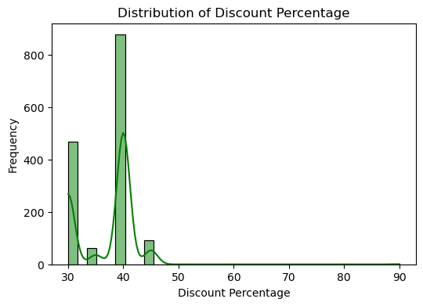
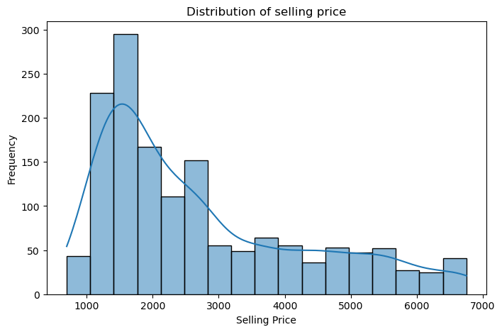
EXPLORATORY DATA ANALYSIS · UNIVARIATE
Discount & Selling Price Distributions
Distribution of Discount Percentage
Distribution of Selling Price
INSIGHT
Most discounts are around 30–40%, and 40% is the most common. Discounts above 50% are rare.
Most products sell between ₹1,000 and ₹3,000. Very few sell above ₹5,000 (skew 0.98).
MYNTRA | E-Commerce Data Analysis
10

Slide 11
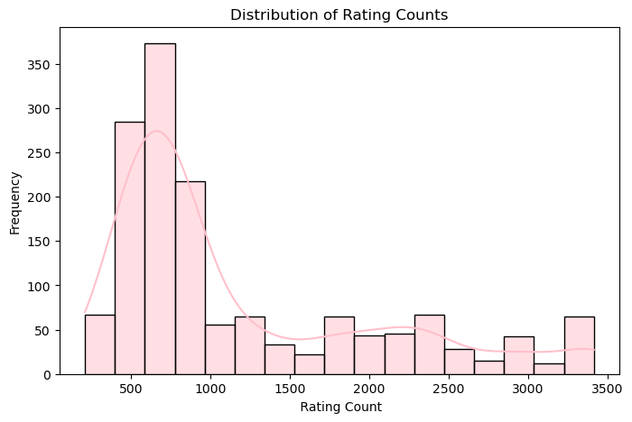
EXPLORATORY DATA ANALYSIS · UNIVARIATE
Rating Count Distribution
Distribution of Rating Counts
INSIGHT
Most products have 500–1,000 ratings. Only a few have more than 2,000 (skew 1.25).
Several top products show exactly 3,415 ratings because that was the cap set while handling outliers.
So a few bestsellers get most of the ratings, while most products get far fewer.
MYNTRA | E-Commerce Data Analysis
11

Slide 12
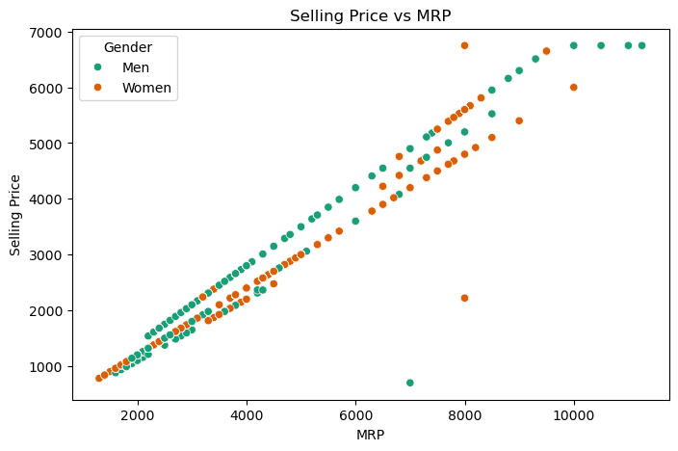
EXPLORATORY DATA ANALYSIS · BIVARIATE
MRP vs. Selling Price
Selling Price vs. MRP (by Gender)
0.984
Relationship score
(MRP and Selling Price)
INSIGHT
MRP and Selling Price move together almost perfectly. When MRP goes up, Selling Price goes up too.
This shows a similar discount pattern is used across the whole catalog.
Men's and Women's products follow the same pattern, with a few outliers.
MYNTRA | E-Commerce Data Analysis
12

Slide 13
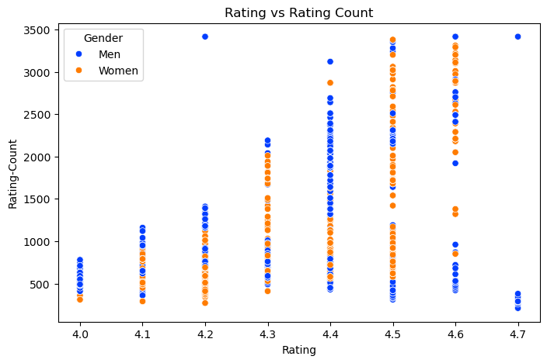
EXPLORATORY DATA ANALYSIS · BIVARIATE
Rating Engagement
Rating vs. Rating Count
INSIGHT
Products with higher ratings usually have more ratings. Products rated 4.4–4.6 show the widest range of rating counts.
MYNTRA | E-Commerce Data Analysis
13

Slide 14
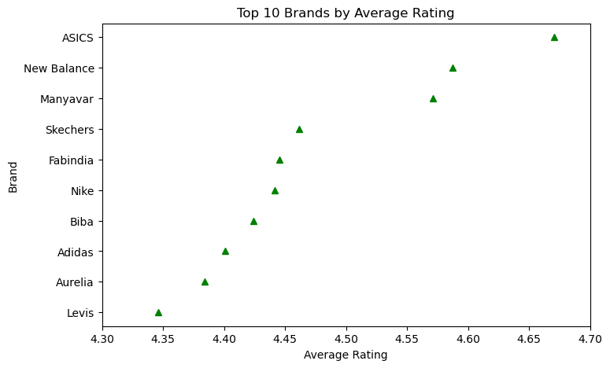
EXPLORATORY DATA ANALYSIS · BRAND ANALYSIS
Top Brands by Average Rating
Top 10 Brands by Average Rating
TOP 5 RATED BRANDS
ASICS
4.67
New Balance
4.59
Manyavar
4.57
Skechers
4.46
Fabindia
4.45
INSIGHT
All top 10 average ratings are between 4.35 and 4.67, so quality looks consistently good across brands.
MYNTRA | E-Commerce Data Analysis
14

Slide 15
SUMMARY
Business Insights
Category Mix
Pricing Strategy
Discounting
Clothing makes up 70% and Footwear 30%. Sports Shoes is the biggest sub-category.
MRP and Selling Price are closely linked (0.984), so discounts follow a similar pattern across the catalog.
Most products have a 30–40% discount. Discounts above 50% are rare.
Customer Ratings
Brand Landscape
Rating Spread
Ratings are high (4.1–4.6) across products and brands, so customers are mostly happy.
Top brands (Puma, Biba, Adidas, Libas, Manyavar, Nike) have a similar share. No single brand dominates.
A few bestsellers get most of the ratings, while most products get far fewer.
MYNTRA | E-Commerce Data Analysis
MYNTRA | E-Commerce Data Analysis
15
15

Slide 16
WRAP-UP
Conclusion
The data is fully cleaned: no missing values and no duplicate rows across all 1,500 products and 11 columns.
Wrong values (negative ratings, impossible rating counts, mixed category names) were fixed, and extreme values in MRP, Selling Price and Rating Count were capped using the IQR method.
Prices follow a steady pattern (MRP and Selling Price match at 0.984), not random discounts.
Customers are happy: most ratings are between 4.1 and 4.6 across brands and categories.
Clothing (70%) and Sports Shoes are the main part of the catalog, and a few bestsellers get most of the ratings.
This clean data is now ready for the next step, like predicting ratings or demand from price and discount.
MYNTRA | E-Commerce Data Analysis
16

Slide 17
Thank You

