Slide 1



E-COMMERCE DATA ANALYSIS
Myntra Product Catalog: SQL Analysis
LinkedIn
GitHub

Slide 2
Project Overview & Objectives
INTRODUCTION
PROJECT OVERVIEW
OBJECTIVES
This project analyses a cleaned dataset of 1,500 Myntra product listings covering clothing and footwear. The data is loaded into MySQL and explored with SQL queries to understand brands, prices, discounts and customer ratings.
Answer 10 business questions about Myntra products using SQL
Understand pricing, discounting and customer ratings across brands and categories
Turn query results into clear business insights

Slide 3
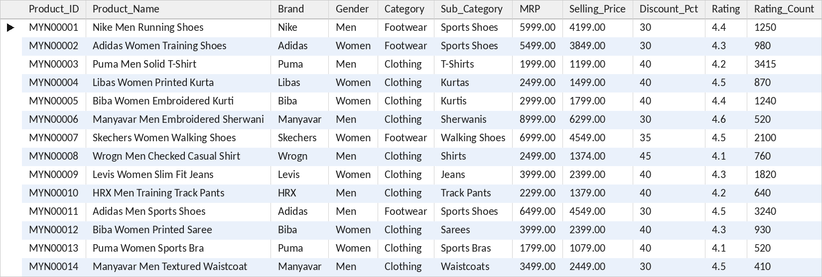
The SQL Table: myntra_products
THE DATA
1,500
11
20
24
Rows Loaded
Columns
Brands
Sub-Categories
CREATE TABLE
CREATE TABLE myntra_products (
Product_ID VARCHAR(10),
Product_Name VARCHAR(150),
Brand VARCHAR(50),
...
Rating DECIMAL(3,1),
Rating_Count DECIMAL(10,0)
);
First 14 of 1,500 rows
NOTE Rating_Count is the number of customer ratings and is used as a sign of how popular a product is.

Slide 4
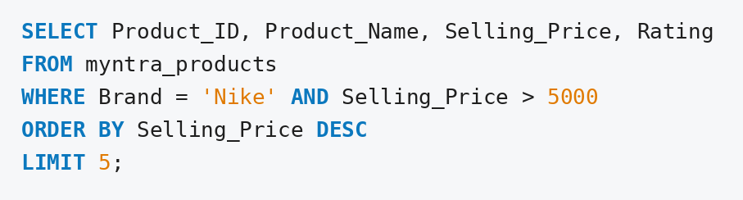
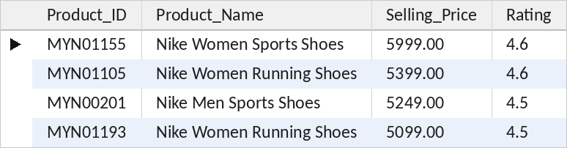
1. Show Nike products priced above Rs 5,000, most expensive first
Query
Output
INSIGHT Only 4 Nike products cost more than Rs 5,000, and all of them are shoes rated 4.5 or higher.

Slide 5
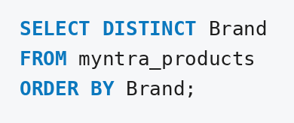
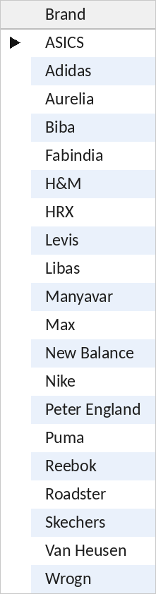
2. Which brands do we sell?
Query
Output
20
unique brands in the catalog
INSIGHT The catalog has 20 unique brands.

Slide 6
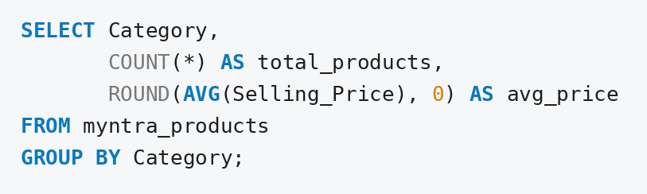
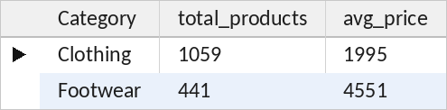
3. How many products and what average price does each category have?
Query
Output
INSIGHT Footwear has fewer products (441 vs 1,059) but costs more than twice as much on average (4,551 vs 1,995).

Slide 7
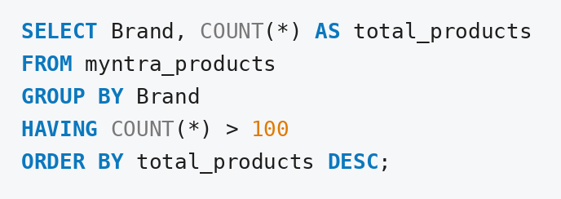
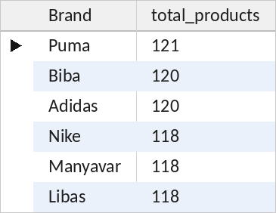
4. Which brands have more than 100 products?
Query
Output
INSIGHT Six brands have more than 100 products, and Puma leads with 121.

Slide 8
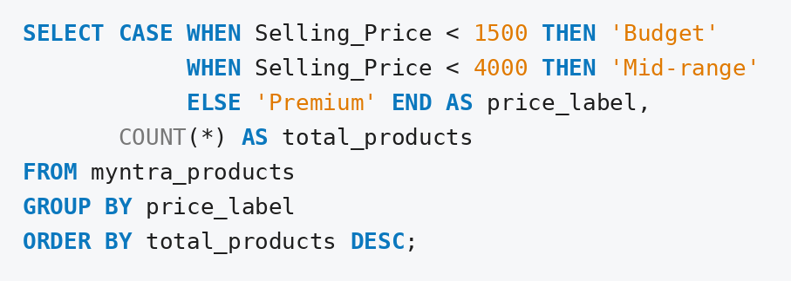
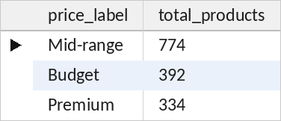
5. Label every product as Budget, Mid-range or Premium
Query
Output
INSIGHT Mid-range is the biggest group with 774 products, followed by Budget (392) and Premium (334).

Slide 9
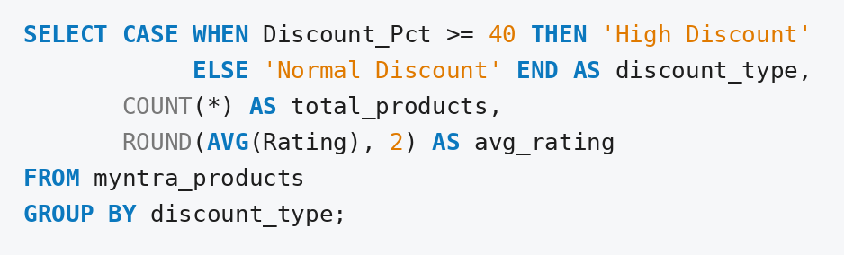
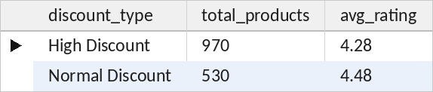
6. Do heavily discounted products (40% or more) get lower ratings?
Query
Output
INSIGHT Products with 40%+ discount average 4.28 stars against 4.48 for the rest, so deeper discounts do not mean better ratings.

Slide 10
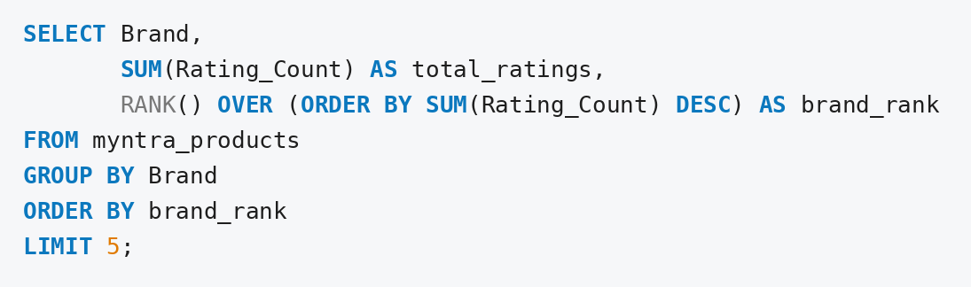
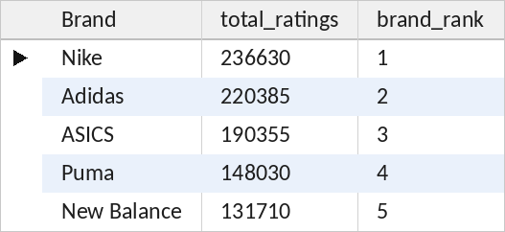
7. Rank brands by total customer ratings
Query
Output
INSIGHT Nike ranks first with 236,630 ratings, followed by Adidas (220,385) and ASICS (190,355).

Slide 11
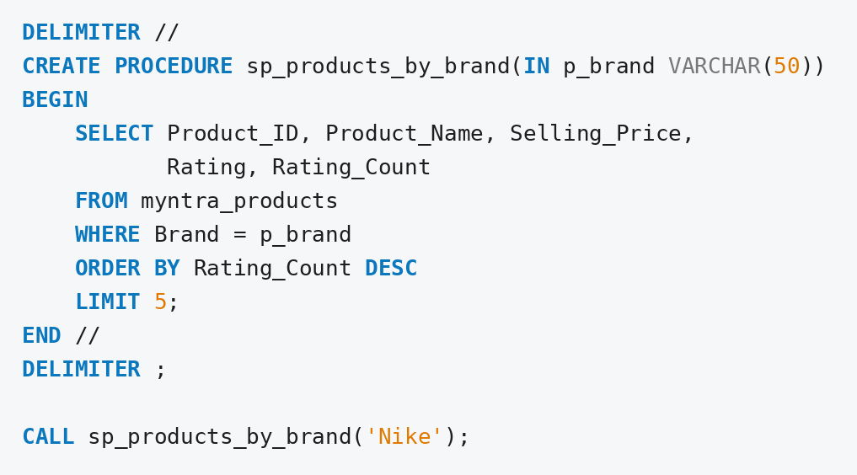
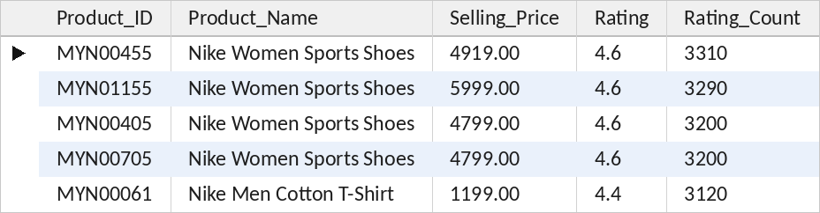
8. Show a brand’s 5 most-rated products
Query
Output
3,310
ratings on Nike's most-rated product
INSIGHT 4 of Nike's 5 most-rated products are women's sports shoes. Change the brand name in CALL to see any other brand.

Slide 12
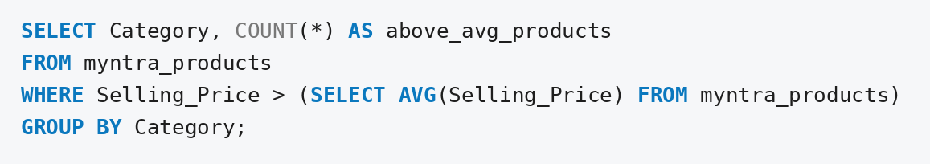
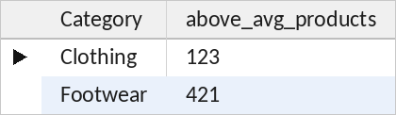
9. How many products per category cost more than the overall average price?
Query
Output
INSIGHT 421 of 441 footwear products sit above the overall average price, against 123 of 1,059 clothing products.

Slide 13
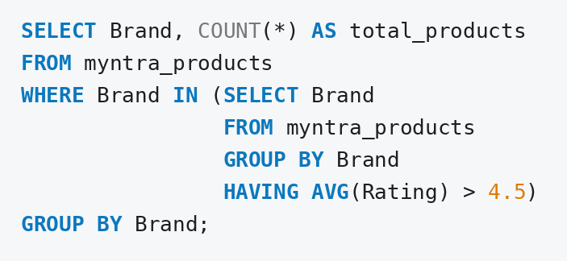
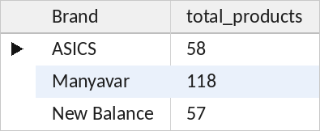
10. Show only brands whose average rating is above 4.5
Query
Output
INSIGHT Only 3 of the 20 brands (ASICS, Manyavar and New Balance) average above 4.5 stars.

Slide 14
Business Insights from the SQL Analysis
SYNTHESIS
Pricing
Price Segments
Discounting
Footwear averages Rs 4,551 against Rs 1,995 for clothing, and 421 of 441 footwear items sit above the overall average price.
Mid-range (Rs 1,500 to 3,999) is the largest group with 774 of the 1,500 products.
Products with 40%+ discount average 4.28 stars, against 4.48 for the rest.
Top Brand
Quality Leaders
Brand Landscape
Nike has the most customer ratings (236,630), ahead of Adidas and ASICS.
Only ASICS, Manyavar and New Balance average above 4.5 stars.
20 brands in total; six have more than 100 products, led by Puma with 121.

Slide 15
Conclusion
WRAP-UP
1
Filtering & sorting
2
Grouping & aggregates
WHERE, DISTINCT, ORDER BY and LIMIT answered problems 1 and 2.
COUNT, AVG and SUM with GROUP BY and HAVING answered problems 3 and 4.
3
CASE logic
4
Window function & procedure
Price and discount labels were created with CASE WHEN in problems 5 and 6.
RANK() ranked brands in problem 7, and a stored procedure listed any brand’s top products in problem 8.
5
Subqueries
6
Business thinking
A scalar subquery and an IN subquery answered problems 9 and 10.
Every query ends with an insight that a manager can act on.

Slide 16
Thank You !!
Questions & Discussion
LinkedIn
GitHub

