Slide 1
Computational Analysis of piRNA Sequence Present in Covid Sample using Galaxy Software

Slide 2
  Introduction
  Covid Sample Dataset
  Methodology
  Result and Discussions
  Future scope
  References
CONTENT

Slide 3
INTRODUCTION

Slide 4
What are piRNAs?
  piRNA stands for Piwi-interacting RNA.
  It is a type of small non-coding RNA, typically 24–31 nucleotides long.
ROLES:
  piRNAs maintain genomic integrity by guiding PIWI proteins to silence harmful genetic elements through transcriptional and post-transcriptional gene silencing.
  Emerging evidence shows piRNAs are also found in somatic (non-reproductive) cells.
  Gene Regulation – Control gene activity.
  Epigenetic Control – Modify DNA for stability.

Slide 5
Relevance to COVID-19 Infection
  During SARS-CoV-2 infection, the host immune system undergoes complex changes.
  Recent studies propose that piRNA expression patterns may change in infected individuals.
  These changes could:
  Reflect the body’s response to viral stress
  Serve as potential biomarkers for disease severity
  Help understand virus-host interactions
  4.Investigating piRNAs in COVID-19 patients can reveal new targets for diagnostics or therapy.

Slide 6
Objective of the Study
  To perform a computational analysis of piRNA sequences present in COVID-19 patient samples.
  Identify potential changes in piRNA expression between:
    Healthy individuals
    Symptomatic (ICU) patients
    Asymptomatic (non-ICU) patients

Slide 7
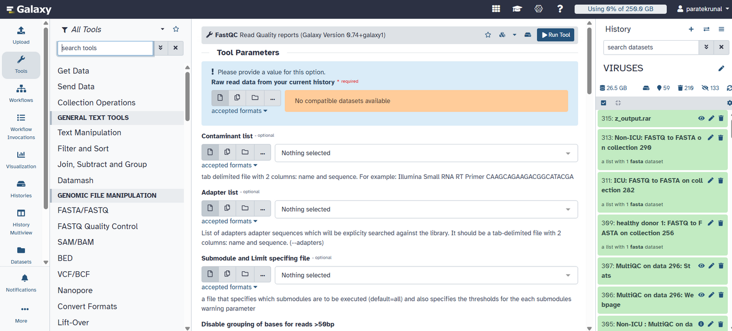
GALAXY Software
Galaxy is an open-source, web-based platform that enables users to perform complex bioinformatics analyses through an easy-to-use graphical interface. It supports reproducible research by allowing workflow creation, tool integration, and data sharing without programming skills.

Slide 8
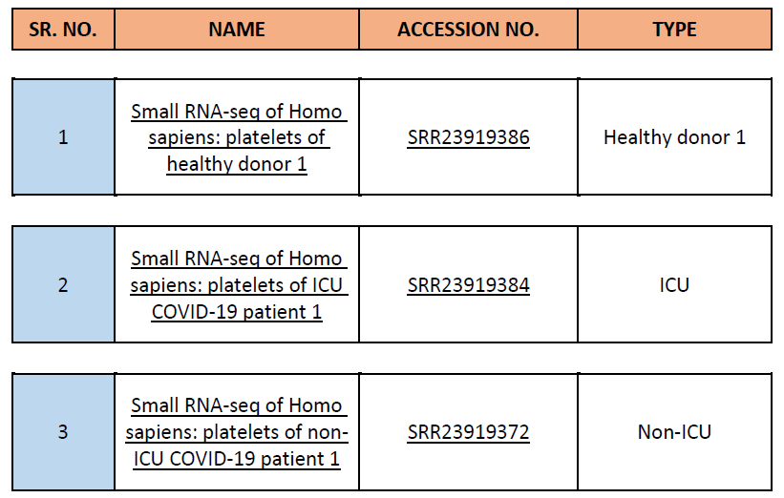
DATA COLLECTION
This data is collected from NCBI [National Centre of Biotechnology Information ]

Slide 9
METHODOLOGY
Data Upload
Adapter Trimming
Quality Analysis
Mapping with tRNA
BLAST with piRNA
Data Analysis

Slide 10
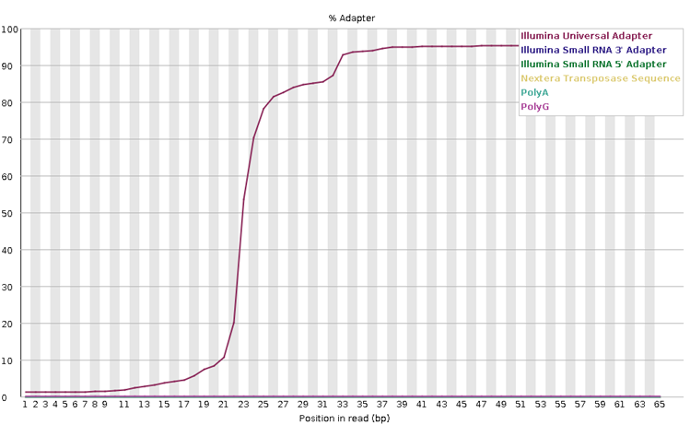
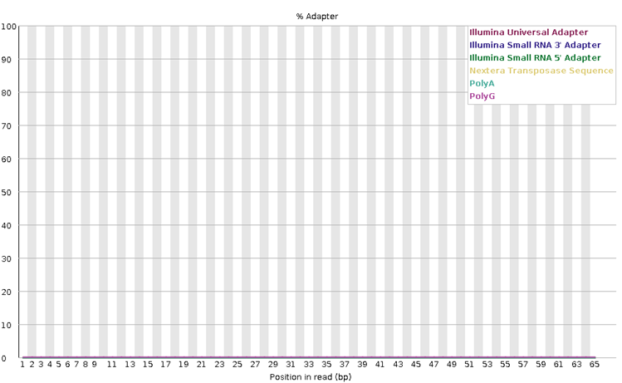
RESULTS
Adapter Trimming
Before Trimming
After Trimming

Slide 11
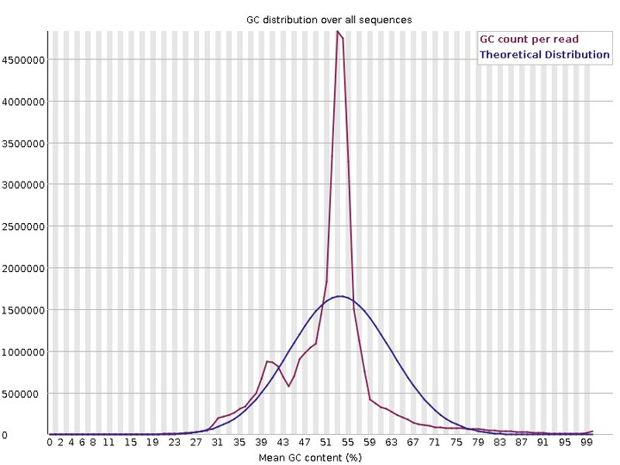
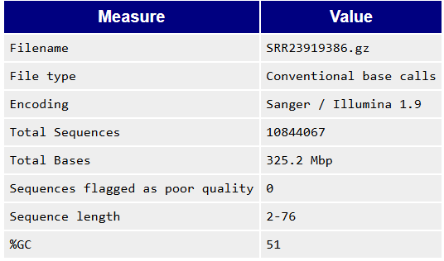
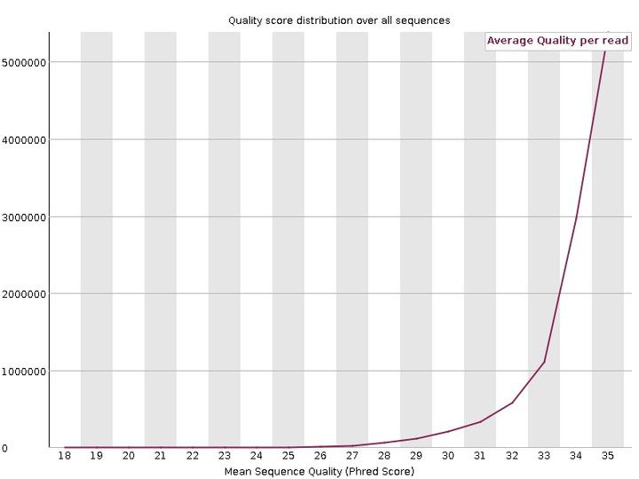
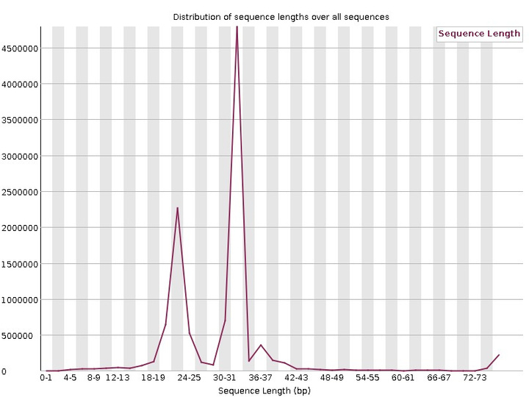
RESULTS
Healthy donor patient
Per Sequence GC Content
Per Sequence Quality Score
Sequence Length Distribution

Slide 12
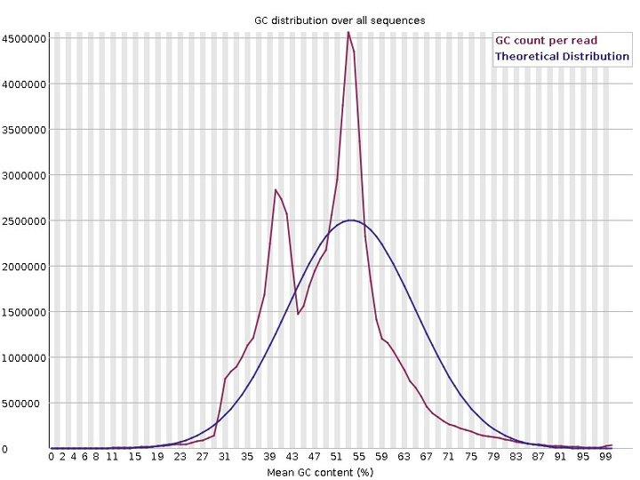
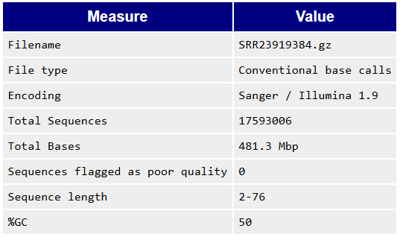
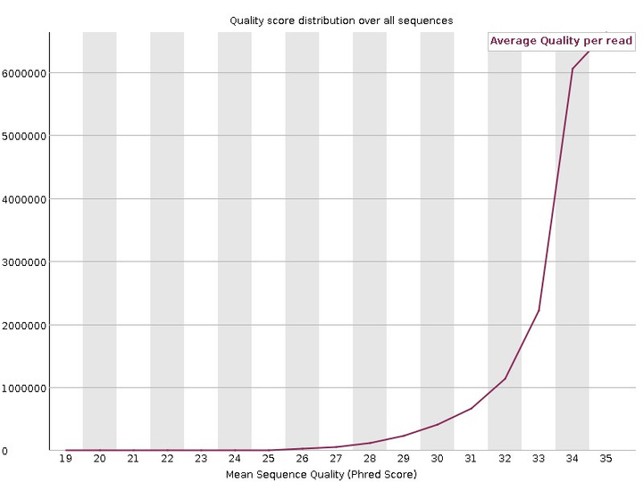
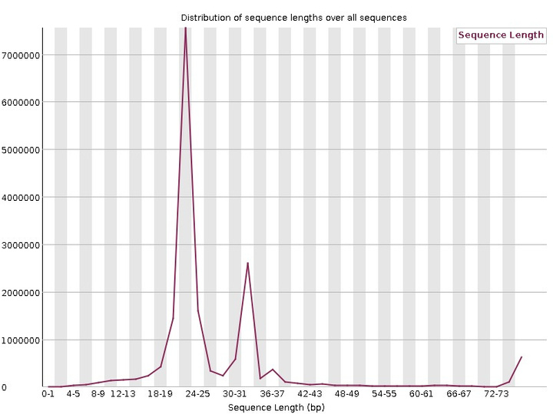
ICU [Symptomatic] patient
Per Sequence GC Content
Per Sequence Quality Score
Sequence Length Distribution

Slide 13
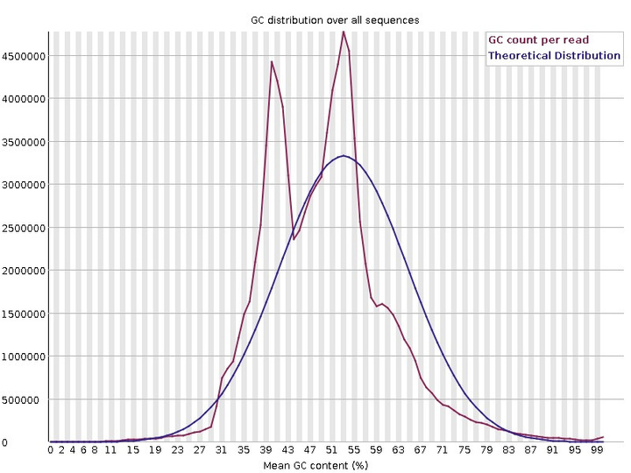
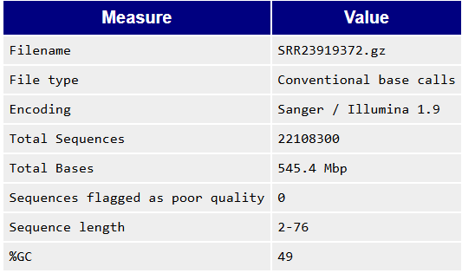
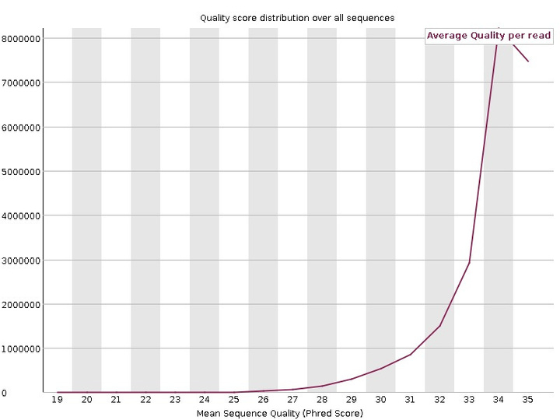
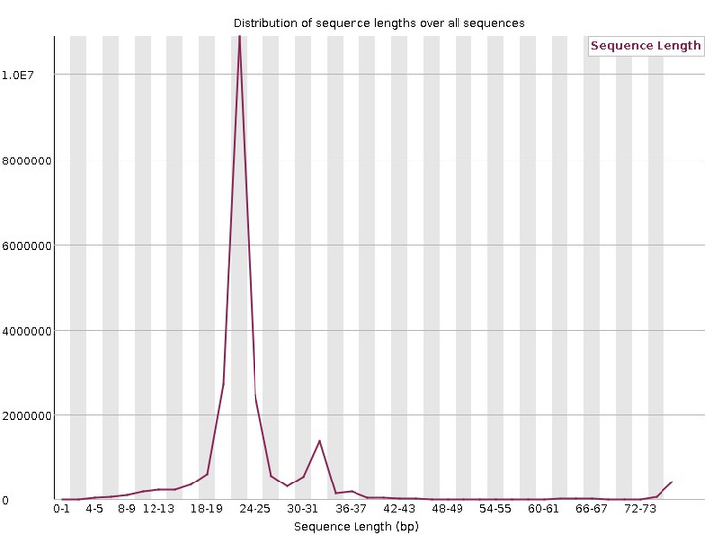
Non-ICU [Asymptomatic] patient
Per Sequence GC Content
Per Sequence Quality Score
Sequence Length Distribution

Slide 14
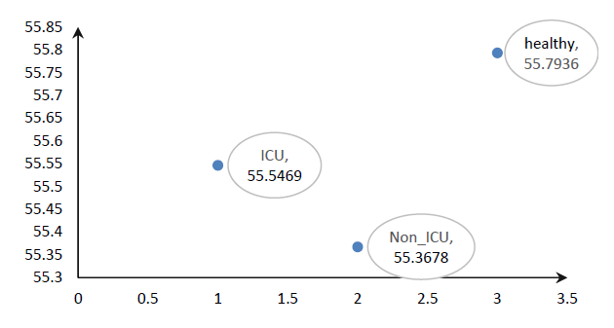
COMPARATIVE STUDY ANALYSIS
1. Bit Score
The Bit Score is a normalized measure provided by BLAST that reflects the quality of sequence alignment—the higher the score, the better the alignment.
The results suggest that Covid infection, particularly in non-ICU patients, may alter the sequence conservation of piRNAs,

Slide 15
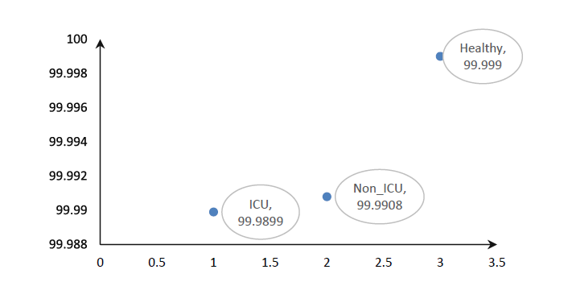
2. Percent Alignment
Percent alignment indicates the proportion of each piRNA sequence that successfully aligns with a reference sequence from the human piRNA database using BLAST.
These slight reductions in alignment percentage in Covid-affected groups could reflect the stress or immune modulation induced by viral infection

Slide 16
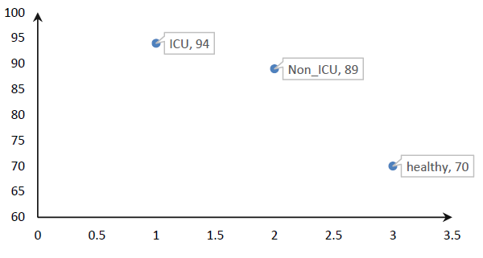
3. Mismatch
Mismatch count refers to the number of nucleotide mismatches observed during sequence alignment between query piRNA sequences and the reference database.
The increased mismatch counts in Covid-infected samples, especially ICU patients, may suggest a disturbance in the piRNA population, possibly due to viral interaction, immune stress, or cellular response mechanisms during severe infection.

Slide 17
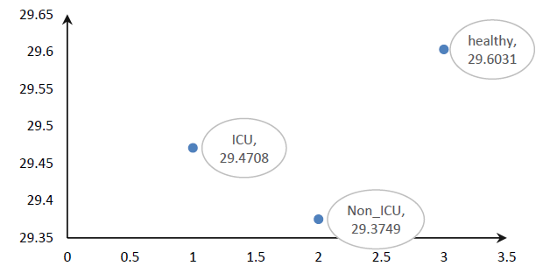
4. Raw Score
The Raw Score in BLAST output quantifies the alignment score. . It directly reflects the total number of matches, mismatches, and gaps in the alignment the higher the score, the better the alignment quality.
These lower scores in Covid-affected individuals may be attributed to increased mismatches or sequence variations in the piRNA reads.

Slide 18
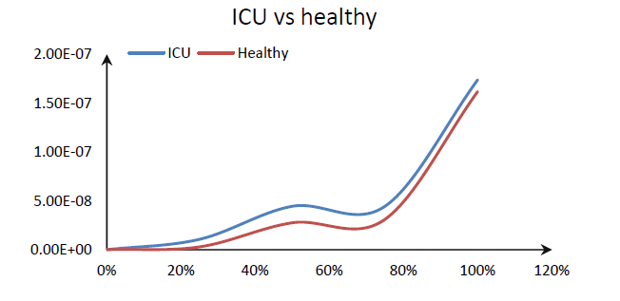
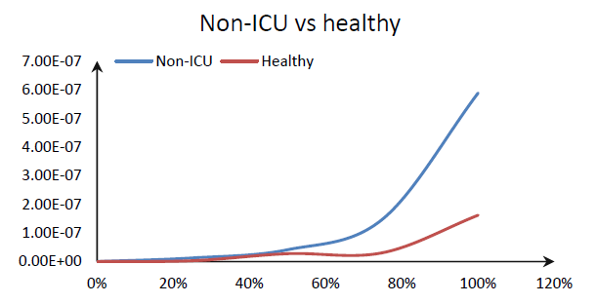
5. Evalue
The E-value (Expect value) represents the number of hits one can expect to see by chance when searching a database of a particular size.
The ICU samples showed slightly higher alignment than Non-ICU, possibly indicating a more active or disrupted piRNA regulatory mechanism under severe infection conditions.

Slide 19
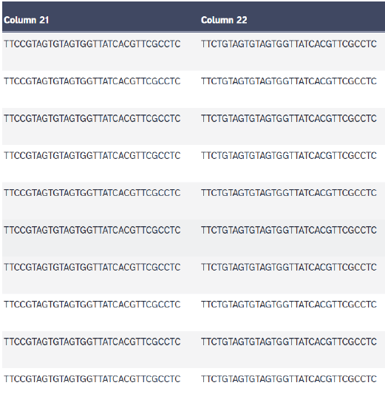
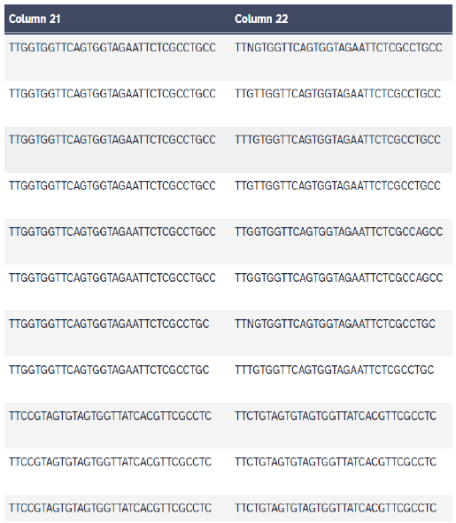
QUERY SEQUENCE COMPARISON WITH ICU AND NON-ICU SAMPLE
BLAST performed non-ICU with piRNA
BLAST performed ICU with piRNA

Slide 20
CONCLUSION
  piRNA profiles showed noticeable variations between healthy, non-ICU, and ICU COVID-19 patients.
  Increased mismatch and reduced alignment scores suggest piRNA dysregulation during infection.
  ICU samples exhibited greater sequence divergence, indicating a stronger disruption in piRNA pathways.
  The study highlights piRNAs as potential biomarkers reflecting disease severity and immune response.

Slide 21
FUTURE WORK
  Expand dataset to include more diverse patient samples for higher statistical power.
  Perform functional enrichment analysis to link altered piRNAs to gene regulatory networks.
  Validate in silico findings with experimental approaches (e.g., qRT-PCR or piRNA arrays).
  Investigate piRNA changes in post-COVID or long-COVID cases for prognostic insight.
  Explore piRNA-based therapeutic or diagnostic applications in viral infections.

Slide 22
THANK YOU

