Slide 1
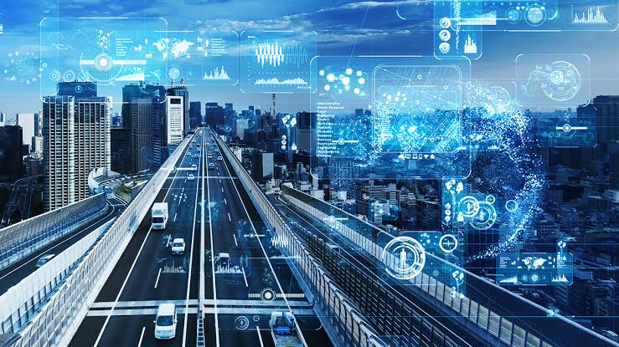
TRAFFIC MANAGEMENT SYSTEMS

Slide 2

INDRODUCTION:
Traffic management is a crucial aspect of urban planning and transportation engineering aimed at ensuring the safe, efficient, and organized movement of vehicles, pedestrians, and other forms of transportation on roads and highways. It involves a comprehensive set of strategies, policies, and technologies designed to optimize traffic flow, reduce congestion, enhance road safety, and minimize environmental impact.

Slide 3
IOT IN TRAFFIC MANAGEMENT
Sensors play a vital role in modern traffic management systems, offering real-time data collection and analysis to optimize traffic flow, enhance safety, and improve overall transportation efficiency. Here are some specific applications of sensors in traffic management

Slide 4
SENSORS TYPES
Inductive Loop Sensors:
Infrared Sensors:
GPS (Global Positioning System)

Slide 5
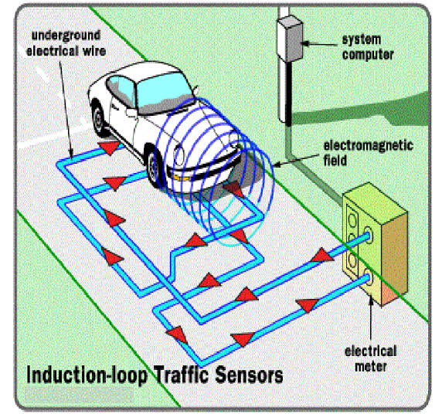
INDUCTIVE LOOP SENSOR:
These sensors are embedded in the road surface at intersections. They detect the presence of vehicles by measuring changes in inductance when a vehicle passes over them. Inductive loop sensors are commonly used to control traffic signal timings.

Slide 6
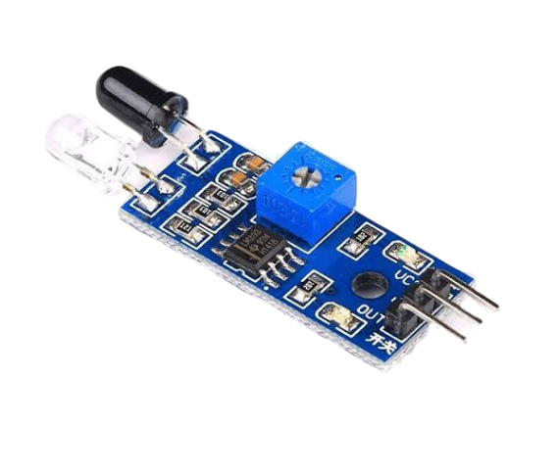
INFRARED SENSOR:
Infrared sensors use infrared light to detect the presence and movement of vehicles. They are often used in traffic monitoring systems, toll booths, and parking facilities.

Slide 7
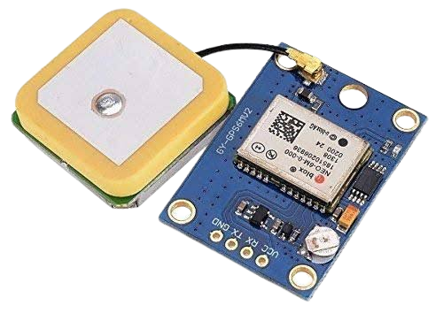
GPS (Global Positioning System)
GPS devices in vehicles can provide real-time location data, which can be used for traffic analysis, route optimization, and monitoring vehicle movements.

Slide 8
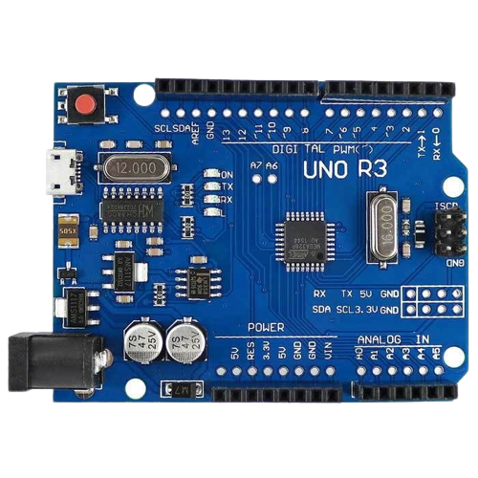
ARDUINO:
Arduino, an open-source electronics platform based on easy-to-use hardware and software, finds applications in various fields, including traffic management. Here are a few ways Arduino can be used in traffic management.
Arduino boards can be programmed to control traffic lights at intersections. They can detect vehicle presence using sensors and adjust signal timings based on traffic flow, thereby optimizing traffic movement.

Slide 9
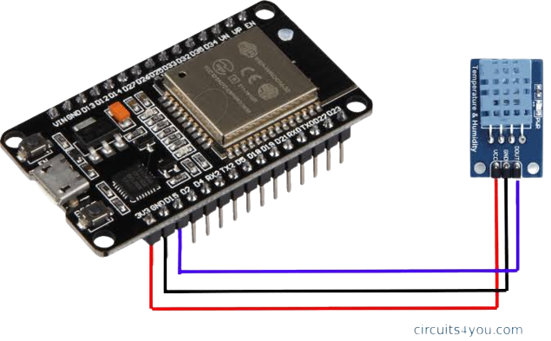
ESP32:
ESP32 boards can be equipped with sensors (such as infrared sensors or ultrasonic sensors) to collect data on traffic flow, vehicle counts, and speed. This data can be sent to a central system for analysis and traffic planning.
ESP32 can be used to create intelligent traffic light systems. By interfacing with sensors that detect traffic density, the ESP32 can optimize traffic light timings, reducing congestion and improving the flow of vehicles

Slide 10
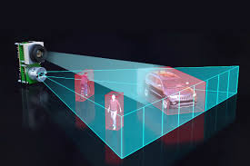
LIDAR Sensors (Light Detection and Ranging):
LIDAR sensors use laser light to measure distances and create detailed 3D maps of their surroundings. In traffic management, LIDAR sensors can be used for vehicle and pedestrian detection, as well as mapping the road environment.

Slide 11
CONCLUSION:
Traffic management is a multifaceted approach that plays a critical role in urban planning and transportation systems. By employing a combination of hardware, sensors, intelligent technologies, and data-driven strategies, traffic management aims to achieve several key objectives.

