Slide 1

Final Presentation
THD-Chatbot
Krupaben Kashyapkumar Patel - 8796214

Slide 2
Content
Introduction
Project Proposal
Tools and Environment
Risks and Dependencies
High Level Design
Detailed Design for Database
Project Feature
Demo Images
Conclusion Remarks

Slide 3
Introduction
The project considers building a chat bot that can help employees at company like home depot. For example, in their warehouses, a lot of time employees describe what they want to the employees instead it could easily be done using a chat bot rather than talking to a person and also from their comfort place like home or anywhere else remote.
Along with which if it is not a custom order, the customers/employee may also find an item description using the chat bot.
It involves following interactive entities: Home Depot Customers, Home Depot Employees.

Slide 4
Project Proposal
The problem that is currently present in the scenario is that when a customer orders a new custom item at home depot. The details of that item have to be written down by employee instead of which if the details are to be stored in computer database, employees would be able to just enter username and get all the information regarding their order on chat bot.
This project encapsulates a lot of new technologies to build it while also solving major problems. The scope of this project in general overview is that we can implement in different however similar way operating companies with the same product as the problem would be same and if there are minor changes that need to be done, they can be performed.
The restricting factor here would be understanding all-natural language that a user sends towards the chat bot. Natural language processing is one of the major problem that is still being worked on by lot of engineers/scientists/researchers.

Slide 5
Tools and Environment
The operating environment with respect to chatbot would be Mobile-Phone (Android/iOS), Desktop, Laptop, Tablet, etc.
Tools to be used during project: Visual Studio C#, GitHub.
Constraints
The users would be able to get answers only for the generic questions regarding the product in Home Depot.
Users would only be able to engage with chatbot in standard English language

Slide 6
Risks and Dependencies
Risks
There might be bigger toll in customer satisfaction while conversing with chatbot due to higher error rate of language understanding.
Due to any error with network issues on application side, the user would have bad experience as they would not get the information that they are looking for in that moment due to application connectivity issue and thus, might stop using application.
Dependencies
The application requires user to have a device like Phone, Tablet or Laptop alongside them.
The application also requires users to have internet connectivity.

Slide 7
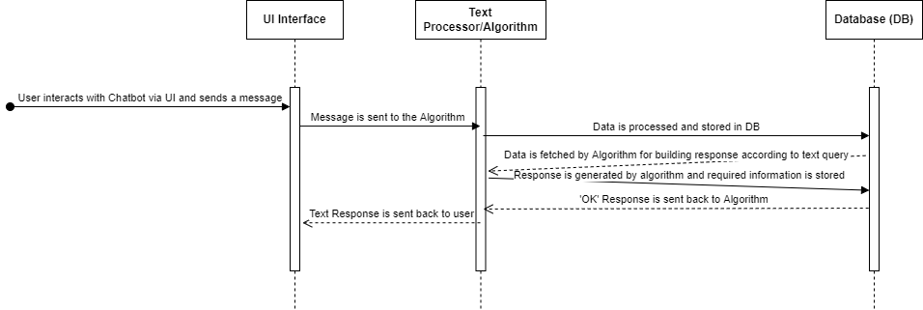
High Level Design

Slide 8
Detailed Design for Database
Table name – Products
Column Name | Data Type | Constraints
Id | Integer | Primary Key / Auto Increment
Dept_id | Integer | Foreign Key (Department)
Name | Char(250) | Not null
Description | Char(250)
Location | char(20) | Not null
Table name – Department
Column Name | Data Type | Constraints
Id | Integer | Primary Key / Auto Increment
Name | Char(50) | Not null

Slide 9
Product Feature
Greeting Feature - Basically the chatbot will first greet the user to start the positive conversation with the user, which will create a positive impact as per the human psychology. Greeting will help the user to engage with it and get all the required information from the chatbot.
Generic Question/Answer Feature - Once the initial greeting conversation is done, the chatbot will now ask what the user is looking for at the store.
Information Extraction Feature - The product user is looking for will be searched in the database and presented in the structured manner to the user. This will continue till the user gets all the information they were looking for and presses exit.

Slide 10
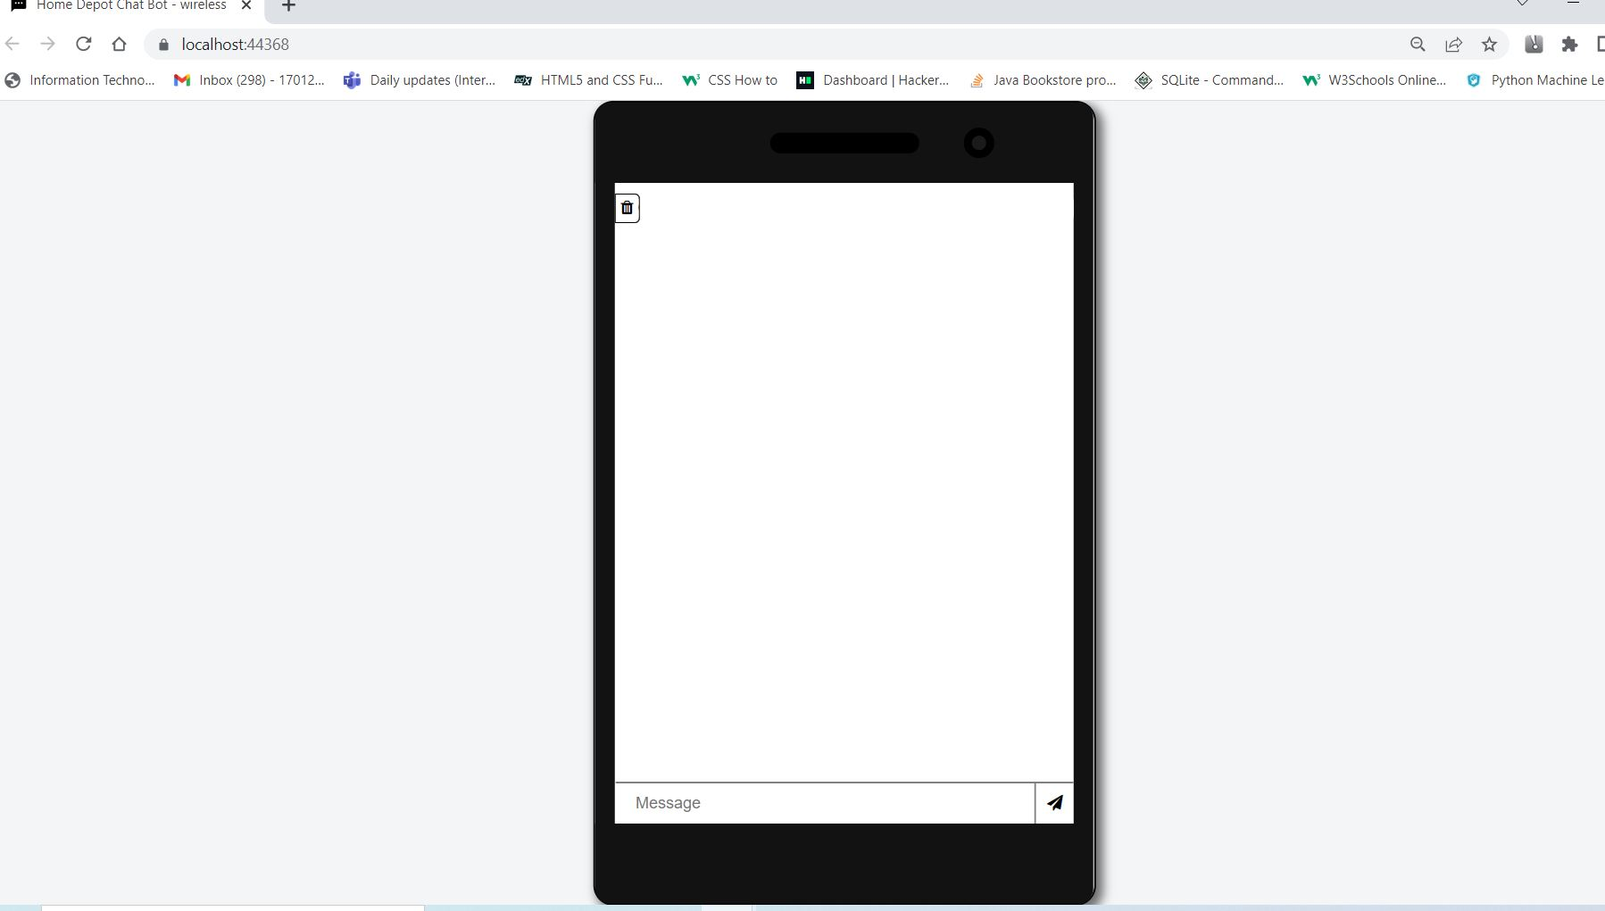
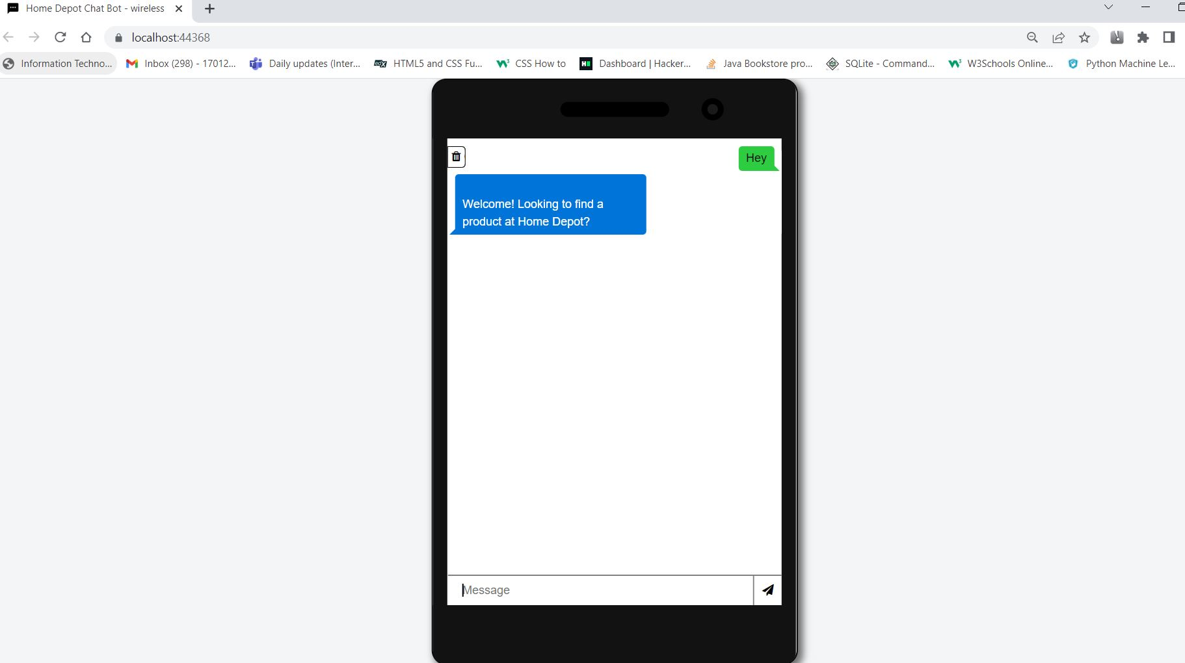
Chatbot Frame and Initial Conversation Image

Slide 11
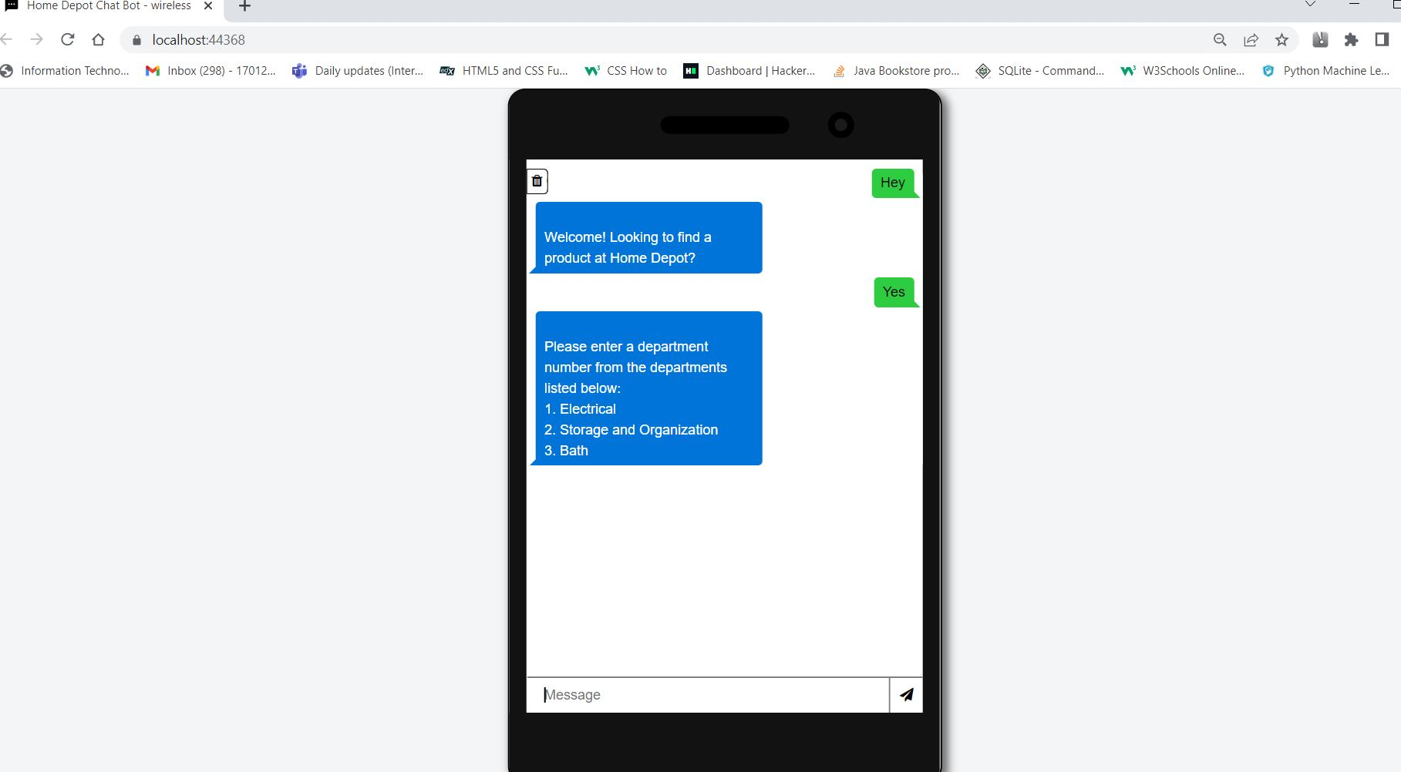
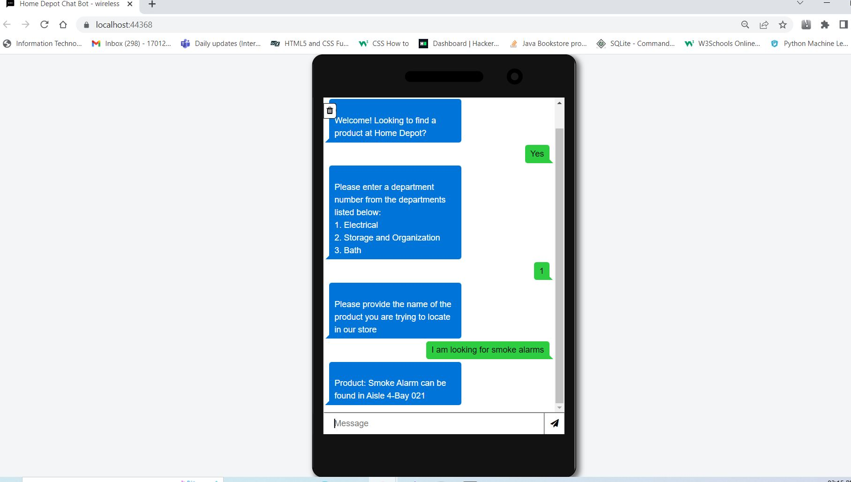
Listing Department and Products Details

Slide 12
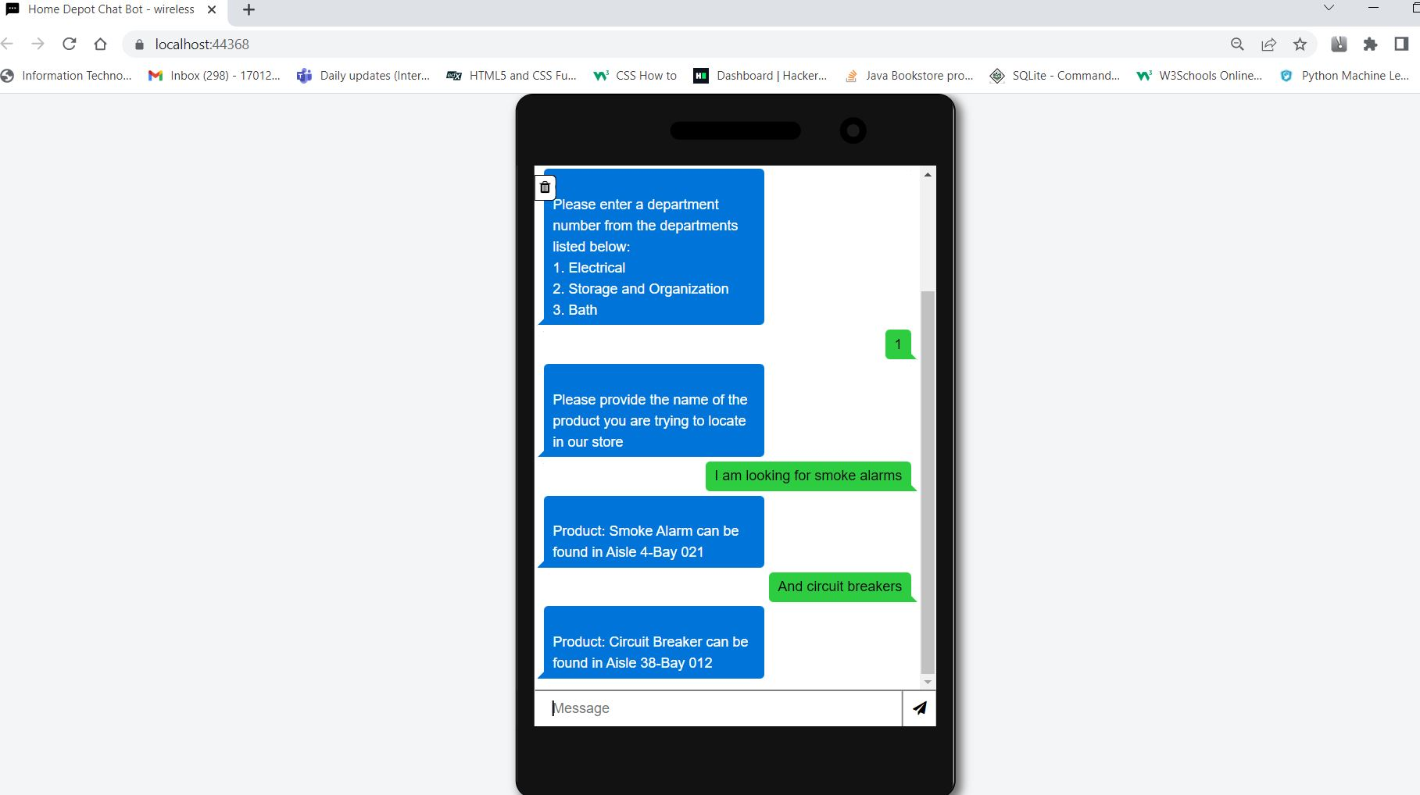
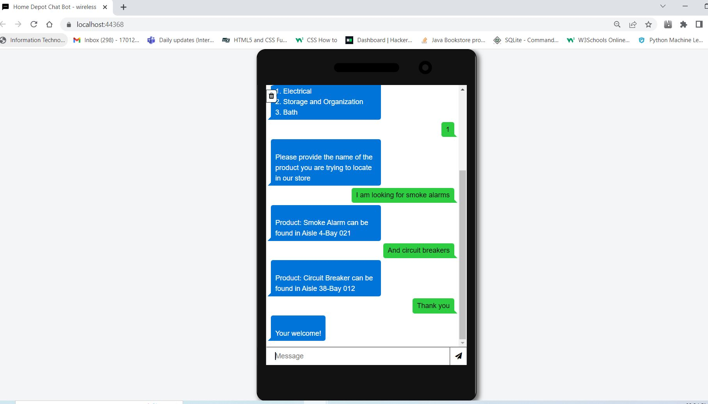
Another Product and Thank You Message

Slide 13
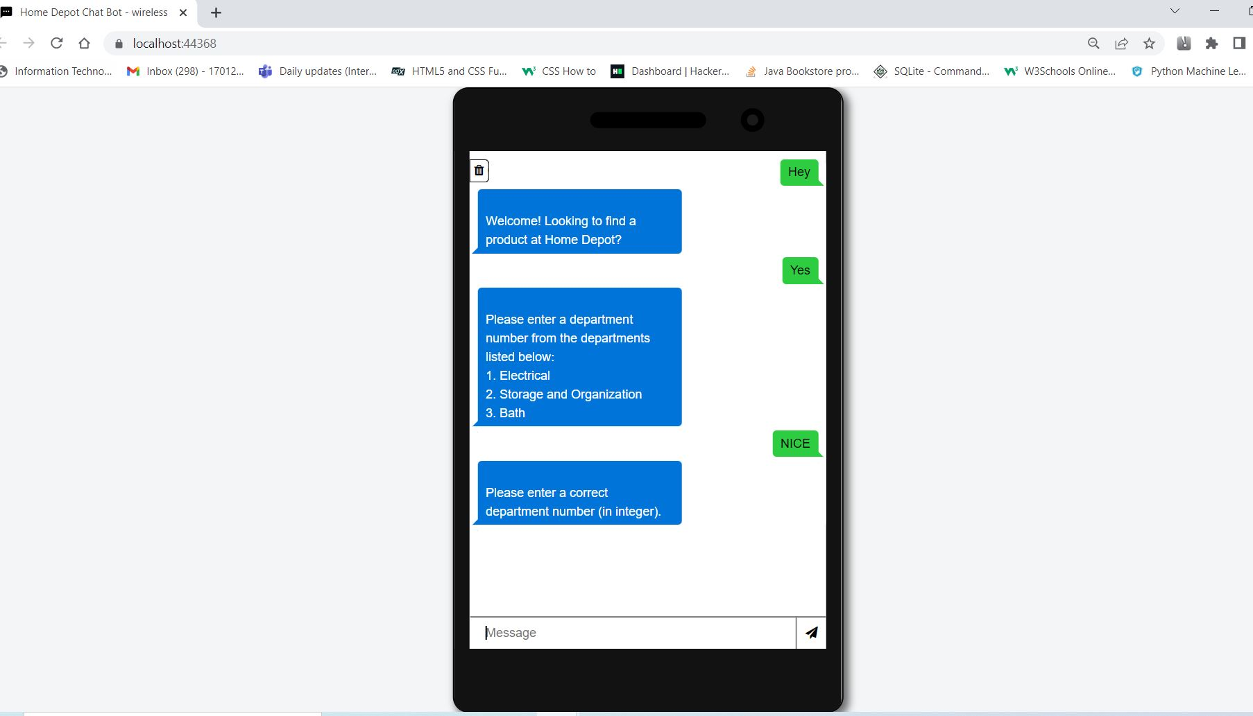
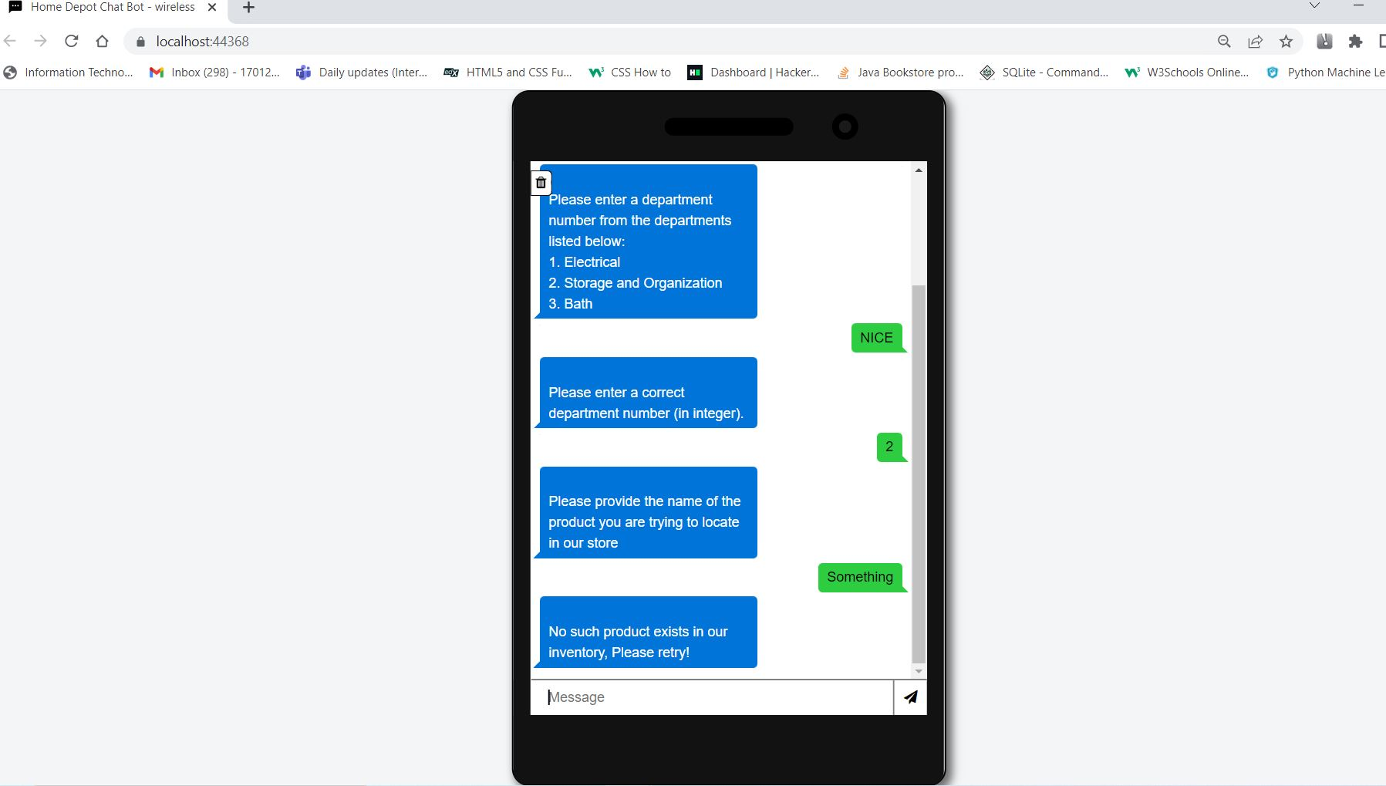
Error Identification and Product Not Available

Slide 14
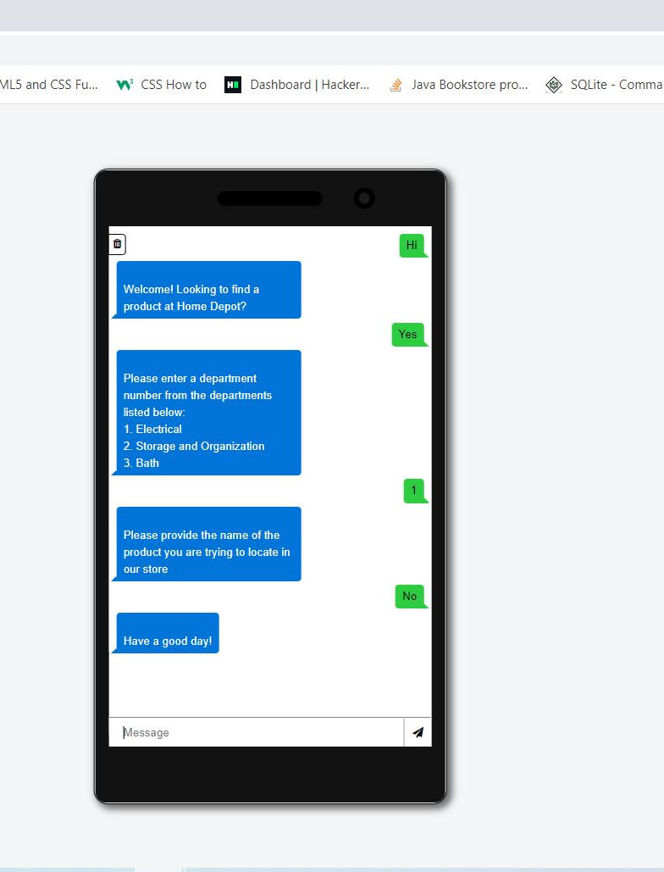
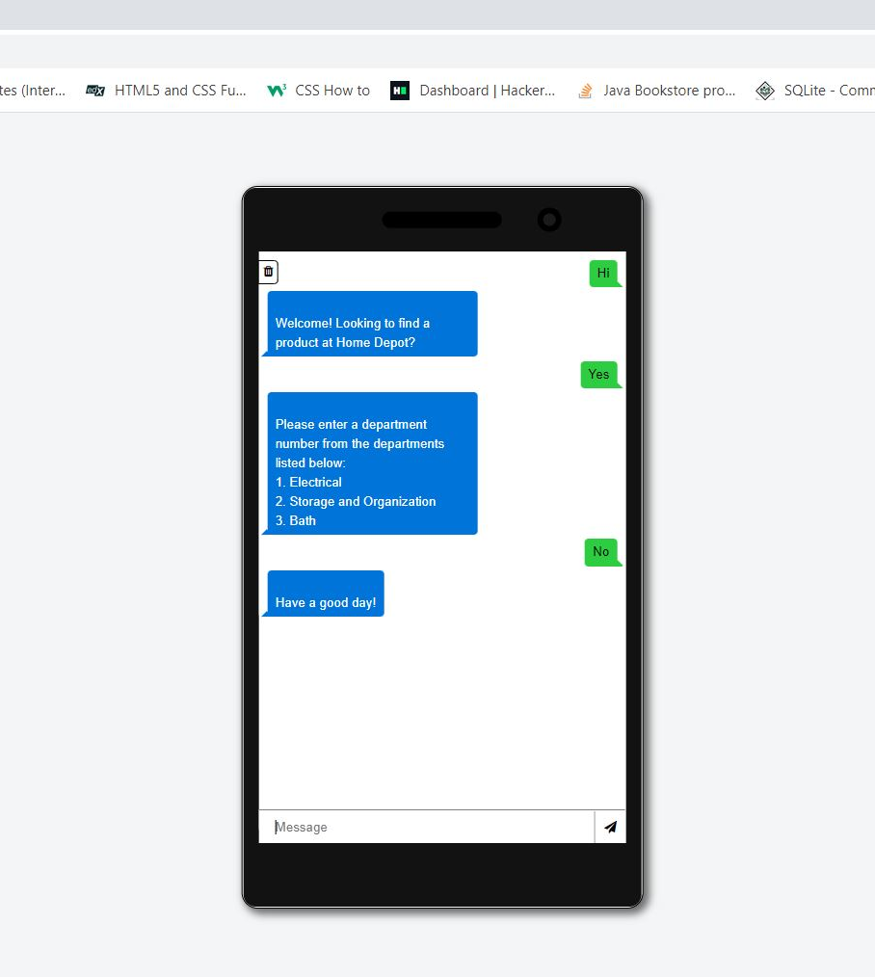
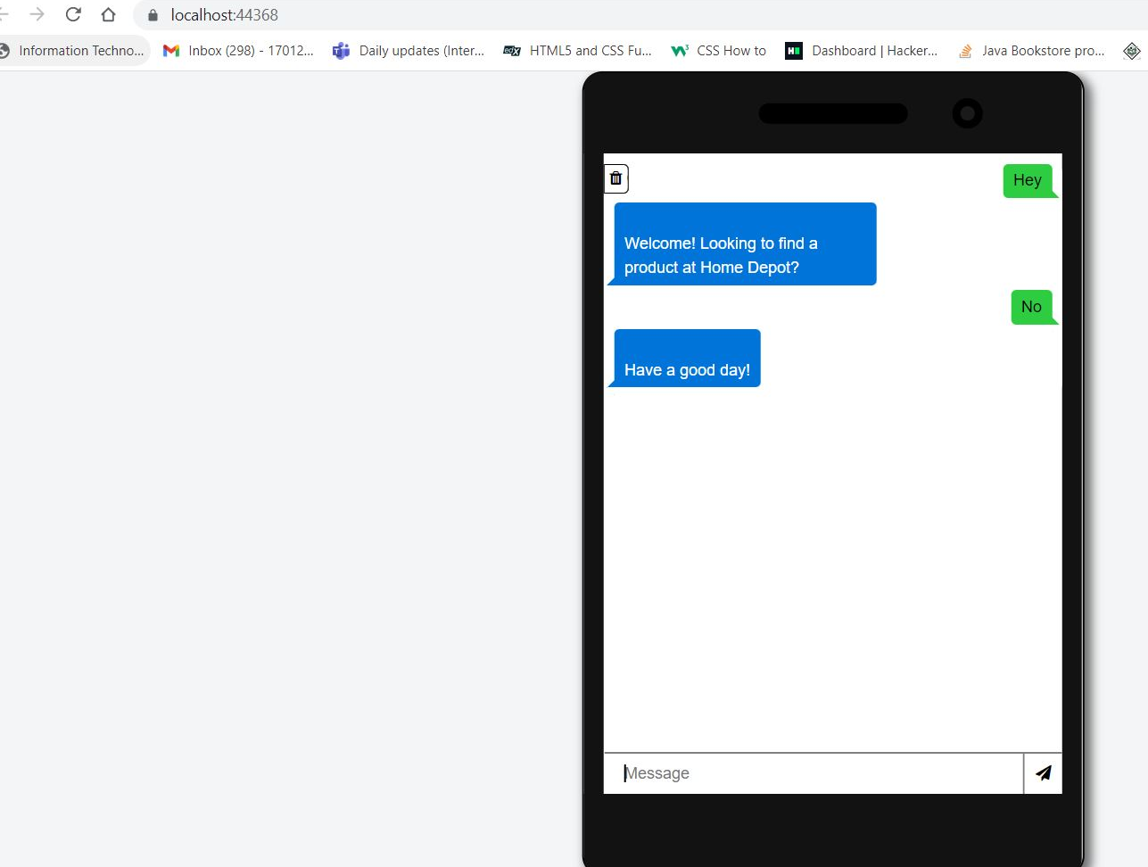
Exit Tests

Slide 15
Concluding Remarks
The above display of the product framework and working winds up the objective that we were trying to achieve
It helps both customers and employees of Home Depot Store/Warehouse.
Further work might include, creating a better function to increase the human understanding and increase the conversation ability of the chat-bot along with additional features to directly buy products through the chat-bot.

Slide 16
Thank You

