Slide 1
HR Analytics Insights: Understanding Employee Attrition and Trends
Krupa Patel

Slide 2
HR analytics findings.
Key Performance Indicators:
Active Employees: 1233
Overall Employees: 1470
Attrition Count: 237
Attrition Rate: 16.12%
Average Age: 37

Slide 3
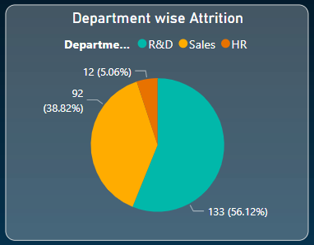
Department-wise Attrition
Analyzed
R&D: Experiencing a significant attrition rate of 56.12%.
Sales: Demonstrating a moderate attrition rate of 38.82%.
HR: Observing a comparatively lower attrition rate of 12%.
Focus
Why is R&D experiencing such high attrition?
Conduct exit interviews and identify pain points (e.g., workload, growth opportunities).
How can we retain R&D talent?
Offer career development paths, mentorship, and recognition programs.

Slide 4
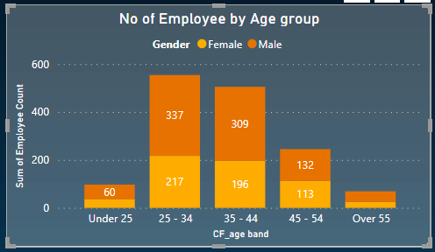
No. of employees by gender
Why?
Female Mentorship Programs
Implement wellness initiatives and work-life balance policies
Why the number of females is less than males?

Slide 5
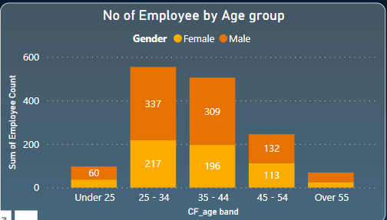
No. of employees by age
What did we find?
Age 25-34 and 35-44-More in numbers
For Under 25 and Over 55- the count is very low
What we should do?
Offer flexible retirement options and knowledge transfer programs.
Cross-Generational Pairing
Internship Programs: (Offer structured internship), (Convert successful interns to full-time hires)
Digital Presence and Social Media: (Leverage platforms like LinkedIn and Instagram), (Showcase company culture and opportunities)

Slide 6
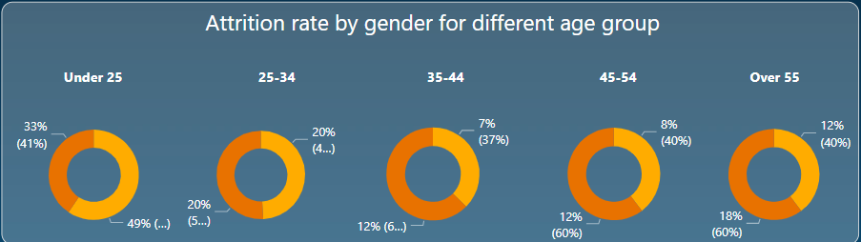
Attrition rate by gender and age

Slide 7
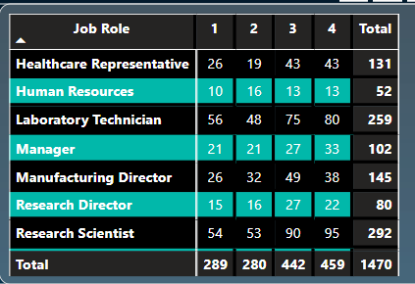
Job Roles Matrix
Which roles are critical for our organization?
1 | 2 | 3 | 4
19% | 19% | 30% | 31%
What can be done?
Regular Feedback and Recognition
Work-Life Balance

Slide 8
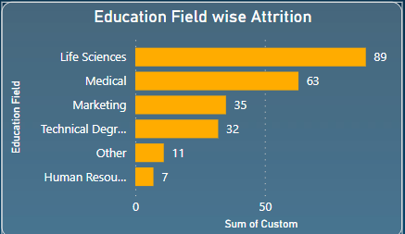
Education-wise Attrition
What is the scenario?
Life Sciences & Medical: Highest attrition
Why is attrition high in Life Sciences & Medical?
Analyze work conditions, career paths, and job satisfaction
Provide growth opportunities and recognize their contributions.

Slide 9
Decision-Making Tips
Recommendations for retention.
Continuous Learning: Invest in training and development programs.
Recognition and Rewards: Acknowledge achievements and provide incentives.
Feedback Culture: Foster open communication and address employee concerns.

Slide 10
Thank You
Krupa Patel
91-8780825775
Krupa25562@gmail.com

